Slide 1
What do I know now?
Bonjour ! Ça va ?
rouge
Révision
Several SSC
Notes:
Artwork by Steve Clarke. Pronoun pictures from NCELP (www.ncelp.org). All additional pictures selected from Pixabay and are
available under a Creative Commons license, no attribution required.
The AUDIO version of the lesson material includes additional audio for the new language presented (phonics, vocabulary) and audio for the instructions on the slide.
In addition, it includes VIDEO clips of the phonics and the phonics’ source words. Pupils can be encouraged to look at the shape of the mouth/lips on slides where these appear, and try to copy it/them.
Phonics: Revisit several SSC: [SFe] [ç] (and soft -c) [-ien] [qu] [j] (soft g) [-tion] [r]
Vocabulary (new words in bold): Revisit Term 3 vocabulary
Revisit 1: an [76] faim [1986] raison [72] soif [4659] tort [1652]
Revisit 2: combien [800] chose [125] des [2]
Londsale, D., & Le Bras, Y. (2009). A Frequency Dictionary of French: Core vocabulary for learners London: Routledge.
The frequency rankings for words that occur in this PowerPoint which have been previously introduced in these resources are given in the SOW and in the resources that first introduced and formally re-visited those words. For any other words that occur incidentally in this PowerPoint, frequency rankings will be provided in the notes field wherever possible.
1

Slide 2
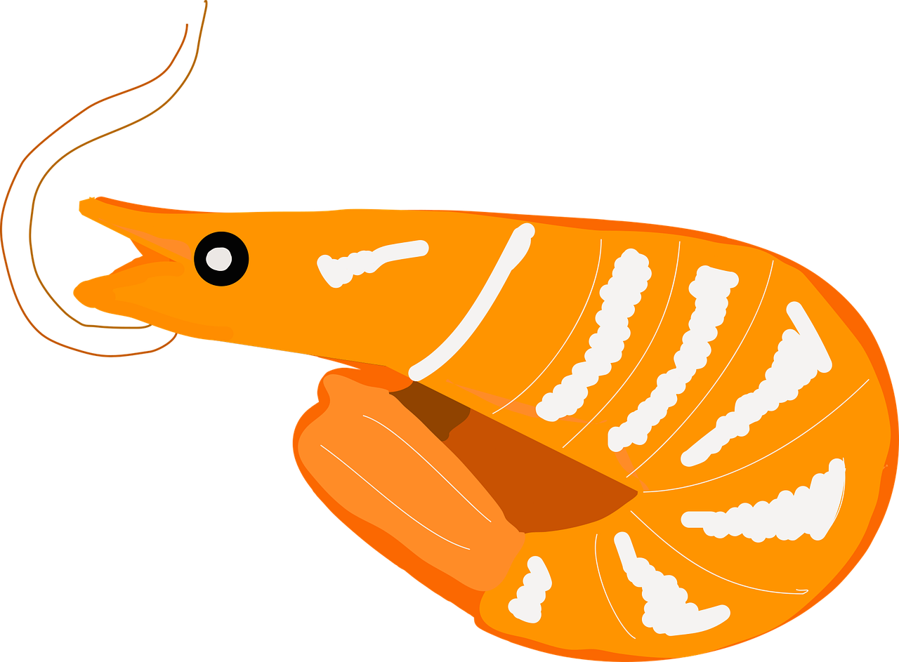
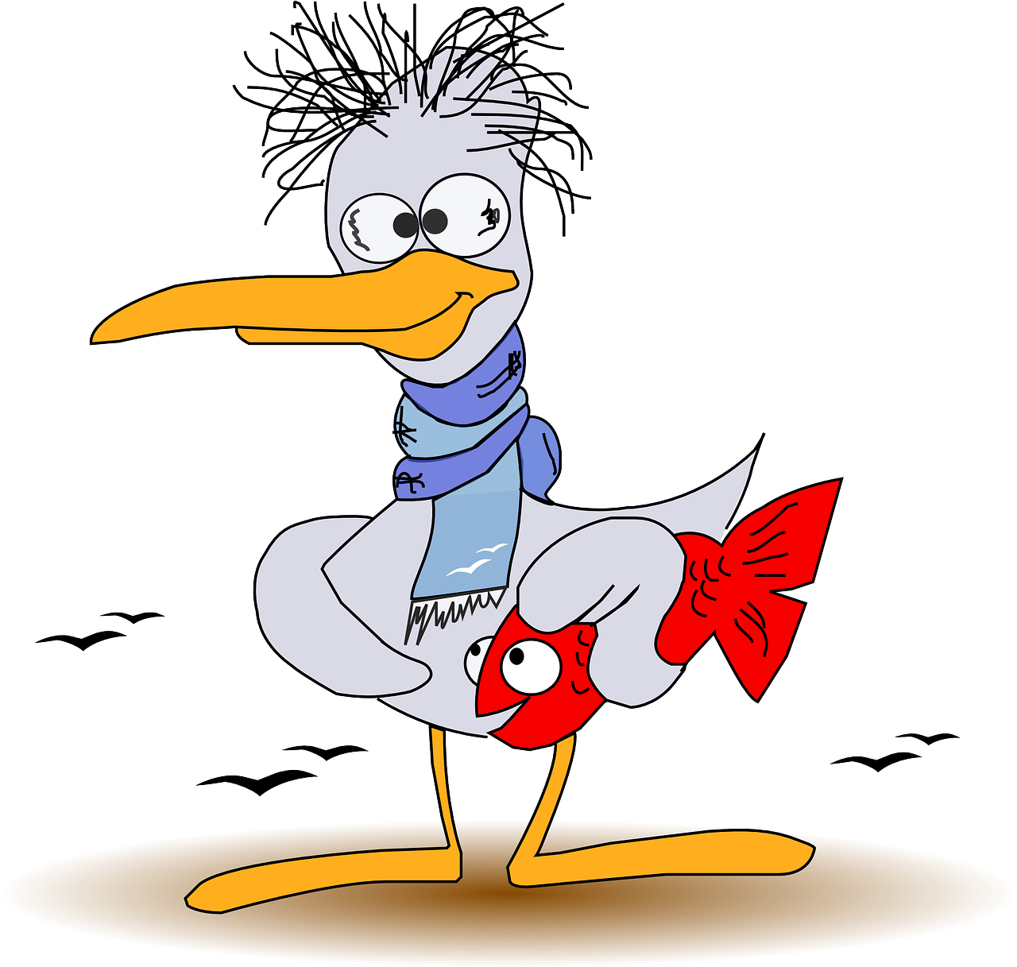
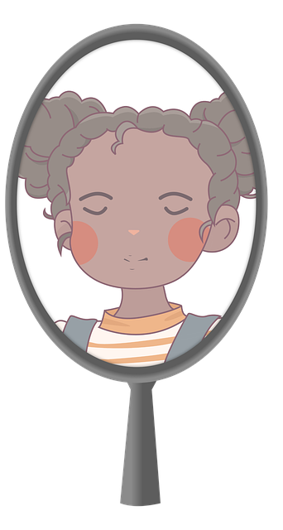
La phonétique
Écoute bien. Écris les SSC correspondants.
colombien
[Colombian]
colom_ _ _ |  | no_ _ _ _ | aba_ _ e | c_evette |  | m_r
m_ _ette |  | mir_ _ r |  | courb_ |  | rel_ _ s
aga_ant | rom_ _ | _us |  | crott_ _ | sav_ _ | m_ _ gler
notion [notion]
abaque [abacus]
crevette
[prawn]
mur
[wall]
45
mouette
[seagull]
miroir [mirror]
courbe
[curve]
relais [relay]
S
agaçant
[annoying]
roman
[novel]
jus [juice]
crottin
[dung]
savon
[soap]
meugler [to moo]
Moo!
0
DÉBUT
Notes:
Timing: 5 minutes
Aim: to practise applying knowledge of a selection of 15 of this year’s SSC to unknown words.
Procedure: 1. Click on the picture to hear the word. Pupils transcribe the missing letter(s).
2. Click to correct.
3. Start the timer. Attempt to elicit choral pronunciation of all the words again, using the animated prompts, within the 45 seconds allowed.
Frequency of unknown words and cognates: abaque [>5000] agaçant [>5000] colombien [>5000] courbe [>5000] crevette [>5000] crottin [>5000] jus [>5000] meugler [>5000] miroir [>5000] mouette [>5000] mur [>5000] notion [1570] relais [<5000] roman [>5000] savon [>5000]
Londsale, D., & Le Bras, Y. (2009). A Frequency Dictionary of French: Core vocabulary for learners London: Routledge.

Slide 3
écouter
Écoute la question. La réponse correspondante, c’est quoi ?
A
B
C
1a
⚠ when question words are at the end, it is informal.
Je suis sympa. | Il est amusant. | Ça va bien, merci.
1b
2
Non, je suis Max. | Oui, tu es Alex. | Oui, elle est Alex.
3
Tu habites dans un village. | Il est où ? | J’habite à Manchester.
4
Oui, j’ai un frère, Simon. | Oui, tu as des sœurs. | Oui, il a un frère.
5
Oui, j’ai une sœur, Amélie. | Non, mais j’ai faim. | Non, j’ai un frère.
Non, tu détestes les films. | Oui, elle aime regarder les films. | Oui, et j’aime aussi chanter.
6
Notes:
Timing: 5 minutes
Aim: to practise aural comprehension of questions and written comprehension of answers containing a variety of revisited language from this term.
Procedure:
Click on the first audio button to hear a question. Pupils listen carefully and decide whether option A, B or C contains the correct answer.
Repeat for questions 2-6.
Click to reveal the answers and clarify any misunderstandings.
Transcript: 1. Comment ça va ? / Ça va comment ?
2. Tu es Alex ?
3. Tu habites où ?
4. Tu as des frères ou des sœurs ?
5. Tu as soif ?
6. Tu aimes regarder des films ?
3

Slide 4
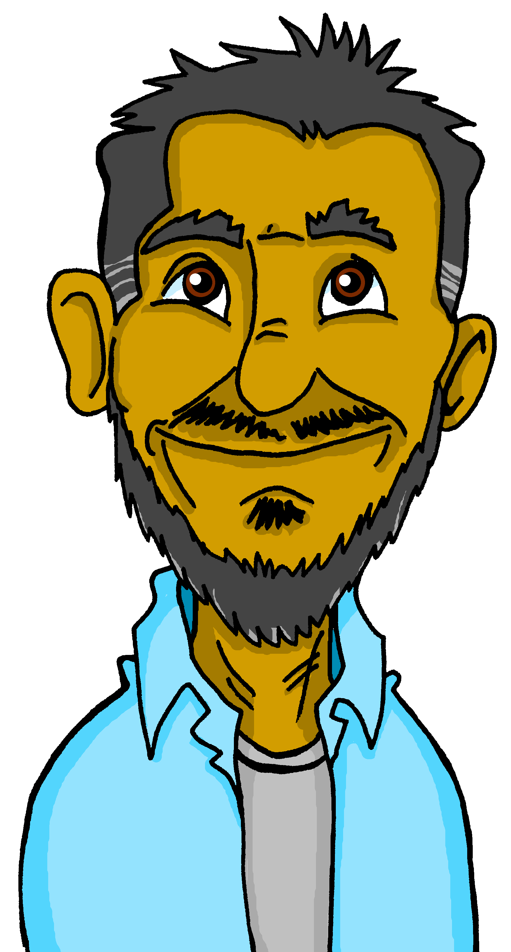
Vokabeln
L’amitié*
l’amitié- friendship
Remember! Learning languages is about making friends and communicating.
Being polite can be one way to communicate kindly to everyone.
Let’s remember some French we know to show politeness!
S’il vous plait !
⚠ Say s’il vous plait to adults outside your family.
S’il te plait !
_’_ _ _ _ _ _ _ _ _ _ _ !
_’ _ _ _ _ _ _ _ _ _!
merci
_ _ _ _ _
Can you ask questions when meeting a new friend for the first time?
How are you?
Ça va ?
Tu es Alex ?
Where do you live?
Tu aimes les fruits ?
Are you Alex?
Are you hungry?
Tu habites où ?
Tu as faim ?
Do you like fruit?
You are nice!
Tu es sympa !
You might get a positive reaction like this!
Notes:
Timing: 3 minutes
Aim: to revisit the idea that learning other languages opens the door to new friendships, and that a few kind words go a long way; to revisit some previously-taught language from this term that fits our category of ‘friendship sentences’. This is an idea we will return to now and then during the course.
Procedure:
Click to present the information on the slide.
Elicit the French from pupils for the English politeness statements and for the five questions and example positive reaction.
Allow pupils a few moments to turn to those around them and ask them two questions each.
Remind pupils that we all need to hear kind words every day, in whatever language!
4

Slide 5
écrire
S’il te plait | S’il vous plait
Let’s practise writing it.
Write each part on your sleeve with your finger. Check each part.
It helps if you say the words as you write them, too.
S’il te plait
1
2
3
4
S’il te plait !
1
2
3
4
S’il vous plait !
Parts 1, 2, 4 of formal ‘please’ are the same. Practise in the same way.
S’il vous plait
Notes:
Aim: to practise written production of the two phrases for please.
Procedure:
Introduction to writing please in French – pupils practise by writing on their sleeve with their finger.
Click through the animations.
Click on the phrase to bring up the sound, if you wish.
Help pupils break down the words into syllables as they write on their sleeves. Pupils should look down to write and look up to check.
Repeat a couple of times with each version.
Some pupils will challenge themselves to write the whole phrase at this point.
5

Slide 6
lire
Pierre prépare un email pour Max.
Mais il y a un problème ! C’est Pierre (I), Adèle (she) ou Max (you) ?
1
Elle est ma sœur.
I
she
2
Tu as neuf ans.
she
you
you
5
Tu habites à Manchester.
she
I
3
J’ ai huit ans.
I
6
I
you
J’ habite à Lorient.
4
Elle aime chanter.
she
you
Notes:
Timing: 5 minutes
Aim: to practice written recognition of singular verb forms and their connection with meaning.
Procedure:
1. Pupils write 1-6 in their books.
2. Teachers explain the context of the activity, ensuring understanding of the title and instruction given.
3. Pupils read the sentences and decide who the sentence is about.
4. Click to reveal answers.
5. Ask students for the meanings of the sentences in English.
6. To hear native speaker audio, click on the numbered buttons to the left of each text.
6

Slide 7
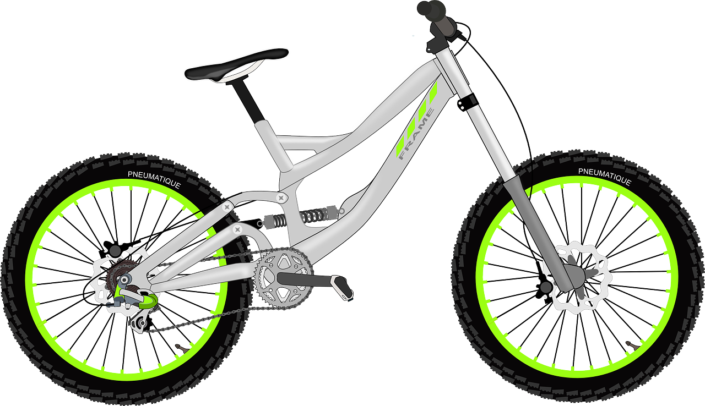
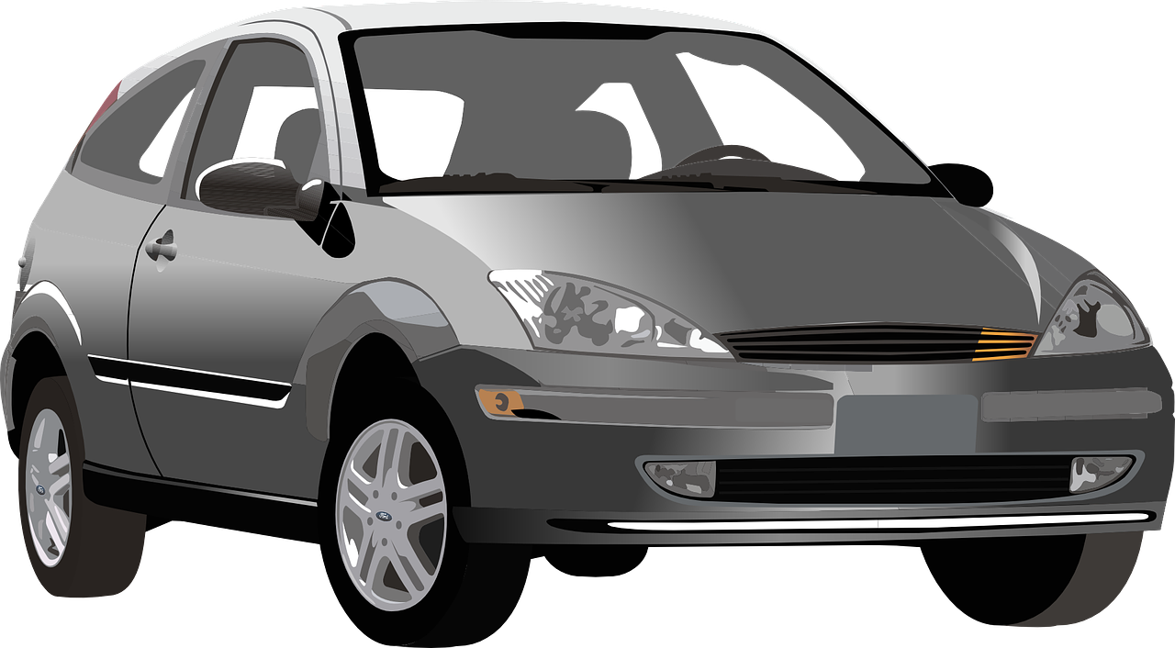
Adjectives following the noun
Remember that French adjectives normally come after the noun.
very
très
In French we say what it is and then what it is like.
a slow bike
un vélo lent
^
^
⚠ Remember: Many adjectives add -e to describe feminine nouns. You then pronounce the final consonant.
a slow car
une voiture lente
a serious book
un livre sérieux
?
⚠ Remember: Adjectives that end in -eux change to –euse to describe singular feminine nouns.
a serious thing
une chose sérieuse
Notes:
Timing: 3 minutes
Aim: to recap postnominal adjective agreement and remind pupils about the gender agreement pattern for adjectives ending –eux.
Procedure:
Click through the animations to present the information.
Elicit English translations for the French examples provided.
Callout 1 highlights the difference between English and French.
Callout 2 reminds pupils about gender agreement of adjectives.
Callout 2 reminds pupils about –eux changing to –euse.

Slide 8
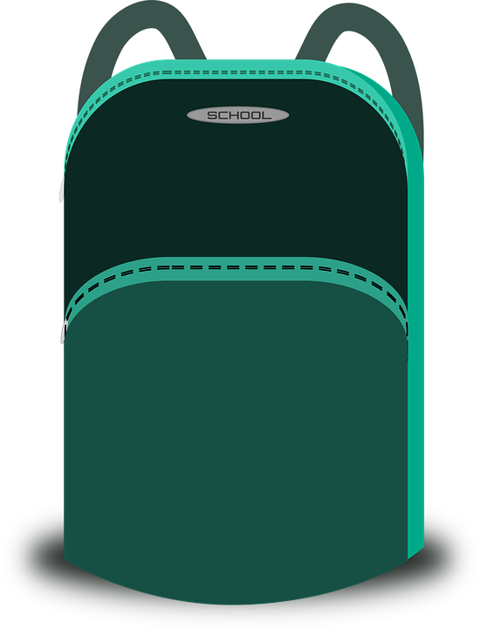
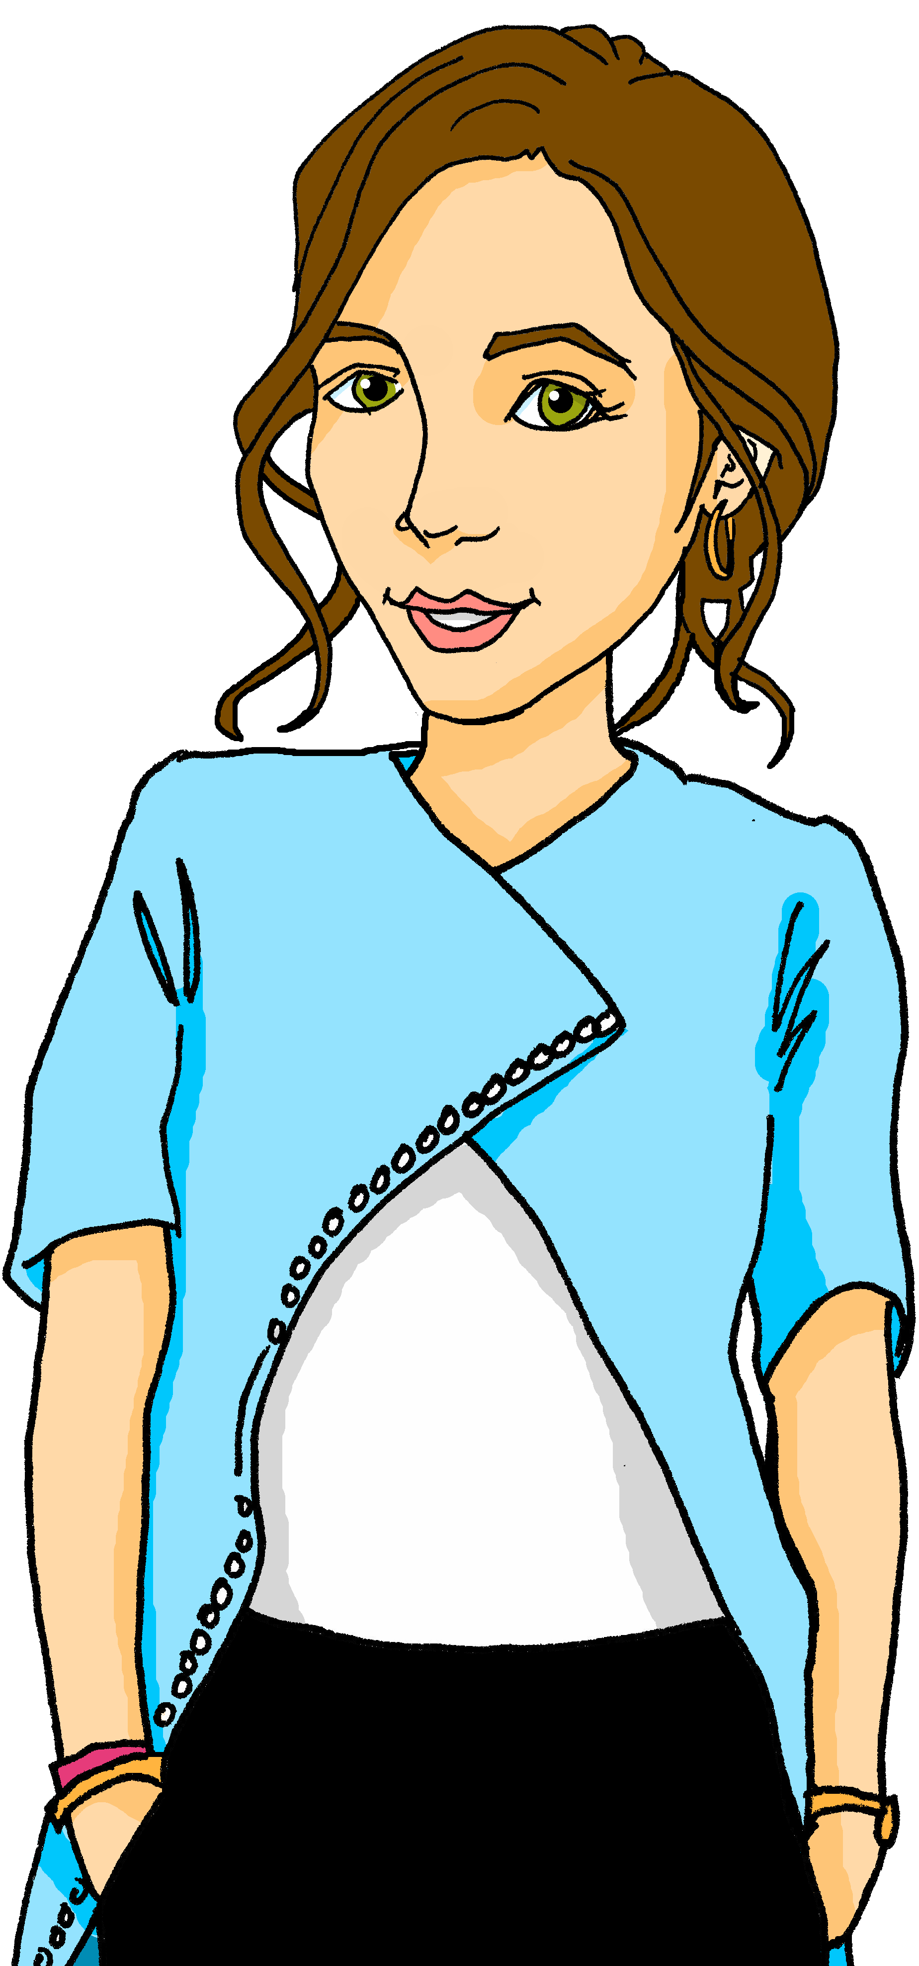
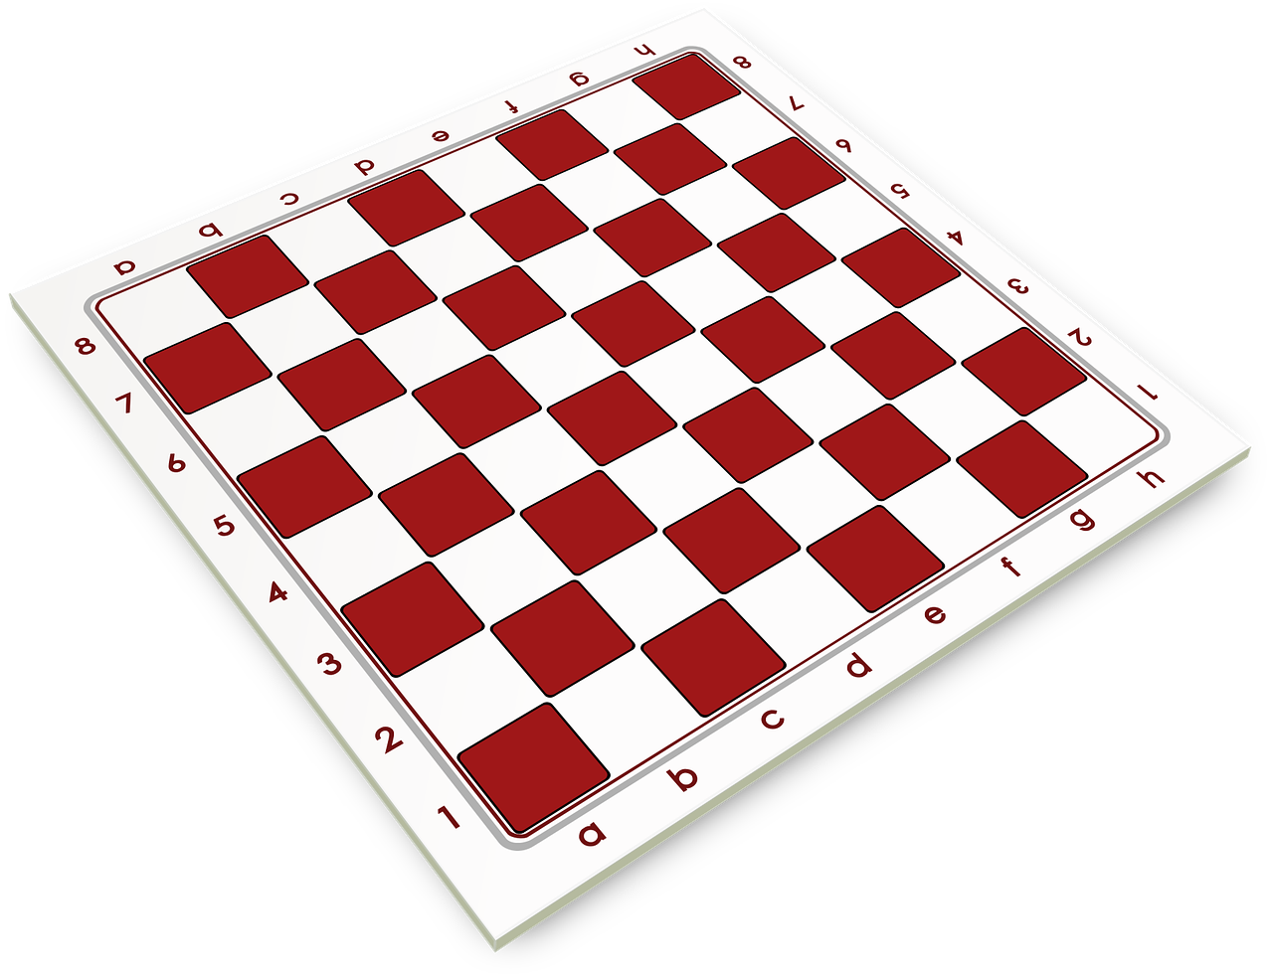
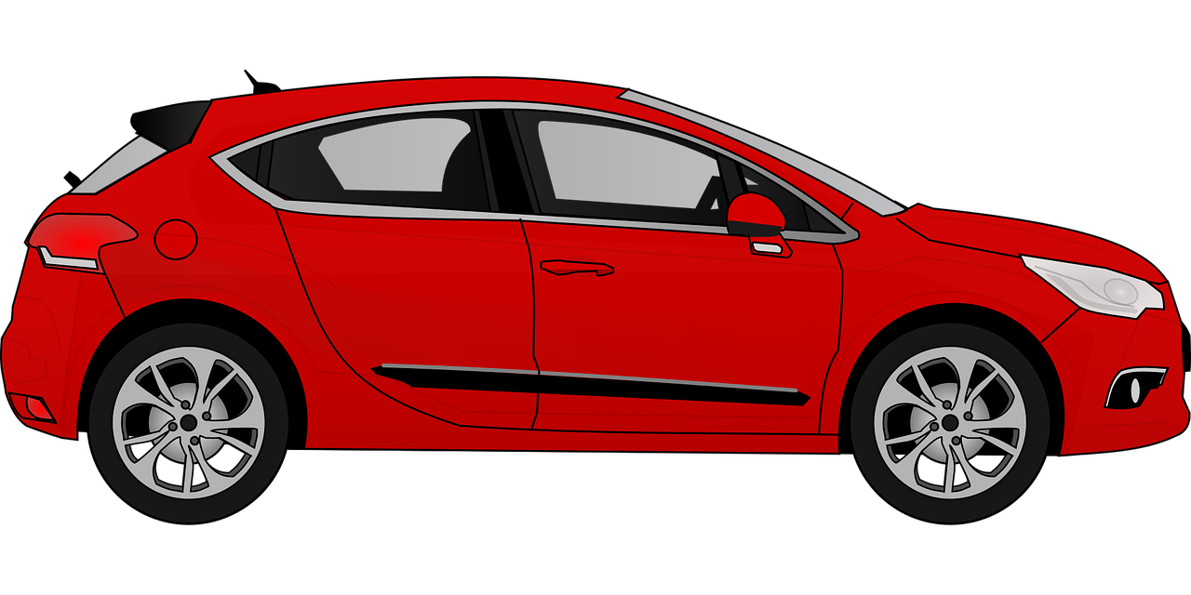
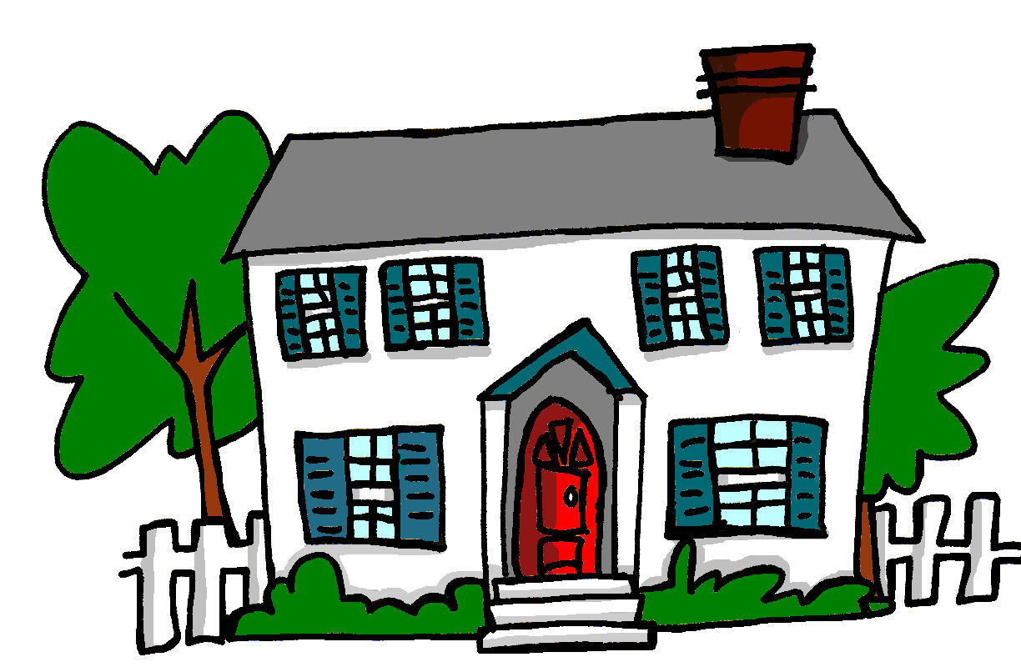
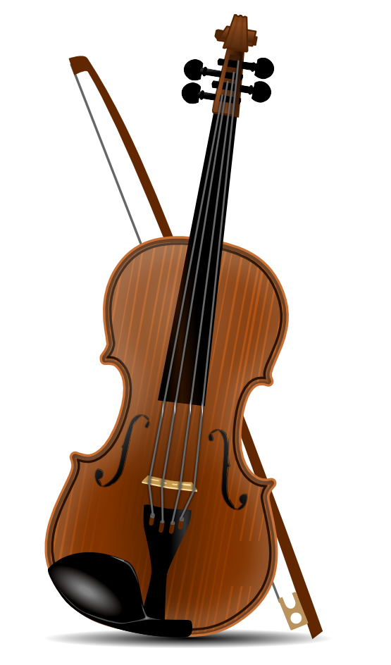
écrire
Écris cinq phrases. Lis les phrases à ton/ta partenaire.
⚠ Remember to change the adjective spelling, if needed.
Exemple :
une chanson lente
Exemple :
le cousin amusant
amusant bleu calme
cher
content
courageux
different difficile
gris
heureux
jaune
important
intelligent
lent
malade méchant
normal parfait
rapide
rouge sérieux
sympa(thique)
triste
vert
Notes:
Timing: 3 minutes
Aim: to practise written production and aural comprehension of a lot of noun + adjectives in French, practising their word order and agreement.
Procedure:
Ensure that pupils understand the task.
They select 5 nouns and adjectives and write short phrases, without their partner seeing.
They then take turns to read their phrases to their partner.
For each phrase that matches theirs, they get 1 point. For each phrase that is unique they get 2 points.
Elicit a few phrases from pupils and overall scores for the game.
8

Slide 9
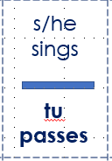
parler
Écoute et complète les dominos.
lire
Personne 1 lit la carte.
Personne 2 lit la carte.
Personne 3 lit la carte.
Tu as le verbe en anglais ?
Tu as ‘elle chante’ en anglais ?
Notes:
Timing: 7 minutes
Aim: to practise written recognition and read aloud of a number of previously taught present tense verbs.
Procedure:
Ensure that pupils understand the task.
Give one domino to each pupil (if there are more dominoes than pupils give some pupils two dominoes).
The pupil with the domino that starts with ‘début' begins by saying the French verb.
The pupil with the matching verb in English says it and then the French verb that forms the other side of their domino.
Keep going until the class reaches the final domino.
NB. Teachers can add a competitive element by challenging pupils to get through the whole domino set in less than 3 minutes.
9

Slide 10
s/he sings
you spend, pass
I play
s/he lives
you eat
début
I use
he likes
elle chante
tu passes
tu manges
elle donne
je joue
il habite
j’utilise
iI aime
s/he gives
you prepare
I watch
he works
I prefer
s/he wears
you hate
I speak
tu prépares
je regarde
il travaille
je préfère
elle porte
tu détestes
je parle
elle aide
she helps
he watches
you repeat
I work
he likes
you help
she uses
you speak
il regarde
tu répètes
je travaille
elle utilise
tu parles
il aime
tu aides
fin
Notes:
This is an animated version. The audio version has the French audio attached.

Slide 11
parler
Morpion*
Morpion – Noughts and crosses
lire
J’ai un an.
J’ai six ans.
J’ai douze ans.
Notes:
Timing: 5 minutes
Aim: to practise saying ages.
Procedure:
Explain the task by using the model
Pupils draw a 3x3 grid, and randomly write numbers 1-12 in the grid.
They work in pairs. One person takes circles, the other crosses.
Pupils take it in turns to claim a square by saying ‘J’ai XXX ans’. If their partner also has that number, they must mark it off on their grid using their partner’s symbol.
The aim is to get three in a row. As pupils will not know what is on their partner’s grid, they may inadvertently block their partner!
11

Slide 12
Au revoir !
rouge
Notes:
12

Slide 13
s/he sings
you spend, pass
I play
s/he lives
you eat
début
I use
he likes
elle chante
tu passes
tu manges
elle donne
je joue
il habite
j’utilise
iI aime
s/he gives
you prepare
I watch
he works
I prefer
s/he wears
you hate
I speak
tu prépares
je regarde
il travaille
je préfère
elle porte
tu détestes
je parle
elle aide
she helps
he watches
you repeat
I work
he likes
you help
she uses
you speak
il regarde
tu répètes
je travaille
elle utilise
tu parles
il aime
tu aides
fin
Notes:
Domino template – 1 for the whole class – cut up and distribute.

