Slide 1
What do I know now?
Bonjour ! Ça va ?
rouge
Follow ups 1-5
Notes:
Artwork by Steve Clarke. Pronoun pictures from NCELP (www.ncelp.org). All additional pictures selected from Pixabay and are available under a Creative Commons license, no attribution required.
Phonics: Revisit several SSC: [SFe] [ç] (and soft -c) [-ien] [qu] [j] (soft g) [-tion] [r]
Vocabulary (new words in bold): Revisit Term 3 vocabulary
Revisit 1: an [76] faim [1986] raison [72] soif [4659] tort [1652]
Revisit 2: combien [800] chose [125] des [2]
Londsale, D., & Le Bras, Y. (2009). A Frequency Dictionary of French: Core vocabulary for learners London: Routledge.
The frequency rankings for words that occur in this PowerPoint which have been previously introduced in these resources are given in the SOW and in the resources that first introduced and formally re-visited those words.
For any other words that occur incidentally in this PowerPoint, frequency rankings will be provided in the notes field wherever possible.

Slide 2
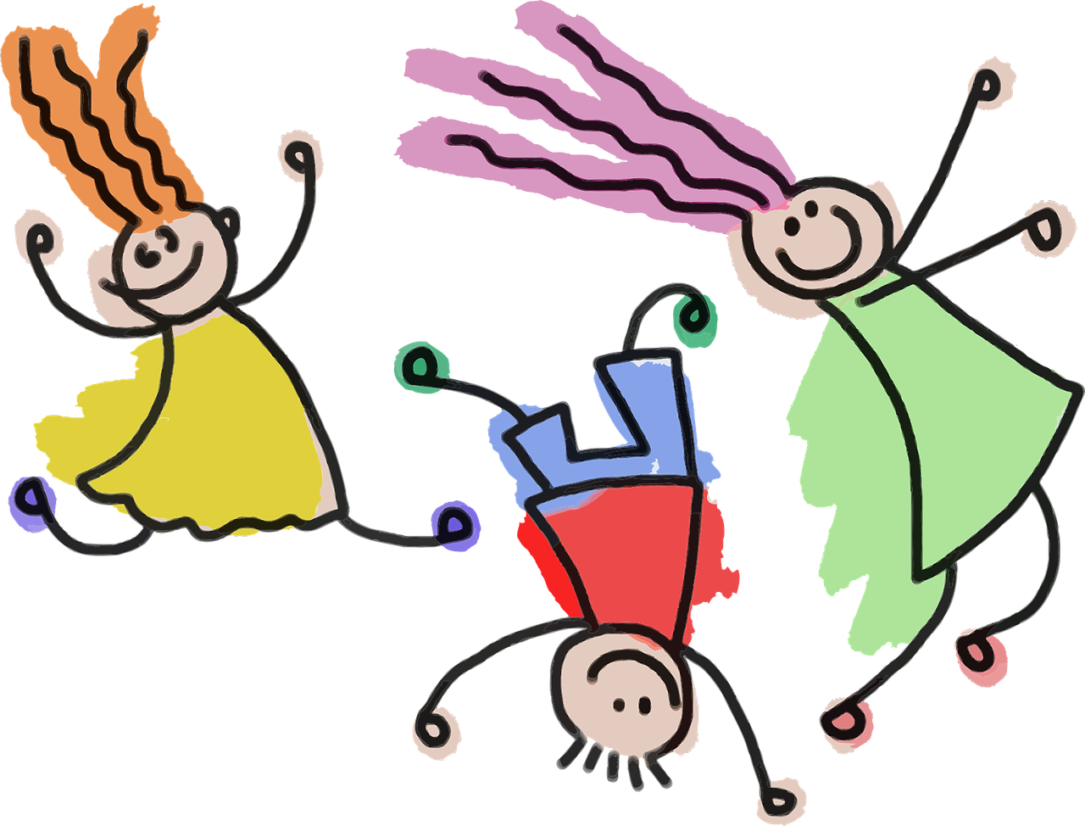
Follow up 3:
Prononce les mots.
prononcer
[an/en]
[-ien]
[(a)in]
[kid]
tente
canadien
gamin
Notes:
Timing: 5 minutes (five slides)
Aim: to revisit read aloud 15 of this year’s SSC.
Procedure:
Click to bring up the first flashcard.
Elicit choral read aloud.
If desired, click on the word to listen to the pronunciation.
Continue with the remaining flashcards.
Go on to the next slide and repeat.
Frequency of unknown words and cognates:
aboie (aboyer) [>5000] bloquer [2004] canadien [611] conte [4371] discuter [737] fameux [2060] gamin [>5000] juge [1323] lecture [1016] portion [3806] raide [3533] rouet [>5000] tente [4336] traite [4896] trône [3839]
Londsale, D., & Le Bras, Y. (2009). A Frequency Dictionary of French: Core vocabulary for learners London: Routledge.

Slide 3
Follow up 3:
Prononce les mots.
prononcer
[-tion]
[on]
[oi]
[tale, story]
[barks]
portion
conte
aboie
Notes:
[2/5]

Slide 4
Follow up 3:
Prononce les mots.
prononcer
[ai]
[é|er]
[eu]
[straight]
[to chat]
raides
discuter
fameux
Notes:
[3/5]

Slide 5
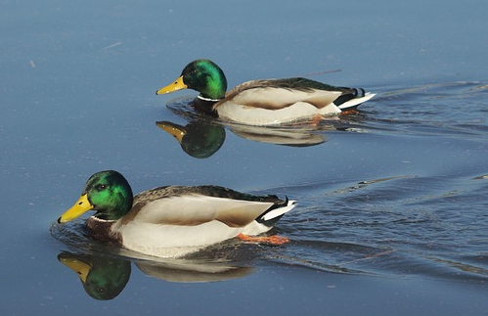
Follow up 3:
Prononce les mots.
prononcer
[u]
[SFC]
[SFe]
[reading]
[ducks]
[milking]
lecture
canards
traite
Notes:
[4/5]

Slide 6
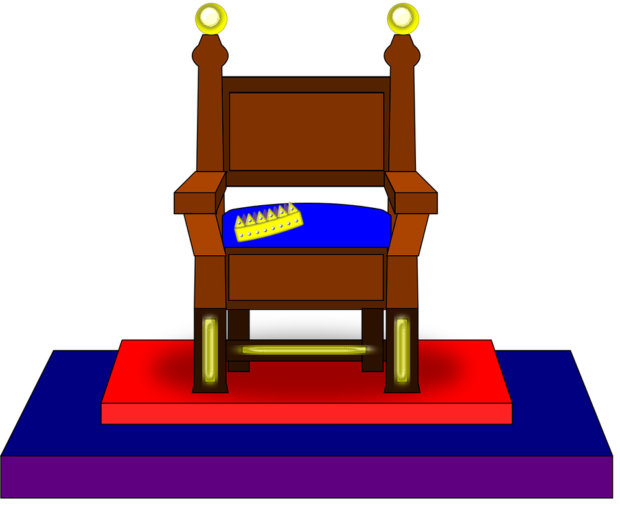
Follow up 3:
Prononce les mots.
prononcer
[r]
[qu]
[j|g]
trône
bloquer
juge
Notes:
[5/5]

Slide 7
Follow up 2a:
Écoute. La catégorie correcte, c’est quoi ?
 | Catégorie
écouter
1
cousine | mère | frère
famille
2
femme | homme | garçon
personne
3
onze | quatre | neuf
nombre
4
rouge | bleu | jaune
couleur
5
s’il te plait | merci | bonjour
phrase
6
travailler | jouer | aimer
verbe
7
quoi | comment | où
question
8
mardi | vendredi | dimanche
jour
9
présent | intelligent | méchant
description
verbe
personne
question
couleur
famille
phrase
jour
description
nombre
Notes:
Timing: 5 minutes
Aim: to revisit aural recognition of previously taught words and their connection to other previously taught ‘category’ words.
Procedure:
Click to play the audio.
Pupils listen and write down the category word.
Elicit answers in any order and click on the category words to provide feedback.
Continue to the next slide for a written extension to the activity.
Transcript:
1. cousine, mère, frère
2. Femme, homme, garçon
3. onze, quatre, neuf
4. rouge, bleu, jaune
5. s’il te plait, merci, bonjour
6. travailler, jouer, aimer
7. quoi, comment où
8. mardi, vendredi, dimanche
9. présent, intelligent, méchant

Slide 8
Follow up 2b:
Écris un mot en français pour chaque catégorie.
écrire
 | Catégorie
| père | sœur
cousine | mère | frère
famille
femme | homme | garçon
| fille | Monsieur | Madame
personne
onze | quatre | neuf
| un | deux| trois | cinq | six | sept | huit
nombre
| gris | vert |
rouge | bleu | jaune
couleur
s’il te plait | merci | bonjour
| salut | Ça va ? | Au revoir
phrase
travailler | jouer | aimer
|détester | écouter | lire | porter |être
verbe
quoi | comment | où
| combien |
question
mardi | vendredi | dimanche
|lundi| mercredi| jeudi | samedi
jour
présent | intelligent | méchant
| facile | préféré | lent | malade
description
Notes:
Timing: 4 minutes
Aim: to practise written production of some of this year’s vocabulary.
Procedure:
1. Pupils try to write one or two words that could plausibly belong to the 9 categories.
2. Click to provide possible suggested answers. Note that some of the categories have many possible answers.

Slide 9
Follow up 3:
Lis le texte. Écris en anglais.
lire
Bonjour !
Ça va ? Je suis Alex. J’ai dix ans et j’habite à Lille. C’est une ville en France. Aujourd’hui, c’est mercredi et je suis à l’école avec Madame Marchand. Elle est ma professeure.
J’aime l’anglais mais prononcer, c’est très difficile. Par exemple, le vélo, c’est ‘bicycle’. J’ai raison, oui ? Mon mot* préféré est ‘lunch’! J’ai toujours* faim ! C’est quoi en français ? Ton mot préféré, c’est quoi ?
Je joue avec mon ami Éric tous les jours. Je trouve ça super ! Il est amusant et courageux. Il aime regarder des films d’action. Moi, aussi ! Tu aimes aussi regarder des films ?
Écris-moi ! Alex
1. What two details do we find out about Alex?
They are 10 years old and they live in Lille.
2. What does Alex say about today? (3 details)
Today is Wednesday, they are at school, with their teacher Mrs Marchand.
3. What does Alex say about learning English? ….(2 details)
They like it, but pronouncing it is hard. Favourite word is lunch.
4. What does Alex say about their friend Eric?
(3 details)
They play with Eric every day. He is funny and brave. He likes watching films.
5. What questions does Alex ask in the letter? (5 questions)
How are you? Am I right? What is ‘lunch’ in French? What is your favourite word? Do you like watching films, too?
le mot – word | toujours – always
Notes:
Timing: 5 minutes
Aim: to practise written comprehension of a longer text made up of previously taught language from this year.
Procedure: 1. Read the text aloud with pupils (or click to play the audio). 2. Give pupils time to answer the question themselves. 3. Elicit and check answers.
Note: this task can be made less challenging if needed by giving pupils a smaller portion of the text and fewer questions to answer.

Slide 10
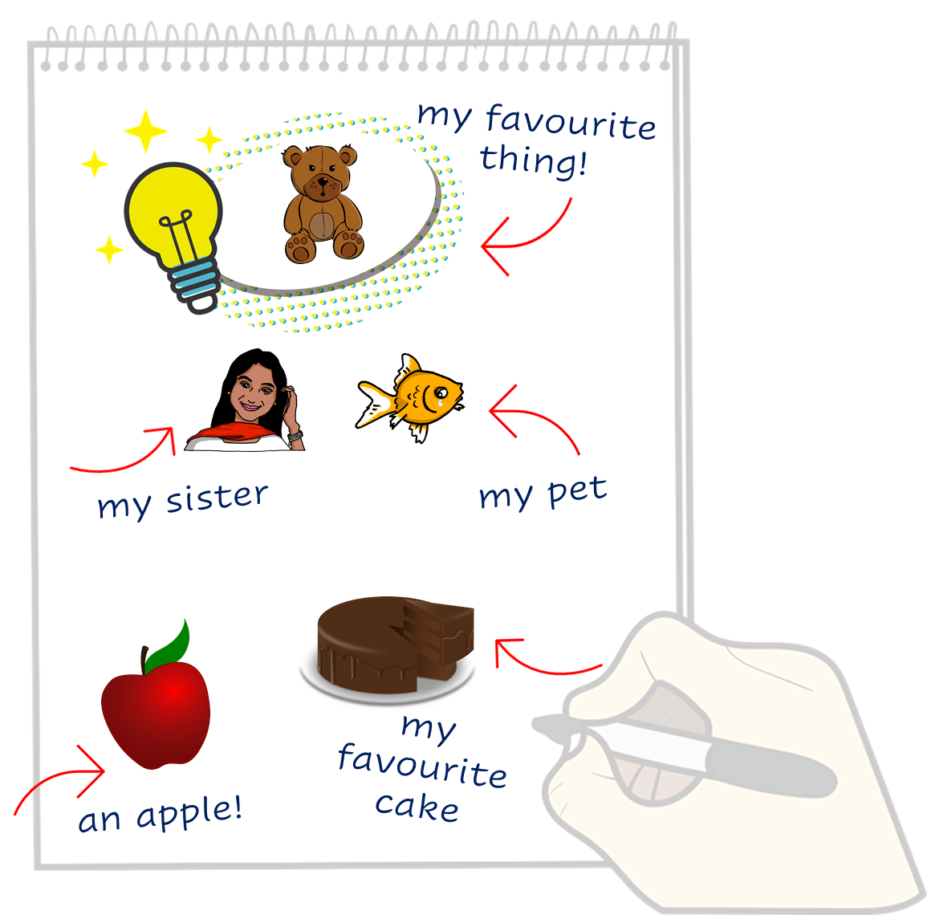
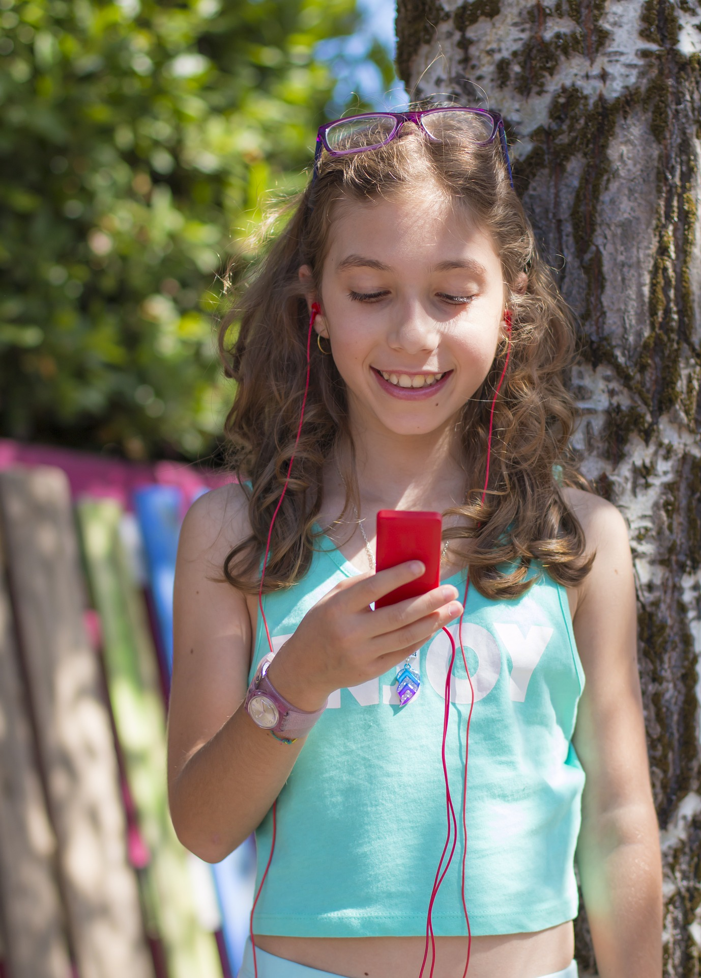
Follow up 4:
Lis le texte. Écris des mots en français.
Just have a go! Write any of these English words in French. You can add different words, too.
écrire
Notes:
Timing: 5 minutes
Aim: to practise written production of this year’s vocabulary.
Note: This is a more straightforward version of the activity, asking pupils for individual words. A more challenging version can be found on the following slide, where pupils are encouraged to write a mixture of sentences and words.
Procedure:
Pupils read the message from Sophie in the green text box.
Pupils use Sophie’s message and the words and pictures on the notebook to the right as inspiration. They use the lines on the left to write any words in French that they could use to reply to Sophie. They could use any of the words on the notebook, and any other words they know.

Slide 11
Follow up 4:
Write a message to Sophie in French. Write anything you like. You can write short sentences or words or a mixture, like Sophie.
Écris en français.
écrire
Notes:
Timing: 8 minutes
Aim: to practise written production of this term’s vocabulary and to practise written production of short sentences.
Note: This is a more challenging version of the activity, where pupils are encouraged to write a mixture of sentences and words. A more straightforward version of the activity can be found on the previous slide, where pupils are asked to write individual words.
Procedure:
Pupils read the message from Sophie in the green text box.
Pupils use Sophie’s message and the words and pictures on the notebook to the right as inspiration. They use the lines on the left and the empty notepad to write any words or sentences in French that they could use to reply to Hanna.

Slide 12
vocabulaire
Follow up 5a: Écris en anglais: Can you get at least 15 points?
mots
 | lente | sympa(thique) | préféré
 | très | trop | en retard
 | chère | gris | le vélo
 | combien ? | les | des
 | le tort | la raison | l’an
 | la chose | la soif | la faim
slow (f)
nice (m/f)
favourite (m)
x3
very
too (much)
late
expensive (f)
grey (m)
(the) bicycle
x2
how many?
the (pl m/f)
some
(the) wrong
(the) reason, right
(the) year
x1
(the) thing
(the) thirst
(the) hunger
Notes:
Timing: 5 minutes
Aim: to practise written comprehension of vocabulary from week 1, last week and this week.
Procedure: 1. Give pupils a blank grid. They fill in the English meanings of any of the words they know, trying to reach 15 points in total. 2. Remind pupils that adjectives can refer to male or female persons and they should note this in their translations. E.g. pleased (f), short (m).
Note: The most recently learnt and practised words are pink, words from the previous week are green and those from week 1 are blue, thus more points are awarded for them, to recognise that memories fade and more effort (heavy lifting!) is needed to retrieve them.
12

Slide 13
vocabulaire
Follow up 5b: Écris en français: Can you get at least 15 points?
mots
 | favourite | too (much) | late
 | slow (m) | very | nice (m/f)
 | (the) bike) | expensive (m) | grey (f)
 | some | how many? | the (pl m/f)
 | (the) thirst | (the) wrong | (the) thing
 | (the) year | (the) hunger | (the) reason, right
préféré
trop
en retard
x3
lent
très
sympa(thique)
le vélo
cher
grise
x2
des
combien ?
les
la soif
le tort
la chose
x1
l’an
la faim
la raison
Notes:
Timing: 5 minutes
Aim: to practise written comprehension of vocabulary from week 1, last week and this week.
Procedure: 1. Give pupils a blank grid. They fill in the French meanings of any of the words they know, trying to reach 15 points in total. 2. Remind pupils that adjectives can refer to male or female persons and they should note this in their translations. E.g. pleased (f), short (m).
Note: The most recently learnt and practised words are pink, words from the previous week are green and those from week 1 are blue, thus more points are awarded for them, to recognise that memories fade and more effort (heavy lifting!) is needed to retrieve them.
13

