Slide 1
Describing things and people
friendship
plural definite article ‘les’
SSC [r]
rouge
Notes:
Artwork by Steve Clarke. Pronoun pictures from NCELP (www.ncelp.org). All additional pictures selected from Pixabay and are
available under a Creative Commons license, no attribution required.
The AUDIO version of the lesson material includes additional audio for the new language presented (phonics, vocabulary) and audio for the instructions on the slide.
In addition, it includes VIDEO clips of the phonics and the phonics’ source words. Pupils can be encouraged to look at the shape of the mouth/lips on slides where these appear, and try to copy it/them.
Phonics: [r] rue [598] triste [1843] moderne [1239] être [5] parler [106]
Vocabulary (new words in bold): les [1] pomme [2847] merci [1070] s'il te plaît/s'il vous plaît [n/a]
Liaison after les + noun.
Revisit 1: cousin, cousine [3387] femme [154] homme [136] bleu [1216] rouge [987]
Revisit 2: il y a [n/a] un [3] deux [41] trois [115] quatre [253] cinq [288] six [450] sept [905] huit [877] neuf [787] dix [372] onze [2447] douze [1664]
Londsale, D., & Le Bras, Y. (2009). A Frequency Dictionary of French: Core vocabulary for learners London: Routledge.
The frequency rankings for words that occur in this PowerPoint which have been previously introduced in these resources are given in the SOW and in the resources that first introduced and formally re-visited those words. For any other words that occur incidentally in this PowerPoint, frequency rankings will be provided in the notes field wherever possible.
1

Slide 2
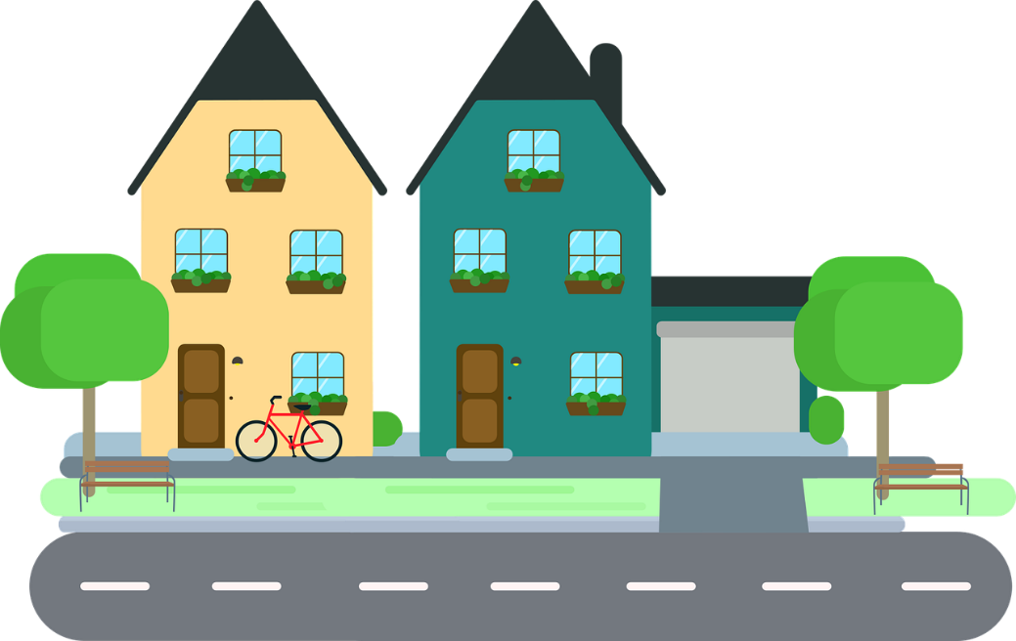
[r]
prononcer
rue
Notes:
Timing: 1 minute
Aim: To introduce SSC [r]
Procedure: 1. Present the letter(s) and say the [r] sound first, on its own. Students repeat it with you. 2. Bring up the word ”rue” on its own, say it, students repeat it, so that they have the opportunity to focus all of their attention on the connection between the written word and its sound.
3. Say the word and do the gesture, if using.
4. Roll back the animations and work through 1-3 again, but this time, dropping your voice completely to listen carefully to the students saying the [r] sound, pronouncing ”rue” and, if using, doing the gesture.
Gesture: https://www.signbsl.com/sign/road
The 1st video top left – trace the shape of a road with index fingers of both hands held parallel, tracing a road shape in the air away from the body.
Word frequency (1 is the most frequent word in French):
rue [144]
Source: Londsale, D., & Le Bras, Y. (2009). A Frequency Dictionary of French: Core vocabulary for learners London: Routledge.
2

Slide 3
[r]
prononcer
triste
moderne
rue
être
parler
Notes:
Timing: 2 minutes
Aim: To introduce SSC [r]
Procedure:
Introduce and elicit the pronunciation of the individual SSC [r] and then the source word again ‘rue’ (with gesture, if using). Then present and elicit the pronunciation of the five cluster words. The cluster words have been chosen for their high-frequency, from a range of word classes, with the SSC (where possible) positioned within a variety of syllables within the words (e.g. initial, 2nd, final etc.). Additionally, we have tried to use words that build cumulatively on previously taught SSCs (see the Phonics Teaching Sequence document) and do not include new SSCs. Where new SSCs are used, they are often consonants which have a similar symbol-sound correspondence in English.
Word frequency (1 is the most frequent word in French): rue [598] triste [1843] moderne [1239] être [5] parler [106] Source: Londsale, D., & Le Bras, Y. (2009). A Frequency Dictionary of French: Core vocabulary for learners London: Routledge.
3

Slide 4
[r]
⚠ There is no sound like this in English!
prononcer
French [r] is a raspy sound pronounced in the back of the throat.
Follow these steps to practise French [r]:
1. Open your mouth. Put your tongue flat and against the bottom teeth.
2. Close your throat as if to gargle and say ‘k’ several times.
3. Start again but don’t close your throat completely.
4. Instead of ‘k’, say “ra-ra-ra”. You should feel the throat vibrating.
Notes:
Timing: 3 minutes (two slides)
Aim: to build familiarity with movement in the mouth and throat when saying SSC [r].
Procedure:
1. Click to reveal step by step process of pronouncing [r].
2. Students should practise for a minute.
3. Move to the next slide.
4

Slide 5
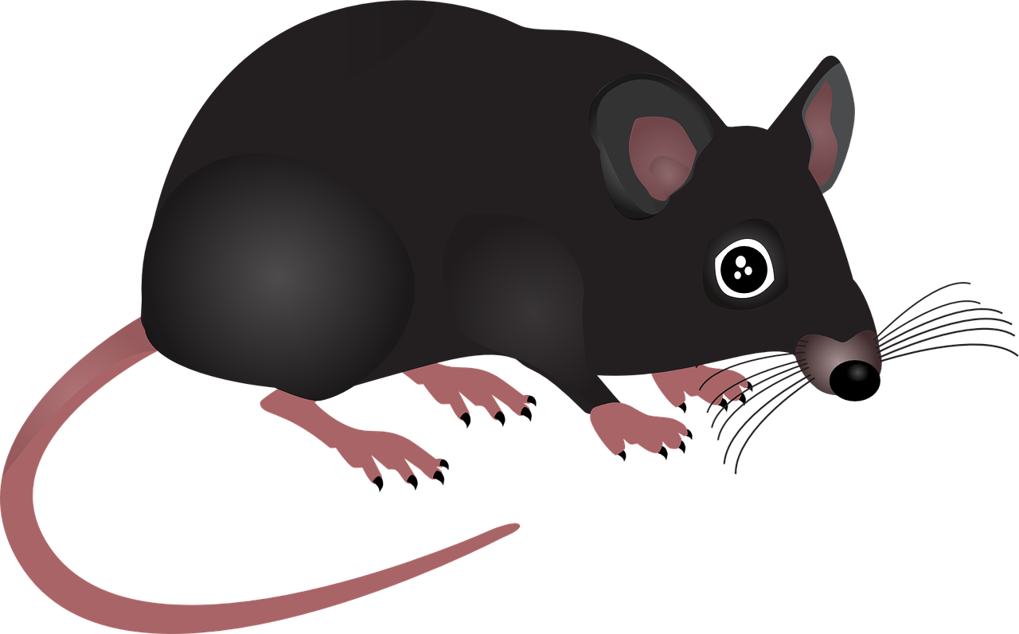
[r]
le trou - hole
Prononce le virelangue.
gros - fat
prononcer
1
Trois grands gros rats dans trois grands gros trous !
2
3
3
Notes:
Procedure:
Click to play the slowest version of the tongue twister.
Pupils read aloud themselves.
Click to listen to the two faster speeds, and pupils try to emulate.
Frequency of unknown words and cognates:
gros [419] trou [2180]
Londsale, D., & Le Bras, Y. (2009). A Frequency Dictionary of French: Core vocabulary for learners London: Routledge.
5

Slide 6
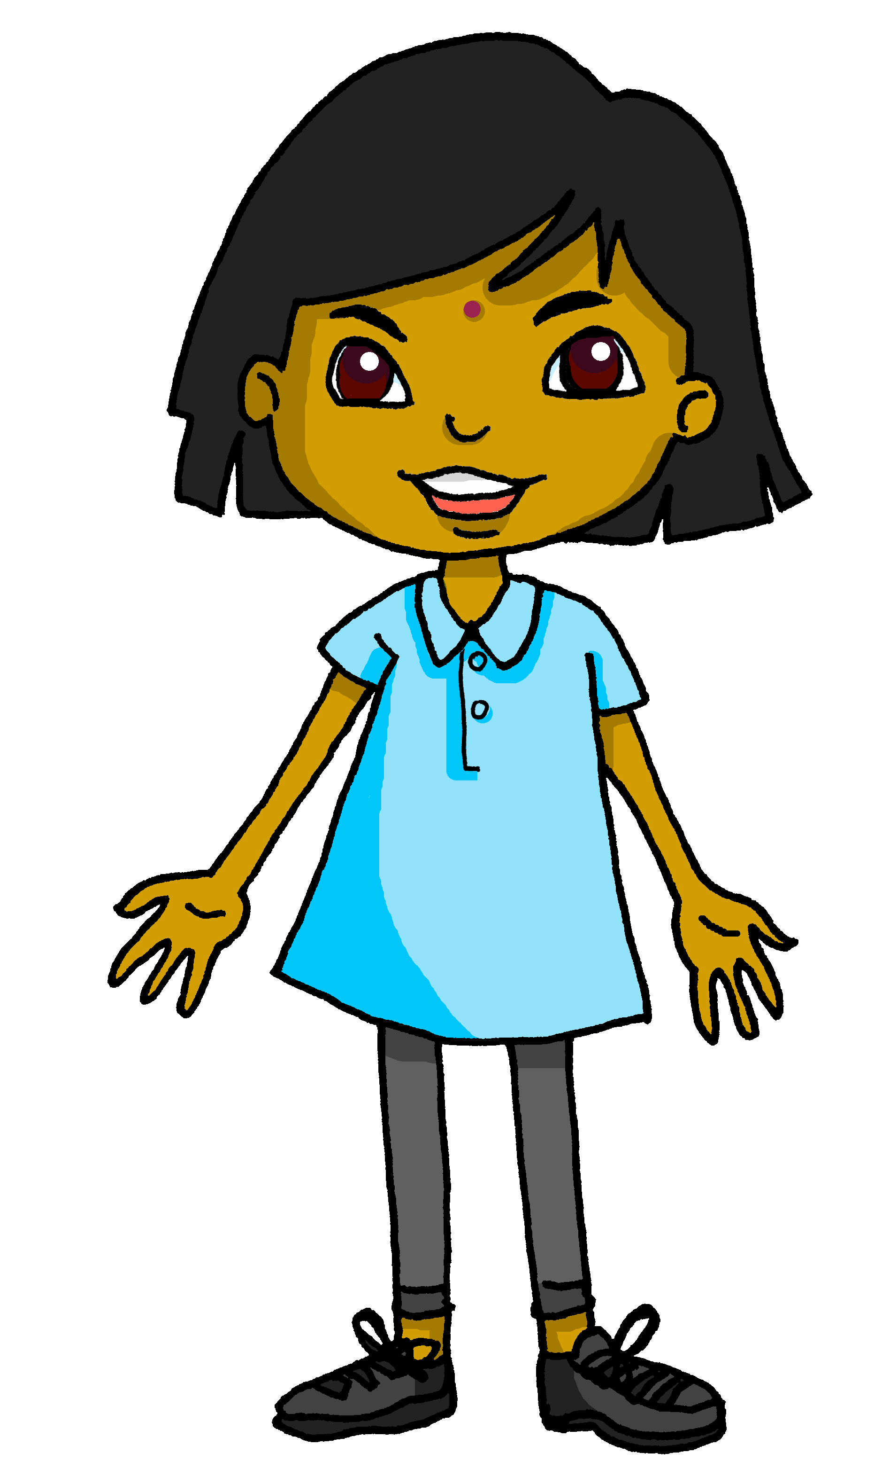
[r]
Sanaya compare l’anglais avec le français.
Les les mots en anglais et en français.
Attention ! Il y a une différence !
prononcer
fruit | fruit
crayon | crayon
universe | univers
phrase | phrase
orange | orange
university | université
rapid | rapide
prefer | préférer
1
2
3
4
5
6
7
8
Notes:
Timing: 5 minutes
Aim: to practise pronouncing French [r] and noticing the difference physically in the mouth when making French and English [r] sounds.
Procedure:
Pupils say the English words, with their hands on their throats, paying particular attention to the pronunciation of [r]. They shouldn’t feel any vibration when pronouncing the [r].
Click on the letters to hear the French word. Pay attention to the pronunciation of the [r]. Before attempting to say the words, pupils should ‘warm up’ by saying the English letter ‘g’ a few times, feeling the vibration in their throats.
pupils repeat the French word as many times as is necessary with their hands on their throats. They should feel a vibration when saying the [r].
Transcript:
1. fruit
2. crayon
3. univers
4. phrase
5. orange
6. université 7. rapide 8. préférer
Word frequency of unknown words and cognates (1 is the most frequent word in French): université [1192]
Source: Londsale, D., & Le Bras, Y. (2009). A Frequency Dictionary of French: Core vocabulary for learners London: Routledge.
6

Slide 7
Vokabeln
L’amitié*
l’amitié- friendship
Learning languages is about making friends.
You show kindness when you learn even a few words in another language.
Let’s remember some of the friendship sentences we have learnt already!
Salut !
Bonjour !
_ _ _ _ _ !
_ _ _ _ ?
_ _ _ _ _ _ _ !
Ça va ?
Can you say other kind things?
Are you pleased?
Tu es content(e) ?
C’est parfait!
Tu es mon ami(e).
It’s perfect!
You are my friend.
I like your bag!
J’aime ton sac !
You are nice!
Tu es sympa !
Notes:
Timing: 3 minutes
Aim: to introduce the idea that learning other languages opens the door to new friendships, and that a few kind words go a long way; to revisit some previously-taught language from this term that fits our category of ‘friendship sentences’. This is an idea we will return to now and then during the course.
Procedure:
Click to present the information on the slide.
Elicit the French from pupils for the English greetings and friendly statements.
Allow pupils a few moments to turn to those around them and greet them and say something kind about their work or about them themselves.
Remind pupils that we all need to hear kind words every day, in whatever language!
7

Slide 8
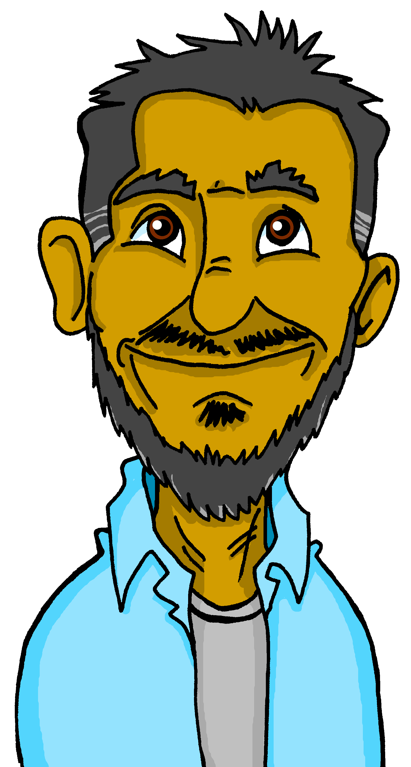
vocabulaire
Let’s learn two more.
⚠ Say s’il te plait to friends, family, and people your old age.
mots
Écoute et répète.
s’il te plait
merci
⚠ Literally it means: if it you pleases.
⚠ Say s’il vous plait to adults outside your family.
s’il vous plait
⚠ This is the more formal way to say please.
Notes:
Timing: 5 minutes (two slides) Aim: to introduce three of the new words for this week.
Procedure: 1. Click to present and say the words. 2. Pupils repeat.
3. Click to reveal the callouts about the two forms (formal and informal) of please.
Note: We follow here the latest recommendations from the Académie francaise regarding the omission of circumflexe accents on u and i, hence s’il te plait and not s’il te plaît.
8

Slide 9
écrire
S’il te plait | S’il vous plait
Let’s practise writing it.
Write each part on your sleeve with your finger. Check each part.
It helps if you say the words as you write them, too.
S’il te plait
1
2
3
4
S’il te plait !
1
2
3
4
S’il vous plait !
Parts 1, 2, 4 of formal ‘please’ are the same. Practise in the same way.
S’il vous plait
Notes:
Aim: to practise written production of the two phrases for please.
Procedure:
Introduction to writing please in French – pupils practise by writing on their sleeve with their finger.
Click through the animations.
Click on the phrase to bring up the sound, if you wish.
Help pupils break down the words into syllables as they write on their sleeves. Pupils should look down to write and look up to check.
Repeat a couple of times with each version.
Some pupils will challenge themselves to write the whole phrase at this point.
9

Slide 10
Les
We usually add –s to nouns in French, to talk about more than one:
Il y a deux vélos.
Il y a quatre voitures.
There are two bikes.
There are four cars.
We know the word ‘des’ means some for both masculine and feminine nouns:
Voici des vélos.
Voici des voitures.
The plural word for ‘the’ is ‘les’. It is the same for both masculine and feminine nouns.
les chiens
les pommes
Notes:
Timing: 5 minutes (two slides)
Aim: to introduce the plural word for ‘the’ and recap the most common way to form plural nouns, and the word for ‘some’.
Procedure: 1. Click to present the information.
2. Elicit responses from pupils, following the animated question marks.

Slide 11
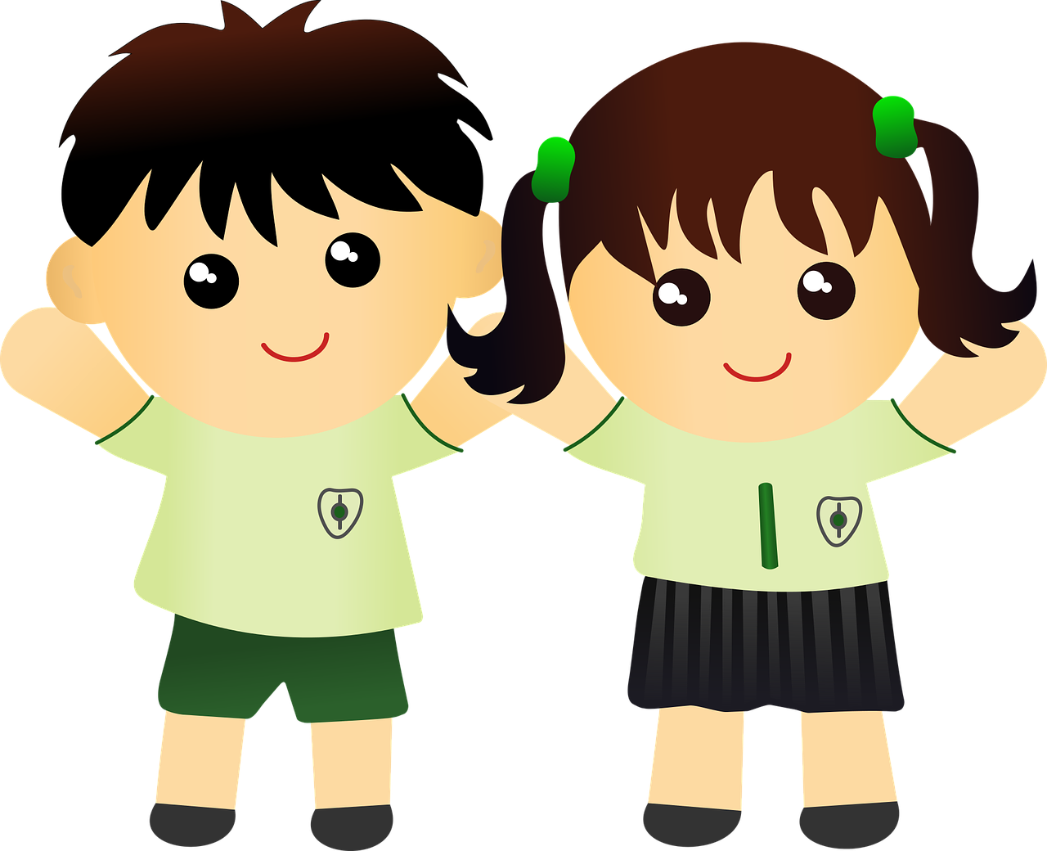
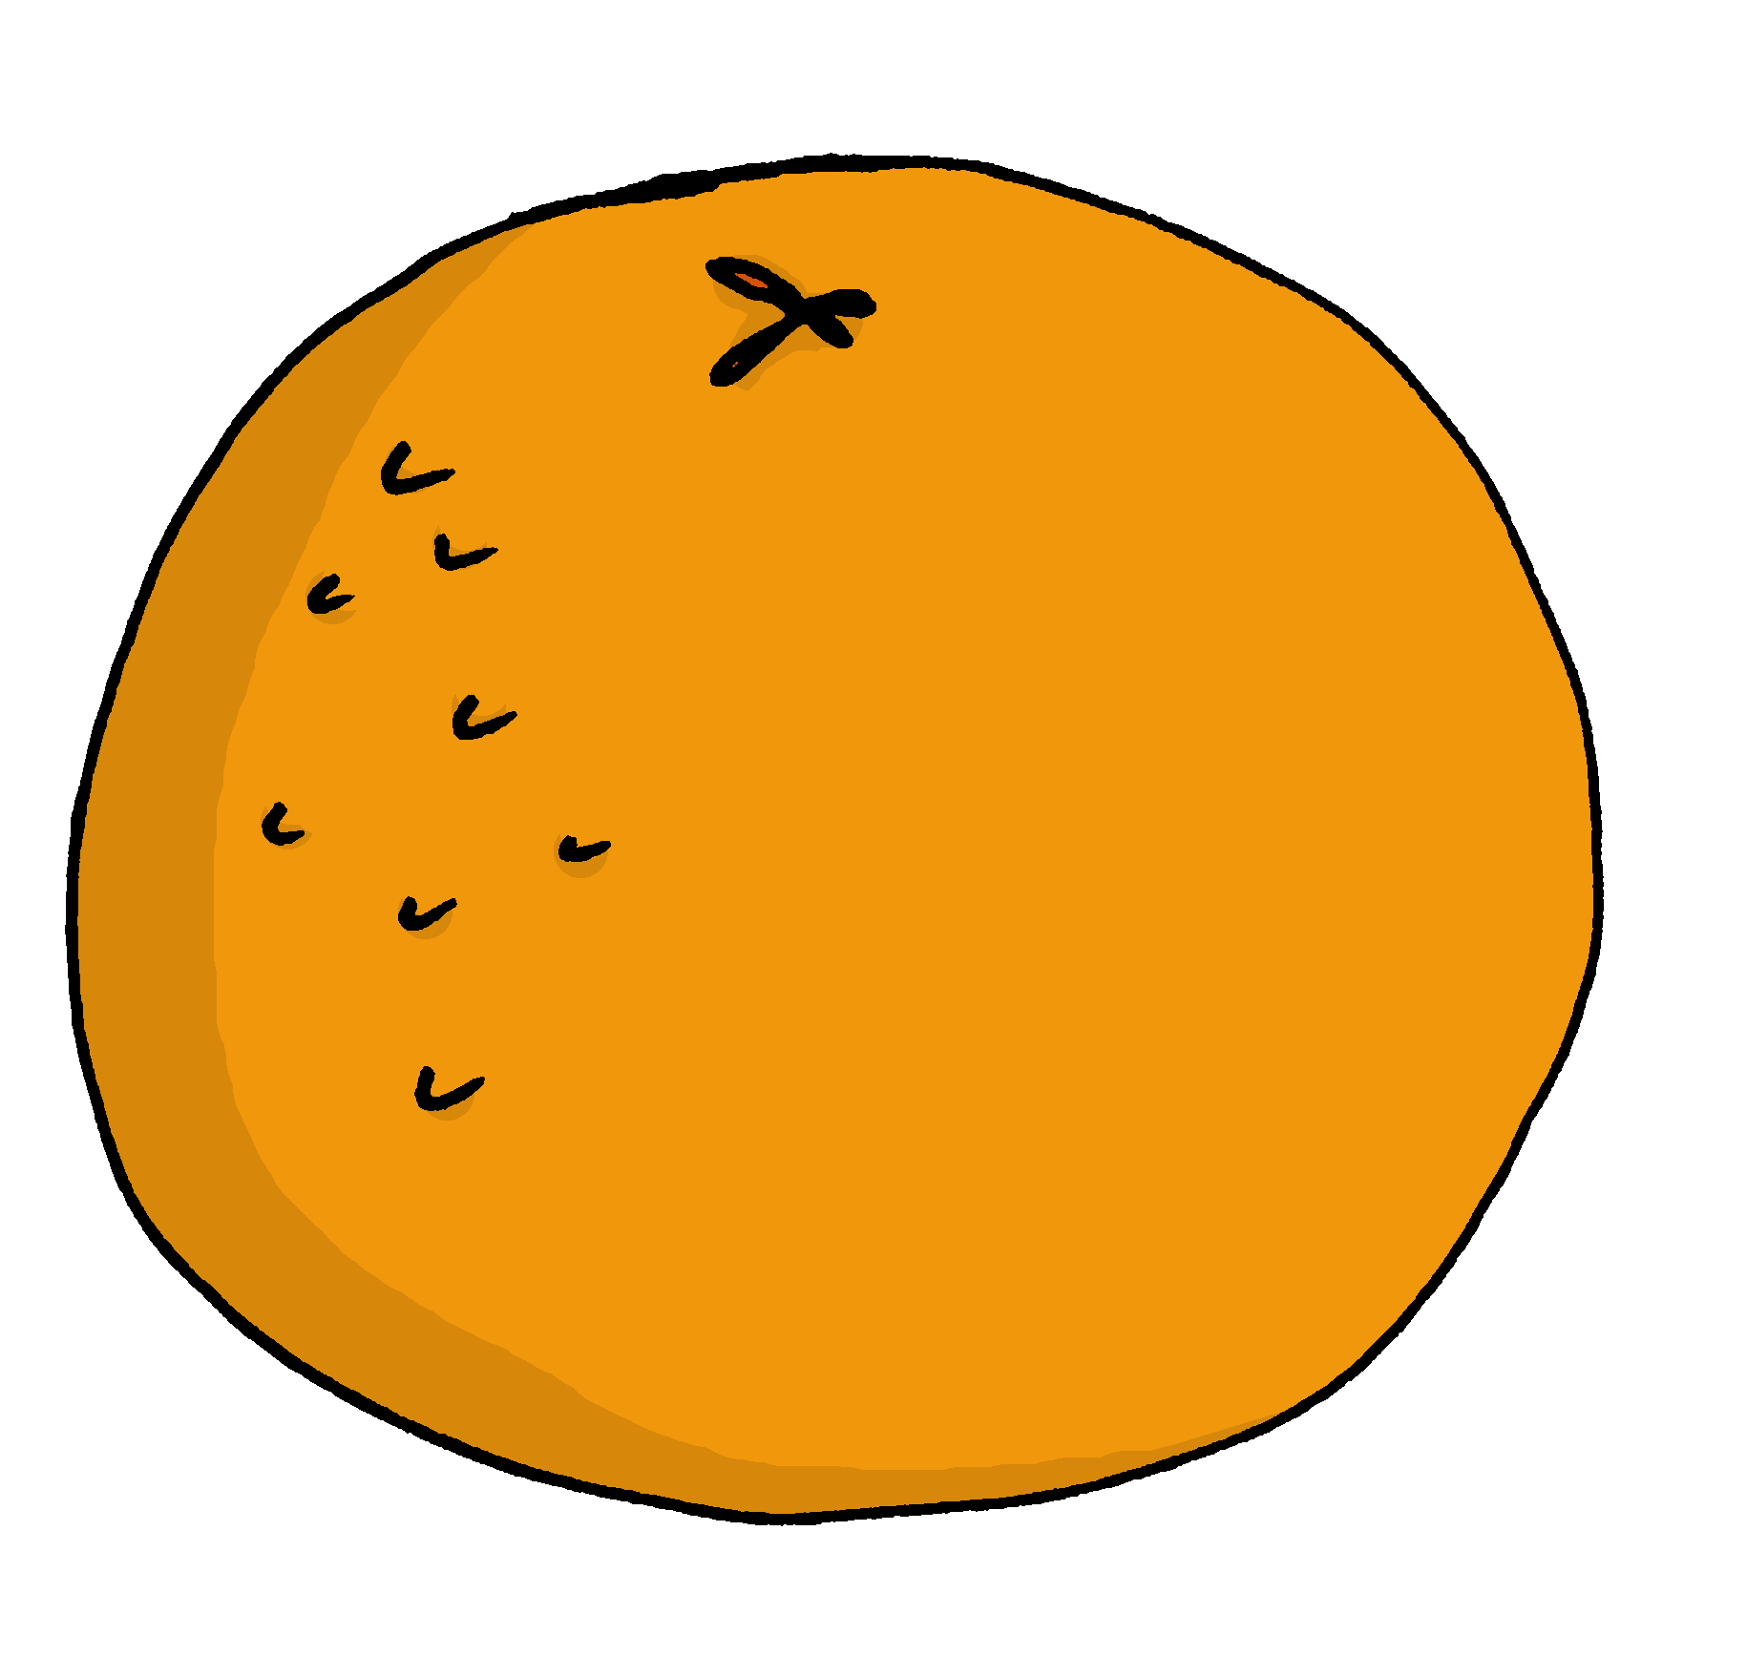
Les avec la liaison
Remember! Use l’ to mean ‘the’ for singular nouns that begin with a vowel or silent ‘h’:
We make a liaison after ‘les’ with plural forms of nouns that begin with a vowel or silent ‘h’:
l’uniforme
les uniformes
l’homme
les hommes
l’école
les écoles
l’orange
les oranges
Notes:
Procedure: 1. Click to present the information.
2. Elicit responses from pupils, following the animated question marks.

Slide 12
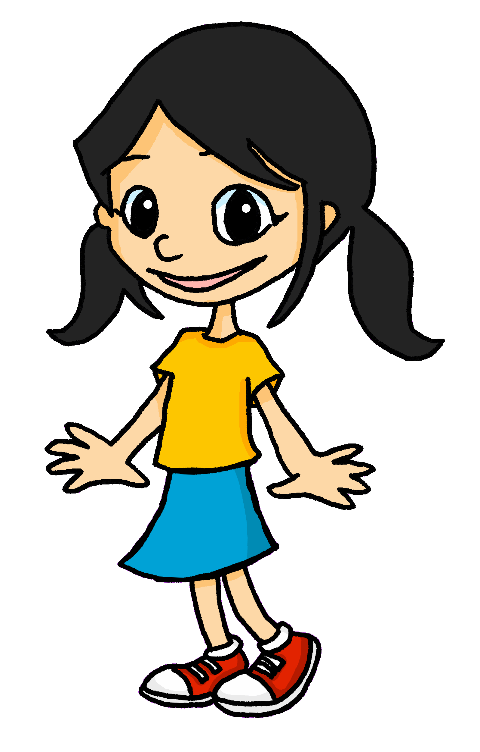
lire
Eugénie donne des opinions. Elle dit quoi exactement ?
J’aime les fruits.
4
J’aime le crayon bleu.
1
fruit | fruits
crayon | crayons
La phrase ‘s’il vous plait’ est importante.
phrases | phrase
Voici les réponses. J’ai raison ?
2
5
réponses | réponse
Je déteste les uniformes.
Quand j’ai faim j’adore la pizza.
3
uniformes | uniforme
6
pizzas | pizza.
Notes:
Timing: 5 minutes
Aim: Written recognition of the singular and plural forms of definite articles and connecting form with meaning.
Procedure:
1. Students write 1-6 in their books.
2. Students read the sentences and decide whether which noun is being described. Tell them they need to look at the definite article to get this information.
3. Click to reveal answers.
4. Ask students for the meanings of the sentences in English.
Note: we recognise that in numbers 2 and 4 pupils could get the answer from the verb (est) or the adjective (bleu) instead of the definite article but think that pupils are most likely to focus on the article as it appears first in the sentence and is the designated focus for the activity.
12

Slide 13
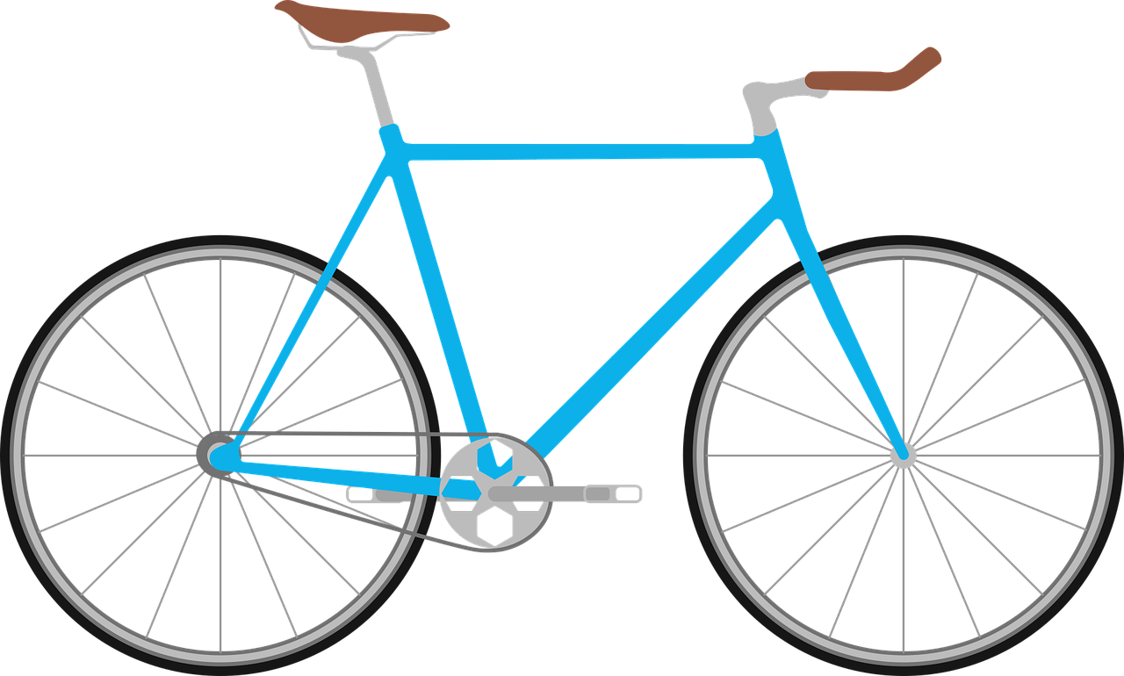
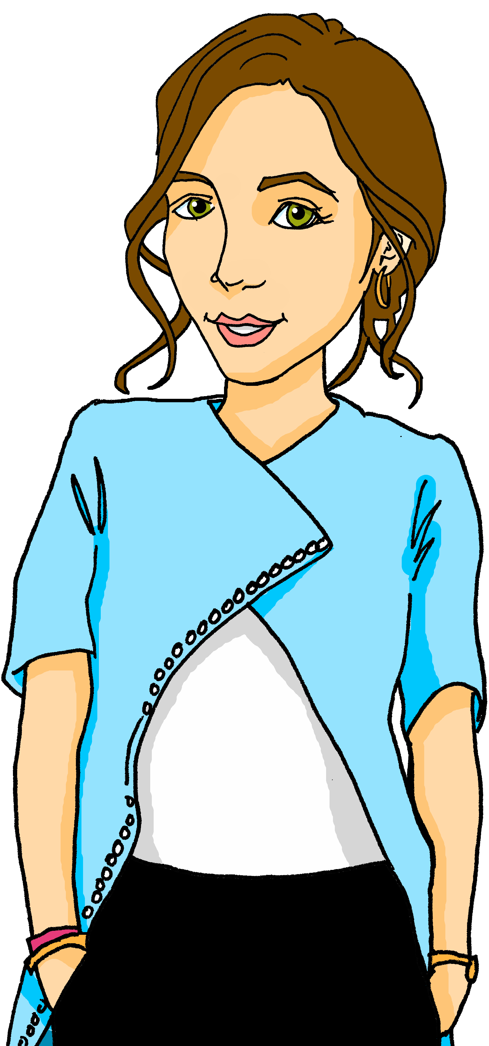
écouter
Écoute. C’est ‘le’, ‘la’ ou ‘les’?
1
4
le vélo
les cousins
écrire
2
5
les femmes
la voiture
3
6
les pommes
la professeure
Notes:
Timing: 3 minutes
Aim: to practise aural recognition of the singular and plural forms of definite articles and connecting form with meaning.
Procedure:
Click on a number to hear an article said aloud.
Students write 1-6 and the French word for what the article refers to.
Click to reveal answers and spelling.
Transcript:
le
les
la
les
la
les
13

Slide 14
Au revoir !
rouge
Notes:
14

