Slide 1
Describing me and others
friendship
rouge
Follow ups 1-5
Notes:
Artwork by Steve Clarke. Pronoun pictures from NCELP (www.ncelp.org). All additional pictures selected from Pixabay and are available under a Creative Commons license, no attribution required.
Frequency of new vocabulary and phonics:
Phonics: [r] rue [598] triste [1843] moderne [1239] être [5] parler [106]
Vocabulary (new words in bold): les [1] pomme [2847] merci [1070] s'il te plaît/s'il vous plaît [n/a]
Liaison after les + noun.
Revisit 1: cousin, cousine [3387] femme [154] homme [136] bleu [1216] rouge [987]
Revisit 2: il y a [n/a] un [3] deux [41] trois [115] quatre [253] cinq [288] six [450] sept [905] huit [877] neuf [787] dix [372] onze [2447] douze [1664]
Londsale, D., & Le Bras, Y. (2009). A Frequency Dictionary of French: Core vocabulary for learners London: Routledge.
The frequency rankings for words that occur in this PowerPoint which have been previously introduced in these resources are given in the SOW and in the resources that first introduced and formally re-visited those words.
For any other words that occur incidentally in this PowerPoint, frequency rankings will be provided in the notes field wherever possible.

Slide 2
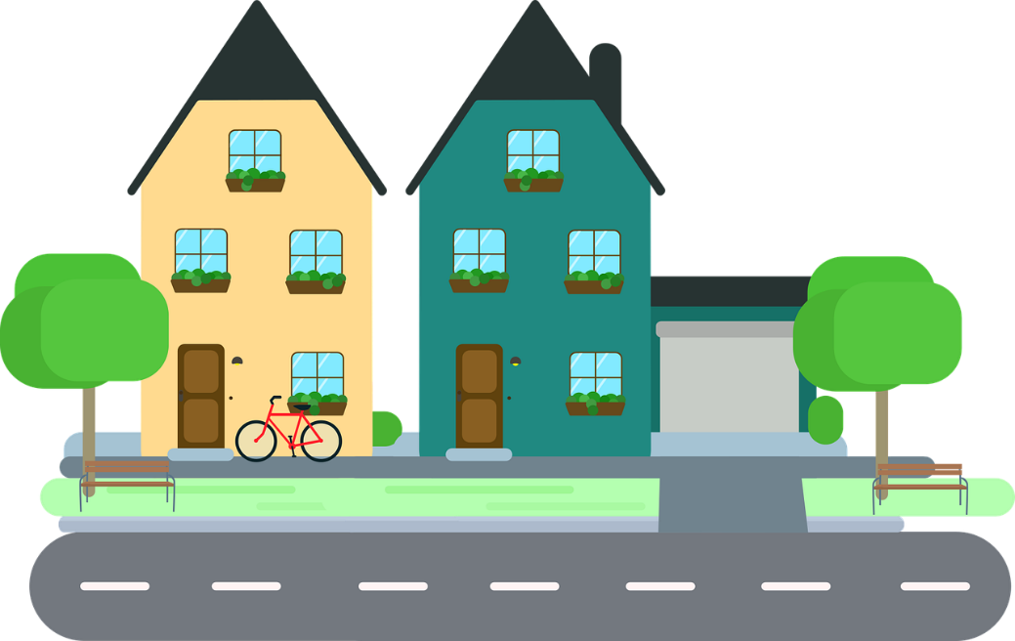
[r]
prononcer
rue
Notes:
Timing: 1 minute
Aim: To introduce SSC [r]
Procedure: 1. Present the letter(s) and say the [r] sound first, on its own. Students repeat it with you. 2. Bring up the word ”rue” on its own, say it, students repeat it, so that they have the opportunity to focus all of their attention on the connection between the written word and its sound.
3. Say the word and do the gesture, if using.
4. Roll back the animations and work through 1-3 again, but this time, dropping your voice completely to listen carefully to the students saying the [r] sound, pronouncing ”rue” and, if using, doing the gesture.
Gesture: https://www.signbsl.com/sign/road
The 1st video top left – trace the shape of a road with index fingers of both hands held parallel, tracing a road shape in the air away from the body.
Word frequency (1 is the most frequent word in French):
rue [144]
Source: Londsale, D., & Le Bras, Y. (2009). A Frequency Dictionary of French: Core vocabulary for learners London: Routledge.
2

Slide 3
[r]
prononcer
triste
moderne
rue
être
parler
Notes:
Timing: 2 minutes
Aim: To introduce SSC [r]
Procedure:
Introduce and elicit the pronunciation of the individual SSC [r] and then the source word again ‘rue’ (with gesture, if using). Then present and elicit the pronunciation of the five cluster words. The cluster words have been chosen for their high-frequency, from a range of word classes, with the SSC (where possible) positioned within a variety of syllables within the words (e.g. initial, 2nd, final etc.). Additionally, we have tried to use words that build cumulatively on previously taught SSCs (see the Phonics Teaching Sequence document) and do not include new SSCs. Where new SSCs are used, they are often consonants which have a similar symbol-sound correspondence in English.
Word frequency (1 is the most frequent word in French): rue [598] triste [1843] moderne [1239] être [5] parler [106] Source: Londsale, D., & Le Bras, Y. (2009). A Frequency Dictionary of French: Core vocabulary for learners London: Routledge.
3

Slide 4
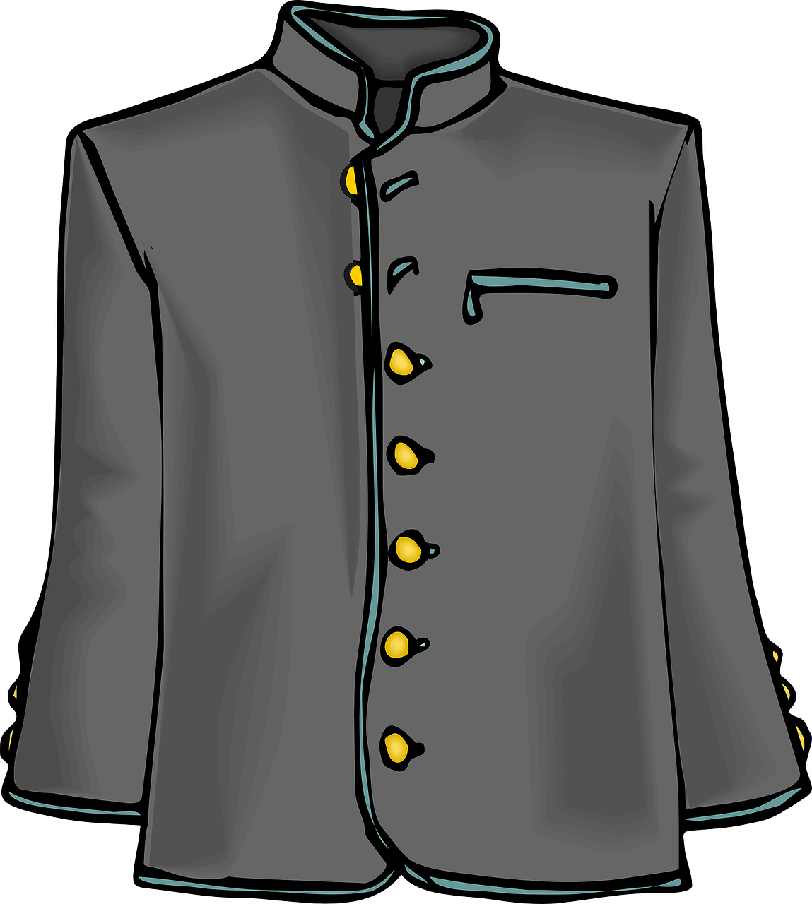
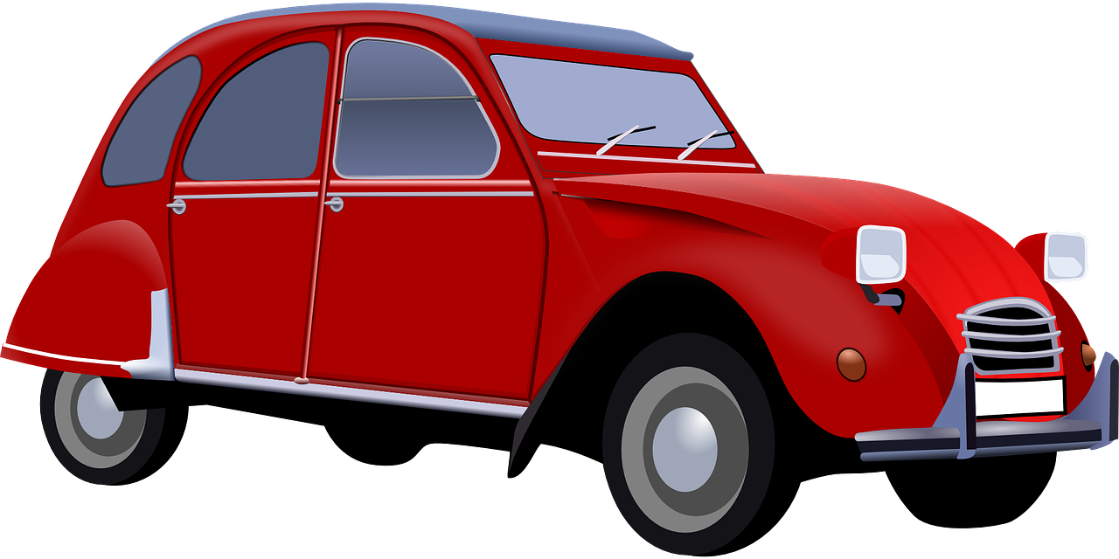
Follow up 1:
Qui va avec chaque phrase ?
[r]
Prononce les phrases.
Raphaël
Maurice
Rose
Alexandre
Marine
Ambre
Ambre
1
Raphaël
2
Rose
3
…préfère être grande.
…prépare un reportage important.
…regarde la voiture rouge.
Alexandre
4
Marine
5
Maurice
6
…aime répéter des phrases en français.
…adore le sport et elle est très rapide.
…déteste porter un uniforme gris.
un reportage – a report
Notes:
Timing: 5 minutes
Aim: Consolidation of SSC [r]
Procedure:
Pupils read the phrases aloud in pairs and match them to each person.
Click on buttons to play the audio.
Pupils listen and check their answers.
Click to reveal answers.
Transcript:
Ambre préfère être grande.
Raphaël prépare un reportage important.
Rose regarde la voiture rouge.
Alexandre aime répéter des phrases en français.
Marine adore le sport et elle est très rapide.
Maurice déteste porter un uniforme gris.
Word frequency of unknown words and cognates (1 is the most frequent word in French): reportage [2820]
Source: Lonsdale, D., & Le Bras, Y. (2009). A Frequency Dictionary of French: Core vocabulary for learners London: Routledge.

Slide 5
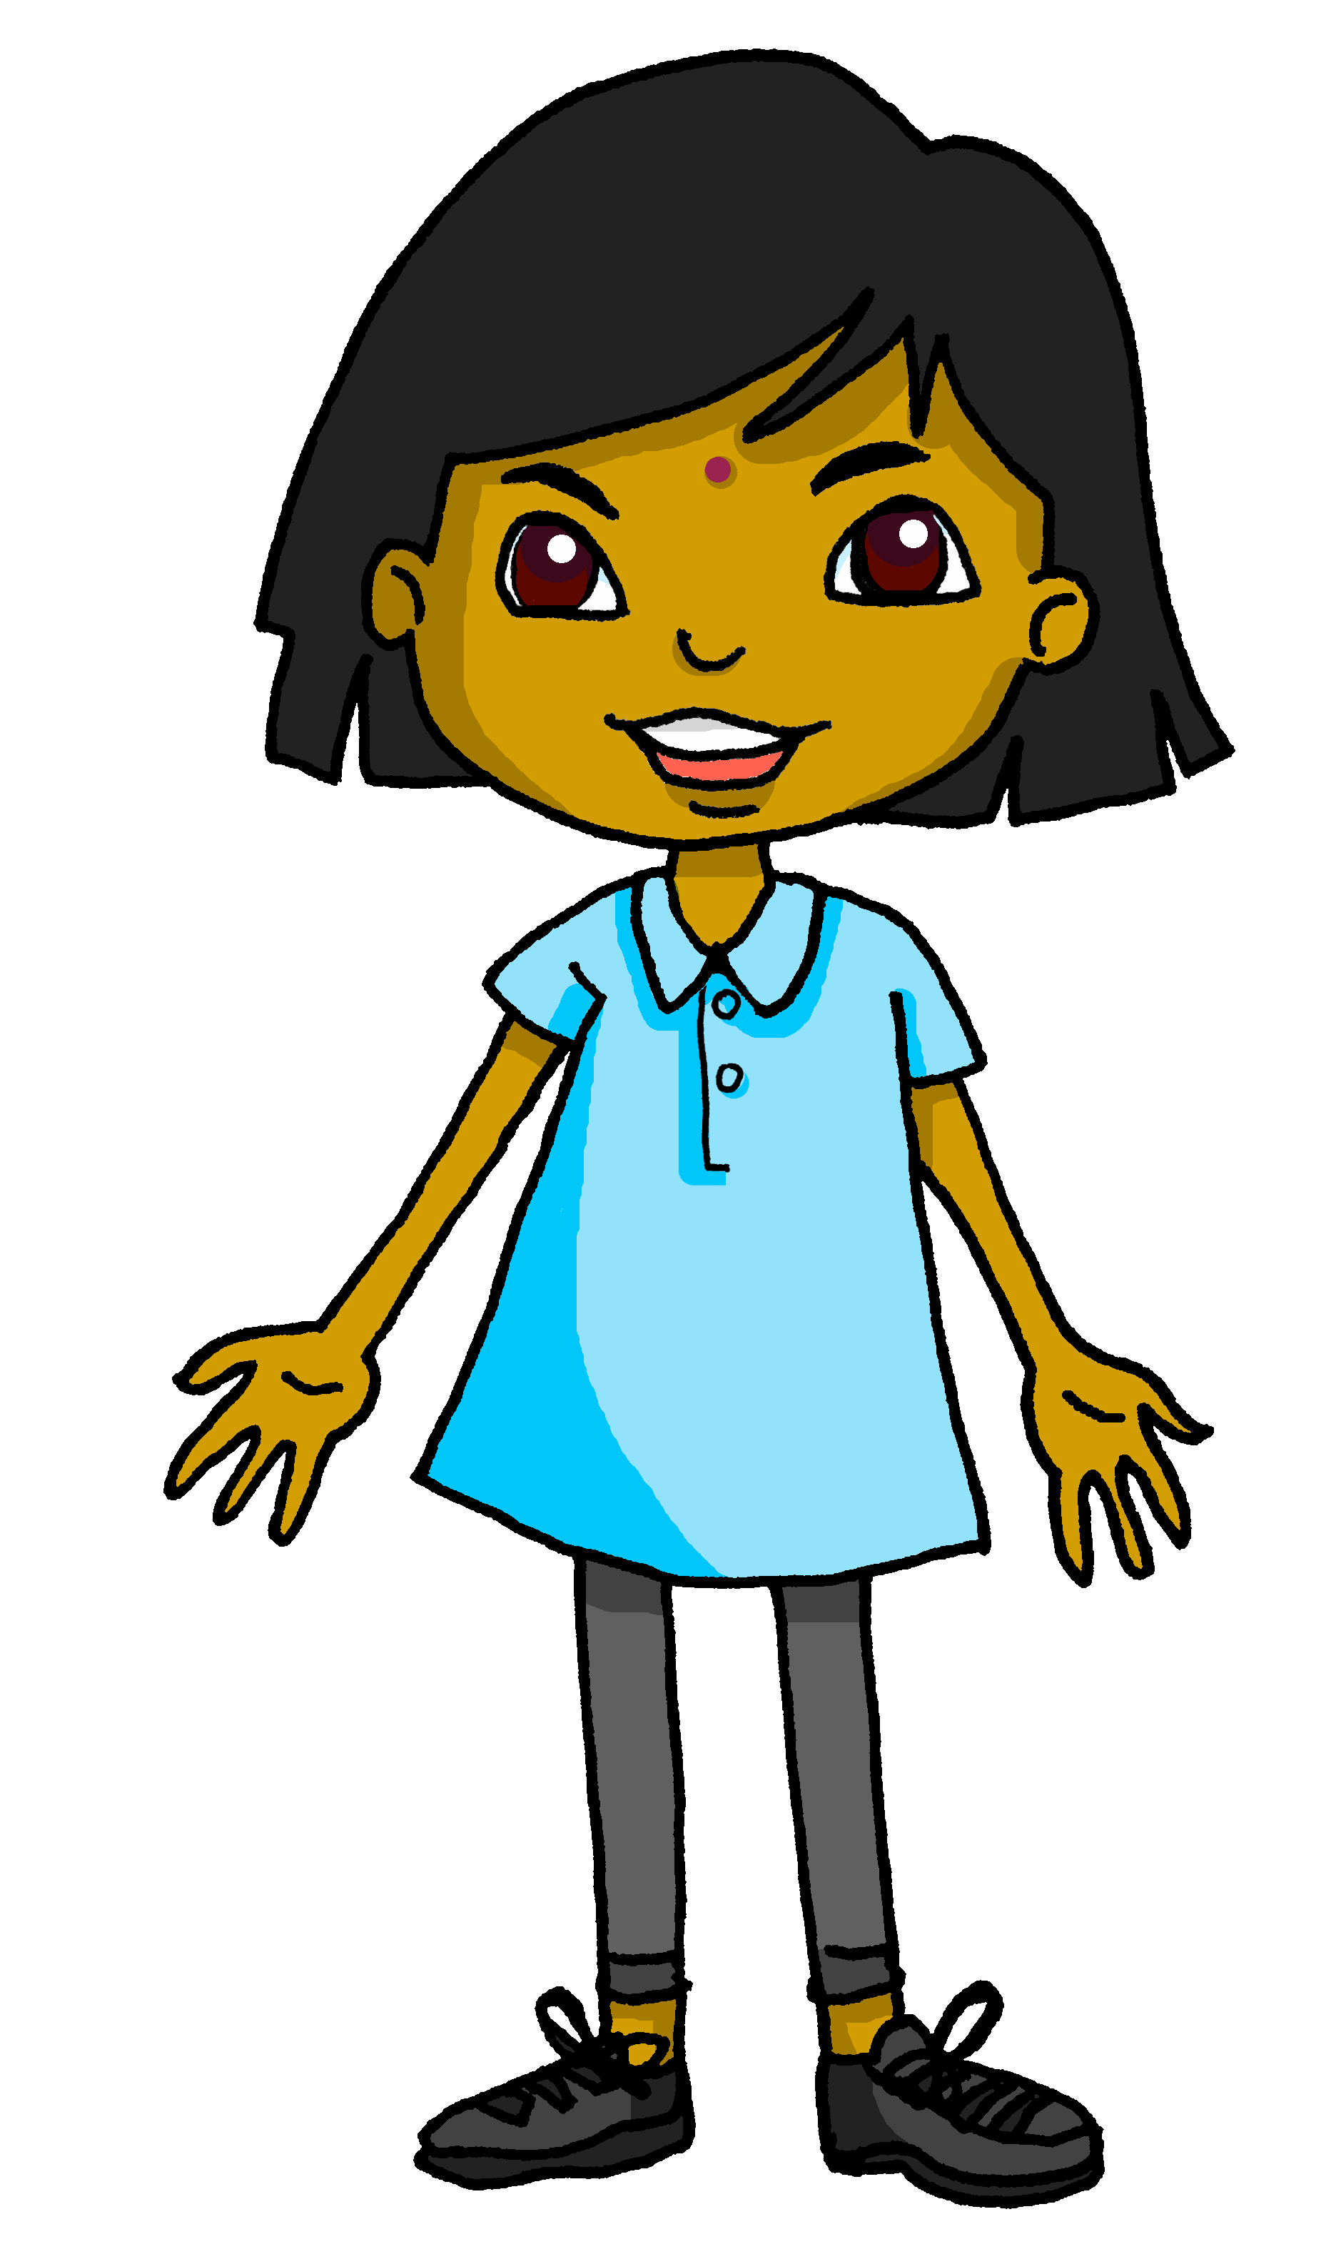
Follow up 2:
Sanaya décrit son école. [1/2]
What is she showing you?
⚠ Choose the answer based on liaison.
écouter
1
Voici les … livres. | amis.
2
Voici les … uniformes. | professeurs.
3
Voici les … pommes. | oranges.
4
Voici les … femmes. | hommes.
5
Voici les … ordinateurs. | garçons.
6
Voici les … filles | acteurs.
Notes:
Timing: 5 minutes (two slides)
Aim: to practise aural recognition of liaison after plural definite article ‘les’ and to connect this with meaning.
Procedure:
Pupils write 1-6.
Click on a button to hear a form of ‘voici les’, followed by a beep.
Based on the presence or absence of a liaison, pupils decide what comes next. Remind them it is the presence or absence of a -s- sound that will give them this information.
Click to check.
Full audio can be found on the next slide.
Transcript
1. Voici les [livres].
2. Voici les [uniformes].
3. Voici les [oranges].
4. Voici les [femmes].
5. Voici les [garçons].
6. Voici les [acteurs].

Slide 6
Follow up 2:
Sanaya décrit son école. [2/2]
Prononce bien les phrases.
écouter
1
Voici les livres.
2
Voici les uniformes.
3
Voici les oranges.
4
Voici les femmes.
5
Voici les garçons.
6
Voici les acteurs.
Notes:
[2/2]
Procedure:
Pupils pronounce each sentence.
Click to listen and check.
Transcript
1. Voici les livres.
2. Voici les uniformes.
3. Voici les oranges.
4. Voici les femmes.
5. Voici les garçons.
6. Voici les acteurs.

Slide 7
Follow up 3:
Écoute. C’est quoi en anglais ?
⚠ Remember! I like + noun in French needs an article (le|la|l’|les). In English we often leave out the article.
1
J’aime regarder les voitures.
écouter
I like watching (the) cars.
2
Je déteste les fruits.
I hate fruits.
3
J’aime l’école.
I like school.
4
Je déteste travailler en silence.
I hate working in silence.
5
Je préfère les villages.
I prefer villages.
6
J’aime jouer avec des amis.
I like playing with friends.
Notes:
Timing: 5 minutes
Aim: to practise aural comprehension of vocabulary and structures from this and previous weeks.
Procedure:
Pupils write 1-6.
Click on a button to hear each sentence.
Pupils write the English meaning.
Click to reveal the French and then elicit the English meaning from pupils
Click to confirm the English meaning.
Transcript
1. J’aime regarder les voitures. 2. Je déteste les fruits. 3. J’aime l’école. 4. Je déteste travailler en silence.
5. Je préfère les villages.
6. J’aime jouer avec des amis.

Slide 8
Follow up 4:
Le, la, l’ ou les ? Lis les mots.
parler
___
l’animal
[1/8]
Notes:
[1/8] Timing: 5 minutes
Aim: to connect previously taught vocabulary with its correct definite article and practise accurate read aloud.
Procedure:
Pupils say the correct definite article and read the noun, chorally.
Click to reveal the article.
Continue with items 2-8.

Slide 9
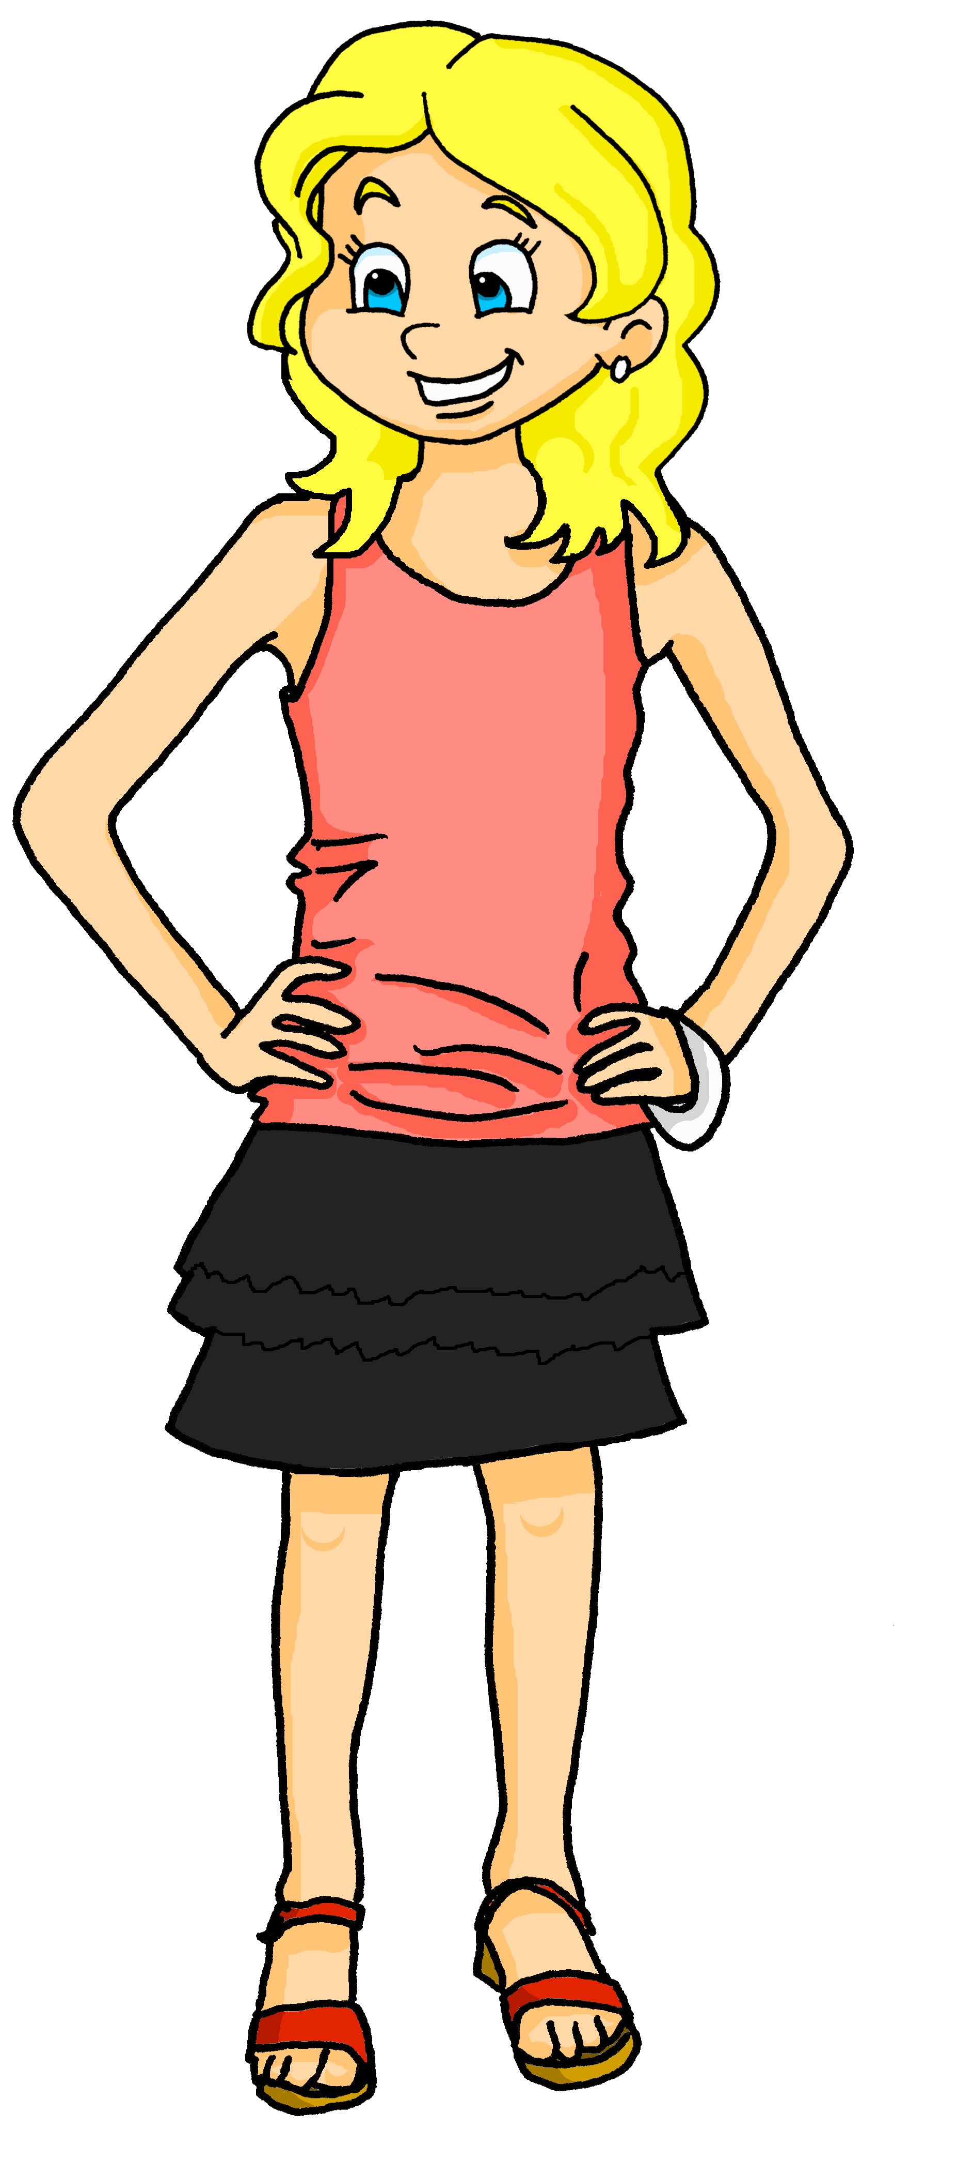
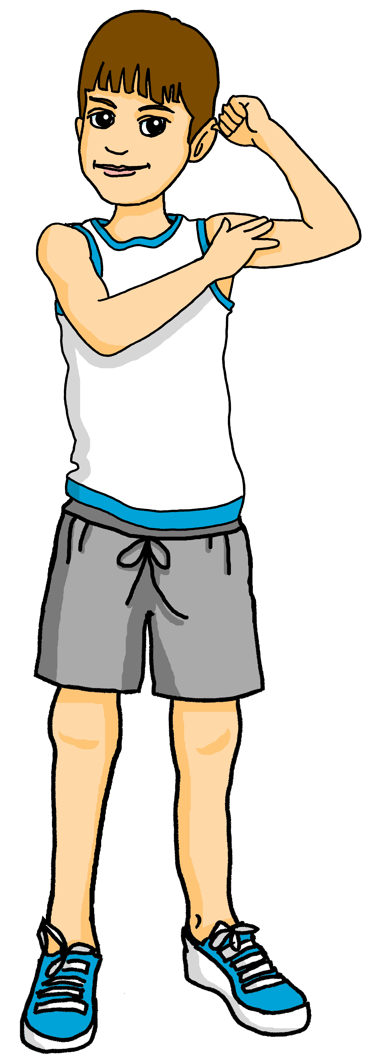
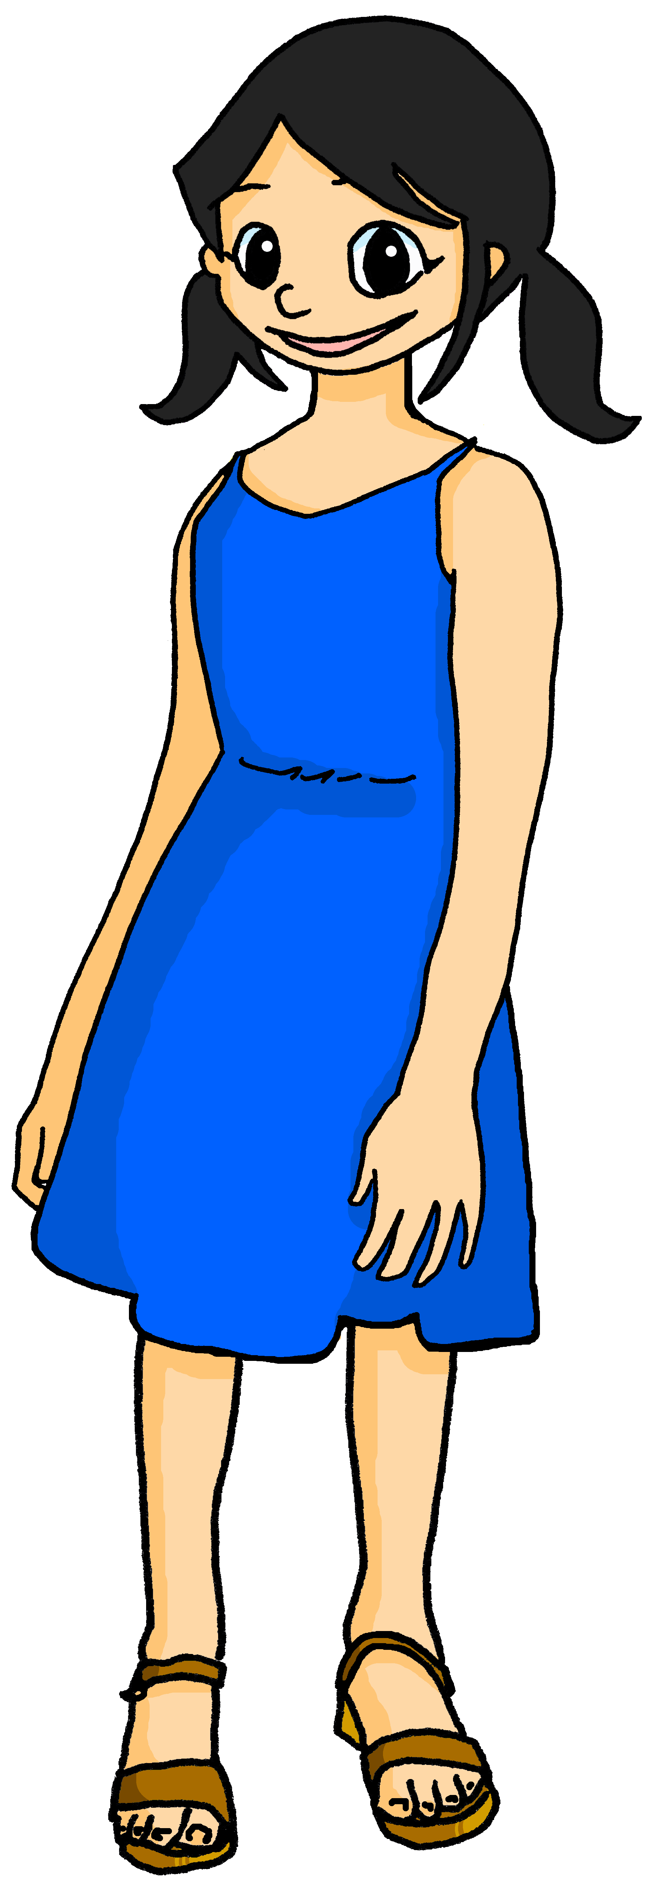
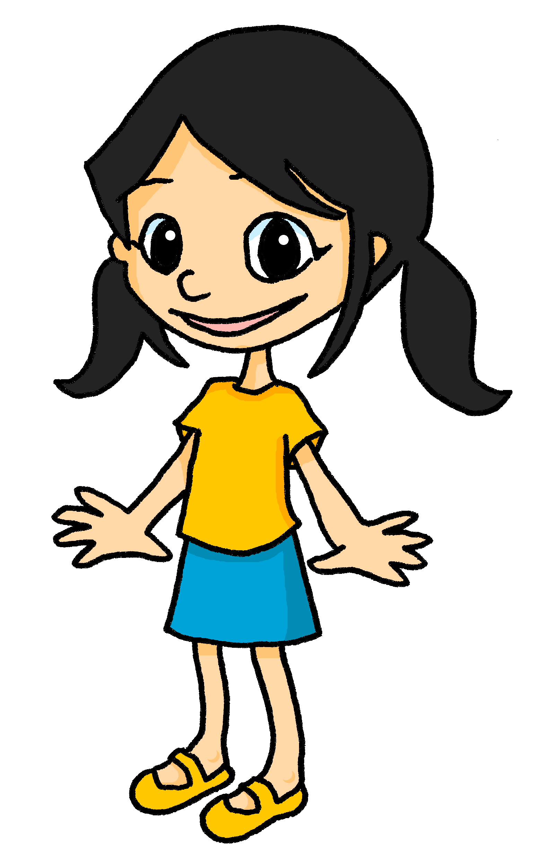
Follow up 4:
Le, la, l’ ou les ? Lis les mots.
parler
___
les amis
[2/8]
Notes:
[2/8]

Slide 10
Follow up 4:
Le, la, l’ ou les ? Lis les mots.
parler
___
les personnes
[3/8]
Notes:
[3/8]

Slide 11
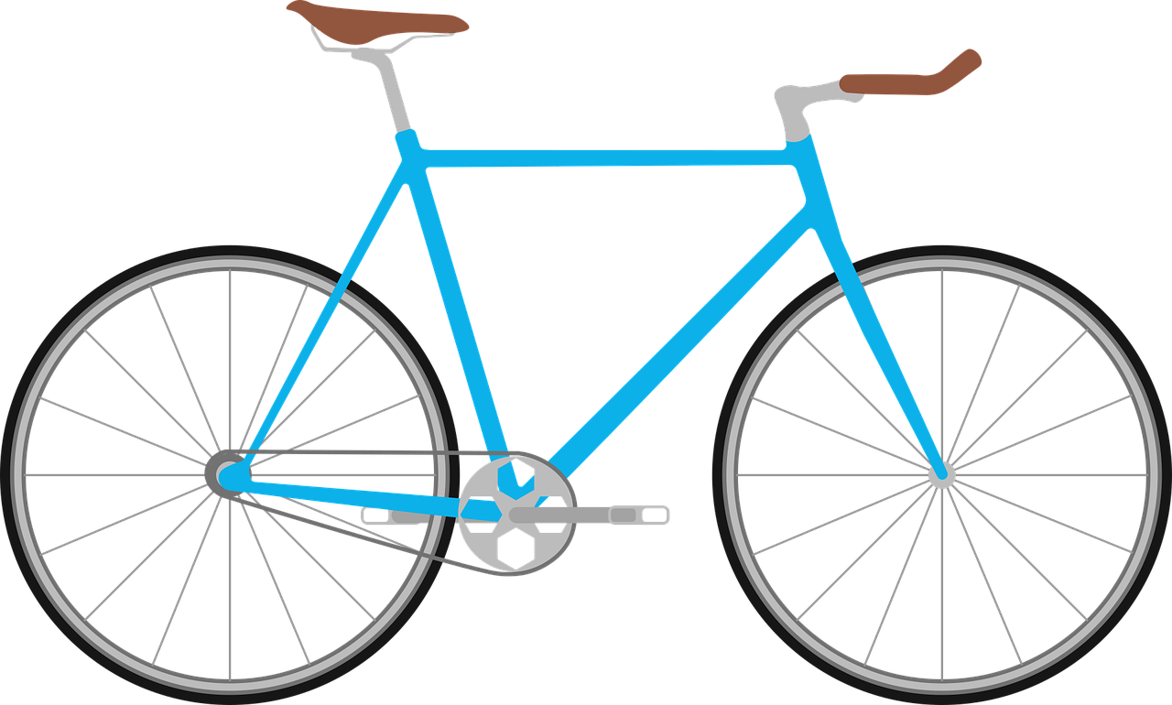
Follow up 4:
Le, la, l’ ou les ? Lis les mots.
parler
___
le vélo
[4/8]
Notes:
[4/8]

Slide 12
Follow up 4:
Le, la, l’ ou les ? Lis les mots.
parler
___
la pomme
[5/8]
Notes:
[5/8]

Slide 13
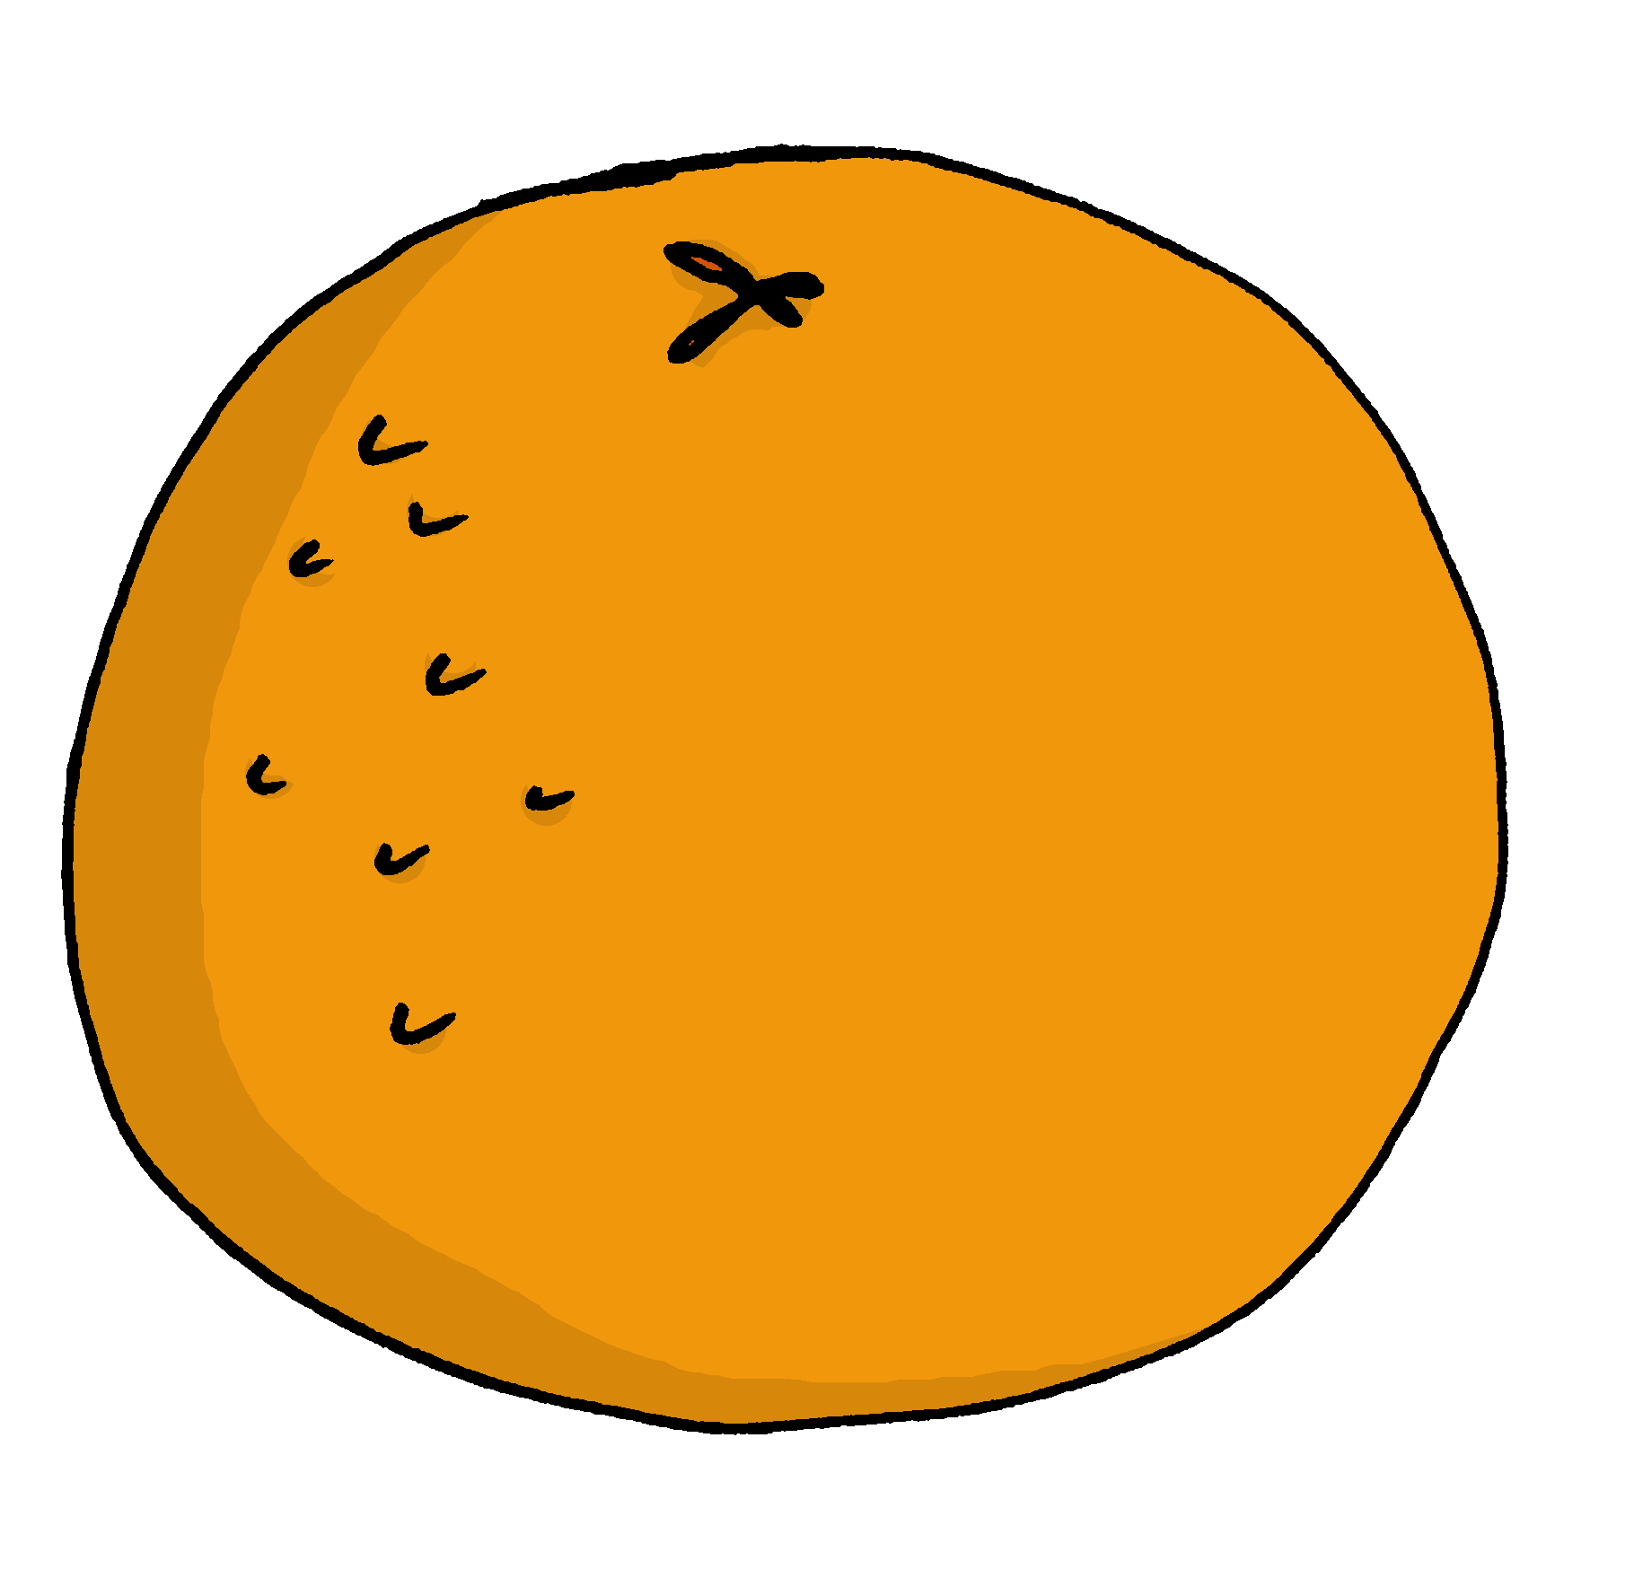
Follow up 4:
Le, la, l’ ou les ? Lis les mots.
parler
___
les oranges
[6/8]
Notes:
[6/8]

Slide 14
Follow up 4:
Le, la, l’ ou les ? Lis les mots.
parler
___
la femme
[7/8]
Notes:
[7/8]

Slide 15
Follow up 4:
Le, la, l’ ou les ? Lis les mots.
parler
___
les hommes
[8/8]
Notes:
[8/8]

Slide 16
Follow up 5a
Écris en français.
Write 5 phrases in French. Read them to you partner, who will translate them into English. Can you do them all in 45 seconds?
écrire
I you he she | like likes hate hates prefer prefers | working being playing wearing watching | in silence late with (some) friends (some) oranges a uniform (some) films in/at school
45
S
⚠ Remember! In French we always need an article. After the 2nd verb, with plural nouns, use ‘des’.
0
DÉBUT
Notes:
Timing: 5 minutes Aim: to practise writing short sentences from memory with structural support from the English frame.
Procedure:
Both pupils write 5 sentences (in French) made up of words from the table.
Partner A reads his/her sentences and B tries to translate all B’s sentences into English (orally) within 45 seconds.
Then they swap roles and repeat the task.

Slide 17
Follow up 5a
Écris en français.
Write 5 phrases in French. Read them to you partner, who will translate them into English. Can you do them all in 45 seconds?
parler
je/j’ tu il elle | aime aimes déteste détestes préfère préfères | travailler être jouer porter regarder | un uniforme en retard en silence à l’école avec des amis des oranges des films
45
S
⚠ Remember! In French we always need an article. After the 2nd verb, with plural nouns, we use ‘des’.
0
DÉBUT
Notes:
NB: This is a less challenging version of the task, which practises written comprehension and then spoken production, rather than written production from memory.
Timing: 5 minutes Aim: to practise written comprehension and oral production of structures from week 7 and previously taught vocabulary.
Procedure:
Both pupils write 5 sentences (in English) made up of words from the table.
They swap sentences.
Partner A tries to say all B’s sentences in French within 45 seconds.
Then Partner B tries to say all A’s sentences in French within 45 seconds.

Slide 18
Follow up 5b:

Écris en anglais. Can you get at least 15 points?
mots
 | huit | douze | quatre
 | sept | neuf | trois
 | l’homme | le cousin | la cousine
 | la femme | bleu | rouge
 | merci | la pomme | s’il vous plait
 | les | Il y a | s’il te plait
8
12
4
vocabulaire
x3
7
9
3
(the) man
(the) cousin (m)
(the) cousin (f)
x2
(the) woman
blue
red
thank you
(the) apple
please (formal)
x1
the (m/fpl)
there is / are
please (informal)
Notes:
Timing: 5 minutes
Aim: to practise written comprehension of vocabulary from week 1, last week and this week.
Procedure: 1. Give pupils a blank grid. They fill in the English meanings of any of the words they know, trying to reach 15 points in total. 2. Remind pupils that adjectives can refer to male or female persons and they should note this in their translations. E.g. pleased (f), short (m).
Note: The most recently learnt and practised words are pink, words from the previous week are green and those from week 1 are blue, thus more points are awarded for them, to recognise that memories fade and more effort (heavy lifting!) is needed to retrieve them.

Slide 19
Follow up 5b:

Écris en français. Can you get at least 15 points?
mots
 | 3 | 9 | 7
 | 12 | 8 | 4
 | (the) man | blue | red
 | the cousin (m) | the cousin (f) | (the) woman
 | please (informal) | please (formal) | there is/are
 | the (m/fpl) | (the) apple | thank you
trois
neuf
sept
vocabulaire
x3
douze
huit
quatre
l’homme
bleu
rouge
x2
le cousin
la cousine
la femme
s’il te plait
s’il vous plait
Il y a
x1
the (m/fpl)
la pomme
merci
Notes:
Timing: 5 minutes
Aim: to practise written comprehension of vocabulary from week 1, last week and this week.
Procedure: 1. Give pupils a blank grid. They fill in the French meanings of any of the words they know, trying to reach 15 points in total.
Note: The most recently learnt and practised words are pink, words from the previous week are green and those from week 1 are blue, thus more points are awarded for them, to recognise that memories fade and more effort (heavy lifting!) is needed to retrieve them.

Slide 20
vocabulaire
Follow up 5b - Écris en anglais : Can you get at least 15 points?
mots
 | huit | douze | quatre
 | sept | neuf | trois
 | l’homme | le cousin | la cousine
 | la femme | bleu | rouge
 | merci | la pomme | s’il vous plait
 | les | Il y a | s’il te plait
x3
x2
x1
Notes:
HANDOUT
20

Slide 21
vocabulaire
Follow up 5b - Écris en français : Can you get at least 15 points?
mots
 | 3 | 9 | 7
 | 12 | 8 | 4
 | (the) man | blue | red
 | the cousin (m) | the cousin (f) | (the) woman
 | please (informal) | please (formal) | there is/are
 | the (m/fpl) | (the) apple | thank you
x3
x2
x1
Notes:
HANDOUT
21

