Slide 1
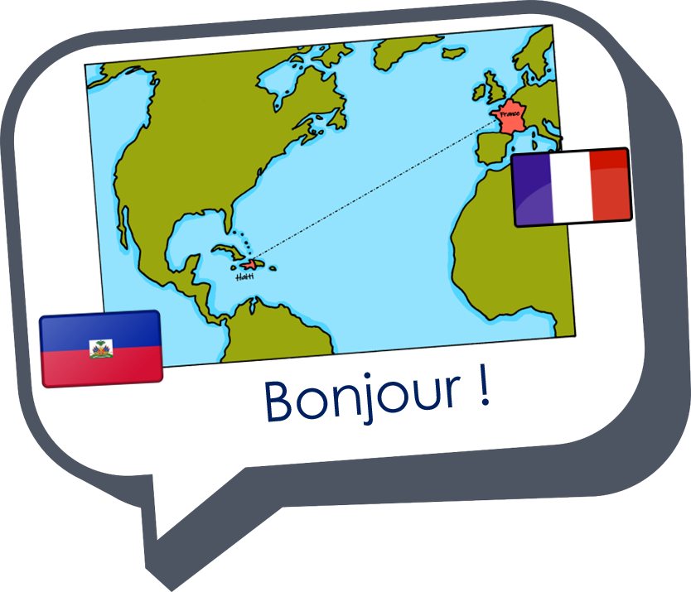
Expressing likes and saying what I and others do
rouge
2-verb structures (aimer, détester)
SSC [-tion]
Notes:
Artwork by Steve Clarke. Pronoun pictures from NCELP (www.ncelp.org). All additional pictures selected from Pixabay and are
available under a Creative Commons license, no attribution required.
The AUDIO version of the lesson material includes additional audio for the new language presented (phonics, vocabulary) and audio for the instructions on the slide.
In addition, it includes VIDEO clips of the phonics and the phonics’ source words. Pupils can be encouraged to look at the shape of the mouth/lips on slides where these appear, and try to copy it/them.
Phonics: [-tion] population [509] action [355] situation [223] international [282] solution [608] attention [482]
Vocabulary (new words in bold): détester [2898] jouer [219] travailler [290] silence [1281] en retard [n/a] Revisit 1: difficile [296] jaune [2585] préféré [597] trop [195]
Revisit 2: préférer [597] village [1295] ville [260] dans [11] en ce moment [n/a]
Londsale, D., & Le Bras, Y. (2009). A Frequency Dictionary of French: Core vocabulary for learners London: Routledge.
The frequency rankings for words that occur in this PowerPoint which have been previously introduced in these resources are given in the SOW and in the resources that first introduced and formally re-visited those words. For any other words that occur incidentally in this PowerPoint, frequency rankings will be provided in the notes field wherever possible.
1

Slide 2
[-tion]
prononcer
Attention !
Notes:
Timing: 1 minute
Aim: To consolidate SSC [-tion]
Procedure: 1. Present the letter(s) and say the [-tion] sound first, on its own. Pupils repeat it with you. 2. Bring up the word ”Attention” on its own, say it, pupils repeat it, so that they have the opportunity to focus all of their attention on the connection between the written word and its sound.
3. Clarify the meaning (Watch out! Take care!).
3. A possible gesture for this word would be to hold up the right index finger up and waggle it quickly from side to side as a gesture of warning. 4. Roll back the animations and work through 1-3 again, but this time, dropping your voice completely to listen carefully to the pupils saying the [-tion] sound, pronouncing ”Attention” and, if using, doing the gesture.
2

Slide 3
[-tion]
prononcer
motion
pollution
Attention !
solution
population
Notes:
Timing: 2 minutes
Aim: to consolidate SSC [-tion]
Procedure:
1. Introduce and elicit the pronunciation of the individual SSC [-tion] and then the source word again ‘Attention !’ (with gesture, if using). 2. Then present and elicit the pronunciation of the four cluster words.
The cluster words have been mainly chosen for their high-frequency, from a range of word classes, with the SSC (where possible) positioned within a variety of syllables within the words (e.g. initial, 2nd, final etc.). Additionally, we have tried to use words that build cumulatively on previously taught SSCs (see the Phonics Teaching Sequence document) and do not include new SSCs. Where new SSCs are used, they are often consonants which have a similar symbol-sound correspondence in English.
Word frequency (1 is the most frequent word in French): attention [482] motion [855] pollution [3073] population [509] solution [608] Source: Londsale, D., & Le Bras, Y. (2009). A Frequency Dictionary of French: Core vocabulary for learners London: Routledge.
3

Slide 4
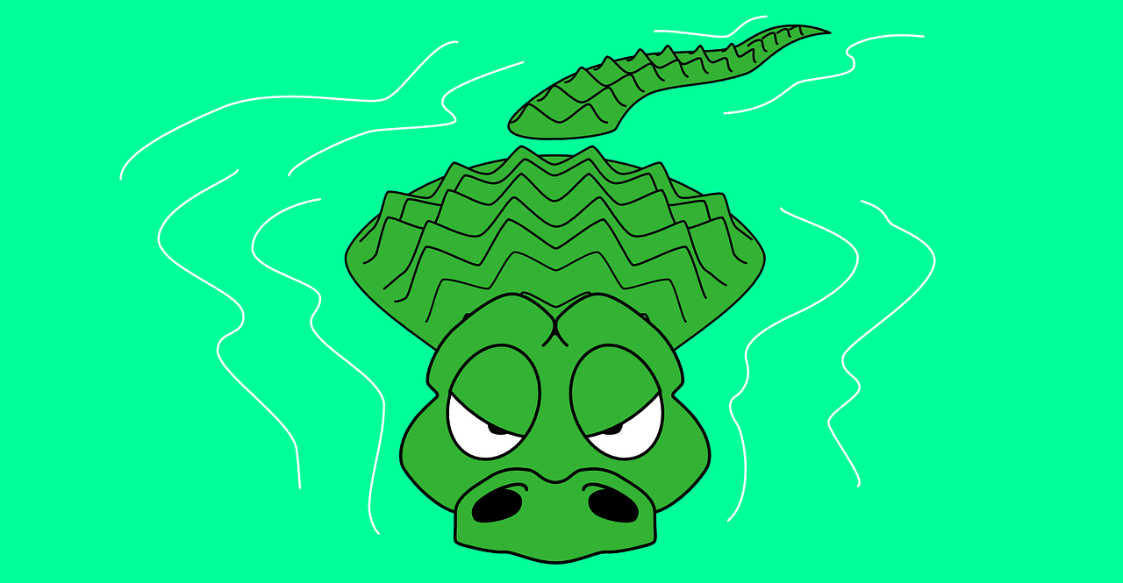
prononcer
. Écoute les noms des animaux. C’est [ien] ou [(a)in]?
Lis les mots en français.
. Écoute les noms des animaux. C’est [ien] ou [(a)in]?
Attention ! Il y a des crocodiles dans l’eau !
mission
émotion
S
correction
situation
12
permission
passion
direction
0
DÉBUT
Notes:
Timing: 3 minutes
Aim: to consolidate SSC [-tion] and raise awareness that –ssion cognates are pronounced as –tion in French.
Procedure:
Start the timer. Pupil A tries to say all 7 words with correction pronunciation within 12 seconds.
Pupil B listens and if pupil A uses English pronunciation for a word s/he can stop her/his partner as they will have fallen into crocodile-infested waters and their turn is over!
They swap roles and repeat.
If either pupil hasn’t completed the task in the time, the teacher can offer additional rounds of practice against the timer.
Click on each word to listen and check.
4

Slide 5
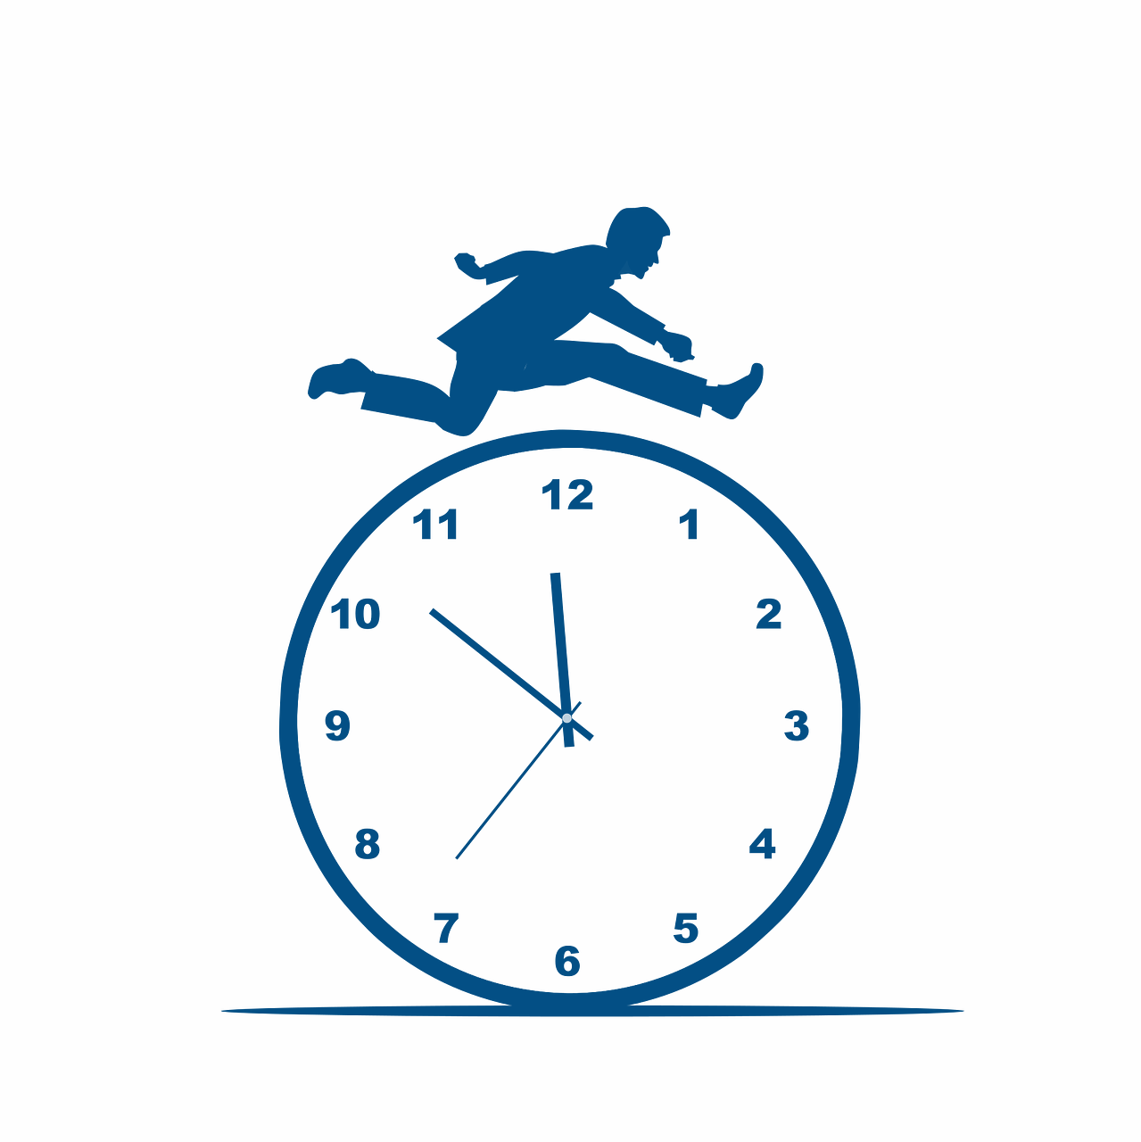
vocabulaire
Vocabulaire
Écoute et répète.
mots
aimer
détester
travailler
[to hate, hating]
[to work, working]
[to like,
liking]
jouer
en retard
le silence
[to play, playing]
[late]
Notes:
Timing: 5 minutes
Aim: to introduce new vocabulary for this week.
Procedure: 1. Teacher clicks to present the French words one by one. Pupils can repeat. (1 minute)
2. Pupils either work individually or in pairs, reading the French words out loud and looking at the English meanings (1 minute). 3. Then the teacher removes the English words or pictures (one by one) and pupils try to recall the English orally (chorally), looking at the French (1 minute).
4. When teacher clicks, the French words re-appear (with audio in the audio version). 5. Then the French meanings are removed (one by one) and pupils try to recall them orally (again, chorally), looking at the English (1 minute) 6. Further rounds of learning can be facilitated by one pupil turning away from the board, and his/her partner asking him/her the meanings (‘Comment dit-on XXX en anglais/français ?’). This activity can work from L2 🡪 L1 or L1 🡪 L2.
5

Slide 6
Knowing who does what
It is also the form of a verb you see in a dictionary.
[–er verbs]
We know the infinitive verb tells us the general meaning.
parler
to speak, speaking
To mean ‘I’ ‘you’ or ‘s/he’ with a verb, change the ending to match the pronoun:
Note that parle and parles sound the same because of the Silent Final Consonant.
Je parle français.
I speak French.
Tu parles français.
You speak French.
Il/Elle parle français.
He/She speaks French.
Notes:
Timing: 3 minutes
Aim: to recap 1st and 2nd and 3rd persons singular for –er verbs.
Procedure:
Click through the animations to present the information.
Remind pupils that the verb is never in the long (infinitive) form when used with a pronoun.
Remind them also that the infinitive gives information about the ‘what’, but not about the ‘who’. The information about who comes from the verb ending as well as the pronoun.
Elicit English translations for the French examples provided.

Slide 7
lire
Pierre écrit des messages à Yves. Il décrit des activités à l’école.
C’est Pierre (je) ou Yves (tu) ?
1
4
I
I
Tu aides Madame Vidal.
Tu aimes le français.
you
you
2
5
Tu répètes les instructions.
I
J’ écoute les instructions. ☺
I
you
you
3
6
J’ utilise un dictionnaire.
I
Je parle en anglais.
I
you
you
Notes:
Timing: 5 minutes
Aim: to practise written comprehension of question and statements.
Procedure:
Pupils write 1-5 and the correct English meaning from the two options given.
Click to reveal answers.
In the audio version, the full sentence answers are heard with the animated ticks.
7

Slide 8
Infinitive verbs
Remember that there are two ways to translate French infinitives into English:
You add ‘de’ to link adjective and verb.
C’est facile de parler français.
It’s easy to speak French.
Parler français, c’est facile !
Speaking French is easy!
Notes:
Timing: 3 minutes
Aim: to recap French infinitive –ER verbs and their two positions and two English translations.
Procedure:
Click through the animations to present the information.
Elicit English translations for the French examples provided.

Slide 9
Two-verb structures
When a sentence has two verbs, the 2nd verb is in infinitive form.
For example, this is how to say ‘I like speaking French’:
Note that when a noun follows aimer or détester, we always need an article in French:
This is the 1st verb.
This is the 2nd verb.
J’aime parler français.
J’aime le français.
I like French.
In English we usually say –ing in two-verb structures.
Je déteste avoir des problèmes.
Je déteste les problèmes.
I hate having problems.
I hate problems.
Notes:
Timing: 3 minutes
Aim: to introduce two-verb structures with aimer and détester, and contrast these with opinion verbs + noun which require a definite article in French, where none is needed in English.
Procedure:
Click through the animations to present the information.
Elicit English translations for the French examples provided.

Slide 10
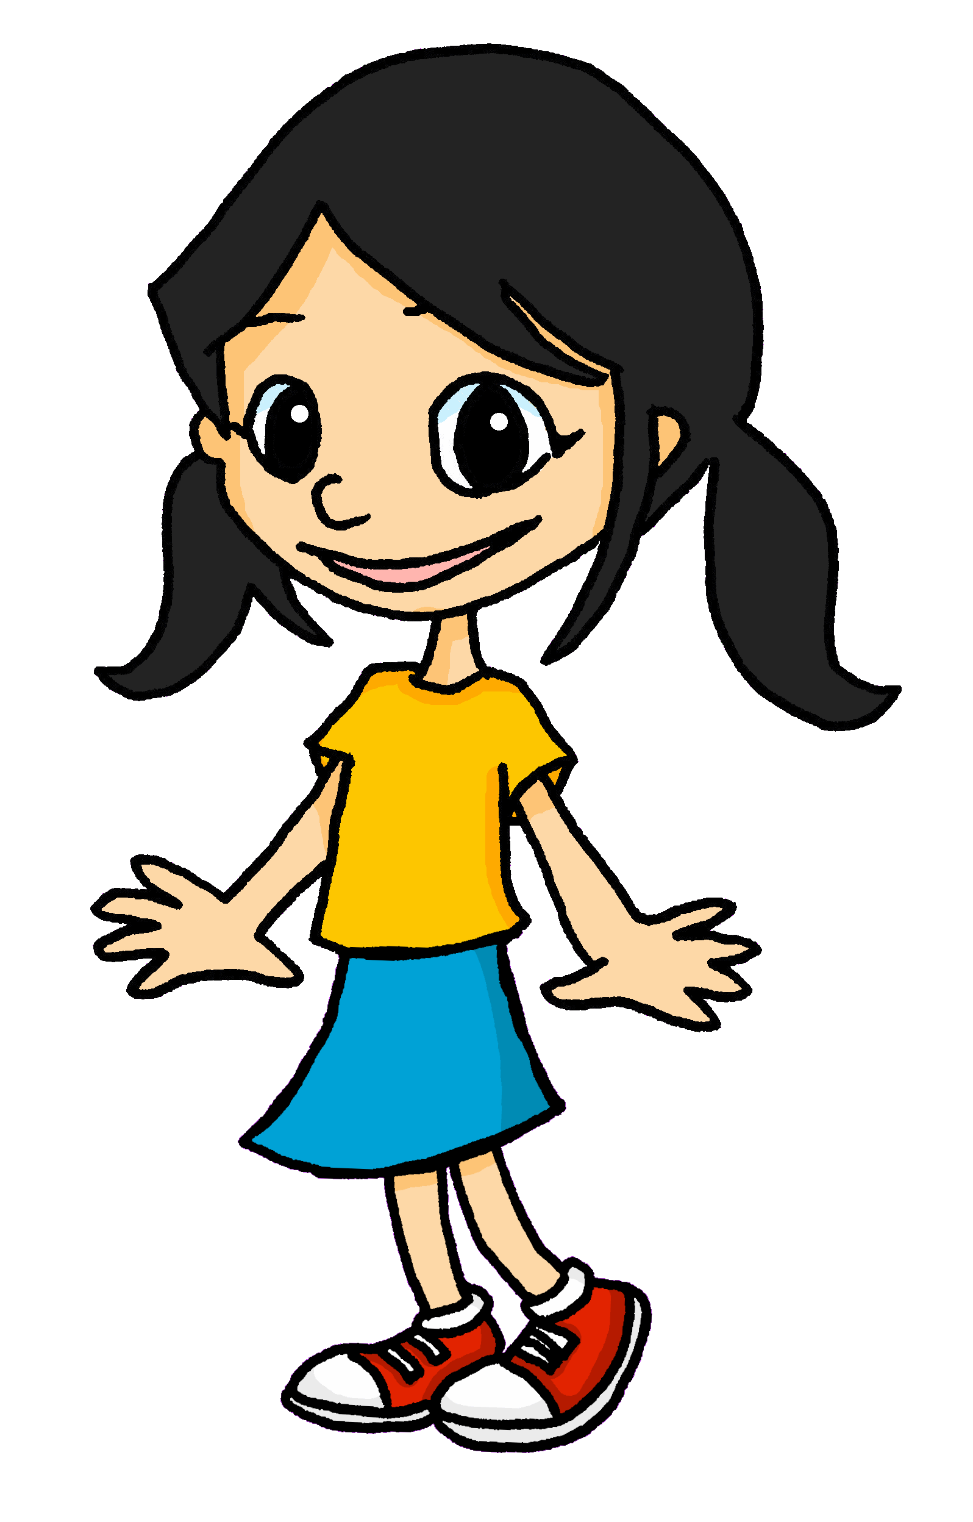
lire
Léa décrit les activités d’Eugénie à l’école.
Is it what Eugénie does or her opinion about what she does? Write 1-7 and A for activity or O+A for opinion + activity.
1
Elle joue avec une amie.
6
Elle porte un déguisement.
A
A
Elle chante en anglais.
7
Elle déteste être en retard.
2
A
O+A
Elle déteste travailler en silence.
3
O+A
Elle aime regarder des films.
School assemblies are not very common in France but pupils like preparing a show (un spectacle) for the end of the year. They rehearse in the big hall or gym. Sometimes they wear a costume (un déguisement), too.
4
O+A
5
Elle aime préparer un spectacle.
O+A
Notes:
Timing: 5 minutes
Aim: to practise distinction between single verb and two-verb structures in form/meaning as well as written comprehension of this week’s vocabulary and a range of previously taught vocabulary.
Procedure:
1. Tell pupils that the dark blue boxes may be hiding a verb or nothing at all. Pupils write 1-7 for each sentence and note A or O+A, paying close attention to the form of the verb following the dark blue box.
2. Elicit the answers from pupils (and whole sentences for additional pronunciation practice)
3. Click to reveal the written answers.
4. In the audio version, click on the numbers to hear the full audio, if desired. Alternatively use it as a listen and check stage.
10

Slide 11
Au revoir !
rouge
Notes:
11

