Slide 1
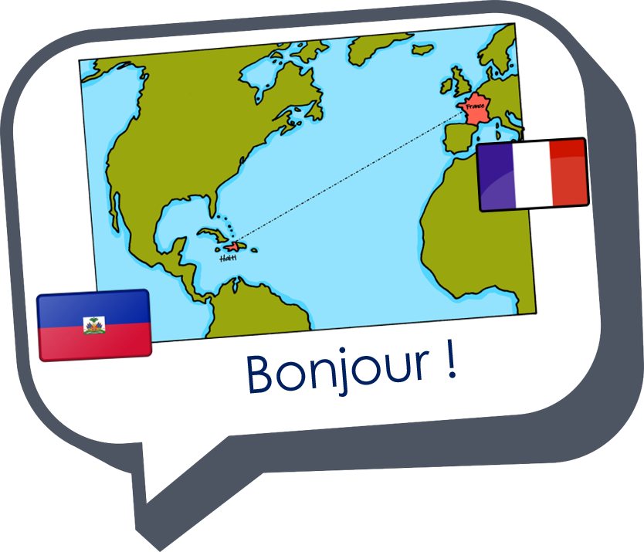
Expressing likes and saying what I and others do
rouge
Follow ups 1-5
Notes:
Artwork by Steve Clarke. Pronoun pictures from NCELP (www.ncelp.org). All additional pictures selected from Pixabay and are available under a Creative Commons license, no attribution required.
Phonics: [-tion] population [509] action [355] situation [223] international [282] solution [608] attention [482]
Vocabulary (new words in bold): détester [2898] jouer [219] travailler [290] silence [1281] en retard [n/a] Revisit 1: difficile [296] jaune [2585] préféré [597] trop [195]
Revisit 2: préférer [597] village [1295] ville [260] dans [11] en ce moment [n/a]
Londsale, D., & Le Bras, Y. (2009). A Frequency Dictionary of French: Core vocabulary for learners London: Routledge.
The frequency rankings for words that occur in this PowerPoint which have been previously introduced in these resources are given in the SOW and in the resources that first introduced and formally re-visited those words. For any other words that occur incidentally in this PowerPoint, frequency rankings will be provided in the notes field wherever possible.

Slide 2
Follow up 1:
[-tion]
The words in this activity are exact cognates, i.e., spelt the same in English.
Écoute. C’est –ssion ou –tion ?
A
B
A
B
 | [-tion] | [-ssion] | mot
1
2
3
4
 | [-tion] | [-ssion] | mot
5
6
7
8
solution
émotion
passion
situation
mission
possession
direction
permission
Notes:
Timing: 5 minutes
Aim: to practise aural recognition of cognates and predict the spelling of cognates that have the SSC –tion but may be spelt –ssion. Pupils should use their knowledge of English to help them with the spelling.
Procedure:
Click on each audio symbol to listen to the word.
Pupils write A or B for each OR they write the full word’s spelling if they want to challenge themselves.
Click for answers.
Elicit the pronunciation of each word before moving to the next item.
Transcript 1. solution
2. passion
3. mission
4. direction
5. émotion
6. situation
7. possession
8. permission

Slide 3
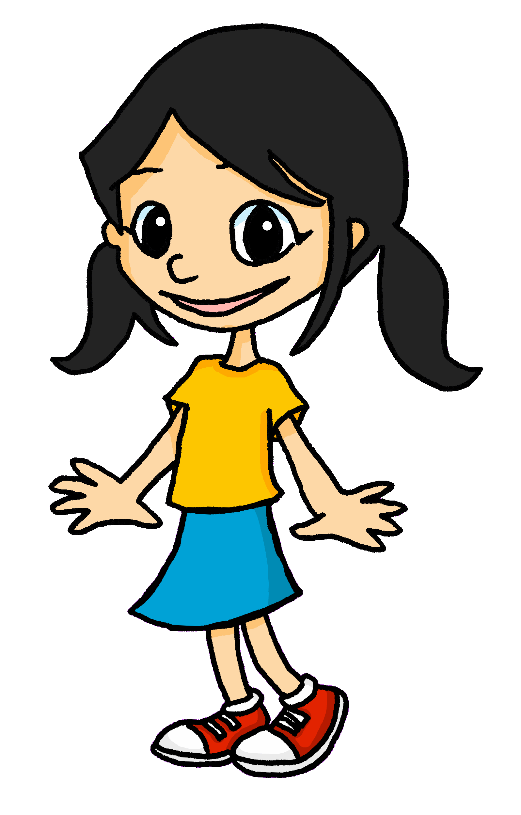
Follow up 2:
Eugénie parle de l’école.
Elle aime quoi ? Elle déteste quoi ?
C’est une chose ou une activité ? Écris en anglais.
écouter
 | chose | activité | en anglais
1
2
3
4
1
I like my book.
2
I like singing in English.
3
I hate preparing the bag.
4
I like my teacher.
5
I hate being hungry.
6
I hate my blue pen.
Notes:
Timing: 5 minutes
Aim: to practise transcribing the missing vowels in unknown words.
Procedure:
Click to listen to each word.
Listen and write the missing letter(s).
Click to reveal answers.
Transcript:
J’aime mon livre. J’aime chanter en anglais. Je déteste préparer le sac. J’aime ma professeure. Je déteste avoir faim. Je déteste mon stylo bleu.

Slide 4
Follow up 3
Lis les phrases et écris une phrase correspondante avec ‘aimer’ ou ‘détester’.
lire
Exemple :
C’est facile de lire en anglais. J’aime lire en anglais.
C’est amusant de jouer un jeu avec mon ami/mon amie. J’aime jouer un jeu avec mon ami/mon amie.
3
[I like reading in English.]
[I like playing a game with my friend (m), my friend (f).]
écrire
Regarder des films, c’est amusant. J’aime regarder des films.
1
4
C’est difficile de travailler en silence. Je déteste travailler en silence.
[I like watching (some) films.]
[I hate working in silence.]
2
Avoir un problème avec mon cousin/ma cousine, c’est difficile. Je déteste avoir un problème avec mon cousin/ma cousine.
5
Trouver des solutions, c’est facile.
J’aime trouver des solutions.
[I like finding (some) solutions.]
[I hate having a problem with my cousin (m), my cousin (f).]
Notes:
Timing: 8 minutes
Aim: to practise written comprehension of French infinitive phrases and previously taught vocabulary; to practise written production of two-verb structures with aimer/détester.
Procedure: 1. Model the task with the example.
2. Pupils write phrases 1-5 in their books.
3. Click to check answers.
4. In the audio version, click on the numbers to hear the whole message. This can work as a listen and check stage, too.

Slide 5
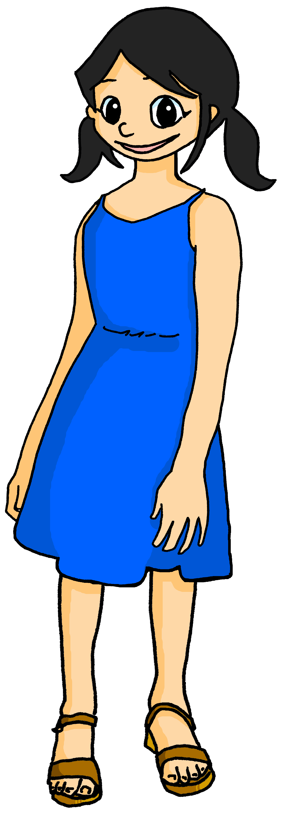
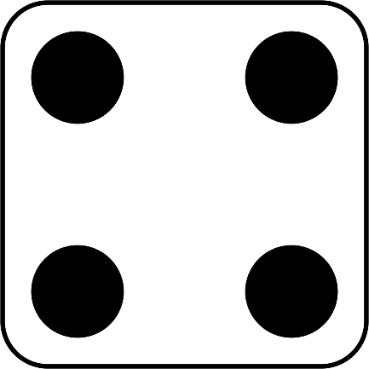
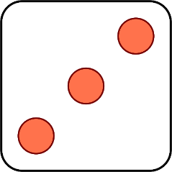
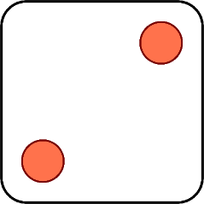
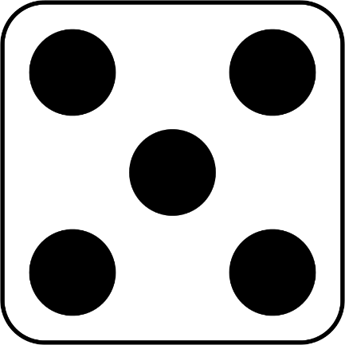
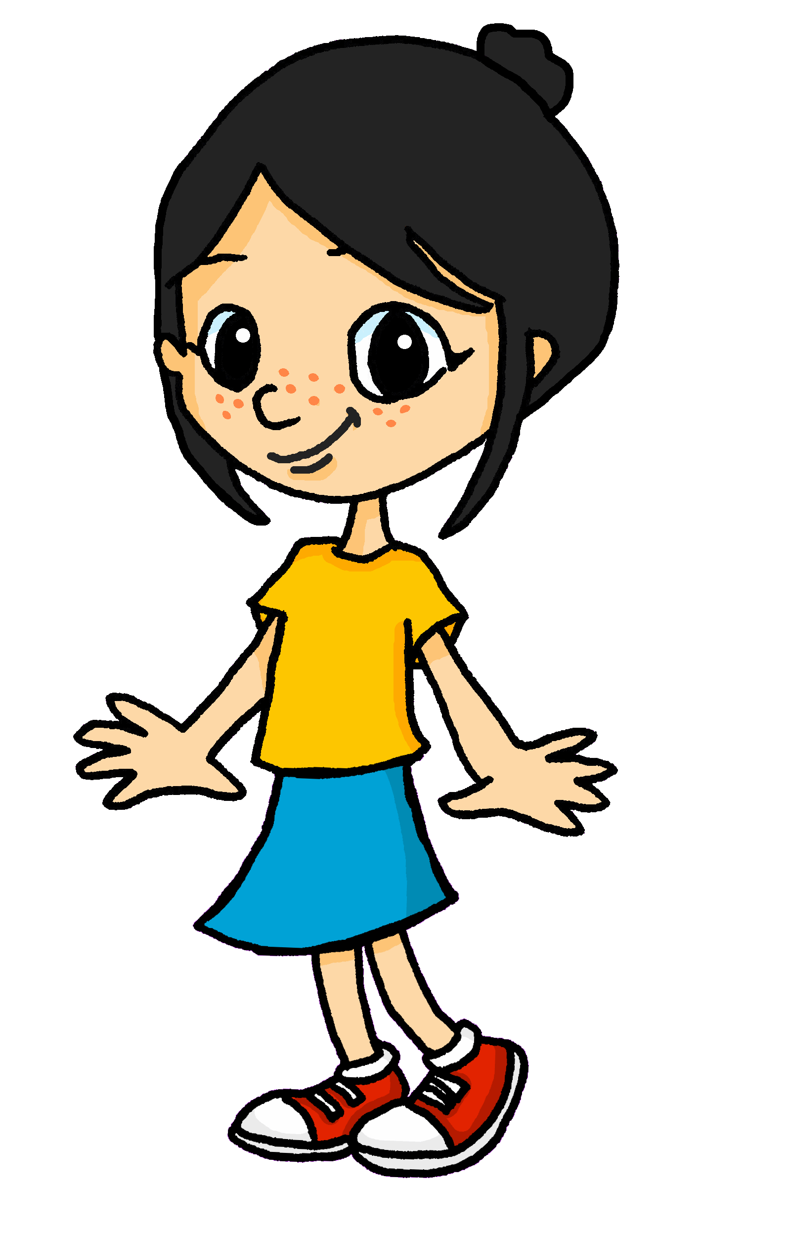
Follow up 4:
Parle en français. [1/2]
Eugénie joue avec Léa. Elle pratique l’anglais.
parler
Tu aimes lire un livre.
Tu détestes avoir faim.
Il aime chanter des chansons.
J’aime jouer avec mon ami(e).
Je déteste porter un uniforme.
Elle déteste être en retard.
1 | I like…
2 | You like…
3 | He likes…
4 | I hate…
5 | You hate…
6 | She hates…
1 | wearing (a) uniform
2 | reading a book
3 | playing with my friend
4 | being hungry
5 | singing (some) songs
6 | being late
Notes:
Timing: 5 minutes (two slides)
Aim: to practise saying what people like/hate doing using two-verb sentences with aimer/détester.
Procedure: 1. Click to ‘roll’ the dice.
2. Students use the opinion verb and verb phrase the numbers of which correspond to the respective dice, then make a sentence. They say the answer chorally.
3. Click to reveal the correct sentence.
4. Repeat until all combinations have been tried.

Slide 6
Follow up 4:
Parle en français. [2/2]
Eugénie joue avec Léa. Elle pratique l’anglais.
parler
Il aime utiliser un stylo.
J’aime jouer avec mon ami(e).
Je déteste travailler en silence.
Tu détestes répéter des phrases.
Elle déteste avoir tort.
Tu aimes aider la professeure.
1 | I like…
2 | You like…
3 | He likes…
4 | I hate…
5 | You hate…
6 | She hates…
1 | working in silence
2 | helping the teacher (f)
3 | playing with my friend
4 | repeating some phrases
5 | using a pen
6 | being wrong
Notes:
[2/2]

Slide 7
vocabulaire
Follow up 5- Écris en anglais : Can you get at least 15 points?
mots
 | le village | préférer
 | dans | en ce moment | la ville
 | préféré | difficile
 | jaune | trop | aimer
 | détester | travailler
 | le silence | jouer | en retard
(the) village
to prefer, preferring
x3
in
at the moment
(the) town
favourite (m)
difficult
x2
yellow
too
to like, liking
to hate, hating
to work, working
x1
(the) silence
to play, playing
late
Notes:
Note: bleu and rouge are officially new words this week. They have not been explicitly practised yet, but pupils have seen rouge every week on the lesson title slide, and bleu is similar to blue, so it is anticipated that pupils may be fine with these, following this practice in Follow up 4.
Timing: 5-10 minutes
Aim: to practise written comprehension of vocabulary from this week and previous weeks.
Procedure: Give pupils a blank grid. They fill in the English meanings of any of the words they know, trying to reach 15 points in total.
Note: The most recently learnt and practised words are pink, words from the previous week are green and those from earlier are blue, thus more points are awarded for them, to recognise that memories fade and more effort (heavy lifting!) is needed to retrieve them.
7

Slide 8
Follow up 5:
Écris en français.
mots
 | in | at the moment
 | to prefer, preferring | (the) village | (the) town
 | favourite (f) | too
 | to like, liking | difficult | yellow
 | (the) silence | late
 | to hate, hating | to work, working | to play, playing
vocabulaire
dans
en ce moment
x3
préférer
le village
la ville
préférée
trop
x2
aimer
difficile
jaune
le silence
en retard
x1
détester
travailler
jouer
Notes:
Timing: 5-10 minutes
Aim: to practise written comprehension of vocabulary from this week and previous weeks.
Procedure: Give pupils a blank grid. They fill in the French meanings of any of the words they know, trying to reach 15 points in total.
Note: The most recently learnt and practised words are pink, words from the previous week are green and those from earlier are blue, thus more points are awarded for them, to recognise that memories fade and more effort (heavy lifting!) is needed to retrieve them.

Slide 9
vocabulaire
Écris en anglais : Can you get at least 15 points?
mots
 | le village | préférer
 | dans | en ce moment | la ville
 | préféré | difficile
 | jaune | trop | aimer
 | détester | travailler
 | le silence | jouer | en retard
x3
x2
x1
Notes:
HANDOUT 4a
9

Slide 10
vocabulaire
Écris en français : Can you get at least 15 points?
mots
 | in | at the moment
 | to prefer, preferring | (the) village | (the) town
 | favourite (f) | too
 | to like, liking | difficult | yellow
 | (the) silence | late
 | to hate, hating | to work, working | to play, playing
x3
x2
x1
Notes:
HANDOUT 4b
10

