Slide 1
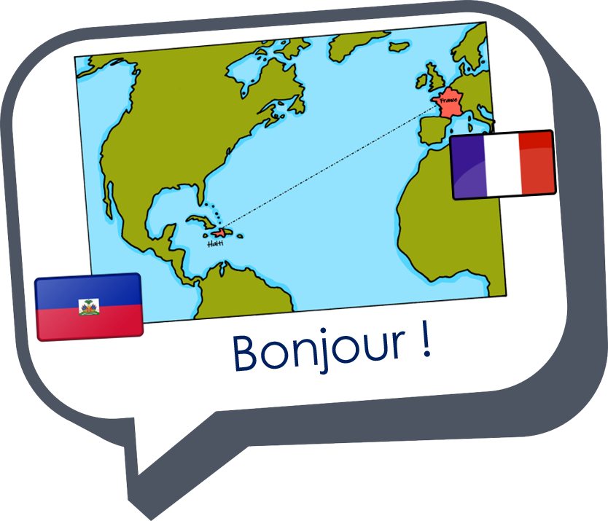
Describing things and people
J’ai faim !
J’ai soif !
J’ai neuf ans.
rouge
« Avoir » meaning ‘be’
SSC [j/soft g]
Notes:
Artwork by Steve Clarke. Pronoun pictures from NCELP (www.ncelp.org). All additional pictures selected from Pixabay and are
available under a Creative Commons license, no attribution required.
The AUDIO version of the lesson material includes additional audio for the new language presented (phonics, vocabulary) and audio for the instructions on the slide.
In addition, it includes VIDEO clips of the phonics and the phonics’ source words. Pupils can be encouraged to look at the shape of the mouth/lips on slides where these appear, and try to copy it/them.
Phonics: [j] (soft g) jour [78] j’ai [8 - avoir] génial [3872] gymnastique [>5000] déjà [58]
Vocabulary (new words in bold): an [76] faim [1986] raison [72] soif [4659] tort [1652]
Revisit 1: professeur, professeure [110] sympathique [4164] comment [234]
Revisit 2: aider [413] aimer [232] habiter [1186] école [477] aussi [44] à (meaning ‘in’) [4]
Londsale, D., & Le Bras, Y. (2009). A Frequency Dictionary of French: Core vocabulary for learners London: Routledge.
The frequency rankings for words that occur in this PowerPoint which have been previously introduced in these resources are given in the SOW and in the resources that first introduced and formally re-visited those words. For any other words that occur incidentally in this PowerPoint, frequency rankings will be provided in the notes field wherever possible.
1

Slide 2
[j/soft g]
prononcer
jour
Notes:
Timing: 1 minute
Aim: To introduce SSC [j/soft g]
Procedure: 1. Present the letter(s) and say the [j/soft g] sound first, on its own. Students repeat it with you. 2. Bring up the word ”jour” on its own, say it, students repeat it, so that they have the opportunity to focus all of their attention on the connection between the written word and its sound.
3. Roll back the animations and work through 1-3 again, but this time, dropping your voice completely to listen carefully to the students saying the [j/soft g] sound, pronouncing ”jour” and, if using, doing the gesture.
Gesture suggestion:
https://www.signbsl.com/sign/day The sign is both palms facing inwards, towards each other, finger tips slightly overlapping – then pulled apart – the motion mimes the break of day with the sun rising.
Word frequency (1 is the most frequent word in French):
jour [78].
Source: Londsale, D., & Le Bras, Y. (2009). A Frequency Dictionary of French: Core vocabulary for learners London: Routledge.
2

Slide 3
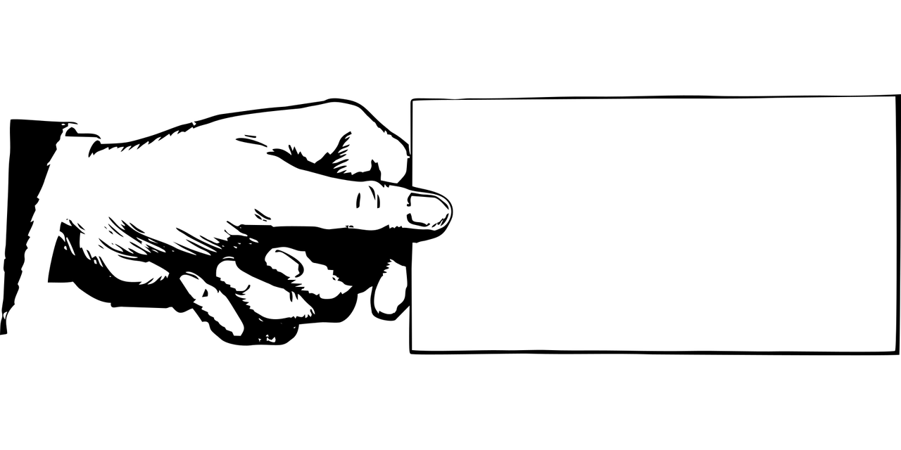
[j/soft g]
prononcer
I have
j’ai
génial
jour
déjà
gymnastique
Notes:
Timing: 2 minutes
Aim: To introduce SSC [j/soft g]
Procedure:
1. Introduce and elicit the pronunciation of the individual SSC [j/soft g] and then the source word again ‘jour’ (with gesture, if using). 2. Then present and elicit the pronunciation of the four cluster words.
The cluster words have been chosen for their high-frequency, from a range of word classes, with the SSC (where possible) positioned within a variety of syllables within the words (e.g. initial, 2nd, final etc.). Additionally, we have tried to use words that build cumulatively on previously taught SSCs (see the Phonics Teaching Sequence document) and do not include new SSCs. Where new SSCs are used, they are often consonants which have a similar symbol-sound correspondence in English.
Word frequency: jour [78] j’ai [8 - avoir] génial [3872] gymnastique [>5000] déjà [58]
Source: Londsale, D., & Le Bras, Y. (2009). A Frequency Dictionary of French: Core vocabulary for learners London: Routledge.
3

Slide 4
prononcer
. Écoute les noms des animaux. C’est [ien] ou [(a)in]?
. Écoute les noms des animaux. C’est [ien] ou [(a)in]?
Écoute. C’est [j/soft g] ou [g] ?
Puis, prononce les mots.
⚠ [j] and soft [g] sound the same. Can you remember how these words are spelt?
[j/soft g] [g]
[j/soft g] [g]
l a p l a g e
c o u r a g e u x
l a l a n g u e
l a g a u c h e
l e v i l l a g e
g r a n d
m a n g e r
j a u n e
1
_
5
_
2
_
6
_
3
_
7
_
4
_
8
_
Notes:
Timing: 5 minutes
Aim: to consolidate SSC [j/soft g] and hard [g].
Procedure:
Pupils write 1-8 and two column headings: [j/soft g] and hard [g].
Click to listen.
Pupils tick the correct SSC in their columns.
Click to reveal the answers and pupils pronounce the words.
Note: they have been taught some of these words so teachers may want to elicit English meanings for additional consolidation. They will be learning the unknown words in upcoming lessons.
4

Slide 5
Avoir not être
You know that avoir means ‘to have, having’:
J’ai un chien.
I have a dog.
Elle a un chat.
She has a cat.
In French, we sometimes also use avoir to mean ‘to be, being’:
J’ai faim.
I am hungry.
We also use avoir to say our age:
J’ai neuf ans.
I am nine years old.
Tu as soif
You are thirsty.
⚠ Word for word, this means ‘I have nine years’.
Il a raison.
He is right.
⚠ These literally mean: I have hunger. You have thirst. He has reason/right. She has wrong.
Elle a tort.
She is wrong.
Notes:
Timing: 2 minutes
Aim: to present new uses of avoir expressions meaning ‘be’.
Procedure: 1. Click to present the information.
2. Elicit responses from pupils, following the animated question marks.

Slide 6
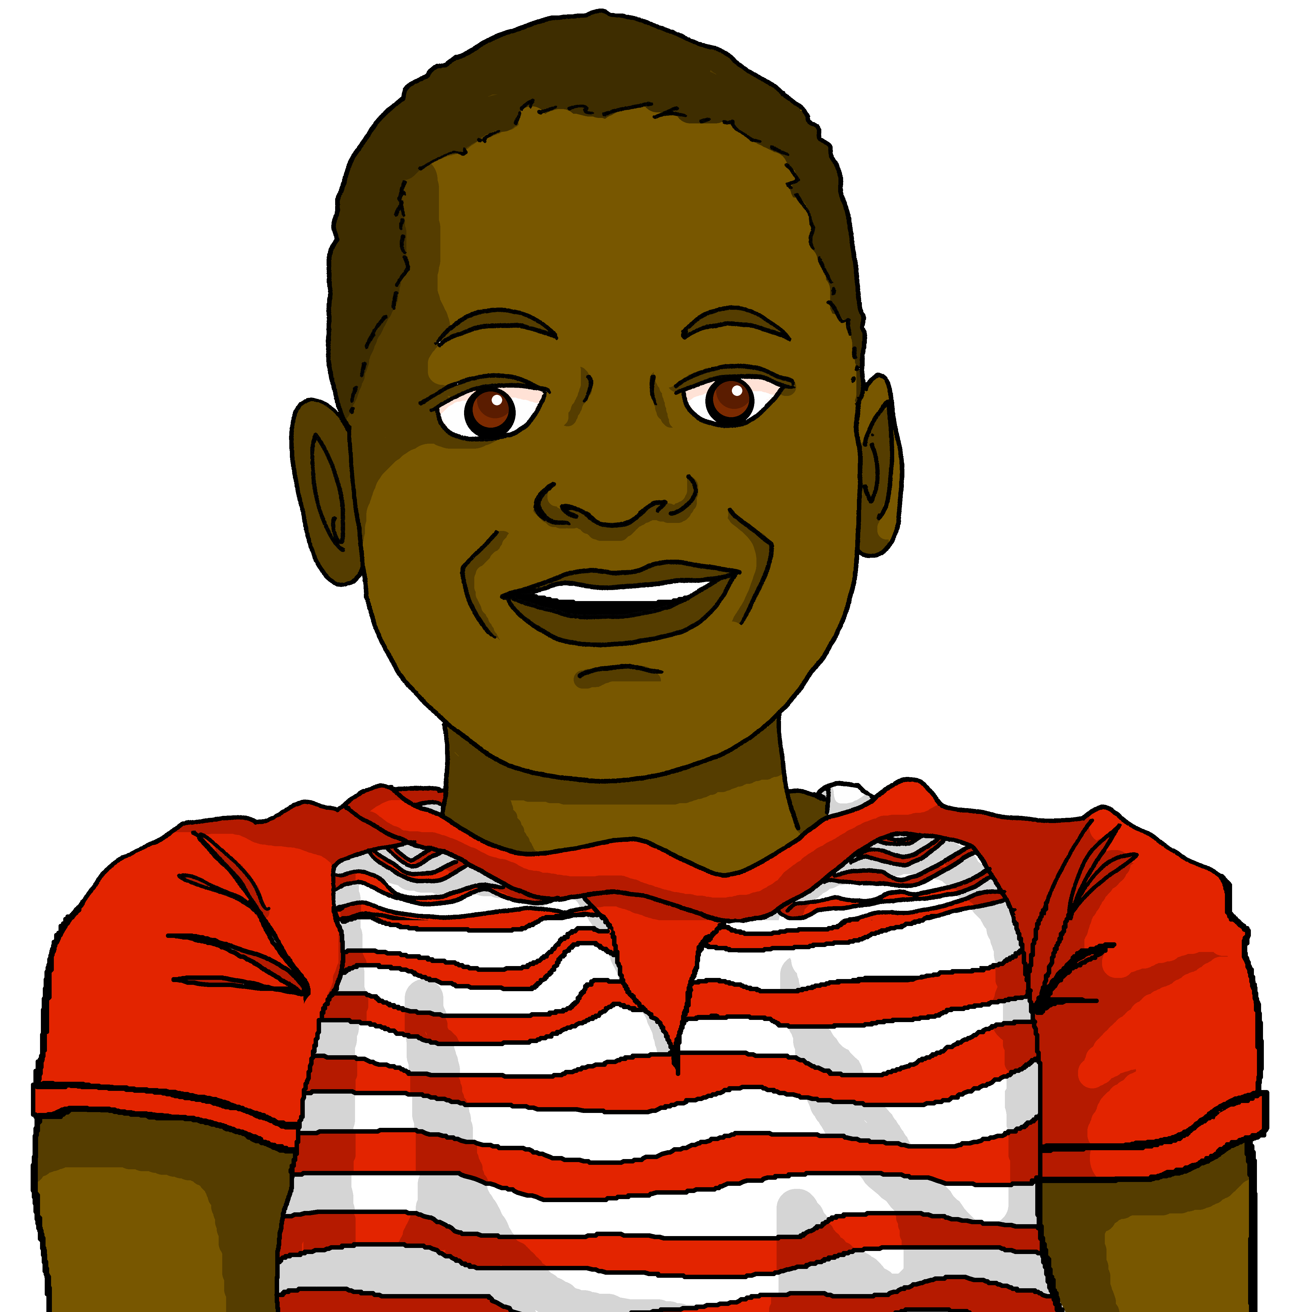
lire
Lis les phrases. Le mot correct, c’est quoi ?
1
J’aide maman avec le déjeuner. J’ai faim !
2
2+2=5 ?! Non ! Tu as tort !
____
____
Aujourd’hui, c’est l’anniversaire de Gérard. Il a dix ans.
Où est ma bouteille ? J’ai soif !
3
4
___!
____.
Tu aimes les sandwichs ? Tu as faim ?
5
La réponse est correcte. Elle a raison.
6
____
____
ans | soif | tort | faim | raison
Notes:
Timing: 5 minutes
Aim: to consolidate written comprehension of this week’s vocabulary and a range of previously taught vocabulary.
Procedure:
1. Pupils write 1-6 for each speech bubble they note the missing word.
2. Elicit the answers from pupils (for additional pronunciation practice)
3. Click to reveal the written answers.
4. Click on the speech bubble to hear the full audio, if desired. Alternatively use it as a listen and check stage.
6

Slide 7
écouter
Écoute. L’option correcte, c’est quoi ?
neuf ans | cadeau | I have a present.
faim | fruit | I am hungry.
tort | gâteau | I have a cake.
soif | bouteille | I am thirsty.
raison | professeure | I have a (female) teacher.
maison | tort | I have a house.
chat | raison | I am right.
faim | vélo | I have a bike.
1
____________________________________
2
____________________________________
3
____________________________________
4
____________________________________
5
____________________________________
6
____________________________________
7
____________________________________
8
____________________________________
Notes:
Timing: 10 minutes
Aim: to practise aural distinction between avoir + noun (with article) and avoir meaning ‘be’ with no article.
Procedure:
Pupils write 1-8.
They listen to each sentence and decide which word completes it, based on the presence or absence of an article.
They then either write or feed back orally the meaning of the sentence.
Click to reveal the correct end to the sentence and the English meaning.
Transcript:
J’ai un [cadeau].
J’ai [faim].
J’ai un [gâteau].
J’ai [soif].
J’ai une [professeure].
J’ai une [maison].
J’ai [raison].
J’ai un [vélo].
7

Slide 8
Au revoir !
rouge
Notes:
8

