Slide 1
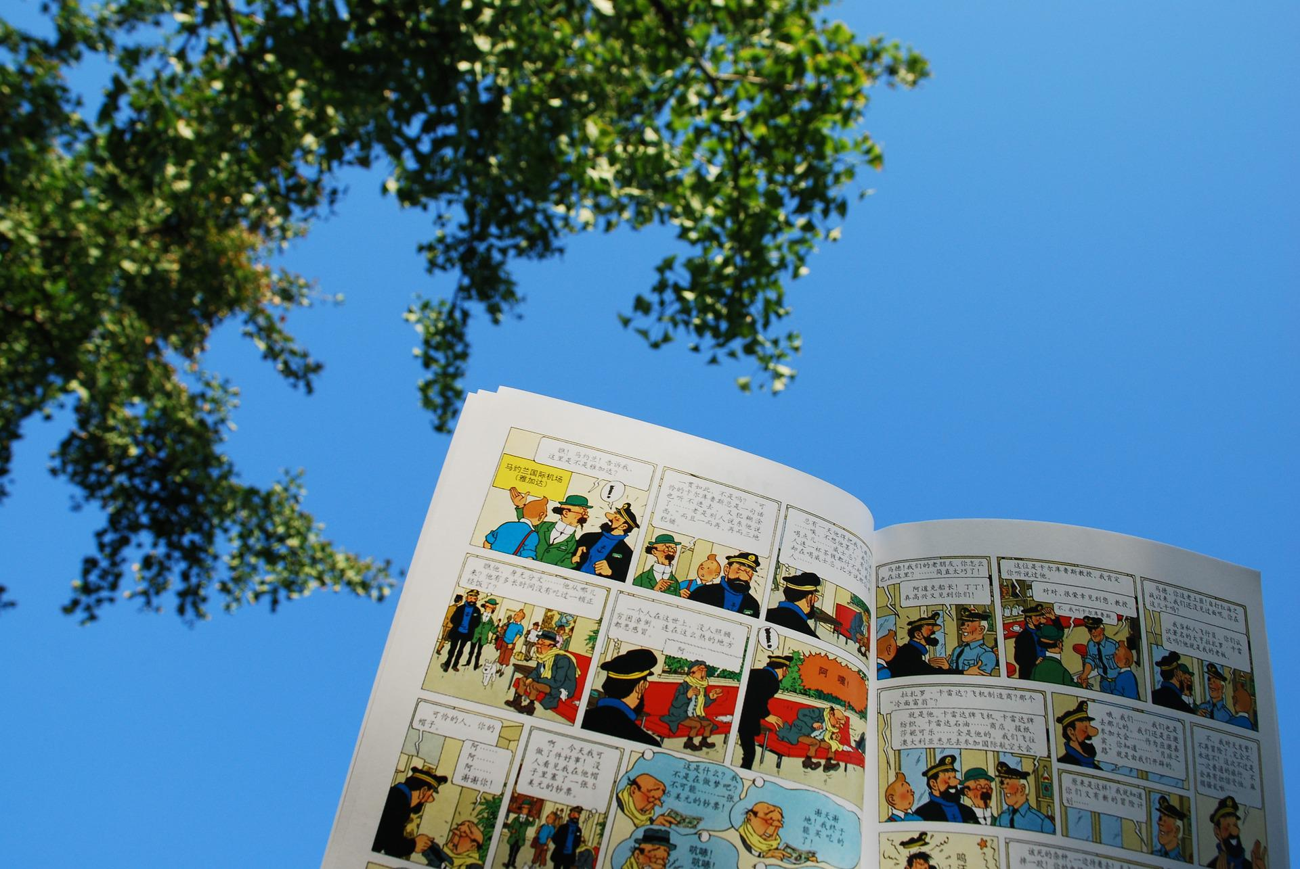
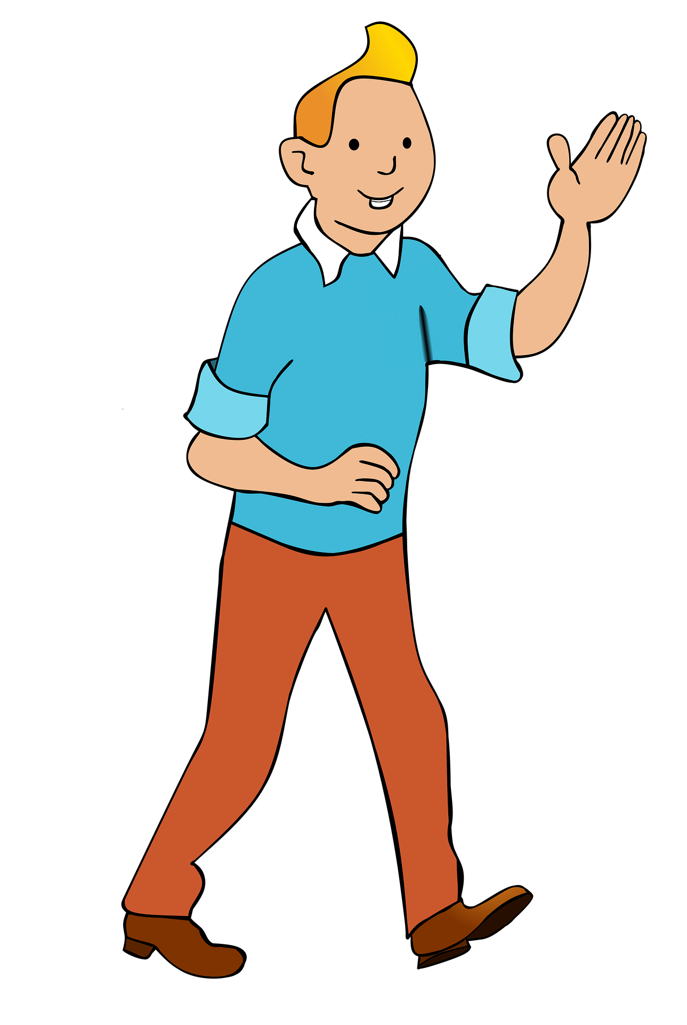
Describing things and people
Les aventures de Tintin
Salut ! Je suis Tintin.
rouge
avoir ou être
SSC [qu]
Notes:
Note: This week pupils are introduced to Tintin and a few of the characters from the comic strip. Most of these activities are in the follow ups so don’t skip over those! In this first part of the week’s material, we just see glimpses of a few characters on the slides. At the start of this lesson, when showing pupils this title slide, perhaps elicit pronunciation of the main character’s name – practising the SSC [(a)in] which pupils practised last week – and tell them that he is a character from a very famous Belgian comic strip, written in French, because French is one of the languages spoken by people in Belgium.
Artwork by Steve Clarke. Pronoun pictures from NCELP (www.ncelp.org). All additional pictures selected from Pixabay and are
available under a Creative Commons license, no attribution required.
The AUDIO version of the lesson material includes additional audio for the new language presented (phonics, vocabulary) and audio for the instructions on the slide.
In addition, it includes VIDEO clips of the phonics and the phonics’ source words. Pupils can be encouraged to look at the shape of the mouth/lips on slides where these appear, and try to copy it/them.
Phonics: [qu] question [144] quatre [283] musique [1139] expliquer [252] unique [402]
Vocabulary (new words in bold): cousin, cousine [3387] femme [154] homme [136] bleu [1216] rouge [987]
Revisit 1: différent [350] lent [2572] vert [1060] très [66]
Revisit 2: passer [90] manger [1338] ami, amie [467] déjeuner [2724] weekend [2475] mon, ma [60] ton, ta [330] voici [1103]
Londsale, D., & Le Bras, Y. (2009). A Frequency Dictionary of French: Core vocabulary for learners London: Routledge.
The frequency rankings for words that occur in this PowerPoint which have been previously introduced in these resources are given in the SOW and in the resources that first introduced and formally re-visited those words. For any other words that occur incidentally in this PowerPoint, frequency rankings will be provided in the notes field wherever possible.
1

Slide 2
[qu]
prononcer
question
Notes:
Timing: 1 minute
Aim: To introduce SSC [qu]
Procedure: 1. Present the letter(s) and say the [qu] sound first, on its own. Students repeat it with you. 2. Bring up the word ”question” on its own, say it, students repeat it, so that they have the opportunity to focus all of their attention on the connection between the written word and its sound.
3. Say the word and do the gesture, if using.
4. Roll back the animations and work through 1-3 again, but this time, dropping your voice completely to listen carefully to the students saying the [qu] sound, pronouncing ”question” and, if using, doing the gesture.
Gesture: https://www.signbsl.com/sign/question
The 2nd video from the left – trace the shape of a question mark in the air
Word frequency (1 is the most frequent word in French):
question [144]
Source: Londsale, D., & Le Bras, Y. (2009). A Frequency Dictionary of French: Core vocabulary for learners London: Routledge.
2

Slide 3
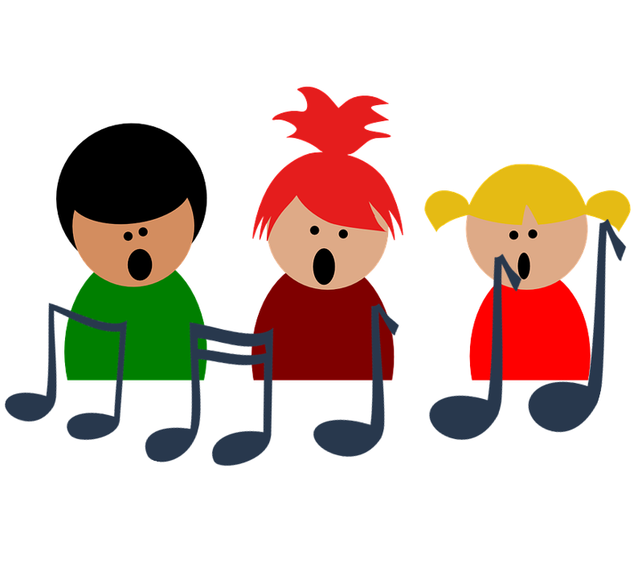
[qu]
prononcer
to explain
quatre
expliquer
question
musique
unique
Notes:
Timing: 2 minutes
Aim: To introduce SSC [qu]
Procedure:
1. Introduce and elicit the pronunciation of the individual SSC [qu] and then the source word again ‘question’ (with gesture, if using). 2. Then present and elicit the pronunciation of the four cluster words.
The cluster words have been chosen for their high-frequency, from a range of word classes, with the SSC (where possible) positioned within a variety of syllables within the words (e.g. initial, 2nd, final etc.). Additionally, we have tried to use words that build cumulatively on previously taught SSCs (see the Phonics Teaching Sequence document) and do not include new SSCs. Where new SSCs are used, they are often consonants which have a similar symbol-sound correspondence in English.
Word frequency: quatre [283] musique [1139] expliquer [252] unique [402] question [144] Source: Londsale, D., & Le Bras, Y. (2009). A Frequency Dictionary of French: Core vocabulary for learners London: Routledge.
3

Slide 4
prononcer
.
.
Écoute. C’est [qu] ou [c]?
Puis, prononce les mots.
⚠ [qu] and hard [c] sound the same. Can you remember how these words are spelt?
[qu] [c]
[qu] [c]
c a l m e
l e s a c
s y m p a t h i q u e
a v e c
q u a t r e
c h a q u e
c o m m e n t
l e c a d e a u
q u o i
c o m b i e n
1
__
6
__
2
__
7
__
3
__
8
__
4
__
9
__
5
__
10
__
Notes:
Timing: 5 minutes
Aim: to consolidate SSC [qu] and hard [c].
Procedure:
Pupils write 1-10 and two column headings: [qu] and hard [c].
Click to listen.
Pupils tick the correct SSC in their columns.
Click to reveal the answers and pupils pronounce the words.
Note: they have been taught these words so teachers may want to elicit English meanings for additional consolidation.
4

Slide 5
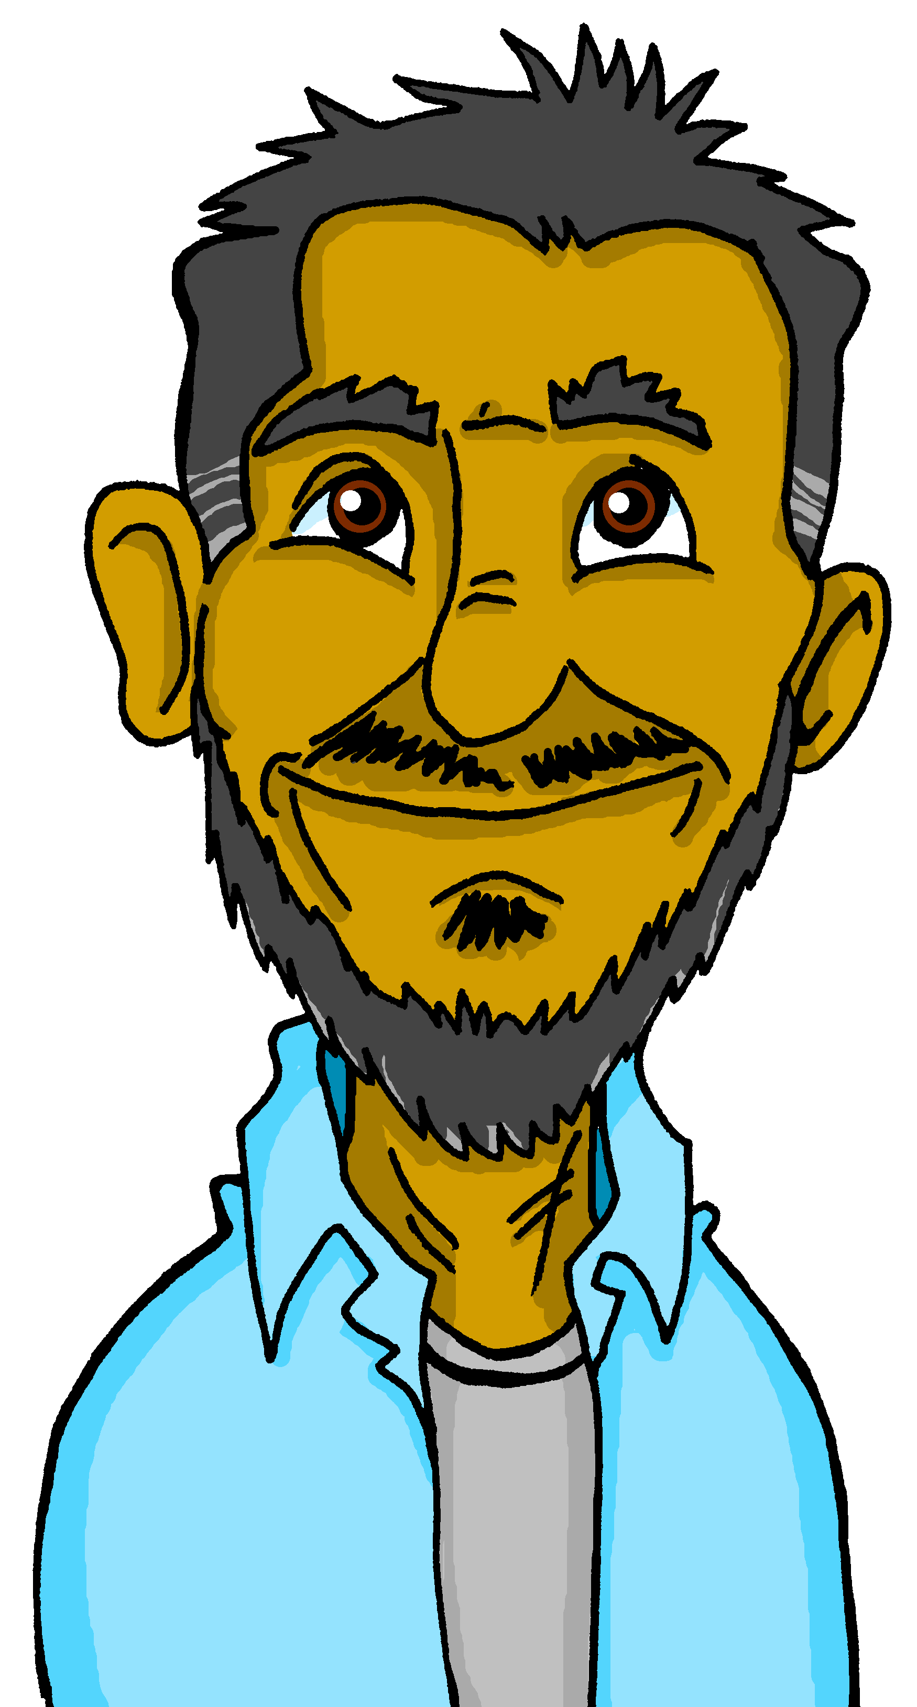
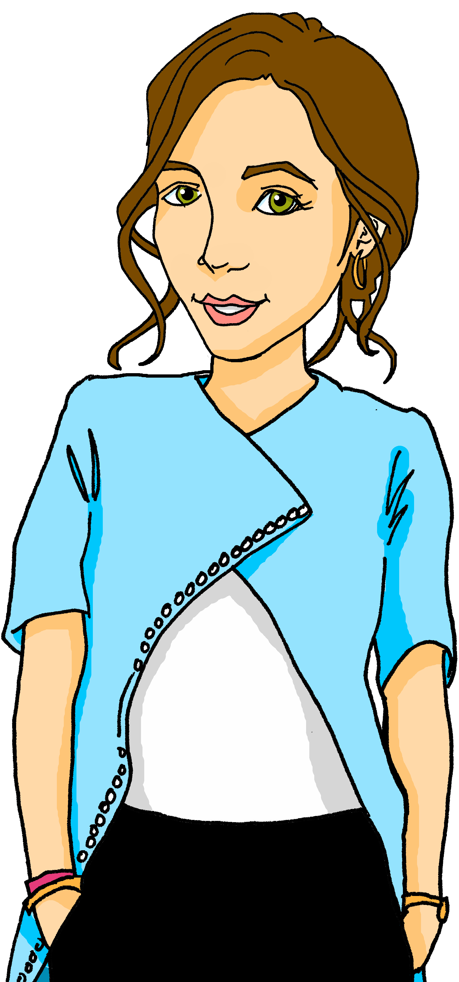
Male and female person nouns
The words for ‘man’ and ‘woman’ are different:
un homme
a man
une femme
a woman
Remember that some people nouns just add ‘e’ for the feminine form (just like some adjectives):
un professeur.
une professeure
a (male) teacher
a (female) teacher
un ami
une amie
⚠ This time, the Silent Final ‘e’ (SFe) means we hear the final consonant.
a (male) friend
a(female) friend.
un cousin
une cousine
a (male) cousin
a (female) cousin
Notes:
Timing: 2 minutes
Aim: to recap the formation of some person nouns, adding ‘e’ for the feminine form.
Procedure: 1. Click to present the information.
2. Elicit responses from pupils, following the animated question marks.

Slide 6
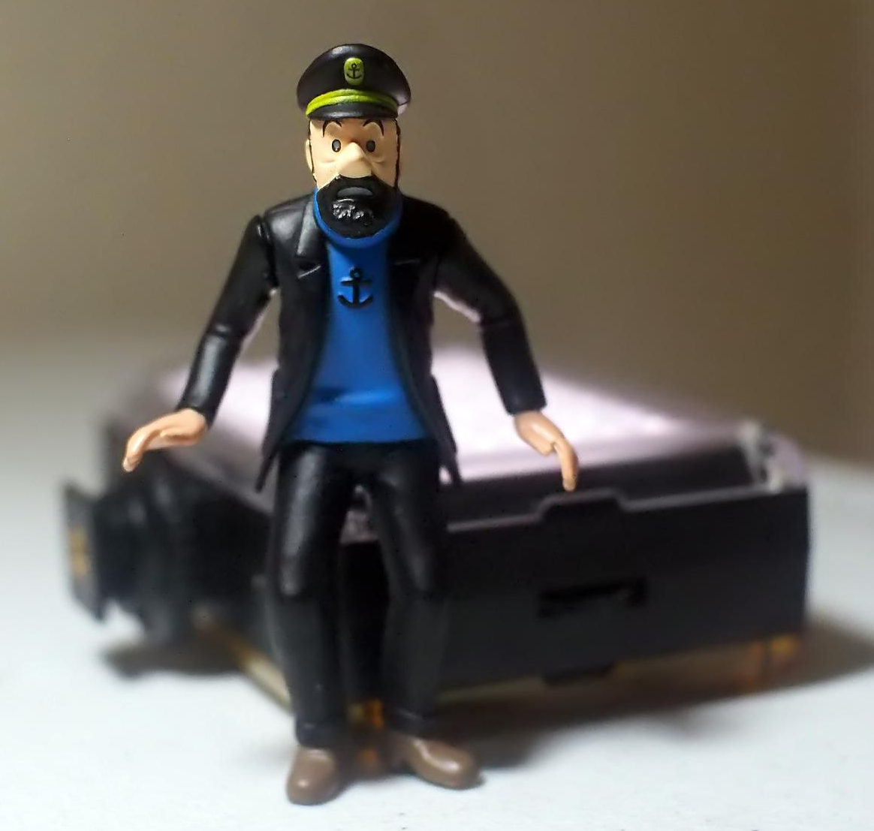
lire
C’est un homme ou une femme ? Coche* l’option correcte.
Le mot pour ‘the’, c’est quoi ?
 |  | un homme | une femme
1 | le professeur
2 | la cousine
3 | l’ amie
4 | le cousin
5 | la professeure
6 | l’ ami
___
___
___
___
___
___
Notes:
Timing: 5 minutes
Aim: to consolidate written recognition of male and female noun forms, and to gain a further encounter with this week’s and previously taught vocabulary.
Procedure:
1. Pupils write 1-6 and two headings ‘un homme’ and ‘une femme’ and choose ‘un homme’ or ‘une femme’ for each.
2. Click to reveal the answers.
3. Then elicit, chorally, the full word with article and click to reveal each time.
6

Slide 7
Avoir et être
avoir
Remember: to talk about having something we use the verb _________:
I have
j’ai
you have
tu as
he has
il a
she has
elle a
Elle a un chien.
être
To talk about being something we use the verb _________:
I am
je suis
you are
tu es
he is
il est
she is
elle est
Elle est calme.
Notes:
Timing: 2 minutes
Aim: to revisit singular persons of avoir and être.
Procedure: 1. Click to present the information.
2. Elicit responses from pupils, following the animated question marks.

Slide 8
lire
Jean-Michel complète les devoirs d’anglais.
écrire
J’ai une professeure amusante. | I have a funny (female) teacher.
Elle est aussi très sympa. | She is also very nice.
Tu es sympa et amusant ? | Are you nice and funny?
Il a une cousine intelligente. | He has an intelligent cousin.
Tu as un cousin ? | Do you have a cousin?
Je suis très sérieux. | I am very serious.
1
_____
____________________________________
2
_____
____________________________________
3
_____
____________________________________
4
_____
____________________________________
5
_____
____________________________________
6
_____
____________________________________
Notes:
Timing: 10 minutes
Aim: to consolidate aural recognition and transcription of avoir and être, and written comprehension of these and other vocabulary.
Procedure:
Pupils write 1-6.
Explain that Jean-Michel is doing his English homework and the class is going to help. The homework is to listen and complete the sentence in French first and then to translate it all into English (trickier for Jean-Michel than for them, so they can help).
Click to listen to each sentence. Pupils write the missing verb forms only.
Then elicit, chorally the full sentence and click to reveal each verb.
Then elicit the English meanings of each sentence. There is no need for pupils to write these down.
Respond to anything that pupils find tricky (e.g. translating the word order of the sentences with noun + adjective).
8

Slide 9
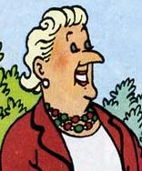
C’est
We use c’est to mean ‘this is’ or ‘it is/it’s’ when saying what something is:
It’s a dog.
C’est un chien.
This is a dog.
⚠ So c’est can mean she is, he is, too.
Also use c’est with people to say what or who they are:
C’est une femme.
It’s a woman.
This is a woman.
⚠ You can also say: Elle est une femme.
She is a woman.
⚠ You can also say: Elle est une femme sympa.
C’est une femme sympa.
It’s a nice woman.
This is a nice woman.
She is a nice woman.
Notes:
Timing: 2 minutes
Aim: to explain additional meanings of c’est and use with people, where English uses ‘she’ or ‘he’.
Procedure: 1. Click to present the information.
2. Elicit responses from pupils, following the animated question marks.

Slide 10
lire
Comment dit-on ‘c’est’ en anglais ? C’est ‘she/he/it is’ ou ‘it is’ ?
1
5
6
écouter
2
3
6
4
6
Notes:
Picture attribution (Tintin and le Capitaine Haddock): infomatique/William Murphy, CC BY-SA 2.0, via Wikimedia Commons
Timing: 6 minutes
Aim: to practise comprehension of different meanings of ‘c’est’.
Procedure:
Explain that Tintin has lots of adventures in the stories, encounters lots of things and meets lots of people along the way.
Say that they are going to listen (and/or listen and read) to some of the *sorts of* things and people that are in Tintin’s adventures and say what/who they are in English. *Note that not all the objects are known to appear in the comics.
Note: depending on the level of challenge required, pupils could first listen only and see if they can work out what/who. If they need more support, a picture appears on the next mouse click. Pupils then decide whether their English sentence starts she, he or it. They should use she or he when it makes sense to do so in English.
Teachers elicit English answers and confirm orally (see answers below, if needed).
Transcript: C’est un vélo bleu. C’est un ami très sympa. C’est une voiture lente.
C’est un fruit rouge. C’est une femme française. C’est un homme différent.
C’est un jeu difficile. C’est un animal vert.
Answers: It’s a blue bike.
He’s a very nice friend. It’s a slow car. It’s a red fruit. She’s a French woman. He’s a difficult man. It’s a difficult game. It’s a green animal.
10

Slide 11
Au revoir !
rouge
Notes:
11

