Slide 1
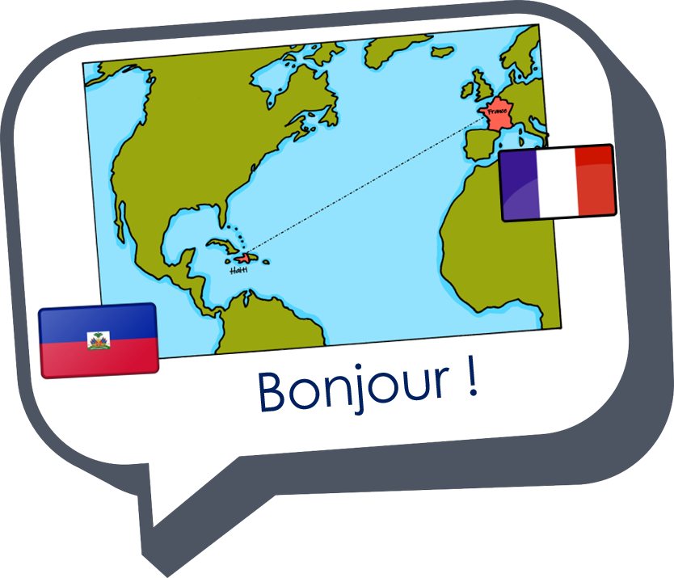
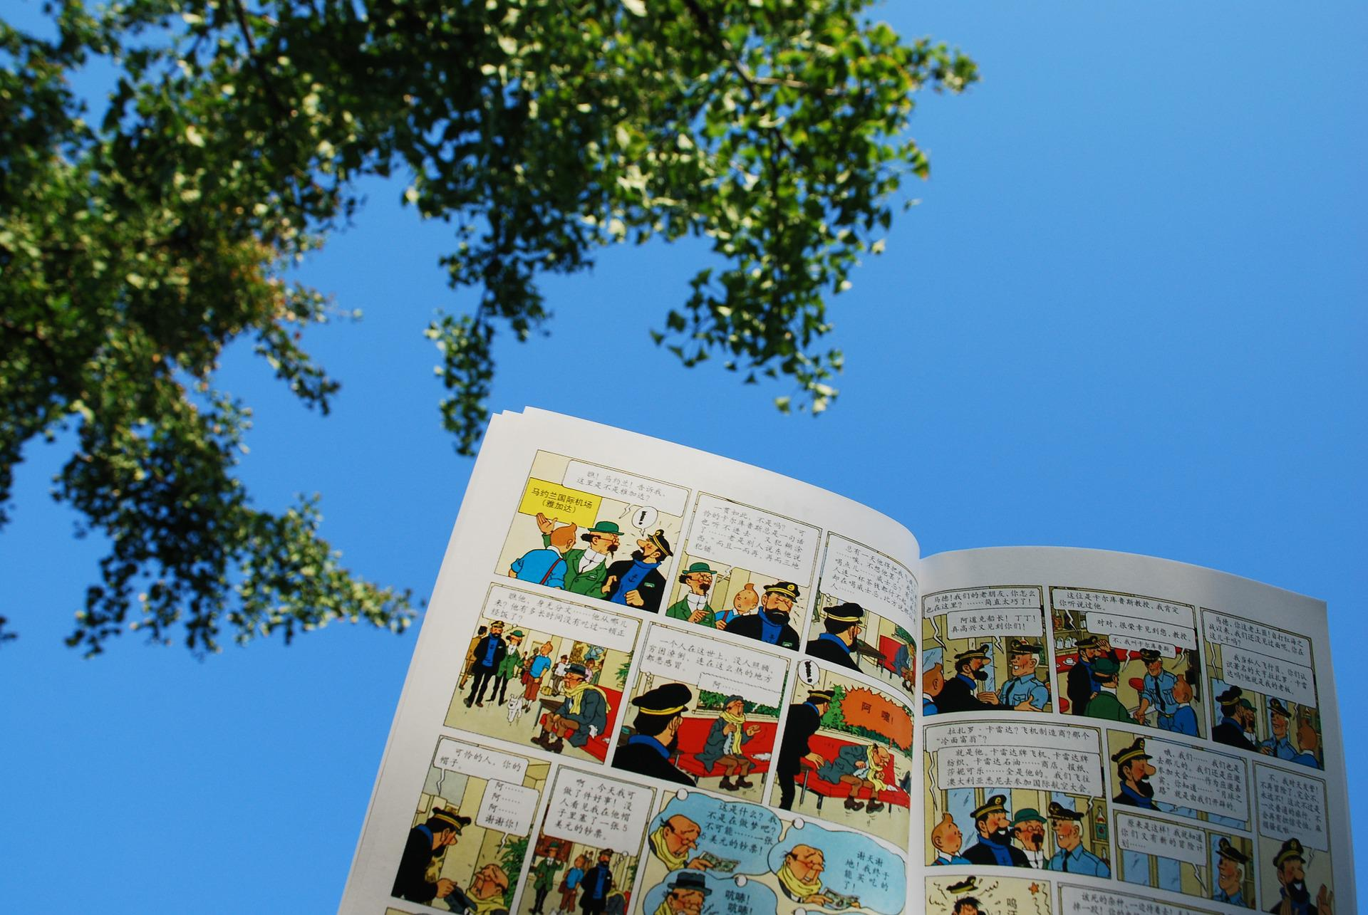
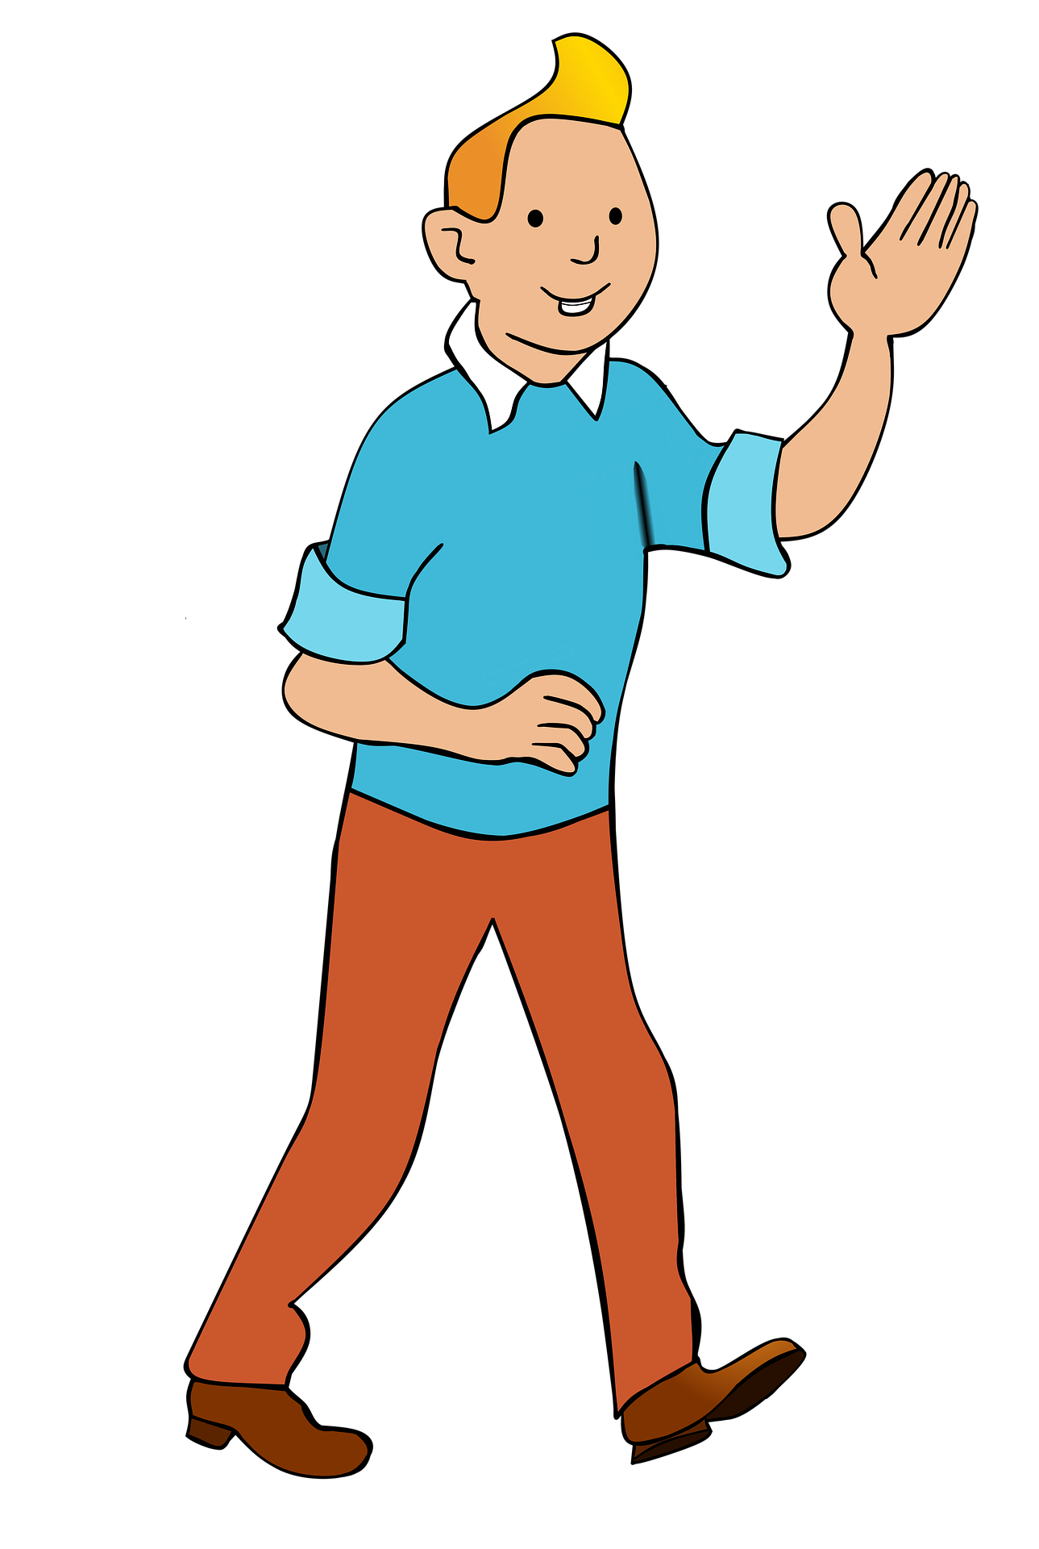
Describing things and people
Salut ! Je suis Tintin.
rouge
Follow ups 1-5
Notes:
Artwork by Steve Clarke. Pronoun pictures from NCELP (www.ncelp.org). All additional pictures selected from Pixabay and are
available under a Creative Commons license, no attribution required.
The AUDIO version of the lesson material includes additional audio for the new language presented (phonics, vocabulary) and audio for the instructions
on the slide.
In addition, it includes VIDEO clips of the phonics and the phonics’ source words. Pupils can be encouraged to look at the shape of the mouth/lips on slides where these appear, and try to copy it/them.
Phonics: [SFe] [ç] (and soft -c) ici [167] français [251] garçon [1599] cinéma [1623] décider [165]
Vocabulary (new words in bold): professeur, professeure [110] sympathique [4164] comment [234]
Revisit 1: chose [125] des [2] combien [800]
Revisit 2: donner [46] préparer [368] trouver [83] famille [172] frère [1043] mère [645] père [559] sœur [1558] le [1] la [1] à (meaning ‘to’) [4]
Londsale, D., & Le Bras, Y. (2009). A Frequency Dictionary of French: Core vocabulary for learners London: Routledge.
The frequency rankings for words that occur in this PowerPoint which have been previously introduced in these resources are given in the SOW and in the resources that first introduced and formally re-visited those words. For any other words that occur incidentally in this PowerPoint, frequency rankings will be provided in the notes field wherever possible.

Slide 2
[qu]
prononcer
question
Notes:
Timing: 1 minute
Aim: To consolidate SSC [qu]
Procedure: 1. Present the letter(s) and say the [qu] sound first, on its own. Students repeat it with you. 2. Bring up the word ”question” on its own, say it, students repeat it, so that they have the opportunity to focus all of their attention on the connection between the written word and its sound.
3. Say the word and do the gesture, if using.
4. Roll back the animations and work through 1-3 again, but this time, dropping your voice completely to listen carefully to the students saying the [qu] sound, pronouncing ”question” and, if using, doing the gesture.
Gesture: https://www.signbsl.com/sign/question
The 2nd video from the left – trace the shape of a question mark in the air
Word frequency (1 is the most frequent word in French):
question [144]
Source: Londsale, D., & Le Bras, Y. (2009). A Frequency Dictionary of French: Core vocabulary for learners London: Routledge.
2

Slide 3
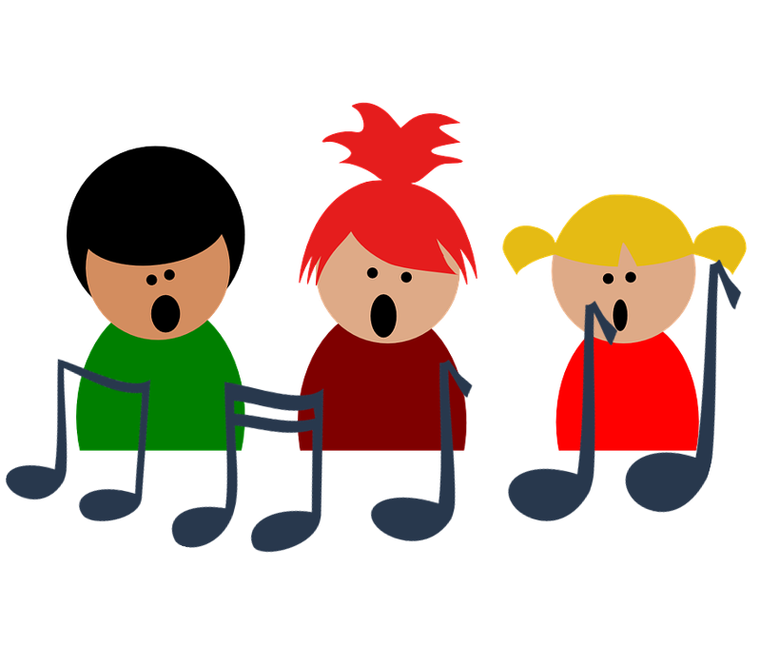
[qu]
prononcer
to explain
quatre
expliquer
question
musique
unique
Notes:
Timing: 2 minutes
Aim: To consolidate SSC [qu]
Procedure:
1. Introduce and elicit the pronunciation of the individual SSC [qu] and then the source word again ‘question’ (with gesture, if using). 2. Then present and elicit the pronunciation of the four cluster words.
The cluster words have been chosen for their high-frequency, from a range of word classes, with the SSC (where possible) positioned within a variety of syllables within the words (e.g. initial, 2nd, final etc.). Additionally, we have tried to use words that build cumulatively on previously taught SSCs (see the Phonics Teaching Sequence document) and do not include new SSCs. Where new SSCs are used, they are often consonants which have a similar symbol-sound correspondence in English.
Word frequency: quatre [283] musique [1139] expliquer [252] unique [402] question [144] Source: Londsale, D., & Le Bras, Y. (2009). A Frequency Dictionary of French: Core vocabulary for learners London: Routledge.
3

Slide 4
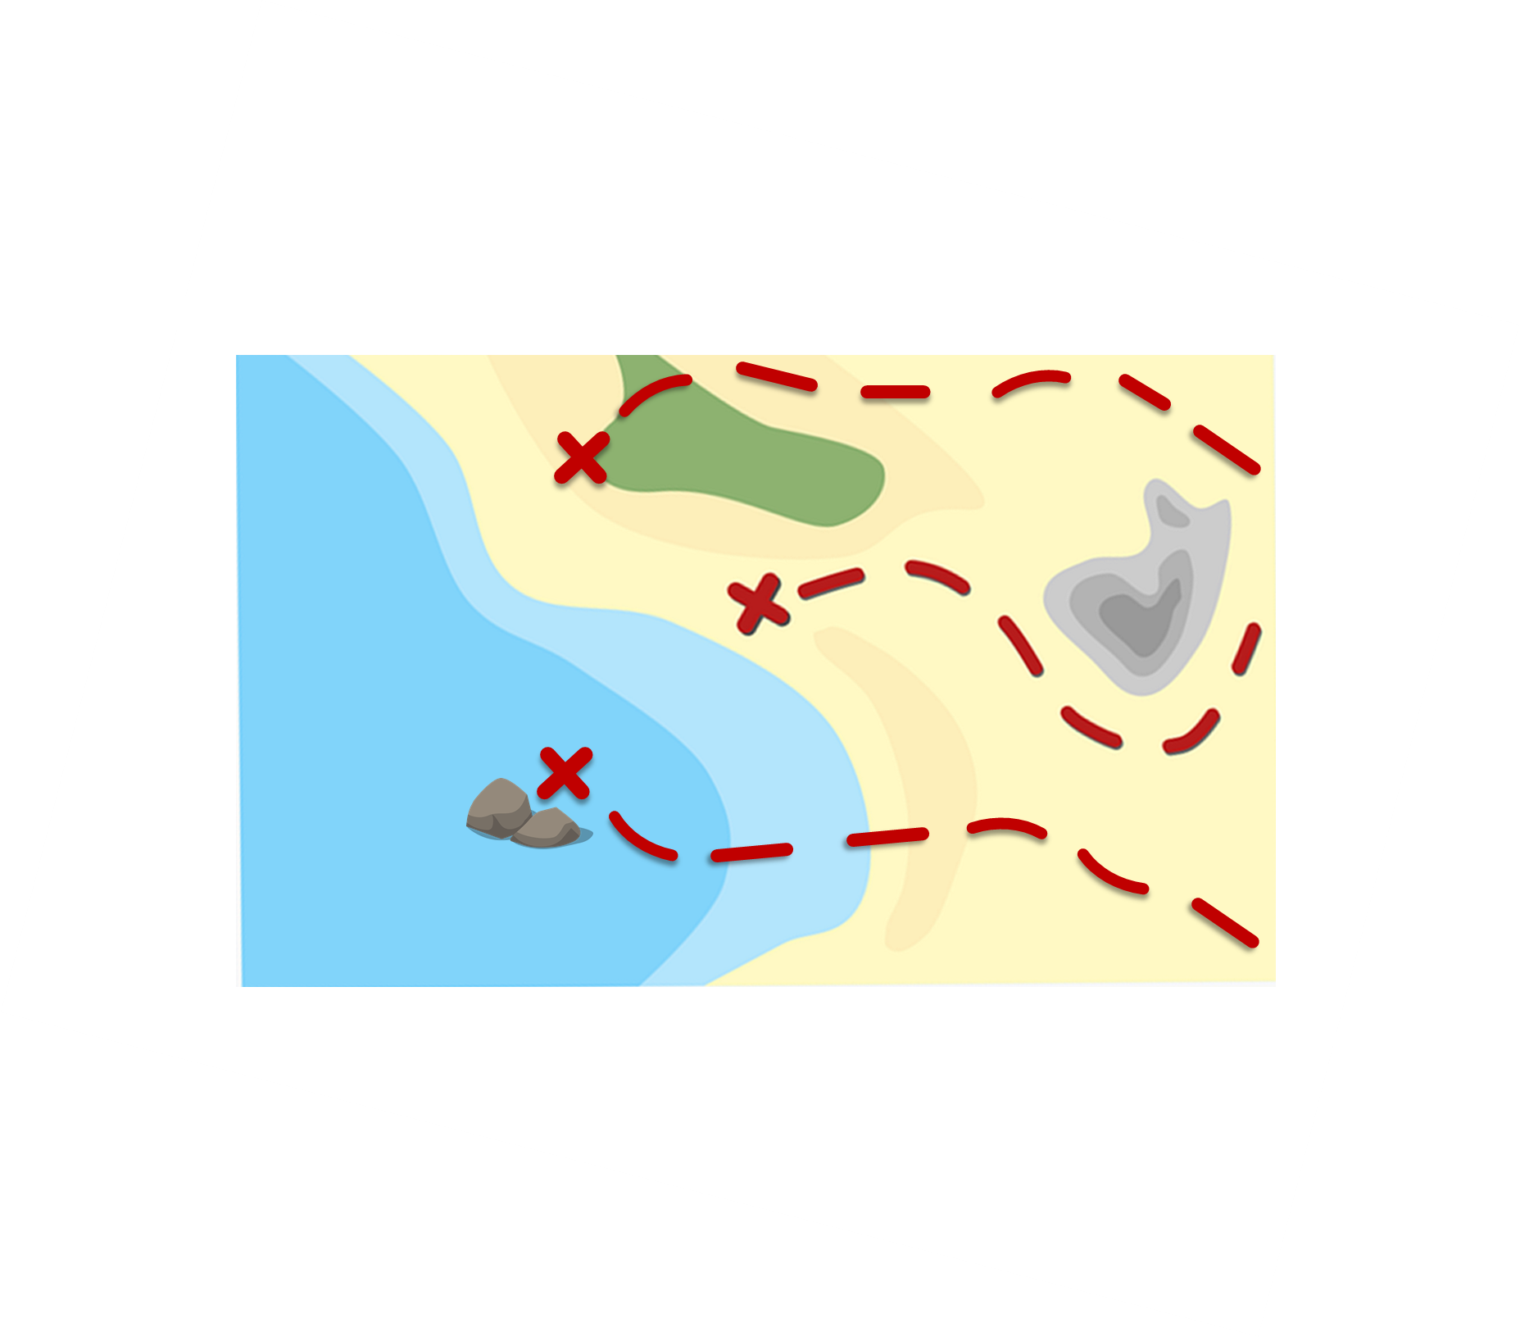
prononcer
Follow up 1:
*la pièce – piece, coin
Prononce les mots et collecte des pièces*.
conséquence
60
qualification
fréquent
liquide
équipement
S
qualité
séquence
chèque
équivalent
0
question
tranquille
quantité
DÉBUT
Notes:
Timing: 5 minutes [2 rounds]
Aim: To practise the pronunciation of French words with the SSC [-tion].
Procedure:
Pupils work in pairs to practise pronunciation. They can choose where to start and have one minute to collect as many coins as possible.
Divide the class in A & B and click to indicate it’s ‘personne A’’s turn.
Pupil A starts from either ‘liquide’ ‘qualité’ or ‘quantité’, and follows the path to pronounce the words and collect the corresponding coins. Pupil B listens and notes down the number of coins for his/her partner.
Click to bring up Personne B’s turn.
Click on each word to hear it pronounced, as required.
Frequency of unknown words and cognates: chèque [>5000] conséquence [617] équipement [1704] équivalent [2476] fréquent [2684] liquide [3520] qualité [606] quantité [1680] question [144] qualification [4004] séquence [3100] tranquille [2555]
4

Slide 5
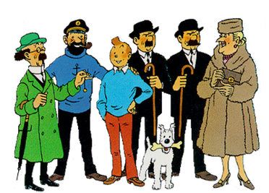
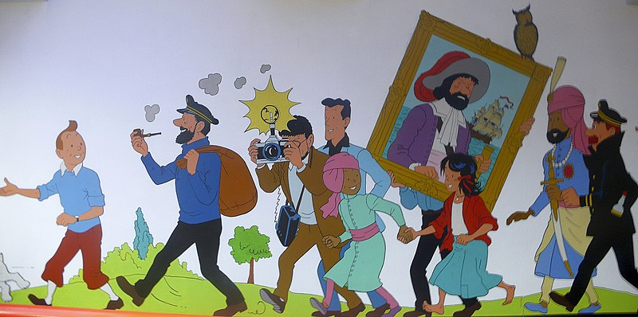
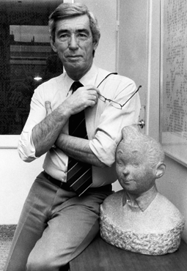
Follow up 2
Salut ! Je suis Tintin.
Les aventures de Tintin
bande dessinée – comic
lire
Les aventures de Tintin sont une série de bandes dessinées.
C’est la création de Hergé, un auteur belge.
Tintin est un jeune reporter. Il a un fox-terrier Milou et deux amis importants : le capitaine Haddock et le Professeur Tournesol.
Il y a aussi une chanteuse, Bianca Castafiore, et deux détectives Dupond et Dupont.
jeune – young chanteuse – singer
Tintin voyage en Chine, en Égypte, en Inde, au Congo, au Tibet et au Pérou, et même sur la Lune.
voyager – to travel même – even
Hergé, l’auteur de Tintin
Notes:
Timing: 10 minutes (3 slides, but one slide can be omitted)
Aim: To use gender codes in order to be able to use the correct definite and indefinite articles with unknown nouns.
Procedure:
1. Teachers read the instruction and clarify the meaning of ‘article’.
2. Teachers draw pupils’ attention to the codes for each of the nouns (giraffe, lion, rivière).
3. Pupils work in pairs to read the description aloud, selecting the correct translation for ‘the’ or ‘a/an’.
4. Teacher elicits answers from pupils.
5. Click the picture to hear the full text for the description, if desired.
6. Pupils can read aloud again (whole class) to practise SSC knowledge, time allowing.
Image attributions: Non-free use rationale Hergé: https://en.wikipedia.org/wiki/File:Herge_with_bust_of_Tintin.png
Bianca Castafiore: https://en.wikipedia.org/wiki/File:Bianca_Castafiore.jpg
Tintin Main cast: https://en.wikipedia.org/wiki/File:Tintin-mainCast.png

Slide 6
Follow up 2
Lis les phrases. Avoir ou être ? C’est qui ?
lire
C
D
 |  | having | being | ?
 | Il a un chapeau vert.
 | Il a un animal.
 | Elle est chanteuse.
 | Il a le nom Milou.
 | Il est un ami important.
 | Il est un garçon courageux.
E
1
B
B
2
A
3
E
4
F
A
F
5
C
6
A
Notes:
Aim: to practise written understanding of the forms of avoir and être in sentences; to practise comprehension of previously taught vocabulary.
Procedure:
Do the first item with pupils to model the two elements of the task: differentiating between having and being and understanding vocabulary.
Pupils write 2 – 6 and note either having or being and the correct letter.
Click to reveal the answers.
Image attribution: Non-free use rationale Tintin Main cast: https://en.wikipedia.org/wiki/File:Tintin-mainCast.png

Slide 7
Follow up 2
Écoute. Avoir ou être ? C’est qui ?
écouter
C
D
 |  | having | being | ?
 | Il a un t-shirt bleu.
 | Il est un chien.
 | Il est un professeur amusant.
 | Il a le nom Dupond/t.
 | Il est un ami important.
 | Elle est difficile mais amusante.
E
1
A
B
2
F
3
B
4
D
A
F
5
C
6
E
Dupont and Dupond sound the same because of SFC –t, -d!
Notes:
Note: omit this activity if time does not allow for it.
Aim: to practise aural understanding of the forms of avoir and être in sentences; to practise comprehension of previously taught vocabulary.
Procedure:
Do the first item with pupils to model the two elements of the task: differentiating between having and being and understanding vocabulary.
Click to listen. Pupils write 2 – 6 and note either having or being and the correct letter.
Click to reveal the answers.
Image attribution: Non-free use rationale Tintin Main cast: https://en.wikipedia.org/wiki/File:Tintin-mainCast.png

Slide 8
Follow up 3
Parle avec ton ou ta partenaire.
I have a brave dog!
J’ai un chien courageux !
parler
He is a nice man!
Il est un homme sympa !
C’est un homme sympa !
J’ai un professeur intelligent.
I have an intelligent teacher/professor.
She is a funny woman.
Elle est une femme amusante.
C’est une femme amusante.
He is a funny friend.
C’est un ami amusant.
Il est un ami amusant.
Do you have a funny friend?
Tu as un ami amusant ?
Notes:
Timing: 5 minutes
Aim: to practise spoken production of the new and revisited language from this week.
Procedure:
Do number 1 with pupils to model the task.
Click to reveal the answer.
Click for the next sentence. Give pupils 30 seconds to work the sentence out orally with a partner.
Elicit the sentence from the whole class chorally, then click to confirm.
Repeat steps 3-4 for the remaining sentences.
Image attribution: Non-free use rationale Tintin Main cast: https://en.wikipedia.org/wiki/File:Tintin-mainCast.png

Slide 9
vocabulaire
Follow up 4a - Écris en anglais : Can you get at least 15 points?
mots
 | le déjeuner | l’ami, l’amie | passer
 | voici | ton, ta | mon, ma
 | différent | très | manger
 | vert | difficile | lent
elle | la femme | la cousine | l’homme
 | bleu | rouge | le cousin
(the) lunch
(the) friend (m), (f)
to spend, spending
x3
here is, this is
your (m), (f)
my (m), (f)
different (m)
very
to eat, eating
x2
green (m)
difficult (m, f)
slow (m)
(the) woman
(the) female cousin
(the) man
x1
blue
rouge
(the) male cousin
Notes:
Note: bleu and rouge are officially new words this week. They have not been explicitly practised yet, but pupils have seen rouge every week on the lesson title slide, and bleu is similar to blue, so it is anticipated that pupils may be fine with these, following this practice in Follow up 4.
Timing: 5-10 minutes
Aim: to practise written comprehension of vocabulary from this week and previous weeks.
Procedure: Give pupils a blank grid. They fill in the English meanings of any of the words they know, trying to reach 15 points in total.
Note: The most recently learnt and practised words are pink, words from the previous week are green and those from earlier are blue, thus more points are awarded for them, to recognise that memories fade and more effort (heavy lifting!) is needed to retrieve them.
9

Slide 10
Follow up 4b
Écris en français.
Écris en anglais.
mots
 | my (m), (f) | your (m), (f) | here is, this is
 | to spend, spending | (the) friend (m), (f) | (the) lunch
 | green (m) | difficult (m, f) | to eat, eating
 | different (m) | slow (m) | very
 | red | (the) male cousin | (the) female cousin
 | (the) woman | (the) man | blue
vocabulaire
mon, ma
ton, ta
voici
x3
passer
l’ami, l’amie
le déjeuner
vert
difficile
manger
x2
différent
lent
très
rouge
le cousin
la cousine
x1
la femme
l’homme
bleu
Notes:
Timing: 5-10 minutes
Aim: to practise written comprehension of vocabulary from this week and previous weeks.
Procedure: Give pupils a blank grid. They fill in the French meanings of any of the words they know, trying to reach 15 points in total.
Note: The most recently learnt and practised words are pink, words from the previous week are green and those from earlier are blue, thus more points are awarded for them, to recognise that memories fade and more effort (heavy lifting!) is needed to retrieve them.

Slide 11
Follow up 5
Écris en français.
écrire
Elle est ma cousine. [She is also very nice.]
Tu as un cousin ? [I have an intelligent (female) cousin.]
[My (male) cousin is very serious.]
[My (female) friend has a red hat.]
[Do you have a pet? I have a blue dog!]
1
Elle est aussi très sympa.
2
J’ai une cousine intelligente.
3
Mon cousin est très sérieux.
4
Mon amie a un chapeau rouge.
5
Tu as un animal ? J’ai un chien bleu !
Notes:
Timing: 5 minutes
Aim: to practise written production of the new and revisited language from this week.
Procedure:
Do number 1 with pupils to model the task.
Click to reveal the answer.
Pupils complete sentences 2-5.
Click to reveal the answers.

Slide 12
vocabulaire
Écris en anglais : Can you get at least 15 points?
mots
 | le déjeuner | l’ami, l’amie | passer
 | voici | ton, ta | mon, ma
 | différent | très | manger
 | vert | difficile | lent
elle | la femme | la cousine | l’homme
 | bleu | rouge | le cousin
x3
x2
x1
Notes:
HANDOUT 4a
12

Slide 13
vocabulaire
Écris en français : Can you get at least 15 points?
mots
 | my (m), (f) | your (m), (f) | here is, this is
 | to spend, spending | (the) friend (m), (f) | (the) lunch
 | green (m) | difficult (m, f) | to eat, eating
 | different (m) | slow (m) | very
 | red | (the) male cousin | (the) female cousin
 | (the) woman | (the) man | blue
x3
x2
x1
Notes:
HANDOUT 4b
13

