Slide 1
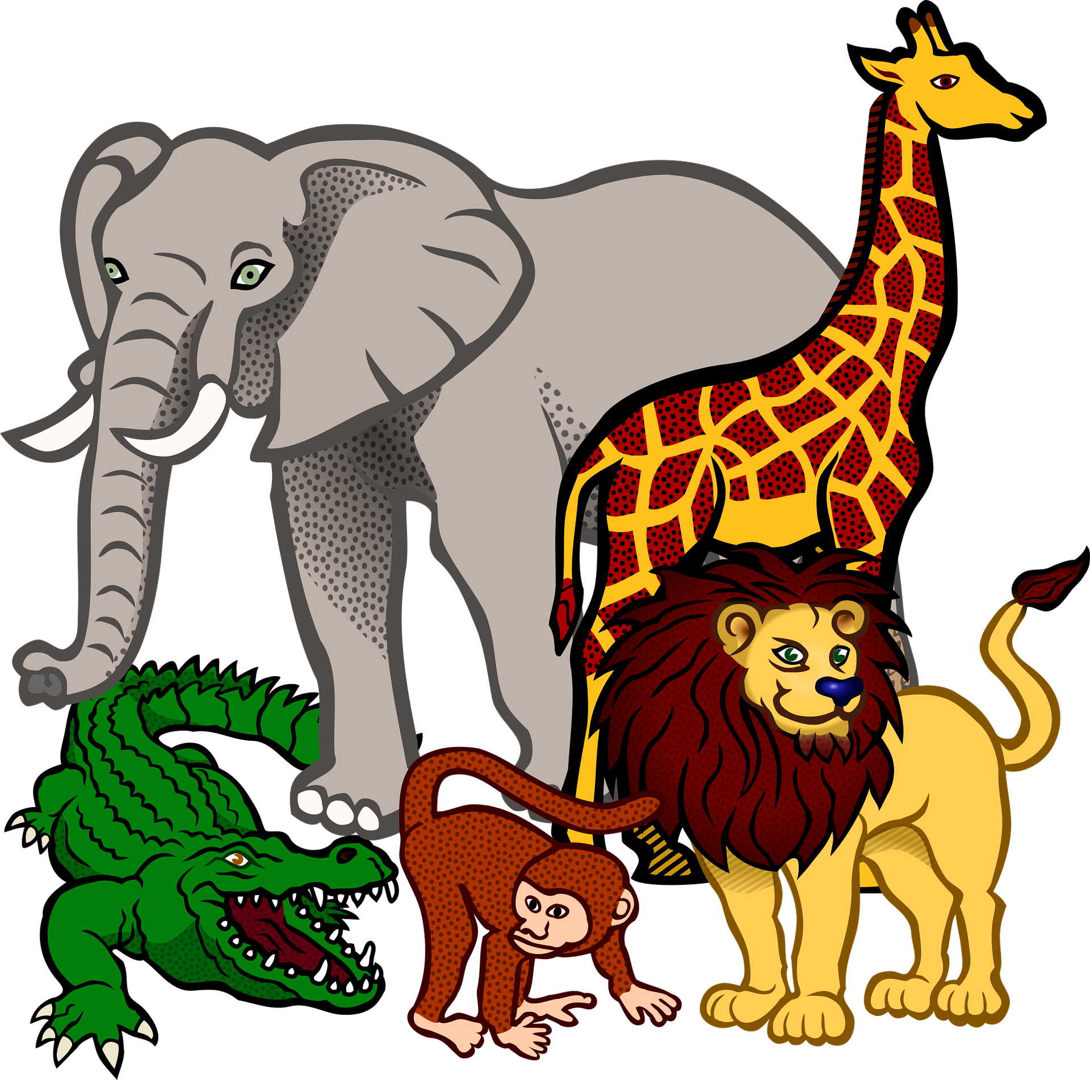
Describing things and people
rouge
Il / elle meaning ‘it’
adjective agreement
soft ç|c
Notes:
Artwork by Steve Clarke. Pronoun pictures from NCELP (www.ncelp.org). All additional pictures selected from Pixabay and are
available under a Creative Commons license, no attribution required.
The AUDIO version of the lesson material includes additional audio for the new language presented (phonics, vocabulary) and audio for the instructions
on the slide.
In addition, it includes VIDEO clips of the phonics and the phonics’ source words. Pupils can be encouraged to look at the shape of the mouth/lips on
slides where these appear, and try to copy it/them.
Phonics: revisit [SFe] professeur, professeure [110] sympathique [4164] comment [234]
Vocabulary (new words in bold): différent [350] lent [2572] vert [1060] très [66]
Revisit 1: chose [125] des [2] combien [800]
Revisit 2: donner [46] préparer [368] trouver [83] famille [172] frère [1043] mère [645] père [559] sœur [1558] le [1] la [1] à (meaning ‘to’) [4]
Londsale, D., & Le Bras, Y. (2009). A Frequency Dictionary of French: Core vocabulary for learners London: Routledge.
The frequency rankings for words that occur in this PowerPoint which have been previously introduced in these resources are given in the SOW and in the resources that first introduced and formally re-visited those words. For any other words that occur incidentally in this PowerPoint, frequency rankings will be provided in the notes field wherever possible.
1

Slide 2
[ien]
prononcer
good, well
bien
Notes:
Timing: 1 minute
Aim: to introduce SSC [ien]
Procedure: 1. Present the letter(s) and say the [ien] sound first, on its own. Students repeat it with you. 2. Bring up the word ”bien” on its own, say it, students repeat it, so that they have the opportunity to focus all of their attention on the connection between the written word and its sound.
3. A possible gesture for this would be to give a thumbs up sign. 4. Roll back the animations and work through 1-3 again, but this time, dropping your voice completely to listen carefully to the students saying the [ien] sound, pronouncing ”bien” and, if using, doing the gesture.
Word frequency (1 is the most frequent word in French):
bien [47]
Source: Londsale, D., & Le Bras, Y. (2009). A Frequency Dictionary of French: Core vocabulary for learners London: Routledge.
2

Slide 3
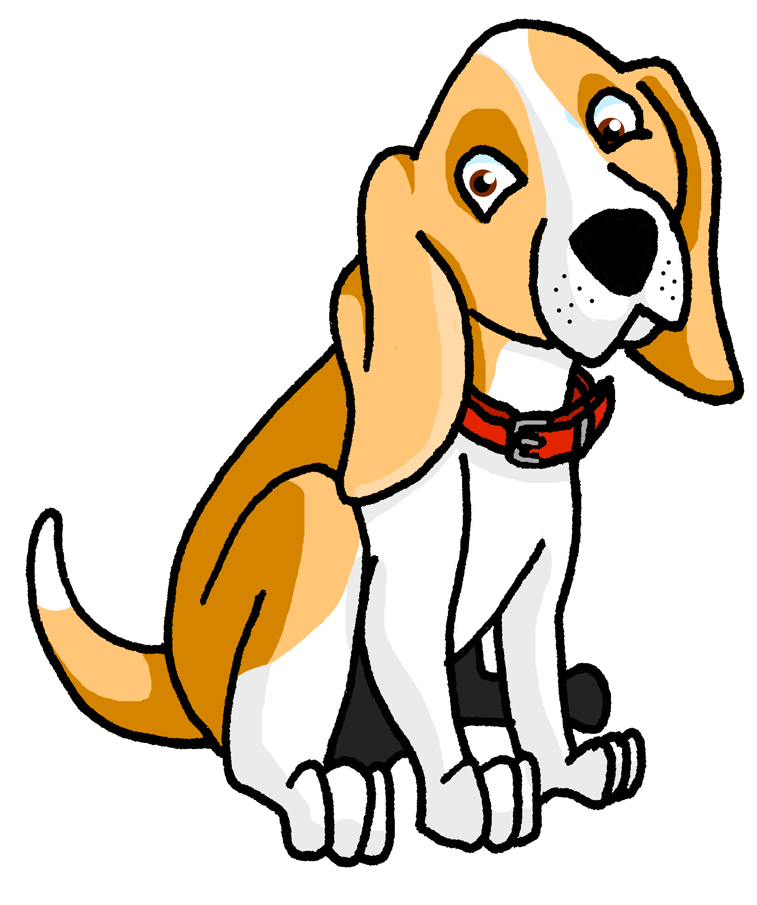
[ien]
prononcer
chien
ancien
bien
€ ?
bientôt
combien
Notes:
Timing: 2 minutes
Aim: to consolidate SSC [ien]
Procedure:
1. Introduce and elicit the pronunciation of the individual SSC [ien] and then the source word again ‘bien’ (with gesture, if using). 2. Then present and elicit the pronunciation of the five cluster words.
The cluster words have been chosen for their high-frequency, from a range of word classes, with the SSC (where possible) positioned within a variety of syllables within the words (e.g. initial, 2nd, final etc.). Additionally, we have tried to use words that build cumulatively Word frequency (1 is the most frequent word in French): ancien [392] bien [47] bientôt [1208] chien [1744] combien? [800] Source: Londsale, D., & Le Bras, Y. (2009). A Frequency Dictionary of French: Core vocabulary for learners London: Routledge.
3

Slide 4
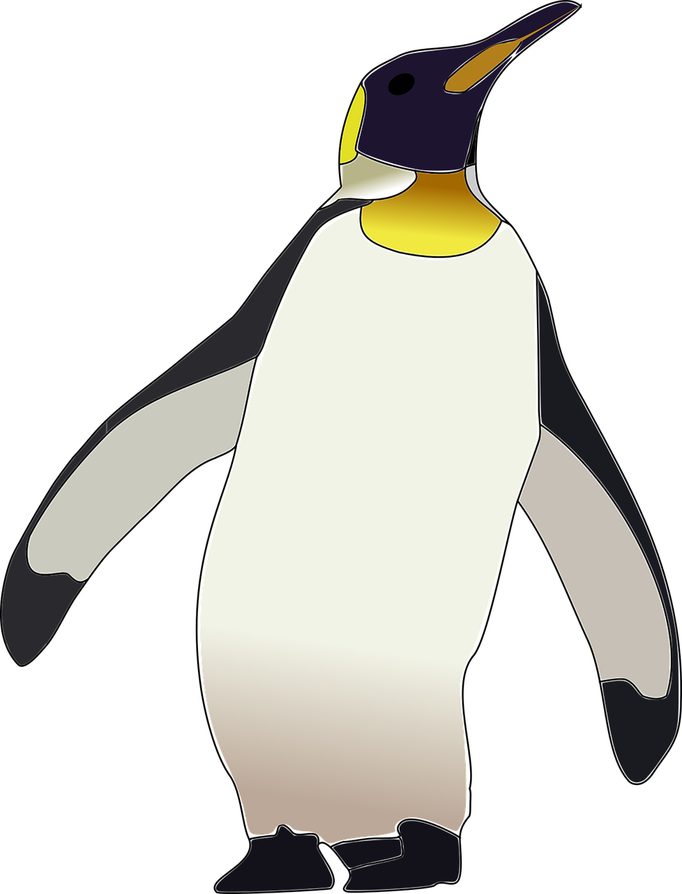
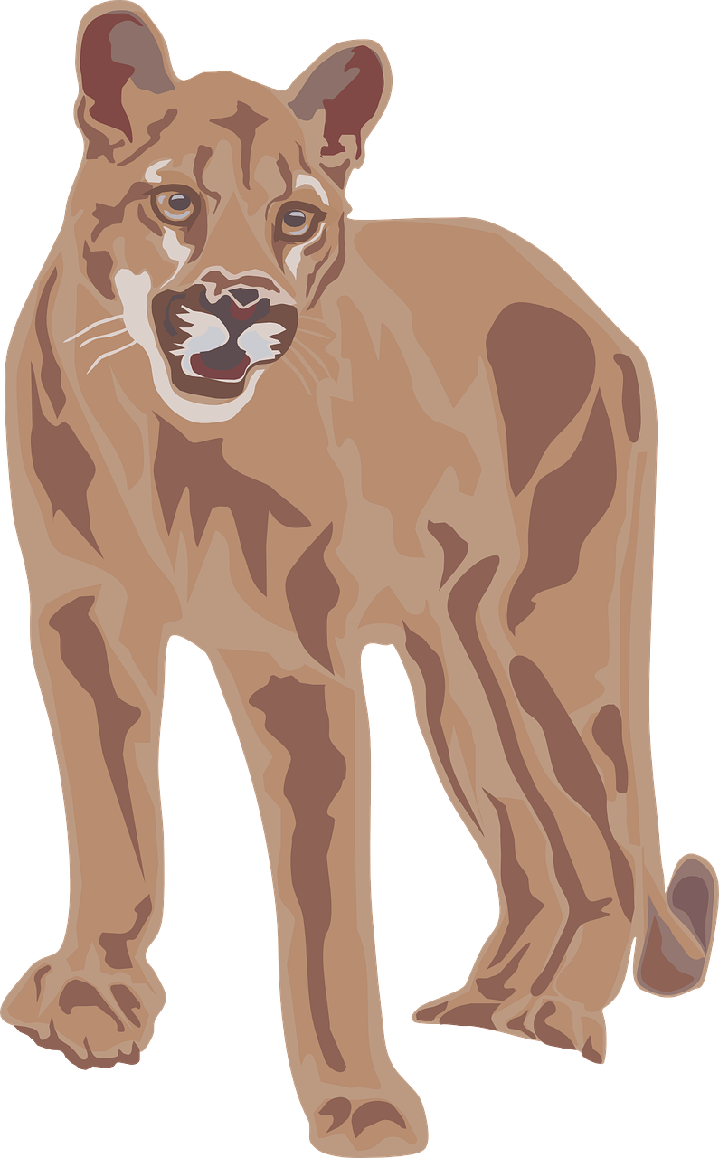
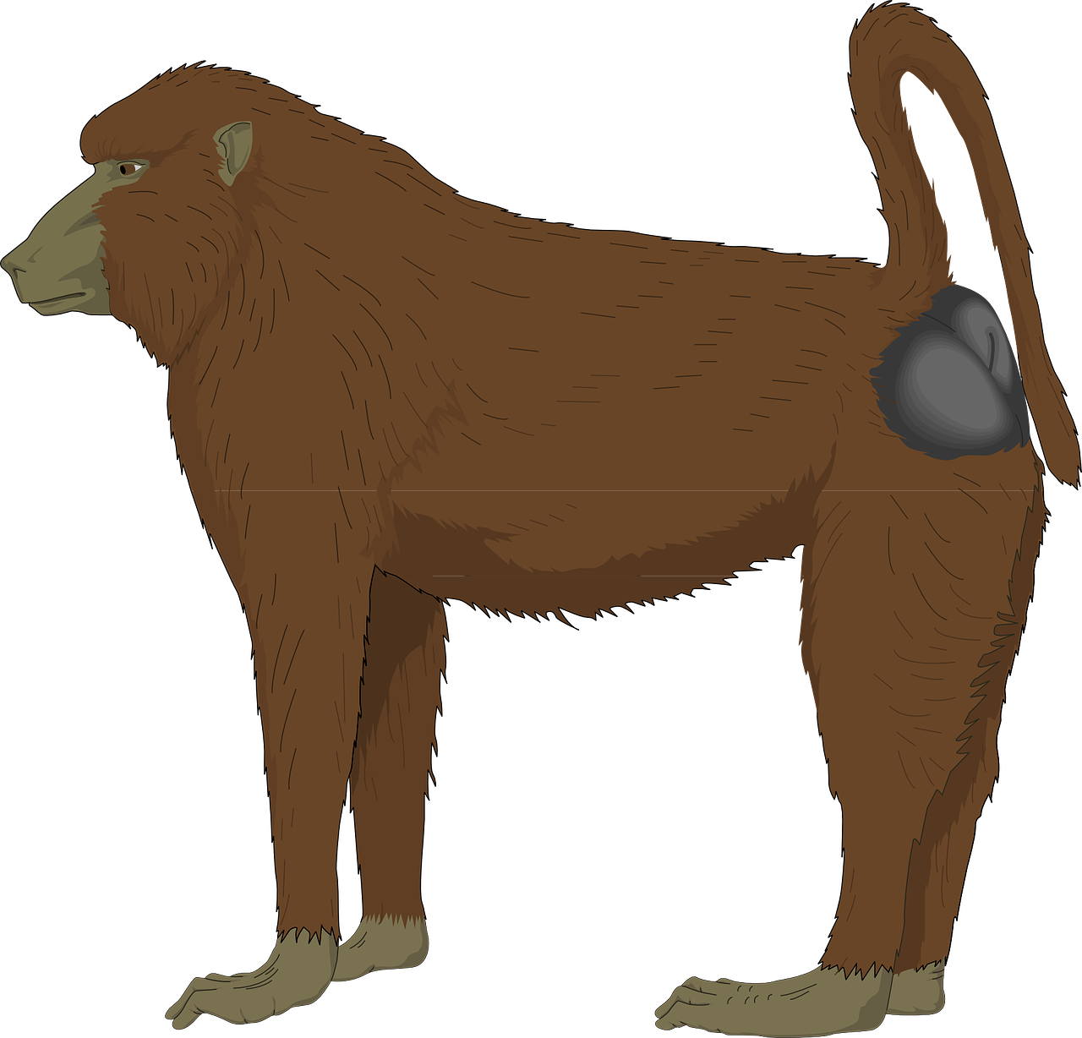
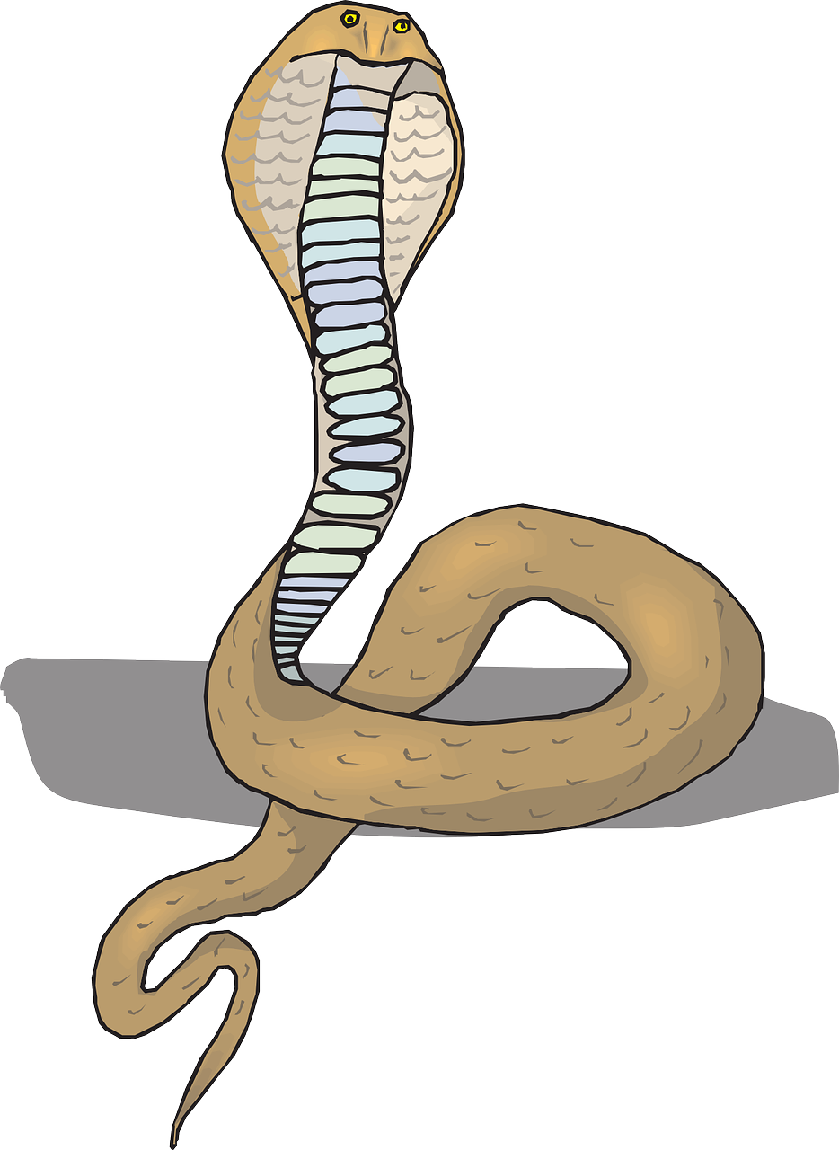
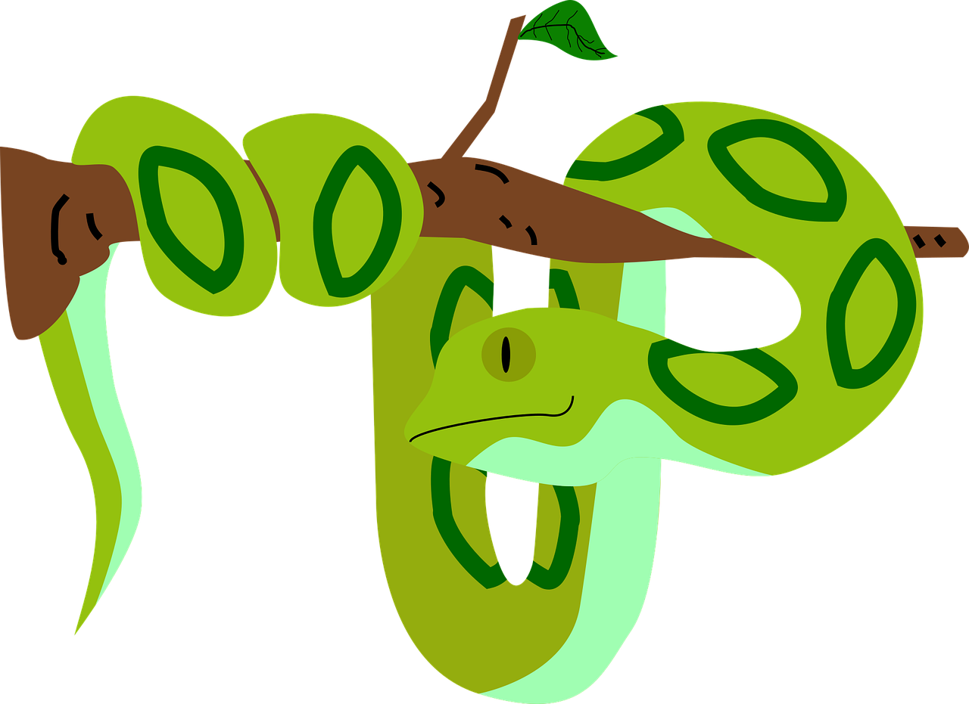
prononcer
. Écoute les noms des animaux. C’est [ien] ou [(a)in]?
Au zoo. Écoute les noms des animaux. C’est [ien] ou [(a)in]?
. Écoute les noms des animaux. C’est [ien] ou [(a)in]?
Puis, prononce les mots.
[ien] [(a)in]
[ien] [(a)in]
p i n g o u i n
f é l i n
c h i e n
r e q u i n
p y t h o n i n d i e n
d a l m a t i e n
b a b o u i n
d a u p h i n
c o b r a é g y p t i e n
s c o r p i o n l a n g u e d o c i e n
1
______
6
______
2
______
7
______
3
______
8
______
4
______
9
______
5
10
______
______
Notes:
Timing: 5 minutes
Aim: to consolidate SSC [ien] and [(a)in].
Procedure:
Pupils work in pairs. Pupil A secretly chooses 5 of the 16 words.
Pupil B has 12 guesses to try to get them all. If s/he pronounces the ç as hard ‘a’ and Pupil A spots it, s/he doesn’t have to answer oui/non to that word and B loses one of the 12 guesses.
They then swap over.
Finally, click to reveal the English meanings of the words. Depending on time, first elicit what pupils think them mean. Some are clear cognates, some are inferable from the pictures, but for those that are not obvious, reveal the meanings rather than allow extended guessing.
Word frequency (1 is the most frequent word in French): pingouin [>5000] félin [>5000] requin [>5000] python [>5000] indien [1679] dalmatien [>5000] babouin [>5000] dauphin [>5000] cobra [>5000] égyptien [4167] scorpion [>5000] languedocien [>5000] Source: Londsale, D., & Le Bras, Y. (2009). A Frequency Dictionary of French: Core vocabulary for learners London: Routledge.
4

Slide 5
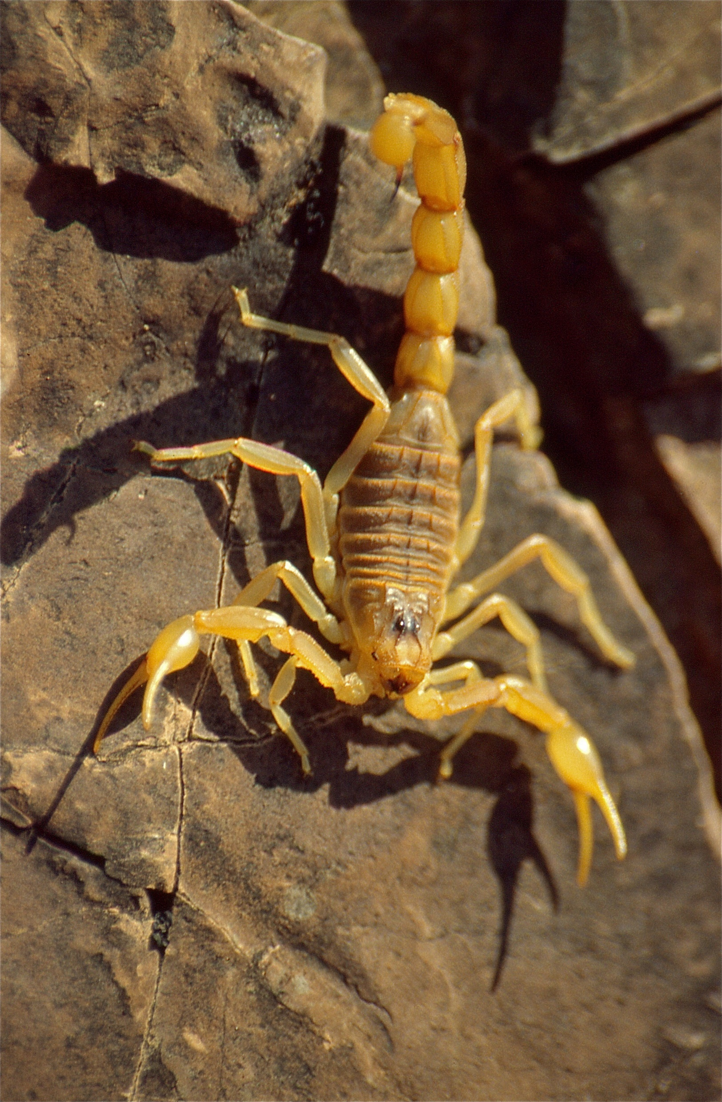
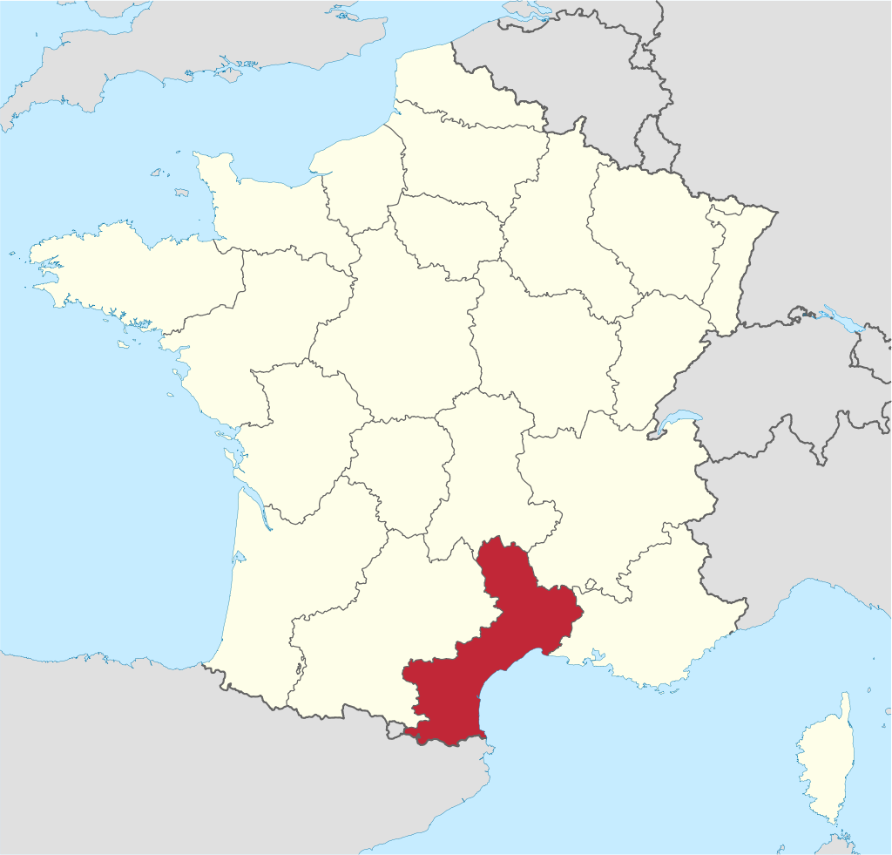
lire
Le scorpion languedocien
le scorpion languedocien est un scorpion jaune. Il se trouve dans le sud de la France et dans l’est de l'Espagne.
le Languedoc
La piqûre* du scorpion languedocien est très douloureuse* mais pas mortelle !
la piqûre – bite, sting douloureux - painful
Image: Bernard Dupont
Notes:
Timing: 2 minutes
Aim: to introduce pupils to the yellow scorpion, found in large numbers in the south of France.
Procedure:
Read the text aloud, so pupils can follow.
Ask pupils to tell you anything they can about the scorpion languedocien.
Image attribution: Bernard DUPONT from FRANCE, CC BY-SA 2.0, via Wikimedia Commons
Link to licence: https://creativecommons.org/licenses/by-nc/2.0/
5

Slide 6
vocabulaire
Vocabulaire
mots
Le mot, c’est quoi en français ?
méchant
rapide
lent
gris
préféré
différent
too
favourite
yellow
small
naughty
different
fast
grey
big, tall
perfect
difficult
slow
trop
jaune
difficile
parfait
petit
grand
Notes:
Timing: 5 minutes
Aim: to present and practise written comprehension and read aloud of previously taught words and the new vocabulary for this week.
Procedure: 1. Click for an English word. Elicit French translation from pupils.
2. Continue until the final word (trop) has been introduced. 3. Elicit choral pronunciation of all words again, clicking to provide an emphasis animation.
6

Slide 7
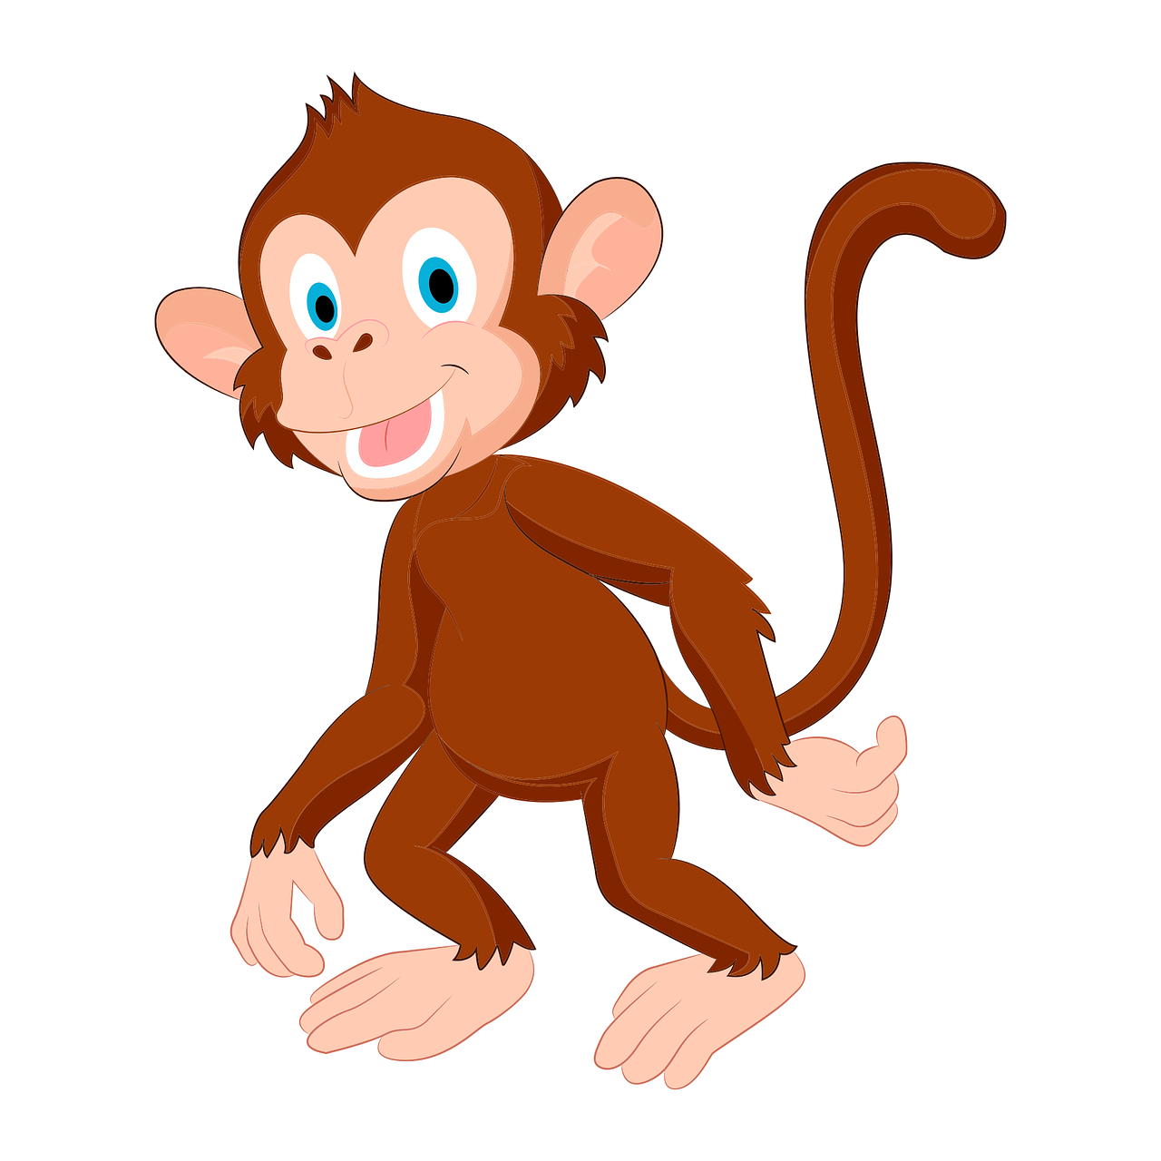
Saying ‘it’ in French [2]
In English, we refer to pets as ‘he’ or ‘she’ but we use ‘it’ for animals in general:
Look at the monkey!
It’s very naughty!
Remember that in French we use ‘il’ and ‘elle’ to mean ‘it’ as well as ‘he’ and ‘she’. So this works for all animals:
We use ‘il’ for masculine nouns and ‘elle’ for feminine nouns:
Médor est mon chien.
Il est super !
He is super!
Regarde le singe !
Il est très méchant !
It is very naughty!
Regarde la girafe !
Elle est grande !
It is tall!
Notes:
Timing: 2 minutes
Aim: to introduce the use of il / elle to mean ‘it’ with masculine / feminine nouns
Procedure:
Click through the animations to present the new knowledge orally and in writing.
Elicit the English meanings for the French examples.

Slide 8
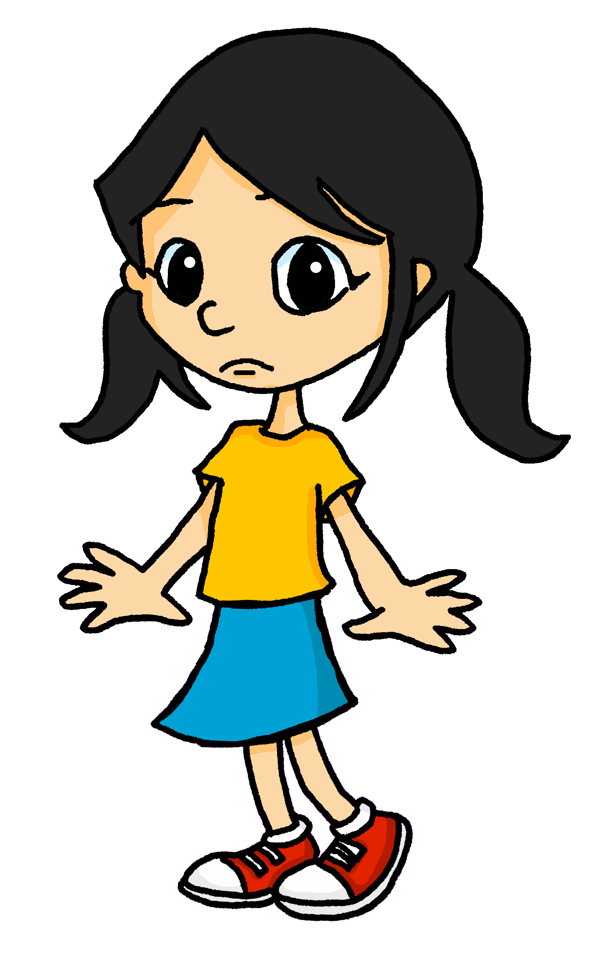
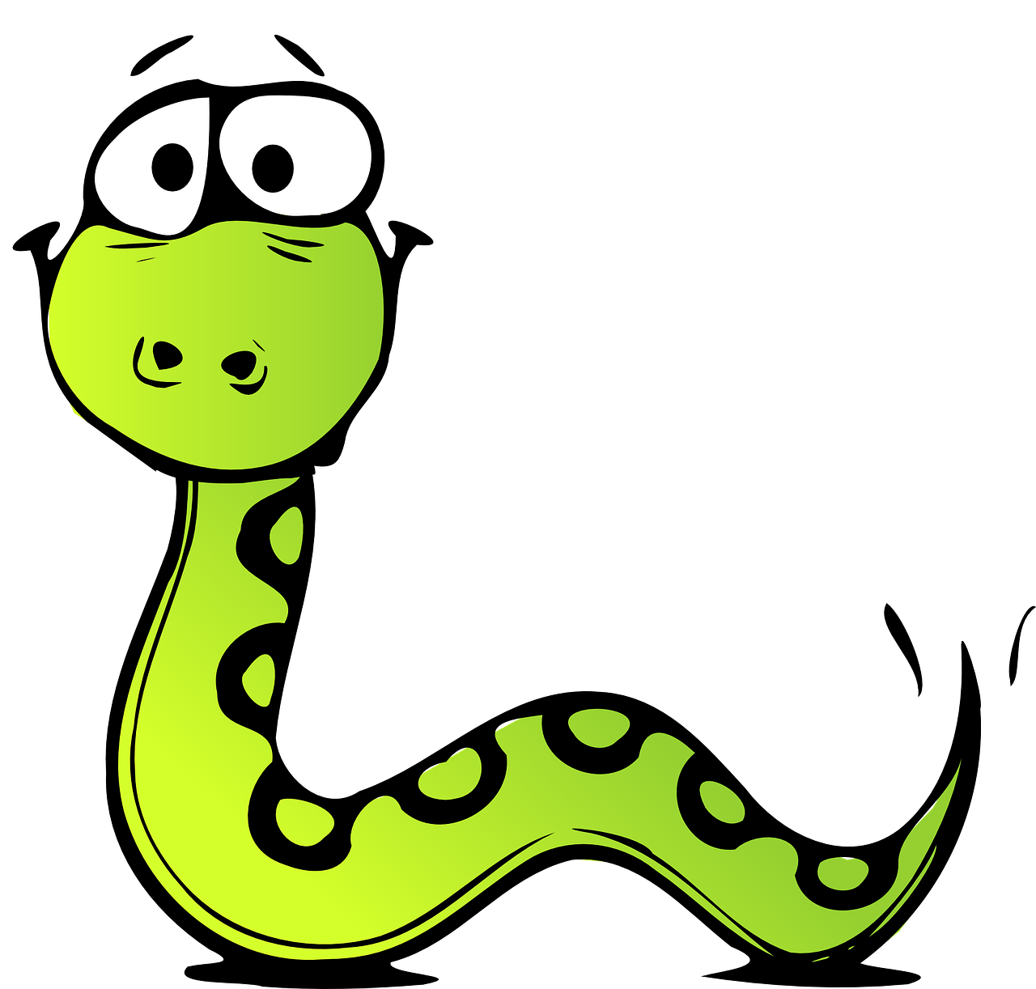
lire
Eugénie est au zoo avec sa mère. Elle envoie* des messages Whatsapp à Léa mais il y a un problème.
Lis les messages et écris les mots correspondants.
Help Léa work out what Eugénie is saying.
Salut, Léa ! Au zoo je regarde un serpent, mais il est trop méchant pour moi !
grande | méchant
Notes:
Slide 1 of 8 slides
Timing: 10 minutes
Aim: to consolidate written recognition of the connection between subject pronoun and noun gender, and adjective ending and word gender.
Procedure:
Pupils read the message and work out the missing pronoun from the gender of the noun it refers to.
Pupils then choose the corresponding adjective, according to its form (i.e. here it must be méchant because grande could only describe a feminine noun).
If desired, click on whatsapp audio icon to hear the message, or read aloud for/with pupils.
4. Teachers can elicit the English for the Whatsapp message, orally from all pupils.
8

Slide 9
lire
Je regarde une tortue, mais elle est trop lente pour moi !
lente | vert
2
Notes:
[2/8]
9

Slide 10
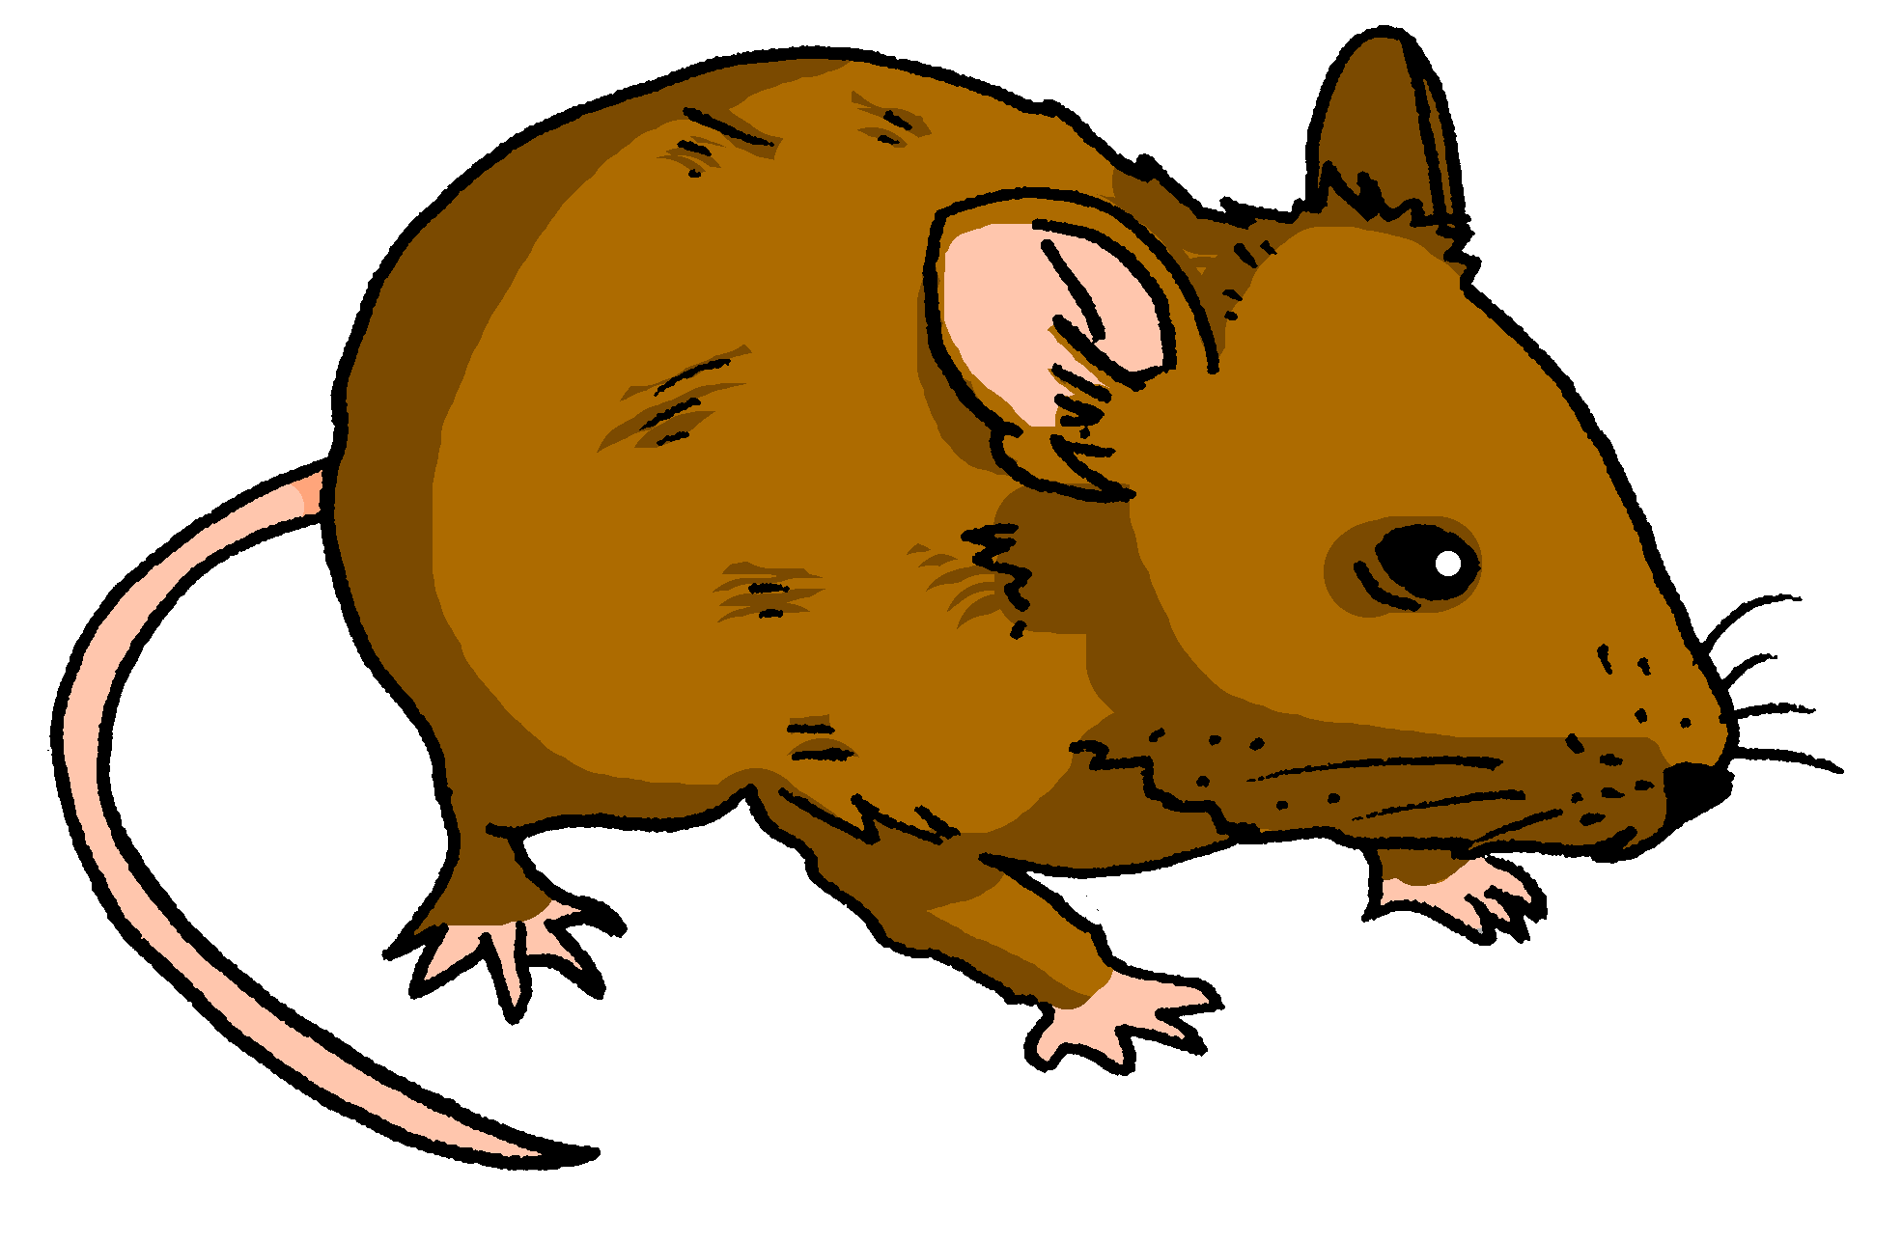
lire
Je regarde une souris, mais elle est trop petite pour moi !
gris | petite
3
Notes:
[3/8]
10

Slide 11
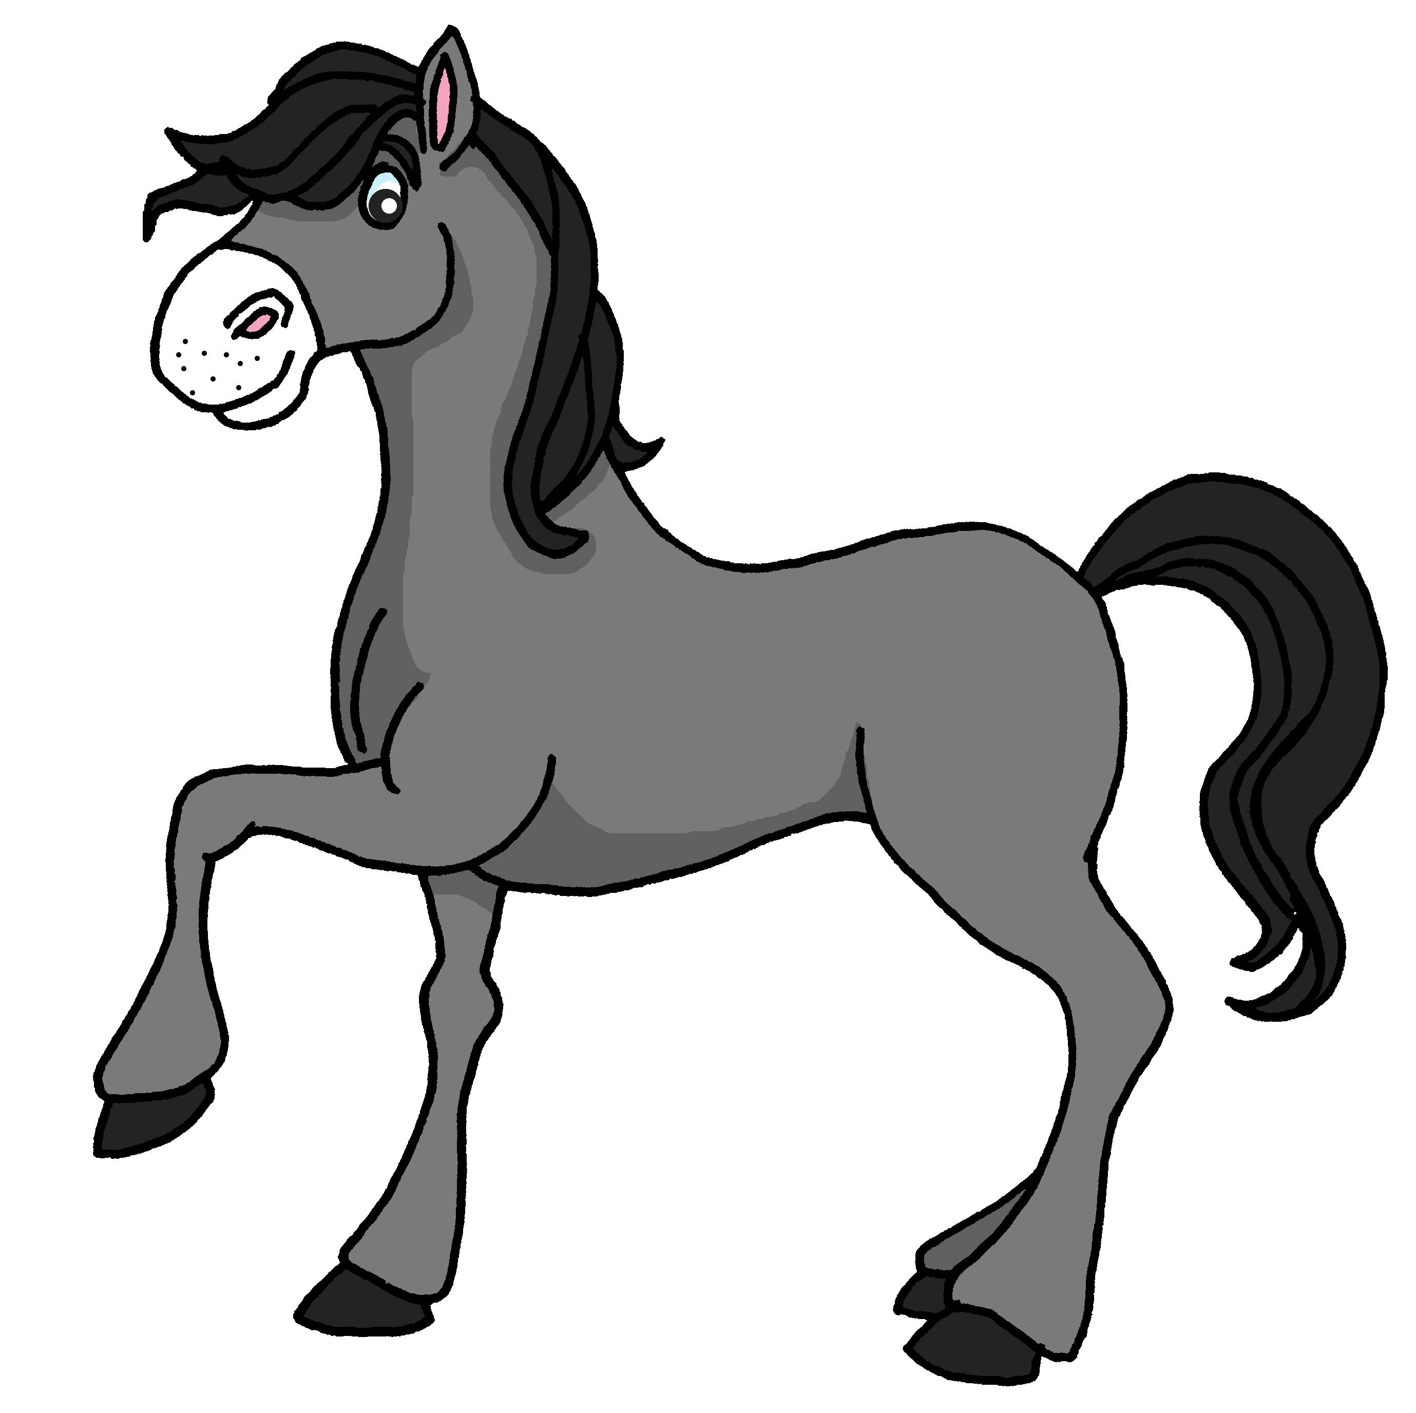
lire
Je regarde un cheval, mais il est trop grand pour moi !
chère | grand
4
Notes:
[4/8]
11

Slide 12
lire
Je regarde un éléphant, mais il est trop calme et lent pour moi !
calme | lent
5
Notes:
[5/8]
12

Slide 13
lire
Je regarde un scorpion jaune, mais il est trop difficile pour moi !
difficile | petite
6
Notes:
[6/8]
13

Slide 14
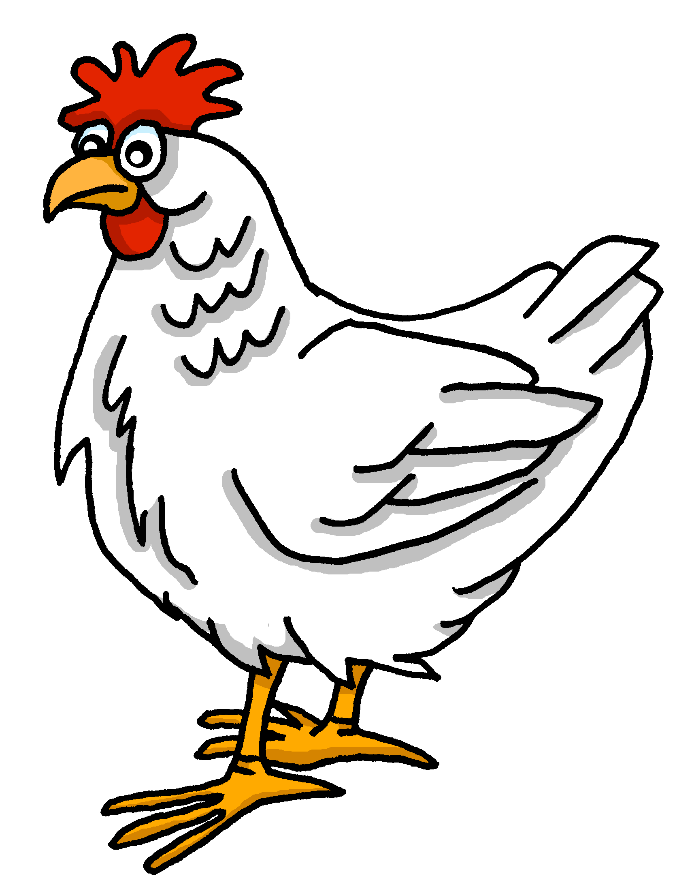
lire
Je regarde une poule, mais elle est trop curieuse pour moi !
petit | curieuse
7
Notes:
[7/8]
14

Slide 15
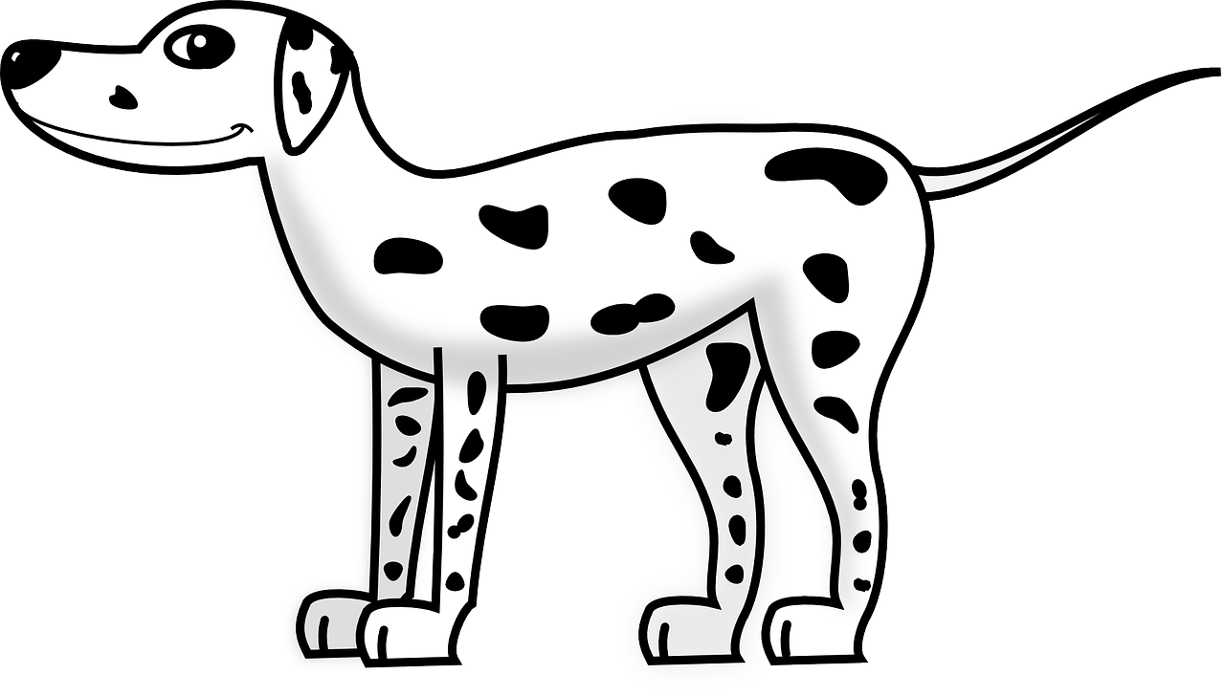
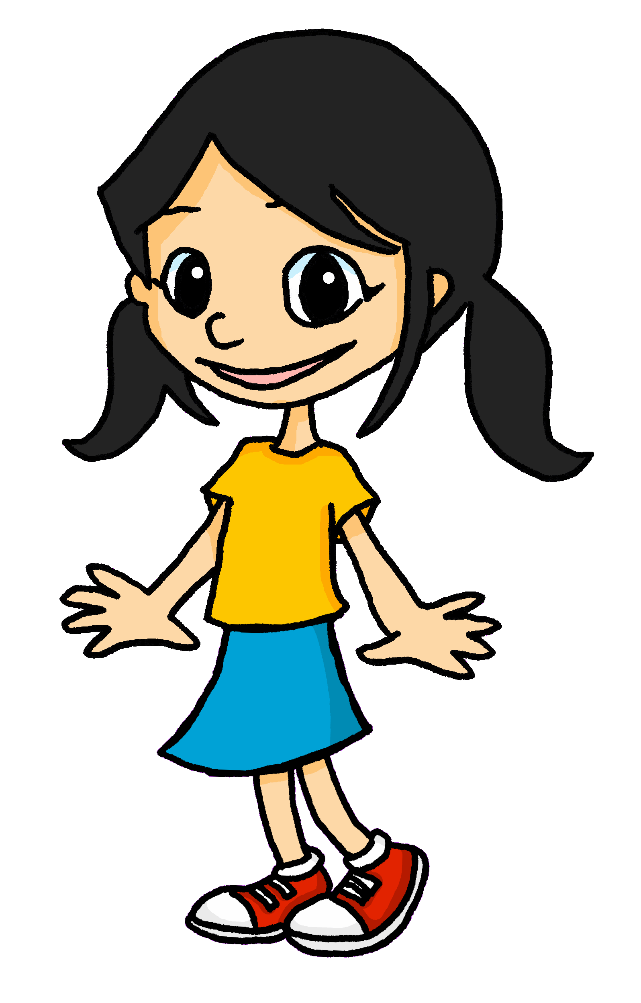
lire
Je regarde un dalmatien et il est parfait pour moi ! Mon animal préféré est le chien !
excellente | parfait
8
Notes:
[8/8]
15

Slide 16
écrire
Écris les adjectifs en français.
Le serpent est trop méchant. La tortue est trop lente. La souris est trop petite. Le cheval est trop grand. L’éléphant est trop calme et lent. Le scorpion jaune est trop difficile. La poule est trop curieuse. Le dalmatien est parfait !
[naughty]
1
Mon animal préféré est le chien.
2
[slow]
3
[small]
4
[big, tall]
5
[calm and slow]
6
[difficult]
7
[curious]
8
[perfect]
Notes:
Timing: 7 minutes
Aim: to practise written production of previously taught adjectives.
Procedure:
Remind pupils that French adjectives sometimes change their endings to match the noun (in this case, the animal) that they describe, but that adjectives already ending in ‘e’ do not change.
Pupils might work on mini whiteboards to allow teachers to check answers one by one, providing feedback after each.
If pupils need more support with the task, teachers could move the English text boxes to the right to reveal the initial 1-2 letters of each adjective.
Elicit full sentences from pupils when checking answers (this could be done chorally) and if desired, click to hear each full sentence.
Clarify the meaning of Eugénie’s speech bubble and practise the pronunciation.
If time allows, ask pupils to tell you their favourite animal.
16

Slide 17
Au revoir !
rouge
Notes:
17

