Slide 1
Describing things and people
rouge
Follow ups 1-5
Notes:
Artwork by Steve Clarke. Pronoun pictures from NCELP (www.ncelp.org). All additional pictures selected from Pixabay and are
available under a Creative Commons license, no attribution required.
The AUDIO version of the lesson material includes additional audio for the new language presented (phonics, vocabulary) and audio for the instructions
on the slide.
In addition, it includes VIDEO clips of the phonics and the phonics’ source words. Pupils can be encouraged to look at the shape of the mouth/lips on slides where these appear, and try to copy it/them.
Phonics: [SFe] [ç] (and soft -c) ici [167] français [251] garçon [1599] cinéma [1623] décider [165]
Vocabulary (new words in bold): professeur, professeure [110] sympathique [4164] comment [234]
Revisit 1: chose [125] des [2] combien [800]
Revisit 2: donner [46] préparer [368] trouver [83] famille [172] frère [1043] mère [645] père [559] sœur [1558] le [1] la [1] à (meaning ‘to’) [4]
Londsale, D., & Le Bras, Y. (2009). A Frequency Dictionary of French: Core vocabulary for learners London: Routledge.
The frequency rankings for words that occur in this PowerPoint which have been previously introduced in these resources are given in the SOW and in the resources that first introduced and formally re-visited those words. For any other words that occur incidentally in this PowerPoint, frequency rankings will be provided in the notes field wherever possible.

Slide 2
[ien]
prononcer
good, well
bien
Notes:
Timing: 1 minute
Aim: to recap SSC [ien]
Procedure: 1. Present the letter(s) and say the [ien] sound first, on its own. Students repeat it with you. 2. Bring up the word ”bien” on its own, say it, students repeat it, so that they have the opportunity to focus all of their attention on the connection between the written word and its sound.
3. A possible gesture for this would be to give a thumbs up sign. 4. Roll back the animations and work through 1-3 again, but this time, dropping your voice completely to listen carefully to the students saying the [ien] sound, pronouncing ”bien” and, if using, doing the gesture.
Word frequency (1 is the most frequent word in French):
bien [47]
Source: Londsale, D., & Le Bras, Y. (2009). A Frequency Dictionary of French: Core vocabulary for learners London: Routledge.
2

Slide 3
[ien]
prononcer
chien
ancien
bien
€ ?
bientôt
combien
Notes:
Timing: 2 minutes
Aim: to revisit SSC [ien]
Procedure:
1. Introduce and elicit the pronunciation of the individual SSC [ien] and then the source word again ‘bien’ (with gesture, if using). 2. Then present and elicit the pronunciation of the five cluster words.
The cluster words have been chosen for their high-frequency, from a range of word classes, with the SSC (where possible) positioned within a variety of syllables within the words (e.g. initial, 2nd, final etc.). Additionally, we have tried to use words that build cumulatively Word frequency (1 is the most frequent word in French): ancien [392] bien [47] bientôt [1208] chien [1744] combien? [800] Source: Londsale, D., & Le Bras, Y. (2009). A Frequency Dictionary of French: Core vocabulary for learners London: Routledge.
3

Slide 4
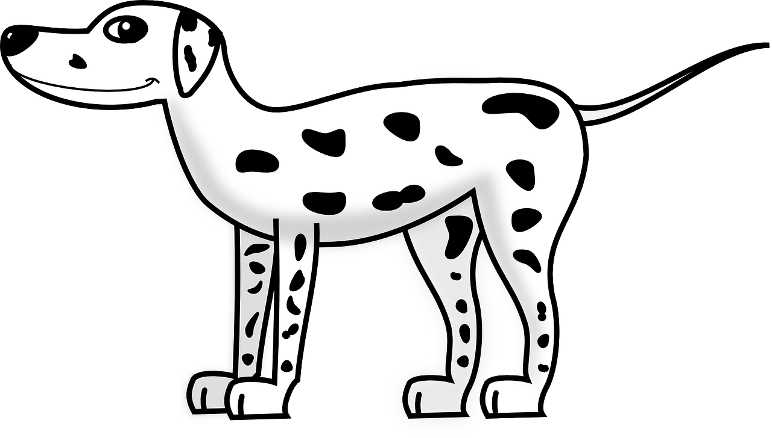
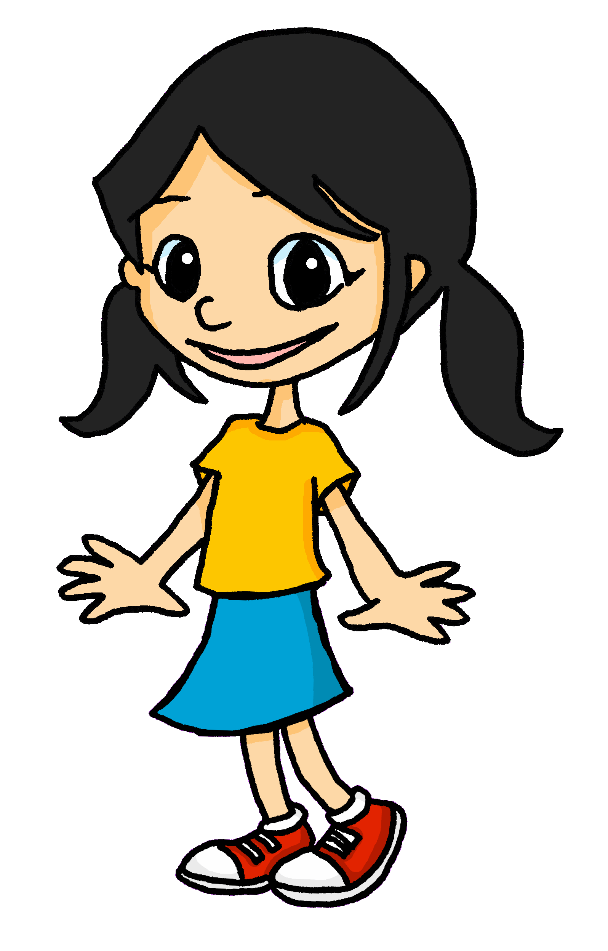
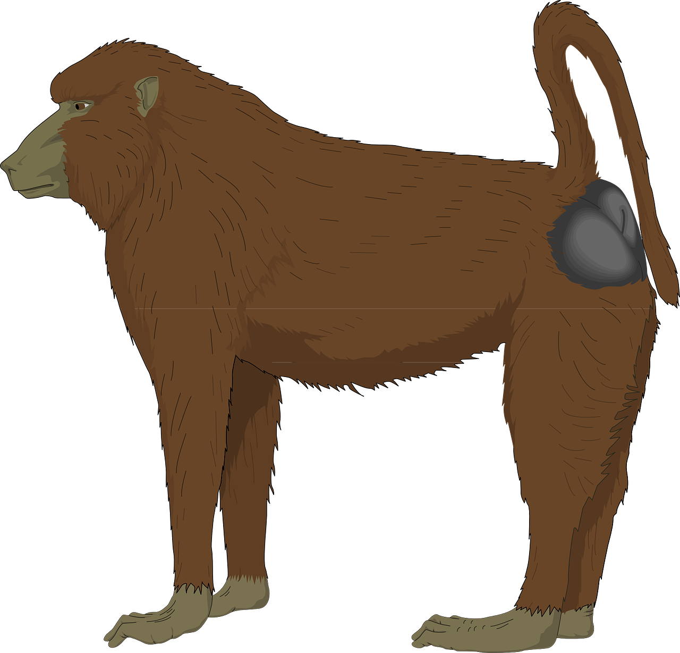
Follow up 1
Décris la visite d’Eugénie. Elle regarde quoi ?
l’être humain
prononcer
les muscardins
les dauphins
le dalmatien
l’ours canadien
le ragondin
le scorpion languedocien
le rhinocéros indien
le babouin
Notes:
Timing: 5 minutes
Aim: to practise read aloud of the SSC [ien] and [(a)in].
Procedure:
Click to move the ‘pin’ to an animal enclosure. Pupils pronounce the animal that Eugénie is visiting.
Click on the animal word to listen and check, if required.
Continue until the pin arrives with the last item - human being (the dalmatian’s owner). Pupils should recognize the verb ‘être’ as ‘being’ and ‘humain’ as cognate for ‘human’ – point out the position of the adjective (and the bear, rhino and scorpion are further examples) that in French, we say ‘what’ something is first and then ‘what is it like’.

Slide 5
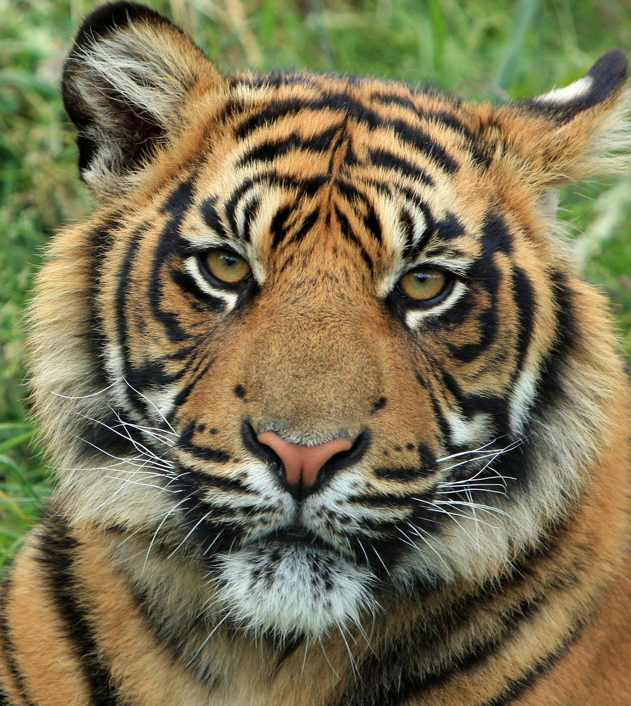
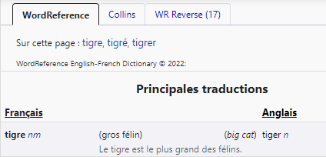
Using reference materials
[understanding symbols]
All dictionaries have symbols with useful information about the type of word, (e.g., noun, adjective) and noun gender (masculine or feminine).
www.wordreference.com
n = noun
m = masculine
f = feminine
We can’t tell by looking at the word so let’s use a dictionary to find out the gender.
This can help us find out the grammatical gender of a noun.
masculine
______ tigre [the tiger]
le
Exemple : tigre
un
______ tigre [a tiger]
Notes:
Timing: 3 minutes
Aim: to introduce pupils to reference skills – understanding codes in a dictionary in order to find out the gender of a noun. Note that the practice activities that follow in this lesson don’t require the use of dictionaries as the codes are reproduced on each slide, but this introduces pupils to the opportunity to search for new language themselves.
Procedure:
1. Teachers click to present the information on the slide.
2. Pupils can volunteer the articles.

Slide 6
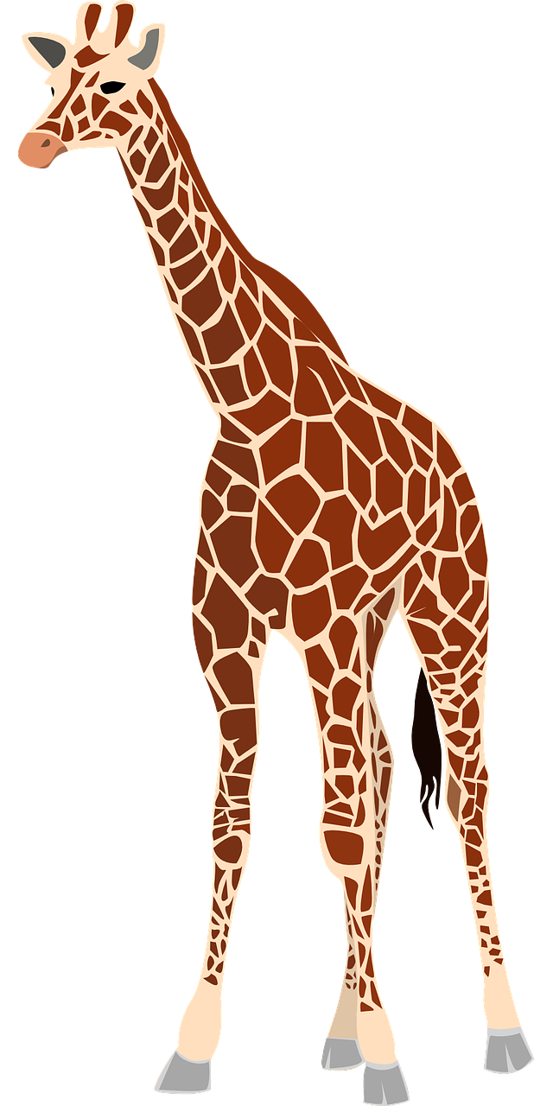
Follow up 2
Lis la description : l’article correct, c’est quoi ? [1/3]
le | la
un | une
lire
girafe (nf) = giraffe
lion (nm) = lion
rivière (nf) = river
écrire
la
[the giraffe]
____ girafe,
____ lion,
et au centre, ___ rivière.
le
[the lion]
une
[and, in the middle, a river]
Notes:
Timing: 5 minutes [3 slides]
Aim: To use gender codes in order to be able to use the correct definite and indefinite articles with unknown nouns.
Procedure:
1. Teachers read the instruction and clarify the meaning of ‘article’.
2. Teachers draw pupils’ attention to the codes for each of the nouns (giraffe, lion, rivière).
3. Pupils work in pairs to read the description aloud, selecting the correct translation for ‘the’ or ‘a/an’.
4. Teacher elicits answers from pupils.
5. Click the picture to hear the full text for the description, if desired.
6. Pupils can read aloud again (whole class) to practise SSC knowledge, time allowing.

Slide 7
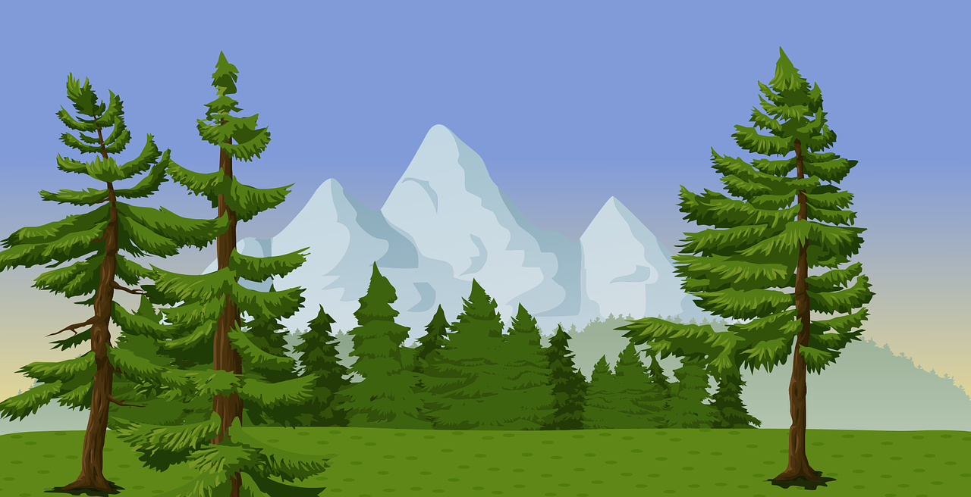
Follow up 2
Lis la description : l’article correct, c’est quoi ? [2/3]
le | la
un | une
lire
montagne (nf) = mountain
champ (nm) = field
ours (nm) = bear
écrire
la
[the mountain]
____ montagne,
____ champ,
et au centre, ___ ours.
le
[the field]
un
[and, in the middle, a bear]
Notes:
[2/3]

Slide 8
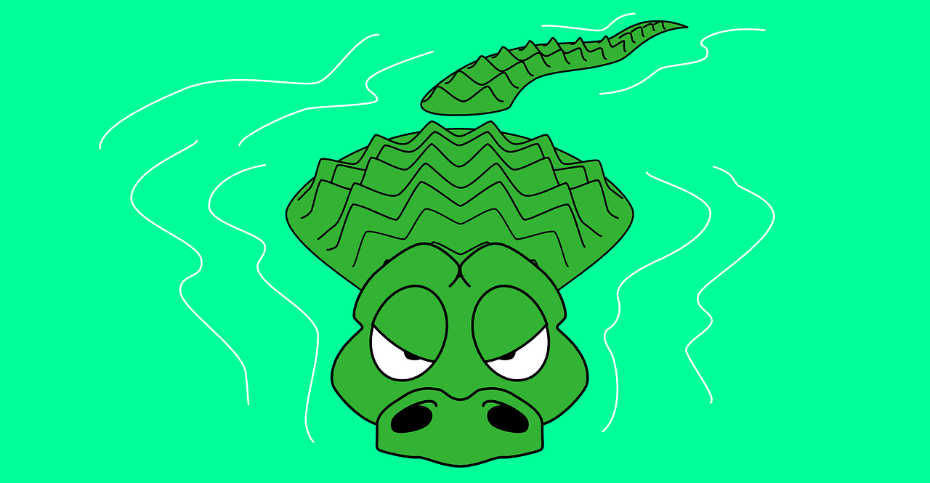
Follow up 2
Lis la description : l’article correct, c’est quoi ? [3/3]
le | la
un | une
lire
jungle (nf) = jungle
cascade (nf) = waterfall
crocodile (nm) = crocodile
écrire
la
[the jungle]
____ jungle,
____ cascade,
et au centre, ___ crocodile.
la
[the waterfall]
un
[and, in the middle, a crocodile]
Notes:
[3/3]

Slide 9
Follow up 3
*propre = own *dessiner = to draw
Écris ta propre* description. Puis, lis ta description à ton ou ta partenaire. Ton/ta partenaire dessine*.
⚠ Remember, in French say ‘what’ it is (noun) and then ‘what it is like’ (adjective)
écrire
le | la
un | une
[article] [noun] [adjective],
[article] [noun] [adjective],
et au centre, [article] [noun] [adjective]
⚠ Two exceptions: the adjectives ‘petit’ and ‘grand’ go before the noun, as in English. E.g. un petit chien.
Masculine nouns:
cheval, univers, jeu, stylo, sac, cahier, ballon, animal, chien, chat, crayon, livre, cadeau, gâteau, chapeau, uniforme, frère, père, fruit, garçon, ami, déjeuner, village, vélo, lapin, professeur
Feminine nouns:
banane, moto, bouteille, peluche, orange, photo, table, règle, gomme, maison, famille, mère, sœur, fête, fille, amie, école, ville, voiture, professeure
Adjectives:
méchant, rapide, lent, gris, différent, jaune, parfait, difficile, calme, intelligent, amusant, sérieux, curieux, triste, heureux, courageux, important, sympathique
Notes:
Timing: 5 minutes
Aim: to practise guided written production of a noun + adjective description.
Procedure:
Pupils can use the frame provided (or the descriptions used in the lessons) to write their own description, including adjectives. Note that there is an example (one of the Follow up 2 descriptions with added adjectives) on the pupil handout.
Pupils then read their description to a partner, who draws it. Alternatively, they can draw the description themselves. This would make a very nice display!
Note: if pupils have access to dictionaries of any kind they could also use these to have more autonomy about the choice of language for their description.
For less challenge, suggest that pupils follow the exact model of the descriptions from Follow up 2, without adjectives.
Note: a callout about ‘petit’ and ‘grand’ has been added here. Pupils will learn about the French adjectives that go before the noun in Y5/6, but because they might decide to use them here, I’ve flagged their different use.
dessiner [2086] propre [237]

Slide 10
Follow up 5: handout
1. Écris ta propre* description.
1. Écris ta propre* description.
Exemple :
Exemple :
La jungle verte,
La cascade rapide,
et au centre, un crocodile sympa.
La jungle verte,
La cascade rapide,
et au centre, un crocodile sympa.
[article] [noun] [adjective],
[article] [noun] [adjective],
et au centre, [article] [noun] [adjective]
[article] [noun] [adjective],
[article] [noun] [adjective],
et au centre, [article] [noun] [adjective]
2. Dessine la description.
2. Dessine la description.
Notes:
Handout

Slide 11
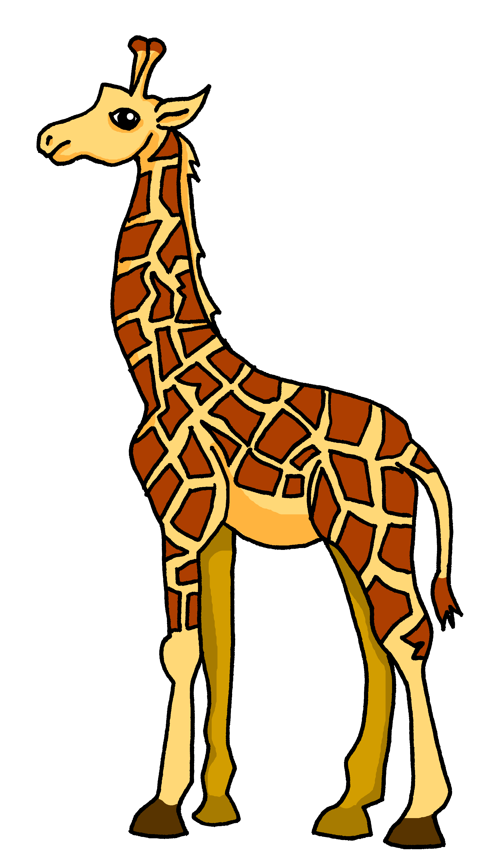
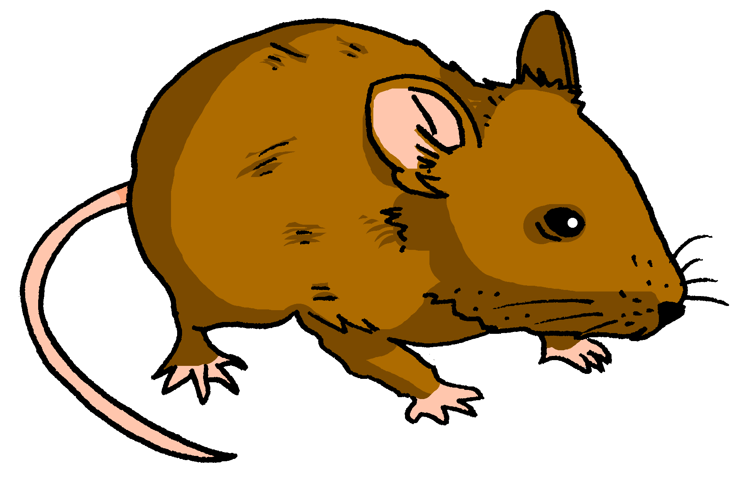
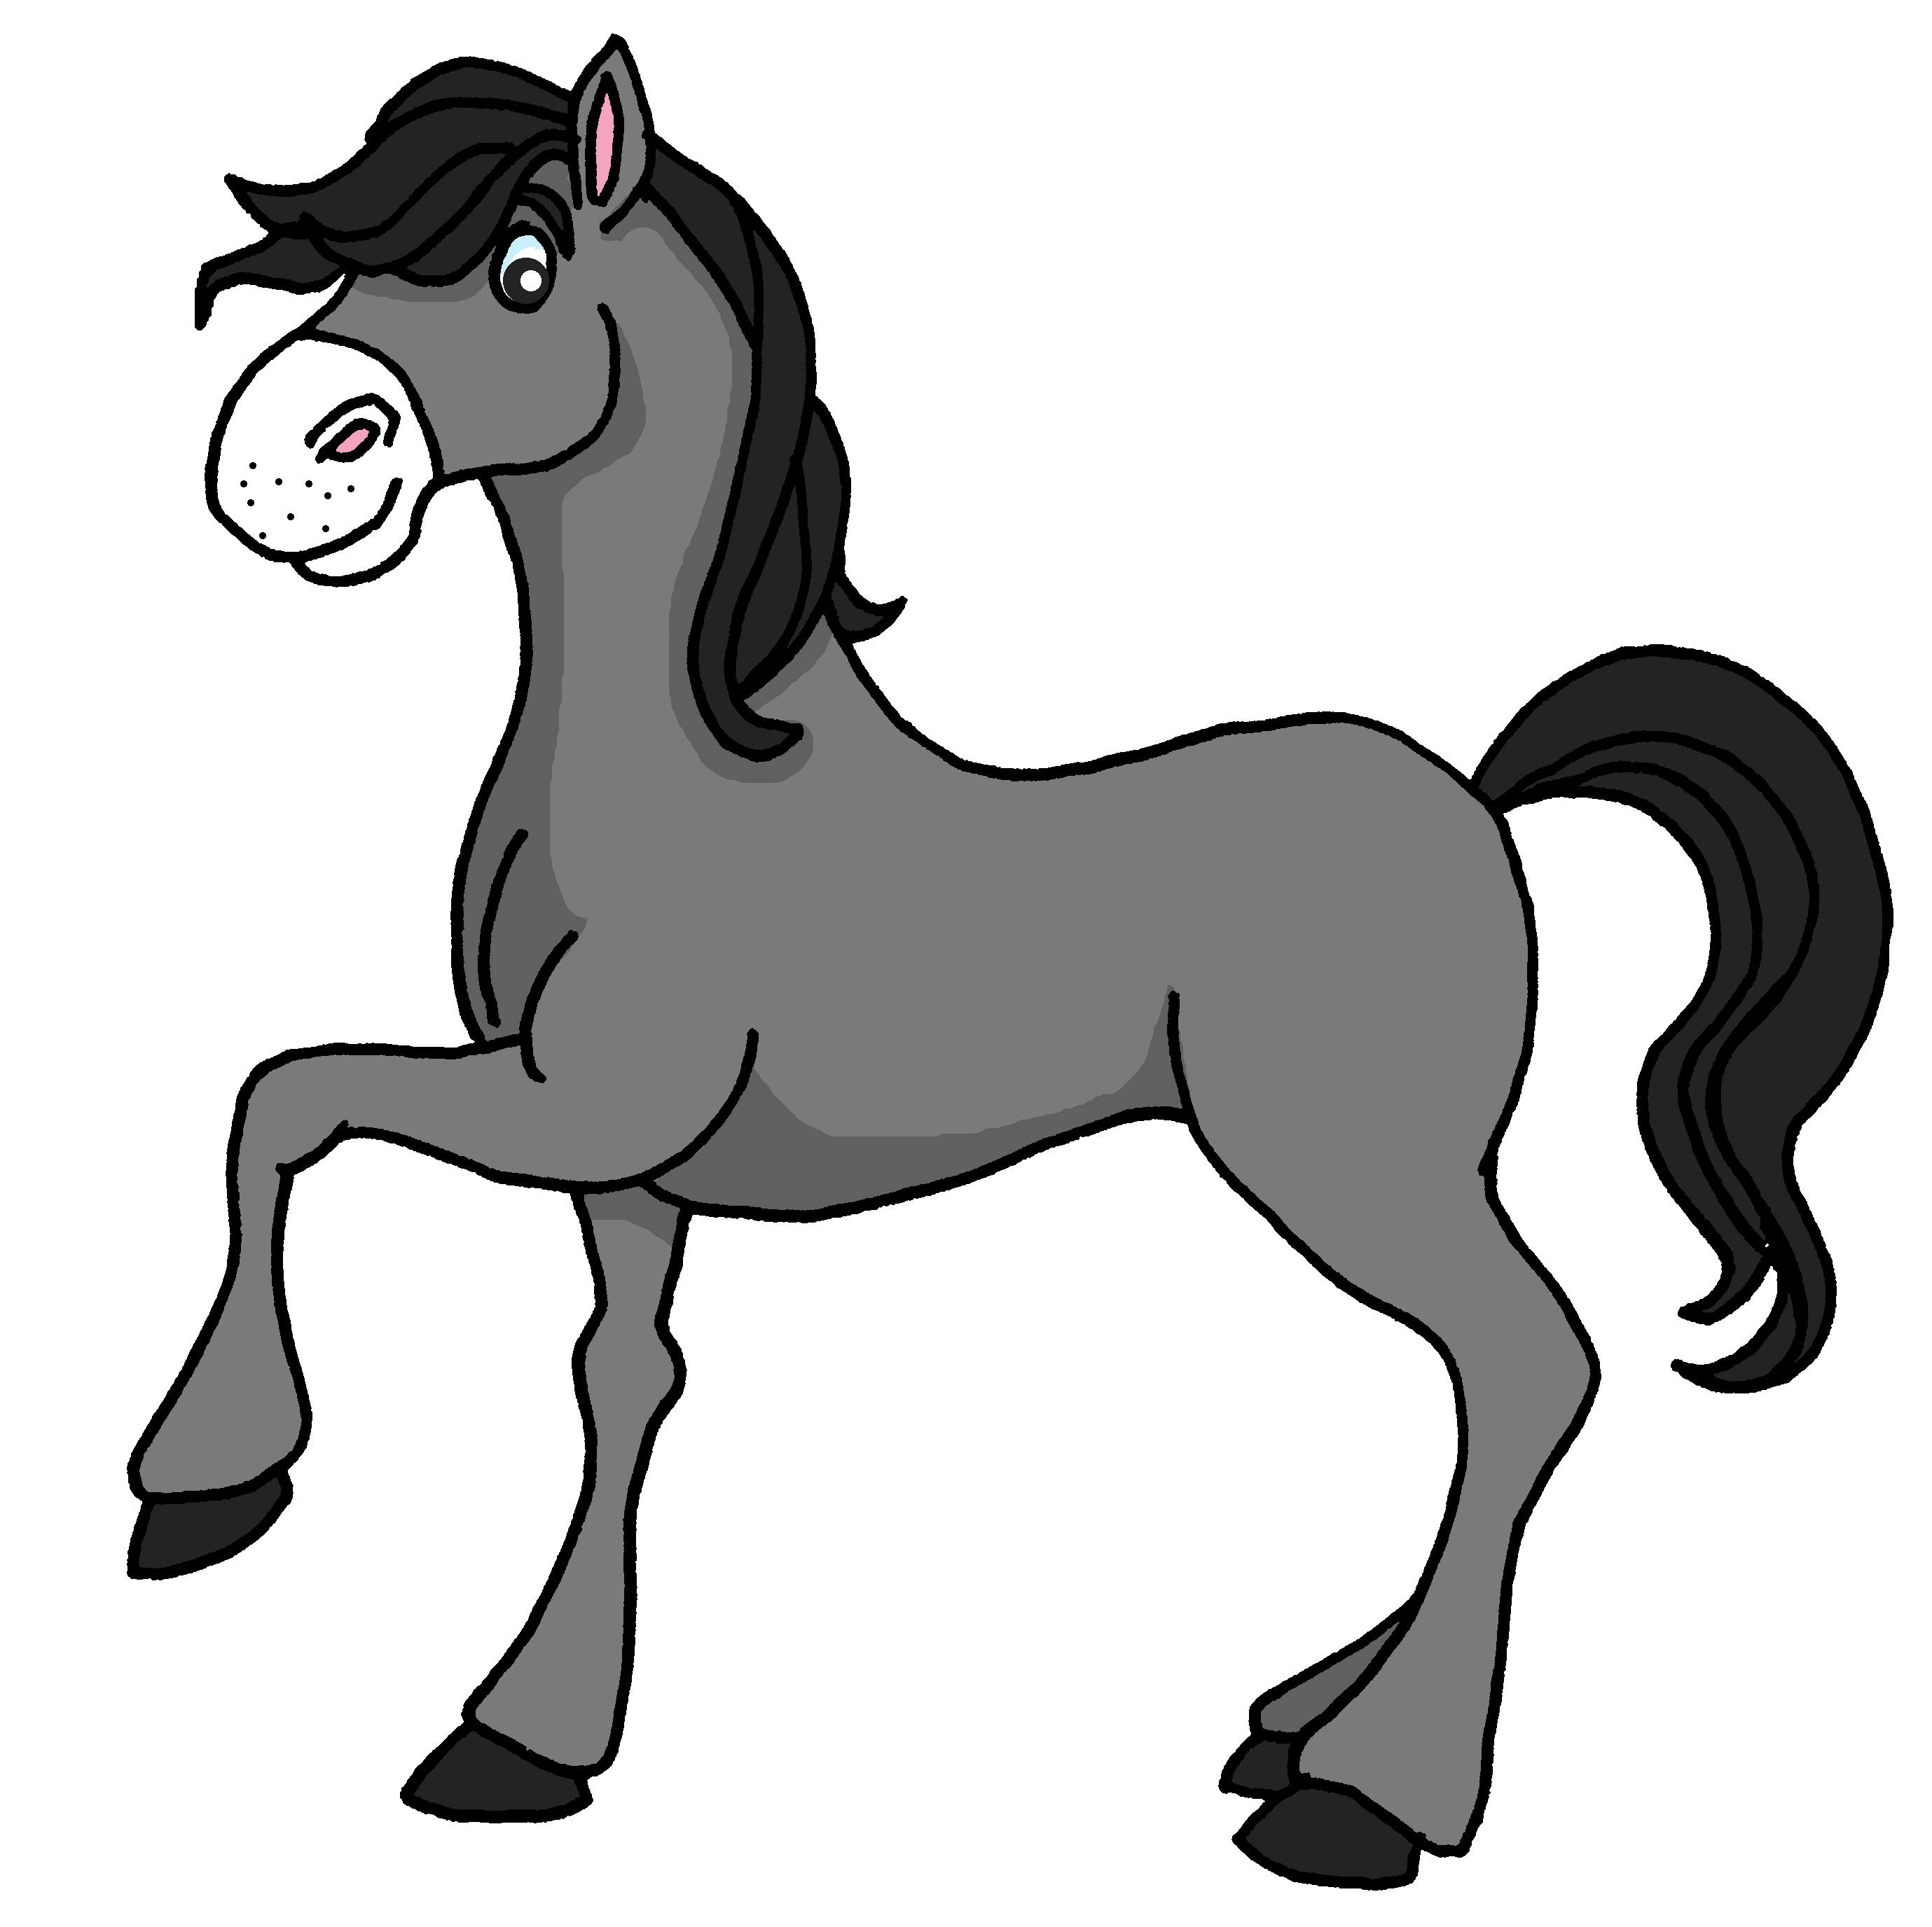
Follow up 4
Mon animal préféré, c’est le chien.
⚠ Note: in French we say ‘My favourite animal is ‘the dog, the mouse etc.’
Ton animal préféré, c’est quoi ? Parle avec ton ou ta partenaire.
parler
A
Mon animal préféré, c’est le chien.
Keep talking until you have used all 12 animals! Choose the animals in any order.
B
Mon animal préféré, c’est le chien et le cheval.
A
Mon animal préféré, c’est le chien, le cheval et la souris.
chat (m)
chien (m)
tigre (m)
dauphin (m)
girafe (f)
ours (m)
éléphant (m)
souris (f)
requin (m)
tortue (f)
cheval (f)
lion (m)
Notes:
Timing: 5 minutes
Aim: to practise spoken production of le/la and its connection with masculine/feminine nouns; to practise read aloud of mainly unknown nouns; to practise saying what your favourite animal is using the new adjective ‘préféré’.
Procedure:
Model the task with pupils, using the sequence provided.
Pupils keep talking until they have used all the animals.
Provide support as needed for the class or individuals.
If needed, the pronunciation of each animal and its articles can be heard by click on the animal image.

Slide 12
vocabulaire
Follow up 5a - Écris en anglais : Can you get at least 15 points?
mots
 | le fruit | le garçon | petit
 | grand | la fille | de
 | rapide | la voiture | gris
 | cher | la fête | le vélo
elle | elle | difficile | préféré
 | trop | il | jaune
(the) fruit
(the) boy
small, short
x3
big, tall
(the) girl
from, of
fast (m, f)
(the) car
grey (m, f)
x2
expensive (m)
party, celebration
(the) bike
she, it (f)
difficult (m, f)
favourite (m)
x1
too
he, it (m)
yellow (m, f)
Notes:
Timing: 5-10 minutes
Aim: to practise written comprehension of vocabulary from this week and previous weeks.
Procedure: Give pupils a blank grid. They fill in the English meanings of any of the words they know, trying to reach 15 points in total.
Note: The most recently learnt and practised words are pink, words from the previous week are green and those from earlier are blue, thus more points are awarded for them, to recognise that memories fade and more effort (heavy lifting!) is needed to retrieve them.
12

Slide 13
Follow up 5b
Écris en français.
mots
 | small, short | big, tall | from, of
 | (the) girl | (the) fruit | (the) boy
 | grey (m) | fast (m, f) | party, celebration
 | (the) bike | (the) car | expensive (m)
 | too | he, it (m) | she, it (f)
 | difficult (m, f) | yellow (m, f) | favourite (m)
vocabulaire
petit
grand
de
x3
la fille
le fruit
le garçon
gris
rapide
la fête
x2
le vélo
la voiture
cher
trop
il
elle
x1
difficile
jaune
préféré
Notes:
Timing: 5-10 minutes
Aim: to practise written comprehension of vocabulary from this week and previous weeks.
Procedure: Give pupils a blank grid. They fill in the French meanings of any of the words they know, trying to reach 15 points in total.
Note: The most recently learnt and practised words are pink, words from the previous week are green and those from earlier are blue, thus more points are awarded for them, to recognise that memories fade and more effort (heavy lifting!) is needed to retrieve them.

Slide 14
vocabulaire
Écris en anglais : Can you get at least 15 points?
mots
 | le fruit | le garçon | petit
 | grand | la fille | de
 | rapide | la voiture | gris
 | cher | la fête | le vélo
elle | elle | difficile | préféré
 | trop | il | jaune
x3
x2
x1
Notes:
HANDOUT 5a
14

Slide 15
vocabulaire
Écris en français : Can you get at least 15 points?
mots
 | small, short | big, tall | from, of
 | (the) girl | (the) fruit | (the) boy
 | grey (m) | fast (m, f) | party, celebration
 | (the) bike | (the) car | expensive (m)
 | too | he, it (m) | she, it (f)
 | difficult (m, f) | yellow (m, f) | favourite (m)
x3
x2
x1
Notes:
HANDOUT 5b
15

