Slide 1
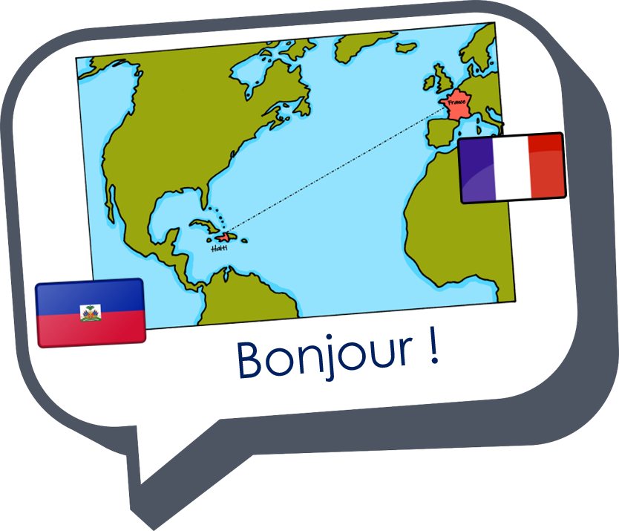
Describing things and people
rouge
Follow ups 1-5
Notes:
Artwork by Steve Clarke. Pronoun pictures from NCELP (www.ncelp.org). All additional pictures selected from Pixabay and are
available under a Creative Commons license, no attribution required.
The AUDIO version of the lesson material includes additional audio for the new language presented (phonics, vocabulary) and audio for the instructions
on the slide.
In addition, it includes VIDEO clips of the phonics and the phonics’ source words. Pupils can be encouraged to look at the shape of the mouth/lips on slides where these appear, and try to copy it/them.
Phonics: [SFe] [ç] (and soft -c) ici [167] français [251] garçon [1599] cinéma [1623] décider [165]
Vocabulary (new words in bold): professeur, professeure [110] sympathique [4164] comment [234]
Revisit 1: chose [125] des [2] combien [800]
Revisit 2: donner [46] préparer [368] trouver [83] famille [172] frère [1043] mère [645] père [559] sœur [1558] le [1] la [1] à (meaning ‘to’) [4]
Londsale, D., & Le Bras, Y. (2009). A Frequency Dictionary of French: Core vocabulary for learners London: Routledge.
The frequency rankings for words that occur in this PowerPoint which have been previously introduced in these resources are given in the SOW and in the resources that first introduced and formally re-visited those words. For any other words that occur incidentally in this PowerPoint, frequency rankings will be provided in the notes field wherever possible.

Slide 2
[ç/c] soft ‘c’
prononcer
[here]
ici
Notes:
Timing: 1 minute
Aim: To introduce SSC [ç/c]
Procedure: 1. Present the letter(s) and say the [ç/c] sound first, on its own. Pupils repeat it with you. 2. Bring up the word ”ici” on its own, say it, pupils repeat it, so that they have the opportunity to focus all of their attention on the connection between the written word and its sound.
3. A possible gesture for this would be to point to the spot on which one is standing / indicate the room in which the lesson is taking place with a sweeping motion of one’s index finger. 4. Roll back the animations and work through 1-3 again, but this time, dropping your voice completely to listen carefully to the pupils saying the [ç/c] sound, pronouncing ”ici” and, if using, doing the gesture.
2

Slide 3
[ç/c] soft ‘c’
prononcer
cinéma
décider
[here]
français
garçon
ici
Notes:
Timing: 2 minutes
Aim: to consolidate SSC [ç/c]
Procedure:
1. Introduce and elicit the pronunciation of the individual SSC [ç/c] and then the source word again ‘ici’ (with gesture, if using). 2. Then present and elicit the pronunciation of the five cluster words.
The cluster words have been chosen for their high-frequency, from a range of word classes, with the SSC (where possible) positioned within a variety of syllables within the words (e.g. initial, 2nd, final etc.). Additionally, we have tried to use words that build cumulatively on previously taught SSCs (see the Phonics Teaching Sequence document) and do not include new SSCs. Where new SSCs are used, they are often consonants which have a similar symbol-sound correspondence in English.
Word frequency (1 is the most frequent word in French): français [251] garçon [1599] cinéma [1623] décider [165] ici [167]. Source: Londsale, D., & Le Bras, Y. (2009). A Frequency Dictionary of French: Core vocabulary for learners London: Routledge.
3

Slide 4
Follow up 1
Écoute. L’intrus, c’est quoi ?
A | B | C
prononcer
1
cinq – ça – candidat
2
leçon – cochon – maçon
3
c’est – là – ici
4
anglaise – française – cinéma
5
prononcer – décider – écrire
6
facile – école – garçon
Notes:
Timing: 5 minutes
Aim: to practise aural recognition of the soft c/ç.
Procedure:
Click on each number to hear three words.
Pupils write 1-6 and A, B or C for each item, depending which does NOT have soft c/ç. That word is the odd one out.
Click to reveal the three words with the odd one out in pink.

Slide 5
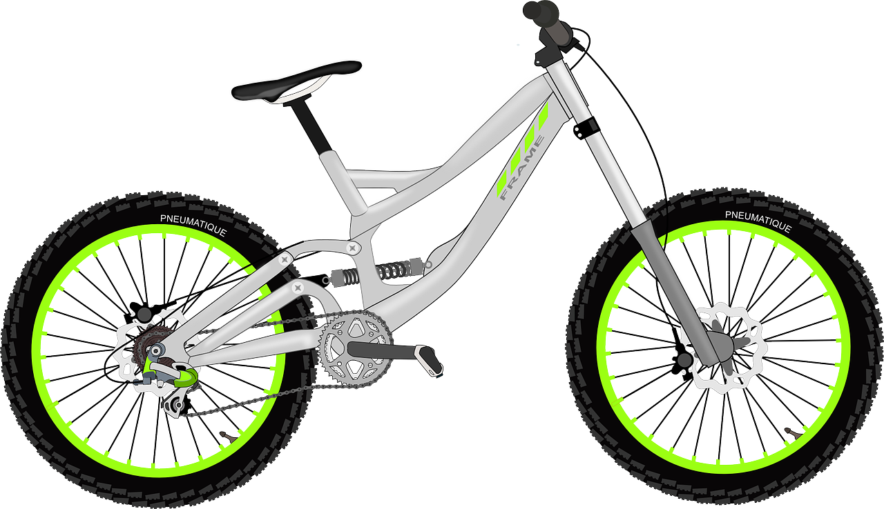
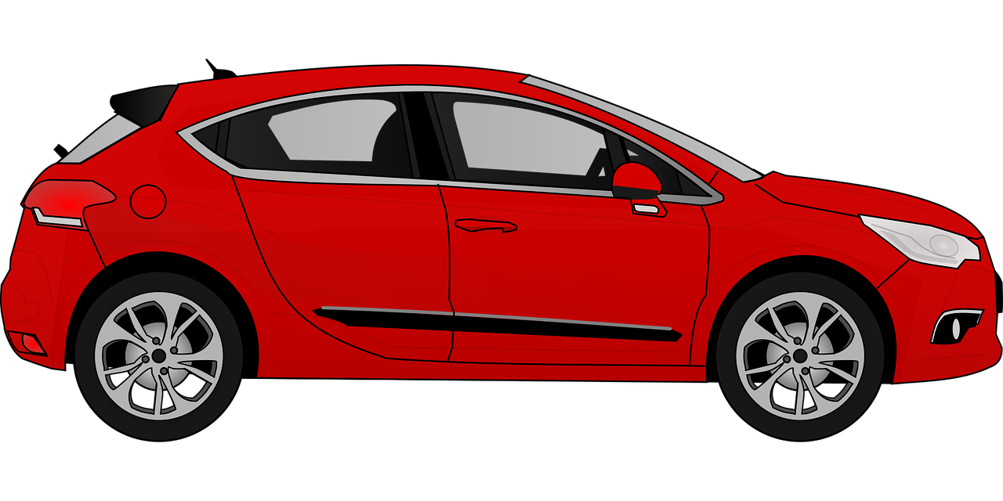
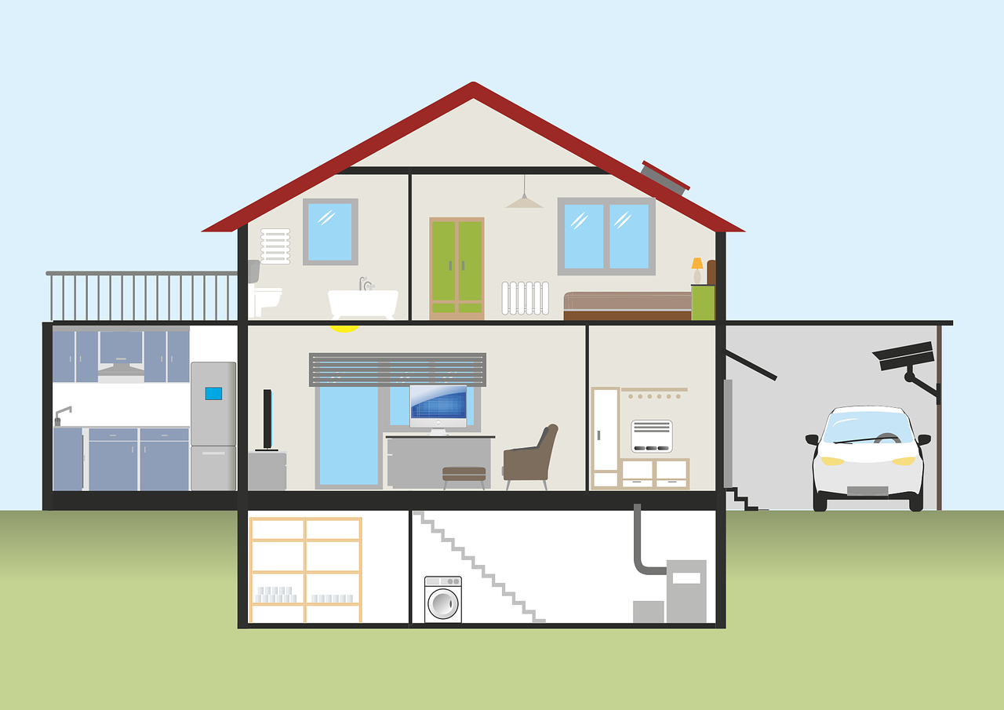
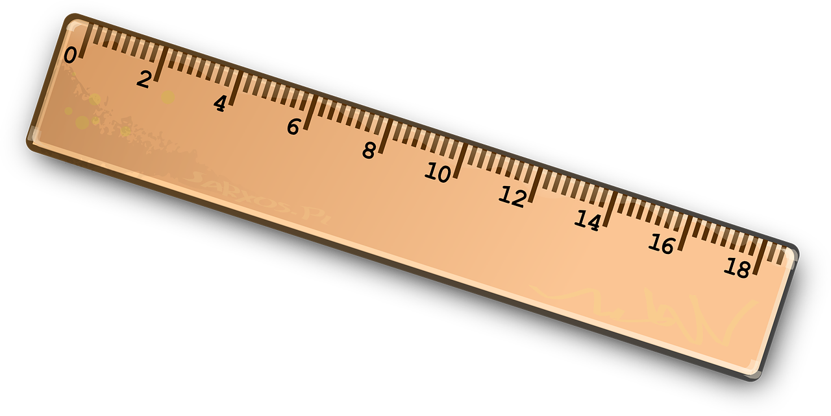
Follow up 2
It – il ou elle ?
Lis. Pierre décrit des choses. Écris A ou B.
lire
 |  | a | b
1 | Elle est rapide.
2 | Il est important.
3 | Il est facile.
 |  | a | b
4 | Elle est verte.
5 | Il est grand.
6 | Elle est grise.
Notes:
Timing: 5 minutes
Aim: written recognition of gender agreement with il / elle meaning ‘it’.
Procedure:
1. Teacher to check pupils know the gender of nouns before they do the activity. Ensure that pupils realise that this is the only way they can identify the correct answer.
2. Write 1-6 and choose if the pronoun refers to the noun in picture ‘a’ or ‘b’.
3. Click to reveal the answers.

Slide 6
Follow up 3
Lis les messages entre Sophie et Eugénie.
Écris mon/ma ou ton/ta.
Puis, écoute et vérifie.
lire
écrire
Dimanche, c’est la Fête des Mères. Tu as une surprise pour ta mère ?
Dimanche, je donne le cadeau à ma mère, je trouve des fleurs dans le jardin ...
*nous – we/us
7
You know ‘le déjeuner’ is lunch. What do you think ‘petit déjeuner’ means?
1
Oui. Je prépare mon cadeau à l’école.
... et je prépare le petit déjeuner* pour ma mère et mon père.
2
Mon professeur nous* aide. C’est super !
8
9
3
Mon cadeau est un dessin de ma peluche Bonny avec mon chien Rex.
4
En juin. Tu prépares quoi pour ton père ?
5
La Fête des Pères, c’est quand ?
10
6
Notes:
Timing: 8 minutes
Aim: to practise written production of mon/ma and ton/ta; to practise written comprehension of familiar language in a longer context.
Procedure:
Do number 1 with pupils to model the task. Ensure that they are clear that they need to consider the following noun’s gender but also the meaning of the whole sentence to know if they need ‘your’ or ‘my’.
Click on the text message to hear it (including the missing possessive adjective) and click to reveal the written answer.
Allow pupils to work on items 2-10.
Provide support as needed for the class or individuals.
Provide feedback through listen and check and written answers.

Slide 7
vocabulaire
Follow up 4a - Écris en anglais : Can you get at least 15 points?
mots
 | le/la | l’ami, l’amie | la famille
 | à | la sœur | le frère
 | le père | la mère | combien ?
 | donner | préparer | trouver
 | comment ? | la professeure | des
 | sympa(thique) | la chose | le professeur
the (m), the (f)
friend (m), (f)
(the) family
x3
to, at, in
(the) sister
(the) brother
(the) father
(the) mother
how many?
x2
to give, giving
to prepare, preparing
to find, finding
how?
(the) teacher (f)
some
x1
nice
(the) thing
(the) teacher (m)
Notes:
Timing: 5-10 minutes
Aim: to practise written comprehension of vocabulary from this week and previous weeks.
Procedure: Give pupils a blank grid. They fill in the English meanings of any of the words they know, trying to reach 15 points in total.
Note: The most recently learnt and practised words are pink, words from the previous week are green and those from earlier are blue, thus more points are awarded for them, to recognise that memories fade and more effort (heavy lifting!) is needed to retrieve them.
7

Slide 8
Follow up 4b
Écris en français.
Écris en anglais.
mots
 | the (m), the f) | to, at, in | friend (m), (f)
 | (the) family | (the) brother | (the) sister
 | to give, giving | to prepare, preparing | to find, finding
 | (the) thing | some | how many?
 | how? | (the) mother | (the) father
 | (the) teacher (m) | (the) teacher (f) | nice
vocabulaire
le, la
à
l’ami, l’amie
x3
la famille
le frère
la sœur
donner
préparer
trouver
x2
la chose
des
combine ?
comment ?
la mère
le père
x1
le professeur
la professeur
sympa(thique)
Notes:
Timing: 5-10 minutes
Aim: to practise written comprehension of vocabulary from this week and previous weeks.
Procedure: Give pupils a blank grid. They fill in the French meanings of any of the words they know, trying to reach 15 points in total.
Note: The most recently learnt and practised words are pink, words from the previous week are green and those from earlier are blue, thus more points are awarded for them, to recognise that memories fade and more effort (heavy lifting!) is needed to retrieve them.

Slide 9
Follow up 5
Écris en français.
Écris en anglais.
mon
Il
est
Voici mon _______ . Il _____ __________.
Voici _____ stylo.___ est bleu.
frère
écrire
1
4
amusant
Here is
is
_____ ___ my pen. It ___ blue.
Here is
_____ ___ my brother. ___ is funny.
He
ma
Elle
Voici _____ bouteille .___ est __________.
5
2
Voici
_______ mon _______ . ___ _____ __________.
livre
Il
importante
est facile
Here is
_____ ___ my bottle. It is important.
Here is ____ book. It is easy.
my
_______ ma _______ . ___ _____ __________, aujourd’hui.
3
ma
Elle
6
Voici
sœur
Elle est
Voici _____ maison .___ est __________.
sympa
triste
my
Here is
house
Here is ____ sister. She is sad, ____________.
_____ ___ my ______. It is nice.
today
Notes:
Timing: 5-10 minutes
Aim: to practise written production and comprehension of language from this week and previous weeks.
Procedure: 1. Pupils use both texts to work out which words are missing.
2. They write the missing words in English and in French from both texts.
3. Elicit the responses orally and click to reveal written answers.

Slide 10
vocabulaire
Écris en anglais : Can you get at least 15 points?
mots
 | le/la | l’ami, l’amie | la famille
 | à | la sœur | le frère
 | le père | la mère | combien ?
 | donner | préparer | trouver
 | comment ? | la professeure | des
 | sympa(thique) | la chose | le professeur
x3
x2
x1
Notes:
HANDOUT 4a
10

Slide 11
vocabulaire
Écris en français : Can you get at least 15 points?
mots
 | the (m), the f) | to, at, in | friend (m), (f)
 | (the) family | (the) brother | (the) sister
 | to give, giving | to prepare, preparing | to find, finding
 | (the) thing | some | how many?
 | how? | (the) mother | (the) father
 | (the) teacher (m) | (the) teacher (f) | nice
x3
x2
x1
Notes:
HANDOUT 4b
11

