Slide 1
Describing things and people
rouge
Adjectives after the noun
SFe – Silent Final e
Notes:
Artwork by Steve Clarke. Pronoun pictures from NCELP (www.ncelp.org). All additional pictures selected from Pixabay and are
available under a Creative Commons license, no attribution required.
The AUDIO version of the lesson material includes additional audio for the new language presented (phonics, vocabulary) and audio for the instructions
on the slide.
In addition, it includes VIDEO clips of the phonics and the phonics’ source words. Pupils can be encouraged to look at the shape of the mouth/lips on
slides where these appear, and try to copy it/them.
Phonics: revisit [SFe] timide [3835] monde [77] moderne [1239] centre [491] douze [1664]
Vocabulary (new words in bold): différent [350] lent [2572] vert [1060] très [66]
Revisit 1: il y a [n/a] un [3] deux [41] trois [115] quatre [253] cinq [288] six [450] sept [905] huit [877] neuf [787] dix [372] onze [2447] douze [1664] Revisit 2: répéter [630] chanter [1820] utiliser [345] phrase [2074] facile [822] important [215] normal [833] avec [23] tous les jours [n/a]
Revisit 2: porter [105] regarder [425] chanson [2142] chapeau [2908] film [848] maison [325] uniforme [1801] et [6] mais [30] à (meaning ‘at’) [4]
Londsale, D., & Le Bras, Y. (2009). A Frequency Dictionary of French: Core vocabulary for learners London: Routledge.
The frequency rankings for words that occur in this PowerPoint which have been previously introduced in these resources are given in the SOW and in the resources that first introduced and formally re-visited those words. For any other words that occur incidentally in this PowerPoint, frequency rankings will be provided in the notes field wherever possible.
1

Slide 2
écouter
Écoute. Écris les mots en anglais dans le bon ordre.
. [(a)in]?
two three ten
1
ten two three
to listen to wear to watch
2
to wear to listen to watch
house hat song
3
house song hat
six five there is/are
4
five there is/are six
5
and but to/at
to/at and but
she has he has there is/are
6
he has there is/are she has
Notes:
Timing: 5 minutes
Aim: to revisit previously taught vocabulary, first through listening and then oral production
Procedure:
Pupils first listen to sets of three French words at a time. They listen and write the three English words in the order that they hear them in French.
The teacher goes through answers with pupils. The correct order of the words is revealed by animation.
3. Then, as a group, pupils say the French words aloud in the order that they see the English words on the board. The teacher plays the audio after each time they do this, so that pupils are given immediate feedback on their oral production.
Note: pupils could also be challenged to turn away from the board to complete part one of the activity without seeing the answer options. They would then turn back to check their answers and do the oral recall part of the activity.
Transcript:
dix, deux, trois
porter, écouter, regarder
la maison, la chanson, le chapeau
six, cinq, il y a
et, mais, à
il a, il y a, elle a
2

Slide 3
vocabulaire
Vocabulaire
mots
vert
lent
green
slow
différent
très
different
very
Notes:
Timing: 5 minutes
Aim: to present and practise written comprehension and read aloud of the new vocabulary for this week.
Procedure: 1. Click for a French word. Elicit pronunciation from pupils.
2. Click for the English meaning and picture prompt. Elicit the French word again.
3. Present all five words like this, in order.
4. Click for one English meaning to disappear. Elicit the English meaning from pupils. Continue with the remaining items.
5. Click for the French word to disappear. Elicit the French from pupils. Continue with the remaining items.
3

Slide 4
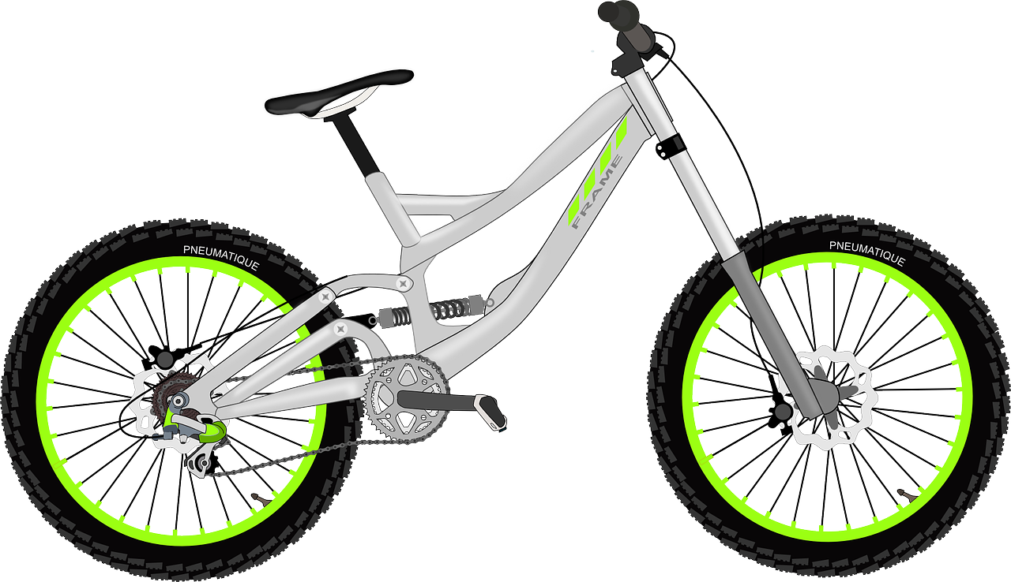
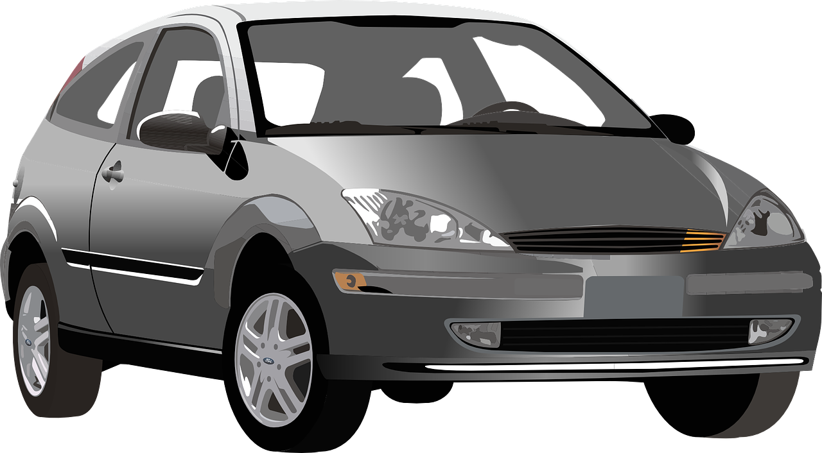
Adjectives following the noun
Remember that French adjectives normally come after the noun.
very
très
In French we say what it is and then what it is like.
a slow bike
un vélo lent
^
^
⚠ Remember: Many adjectives add -e to describe feminine nouns. You then pronounce the final consonant.
a slow car
une voiture lente
a serious book
un livre sérieux
?
⚠ Remember: Adjectives that end in -eux change to –euse to describe singular feminine nouns.
a serious thing
une chose sérieuse
Notes:
Timing: 3 minutes
Aim: to recap postnominal adjective agreement and remind pupils about the gender agreement pattern for adjectives ending –eux.
Procedure:
Click through the animations to present the information.
Elicit English translations for the French examples provided.
Callout 1 highlights the difference between English and French.
Callout 2 reminds pupils about gender agreement of adjectives.
Callout 2 reminds pupils about –eux changing to –euse.

Slide 5
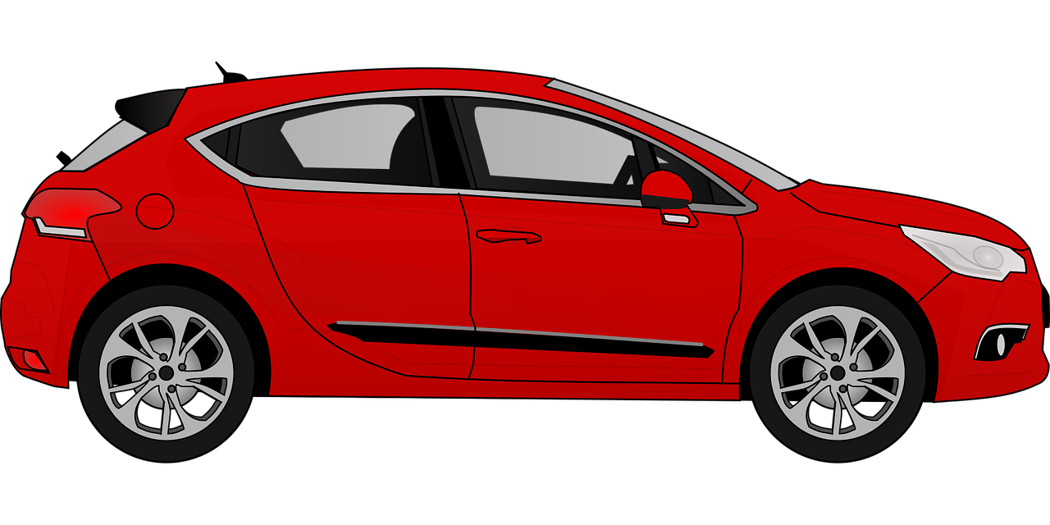
parler
. [(a)in]?
Choisis l’adjectif correct et prononce les phrases.
lire
une souris gris | grise
une moto différent | différente
une voiture lent | lente
un livre français | française
une tortue vert | verte
un t-shirt gris | grise
Notes:
Timing: 3 minutes
Aim: to reinforce the idea that many adjectives add an –e to describe a feminine noun.
Procedure:
Ensure that pupils understand the task.
Elicit each phrase chorally from pupils and click to confirm the correct adjective form. 3. Click the image to hear the full phrase, if desired.
5

Slide 6
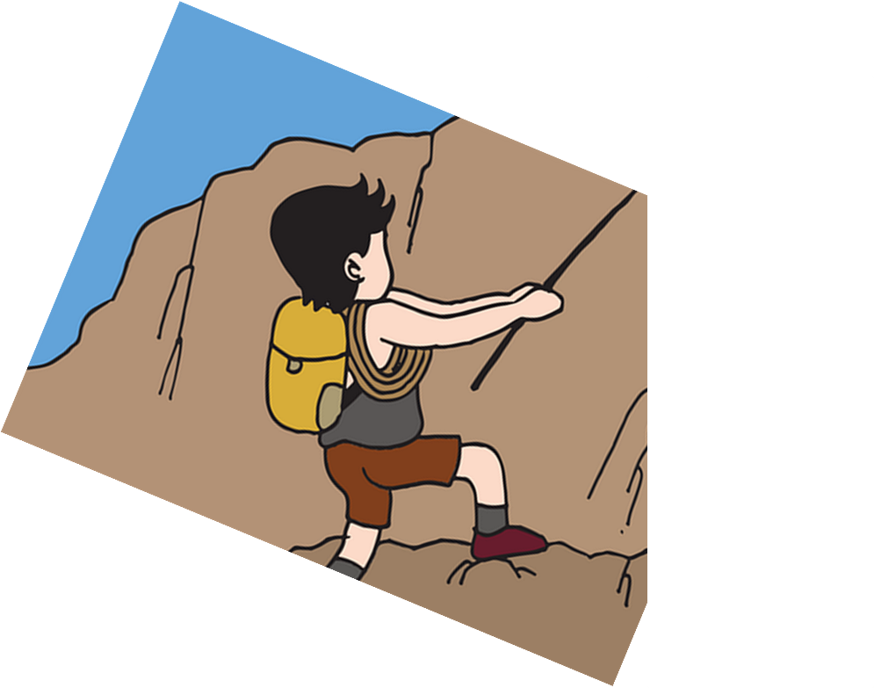
parler
. [(a)in]?
Parle en français.
1. He has your French exercise book.
lire
anglais
française
français
5
cahier
livre
crayon
4
ta
mon
un
ton
3
ai
a
as
y a
2
Elle
Tu
Il
J’
1
Notes:
Timing: 7 minutes [6 slides]
Aim: to use correct forms of avoir, determiner, noun and adjective.
Procedure:
Tell students they need to use the words, starting from the bottom, to climb up the mountain (so that they translate the sentence!).
Ask students to work in pairs to practise first.
Click to trigger the timer (15 seconds per sentence).
Ask a volunteer from a pair to say the French sentence out loud.
Click on the English sentence to hear the French translation.
Repeat with the next 5 sentences (there are 6 in total).
Transcript:
Il a ton cahier français.
6

Slide 7
parler
2. You have my green hat.
lire
gris
verte
vert
5
crayon
livre
chapeau
4
ton
mon
ma
un
3
ai
as
a
y a
2
Elle
Tu
Il
J’
1
Notes:
[2/6]
Transcript:
Tu as mon chapeau vert.
7

Slide 8
parler
3. I have a different house.
lire
important
différent
différente
5
maison
chanson
crayon
4
ta
une
un
la
3
ai
a
as
y a
2
Elle
Tu
J’
Il
1
Notes:
[3/6]
Transcript:
J’ai une maison différente.
8

Slide 9
parler
4. She likes the slow film.
lire
cher
lente
lent
5
livre
film
chanson
4
une
la
un
le
3
ai
aime
as
a
2
Elle
Tu
Il
J’
1
Notes:
[4/6]
Transcript:
Elle aime le film lent.
9

Slide 10
parler
5. There is an expensive car.
lire
chère
cher
verte
5
vélo
moto
voiture
4
une
le
un
la
3
ai
y a
aime
a
2
Elle
Tu
Il
J’
1
Notes:
[5/6]
Transcript:
Il y a une voiture chère.
10

Slide 11
parler
6. Do you have your grey uniform?
lire
grise
vert
gris
cher
5
uniforme
livre
cahier
4
ta
mon
un
ton
3
ai
as
a
y a
2
J’
Il
Tu
Elle
1
Notes:
[6/6]
Transcript:
Tu as mon uniforme gris ?
11

Slide 12
écrire
. [(a)in]?
Écris en français.
1
There are four things here.
Il y a quatre choses ici.
2
I have a very fast bike.
J’ai un vélo très rapide.
3
She has a slow song...
Elle a une chanson lente…
4
…but he has a funny film and an important book.
mais il a un film amusant et un livre important.
5
Do you have your bag at the house/home?
Tu as ton sac à la maison ?
Notes:
Timing: 9 minutes
Aim: to practise written produce of vocabulary and grammar structures practised in this and previous lessons (j’ai and tu as, vocabulary knowledge, order of nouns & adjectives, indefinite articles (un/une), adjective agreement).
Procedure:
1. Recap the grammar points outline above as ‘things to remember’ before students begin the task.
2. Ask pupils to translate the first sentence. Give the them time and give feedback before they complete the remaining sentences.
3. Click to reveal answers.
4. Click on audio buttons to hear the full sentences, if desired. Note that teachers might choose to provide parts of the sentences on slide and leave only certain words for pupils to write independently. In addition, as most of these words were previously taught, learners who need additional support could refer to previous Knowledge Organisers, if needed.
Differentiation: For an activity with more support for learners, note that teachers could use this slide for transcription practice (they could further differentiate this by providing parts

Slide 13
Au revoir !
rouge
Notes:
13

