Slide 1
Describing things and people
rouge
Follow ups 1-5
Notes:
Artwork by Steve Clarke. Pronoun pictures from NCELP (www.ncelp.org). All additional pictures selected from Pixabay and are available under a Creative Commons license, no attribution required.
Phonics: revisit [SFe] timide [3835] monde [77] moderne [1239] centre [491] douze [1664]
Vocabulary (new words in bold): différent [350] lent [2572] vert [1060] très [66]
Revisit 1: il y a [n/a] un [3] deux [41] trois [115] quatre [253] cinq [288] six [450] sept [905] huit [877] neuf [787] dix [372] onze [2447] douze [1664] Revisit 2: répéter [630] chanter [1820] utiliser [345] phrase [2074] facile [822] important [215] normal [833] avec [23] tous les jours [n/a]
Revisit 2: porter [105] regarder [425] chanson [2142] chapeau [2908] film [848] maison [325] uniforme [1801] et [6] mais [30] à (meaning ‘at’) [4]
Londsale, D., & Le Bras, Y. (2009). A Frequency Dictionary of French: Core vocabulary for learners London: Routledge.
The frequency rankings for words that occur in this PowerPoint which have been previously introduced in these resources are given in the SOW and in the resources that first introduced and formally re-visited those words. For any other words that occur incidentally in this PowerPoint, frequency rankings will be provided in the notes field wherever possible.

Slide 2
prononcer
[SFe]
Silent final -e
timide
⚠ Remember: The Silent Final -e means you pronounce the final consonant.
[shy]
Notes:
Timing: 1 minute
Aim: to present and practise SSC Silent Final –e.
Procedure:
Introduce and elicit the pronunciation of the individual SSC [SFe] the source word ‘timide’ with gesture, if using.
Click to bring on the picture and get pupils to repeat (with gesture, if using).
Move to the next slide to present and practise the cluster words.
Suggested gesture: Bring up the palm of one hand in a gesture of covering / hiding the face. This is like the 4th video on the BSL site, here: https://www.signbsl.com/sign/shy
2

Slide 3
prononcer
[SFe]
monde
timide
douze
[shy]
centre
moderne
Notes:
Timing: 2 minutes
Aim: To introduce/consolidate SSC [SFe]
Procedure:
1. Practise the pronunciation of the individual SSC [SFe] and then the source word again ‘timide’ (with gesture, if using). 2. Then present and elicit the pronunciation of the four cluster words.
Frequency: monde [77] moderne [1239] centre [491] vie [132] douze [1664] timide [3835] Source: Londsale, D., & Le Bras, Y. (2009). A Frequency Dictionary of French: Core vocabulary for learners London: Routledge.
3

Slide 4
Follow up 1
. [(a)in]?
Prononce les phrases. L’adjectif, c’est avec ‘e’ ou sans ‘e’ ?
1
_
prononcer
Il écoute une chanson différente.
Je regarde un film très lent.
2
_
3
_
Tu portes un uniforme gris.
4
_
Elle a une maison verte.
_
5
J’ai une chose très importante pour toi.
6
_
Tu as ton cahier français ?
Notes:
Timing: 5 minutes
Aim: to practise use of postnominal adjective agreement in a sentence context, using the determiner and/or prior knowledge of the noun gender to determine whether there is an SFe.
Procedure:
Pupils work in pairs to practise saying the full sentences.
Click on each number to hear them pronounced.
Click to reveal the presence or absence of SFe.
Teacher to ask a few comprehension questions to check comprehension – e.g. what does the speaker say you are wearing? Who is watching and what?

Slide 5
Follow up 2
Écoute et écris les mots en anglais.
. [(a)in]?
écouter
………………
book | thing
E
E
my | your | a | the
important
1
my | your | a | the
expensive
horse | cuddly toy
1
………………
2
slow
bike | car
2
my | your | a | the
………………
3
………………
song | dog
3
my | your | a | the
fast
⚠ rapide is the same for m and f nouns BUT you heard ma not mon.
funny
4
my | your | a | the
………………
hat | house
4
different
phrase | present
5
5
my | your | a | the
………………
Notes:
Timing: 5 minutes
Aim: to practise aural comprehension of revisited nouns, articles and adjectives.
Procedure:
Read the instruction in French.
Do [E] with the pupils. Click to listen. Pupils circle the correct article and the corresponding noun, and write the missing adjective in English.
Click for answer.
Complete items 1-5 and click to correct with the class. NB: Number 3 could be either noun as rapide doesn’t change. A ? appears and teachers can click the audio button to hear that in this instance, it is ‘chanson’, and the next click wiggles the ‘song’ to confirm this.
The 2nd set of audio buttons to the right has the full phrases, if desired. As an extension activity, teachers could elicit the French phrases from the English answers on the slide, and then click to listen and check.
Transcript 1:
la [chose] importante
une [peluche] chère
ton [vélo] lent ma [chanson] rapide
le [chapeau] amusant
mon [cadeau] différent

Slide 6
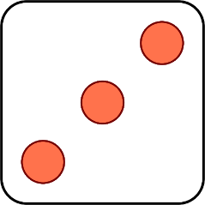
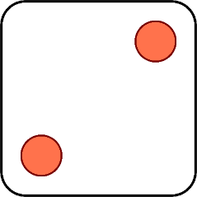
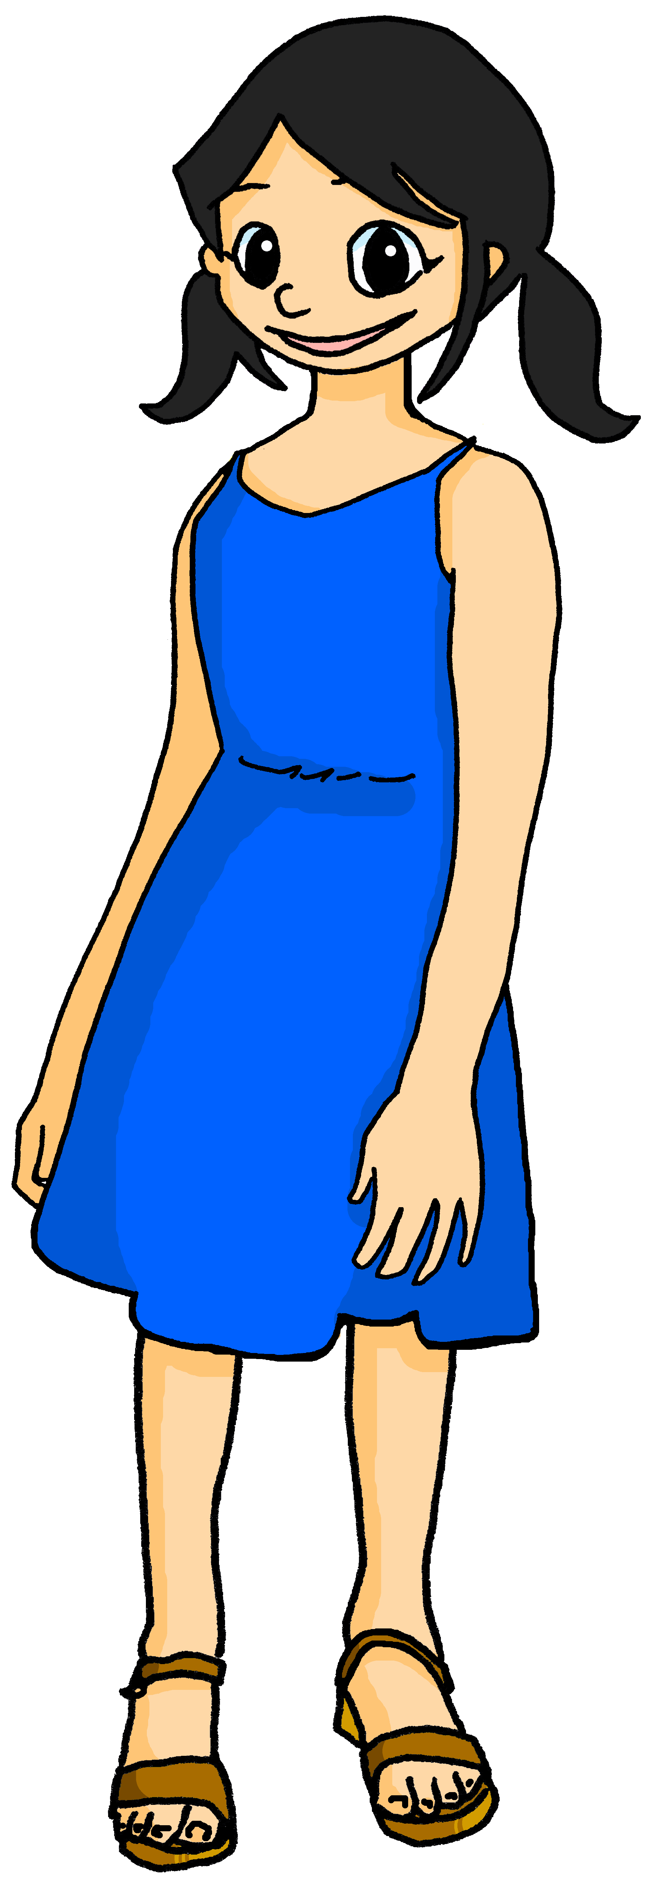
Follow up 3
Parle en français.
. [(a)in]?
Elle/Il porte
Tu as
J’aime
Tu écoutes
Je chante
Elle/Il regarde
parler
[the] film sérieux
[a] voiture rapide
[the] chanson anglaise
[a] livre différent
[a] jeu lent
[the] phrase française
[a] stylo vert
[a] un t-shirt gris
[the] chien amusant
1 | S/he
2 | You
3 | I
4 | S/he
5 | You
6 | I
1 | see/watch
2 | listen to
3 | wear
4 | have
5 | sing
6 | like
Notes:
Timing: 5 minutes (1 of two versions)
Aim: to practise oral production of singular persons of 5 –ER verbs and avoir; indefinite articles, and recognition of previously taught nouns and adjectives.
Procedure: 1. Click to ‘roll’ the dice.
2. Pupils translate the pronouns and verbs and nouns whose numbers correspond to the respective dice to make a short sentence. They say the answer chorally and use one of the French options to form a logical sentence.
3. Click to reveal the correct verb phrase.
4. Repeat until all six combinations have been said.
Note: the version on the next slide is more challenging and requires pupils to translate additionally the English noun phrases.

Slide 7
Follow up 3
Parle en français.
. [(a)in]?
Elle/Il porte
Tu as
J’aime
Tu écoutes
Je chante
Elle/Il regarde
parler
[the] serious film
[a] fast car
[the] English song
[a] different book
[a] slow game
[the] French phrase
[a] green pen
[a] grey t-shirt
[the] funny dog
1 | S/he
2 | You
3 | I
4 | S/he
5 | You
6 | I
1 | see/watch
2 | listen to
3 | wear
4 | have
5 | sing
6 | like
Notes:
(2 of two versions)

Slide 8
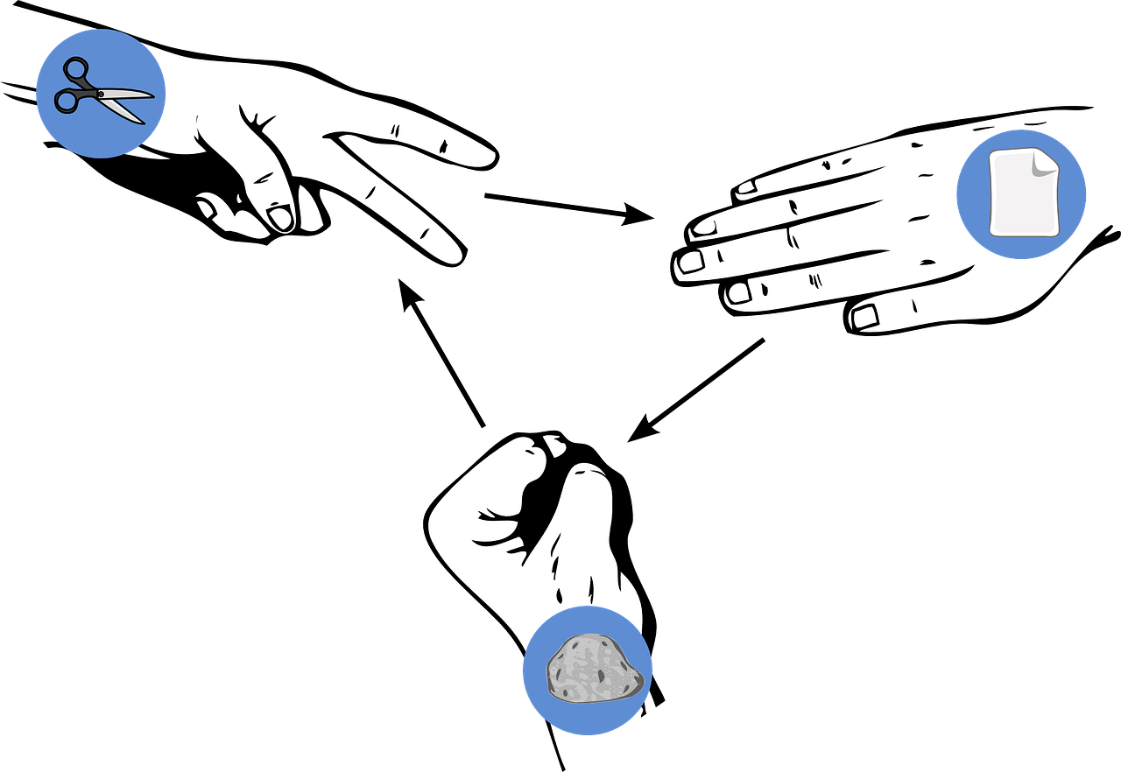
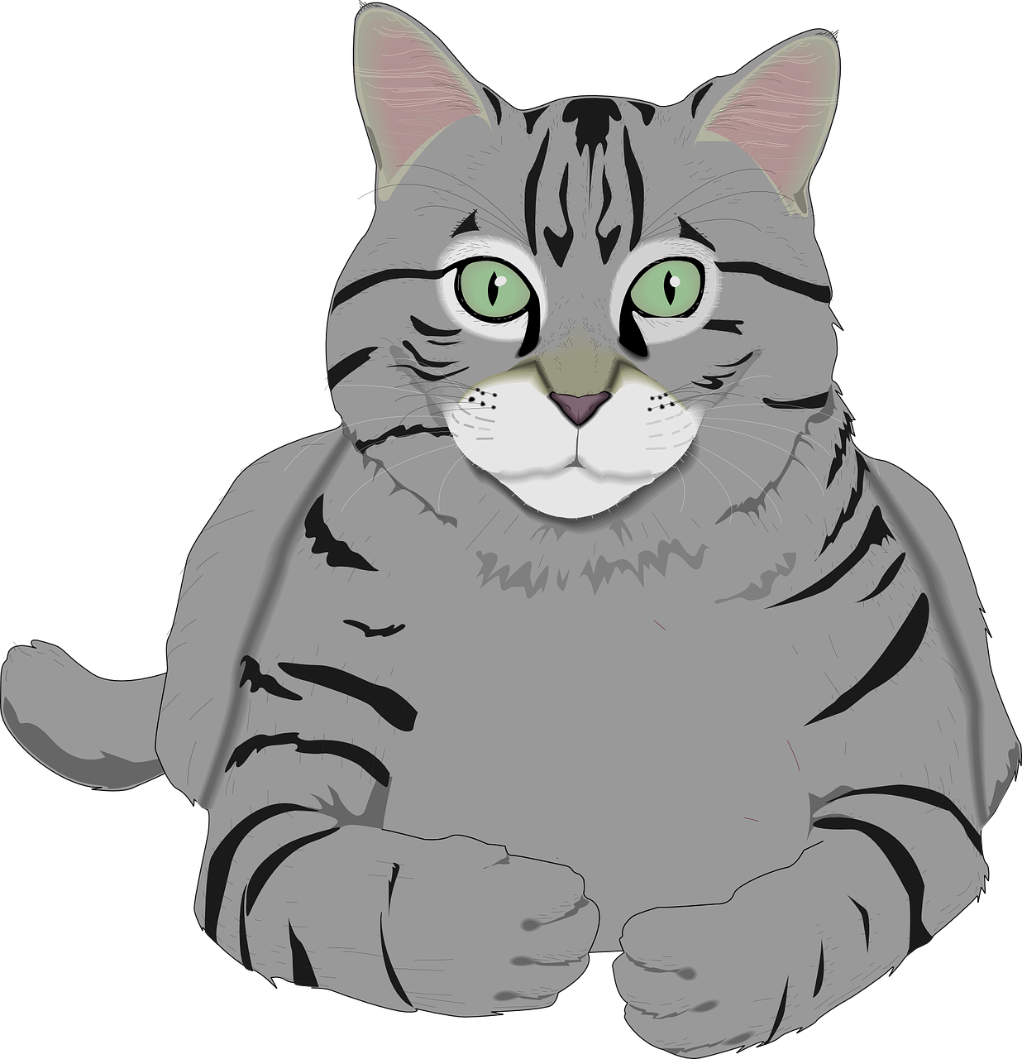
Follow up 4
Pierre-papier-ciseaux*
Choose three objects and write three sentences in French saying what you have: ‘I have…’
écrire
parler
Choose three more objects and write three sentences saying what your partner has: ‘You have…’
Read your sentences. If your partner has the same sentence as you, play rock-paper-scissors. The loser must write/say a different sentence. Play until you have successfully said all your sentences.
Exemple:
J’ai un chat gris.
J’ai un chat gris, aussi !
J’ai une maison verte.
Partenaire A
Partenaire B
[a grey cat]
*Rock-paper-scissors
Notes:
Timing: 5-10 minutes (two rounds of speaking activity)
Aim: to practise oral production and comprehension of singular nouns with indefinite articles and adjectives, and two parts of the verb AVOIR.
Note: This slide shows how the speaking task is intended to work. The stages are animated to support the teacher in modelling the task.
Procedure:
After modelling this example, display the next slide with 10 item choices.
Partner As ask first and Bs answer.
Then swap roles for Round 2.

Slide 9
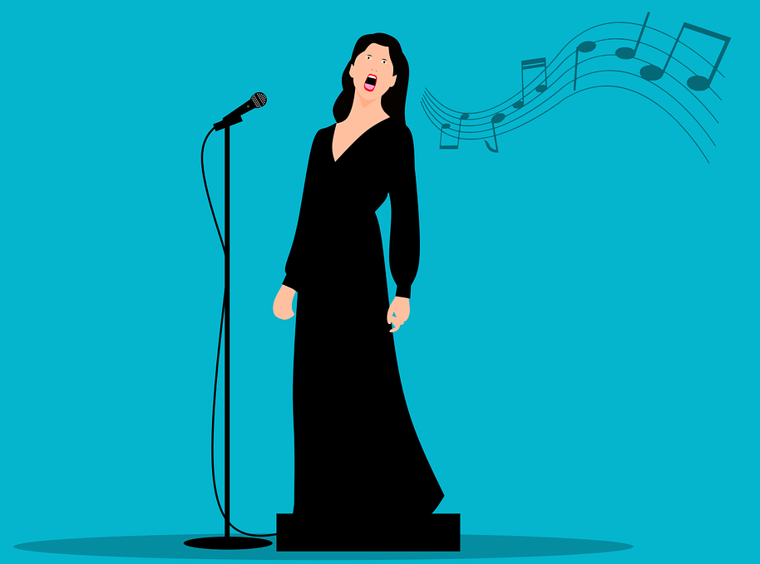
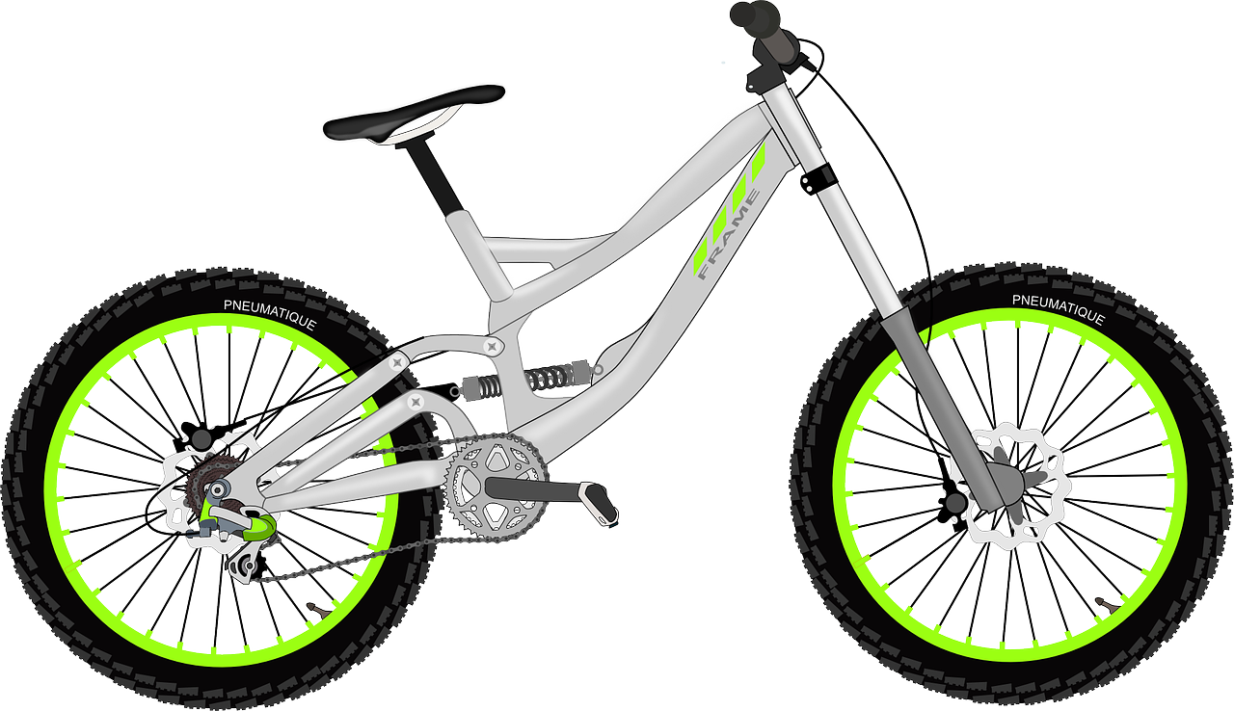
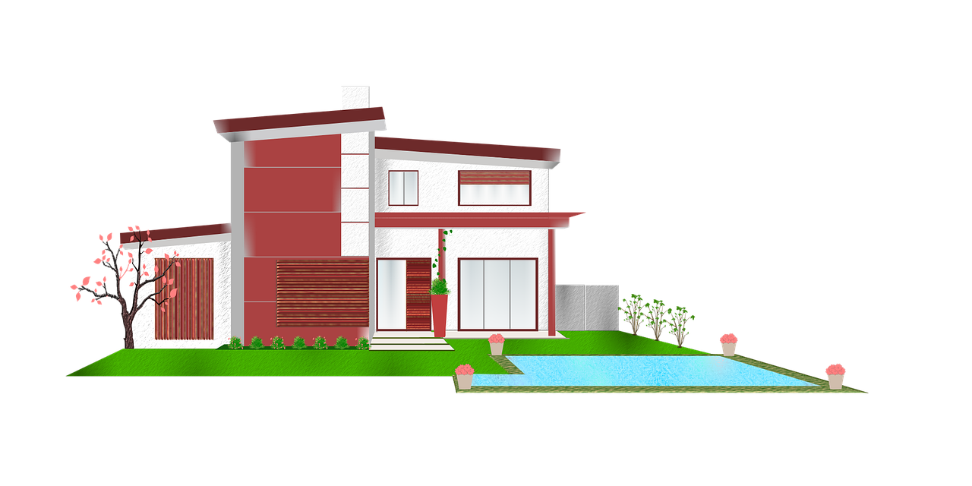
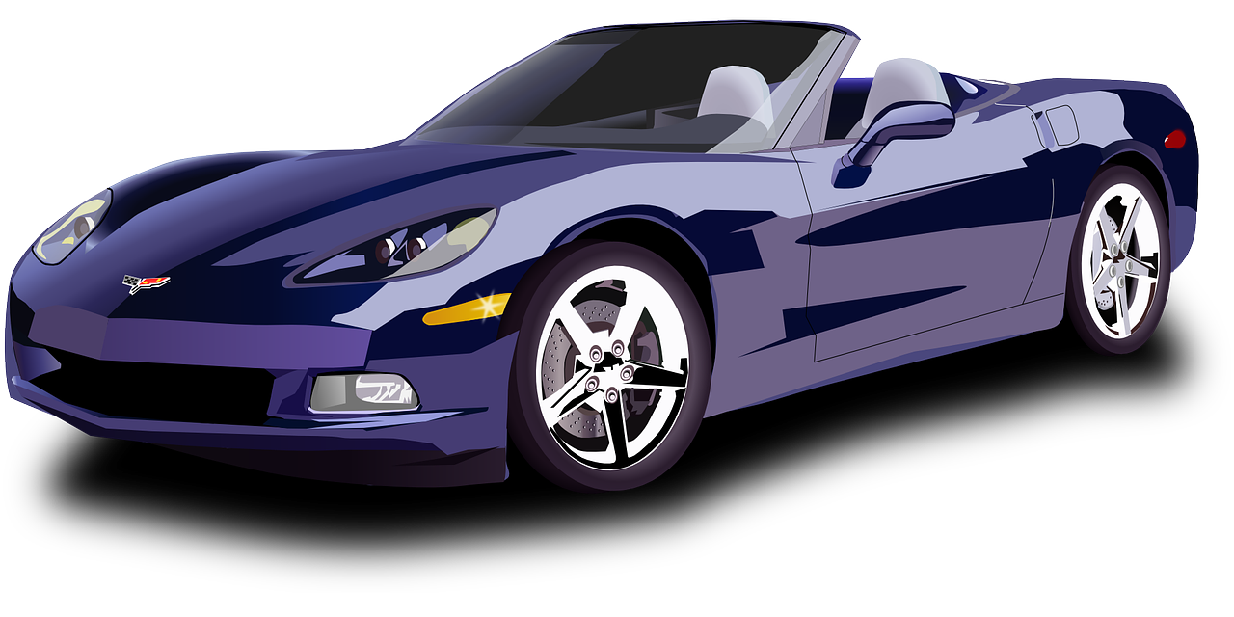
Follow up 4
pierre-papier-ciseaux*
écrire
parler
[a funny book]
[a grey bike]
[an English game]
[a fast dog]
[a slow song]
Ça va ?
[a modern car]
[an expensive house]
[a French phrase]
[a green present]
[a grey horse]
*rock-paper-scissors
Notes:
DISPLAY THIS SLIDE FOR PUPILS DURING THE TASK.

Slide 10
vocabulaire
Follow up 5 - Écris en anglais : Can you get at least 15 points?
mots
 | la maison | regarder | porter
 | le film | le chapeau | la chanson
 | à | mais | et
 | sept | douze | neuf
 | trois | onze | huit
 | très | il y a | un, une
 | différent | lent | vert
(the) house
to watch, watching
to wear, carry
(the) film
(the) hat
(the) song
x3
to, at, in
but
and
seven
twelve
nine
x2
three
eleven
eight
very
there is, there are
a/an, one (m) (f)
x1
slow
different
green
Notes:
Timing: 5-10 minutes
Aim: to practise written comprehension of vocabulary from this week and previous weeks.
Procedure: Give pupils a blank grid. They fill in the English meanings of any of the words they know, trying to reach 15 points in total.
Note: The most recently learnt and practised words are pink, words from the previous week are green and those from earlier are blue, thus more points are awarded for them, to recognise that memories fade and more effort (heavy lifting!) is needed to retrieve them.
10

Slide 11
vocabulaire
Follow up 5 - Écris en français : Can you get at least 15 points?
mots
 | and | but | to, at, in
 | (the) hat | (the) house | (the) film
 | to wear, carry | to watch, watching | (the) song
 | nine | eleven | twelve
 | three | seven | eight
 | slow (m) | green (f) | very
 | There is, are | a/an, one (m) (f) | different (f)
et
mais
à
le chapeau
la maison
le film
x3
porter
regarder
la chanson
neuf
onze
douze
x2
trois
sept
huit
lent
verte
très
x1
un, une
Il y a
différente
Notes:
Timing: 5-10 minutes
Aim: to practise written comprehension of vocabulary from this week and previous weeks.
Procedure: Give pupils a blank grid. They fill in the French meanings of any of the words they know, trying to reach 15 points in total.
Note: The most recently learnt and practised words are pink, words from the previous week are green and those from earlier are blue, thus more points are awarded for them, to recognise that memories fade and more effort (heavy lifting!) is needed to retrieve them.
11

Slide 12
vocabulaire
Écris en anglais : Can you get at least 15 points?
mots
 | la maison | regarder | porter
 | le film | le chapeau | la chanson
 | à | mais | et
 | sept | douze | neuf
 | trois | onze | huit
 | très | il y a | un, une
 | différent | lent | vert
x3
x2
x1
Notes:
HANDOUT 5.1
12

Slide 13
vocabulaire
Écris en français : Can you get at least 15 points?
mots
 | and | but | to, at, in
 | (the) hat | (the) house | (the) film
 | to wear, carry | to watch, watching | (the) song
 | nine | eleven | twelve
 | three | seven | eight
 | slow (m) | green (f) | very
 | There is, are | a/an, one (m) (f) | different (f)
x3
x2
x1
Notes:
HANDOUT 5.2
13

