Slide 1
Describing things and people
rouge
Adjectives after the noun
SFe – Silent Final e
Notes:
Artwork by Steve Clarke. Pronoun pictures from NCELP (www.ncelp.org). All additional pictures selected from Pixabay and are
available under a Creative Commons license, no attribution required.
The AUDIO version of the lesson material includes additional audio for the new language presented (phonics, vocabulary) and audio for the instructions
on the slide.
In addition, it includes VIDEO clips of the phonics and the phonics’ source words. Pupils can be encouraged to look at the shape of the mouth/lips on
slides where these appear, and try to copy it/them.
Phonics: introduce [SFe] timide [3835] monde [77] moderne [1239] centre [491] douze [1664]
Vocabulary (new words in bold): vélo [4594] voiture [881] cher [803] gris [2769] rapide [672]
Revisit 1: préférer [597] village [1295] ville [260] dans [11] en ce moment [n/a]
Revisit 2: répéter [630] chanter [1820] utiliser [345] phrase [2074] facile [822] important [215] normal [833] avec [23] tous les jours [n/a]
Londsale, D., & Le Bras, Y. (2009). A Frequency Dictionary of French: Core vocabulary for learners London: Routledge.
The frequency rankings for words that occur in this PowerPoint which have been previously introduced in these resources are given in the SOW and in the resources that first introduced and formally re-visited those words. For any other words that occur incidentally in this PowerPoint, frequency rankings will be provided in the notes field wherever possible.
1

Slide 2
prononcer
[SFe]
Silent Final -e
timide
⚠ Remember: The Silent Final -e means you pronounce the final consonant.
[shy]
Notes:
Timing: 1 minute
Aim: to present and practise SSC Silent Final –e.
Procedure:
Introduce and elicit the pronunciation of the individual SSC [SFe] the source word ‘timide’ with gesture, if using.
Click to bring on the picture and get pupils to repeat (with gesture, if using).
Move to the next slide to present and practise the cluster words.
Suggested gesture: Bring up the palm of one hand in a gesture of covering / hiding the face. This is like the 4th video on the BSL site, here: https://www.signbsl.com/sign/shy
2

Slide 3
prononcer
[SFe]
monde
timide
douze
[shy]
centre
moderne
Notes:
Timing: 2 minutes
Aim: To introduce/consolidate SSC [SFe]
Procedure:
1. Practise the pronunciation of the individual SSC [SFe] and then the source word again ‘timide’ (with gesture, if using). 2. Then present and elicit the pronunciation of the four cluster words.
Frequency: monde [77] moderne [1239] centre [491] vie [132] douze [1664] timide [3835] Source: Londsale, D., & Le Bras, Y. (2009). A Frequency Dictionary of French: Core vocabulary for learners London: Routledge.
3

Slide 4
écouter
[SFe]
Écoute. C’est avec ‘e’ ou sans ‘e’ ?
⚠ Remember: If you hear the final consonant (d, p, s, t) there is usually a Silent Final -e.
français
1
?
Notes:
Timing: 5 minutes (8 slides)
Aim: to practise aural recognition of the presence of SFe contrasted with SFC (Silent Final Consonant) when there is no ‘e’.
Procedure:
Click to listen to the word.
Pupils respond ‘avec ‘e’’ if they decide there is a SFe and ‘sans ‘e’’ if they decided there is no ‘e’.
Click to remove the rectangle to see the presence or absence of ‘e’.
Click again to bring up the corresponding emoji, and ensure that pupils are clear about the meaning of the word (i.e. smart for a masculine noun/male person)
Repeat steps 1-4 for the next 7 slides.
Transcript: français
4

Slide 5
écouter
[SFe]
Écoute. C’est avec ‘e’ ou sans ‘e’ ?
amusante
2
?
Notes:
[2/8]
Transcript: amusante
5

Slide 6
écouter
[SFe]
Écoute. C’est avec ‘e’ ou sans ‘e’ ?
anglaise
3
?
Notes:
[3/8]
Transcript: anglaise
6

Slide 7
écouter
[SFe]
Écoute. C’est avec ‘e’ ou sans ‘e’ ?
important
4
?
Notes:
[4/8]
Transcript: important
7

Slide 8
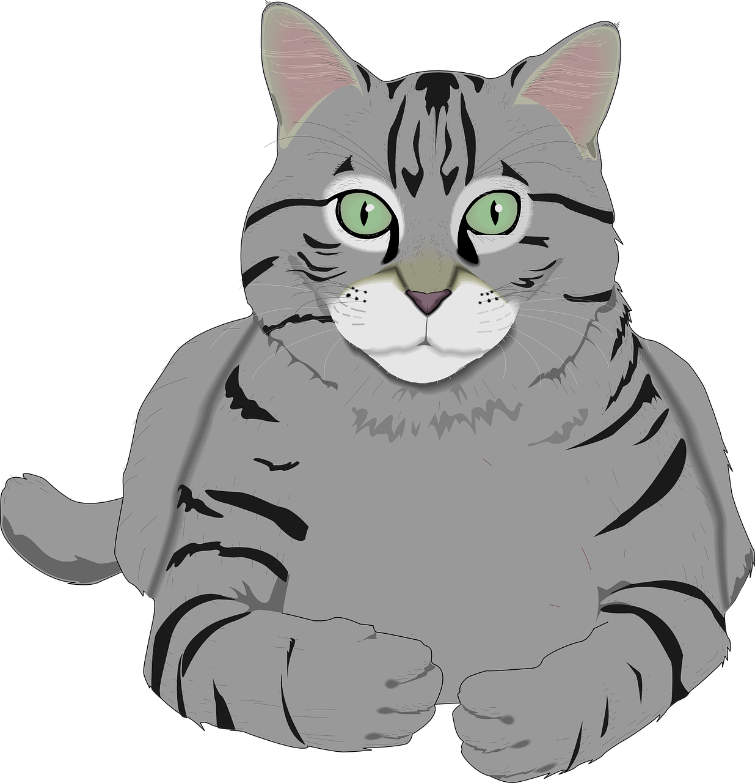
écouter
[SFe]
Écoute. C’est avec ‘e’ ou sans ‘e’ ?
gris
5
?
[grey]
Notes:
[5/8]
Transcript: gris
8

Slide 9
écouter
[SFe]
Écoute. C’est avec ‘e’ ou sans ‘e’ ?
verte
6
?
[green]
Notes:
[6/8]
Transcript: verte
9

Slide 10
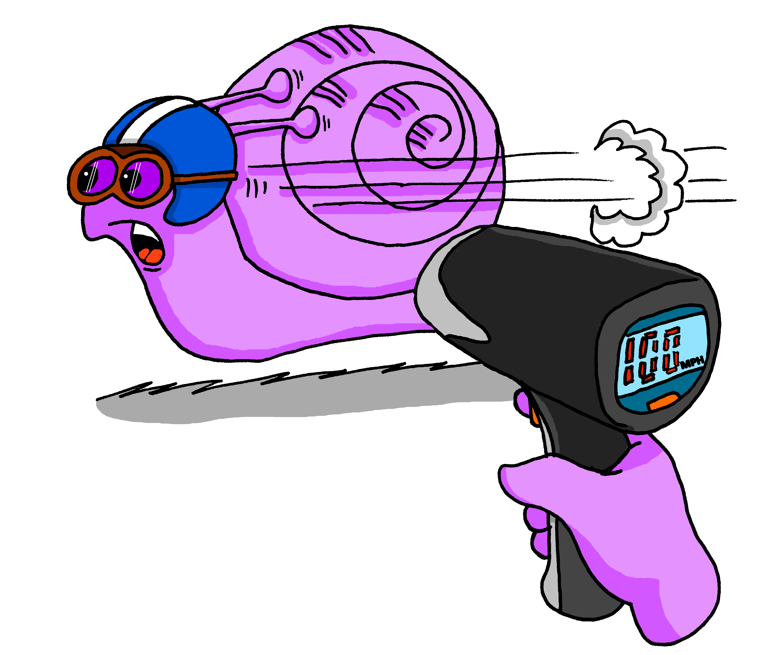
écouter
[SFe]
Écoute. C’est avec ‘e’ ou sans ‘e’ ?
⚠ Remember: some adjectives already have an ‘e’ already. Don’t add another ‘e’!
rapide
7
?
Notes:
[7/8]
Transcript: rapide
10

Slide 11
écouter
[SFe]
Écoute. C’est avec ‘e’ ou sans ‘e’ ?
⚠ Some French adjectives are like English but with a final ‘e’ – e.g. calme, timide.
These don’t change to describe feminine nouns.
moderne
8
?
Notes:
[8/8]
Transcript: moderne
11

Slide 12
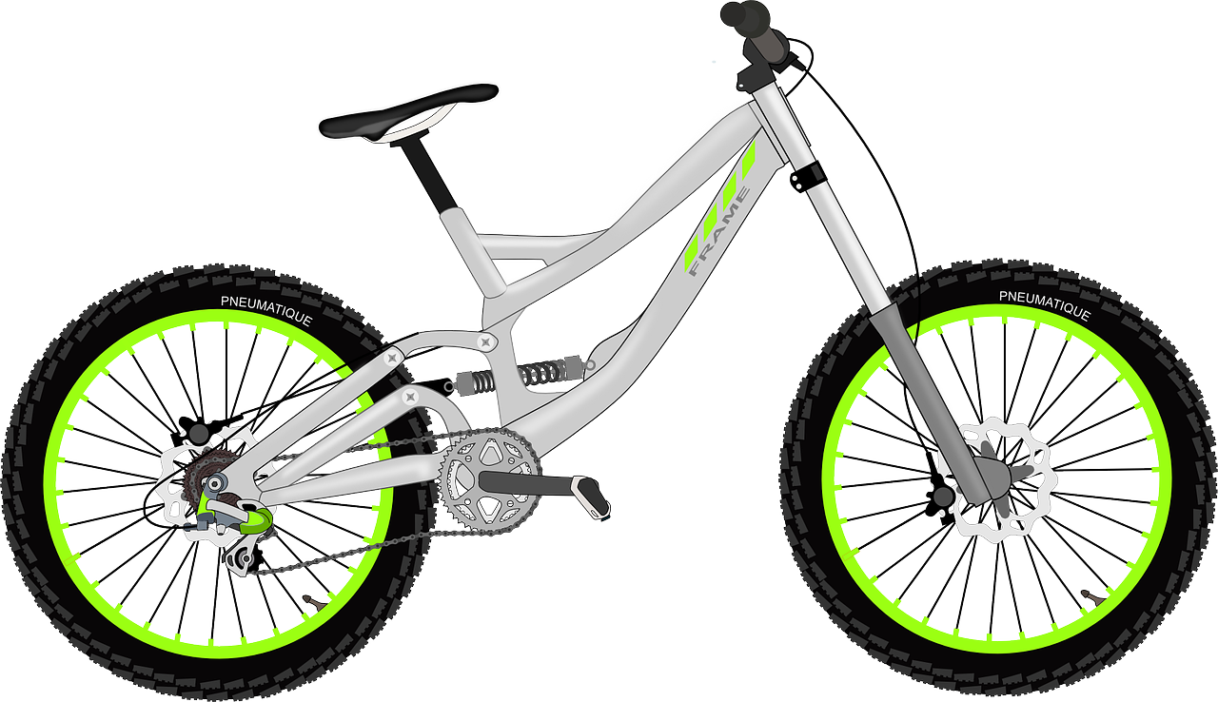
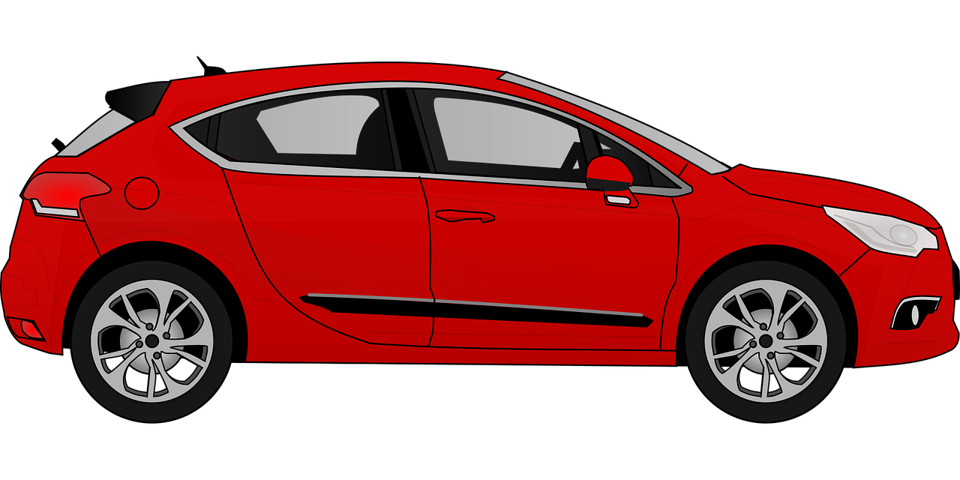
vocabulaire
Vocabulaire
mots
le vélo
la voiture
bicycle/bike
car
£1,000,000
cher
gris
rapide
expensive
grey
fast
Notes:
Timing: 5 minutes
Aim: to present and practise written comprehension and read aloud of the new vocabulary for this week.
Procedure: 1. Click for a French word. Elicit pronunciation from pupils.
2. Click for the English meaning and picture prompt. Elicit the French word again.
3. Present all five words like this, in order.
4. Click for one English meaning to disappear. Elicit the English meaning from pupils. Continue with the remaining items.
5. Click for the French word to disappear. Elicit the French from pupils. Continue with the remaining items.
12

Slide 13
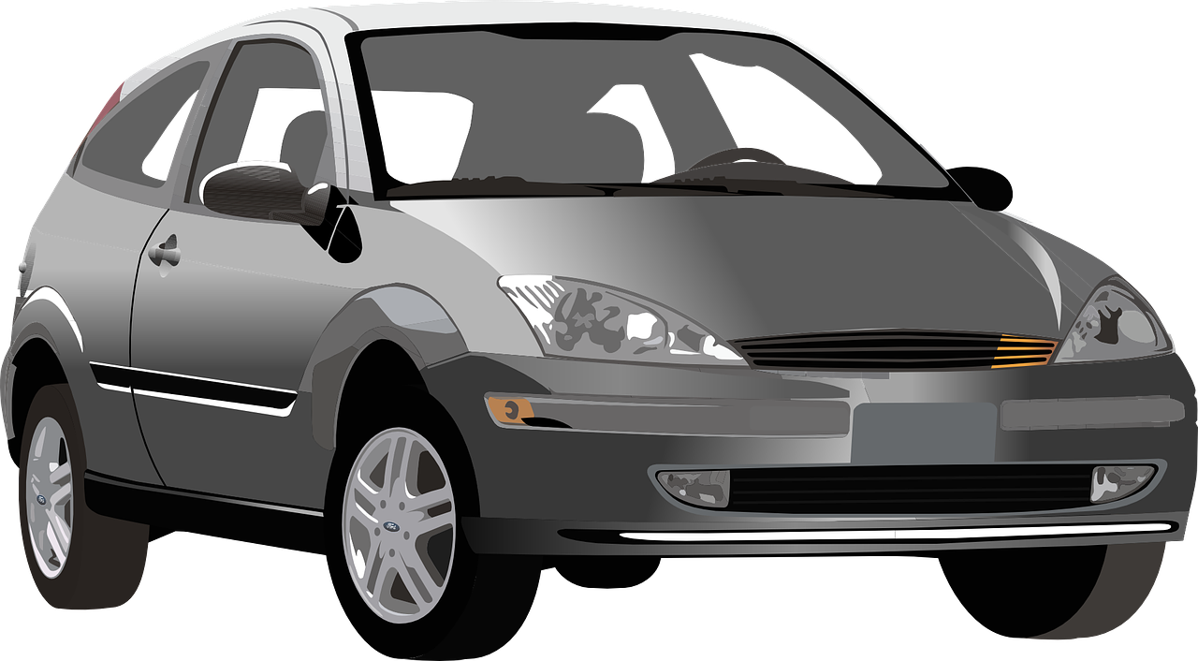
Adjectives following the noun
In English, adjectives come before the noun.
In French, adjectives normally come after the noun.
In French we say what it is and then what it is like.
a grey bike
un vélo gris
⚠ Remember: Many adjectives add -e to describe feminine nouns. You then pronounce the final consonant.
a grey car
une voiture grise
a fast bike
un vélo rapide
⚠ Remember: Adjectives that end in -e stay the same to describe all singular nouns.
a fast car
une voiture rapide
Notes:
Timing: 3 minutes
Aim: to introduce postnominal adjective agreement.
Procedure:
Click through the animations to present the information.
Elicit English translations for the French examples provided.
Callout 1 highlights the difference between English and French.
Callout 2 reminds pupils about gender agreement of adjectives.
Callout 2 reminds pupils about no change for adjectives ending in –e.

Slide 14
écouter
Écoute. Identifie la chose et écris en anglais.
1
a modern car
2
a fast horse
?
3
a French thing
4
an expensive bike
gris
français
5
an expensive car
moderne
cher
rapide
6
a grey thing
Notes:
Timing: 5 minutes
Aim: Aural recognition of adjectives.
Procedure:
Pupils write 1-6 in their books.
Pupils write down the English for the noun and the adjective that they hear.
Check answers on the following slide.
Transcript
J’ai une voiture moderne.
J’ai un cheval rapide.
J’ai une chose française.
J’ai un vélo cher.
J’ai une voiture chère.
J’ai une chose grise.
14

Slide 15
parler
Which adjectives change their spelling and sound to match the feminine noun?
?
lire
une voiture moderne
un cheval rapide
une chose française
⚠ Remember: Adjectives that already end in -e stay the same.
⚠ Remember: Adjectives that already end in -e stay the same.
?
un vélo cher
une voiture chère
une chose grise
cher adds ‘-e’ and an accent, too but cher and chère sound the same.
Notes:
Timing: 3 minutes
Aim: to reinforce the idea that many adjectives add an –e to describe a feminine noun.
Procedure:
Ask the question and elicit ‘française’ and ‘grise’ from pupils.
Click to bring up the callout reminding pupils that adjectives already ending in ‘e’ stay the same.
Click again to draw attention to the feminine form of cher (chère) which adds an accent as well as an ‘e’ but importantly there is no pronunciation change.
Click for an emphasis effect for each noun phrase and elicit English meanings from pupils – this will practise the cross-linguistic difference in word order again. 5. Click on the picture to hear the audio, if desired.
15

Slide 16
lire
Lis. Le mot correct, c’est quoi ?
1
un vélo | une maison
importante
2
une peluche | un cheval
grise
3
une voiture| un livre
anglais
4
un animal | une chose
cher
5
une tortue| un skateboard
rapide
6
une chanson | un sac
moderne
Notes:
Timing: 7 minutes
Aim: to practise written recognition of masculine and feminine forms, their connection to nouns of the matching gender, and comprehension of both nouns and adjectives.
Procedure:
Teacher reads the instruction in French.
Pupils decide which noun it is, based on the form of the adjective.
Elicit the answers from pupils. Note that both answers are right for numbers 5 and 6.
Then click to hear the full phrase, if desired.
Ask questions to elicit comprehension, e.g., what is important? what kind of book is it? - teachers can ask these questions in a jumbled order for greater challenge.
Transcript:
une maison importante une peluche grise
un livre anglais
un animal cher
une tortue rapide, un stakeboard rapide
une chanson moderne, un sac moderne
16

Slide 17
Au revoir !
rouge
Notes:
17

