Slide 1
Describing things and people
rouge
Follow ups 1-5
Notes:
Artwork by Steve Clarke. Pronoun pictures from NCELP (www.ncelp.org). All additional pictures selected from Pixabay and are available under a Creative Commons license, no attribution required.
Phonics: introduce [SFe] timide [3835] monde [77] moderne [1239] centre [491] douze [1664]
Vocabulary (new words in bold): vélo [4594] voiture [881] cher [803] gris [2769] rapide [672]
Revisit 1: préférer [597] village [1295] ville [260] dans [11] en ce moment [n/a]
Revisit 2: répéter [630] chanter [1820] utiliser [345] phrase [2074] facile [822] important [215] normal [833] avec [23] tous les jours [n/a]
Londsale, D., & Le Bras, Y. (2009). A Frequency Dictionary of French: Core vocabulary for learners London: Routledge.
The frequency rankings for words that occur in this PowerPoint which have been previously introduced in these resources are given in the SOW and in the resources that first introduced and formally re-visited those words. For any other words that occur incidentally in this PowerPoint, frequency rankings will be provided in the notes field wherever possible.

Slide 2
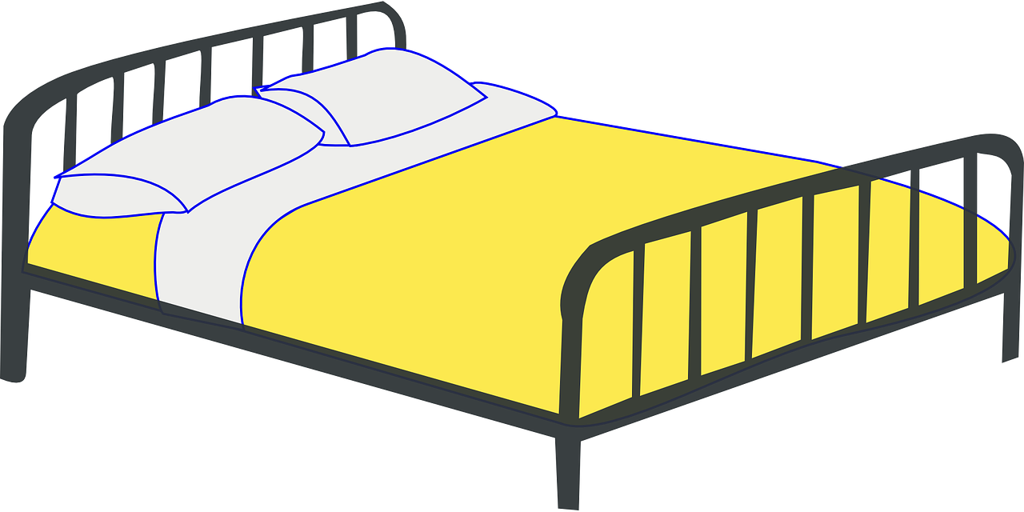
Follow up 1
Écoute. C’est avec ‘e’ ou sans ‘e’ ?
prononcer
Puis, prononce les mots.
f r a i s e
p i e d
s o u r i s
l i s t e
c a r t e
p o r t
c h a i s e
d r a p
1
_
5
_
2
_
6
_
_
7
_
3
4
_
8
_
Notes:
Timing: 3 minutes
Aim: to practise aural distinction between words with SFe and SFC.
Procedure:
Read the instruction.
Do the first one with pupils.
They can write down either [e] or [--].
Elicit responses chorally, and click to reveal the answers.
Transcript:
fraise
pied
souris liste carte port chaise drap Frequency: fraise [>5000] pied [626] souris [4328] liste [924] carte [955] port [1304] chaise [3419] drap [>5000]

Slide 3
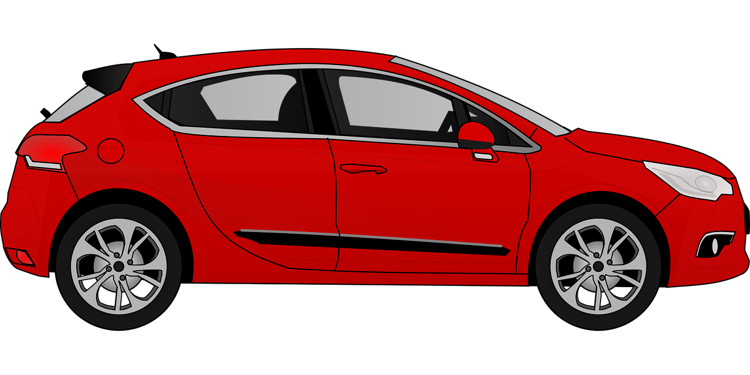
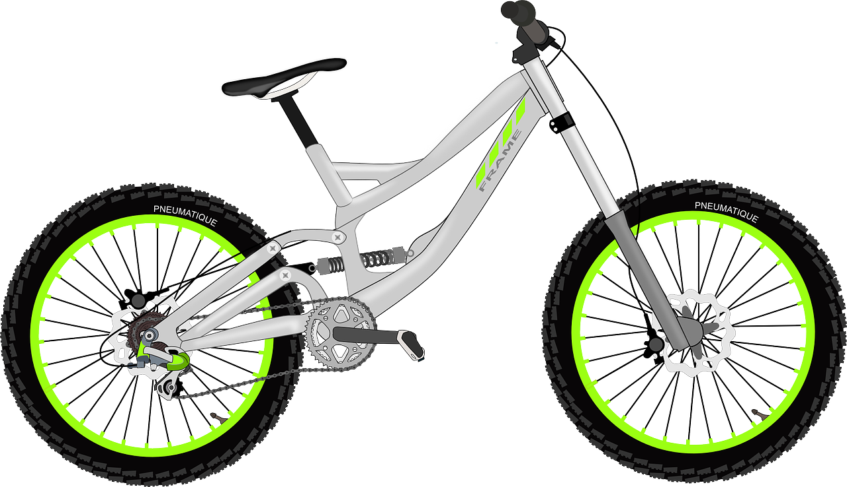
Follow up 2: Écris en français.
Write as many phrases as you can to combine these nouns and adjectives. Remember to agree the adjectives with feminine nouns.
écrire
gris
français
?
cher
rapide
Notes:
Timing: 5 minutes
Aim: to practise written production of noun/adjective phrases.
Procedure:
Pupils write as many combinations of nouns and adjectives as they can in four minutes (a total of 16 combinations is possible!)
Elicit some examples from pupils orally and/or type them up on a slide or on the board.

Slide 4
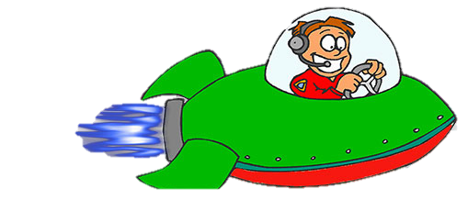
Follow up 3
cher
le vélo
Écris les mots en anglais.
Puis, lis les mots de ta liste en français.
lire
facile
gris
avoir
chanter
en ce moment
la ville
avec
tous les jours
utiliser
dans
Notes:
Timing: 5 minutes
Aim: to revisit 12 items of previously-taught vocabulary in both receptive and productive modes of language use.
Procedure:
Ask pupils to write the numbers 1-12. That way, if they miss one of the words, they can leave that number out and go on to the next one.
Teacher clicks on the screen to trigger each animation.
Pupils write a list with an English translation of each word that appears. They should challenge themselves not to write the French.
Teachers checks the answers to ensure that all pupils have the correct list of 12 words in English.
Afterwards, pupils orally translate each English word on their list into French, working with a partner (either taking turns or each trying to do all twelve). Partners can give each other feedback.
Note: the teacher can speed up the activity by clicking to end one word’s animation and begin the next. In this way s/he can adapt it to suit the class.
English words (in the order in which French words appear on the slide)
to sing, singing
every day
bicycle, bike
grey
town
with
to use, using
to have, having
easy
in
at the moment
expensive

Slide 5
Avoir [to have, having]
The verb avoir means ‘to have’ or ‘having’:
I
je becomes j’ before a vowel.
j’ai
To say I have, use ______.
J’ai un stylo.
I have a pen.
you
tu as
Tu as un crayon.
To say you have, use _____.
You have a pencil.
Notes:
DO BEFORE FOLLOW UP 4
Timing: 2 minutes (two slides)
Aim: to recap the verb avoir (to have), I have, you have and how to form intonation questions.
Procedure:
Click fairly quickly to present the information (as this is revision).
Elicit the English at each stage from pupils after presenting the French examples.

Slide 6
Asking questions
Remember! To change a statement into a yes/no question, raise your voice at the end:
J’ai un livre.
J’ai un livre ?
I have a book.
Do I have a book ?
Tu as un livre.
Tu as un livre ?
You have a book.
Do you have a book?
In English, we add ‘do’, in French we just make our voice go up.
Notes:
Timing: 2 minutes
Aim: to revisit how to form intonation questions.
Procedure:
Click to present the information.
Elicit the English at each stage from pupils after presenting the French examples.

Slide 7
Follow up 4
Parle avec ton/ta partenaire.
Tu as un chien ?
Oui, j’ai un chien.
Exemple:
parler
Partenaire A
Partenaire B
1
Ask your partner if s/he has these things and circle the ones s/he has:
When asked, say you have these:
Tu as une peluche ?
Oui, j’ai une peluche.
Partenaire B
Partenaire A
2
Ask your partner if s/he has these things and circle the ones s/he has:
When asked, say you have these:
Notes:
Timing: 5-10 minutes (two rounds of speaking activity)
Aim: to practise oral production and comprehension of singular and plural nouns with indefinite articles and/or numbers.
Note: This slide shows how the speaking task is intended to work. The stages are animated to support the teacher in modelling the task.
Procedure:
After modelling this example, give out the task sheets (at the end of this PPT).
Partner As ask first and Bs answer.
Then swap roles for Round 2.

Slide 8
vocabulaire
Follow up 5 - Écris en anglais : Can you get at least 15 points?
mots
 | utiliser | chanter | répéter
 | importante | facile | la phrase
 | tous les jours | avec | normal
 | dans | en ce moment | le jour
 | le village | préférer | la ville
 | la voiture | gris | moderne
 | rapide | le vélo | cher, chère
to use, using
to sing, singing
to repeat, repeating
important (f)
easy
(the) phrase
x3
every day
with
normal
in
at the moment
(the) day
x2
(the) village
to prefer, preferring
(the) town
(the) car
grey
modern
x1
fast
(the) bicycle, bike
expensive (m) (f)
Notes:
Timing: 5-10 minutes
Aim: to practise written comprehension of vocabulary from this week and previous weeks.
Procedure: Give pupils a blank grid. They fill in the English meanings of any of the words they know, trying to reach 15 points in total.
Note: The most recently learnt and practised words are pink, words from the previous week are green and those from earlier are blue, thus more points are awarded for them, to recognise that memories fade and more effort (heavy lifting!) is needed to retrieve them.
8

Slide 9
vocabulaire
Follow up 5 - Écris en français : Can you get at least 15 points?
mots
 | (the) phrase | with | everyday
 | easy | to sing, singing | normal (m)
 | important (m) | to repeat, repeating | to use, using
 | (the) village | to prefer | (the) day
 | (the) town | at the moment | in
 | expensive | fast | modern
 | (the) car | (the) bicycle, bike | grey
la phrase
avec
tous les jours
facile
chanter
normal
x3
important
répéter
utiliser
le village
préférer
le jour
x2
la ville
en ce moment
dans
cher, chère
rapide
moderne
x1
la voiture
le vélo
gris
Notes:
Timing: 5-10 minutes
Aim: to practise written comprehension of vocabulary from this week and previous weeks.
Procedure: Give pupils a blank grid. They fill in the French meanings of any of the words they know, trying to reach 15 points in total.
Note: The most recently learnt and practised words are pink, words from the previous week are green and those from earlier are blue, thus more points are awarded for them, to recognise that memories fade and more effort (heavy lifting!) is needed to retrieve them.
9

Slide 10
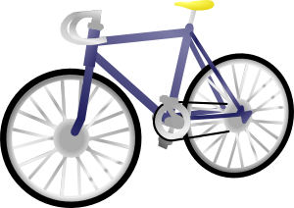
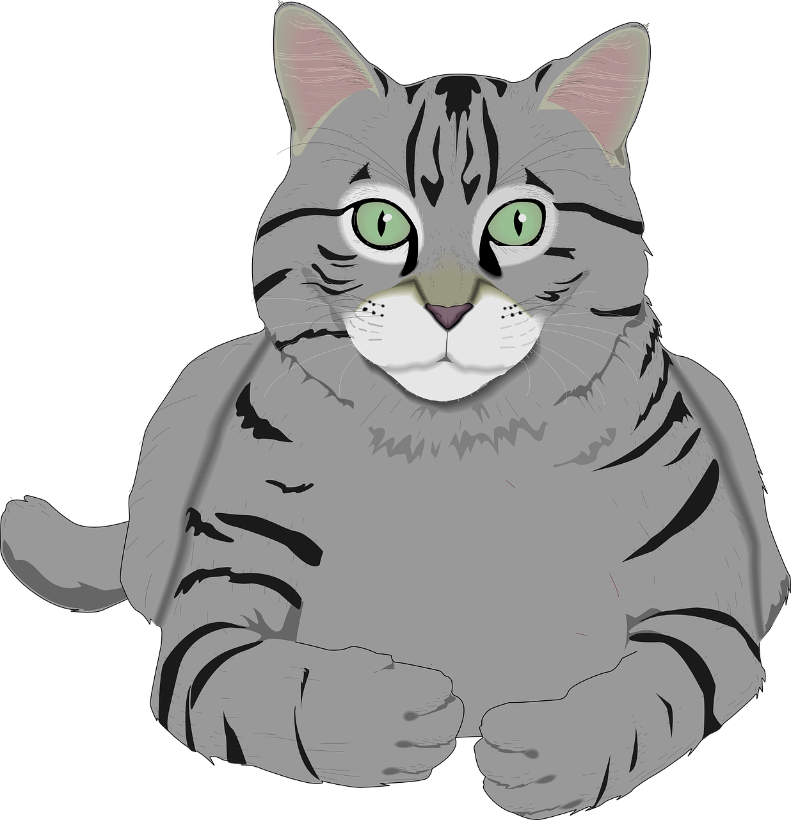
Follow up 4
Partenaire A
Round 1
Round 2
parler
Ask your partner if s/he has these things and circle the ones s/he has:
When asked, say you have these:
Notes:
HANDOUT – PARTENAIRE A

Slide 11
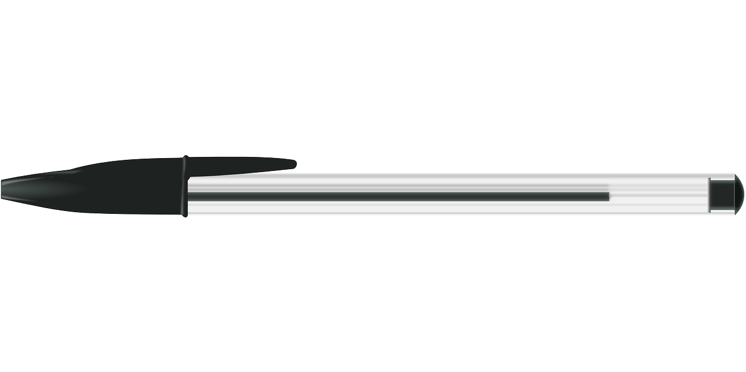
Follow up 4
Partenaire B
Round 1
Round 2
parler
Ask your partner if s/he has these things and circle the ones s/he has:
When asked, say you have these:
Notes:
HANDOUT – PARTENAIRE B

Slide 12
vocabulaire
Écris en anglais : Can you get at least 15 points?
mots
 | utiliser | chanter | répéter
 | importante | facile | la phrase
 | tous les jours | avec | normal
 | dans | en ce moment | le jour
 | le village | préférer | la ville
 | la voiture | gris | moderne
 | rapide | le vélo | cher, chère
x3
x2
x1
Notes:
HANDOUT 5.1
12

Slide 13
vocabulaire
Écris en français : Can you get at least 15 points?
mots
 | (the) phrase | with | everyday
 | easy | to sing, singing | normal (m)
 | important (m) | to repeat, repeating | to use, using
 | (the) village | to prefer | (the) day
 | (the) town | at the moment | in
 | expensive | fast | modern
 | (the) car | (the) bicycle, bike | grey
x3
x2
x1
Notes:
HANDOUT 5.2
13

