Slide 1
Describing me and others
J’ai faim !
rouge
Follow ups 1-5
Term 3 Week 13
Notes:
Artwork by Steve Clarke. Pronoun pictures from NCELP (www.ncelp.org). All additional pictures selected from Pixabay and are
available under a Creative Commons license, no attribution required.
The AUDIO version of the lesson material includes additional audio for the new language presented (phonics, vocabulary) and audio for the instructions on the slide.
In addition, it includes VIDEO clips of the phonics and the phonics’ source words. Pupils can be encouraged to look at the shape of the mouth/lips on slides where these appear, and try to copy it/them.
Phonics: Revisit several SSC
Vocabulary (new words in bold): ce, c’ [12] est [5] dimanche [1235] faim [1986] samedi [1355] vert [1060] un [3]
Revisit 1: détester [2898] jouer [219] travailler [290] silence [1281] en retard [n/a]
Revisit 2: vélo [4594] voiture [881] cher [803] gris [2769] rapide [672]
Londsale, D., & Le Bras, Y. (2009). A Frequency Dictionary of French: Core vocabulary for learners London: Routledge.
The frequency rankings for words that occur in this PowerPoint which have been previously introduced in these resources are given in the SOW and in the resources that first introduced and formally re-visited those words. For any other words that occur incidentally in this PowerPoint, frequency rankings will be provided in the notes field wherever possible.
Unknown vocabulary and cognates:
chenille [>5000]

Slide 2
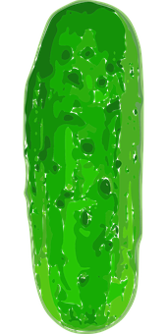
Follow up 1:
Il y a combien de choses ?
une
madeleine
Hay …
deux
cornichons
trois
sucettes
madeleine
quatre
saucisses
cornichon
cinq
glaces
sucette
six
madeleines
saucisse
sept
cornichons
glace
huit
sucettes
neuf
saucisses
dix
glaces
Notes:
Timing: 5 minutes
Aim: guided production of numbers with the vocabulary for the week.
Procedure:
Elicit the number and the food items from pupils, paying attention to pupils’ use of Silent Final Consonant –s.

Slide 3
Follow up 2:
Écris le numéros et le mot.
écrire
quatre madeleines
=
+
madeleine
huit sucettes
+
=
cornichon
sucette
=
saucisse
sept cornichons
-
glace
=
onze saucisses
+
douze glaces
+
+
=
Notes:
Timing: 5 minutes
Aim: written production of numbers with the vocabulary for the week.
Procedure:
1. Pupils do the sum and write down the number and fruit; ensure pupils use the plural form.
2. Click to check answers. Note: the singular items of vocabulary are given as these are not part of pupils’ core vocabulary knowledge, though glace will be taught in Y5, and there is always a role for incidental vocabulary learning. If pupils particularly like or dislike these foods they may well pick up the French words for them.

Slide 4
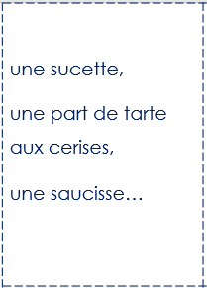
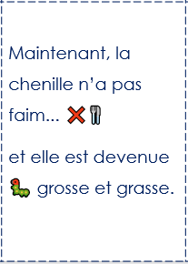
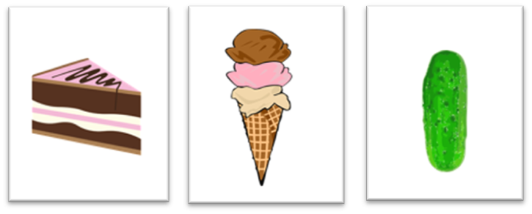
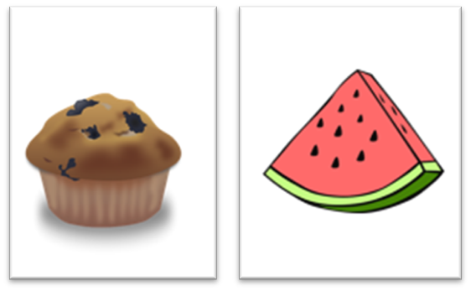
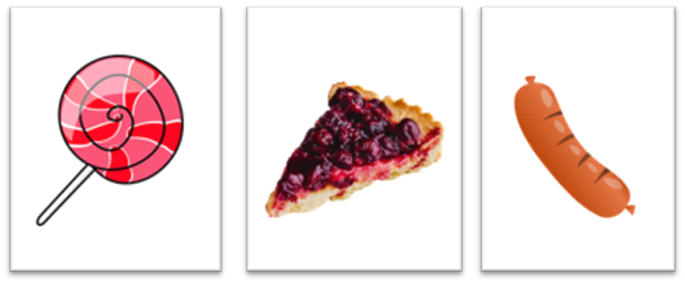
Follow up 3:
Lis à ton/ta partenaire.
Ton/ta partenaire choisit l’image correspondante.
parler
C’est…
C’est
lire
A
B
B
A
écouter
choisit = chooses
Notes:
Timing: 5 minutes
Aim: to extend practice of read aloud, and aural comprehension of key language, and spoken production of days of the week and numbers, through telling and listening to parts of the story with a partner.
Procedure:
Pupils could work in pairs or groups.
Hand out a set of cards and ask pupils to take turns to read a scene from the story. Partner B chooses the card that goes with the scene and then they swap roles.
choisir [226]

Slide 6
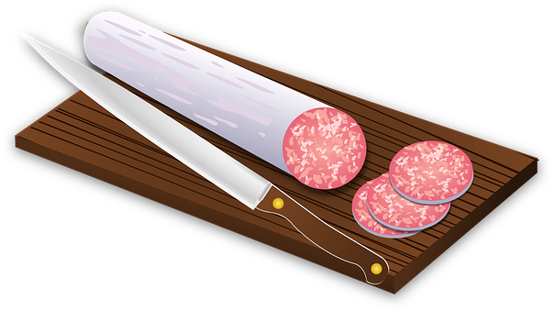
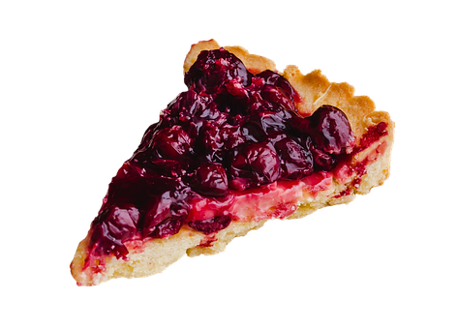

Slide 8
lire

Slide 9
Le samedi, elle croque dans une tranche de gâteau, une glace, un cornichon… | une tranche de fromage, une tranche de saucisson… | une sucette, une part de tarte aux cerises, une saucisse… | une madeleine et une tranche de pastèque. | Puis, elle a mal au ventre 🤢!
Le lendemain, c’est dimanche. la chenille croque dans une feuille verte 🍃 et ça va beaucoup mieux. 😌 | Maintenant, la chenille n’a pas faim... ❌🍴 et elle est devenue 🐛 grosse et grasse. | Elle se construit une maison -un cocon-. | Après deux semaines elle fait un trou dans le cocon et... | maintenant elle est un superbe papillon 🦋!

Slide 10
vocabulaire
Follow up 4
Écris en anglais: Can you get at least 15 points?
mots
 | cher | la voiture | chère
 | le vélo | rapide | gris
 | le silence | en retard | en silence
 | détester | jouer | travailler
 | c’est | verte | le samedi
 | le dimanche | huit | la faim
expensive (m)
(the) car
expensive (f)
x3
(the) bicycle
fast (m/f)
grey (m)
(the) silence
late
in silence
x2
to hate, hating
to play, playing
to work, working
it is, it’s, that’s
green (f)
Saturday
x1
Sunday
eight
hunger
Notes:
Timing: 5 minutes
Aim: to practise written comprehension of vocabulary from week 1, last week and this week.
Procedure: 1. Give pupils a blank grid. They fill in the English meanings of any of the words they know, trying to reach 15 points in total. 2. Remind pupils that adjectives can refer to male or female persons and they should note this in their translations. E.g. pleased (f), short (m).
Note: The most recently learnt and practised words are pink, words from the previous week are green and those from week 1 are blue, thus more points are awarded for them, to recognise that memories fade and more effort (heavy lifting!) is needed to retrieve them.
10

Slide 11
vocabulaire
Écris en anglais: Can you get at least 15 points?
mots
 | cher | la voiture | chère
 | le vélo | rapide | gris
 | le silence | en retard | en silence
 | détester | jouer | travailler
 | c’est | verte | le samedi
 | le dimanche | huit | la faim
x3
x2
x1
Notes:
HANDOUT
11

