Slide 1
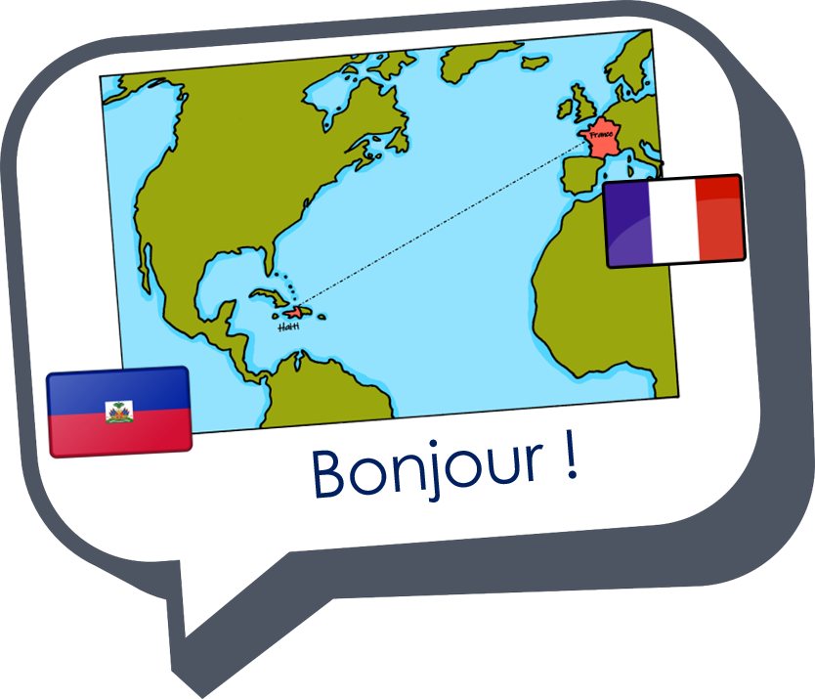
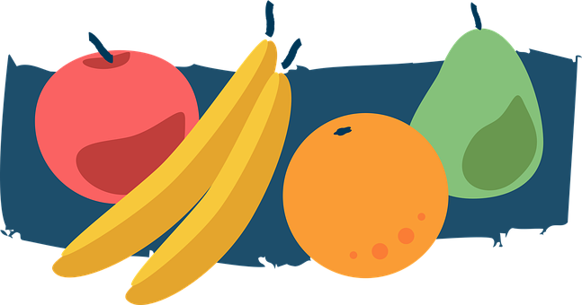
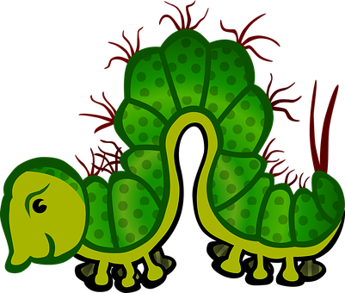
Describing me and others
J’ai faim !
rouge
Follow ups 1-5
Term 3 Week 12
Notes:
Artwork by Steve Clarke. Pronoun pictures from NCELP (www.ncelp.org). All additional pictures selected from Pixabay and are
available under a Creative Commons license, no attribution required.
The AUDIO version of the lesson material includes additional audio for the new language presented (phonics, vocabulary) and audio for the instructions on the slide.
In addition, it includes VIDEO clips of the phonics and the phonics’ source words. Pupils can be encouraged to look at the shape of the mouth/lips on slides where these appear, and try to copy it/them.
Phonics: Revisit several SSC
Vocabulary (new words in bold): ce, c’ [12] combien [800] quoi [297] est [5] il y a [n/a] chose [125] faim [1986] fruit [896] jeudi [1112] jour [78] lundi [1091] mardi [1044] mercredi [1168] orange [3912] pomme [2847] vendredi [1086] rouge [987] vert [1060] un [3] deux [41] trois [115] quatre [253] cinq [288] six [450] sept [905] huit [877] neuf [787] dix [372] onze [2447] douze [1664]
Revisit 1: détester [2898] jouer [219] travailler [290] silence [1281] en retard [n/a]
Revisit 2: vélo [4594] voiture [881] cher [803] gris [2769] rapide [672]
Londsale, D., & Le Bras, Y. (2009). A Frequency Dictionary of French: Core vocabulary for learners London: Routledge.
The frequency rankings for words that occur in this PowerPoint which have been previously introduced in these resources are given in the SOW and in the resources that first introduced and formally re-visited those words. For any other words that occur incidentally in this PowerPoint, frequency rankings will be provided in the notes field wherever possible.
Unknown vocabulary and cognates:
chenille [>5000] fraise [>5000] poire [>5000] prune [>5000] violet [>5000]

Slide 2
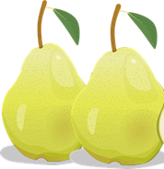
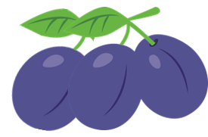
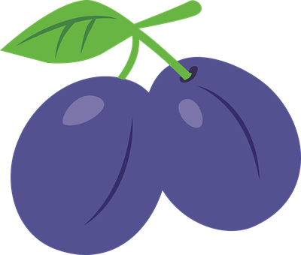
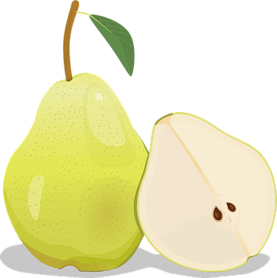
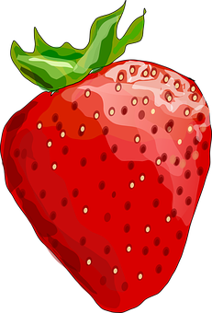
Follow up 1:
Il y a combien de fruits ?
une
pomme
Il y a…
deux
poires
trois
prunes
pomme
quatre
fraises
prune
cinq
oranges
poire
six
pommes
fraise
sept
poires
orange
huit
prunes
neuf
fraises
dix
oranges
Notes:
Timing: 5 minutes
Aim: guided production of numbers with the vocabulary for the week.
Procedure:
Elicit the number and the fruit from pupils, paying attention to pupils’ use of Silent Final Consonant –s.

Slide 3
Follow up 2:
Écris le nombre et le fruit.
écrire
+
=
six
pommes
pomme
+
=
prune
sept
poires
poire
fraise
+
=
neuf
prunes
orange
+
=
dix
fraises
+
+
=
douze
oranges
Notes:
Timing: 5 minutes
Aim: written production of numbers with the vocabulary for the week.
Procedure:
Pupils do the sum and write down the number and fruit; ensure pupils use the plural form. Note: the singular items of vocabulary are given as only two of these items are known vocabulary.

Slide 4
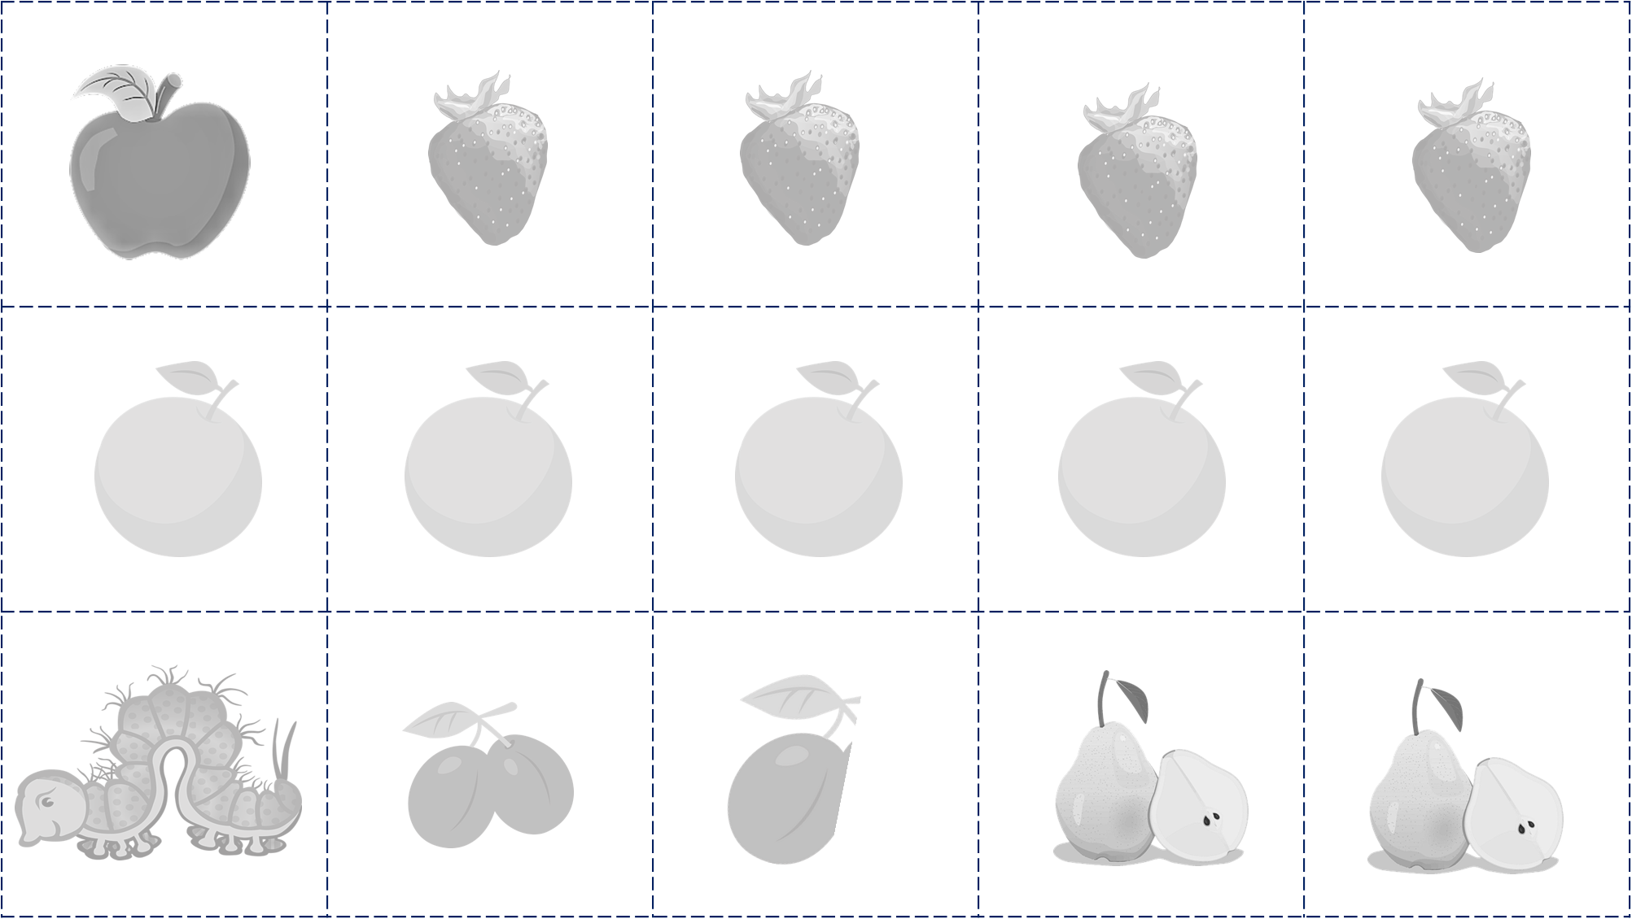
Follow up 3:
Parle avec ton/ta partenaire.
parler
pomme
lundi
mardi
mercredi
jeudi
vendredi
prune
poire
fraise
orange
Notes:
Timing: 5 minutes
Aim: to practise days of the week and the vocabulary introduced this week.
Procedure:
Pupils could work in pairs or groups.
Hand out a set of cards and ask pupils to take turns to turns to say sentences practising the vocabulary (some could be encouraged to add adjectives to their sentences, too.)
NB. Pupils could colour these in and write sentences in preparation or after the speaking activity.

Slide 6
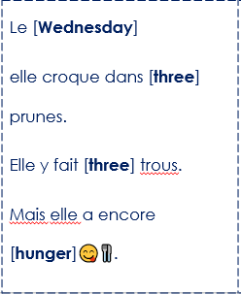
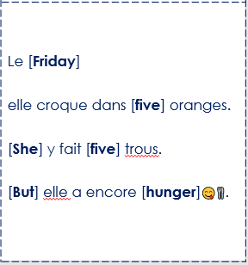
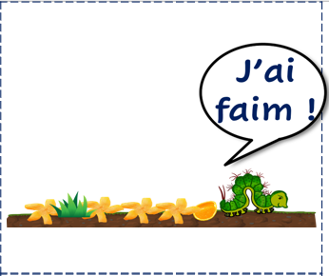
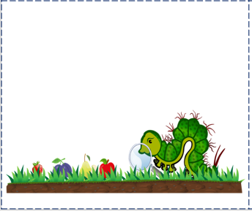
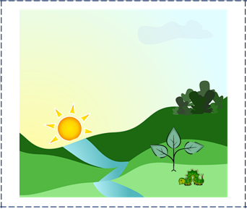
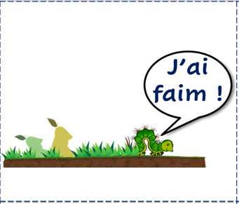
Follow up 4:
Lis à ton/ta partenaire.
Ton/ta partenaire choisit l’image.
parler
C’est…
C’est
lire
B
A
B
A
écouter
choisit = chooses
Notes:
Timing: 5 minutes
Aim: to extend practice of read aloud, and aural comprehension of key language, and spoken production of days of the week and numbers, through telling and listening to parts of the story with a partner.
Procedure:
Pupils could work in pairs or groups.
Hand out a set of cards and ask pupils to take turns to read a scene from the story. Partner B chooses the card that goes with the scene and then they swap roles.
choisir [226]

Slide 7
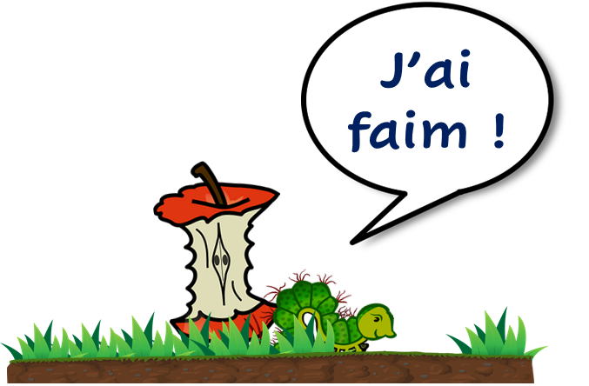
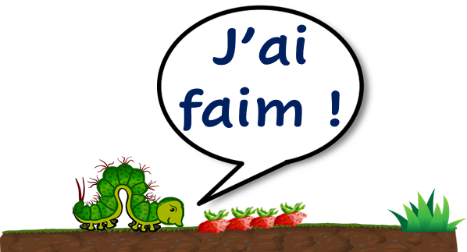
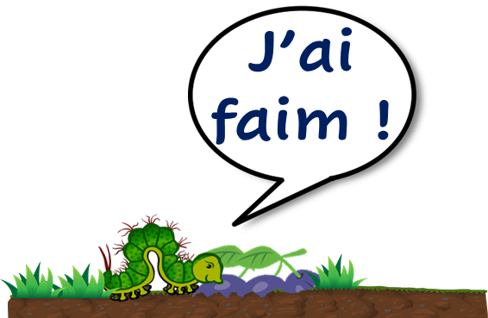
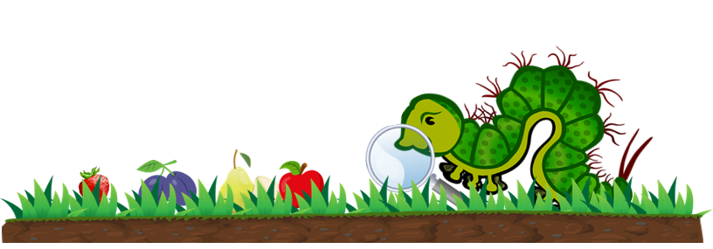
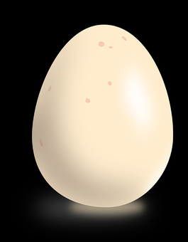

Slide 8
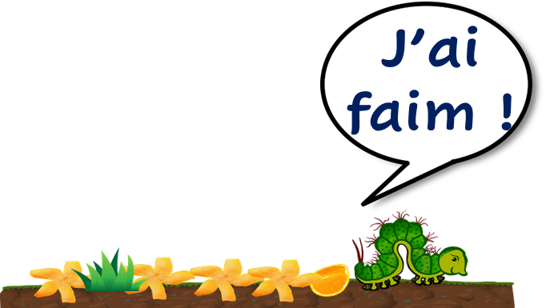
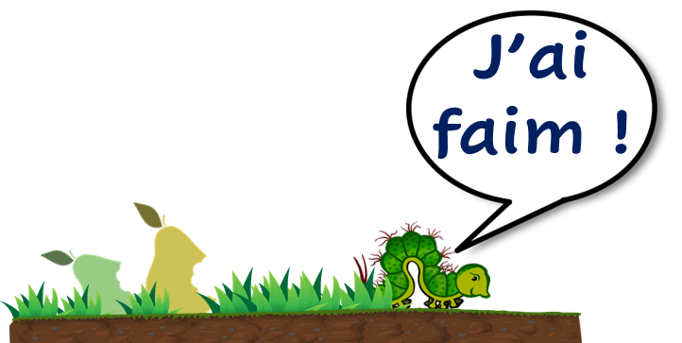
lundi | mardi
jeudi | vendredi
mercredi | dimanche

Slide 9
Dans la lumière 🌃 de la lune 🌑 un petit œuf 🥚 se repose sur une feuille🍃. | Un [Sunday] matin 🌄 une miniscule chenille 🐛 sort de l’œuf 🥚. | Elle a très faim 😋🍴. Immédiatement, elle cherche quelque chose🔎 à manger. 🍴 | Le [Thursday] elle croque dans [four] fraises 🍓. Elle y fait [four] trous. [But] elle a encore [hunger]😋🍴.
Le [Monday] elle croque dans [one] [apple]🍎. Elle y fait [one] trou. Mais elle a encore [hunger]😋🍴. | Le [Tuesday] elle croque dans [two] poires 🍐. Elle y fait [two] trous. Mais elle a encore [hunger]😋🍴. | Le [Wednesday] elle croque dans [three] prunes. Elle y fait [three] trous. Mais elle a encore [hunger]😋🍴. | Le [Friday] elle croque dans [five] oranges. [She] y fait [five] trous. [But] elle a encore [hunger]😋🍴.
Notes:
Storytelling cards for printing.

