Slide 1
What do I know now?
Bonjour ! Ça va ?
rouge
Phonics quiz
Notes:
Artwork by Steve Clarke. Pronoun pictures from NCELP (www.ncelp.org). All additional pictures selected from Pixabay and are
available under a Creative Commons license, no attribution required.
This lesson contains a phonics assessment to check progress in SSC practised in the 2nd term of this year’s course.
The frequency rankings for words that occur in this PowerPoint which have been previously introduced in these resources are given in the SOW and in the resources that first introduced and formally re-visited those words. For any other words that occur incidentally in this PowerPoint, frequency rankings will be provided in the notes field wherever possible.
Frequency of phonics assessment words: moisi [>5000] adieu [3968] démocrate [3554] douve [>5000] façonner [>5000] musicien [3100] pente [2873] potion [>5000] malsain [<5000] milliard [497] mondial [549] moquer [3335] surpris [3408] maigre [3534] visage [1292] capacité [789]
Londsale, D., & Le Bras, Y. (2009). A Frequency Dictionary of French: Core vocabulary for learners London: Routledge.
1

Slide 2
prononcer
[an/en]
[-ien]
prononcer
[slope]
pente
musicien
Notes:
Prior preparation: print out one set of phonics slides and cut in half; print out sufficient pupil feedback sheets to have one per pupil.
Timing: 1 minute per pupil
Aim: to assess pupils’ ability to read aloud the SSC taught this term. Procedure: 1. Give out the independent task that pupils will work on during the lesson. 2. Listen to individual pupils reading the words aloud. Mark in real time.
3. If desired, teachers can listen to the audio versions in preparation.
Note:
there are no follow up lessons this week, so it would be possible to continue the speaking assessments in the follow up time during this week, as needed.
if preferred, and the resources are available, pupils could record their answers (e.g. on computer or ipad) though this would involve the teacher listening back to assess them.
2

Slide 3
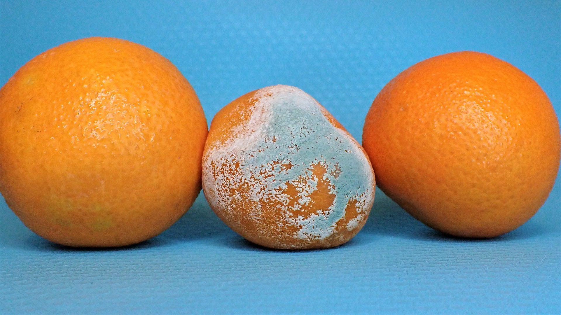
prononcer
[oi]
[-tion]
prononcer
[mouldy]
moisi
potion
Notes:
3

Slide 4
prononcer
[eu]
[é|er]
prononcer
[goodbye]
adieu
capacité
Notes:
4

Slide 5
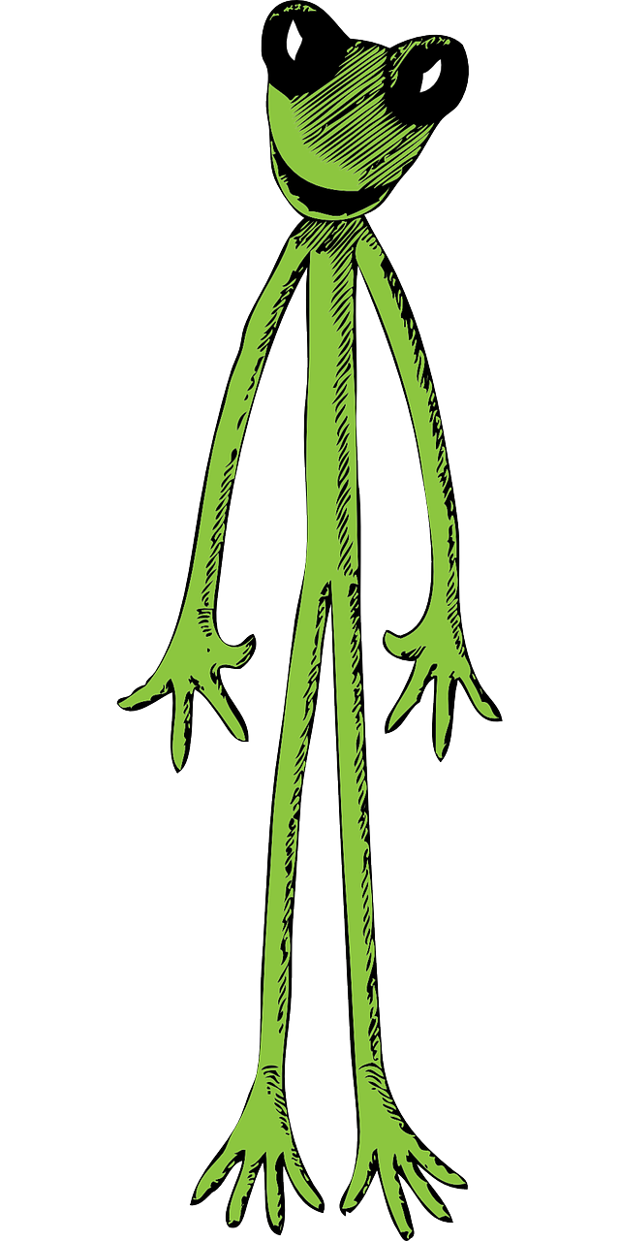
prononcer
[ai]
[(a)in]
prononcer
[thin]
maigre
malsain
Notes:
5

Slide 6
prononcer
[on]
[u]
prononcer
mondial
surpris
Notes:
6

Slide 7
prononcer
[SFC]
[SFe]
prononcer
billion
milliard
[moat]
douve
Notes:
7

Slide 8
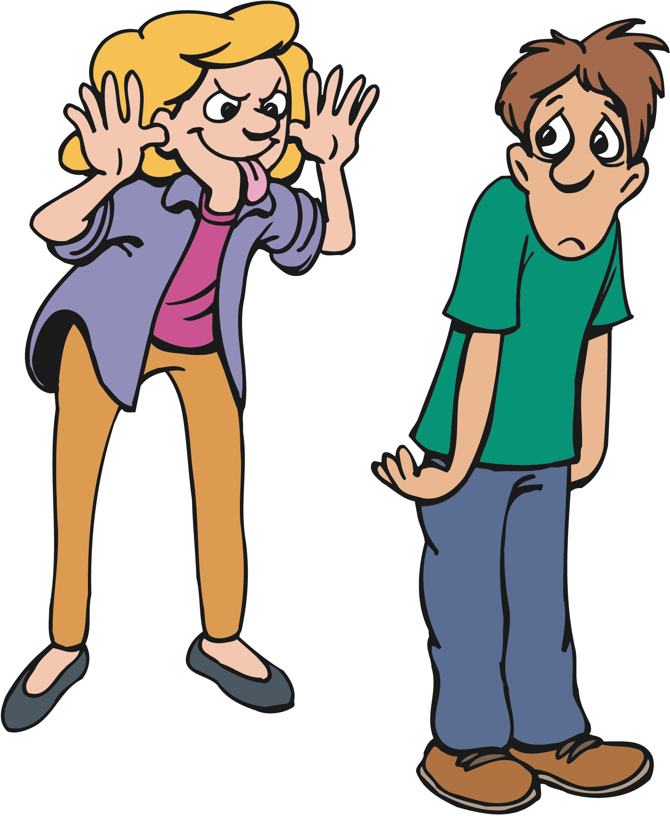
prononcer
[r]
[qu]
prononcer
démocrate
[to tease]
taquiner
Notes:
8

Slide 9
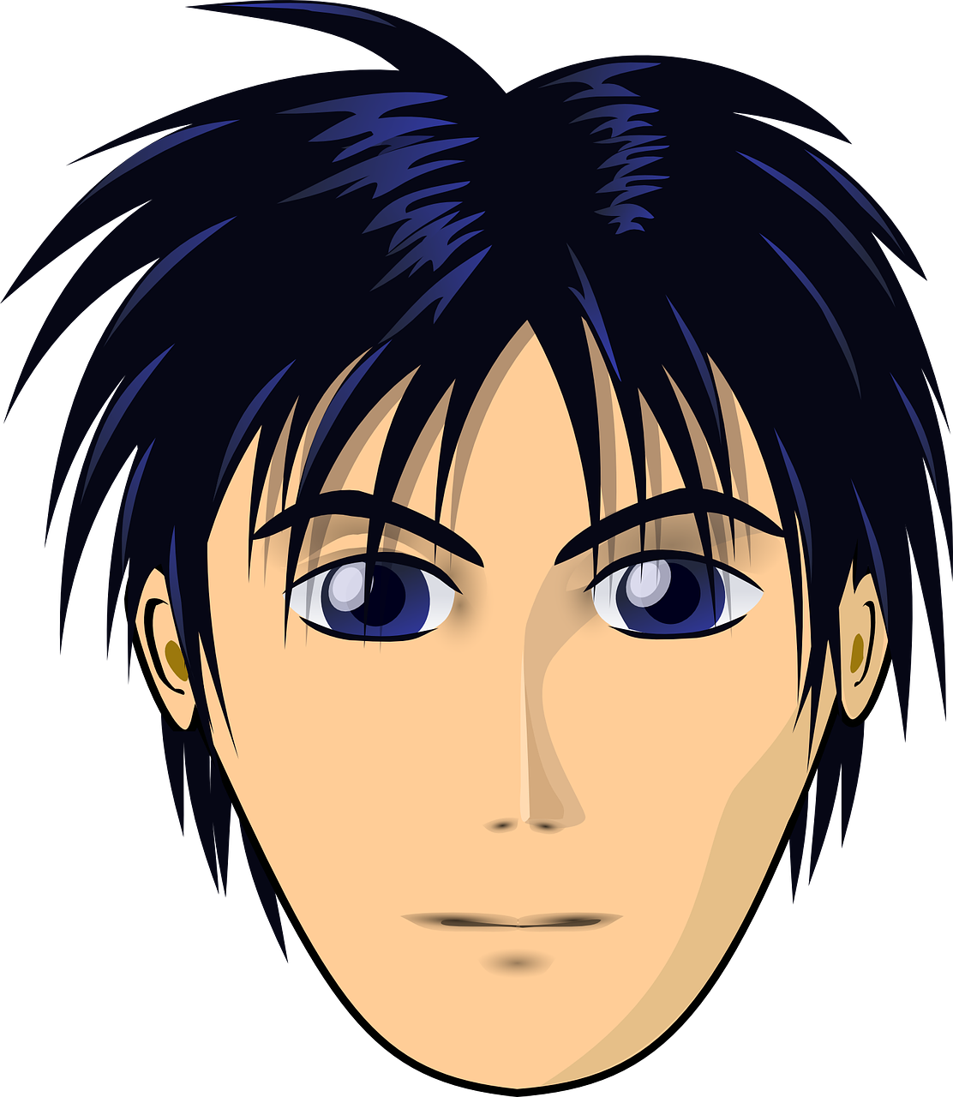
prononcer
[ç|c]
[j/g]
prononcer
[to shape]
façonner
visage
Notes:
9

Slide 10
pronunciar
SSC and word | px
pente
musicien
moisi
potion
adieu
capacité
maigre
malsain
mondial
surpris
milliard
douve
démocrate
taquiner
façonner
visage
SSC and word | px
pente
musicien
moisi
potion
adieu
capacité
maigre
malsain
mondial
surpris
milliard
douve
démocrate
taquiner
façonner
visage
Pupil name:
Pupil name:
Notes:
Pupil feedback and assessment sheet
10

Slide 11
Teacher audio version
SSC and word | px
pente
musicien
moisi
potion
adieu
capacité
maigre
malsain
mondial
surpris
milliard
douve
démocrate
taquiner
façonner
visage
Notes:
Teacher audio version for preparation
11

