Slide 1
Saying how many and describing things
rouge
Follow ups 1-5
Notes:
Artwork by Steve Clarke. Pronoun pictures from NCELP (www.ncelp.org). All additional pictures selected from Pixabay and are available under a Creative Commons license, no attribution required.
Phonics: introduce liaison after x- and s-: deux enfants, trois oranges
Vocabulary (new words in bold): il y a [n/a] un [3] deux [41] trois [115] quatre [253] cinq [288] six [450] sept [905] huit [877] neuf [787] dix [372] onze [2447] douze [1664] Revisit 1: aider [413] aimer [232] habiter [1186] école [477] aussi [44] à (meaning ‘in’) [4]
Revisit 2: --
Londsale, D., & Le Bras, Y. (2009). A Frequency Dictionary of French: Core vocabulary for learners London: Routledge.
The frequency rankings for words that occur in this PowerPoint which have been previously introduced in these resources are given in the SOW and in the resources that first introduced and formally re-visited those words. For any other words that occur incidentally in this PowerPoint, frequency rankings will be provided in the notes field wherever possible.

Slide 2
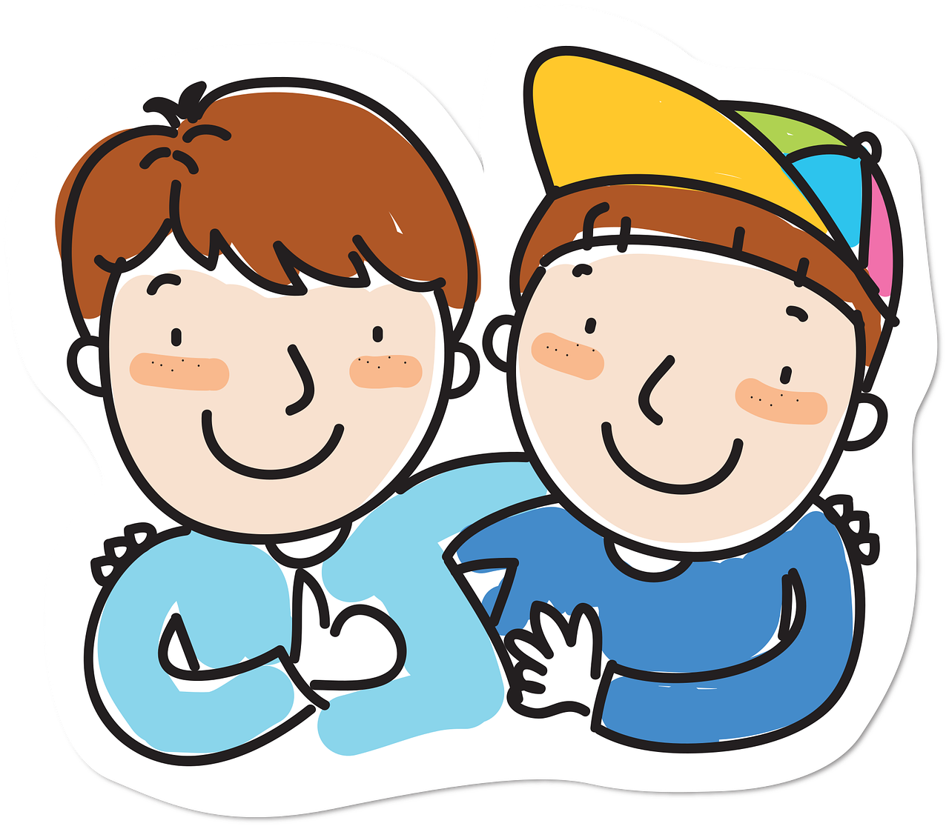
Follow up 1
cocher – to tick
Écoute. C’est ‘(a)in’ ou ‘a’ ?
prononcer
Coche*.
(a)in
a
(a)in
a
(a)in
a
animal
va
africain
[goes]
main
plat
ami
vingt
américain
industrie
Notes:
Timing: 3 minutes
Aim: to practise aural distinction between [(a)in] and [a].
Procedure:
Read the instruction.
Do the first one with pupils.
They can write down the correct SSC or tick if they have a printout.
Some can be encouraged to write the full word.
Elicit responses chorally, and click to reveal the ticks, and the words/pictures.
Transcript:
animal main vingt va plat industrie africain ami américain

Slide 3
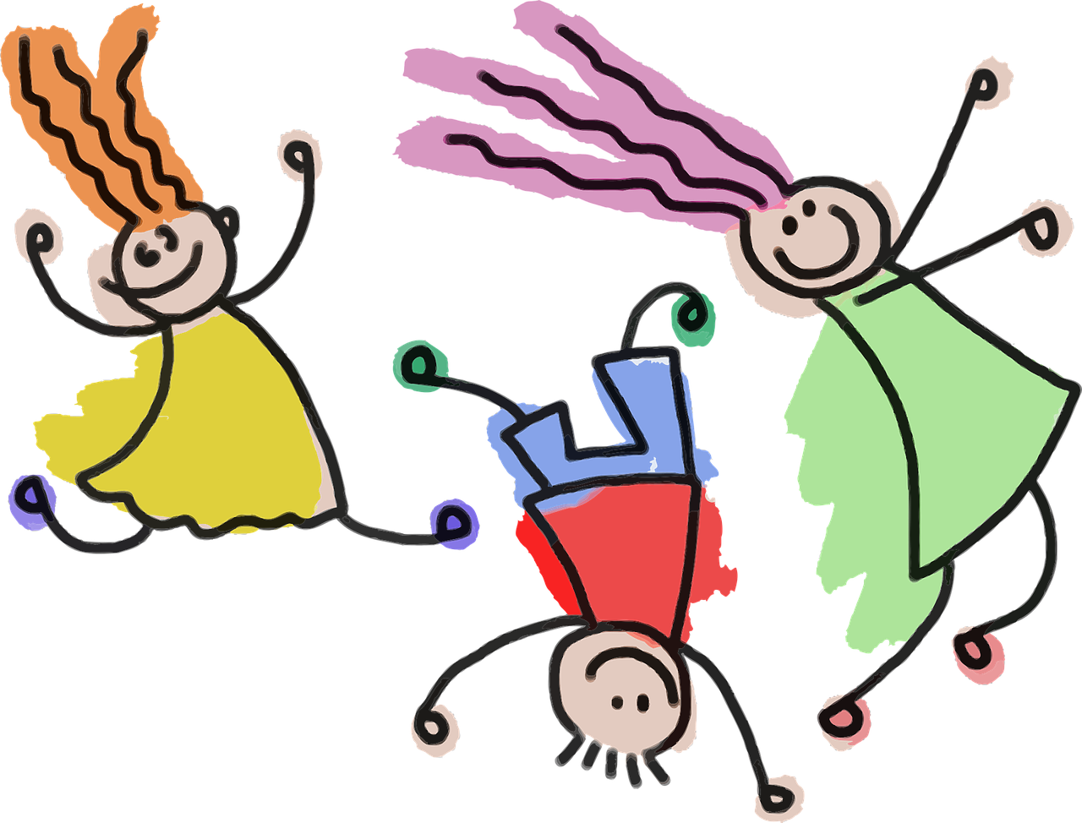
Combien (how many)
Remember! To say how many of something there are, use
‘il y a’ + number or des (some):
Il y a deux maisons.
There are two houses.
Il y a trois familles.
There are three families.
Il y a des enfants.
There are some children.
⚠ Remember the liaison, here.
Notes:
Do before Follow up 2.
Timing: 2 minutes
Aim: to revisit how to say how many using ‘il y a’ + number or des (some); to remember the liaison when the article des (or number ending is –s or –x) comes before a noun beginning with a vowel.
Procedure:
Present the information, using the animated sequence.
Elicit English translation for the French examples provided.

Slide 4
Follow up 2
A
Écoute. C’est A ou B ?
écouter
A
B
en anglais
1
some parties/celebrations
2
some dads/fathers
3
a/one lunch
4
some problems
5
a/one weekend
6
some friends
Notes:
Timing: 5 minutes
Aim: to practise aural comprehension of singular and plural indefinite articles, and previously taught nouns.
Procedure:
Read the instruction in French.
Do [1] with the pupils. Click to listen. Pupils write the correct letter A or B.
Encourage pupils to also write the English translation (or provide it orally during feedback).
Elicit answer and click for to show tick and written answer.
Continue with items 2-6.
Transcript:
Il y a des fêtes. Il y a des pères.
Il y a un déjeuner. Il y a des problèmes. Il y a un weekend. Il y a des amis.

Slide 5
Follow up 3
Écoute. C’est au singulier ou au pluriel ?
A
écouter
Écris 1-6 et ‘one’ ou ‘some’.
Écoute encore. C’est ‘he has’ ou ‘there is/are’ ?
A
B
a/one or some…
1
He has… | There is/are…
He has… | There is/are…
He has… | There is/are…
He has… | There is/are…
He has… | There is/are…
He has… | There is/are…
a sister
2
some films
3
some songs
4
a uniform
5
some books
6
a bag
Notes:
Timing: 5 minutes
Aim: to practise aural comprehension of singular and plural indefinite articles, and previously taught nouns.
Procedure:
Read the instruction in French.
Do [1] with the pupils. Click to listen. Pupils write a or some and, if they can, the noun meaning.
Click to check.
Click to remove the box over ‘he has’ and ‘there is/a’.
Pupils listen again and write the correct letter A or B.
Continue in the same way with items 2-6.
Transcript:
Il a une sœur. Il y a des films. Il a des chansons. Il a un uniforme. Il y a des livres. Il y a un sac.

Slide 6
Follow up 4
C’est qui ? Adèle (je) ou Pierre (tu) ?
Écris 1-6 et Adèle ‘je’ ou Pierre‘tu’. Then answer the questions.
lire
1
4
Who is preparing lunch?
Who eats two oranges?
Who always repeats phrases when they sing?
Who is watching a film?
Who is talking to a friend?
Who is helping in the garden?
What does Adèle’s last message say?
Tu prépares le déjeuner et je trouve le pain pour toi.
Je regarde un film
à la maison et tu regardes des vidéos sur YouTube.
Pierre
Adèle
2
Je mange un
sándwich et deux oranges mais tu manges dix sandwichs !
5
Puis tu aides
Maman dans le jardin et je parle à mon amie sur Whatsapp.
Pierre
Adèle
Adèle
3
Tu chantes mal et tu répètes toujours des phrases !
6
Pierre
C’est un weekend normal chez nous!
It’s a normal weekend at our house.
Notes:
Timing: 5 minutes
Aim: to practise written understanding of range of verbs in ‘je’ and ‘tu’ form in the present tense.
Procedure:
Clarify French instruction.
Model number [1] with pupils
Pupils look at the verb ending to determine whether it is Adèle (je) or Pierre (tu) doing the action.
Elicit answers and click to reveal ‘je’ or ‘tu’.
Look at the English question 1.
Ask pupils to tell you who is preparing the lunch.
Click to reveal the answer. If desired, click on the audio button to hear the full message.
Pupils complete numbers 2-6.
Conduct feedback as above.
Transcript:
Tu prépares le déjeuner et je trouve le pain pour toi.
Je mange un sandwich et deux oranges mais tu manges dix sandwichs ! Tu chantes mal et tu répètes toujours des phrases ! Je regarde un film à la maison et tu regardes des vidéos sur YouTube. Puis tu aides Maman dans le jardin et je parle à mon amie sur Whatsapp. C’est un weekend normal chez nous!

Slide 7
Follow up 5
Parle avec ton/ta partenaire.
Exemple:
parler
Partenaire A
Say there are these things il y a ... | Write here what your partner says there is
1) | 1)
A
Il y a des filles.
Partner A écrit…
some girls
five cuddly toys
Partenaire B
Say there are these things il y a ... | Write here what your partner says there is
1) | 1)
Partner B écrit…
B
five cuddly toys
some girls
Il y a cinq peluches.
Notes:
Timing: 5-10 minutes (3 slides, two rounds of speaking activity)
Aim: to practise oral production and comprehension of singular and plural nouns with indefinite articles and/or numbers.
Note: This slide shows how the speaking task is intended to work. The stages are animated to support the teacher in modelling the task.
Procedure:
After modelling this example, give out the task sheets (at the end of this PPT).
Partner As speak first and Bs write.
Then swap roles for Round 2.
Two answer slides follow this slide.

Slide 8
Follow up 5A
Réponses
Round 1
Partenaire B écrit…
parler
Say there are these things il y a ...
some girls
a party/celebration
ten dogs
some fruit(s)
a school
Write here what your partner says there is/are
1)
2)
3)
4)
5)
Il y a des filles.
1
Il y a une fête.
some girls
2
a party/celebration
Il y a dix chiens.
3
ten dogs
Il y a des fruits.
4
some fruit(s)
Il y a une école.
a school
5
Notes:
ANSWER SLIDE ROUND 1 – DO NOT DISPLAY DURING THE ACTIVITY
Aim: to practise oral production and comprehension of singular and plural nouns with indefinite articles and/or numbers.
Procedure:
Elicit the English from partners B
Elicit the French from partners A
Move to the next slide to give feedback for Round 2.

Slide 9
Follow up 5B
Réponses
Round 2
Partenaire A écrit…
parler
Say there are these things il y a ...
five cuddly toys
two exercise books
some bottles
twelve things
a boy
Il y a cinq peluches.
Write here what your partner says there is/are
1)
2)
3)
4)
5)
1
Il y a deux cahiers.
five cuddly toys
2
two exercise books
Il y a des bouteilles.
3
some bottles
Il y a douze choses.
4
twelve things
Il y a un garçon.
a boy
5
Notes:
ANSWER SLIDE ROUND 2 – DO NOT DISPLAY DURING THE ACTIVITY
Aim: to practise oral production and comprehension of singular and plural nouns with indefinite articles and/or numbers.
Procedure:
Elicit the English from partners A.
Elicit the French from partners B.

Slide 10
vocabulaire
Follow up EXTRA - Écris en anglais : Can you get at least 15 points?
mots
 | l’école | aussi | à
 | aider | aimer | habiter
 | cinq | deux | trois
 | sept | douze | neuf
 | quatre | onze | huit
 | Il y a | un | une
 | des | la chose | combien (de)
(the) school
also
to, at, in
x3
to help, helping
to like, liking
to live, living
five
two
three
seven
twelve
nine
x2
four
eleven
eight
there is/are
a/an, one (m)
a/an, one (f)
x1
some
(the) thing
how many
Notes:
Timing: 5-10 minutes
Aim: to practise written comprehension of vocabulary from this week and previous weeks.
Procedure: Give pupils a blank grid. They fill in the English meanings of any of the words they know, trying to reach 15 points in total.
Note: The most recently learnt and practised words are pink, words from the previous week are green and those from earlier are blue, thus more points are awarded for them, to recognise that memories fade and more effort (heavy lifting!) is needed to retrieve them.
10

Slide 11
vocabulaire
Follow up EXTRA - Écris en français : Can you get at least 15 points?
mots
 | (the) school | also | to, at, in
 | to help, helping | to like, liking | to live, living
 | five | two | three
 | seven | twelve | nine
 | four | eleven | eight
 | there is/are | a/an, one (m) | a/an, one (f)
 | some | (the) thing | how many
l’école
aussi
à
x3
aider
aimer
habiter
cinq
deux
trois
sept
douze
neuf
x2
quatre
onze
huit
Il y a
un
une
x1
des
la chose
combien (de)
Notes:
Timing: 5-10 minutes
Aim: to practise written comprehension of vocabulary from this week and previous weeks.
Procedure: Give pupils a blank grid. They fill in the French meanings of any of the words they know, trying to reach 15 points in total.
Note: The most recently learnt and practised words are pink, words from the previous week are green and those from earlier are blue, thus more points are awarded for them, to recognise that memories fade and more effort (heavy lifting!) is needed to retrieve them.
11

Slide 12
Follow up 5A
Partenaire B écrit…
Partenaire A
Round 1
Round 2
parler
Say there are these things il y a ...
1. some girls
2. a party/celebration
3. ten dogs
4. some fruit(s)
5. a school
Write here what your partner says there is/are
1)
2)
3)
4)
5)
Notes:
HANDOUT – PARTENAIRE A

Slide 13
Follow up 5A
Partenaire B écrit…
Partenaire B
Round 1
Round 2
parler
Write here what your partner says there is/are
1)
2)
3)
4)
5)
Say there are these things il y a ...
1. five cuddly toys
2. two exercise books
3. some bottles
4. twelve things
5. a boy
Notes:
HANDOUT – PARTENAIRE B

Slide 14
vocabulaire
Écris en anglais : Can you get at least 15 points?
mots
 | l’école | aussi | à
 | aider | aimer | habiter
 | cinq | deux | trois
 | sept | douze | neuf
 | quatre | onze | huit
 | Il y a | un | une
 | des | la chose | combien (de)
x3
x2
x1
Notes:
HANDOUT EXTRA 1
14

Slide 15
vocabulaire
Écris en français : Can you get at least 15 points?
mots
 | (the) school | also | to, at, in
 | to help, helping | to like, liking | to live, living
 | five | two | three
 | seven | twelve | nine
 | four | eleven | eight
 | there is/are | a/an, one (m) | a/an, one (f)
 | some | (the) thing | how many
x3
x2
x1
Notes:
HANDOUT EXTRA 2
15

