Slide 1
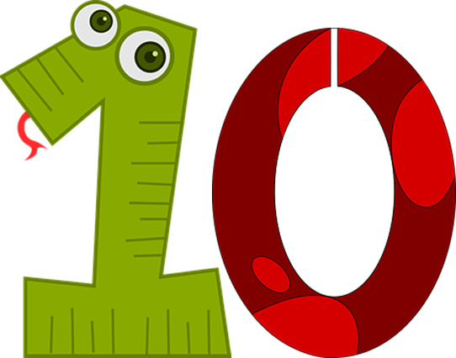
Saying how many and describing things
rouge
Follow ups 1-5
Notes:
Artwork by Steve Clarke. Pronoun pictures from NCELP (www.ncelp.org). All additional pictures selected from Pixabay and are available under a Creative Commons license, no attribution required.
Phonics: introduce liaison after x- and s-: deux enfants, trois oranges
Vocabulary (new words in bold): il y a [n/a] un [3] deux [41] trois [115] quatre [253] cinq [288] six [450] sept [905] huit [877] neuf [787] dix [372] onze [2447] douze [1664] Revisit 1: aider [413] aimer [232] habiter [1186] école [477] aussi [44] à (meaning ‘in’) [4]
Revisit 2: --
Londsale, D., & Le Bras, Y. (2009). A Frequency Dictionary of French: Core vocabulary for learners London: Routledge.
The frequency rankings for words that occur in this PowerPoint which have been previously introduced in these resources are given in the SOW and in the resources that first introduced and formally re-visited those words. For any other words that occur incidentally in this PowerPoint, frequency rankings will be provided in the notes field wherever possible.

Slide 2
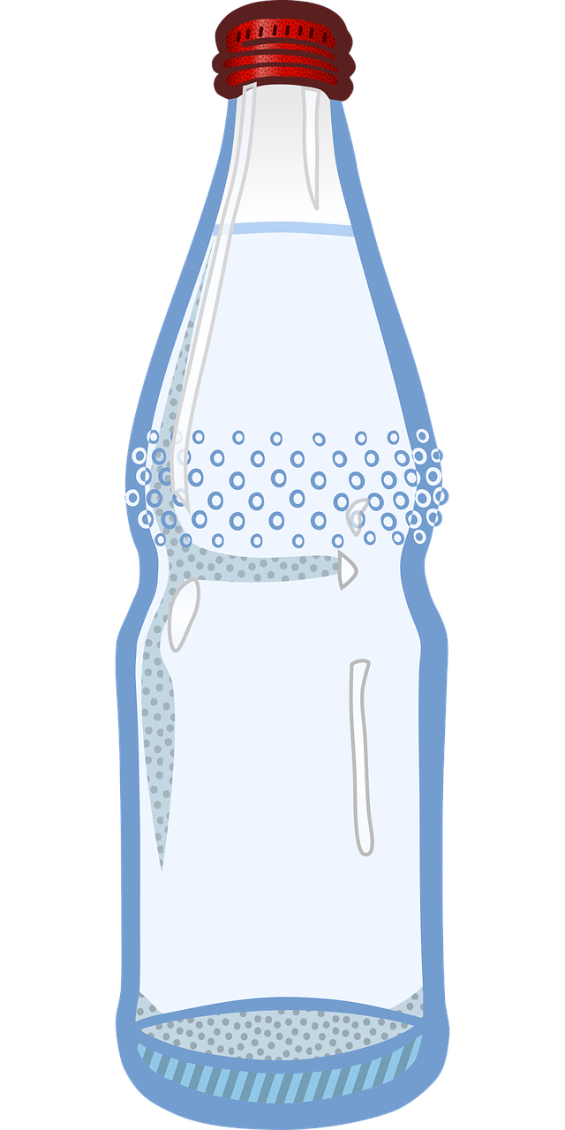
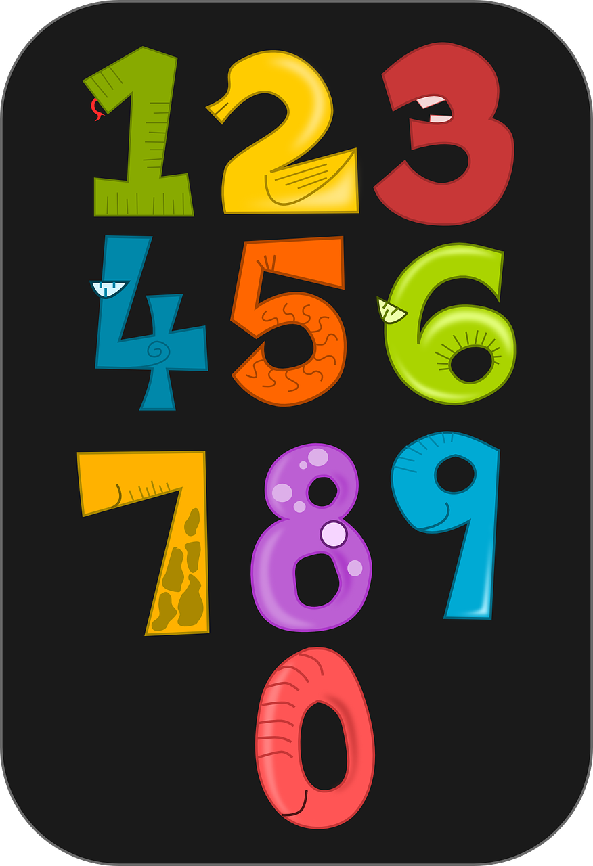
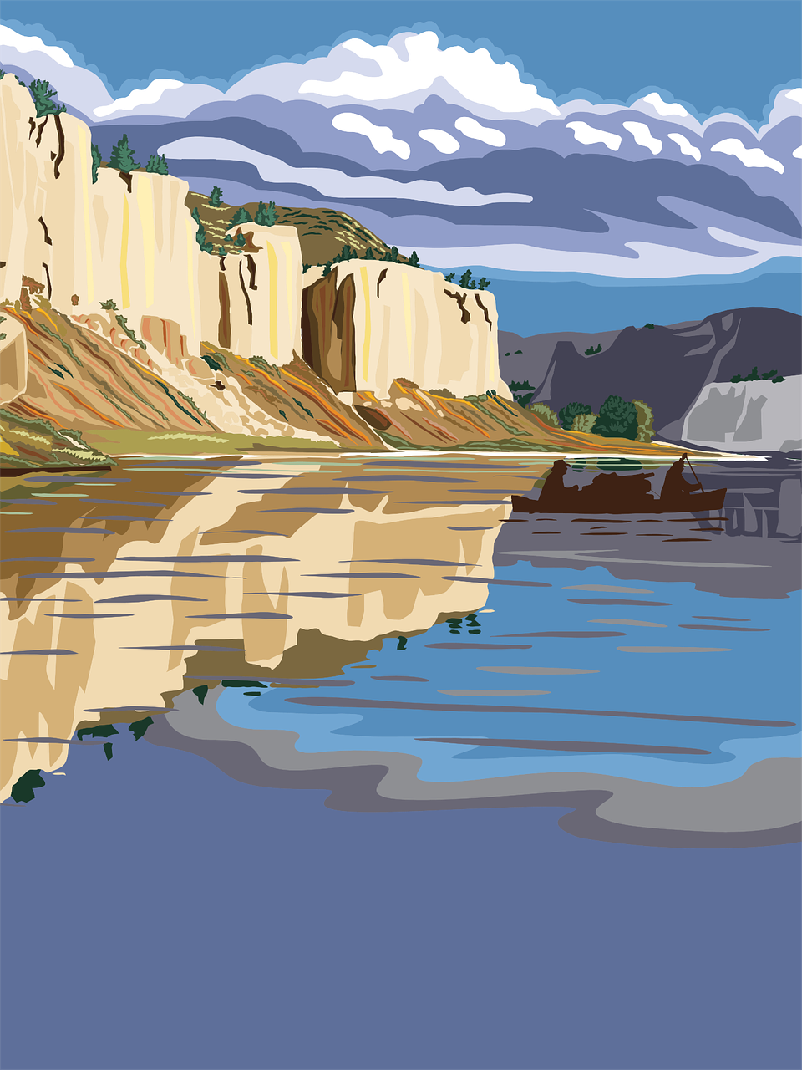
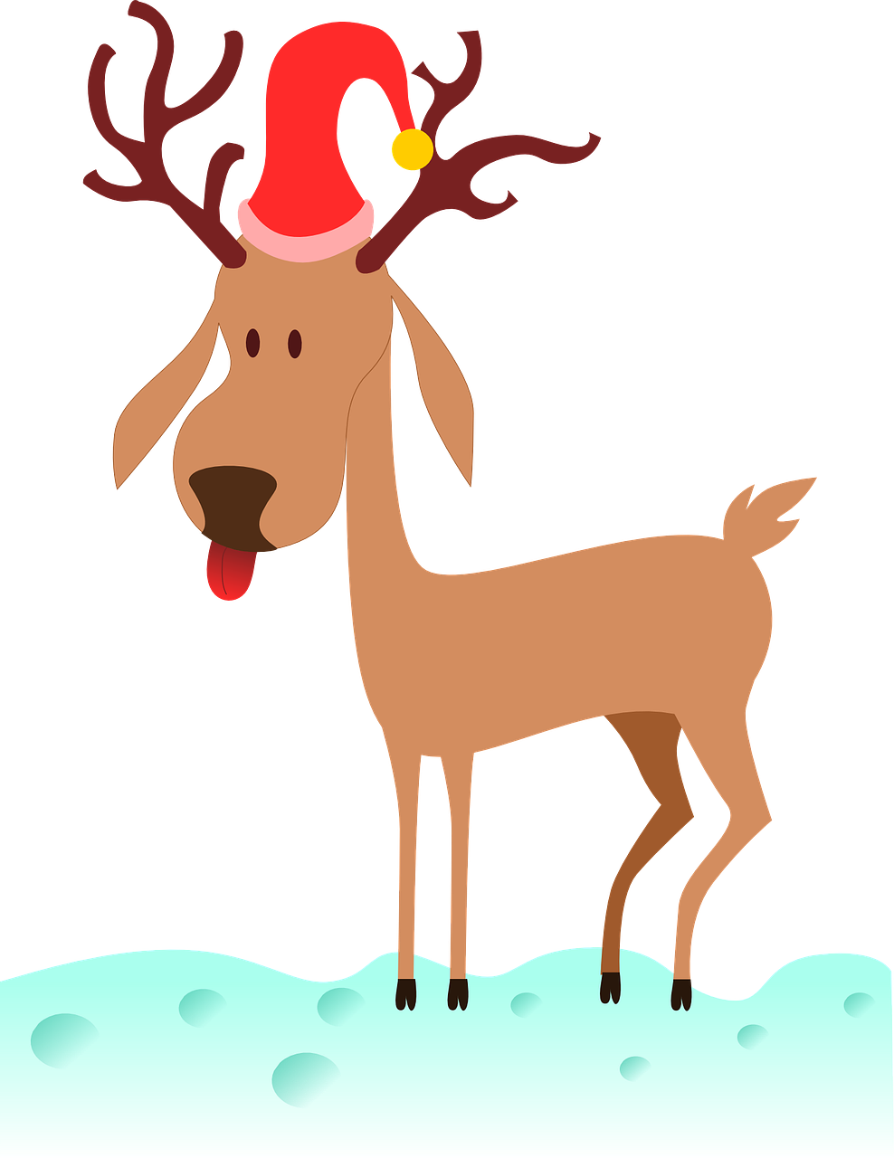
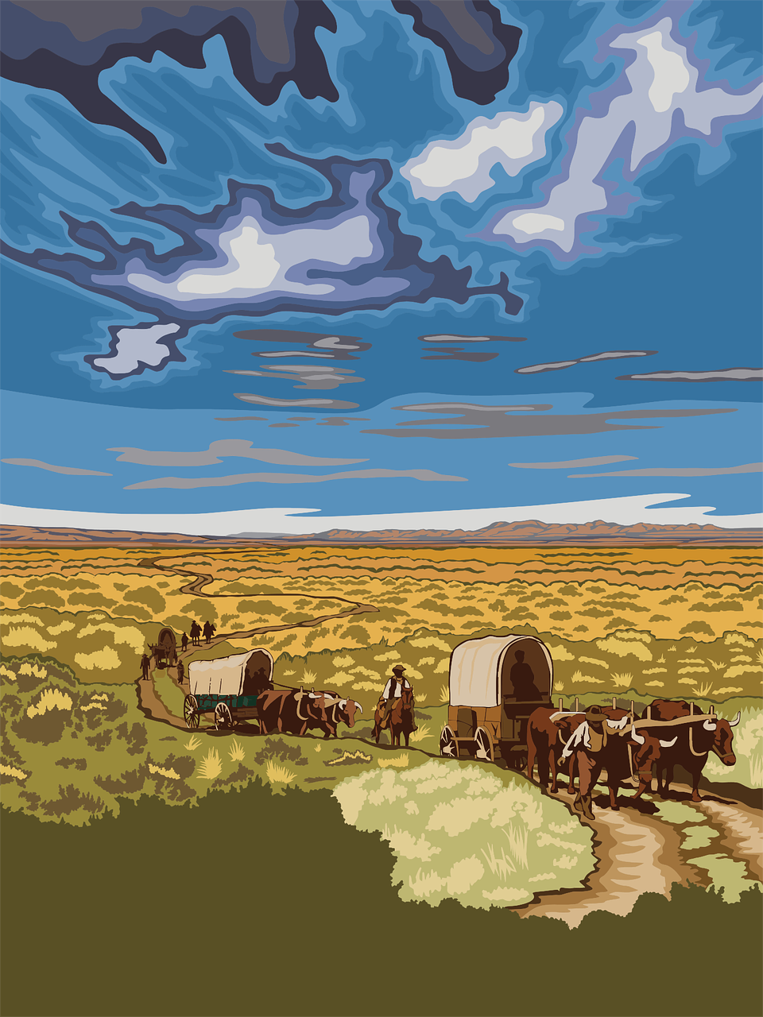
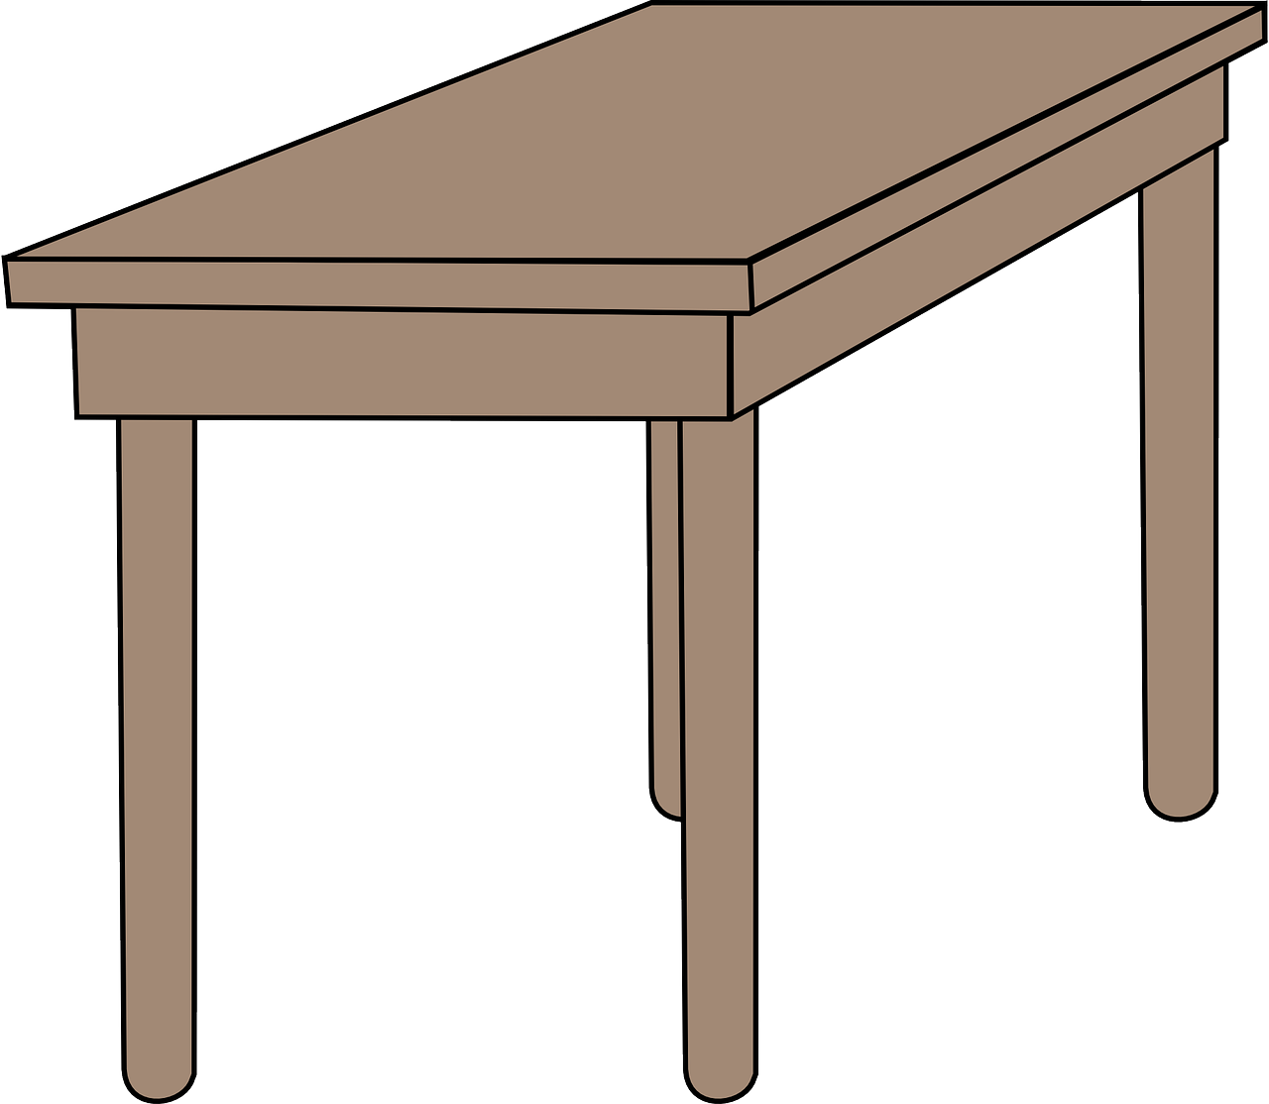
Follow up 1
⚠Remember:
s- and x- before a vowel sound like ‘z’.
Prononce les phrases. Il y a une liaison ?
prononcer
 | deux uniformes
 | trois oranges
 | six peluches
 | deux tables
 | deux enfants
 | dix bouteilles
 | dix affiches
 | trois acteurs
 | trois chats
 | six exercices
deux uniformes
trois oranges
dix affiches
trois acteurs
deux enfants
six exercices
Notes:
Timing: 3 minutes
Aim: to practise s- and x-liaison in with numbers and previously taught nouns.
Procedure:
Do the first one with pupils.
Remind them of the liaison rules, using the callouts. Click to remove them.
Give pupils time in pairs to practise pronunciation.
Elicit responses chorally, and click to reveal liaison or no liaison, and to hear the audio.
Transcript:
deux uniformes trois oranges six peluches deux tables deux enfants dix bouteilles dix affiches trois acteurs trois chats six exercises

Slide 3
Avoir
⚠ To talk about something in the plural (more than one), French often adds ‘s’ to the end of nouns.
[to have | having]
We have seen that the verb avoir means ‘to have’.
I have
j’ai
J’ai deux sacs.
I have two bags.
you have
tu as
Tu as sept stylos.
You have seven pens.
he has
il a
Il a cinq cahiers.
He has five exercise books.
she has
elle a
Elle a neuf peluches.
She has nine cuddly toys.
⚠ Remember also this expression:
there is there are
il y a
Il y a huit chiens.
There are eight dogs.
Notes:
Do before Follow up 2.
Timing: 2 minutes
Aim: to revisit singular persons of avoir, il y a and introduce plural marking of regular nouns.
Procedure:
Present the information, using the animated sequence.
Elicit English translation for the French examples provided.

Slide 4
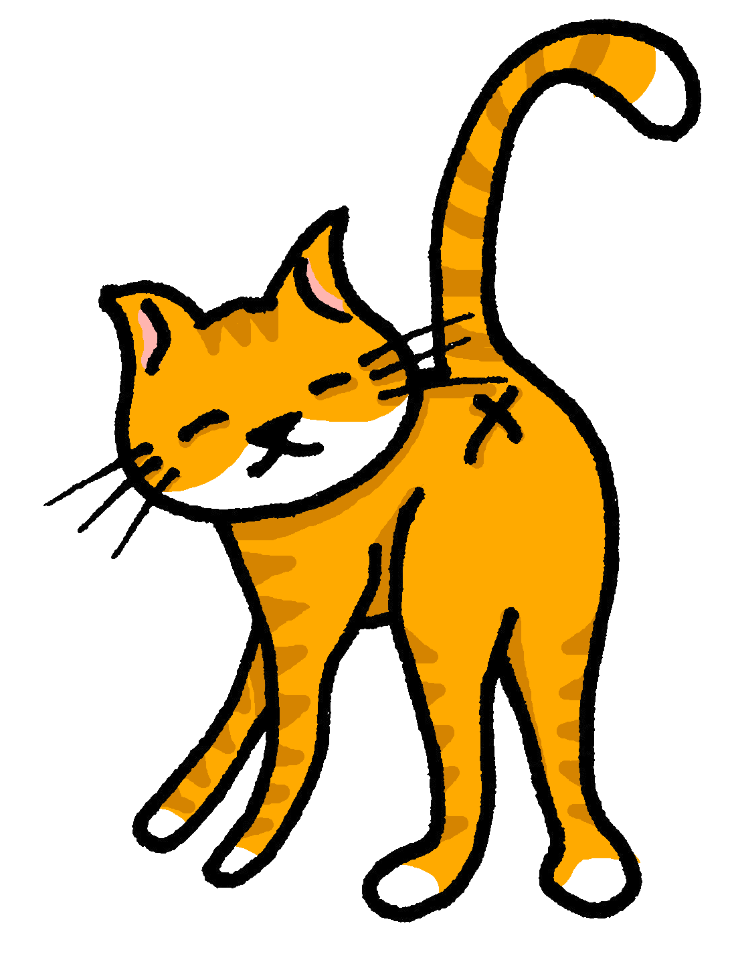
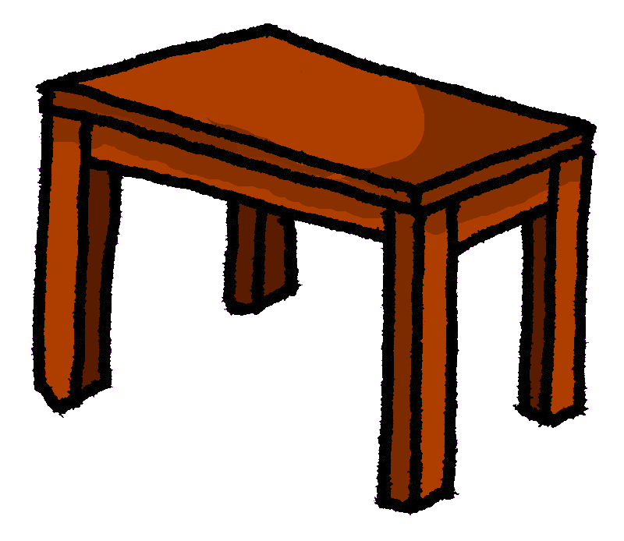
Follow up 2
A
Écoute. La phrase correcte, c’est quoi ?
B Écoute. Trouve l’image correcte et écris le nombre.
écouter
A
B
A | B
C | D
E | F
He has… | There are…
You have… | She has…
There are… | He has…
I have… | You have…
There are… | He has…
There are… | There is…
2
4
1
2
3
9
1
4
5
3
5
6
Notes:
Timing: 5 minutes
Aim: to practise aural comprehension of singular parts of avoir, il y , numbers and revisited vocabulary.
Procedure:
(Part A)
Read the instruction in French.
Do [1] with the pupils. Click to listen. Pupils write the correct letter A or B.
Click for answer.
Complete items 2-6 and click to correct with the class.
(Part B)
Click to listen again.
Write the item letter with the correct number of items mentioned.
Click to correct.
Transcript:
Il y a trois règles. Tu as cinq oranges. Il a deux uniformes. J’ai quatre gommes. Il y a neuf chats. Il y a une table.

Slide 5
vocabulaire
Follow up 3a - Écris en anglais : Can you get at least 15 points?
mots
 | ton | ta | voici
 | ma | mon | le déjeuner
 | l’amie | passer | manger
 | trois | un, une | deux
 | douze | cinq | onze
 | sept | neuf | quatre
 | il y a | dix | huit
your (m)
your (f)
here is, this is
x3
my (f)
my (m)
(the) lunch
(the) friend (f)
to pass, spend (time)
to eat, eating
x2
three
a/an, one (m), (f)
two
twelve
five
eleven
x1
seven
nine
four
there is, there are
ten
eight
Notes:
Timing: 5-10 minutes
Aim: to practise written comprehension of vocabulary from this week and previous weeks.
Procedure: Give pupils a blank grid. They fill in the English meanings of any of the words they know, trying to reach 15 points in total.
Note: The most recently learnt and practised words are pink, words from the previous week are green and those from earlier are blue, thus more points are awarded for them, to recognise that memories fade and more effort (heavy lifting!) is needed to retrieve them.
5

Slide 6
vocabulaire
Follow up 3b - Écris en français : Can you get at least 15 points?
mots
 | your (m) | your (f) | here is, this is
 | my (f) | my (m) | (the) lunch
 | (the) friend (f) | to pass, spend (time) | to eat, eating
 | three | a/an, one (m), (f) | two
 | twelve | five | eleven
 | seven | nine | four
 | there is, there are | ten | eight
ton
ta
voici
x3
ma
mon
le déjeuner
l’amie
passer
manger
x2
trois
un, une
deux
douze
cinq
onze
x1
sept
neuf
quatre
Il y a
dix
huit
Notes:
Timing: 5-10 minutes
Aim: to practise written comprehension of vocabulary from this week and previous weeks.
Procedure: Give pupils a blank grid. They fill in the French meanings of any of the words they know, trying to reach 15 points in total.
Note: The most recently learnt and practised words are pink, words from the previous week are green and those from earlier are blue, thus more points are awarded for them, to recognise that memories fade and more effort (heavy lifting!) is needed to retrieve them.
6

Slide 7
Follow up 4a:
Parle avec ton/ta partenaire.
parler
 | 1, 2, 3, 4, 5, ___ ___ ___ ___
 | 10, 9, 8, 7, ___ ___ ___ ___
 | 2, 1, 3, 1, 4, 1 ___ ___ ___ ___ ___ ___
 | 2, ___, 6, ___, 10
 | 5, 7, 9, 5, __, __, __, __, __
 | 1, 3, 5, ___ ___
1
6
7
8
9
2
6
5
4
3
3
5
1
6
1
7
1
4
4
8
5
7
9
5
7
9
6
7
9
Notes:
Timing: 10 minutes (two slides, two activities)
Aim: to practise oral production of numbers 1-12.
Procedure:
Clarify French instruction.
Model number [1] with pupils
Pupils work in pairs to follow the different series of numbers.
Click on the audio buttons to hear the full sequences.
Encourage pupils to join in to increase fluency in production.

Slide 8
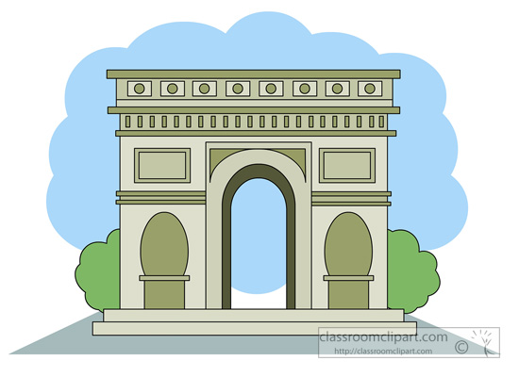
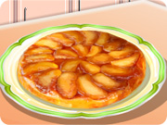
Follow up 4b: Écris en français.
Écris les nombres en français.
écrire
t r o i s
h u i t
s i x
n e u f
u n e
_ _ _ _ _
_ _ _ _
_ _ _
_ _ _ _
_ _ _
d i x
q u a t r e
s e p t
c i n q
d e u x
_ _ _
_ _ _ _ _ _
_ _ _ _
_ _ _ _
_ _ _ _
Notes:
Timing: 8 minutes
Aim: to practise written production of numbers 1-10.
Procedure:
Pupils write the numbers from memory.
Click to reveal the written answers.
Differentiation: For more support, fill in a few of the letters on the slide, and encourage other pupils to turn away from the board to write.

Slide 9
Follow up 5
A
Écoute. Il y a quoi ? Écris en anglais.
écouter
1
There is a/one table.
Il y a une table.
2
There are three books.
Il y a trois livres.
3
There are four friends.
Il y a quatre amis.
4
There are eleven cats.
Il y a onze chats.
5
There are ten girls.
Il y a dix filles.
6
There is a/one boy.
Il y a un garçon.
7
There are twelve people.
Il y a douze personnes.
8
There are two dogs.
Il y a deux chiens.
Notes:
Timing: 5 minutes
Aim: to practise aural comprehension of numbers and previously taught vocabulary.
Procedure:
Read the instruction in French.
Do [1] with the pupils. Click to listen. Pupils write the English.
Click for answer.
Complete items 2-8 and click to correct with the class.
Transcript:
Il y a une table.
Il y a trois livres.
Il y a quatre amis.
Il y a onze chats.
Il y a dix filles.
Il y a un garçon.
Il y a douze personnes.
Il y a deux chiens.

Slide 10
vocabulaire
Écris en anglais : Can you get at least 15 points?
mots
 | ton | ta | voici
 | ma | mon | le déjeuner
 | l’amie | passer | manger
 | trois | un, une | deux
 | douze | cinq | onze
 | sept | neuf | quatre
 | il y a | dix | huit
x3
x2
x1
Notes:
HANDOUT
10

Slide 11
vocabulaire
Écris en français : Can you get at least 15 points?
mots
 | your (m) | your (f) | here is, this is
 | my (f) | my (m) | (the) lunch
 | (the) friend (f) | to pass, spend (time) | to eat, eating
 | three | a/an, one (m), (f) | two
 | twelve | five | eleven
 | seven | nine | four
 | there is, there are | ten | eight
x3
x2
x1
Notes:
HANDOUT
11

