Slide 1
Saying what I and others do
rouge
-ER verbs - present tense
SSC [oi]
Notes:
Artwork by Steve Clarke. Pronoun pictures from NCELP (www.ncelp.org). All additional pictures selected from Pixabay and are
available under a Creative Commons license, no attribution required.
The AUDIO version of the lesson material includes additional audio for the new language presented (phonics, vocabulary) and audio for the instructions
on the slide.
In addition, it includes VIDEO clips of the phonics and the phonics’ source words. Pupils can be encouraged to look at the shape of the mouth/lips on
slides where these appear, and try to copy it/them.
Phonics: introduce [oi] voir [69] avoir [8] au revoir [4/1274] pourquoi ? [193] trois [115]
Vocabulary (new words in bold): préférer [597] village [1295] ville [260] dans [11] en ce moment [n/a] Revisit 1: fête [1490] fille [629] fruit [896] garçon [1599] de¹ [2]
Revisit 2: jour [78] chaque [151] revisit days of the week
Londsale, D., & Le Bras, Y. (2009). A Frequency Dictionary of French: Core vocabulary for learners London: Routledge.
The frequency rankings for words that occur in this PowerPoint which have been previously introduced in these resources are given in the SOW and in the resources that first introduced and formally re-visited those words. For any other words that occur incidentally in this PowerPoint, frequency rankings will be provided in the notes field wherever possible.
1

Slide 2
prononcer
[oi]
voir
[to see, seeing]
Notes:
Timing: 3 minutes (two slides)
Aim: to introduce SSC [oi].
Procedure:
Introduce and elicit the pronunciation of the individual SSC [oi] and the source word ‘voir’.
Click to bring on the picture and get students to repeat (with gesture, if using).
Present and practise the cluster words.
Gesture: gesture for voir
https://www.signbsl.com/sign/see (scroll down to the correct definition of ‘see’ and we recommend the 1st video of these three) – right index finger comes up to the eye and then points away from the body as if tracing the path of sight from the eyes towards an object in view.
2

Slide 3
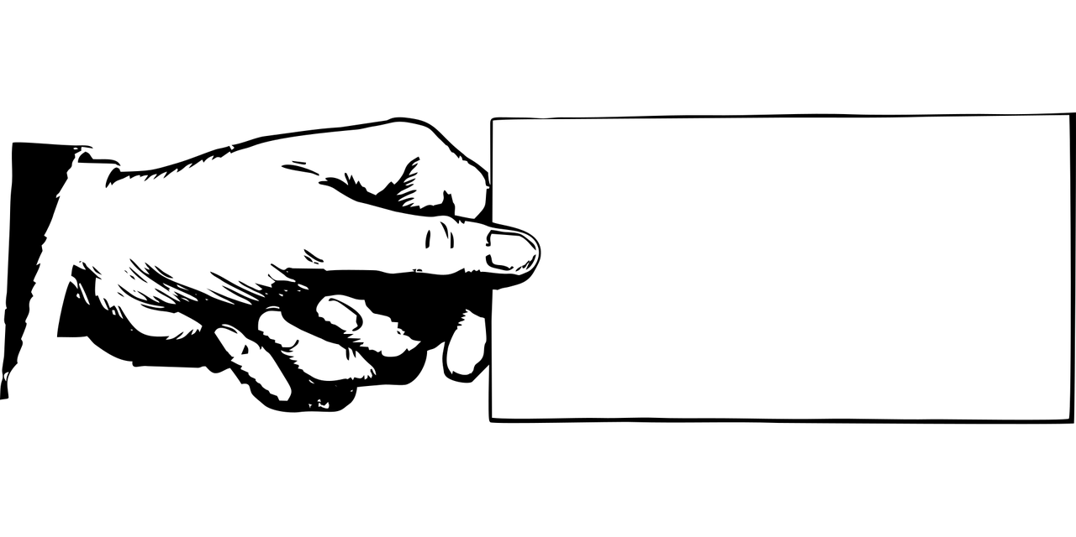
prononcer
[oi]
voir
to have, having
avoir
Au revoir !
[to see, seeing]
[why?]
trois
pourquoi ?
Notes:
Timing: 2 minutes
Aim: to recap SSC [oi].
Procedure:
Introduce and elicit the pronunciation of the individual SSC [oi] and the source word ‘voir’.
Click to bring on the picture and get students to repeat (with gesture, if using).
Present and practise the cluster words.
Gesture: gesture for voir
https://www.signbsl.com/sign/see (scroll down to the correct definition of ‘see’ and we recommend the 1st video of these three) – right index finger comes up to the eye and then points away from the body as if tracing the path of sight from the eyes towards an object in view.
3

Slide 4
Translating the French present tense into English
English has two present tense forms but French has one:
You listen to a song.
Tu écoutes une chanson.
You are listening to a song.
It could be either meaning.
Adverbs of time tell us which English form to use:
Tu écoutes une chanson tous les jours.
This is for a regular, repeated action in the present, like a routine.
You listen to a song every day.
Tu écoutes une chanson en ce moment.
This is for something that is ongoing, happening now.
You are listening to a song at the moment.
Notes:
Timing: 2 minutes
Aim: To compare the English and the French present tenses and focus on the importance of time adverbs in deciding which English translation to use.
Procedure:
Click to present the information.
Elicit the English meanings of the examples.
4

Slide 5
lire
Pierre écrit en anglais mais c’est difficile !
Help Pierre with his English homework by choosing the correct adverb.
I sing…
1
I sing every week.
at the moment | every week.
2
Max is playing football…
at the moment | every week.
Max is playing football at the moment.
3
You speak English every week.
You speak English…
at the moment | every week.
She is listening to a song…
at the moment | every week.
4
She is listening to a song at the moment.
I am helping at the moment.
5
I am helping…
at the moment | every week.
Notes:
Timing: 3 minutes
Aim: to increase awareness of English present tense use (present simple and present continuous) with adverbs of time.
Procedure:
Ensure that the context is clear. Pierre needs the class’ help with his English homework.
Model the first item, eliciting the correct time phrase.
Given pupils one minute to discuss items 2-5.
Elicit responses chorally and click to display the answers.
5

Slide 6
écouter
Pierre écoute en français (c’est facile !) mais il lit en anglais et c’est difficile !
Help Pierre with his English homework by choosing the correct English verb form.
Écoute. Le verbe correct en anglais, c’est quoi ?
1
You help|are helping your sister.
If you hear tous les jours (every day) use the simple present.
2
I prepare|am preparing my bag.
3
I use|am using a pen.
If you hear en ce moment use the continuous (-ing) present.
4
He eats|is eating a sandwich.
5
She watches|is watching a film.
6
You repeat|are repeating a phrase.
7
She lives|is living in a town.
Notes:
Timing: 7 minutes
Aim: to practise aural recognition of two French adverb time phrases and their connection with the correct English verb forms.
Procedure:
Click to bring up the two callouts to remind pupils about the time phrases they will hear.
Click to listen to item 1. Elicit the correct English verb. Click to reveal the written answer.
Repeat step 2 for items 2-7.
Transcript: 1. Tu aides ta sœur en ce moment. 2. Je prépare mon sac tous les jours. 3. J’utilise un stylo tous les jours. 4. Il mange un sandwich en ce moment. 5. Elle regarde un film tous les jours.
6. Tu répètes une phrase en ce moment. 7. Elle habite dans une ville en ce moment.
6

Slide 7
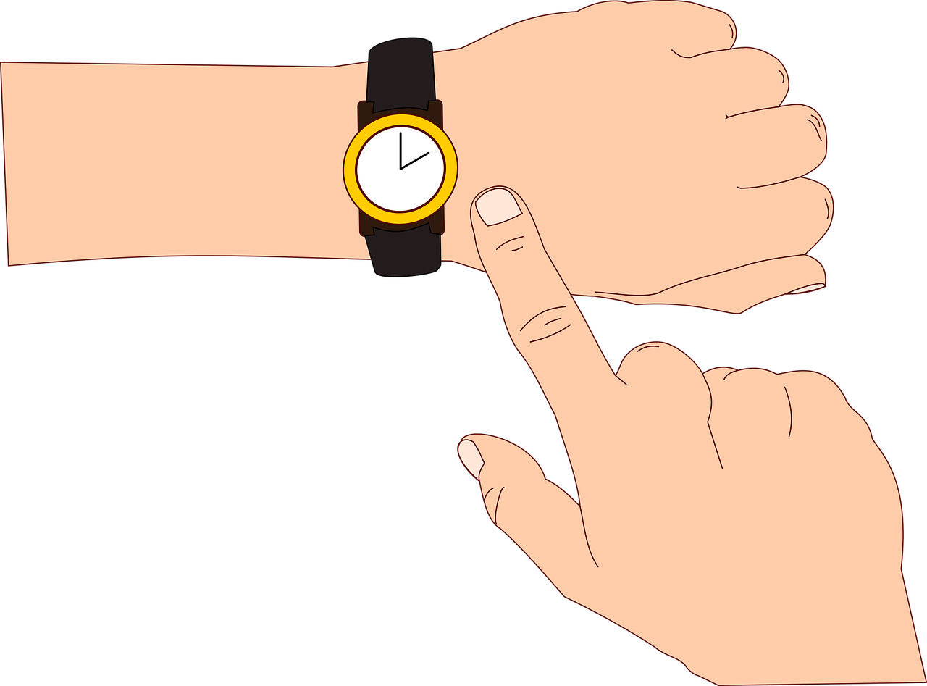
vocabulaire
Écoute et répète.
mots
la ville
prefer
[town]
préférer
le village
[to prefer,
preferring]
[village]
dans
en ce moment
[in]
[at the moment]
Notes:
Timing: 4 minutes (two slides)
Aim: to introduce key vocabulary for this week.
Procedure: 1. Teacher clicks to present the French words one by one. Pupils can repeat. (1 minute)
2. Pupils either work individually or in pairs, reading the French words out loud and looking at the English meanings (1 minute). 3. Then the teacher removes the English words or pictures (one by one) and pupils try to recall the English orally (chorally), looking at the French (1 minute).
4. When teacher clicks, the French words re-appear (with audio in the audio version). 5. Then the French meanings are removed (one by one) and pupils try to recall them orally (again, chorally), looking at the English (1 minute) 6. Further rounds of learning can be facilitated by one pupil turning away from the board, and his/her partner asking him/her the meanings (‘Comment dit-on XXX en anglais/français ?’). This activity can work from L2 → L1 or L1 → L2.
Habiter image attribution: Iconathon, CC0, via Wikimedia Commons

Slide 8
Verbs of opinion
Opinion verbs usually translate into the simple present in English:
J’aime la ville mais je préfère le village.
⚠ Verbs like préférer change the 2nd [é] → [è] in je, tu, il/elle. Others you have seen like this are répéter, compléter.
I like the town but I prefer the village.
Il aime la semaine et il aime aussi le weekend.
He likes the week and he also likes the weekend..
Remember that aussi follows the verb but also goes inbetween the pronoun and verb.
Notes:
Timing: 2 minutes
Aim: To present information about verbs of opinion in French and English, to draw attention to a spelling change with préférer and remind pupils about the position of aussi.
Procedure:
Click to present the information.
Elicit the English meanings of the examples.
8

Slide 9
parler
Parle en français. [1/5]
You like the town and you also like the village.
T_ a_ _ _ _ l_ v_ _ _ _ e_
t_ a_ _ _ _ a_ _ _ _ l_ v_ _ _ _ _ _.
Tu aimes la ville et
tu aimes aussi le village.
Notes:
1/5
Timing: 8 minutes
Aim: to practise spoken production of present tense sentences.
Procedure:
Click to bring up the English prompt.
Click to bring up the speaking scaffold.
Give pupils 30 seconds to work with a partner to work out the sentence.
Cue the class to say the full sentence, together.
Click to reveal the written version of the sentence, and say the full sentence.
Repeat steps 1-5 for the next four slides.
9

Slide 10
parler
Parle en français. [2/5]
She is living in the town at the moment.
E_ _ _ h_ _ _ _ _ d_ _ _ l_ v_ _ _ _ e_ c_ m_ _ _ _ _ _.
Elle habite dans la ville en ce moment.
Notes:
2/5
10

Slide 11
parler
Parle en français. [3/5]
I am watching the film at the moment.
J_ r_ _ _ _ _ _ l_ f_ _ _ e_ c_ m_ _ _ _ _ _.
Je regarde le film en ce moment.
Notes:
3/5
11

Slide 12
parler
Parle en français. [4/5]
I listen to the song every day.
J’_ _ _ _ _ _ l_ c_ _ _ _ _ _ t_ _ _ l_ _ j_ _ _ _.
J’écoute la chanson tous les jours.
Notes:
4/5
12

Slide 13
parler
Parle en français. [5/5]
He likes football but I prefer tennis.
I_ a_ _ _ l_ f_ _ _ _ _ _ _ m_ _ _ j_ p_ _ _ _ _ _ l_ t_ _ _ _ _.
Il aime le football mais je préfère le tennis.
= le football
= le tennis
Notes:
5/5
13

Slide 14
Au revoir !
rouge
Notes:
14

