Slide 1
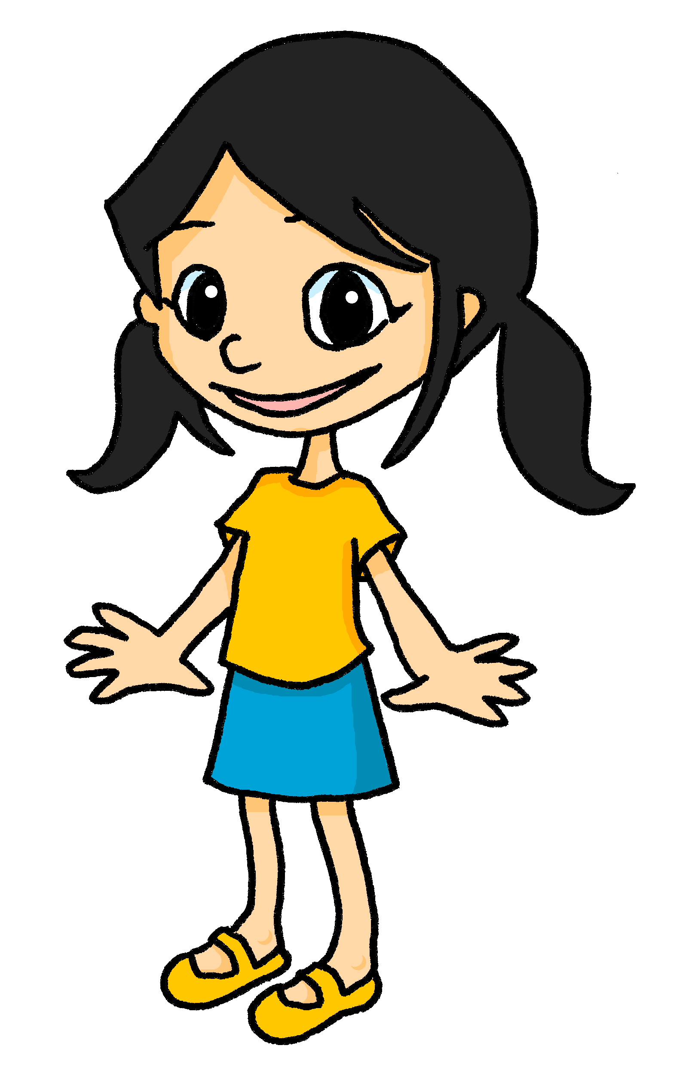
Saying what I and others do
Eugénie et Léa
possessive adjectives mon, ma, ton, ta
meanings of à
SSC [ai]
rouge
Notes:
Artwork by Steve Clarke. Pronoun pictures from NCELP (www.ncelp.org). All additional pictures selected from Pixabay and are
available under a Creative Commons license, no attribution required.
The AUDIO version of the lesson material includes additional audio for the new language presented (phonics, vocabulary) and audio for the instructions
on the slide.
In addition, it includes VIDEO clips of the phonics and the phonics’ source words. Pupils can be encouraged to look at the shape of the mouth/lips on
slides where these appear, and try to copy it/them.
Phonics: introduce [ai] vrai [292] maison [325] aider [413] aimer [242] semaine [245]
Vocabulary (new words in bold): aider [413] aimer [232] habiter [1186] école [477] aussi [44] à (meaning ‘in’) [4] Revisit 1: donner [46] préparer [368] trouver [83] famille [172] frère [1043] mère [645] père [559] sœur [1558] le [1] la [1] à (meaning ‘to’) [4]
Revisit 2: cadeau [2298] gâteau [4845] pour [10] moi [132] toi [510] parfait [1600]
Londsale, D., & Le Bras, Y. (2009). A Frequency Dictionary of French: Core vocabulary for learners London: Routledge.
The frequency rankings for words that occur in this PowerPoint which have been previously introduced in these resources are given in the SOW and in the resources that first introduced and formally re-visited those words. For any other words that occur incidentally in this PowerPoint, frequency rankings will be provided in the notes field wherever possible.
1

Slide 2
prononcer
[ai]
vrai
Notes:
Timing: 3 minutes (two slides)
Aim: to present [ai]
Procedure:
Present the letter(s) and say the [ai] sound first, on its own. Students repeat it with you.
2. Bring up the word ”vrai” on its own, say it, students repeat it, so that they have the opportunity to focus all of their attention on the connection between the written word and its sound.
3. Repeat again, along with the picture, and with gesture, if using.
4. Roll back the animations and work through 1-3 again, but this time, dropping your voice completely to listen carefully to the students saying the [ai] sound, pronouncing ”vrai” and, if using, doing the gesture.
Suggested gesture: gesture for vrai – either mime a tick Or use the BSL (4th video is the best one): https://www.signbsl.com/sign/true
Word frequency (1 is the most frequent word in French):
vrai [292]
Source: Londsale, D., & Le Bras, Y. (2009). A Frequency Dictionary of French: Core vocabulary for learners London: Routledge.
2

Slide 3
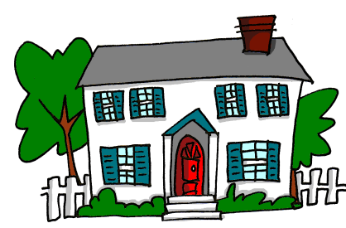
prononcer
[ai]
vrai
to like, liking
to help, helping
aimer
aider
week
maison
semaine
Notes:
Aim: To consolidate SSC [ai]
Procedure:
1. Introduce and elicit the pronunciation of the individual SSC [ai] and then the source word again ‘vrai’ (with gesture, if using). 2. Then present and elicit the pronunciation of the five cluster words.
Word frequency (1 is the most frequent word in French): aider [413] aimer [232] maison [325] semaine [245] vrai [292] Source: Londsale, D., & Le Bras, Y. (2009). A Frequency Dictionary of French: Core vocabulary for learners London: Routledge.
Word frequency (1 is the most frequent word in French):
vrai [292].
Source: Londsale, D., & Le Bras, Y. (2009). A Frequency Dictionary of French: Core vocabulary for learners London: Routledge.
3

Slide 4
vocabulaire
Écoute et répète.
mots
aimer
aider
habiter
[to like,
liking]
[to help, helping]
[to live, living]
l’école (f)
à
aussi
[school]
[in, to, at]
[also, too]
Notes:
Timing: 4 minutes (two slides)
Aim: to introduce new vocabulary for this week.
Procedure: 1. Teacher clicks to present the French words one by one. Pupils can repeat. (1 minute)
2. Pupils either work individually or in pairs, reading the French words out loud and looking at the English meanings (1 minute). 3. Then the teacher removes the English words or pictures (one by one) and pupils try to recall the English orally (chorally), looking at the French (1 minute).
4. When teacher clicks, the French words re-appear (with audio in the audio version). 5. Then the French meanings are removed (one by one) and pupils try to recall them orally (again, chorally), looking at the English (1 minute) 6. Further rounds of learning can be facilitated by one pupil turning away from the board, and his/her partner asking him/her the meanings (‘Comment dit-on XXX en anglais/français ?’). This activity can work from L2 → L1 or L1 → L2.
Habiter image attribution: Iconathon, CC0, via Wikimedia Commons

Slide 5
Saying ‘my’ and ‘your’
We know there are different words for my and your because nouns are either masculine or feminine.
mon frère
my brother
ma sœur
my sister
Also make the liaison when speaking.
We have seen that when the noun starts with a vowel, we always use ‘mon’ or ‘ton’, even when the noun is feminine:
Voici mon amie.
Voici mon ami.
Voici mon amie.
Voici mon ami.
This is my (male) friend.
This is my (female) friend.
Voici ton école.
Voici ton hôtel.
Voici ton école.
Voici ton hôtel.
This is your hotel.
This is also true for most words that start with ‘h’.
This is your school.
Notes:
Timing: 2 minutes
Aim: to recap singular possessive adjectives ‘my’ and ‘your’ and the rule for using ‘mon, ton’ with nouns that begin with a vowel or ‘h’.
Procedure: 1. Click to present the information.
2. Elicit responses from pupils, following the animated question marks.

Slide 6
parler
Prononce la phrase.
Eugénie likes lots of things.
1
J’aime mon amie.
Remember that je → j’ in front of a vowel.
Notes:
Timing: 2 minutes (4 slides)
Aim: to practise pronunciation of ‘mon’, with and without liaison.
Procedure:
Click to bring up Eugénie’s sentence.
Pupils read aloud.
Click the numbered button to listen and checken.
Draw pupils’ attention to the liaison.
5. Repeat steps 1-4 for the next three slides.
Transcript: J’aime mon amie.
6

Slide 7
parler
Prononce la phrase.
2
J’aime mon jeu.
Remember that je → j’ in front of a vowel.
Notes:
(2/4)
Transcript: J’aime mon jeu.
7

Slide 8
parler
Prononce la phrase.
3
J’aime ma sœur.
Remember that je → j’ in front of a vowel.
Notes:
(3/4)
Transcript: J’aime ma sœur.
8

Slide 9
parler
Prononce la phrase.
4
J’aime mon école.
Remember that je → j’ in front of a vowel.
Notes:
(4/4)
Transcript: J’aime mon école.
9

Slide 10
vocabulaire
C’est ‘le’ ou ‘la’ ? Eugénie organise les mots.
mots
photo
école
le, l’
fille
la, l’
ballon
garçon
ballon
cahier
règle
bouteille
sac
table
peluche
stylo
chat
table
stylo
cadeau
bouteille
peluche
chat
animal
maison
sac
jeu
chanson
cahier
animal
chanson
livre
gomme
garçon
école
cadeau
règle
jeu
fille
livre
gomme
maison
photo
Notes:
Timing: 4 minutes
Aim: to practise connecting taught nouns with their gender / definite article.
Procedure:
Each item is triggered, allowing the teacher to elicit answers in any order from pupils.
When pupils say a noun with its correct article, e.g. le sac, the teacher clicks on the word and the animation sees it slot into the correctly gendered box.
3. Repeat for all 20 nouns.
10

Slide 11
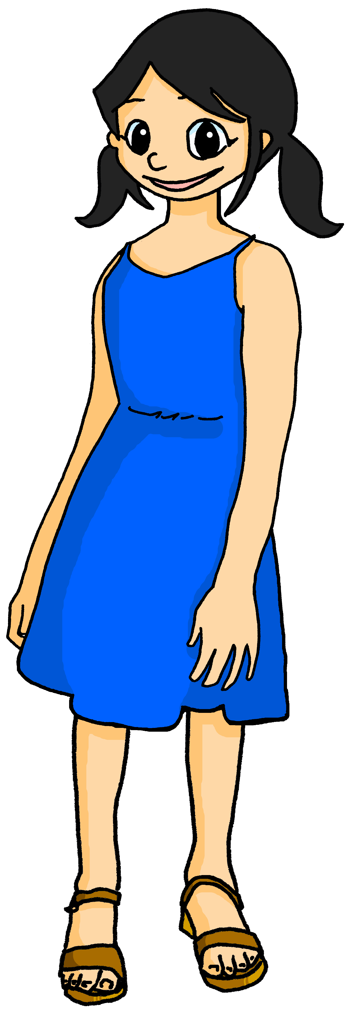
écouter
Eugénie aime la chambre de Léa.
Elle aime quoi exactement ?
 | A ou B | A ou B
 | sac | bouteille | peluche | chat
 | jeu | chanson | photo | livre
 | table | cadeau | ballon | règle
 | stylo | banane | gomme | cahier
 | école | maison | garçon | fille
1
1
2
2
3
3
4
4
5
5
Notes:
Timing: 8 minutes
Aim: to practise aural distinction of ton / ta and their connection with previously taught nouns.
Procedure:
Read the title and clarify the activity. Eugénie likes her older sister’s room and lots of her sister’s things. But which things does she mention?
Ensure that pupils know they will hear either ‘ton’ or ‘ta’ and they need to connect this with the correct noun, depending on the gender. They won’t hear the noun (thing) itself mentioned. They must decide for each word if it goes with ‘ton’ or ta’.
Do number 1 with pupils all together to model the task. Click to play audio.
Pupils write 1. and either A or B (x 2)
Elicit answers from pupils, checking their understanding.
Click the green audio button to listen and check. Clarify any misunderstandings.
Repeat for items 2-5.
Click to check answers and audio buttons to listen and check.
With the answers on display, ask pupils to tell you what it is that Eugénie says she likes. (See answers listed below).
Transcript 1:
“J’aime ton [sac] et j’aime aussi ton [chat].” “J’aime ton [jeu] et j’aime aussi ta [photo].”
“J’aime ta [table] et j’aime aussi ta [règle].”
“J’aime ton [stylo] et j’aime aussi ta [gomme].”
“J’aime ton [école] et j’aime aussi ta [fille].”
Transcript 2:
“J’aime ton sac et j’aime aussi ton chat.” “J’aime ton jeu et j’aime aussi ta photo.”
“J’aime ta table et j’aime aussi ta règle.”
“J’aime ton stylo et j’aime aussi ta gomme.”
“J’aime ton école et j’aime aussi ta fille.”
Answers: 1. bag, cat 2. game, photo 3. table, ruler 4. pen, rubber 5. school, girl
11

Slide 12
Meanings of ‘à’ (to, at, in)
We have learned that à can mean ‘to’:
Je donne un cadeau à Léa.
I give a present to Léa.
We also know that à can mean ‘at’:
J’aide mon père à la maison.
I help my dad at the house/home.
Use à to mean ‘in’ with town and city names, too:
J’habite à Lorient.
I live in Lorient.
You know je → j’ before a vowel. Also use j’ before most words starting with h- because the h- is silent.
Notes:
Timing: 2 minutes
Aim: to recap previously taught meanings of à (to, at) and introduce a further meaning (in).
Procedure: 1. Click to present the information.
2. Elicit responses from pupils, following the animated question marks.

Slide 13
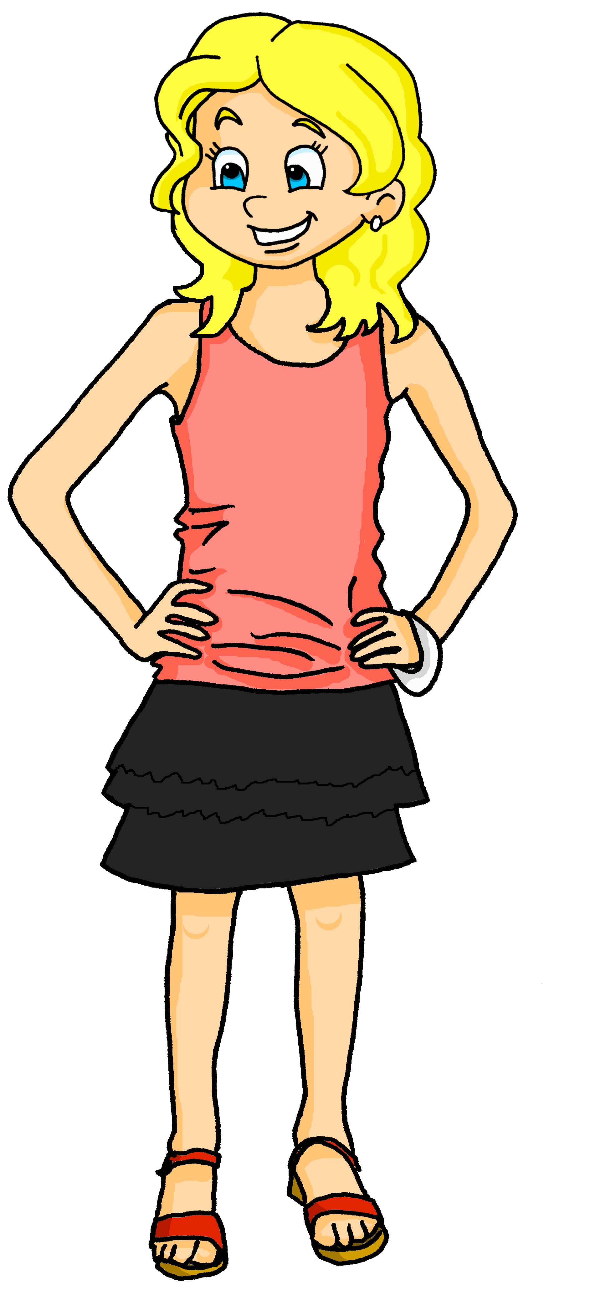
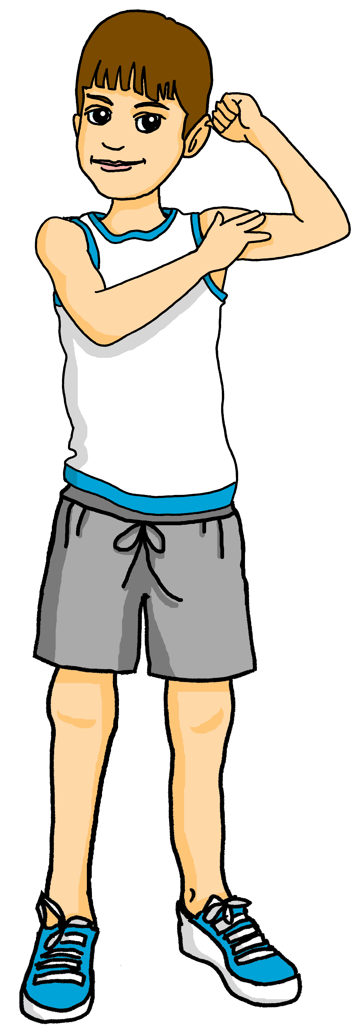
lire
Adèle écrit une déscription pour les devoirs.*
Mais elle décrit Léa ou Yves ?
Décide pour chaque phrase.
1
Voici mon ami.
Yves
à
2
Il habite à Lorient.
Yves
in
Il aide la professeure à l’école.
Yves
at
3
à
4
Elle est intelligente et amusante.
Léa
at
à
Léa
5
Elle aide à la maison chaque jour.
à
Le weekend, il est à Paris.
Yves
6
in
Elle passe le weekend à Lorient avec moi.
Léa
7
à
in
8
to
Je parle à mon amie tous les jours.
Léa
à
Notes:
Timing: 7 minutes
Aim: to practise written comprehension of a range of new and previously learnt vocabulary; to understand the different meanings of à in sentences.
Procedure:
Ensure that the context is clear. Adèle has written descriptions of her friends Léa (a girl) and Yves (a boy). Which sentence is about which person?
Complete number 1 as an example with pupils.
Pupils complete 2-8.
Click to correct and clarify any misunderstandings.
Click to highlight the first instance of à, and elicit the meaning in English.
Continue with the remaining 5 items.
If time allows, elicit any details that Adèle gives about her friends. (See answers below).
ANSWERS Yves – lives in Lorient, helps his (female teacher) at school, is in Paris at the weekend Léa – is intelligent and funny, Adèle talks to her every day, helps at home every day, is spending the weekend in Lorient with Adèle.
13

Slide 14
Au revoir !
rouge
Notes:
14

