Slide 1
Saying what I and others do
Eugénie et Léa
rouge
Follow ups 1-5
Notes:
Artwork by Steve Clarke. Pronoun pictures from NCELP (www.ncelp.org). All additional pictures selected from Pixabay and are available under a Creative Commons license, no attribution required.
Phonics: introduce [ai] vrai [292] maison [325] aider [413] aimer [242] semaine [245]
Vocabulary (new words in bold): aider [413] aimer [232] habiter [1186] école [477] aussi [44] à (meaning ‘in’) [4] Revisit 1: donner [46] préparer [368] trouver [83] famille [172] frère [1043] mère [645] père [559] sœur [1558] le [1] la [1] à (meaning ‘to’) [4]
Revisit 2: cadeau [2298] gâteau [4845] pour [10] moi [132] toi [510] parfait [1600]
Londsale, D., & Le Bras, Y. (2009). A Frequency Dictionary of French: Core vocabulary for learners London: Routledge.
The frequency rankings for words that occur in this PowerPoint which have been previously introduced in these resources are given in the SOW and in the resources that first introduced and formally re-visited those words. For any other words that occur incidentally in this PowerPoint, frequency rankings will be provided in the notes field wherever possible.

Slide 2
prononcer
[ai]
[è]
[ai] and [è] sound the same in French.
vrai
frère
(brother)
Notes:
Timing: 5 minutes (two slides)
Aim: to consolidate [ai] and [è] and teach pupils that it is the same sound in French.
Procedure:
Present the letter(s) and say the [ai] sound first, on its own. Pupils repeat it with you.
2. Bring up the word ”vrai” on its own, say it, pupils repeat it.
3. Repeat again, along with the picture, and with gesture, if using.
4. Present [è] and say the sound on its own. Pupils repeat it.
5. Bring up the word “frère” on its own, say it, pupils repeat it. 6. Repeat again, along with the picture.
7. Ask pupils what they notice (i.e., that they sound the same).
8. Click to bring up the callout to confirm this.
Suggested gesture: gesture for vrai – either mime a tick Or use the BSL (4th video is the best one): https://www.signbsl.com/sign/true
Word frequency (1 is the most frequent word in French):
vrai [292]
Source: Londsale, D., & Le Bras, Y. (2009). A Frequency Dictionary of French: Core vocabulary for learners London: Routledge.
2

Slide 3
Follow up 1:
Écoute et lis le poème.
Maintenant, prononce le poème avec Eugénie.
Mon anniversaire est le vingt-sept mai
1
Mais l’anniversaire de mon petit frère
All the highlighted letters have the same [ai] [è] sound.
2
est dans la derrière semaine de juillet
3
Il aime faire la fête avec son jouet
l’anniversaire = birthday
vingt-sept = 27
mai = May derrière = last
juillet = July faire = do, make
son jouet = his toy
4
Moi je préfère aider ma mère, c’est vrai !
5
Notes:
Aim: to practise connecting different spellings of the same sound.
Procedure:
Click each line of the poem to listen, and pupils read along.
Click to bring up the instruction to pronounce the poem, highlight all the instances of the [ai | è] sound and the callout to remind pupils about this.
Give pupils the opportunity to practise pronouncing the poem.
Click on Léa to hear the poem again in full. Encourage pupils to join in.
Transcript:
Mon anniversaire est le vingt-sept mai
Mais l’anniversaire de mon petit frère
Est dans la derrière semaine de juillet
Il aime faire la fête avec ses jouets
Moi je préfère aider ma mère, c’est vrai !

Slide 4
Follow up 2:
Écoute. Le verbe correct, c’est quoi ?
‘ai’ ((i) have), ‘aime’ (like) and ‘aide’ (help) sound similar. What is Léa saying?
écouter
Écris en français.
Elle aime ton sac.
Écris les phrases en anglais.
1
____
She likes your bag.
J’ aide ma professeure.
2
____
I help my teacher.
J’ ai un stylo et j’ ai aussi une gomme.
3
____
____
I have a pen and I also have a rubber.
4
Tu aides ton père à la maison.
____
You help your dad at the house/home.
Tu aimes ton école.
5
____
You like your school.
Il aide aussi à la maison.
6
____
He also helps at home.
Notes:
Timing: 5 minutes
Aim: to practise aural recognition of and distinction between three present tense verbs with the ‘ai’ sound; to practise written comprehension of present tense sentences in 1st, 2nd, 3rd persons singular with a range of vocabulary.
Procedure:
Read the instructions with pupils.
Do the first item to model the task. Pupils write 1. and transcribe the missing verb. Click to reveal it. Pupils then write the English sentence meaning. Click to reveal.
Pupils complete items 2 – 6.
Click to provide feedback.
Transcript:
1. Elle aime ton sac. 2. J’aide ma professeure.
3. J’ai un stylo et j’ai aussi une gomme. 4. Tu aides ton père tous les jours. 5. Tu aimes ton école. 6. Il aide aussi à la maison.

Slide 5
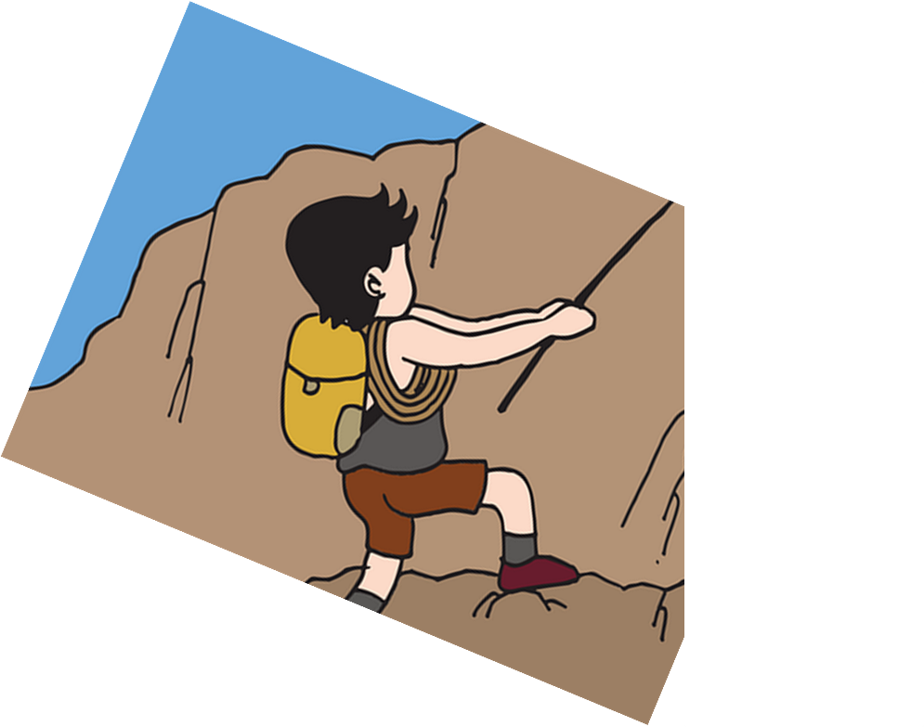
Follow up 3
Lis la phrase et parle en français. [1/5]
He lives with my friend (f).
parler
amie
ami
frère
sœur
5
moi
ma
ton
mon
4
à
pour
avec
et
3
aime
habite
aide
ai
2
Je/J’
Elle
Il
1
Notes:
Timing: 5 minutes [5 slides, 5 items] Slide 1/5
Aim: to practise oral production of 1st , 2nd , 3rd person singular present tense, use of possessive adjectives and definite articles.
Procedure:
Tell students they need to use the words, starting from the bottom, to climb up the mountain (so that they translate the sentence!).
Ask students to work in pairs to practise first.
Click to trigger the timer (15 seconds per sentence).
Ask a volunteer from a pair to say the French sentence out loud and the English translation.
Click on the English sentence to hear its French translation, if required.
Repeat with the next 4 sentences (there are 5 in total).
Transcript: Il habite avec mon amie.

Slide 6
Follow up 3
Lis la phrase et parle en français. [2/5]
I help my sister at the house/home.
parler
maison
table
l’école
à ma
à la
à ta
à
5
mère
amie
sœur
père
4
ton
mon
ta
ma
3
aime
habite
aide
ai
2
Je/J’
Elle
Il
1
Notes:
Slide 2/5
Transcript: J’aide ma sœur à la maison.

Slide 7
Follow up 3
Lis la phrase et parle en français. [3/5]
Do you live at school?
parler
école ?
maison ?
Lorient ?
5
à
à la
à l’
à mon
4
aide
habites
aides
habite
3
2
Je/J’
Tu
Il
1
Notes:
Slide 3/5
Transcript: Tu habites à l’école ?

Slide 8
Follow up 3
Lis la phrase et parle en français. [4/5]
I have a present for my (male) friend.
parler
ami
amie
ma
un
mon
ton
à
avec
pour
5
cadeau
chapeau
bateau
gâteau
4
ton
mon
le
un
3
aime
habite
aide
ai
2
Je/J’
Elle
Il
1
Notes:
Slide 4/5
Transcript: J’ai un cadeau pour mon ami.

Slide 9
Follow up 3
Lis la phrase et parle en français. [5/5]
She likes my hat and my uniforme.
parler
animal
chapeau
uniforme
école
moi
ton
mon
ma
et
5
uniforme
chapeau
gâteau
cadeau
4
ma
la
mon
le
3
aime
ai
aide
aimes
2
Je/J’
Tu
Elle
Il
1
Notes:
Slide 5/5
Transcript: Elle aime mon chapeau et mon uniforme.

Slide 10
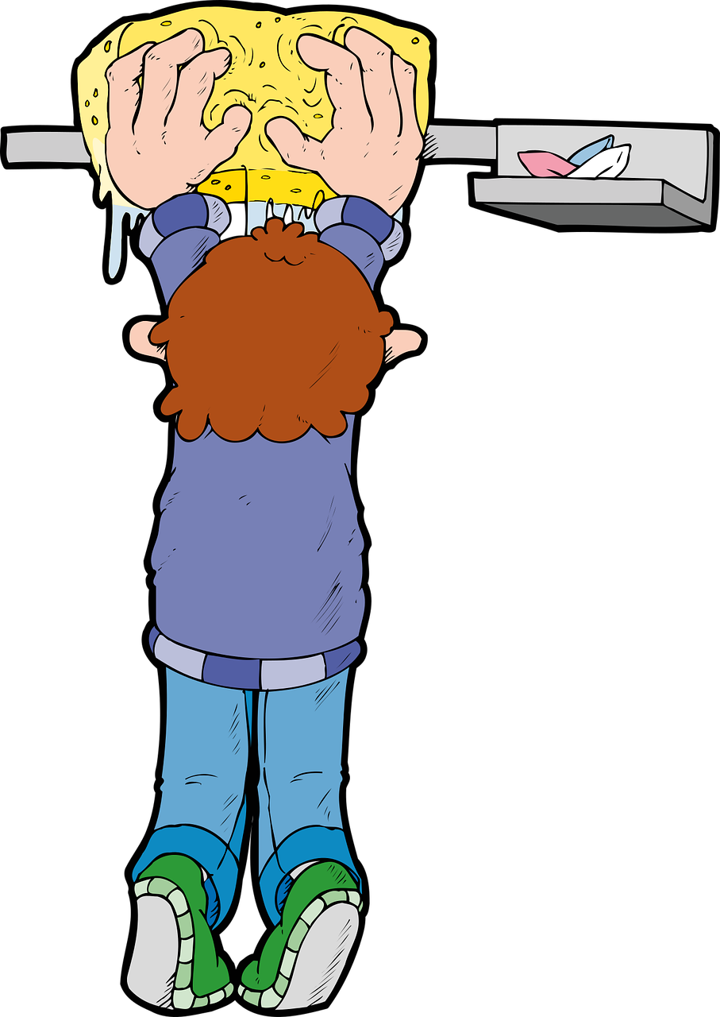
Position of aussi (also, too)
In English we use ‘also’ between the subject and verb:
He also helps at the house/at home.
In French, use aussi after the verb:
Il aide aussi à la maison.
You can also use aussi at the end of the sentence:
In English we put ‘too’ at the end of the sentence, too: He helps at the house, too.
Il aide à la maison aussi.
Notes:
Timing: 2 minutes
Aim: to contrast the position of aussi in French and also, too in English.
Procedure:
Click through the animations to present the information.
Elicit English translations for the French example provided.

Slide 11
Follow up 4
J’aime le livre et j’aime aussi le film.
1
_____________________________.
I like the book and I also like the film.
écrire
J’habite à Lorient et elle habite aussi ici.
2
_____________________________.
I live in Lorient and she also lives here.
Il a une sœur et il a aussi un chien.
3
_____________________________.
He has a sister and he also has a dog.
J’utilise un stylo et tu utilises aussi un stylo.
4
_____________________________.
I use a pen and you also use a pen.
Tu portes un uniforme et elle porte aussi un uniforme.
5
____________________________________.
You wear a uniform and she also wears a uniform.
Notes:
Timing: 8 minutes
Aim: to practise the position of aussi; written production of vocabulary and structures from this and previous weeks.
Procedure:
Pupils complete the sentences, filling in the missing words from memory.
Click to reveal the written answers.
Click on each number to listen and check answers, as required.
Differentiation:
For less support, remove all the French. For more support, add all French except the verb and aussi. For even more support, provide the missing verb forms, jumbled, in a box on the slide.

Slide 12
vocabulaire
Follow up 5a - Écris en anglais : Can you get at least 15 points?
mots
 | moi | toi | parfait
 | le cadeau | le gâteau | pour
 | la sœur | le père | la mère
 | préparer | la famille | le frère
 | donner | trouver | parler
 | l’école (f) | à | aussi
 | habiter | aimer | aider
me (e.g. for me)
you (e.g. for you)
perfect (m)
x3
(the) present
(the) cake
for
(the) sister
(the) father
(the) mother
x2
to prepare, preparing
(the) family
(the) brother
to give, giving
to find, finding
to speak, speaking
(the) school
in, at, to
also, too
x1
to live, living
to like, liking
to help, helping
Notes:
Timing: 5-10 minutes
Aim: to practise written comprehension of vocabulary from this week and previous weeks.
Procedure: Give pupils a blank grid. They fill in the English meanings of any of the words they know, trying to reach 15 points in total.
Note: The most recently learnt and practised words are pink, words from the previous week are green and those from earlier are blue, thus more points are awarded for them, to recognise that memories fade and more effort (heavy lifting!) is needed to retrieve them.
12

Slide 13
vocabulaire
Follow up 5b - Écris en français : Can you get at least 15 points?
mots
 | me (e.g. for me) | you (e.g. for you) | perfect (m)
 | (the) present | (the) cake | for
 | (the) sister | (the) father | (the) mother
 | to prepare, preparing | (the) family | (the) brother
 | to give, giving | to find, finding | to speak, speaking
 | (the) school | in, at, to | also, too
 | to live, living | to like, liking | to help, helping
moi
toi
parfait
x3
le cadeau
le gâteau
pour
la sœur
le père
la mère
x2
préparer
la famille
le frère
donner
trouver
parler
l’école (f)
à
aussi
x1
habiter
aimer
aider
Notes:
Timing: 5-10 minutes
Aim: to practise written comprehension of vocabulary from this week and previous weeks.
Procedure: Give pupils a blank grid. They fill in the French meanings of any of the words they know, trying to reach 15 points in total.
Note: The most recently learnt and practised words are pink, words from the previous week are green and those from earlier are blue, thus more points are awarded for them, to recognise that memories fade and more effort (heavy lifting!) is needed to retrieve them.
13

Slide 14
vocabulaire
Écris en anglais : Can you get at least 15 points?
mots
 | moi | toi | parfait
 | le cadeau | le gâteau | pour
 | la sœur | le père | la mère
 | préparer | la famille | le frère
 | donner | trouver | parler
 | l’école (f) | à | aussi
 | habiter | aimer | aider
x3
x2
x1
Notes:
HANDOUT
14

Slide 15
vocabulaire
Écris en français : Can you get at least 15 points?
mots
 | me (e.g. for me) | you (e.g. for you) | perfect (m)
 | (the) present | (the) cake | for
 | (the) sister | (the) father | (the) mother
 | to prepare, preparing | (the) family | (the) brother
 | to give, giving | to find, finding | to speak, speaking
 | (the) school | in, at, to | also, too
 | to live, living | to like, liking | to help, helping
x3
x2
x1
Notes:
HANDOUT
15

