Slide 1
Saying what I and others do
Ma famille et mon ami(e)
rouge
Follow ups 1-5
Notes:
Artwork by Steve Clarke. Pronoun pictures from NCELP (www.ncelp.org). All additional pictures selected from Pixabay and are available under a Creative Commons license, no attribution required.
Phonics: revisit [é] [è] and [e] - répéter [630] frère [1043] cheval [2220]
Vocabulary (new words in bold): passer [90] manger [1338] ami, amie [467] déjeuner [2724] weekend [2475] mon, ma [60] ton, ta [330] voici [1103] Revisit 1: répéter [630] chanter [1820] utiliser [345] phrase [2074] facile [822] important [215] normal [833] avec [23] tous les jours [n/a]
Revisit 2: avoir [8] j’ai, il a, elle a, quoi [297] animal [1002] chien [1744] chat [3138] photo [1412] table [1019] ou [33]
Londsale, D., & Le Bras, Y. (2009). A Frequency Dictionary of French: Core vocabulary for learners London: Routledge.
The frequency rankings for words that occur in this PowerPoint which have been previously introduced in these resources are given in the SOW and in the resources that first introduced and formally re-visited those words. For any other words that occur incidentally in this PowerPoint, frequency rankings will be provided in the notes field wherever possible.

Slide 2
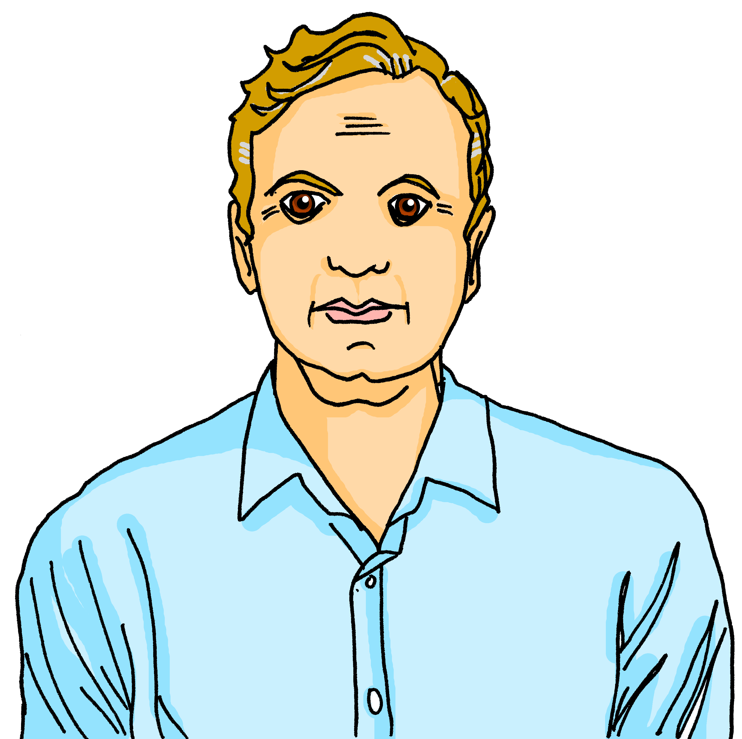
Follow up 1:
La famille Kergosien
1
2
3
4
5
A n n i c k
J a c q u e s
M y l è n e
H e r v é
C l a u d i n e
_
_
_
_
_ _
6
7
8
9
C l é m e n t i n e
J e a n – M i c h e l
A d è l e
P i e r r e
_ _
_ _
_
_
10
11
12
L u l u
É l o i
C h o u c h o u
M é d o r
_
_
_ _
_ _
_
Notes:
Timing: 5 minutes
Aim: to revisit a range of previously taught SSC.
Procedure:
Students write 1-8 and the SSC that they hear. Each dash represents a missing letter.
Click the number to play the word (two plays are recommended).
Click to reveal the missing letter(s).
The teacher can then elicit the names from pupils again, giving French prompts, e.g. ‘La mère de Clémentine, c’est qui ?’ This revisits the possessive ‘de’ taught last week.
Transcript:
Annick
Jacques Mylène Hervé Claudine Clémentine Jean-Michel Adèle Pierre Lulu
Éloi (pupils will meet the SSC ‘oi’ next week) Chouchou Médor

Slide 3
Translating the French present tense into English
In French there is one way to talk about things in the present:
Ma mère regarde un film.
We use the simple present for regular, repeated actions.
In English, there are two ways:
My mum watches a film.
My mum watches a film every weekend.
Ma mère regarde un film chaque weekend.
We use the continuous present for ongoing actions.
My mum is watching a film.
My mum is watching a film now.
Ma mère regarde un film maintenant*.
maintenant = now
Notes:
Timing: 2 minutes
Aim: to contrast the use of the simple present and continuous present in English with the present tense in French.
Procedure:
Click through the animations to present the information.
Elicit English translations for the French example provided.

Slide 4
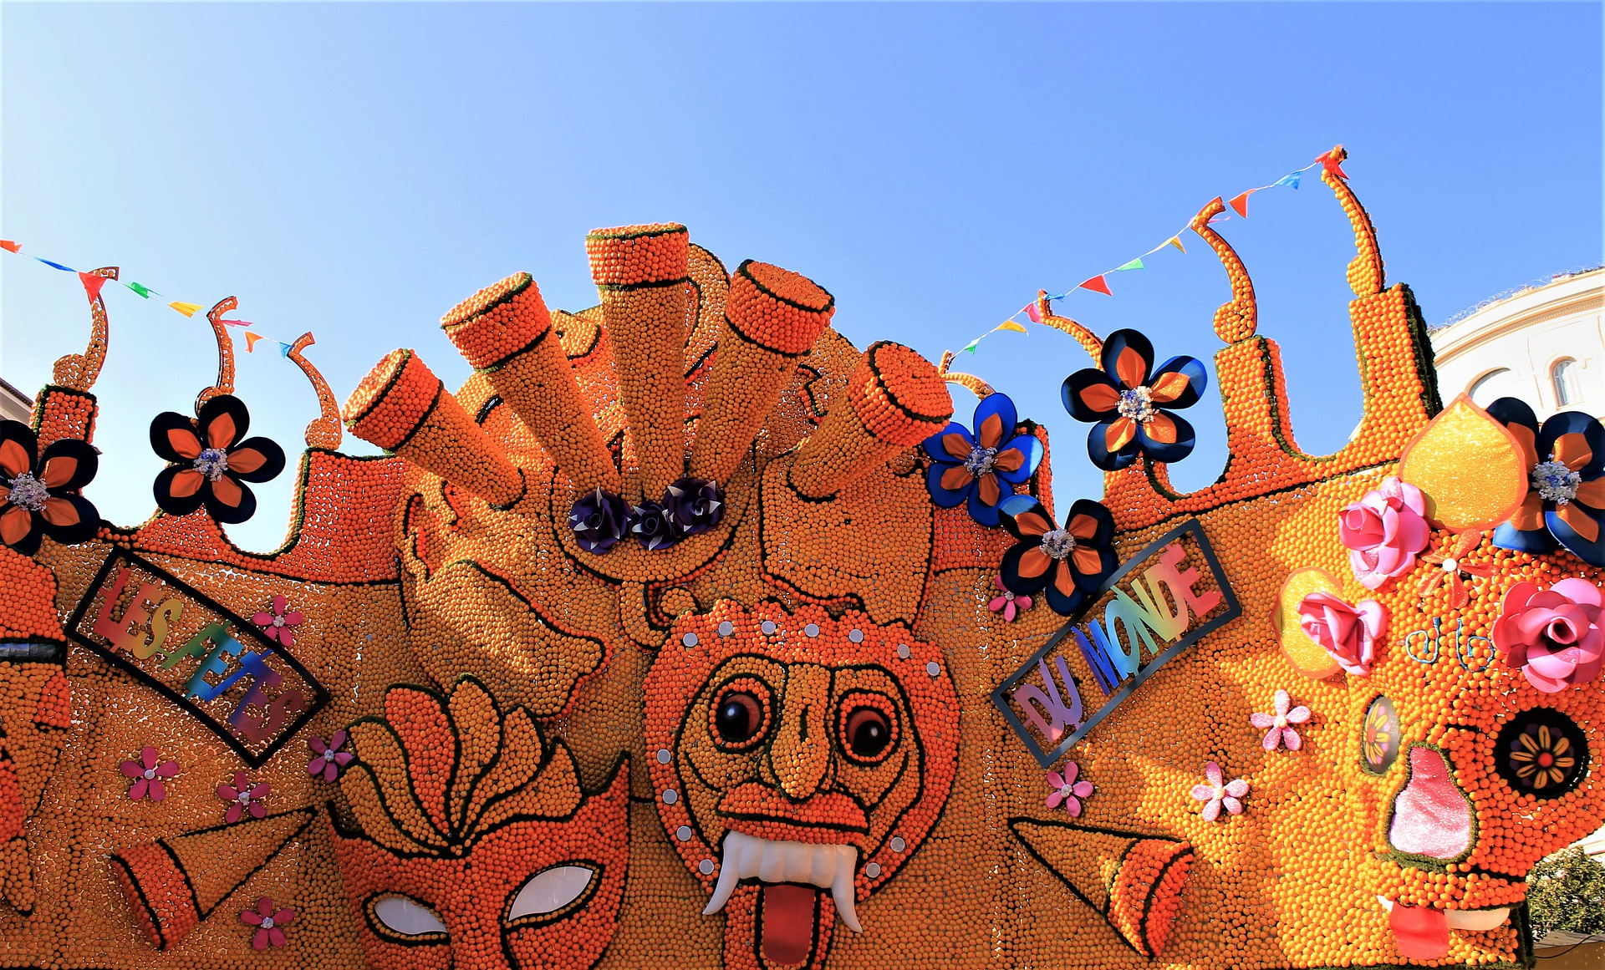
Follow up 2:
Pierre écrit des messages à Adèle.
Je suis la sœur de Pierre.
Pierre is messaging his sister Adèle about what she is doing at the moment. What is he saying?
lire
Écris en anglais.
1
Tu regardes les parades à la fête de Menton.
You are watching the parades at the Menton festival.
2
Papa prépare le déjeuner à la maison.
Dad is preparing lunch at the house.
3
Tu manges un fruit à la fête ?
Are you eating a (piece of ) fruit at the festival?
4
Elle porte un chapeau à la fête ?
Is she wearing a hat at the festival?
5
Tu donnes un cadeau à ton frère ?
Are you giving a present to your brother?
Notes:
Timing: 5 minutes
Aim: to practise written translation of the present tense, using the continuous present in English.
Procedure:
Read the title / context of the activity. Adèle is in still in Menton with Mylène (her aunt) at the citrus festival. Pierre is messaging her from home.
Elicit the English for Adèle’s speech bubble to revisit the meaning of ‘de’ in this context, i.e. I am Pierre’s sister (the sister of Pierre).
Remind pupils that we are talking about ongoing activities.
Pupils translate either the whole sentences or just the verb and pronoun (the bold text).
Elicit responses and click to confirm the translations.
If desired, click on the numbered buttons to hear audio for each sentence.
Transcript:
Tu regardes les parades à la fête de Mentón.
Papa prépare le déjeuner à la maison.
Tu manges un fruit à la fête ?
Elle porte un chapeau à la fête ?
Tu donnes un cadeau a ton frère ?!

Slide 5
Follow up 3:
Pierre parle avec Jean-Michel.
Je suis le cousin de Pierre !
Pierre is talking about what people are doing at the weekend. What is he saying?
écouter
Écris en anglais.
 | en anglais
 | I’m watching a film on Saturday.
 | Mylène is spending the weekend with my sister.
 | Médor is eating my lunch!
 | Dad is preparing lunch at the house.
 | I’m listening to a football match on the radio.
1
___________
___________
2
___________
____ _______
3
____ _______
4
_______
_______
5
_________ _______
Remember: literally, it is match of football.
Notes:
Timing: 5 minutes
Aim: to practise aural comprehension and translation of present tense verbs, possessive adjectives and previously taught vocabulary.
Procedure:
Read the title / context of the activity.
Elicit the English for Jean-Michel’s speech bubble to revisit the meaning of ‘de’ in this context, i.e. I am Pierre’s cousin (the cousin of Pierre).
Do number 1 with them. Click to listen, pupils write the missing English words.
Bring up the answer.
Pupils listen to 2-5 and write the missing word or words.
Click to reveal answers.
Transcript:
1. Je regarde un film le samedi. 2. Mylène passe le weekend avec ma soeur.
3. Médor mange mon déjeuner !
4. Papa prépare le déjeuner à la maison.
5. J’écoute un match de football à la radio.

Slide 6
Follow up 4:
Écris en anglais.
lire
l’amie
l’ami
passer
voici
5
ma
4
ta
ton
le déjeuner
3
2
manger
le weekend
mon
1
Notes:
Timing: 5 minutes (two slides)
Aim: to practise written comprehension of vocabulary.
Procedure:
Tell pupils to be ready to write the English meanings of key vocabulary There will be 11 altogether and they should prepare to work from the bottom of the slide, left to right.
Explain the scenario – it’s raining and the raindrops will splash down and cover the words. They need to write the English. Tell them they will have 5 seconds to get a headstart on the rain.
Click to start number animation.
Click once more to start raindrops. The timing has been carefully set! Don’t click again or all the raindrops will appear at once.
When finished move to the next slide to check answers.

Slide 7
Follow up 4:
Réponses
lire
l’amie
l’ami
(the) friend (f)
(the) friend (m)
passer
voici
ma
to pass, spend (time)
here is, this is
my (f)
ta
ton
le déjeuner
your (f)
your (m)
(the) lunch
manger
le weekend
mon
to eat, eating
(the) weekend
my (m)
Notes:
Procedure:
Elicit responses from the bottom, left to right, from pupils.
Click to bring up a written version of the answer.

Slide 8
Follow up 5:
C’est qui ?
Partenaire A: Ask a question to discover the activity. Then ask another question to discover the person.
Partenaire B: Answer ‘oui’ or ‘non’ to each question.
parler
E.g. Is the person singing?
Adèle
Océane
La personne chante ?
C’est Adèle !
La personne chante à la radio ?
is singing a phrase
is preparing the present
Aurélie
René
Non !
Oui !
Oui !
is preparing lunch
is singing on the radio
à la radio = on the radio
Notes:
Time: 5 minutes (two slides)
Aim: to use raised intonation and present tense oral production to guess their partner’s character.
Read the title in French – C’est qui ? Who is it?
Tell students they are going to work in pairs. Partners take it in turns to ask yes/no questions to try to figure out the other player’s secretly-chosen character. The partner guessing needs to use raised question intonation and the correct verb and then noun to narrow down their options correctly!
Model the task. Click to bring the speech bubbles to make sure students are clear about what the exchange should look like (La personne chante ? / Oui / Non). When the answer is ‘oui’ all those who do not have ‘sing’ as an activity are eliminated.
Click to bring up the question La personne chante à la radio ? When the answer is ‘Non’ this eliminates René, leaving only Adèle.
5. The final statement confirms the identity of the person.
6. Tell pupils that asking the more general question first and then a more specific question should enable them to guess everyone after two questions.
7.Give students 30 seconds to write down 4 names (mixture of male/female).
8. The aim is to work with their partners, to identify all 8 people as quickly as possible.
Note: the activity can be done differently, if pupils are required to ask full questions. The two-phase question process here reduces the cognitive load, allowing pupils to focus first on just the verb, and then prompting a repetition with noun addition.

Slide 9
Follow up 5:
C’est qui ?
à la radio = on the radio
Adèle
Océane
René
Hélène
parler
is singing a phrase
is preparing the present
is eating a fruit
listening to a song
Fidèle
Mylène
Stéphane
Aurélie
is eating lunch
is singing on the radio
is wearing a hat
is preparing lunch
Agnès
Frédéric
Cécile
Éric
is speaking in English
is wearing a uniform
is speaking in French
is singing a song
Notes:
Display this slide for the speaking activity.
If needed, click on the English phrase to hear the matching question: Does the person….?
Transcript: La personne chante une phrase ?
La personne prépare le cadeau ?
La personne mange un fruit ?
La personne écoute une chanson ?
La personne mange le déjeuner ?
La personne chante à la radio ?
La personne porte un chapeau ?
La personne prépare le déjeuner ?
La personne parle en anglais ?
La personne porte un uniforme ?
La personne parle en français ?
La personne chante une chanson ?

Slide 10
Follow up Extra 1:
1
Elle passe le samedi avec ma famille.
____ _______
___
She is spending Saturday with my family.
écrire
2
Il mange un fruit tous les jours.
____ _______
_____ ____ _______
He eats a fruit every day.
3
Tu donnes ton déjeuner à mon chien.
___
___
You give your lunch to my dog.
4
Je regarde un film avec mon amie.
____ _______
___
I am watching a film with my friend (f).
5
Tu passes le weekend à la maison.
____ _______
___
You are spending the weekend at the house.
Notes:
Timing: 8 minutes
Aim: to practise written production of vocabulary and structures from this and previous weeks.
Procedure:
Pupils write the dialogue out, filling in the missing words from memory.
Click to reveal the written answers.
Click on each number to listen and check answers, as required.

Slide 11
vocabulaire
Follow up Extra 2 - Écris en anglais : Can you get at least 15 points?
mots
 | le chat | la table | quoi ?
 | répéter | chanter | ou
 | avec | tous les jours | facile
 | ton | ta | utiliser
 | l’amie | mon | ma
 | le déjeuner | le weekend | l’ami
 | passer | manger | voici
(the) cat
(the) table
what?
x3
to repeat, repeating
to sing, singing
or
with
every day
easy
x2
your (m)
your (f)
to use, using
(the) friend (f)
my (m)
my (f)
(the) lunch
(the) weekend
(the) friend (m)
x1
to pass, spend (time)
to eat, eating
here is, this is
Notes:
Timing: 5-10 minutes
Aim: to practise written comprehension of vocabulary from this week and previous weeks.
Procedure: Give pupils a blank grid. They fill in the English meanings of any of the words they know, trying to reach 15 points in total.
Note: The most recently learnt and practised words are pink, words from the previous week are green and those from earlier are blue, thus more points are awarded for them, to recognise that memories fade and more effort (heavy lifting!) is needed to retrieve them.
11

Slide 12
vocabulaire
Follow up Extra 3 - Écris en français : Can you get at least 15 points?
mots
 | (the) cat | (the) table | what?
 | to sing, singing | to repeat, repeating | or
 | with | every day | easy
 | your (m) | your (f) | to use, using
 | (the) friend (f) | my (m) | my (f)
 | (the) lunch | (the) weekend | (the) friend (m)
 | to eat, eating | to pass, spend (time) | here is, this is
le chat
la table
quoi ?
x3
chanter
répéter
ou
avec
tous les jours
facile
x2
ton
ta
utiliser
l’amie
mon
ma
le déjeuner
le weekend
l’ami
x1
manger
passer
voici
Notes:
Timing: 5-10 minutes
Aim: to practise written comprehension of vocabulary from this week and previous weeks.
Procedure: Give pupils a blank grid. They fill in the French meanings of any of the words they know, trying to reach 15 points in total.
Note: The most recently learnt and practised words are pink, words from the previous week are green and those from earlier are blue, thus more points are awarded for them, to recognise that memories fade and more effort (heavy lifting!) is needed to retrieve them.
12

Slide 13
vocabulaire
Écris en anglais : Can you get at least 15 points?
mots
 | le chat | la table | quoi ?
 | répéter | chanter | ou
 | avec | tous les jours | facile
 | ton | ta | utiliser
 | l’amie | mon | ma
 | le déjeuner | le weekend | l’ami
 | passer | manger | voici
x3
x2
x1
Notes:
HANDOUT
13

Slide 14
vocabulaire
Écris en français : Can you get at least 15 points?
mots
 | (the) cat | (the) table | what?
 | to sing, singing | to repeat, repeating | or
 | with | every day | easy
 | your (m) | your (f) | to use, using
 | (the) friend (f) | my (m) | my (f)
 | (the) lunch | (the) weekend | (the) friend (m)
 | to eat, eating | to pass, spend (time) | here is, this is
x3
x2
x1
Notes:
HANDOUT
14

