Slide 1
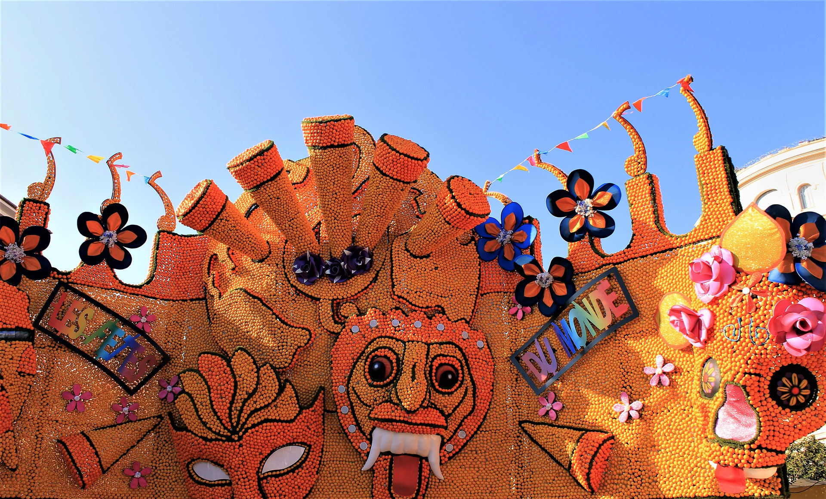
Saying what I and others do
Le Carnaval de Menton
Uses of ‘de’
Singular adjective agreement
SSC [è|ê]
rouge
Notes:
Artwork by Steve Clarke. Pronoun pictures from NCELP (www.ncelp.org). All additional pictures selected from Pixabay and are
available under a Creative Commons license, no attribution required.
The AUDIO version of the lesson material includes additional audio for the new language presented (phonics, vocabulary) and audio for the instructions
on the slide.
In addition, it includes VIDEO clips of the phonics and the phonics’ source words. Pupils can be encouraged to look at the shape of the mouth/lips on
slides where these appear, and try to copy it/them.
Phonics: introduce [è] [ê] - fête [1490] tête [343] frère [1043] être [5], problème [188]
Vocabulary (new words in bold): fête [1490] fille [629] fruit [896] garçon [1599] de¹ [2] Revisit 1: répéter [630] chanter [1820] utiliser [345] phrase [2074] facile [822] important [215] normal [833] avec [23] tous les jours [n/a]
Revisit 2: avoir [8] j’ai, il a, elle a, quoi [297] animal [1002] chien [1744] chat [3138] photo [1412] table [1019] ou [33]
Londsale, D., & Le Bras, Y. (2009). A Frequency Dictionary of French: Core vocabulary for learners London: Routledge.
The frequency rankings for words that occur in this PowerPoint which have been previously introduced in these resources are given in the SOW and in the resources that first introduced and formally re-visited those words. For any other words that occur incidentally in this PowerPoint, frequency rankings will be provided in the notes field wherever possible.
1

Slide 2
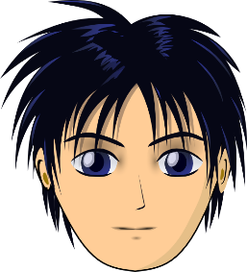
prononcer
[è|ê]
[è] and [ê] sound almost the same. [ê] is a little longer and deeper.
to be, being
fête
être
frère
(brother)
(party, celebration)
tête
problème
(head)
Notes:
Timing: 2 minutes
Aim: to recap SSC [è] and [ê] which are almost the same sound.
Procedure:
Introduce and elicit the pronunciation of the individual SSC [è] and the source word ‘xxx’, which has both spellings of the sound.
Click to bring on the picture and get students to repeat (with gesture, if using).
Present and practise the cluster words.
Gesture: gesture for fête: raise both hands in the air (middle three fingers facing down in a partial fist, with thumb and pinkie facing upwards) and move up and down alternate left and right to suggest a celebration-style dance.
Source: https://www.signbsl.com/sign/party (the 3rd video from the right is the best one, in my view)
2

Slide 3
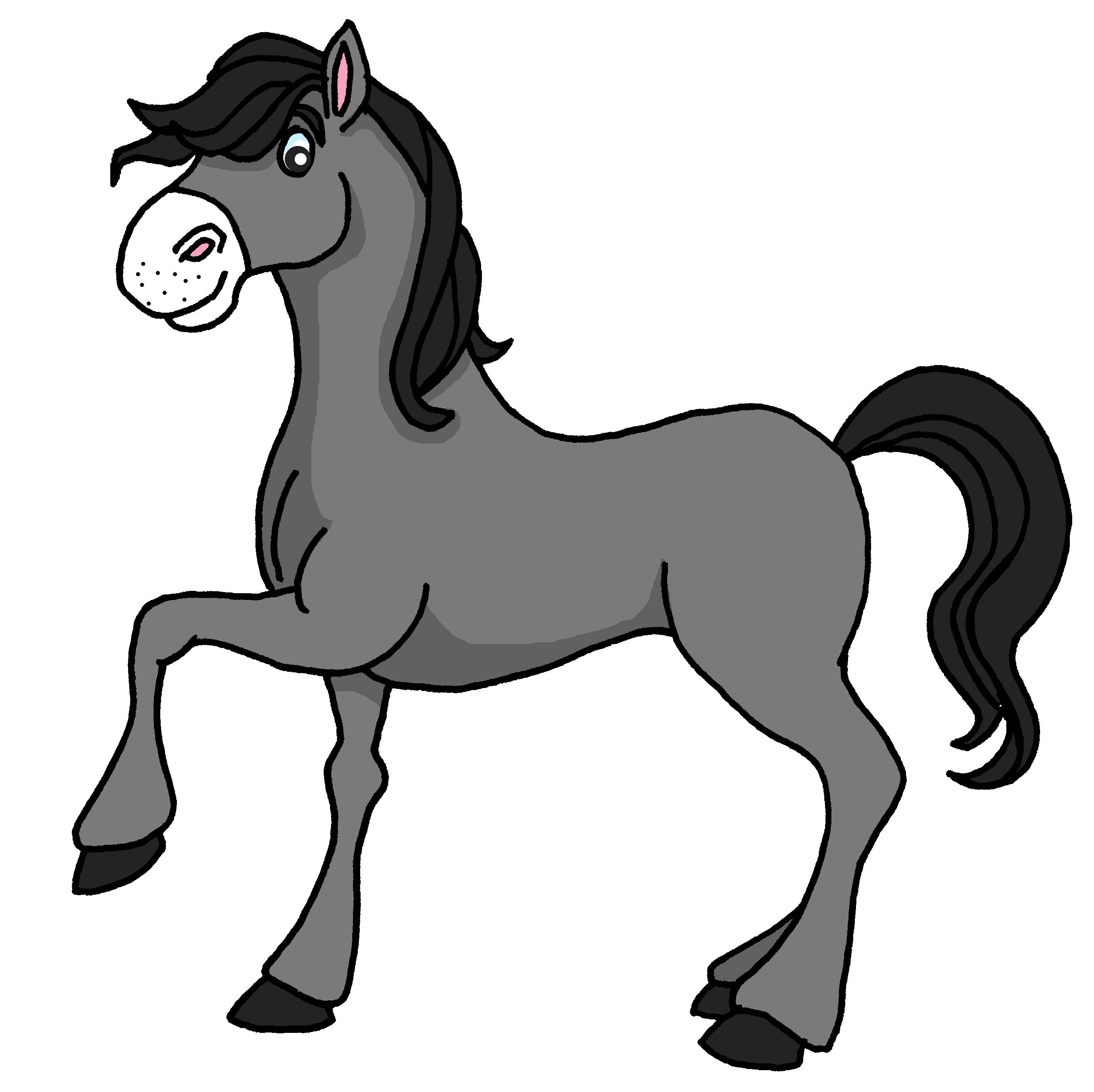
prononcer
Prononce les mots. [1/9]
Le son [è|ê], c’est dans le mot A ou B ?
A
B
la tête
le cheval
Notes:
Timing: 5 minutes (9 slides)
Aim: to practise spoken recall of vocabulary; to connect the SSC [è|ê] with a number of previously taught words, differentiating it from other vowel sounds, namely [e] and [i]
Procedure:
Give pupils 30 seconds (think-pair-share) to retrieve the French words for the images.
Say trois-deux-un and elicit the two words, chorally.
Ask pupils to tell you which word has the SSC [è|ê]. i.e. Le son [è|ê], c’est dans le mot A ou B ?
Click to bring up the two words and then again to highlight the correct word.
Note: if pupils are not able to recall any of the words themselves, just click to bring up the written forms earlier, and pupils can read them aloud.
3

Slide 4
prononcer
Prononce les mots. [2/9]
Le son [è|ê], c’est dans le mot A ou B ?
A
B
[look, watch]
[repeat]
je regarde
je répète
Notes:
[2/9]
4

Slide 5
prononcer
Prononce les mots. [3/9]
Le son [è|ê], c’est dans le mot A ou B ?
A
B
le livre
la règle
Notes:
[3/9]
5

Slide 6
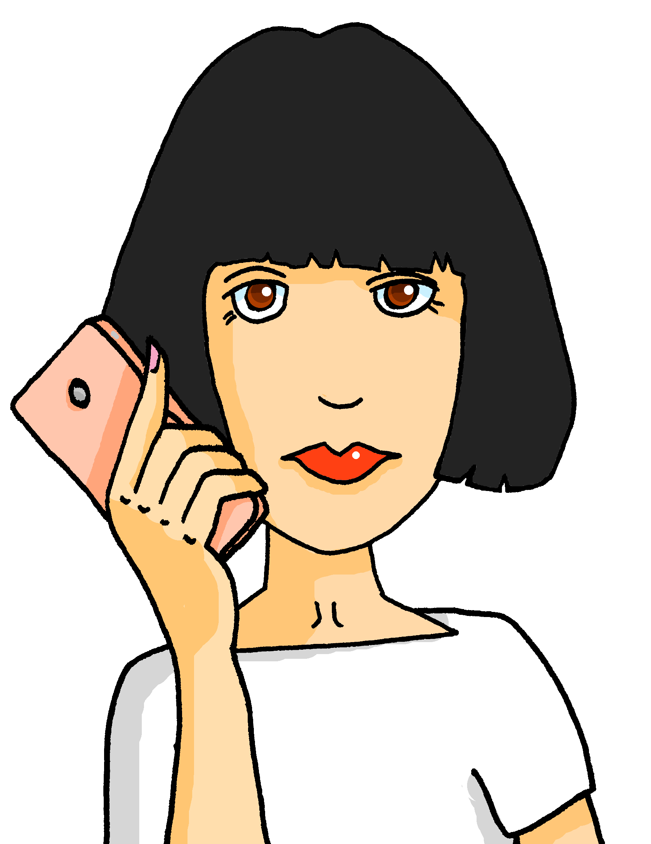
prononcer
Prononce les mots. [4/9]
Le son [è|ê], c’est dans le mot A ou B ?
A
B
la mère
le chien
Notes:
[4/9]
6

Slide 7
prononcer
Prononce les mots. [5/9]
Le son [è|ê], c’est dans le mot A ou B ?
A
B
Saturday
le père
le samedi
Notes:
[5/9]
7

Slide 8
prononcer
Prononce les mots. [6/9]
Le son [è|ê], c’est dans le mot A ou B ?
A
B
brother
short
le frère
petit
Notes:
[6/9]
8

Slide 9
prononcer
Prononce les mots. [7/9]
Le son [è|ê], c’est dans le mot A ou B ?
A
B
Tuesday
(party, celebration)
le mardi
la fête
Notes:
[7/9]
9

Slide 10
prononcer
Prononce les mots. [8/9]
Le son [è|ê], c’est dans le mot A ou B ?
A
B
to be, being
to have, having
être
avoir
Notes:
[8/9]
10

Slide 11
prononcer
Prononce les mots. [9/9]
Le son [è|ê], c’est dans le mot A ou B ?
A
B
le problème
je
Notes:
[9/9]
11

Slide 12
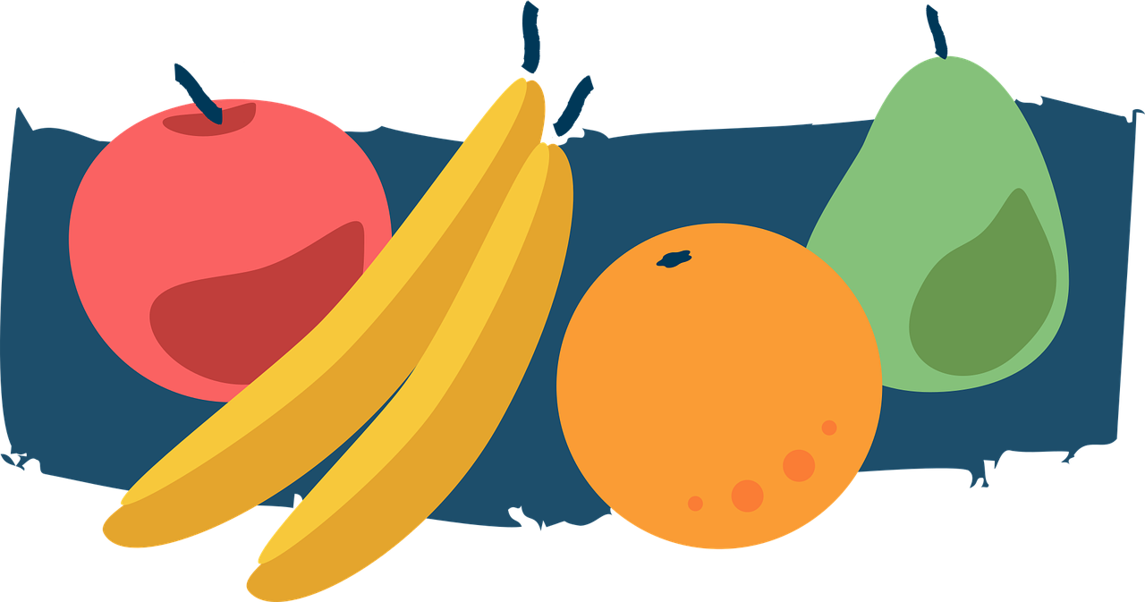
vocabulaire
Écoute et répète.
le fruit = fruit un fruit = a (piece of) fruit
mots
la fête
le fruit
(party, celebration)
la fille
le garçon
[of]
de
(girl)
(boy)
Notes:
Timing: 3 minutes
Aim: to introduce key new vocabulary for this week.
Procedure: 1. Teacher clicks to present the new vocabulary, says the new words, and pupils repeat. Note that words for this week include SSC that pupils have not previously been taught, so they cannot be expected to pronounce them accurately from the written forms (e.g. fruit, fille, garçon). 2. Then the teacher removes the English words or pictures (one by one) and pupils try to recall the English orally (chorally), looking at the French (1 minute). 3. Then the French meanings are removed (one by one) and pupils try to recall them orally (again, chorally), looking at the English (1 minute). The teacher provides the correct French word, orally, following its appearance. 4. Further rounds of learning can be facilitated by one pupil turning away from the board, and his/her partner asking him/her the meanings (‘Comment dit-on XXX en anglais/français ?’). This activity can work from L2 → L1 or L1 → L2.
12

Slide 13
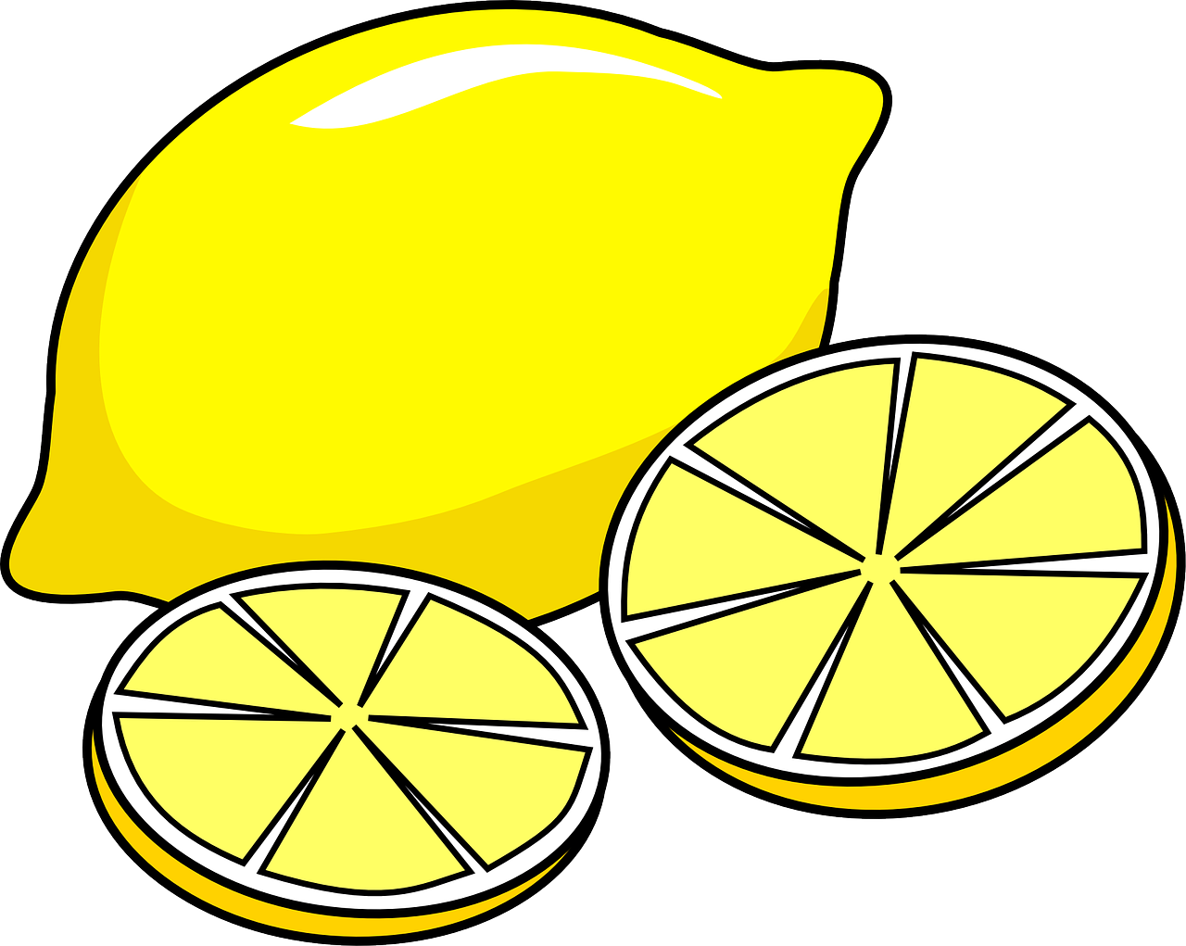
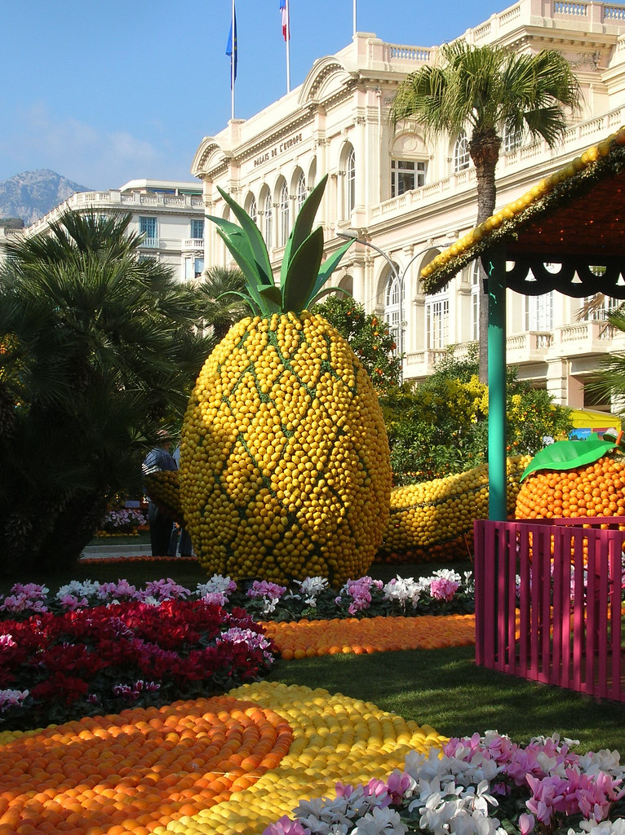
lire
Le carnaval de Menton
Aujourd’hui, Adèle est ici pour le Carnaval de Menton.
de
Menton
Elle est avec la sœur de Jacques et d’Hervé, Mylène.
de
d
Le Carnaval de Menton est une fête des fruits.
de
de
Mylène porte un chapeau pour la fête.
de means ‘of’ but notice what we say in English: le Carnaval de Menton = the Menton Carnival la sœur de Jacques = Jacques’ sister une fête des fruits = a festival of fruits
Notes:
Timing: 5 minutes
Aim: to introduce the context of the lesson, the Menton lemon festival, which is a celebration of citrus fruit, for which the area is famous; to revisit new and known vocabulary in a short text.
Procedure:
Click to present the text, line by line.
Ensure pupils are clear about the meaning.
Mylène, a new character, is the sister of Jacques (Jean-Michel and Clémentine’s dad) and Hervé (Adèle and Pierre’s dad and so their aunt).
Click to highlight all the examples of the new word ‘de’.
Click to bring up information about how ‘de’ is translated into English. There will be more practice of this in the next activity on the next slide.
6. Teachers might want to use the link below to show pupils a little more about the festival – there are some amazing images directly on the homepage.
Further information: https://www.fete-du-citron.com/?lang=en
Picture attribution:
Asdrubale, CC BY 2.0 https://www.flickr.com/photos/neogluk/395427413/
13

Slide 14
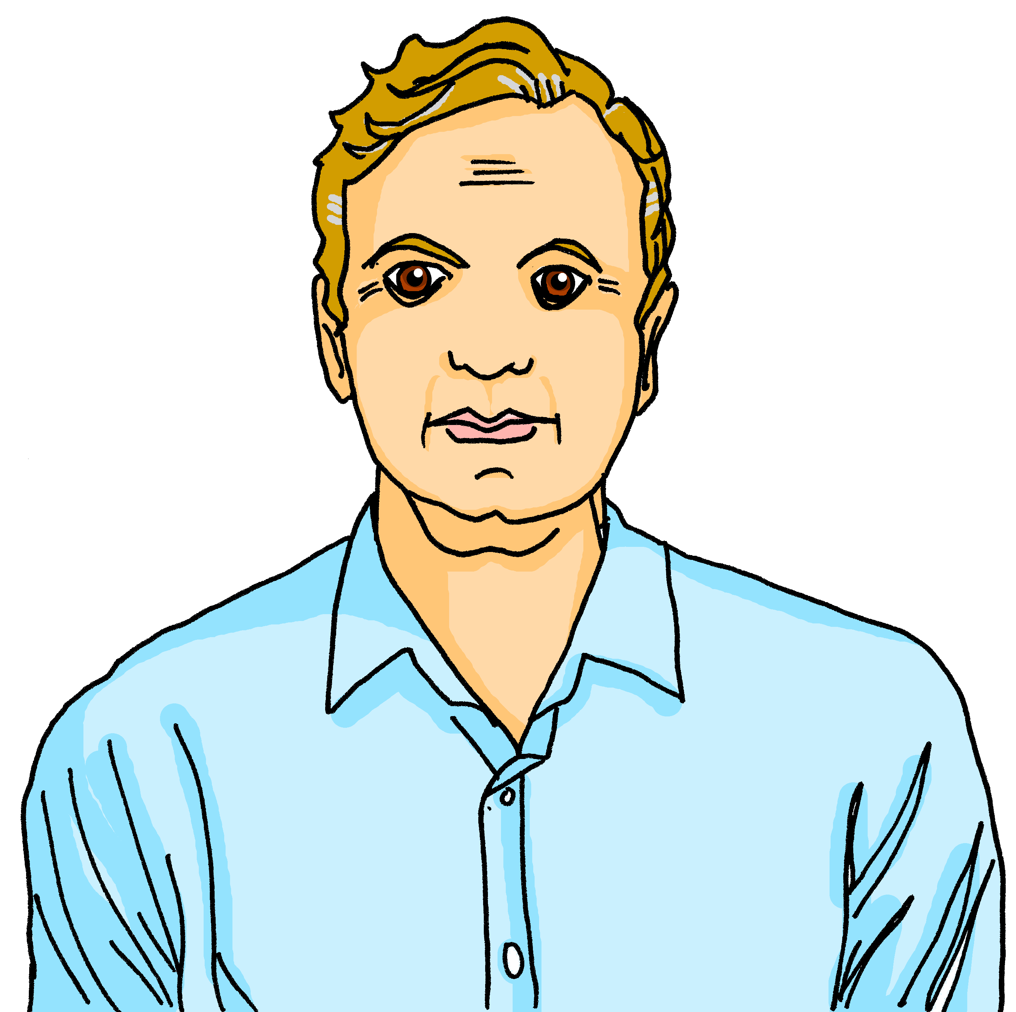
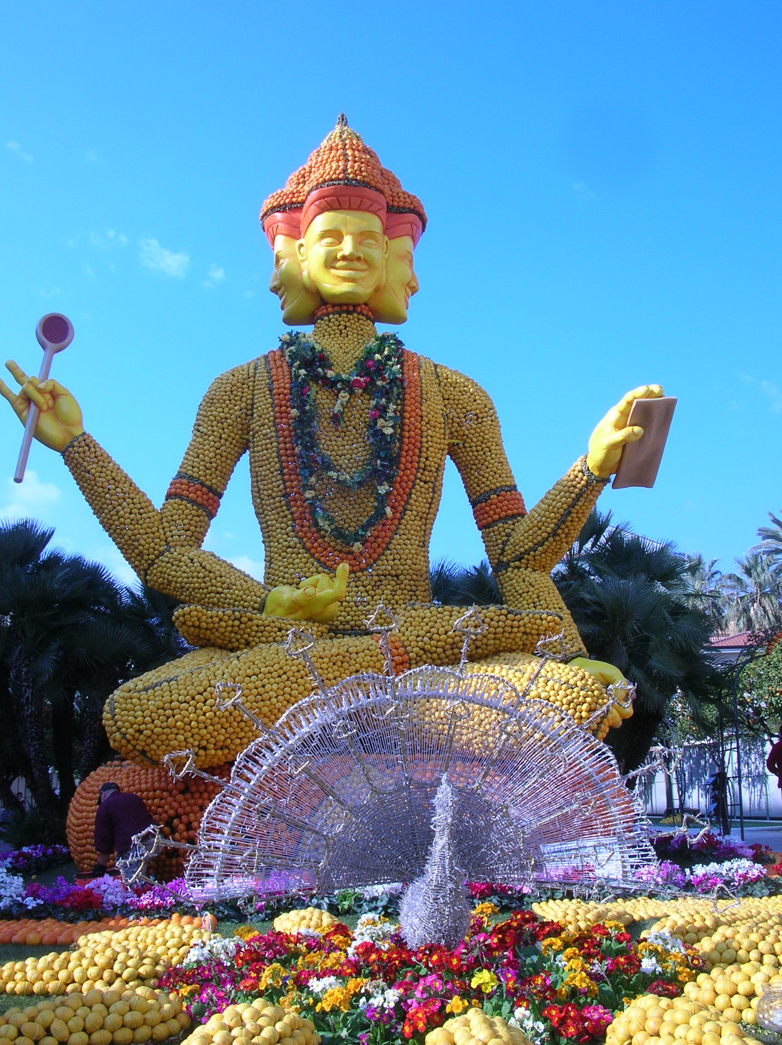
lire
‘de’ [of]
en français
en anglais
le frère de Mylène
Mylène’s brother
Hervé
de in French can be ‘s in English
la sœur de Pierre
Pierre’s sister
Adèle
le père de Jean-Michel
Jean-Michel’s father
Jacques
de in French can be nothing in English
le chapeau de Mylène
Mylène’s hat
Mylène
la fête de Menton
the Menton festival
de in French can also be of in English
la sculpture de Datta
the sculpture of Datta
Notes:
Timing: 3 minutes
Aim: to provide further practice in understanding ‘de’.
Procedure:
Click to present the French text. Pupils read it aloud, chorally.
Elicit the English translation from pupils and click to confirm.
Continue with items 2-6.
14

Slide 15
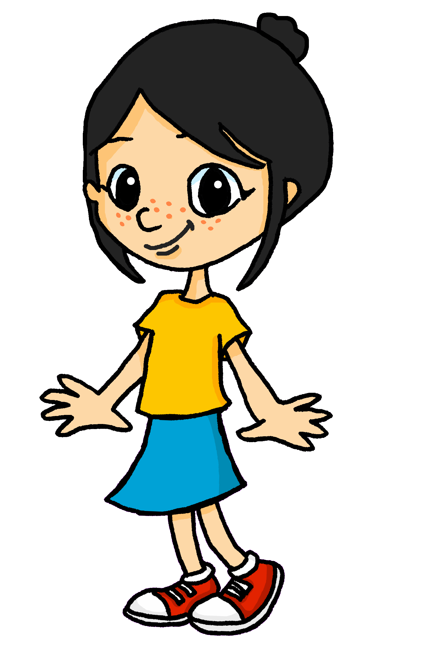
Using adjectives
Remember that adjectives change their spelling to match the gender of the noun:
Le père d’Adèle est grand.
Adèle’s father is tall.
La sœur de Léa est petite.
Léa’s sister is short.
Note that grand means big as well as tall, and petit means small as well as short:
Le fruit est petit.
The fruit is small.
La fête est grande.
The party is big.
Notes:
Timing: 2 minutes
Aim: To recap the meaning of quoi and how to use it in an intonation question.
Procedure:
Click to present the information.
Elicit the English meanings of the examples.
15

Slide 16
écouter
Écoute. C’est l’image A ou B ? [1/6]
1a
A
B
1b
Notes:
Timing: 5 minutes (6 slides)
Aim: to reinforce the connection between noun and gender (as expressed by the definite article)
Procedure:
1. Click the audio button top left to listen to just the article ‘le’ or ‘la’.
2. Pupils select the correct image based on hearing the article and identifying with a previously taught noun.
3. Click the audio button bottom right to hear the full sentence.
4. Elicit the English meaning of the full sentence from pupils, chorally, paying attention to which translation (big/tall/short/small) is the correct one.
Transcript:
La [banane est grande].
16

Slide 17
écouter
Écoute. C’est l’image A ou B ? [2/6]
2a
A
B
(girl)
(boy)
2b
Notes:
[2/6]
Transcript:
Le [garçon est petit].
17

Slide 18
écouter
Écoute. C’est l’image A ou B ? [3/6]
3a
A
B
3b
Notes:
[3/6]
Transcript:
La [tête est petite].
18

Slide 19
écouter
Écoute. C’est l’image A ou B ? [4/6]
4a
A
B
(carnival)
(party, celebration)
4b
Notes:
[4/6]
Transcript:
Le [carnaval est grand].
Picture attribution:
Luckka, CC BY-SA 4.0 via Wikimedia Commons
19

Slide 20
écouter
Écoute. C’est l’image A ou B ? [5/6]
5a
A
B
(boy)
(girl)
5b
Notes:
[5/6]
Transcript:
La [fille est grande].
20

Slide 21
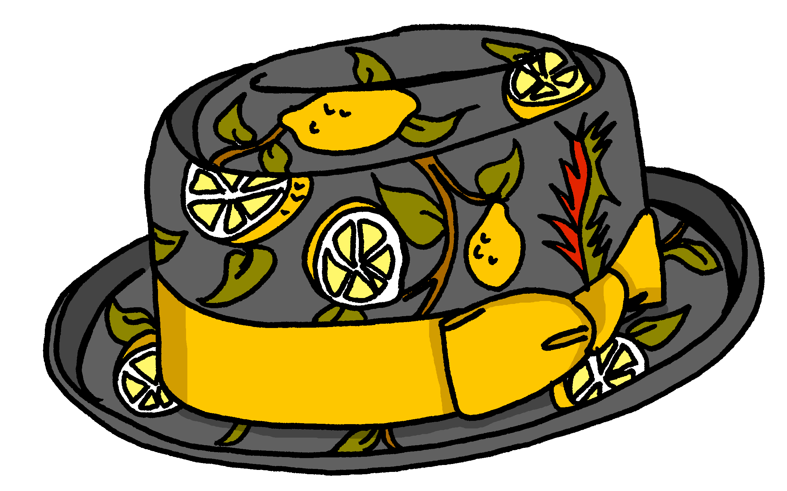
écouter
Écoute. C’est l’image A ou B ? [6/6]
6a
A
B
(carnival)
6b
Notes:
[6/6]
Transcript:
Le [chapeau est grand].
21

Slide 22
lire
Le mot correct, c’est quoi ?
Écris l’adjectif en anglais.
l’adjectif en anglais
1 | La sœur | Le frère est petite.
2 | Le fruit | L’orange est petite.
3 | Le garçon | La fille est grand.
4 | La fête | Le carnaval de Menton est grande.
5 | La maison | Le chapeau de Mylène est petit.
6 | Le père | La mère d’Adèle est grand.
1
short
2
small
3
tall
4
big
5
small
6
tall
Notes:
Timing: 5 minutes
Aim: to practise written comprehension of two polysemous adjectives (adjectives with more than one meaning) and the connection of their forms with appropriate nouns.
Procedure:
Model number 1: Elicit the correct noun from pupils, according to the form of the adjective.
Click to confirm the noun.
Elicit the English meaning of the adjective ‘petit’.
Click to confirm.
Pupils complete items 2-6.
Click to reveal audio buttons.
Use the audio buttons for pupils to listen for and check their noun choices.
Elicit and check the English meanings of the adjectives.
22

Slide 23
Au revoir !
rouge
Notes:
23

