Slide 1
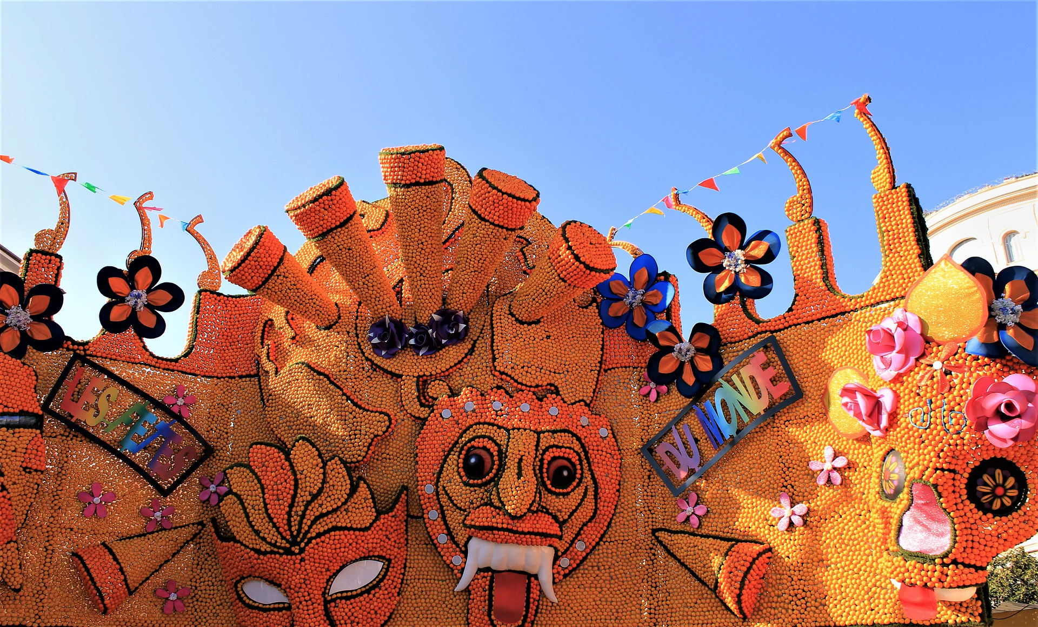
Saying what I and others do
Le Carnaval de Menton
rouge
Follow ups 1-5
Notes:
Artwork by Steve Clarke. Pronoun pictures from NCELP (www.ncelp.org). All additional pictures selected from Pixabay and are available under a Creative Commons license, no attribution required.
Phonics: introduce [è] [ê] - fête [1490] tête [343] frère [1043] être [5], problème [188]
Vocabulary (new words in bold): fête [1490] fille [629] fruit [896] garçon [1599] de¹ [2] Revisit 1: répéter [630] chanter [1820] utiliser [345] phrase [2074] facile [822] important [215] normal [833] avec [23] tous les jours [n/a]
Revisit 2: avoir [8] j’ai, il a, elle a, quoi [297] animal [1002] chien [1744] chat [3138] photo [1412] table [1019] ou [33]
Londsale, D., & Le Bras, Y. (2009). A Frequency Dictionary of French: Core vocabulary for learners London: Routledge.
The frequency rankings for words that occur in this PowerPoint which have been previously introduced in these resources are given in the SOW and in the resources that first introduced and formally re-visited those words.
For any other words that occur incidentally in this PowerPoint, frequency rankings will be provided in the notes field wherever possible.

Slide 2
prononcer
[è|ê]
[è] and [ê] sound almost the same. [ê] is a little longer and deeper.
fête
(party, celebration)
Notes:
Timing: 2 minutes
Aim: to introduce SSC [è] and [ê] which are almost the same sound.
Procedure:
Introduce and elicit the pronunciation of the individual SSC [è] and the source word ‘xxx’, which has both spellings of the sound.
Click to bring on the picture and get students to repeat (with gesture, if using).
Present and practise the cluster words.
Gesture: gesture for fête: raise both hands in the air (middle three fingers facing down in a partial fist, with thumb and pinkie facing upwards) and move up and down alternate left and right to suggest a celebration-style dance.
Source: https://www.signbsl.com/sign/party (the 3rd video from the right is the best one, in my view)
2

Slide 3
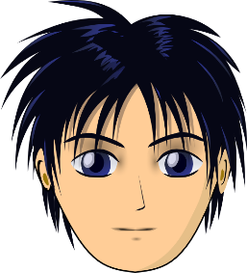
prononcer
[è|ê]
to be, being
être
frère
(brother)
tête
problème
(head)
Notes:
Timing: 2 minutes
Aim: to introduce and practise SSC [è] and [ê] which are almost the same sound.
Procedure:
Introduce and elicit the pronunciation of the individual SSC [è] and the source word ‘xxx’, which has both spellings of the sound.
Click to bring on the picture and get students to repeat (with gesture, if using).
Present and practise the cluster words.
Gesture: gesture for fête: raise both hands in the air (middle three fingers facing down in a partial fist, with thumb and pinkie facing upwards) and move up and down alternate left and right to suggest a celebration-style dance.
Source: https://www.signbsl.com/sign/party (the 3rd video from the right is the best one, in my view)
3

Slide 4
Follow up 1:
Écoute et écris la lettre correspondante.
C’est [e] ou [è] ou [ê] ?
 | [e] | [è|ê]
1
2
3
4
5
 | [e] | [è|ê]
6
7
8
9
10
le frère
le cheval
la fête
il répète
petit
la règle
elle regarde
le problème
la mère
le père
Notes:
Timing: 3 minutes
Aim: to practise aural differentiation between [e] and [è|ê]; to practise accurate spelling of previously taught words.
Procedure:
Pupils listen and decide whether they hear [e] or [è|ê].
They may also write the full word if they are able.
Click to correct each answer.
Transcription: le frère la fête
petit elle regarde la mère
le cheval
il répète la règle le problème le père

Slide 5
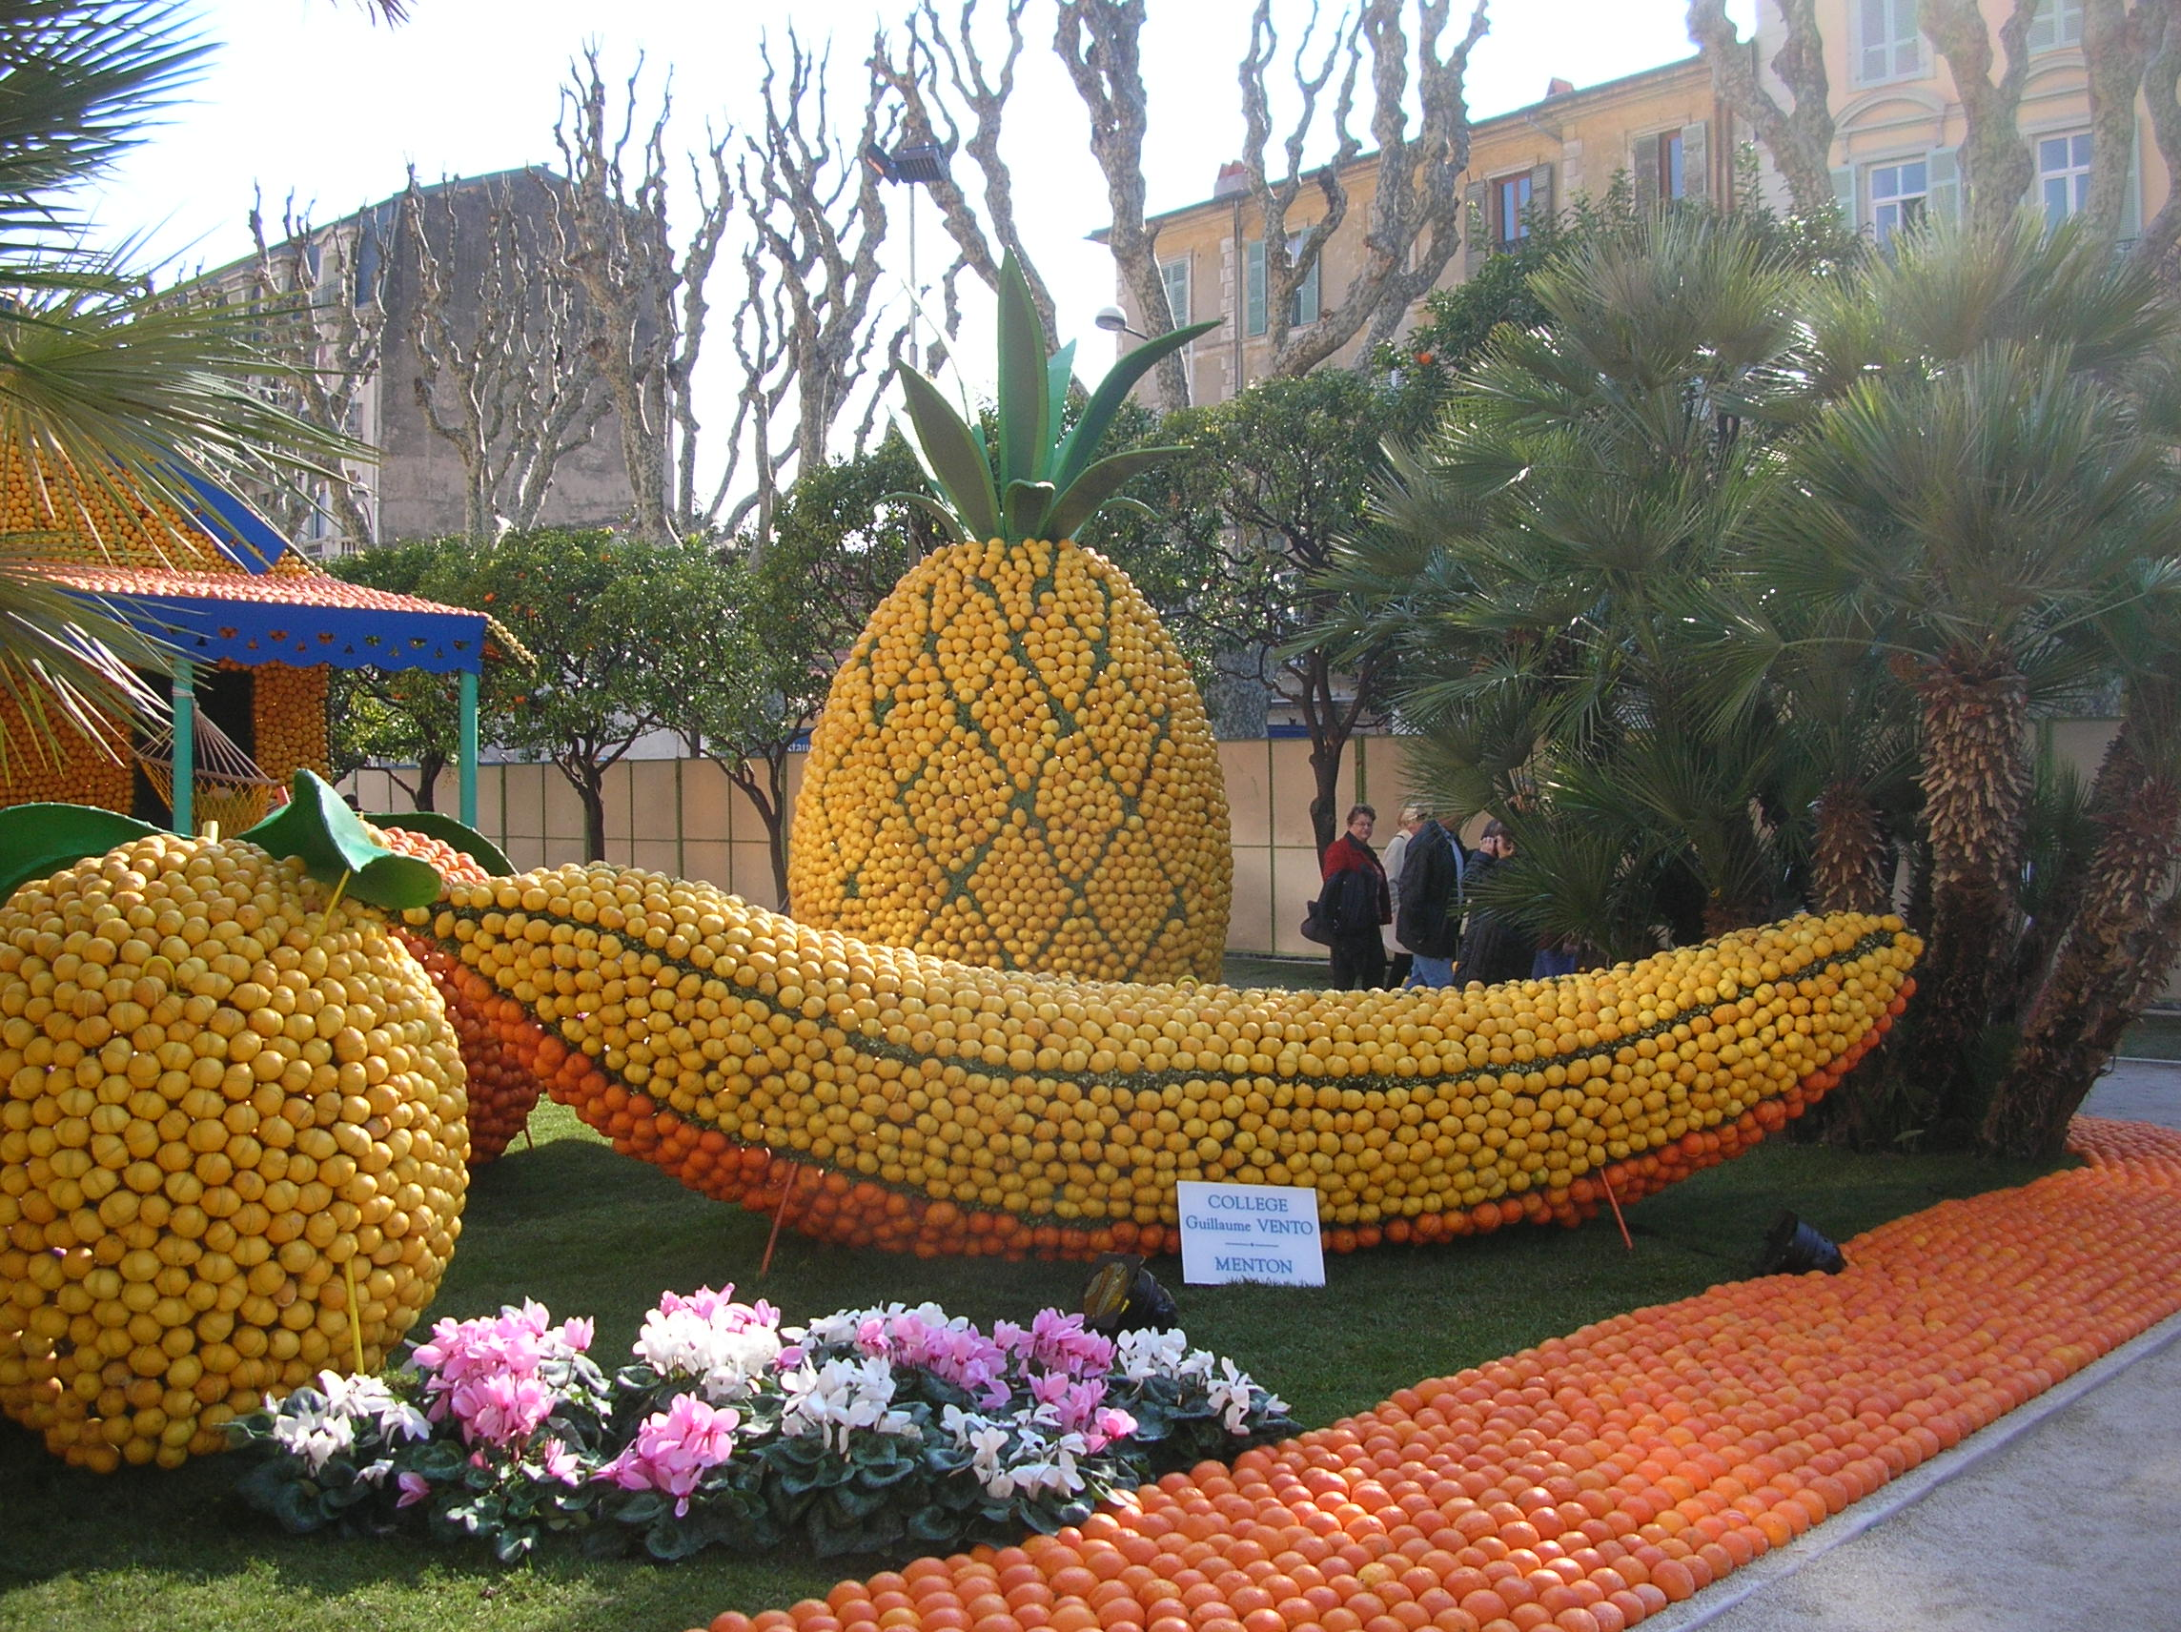
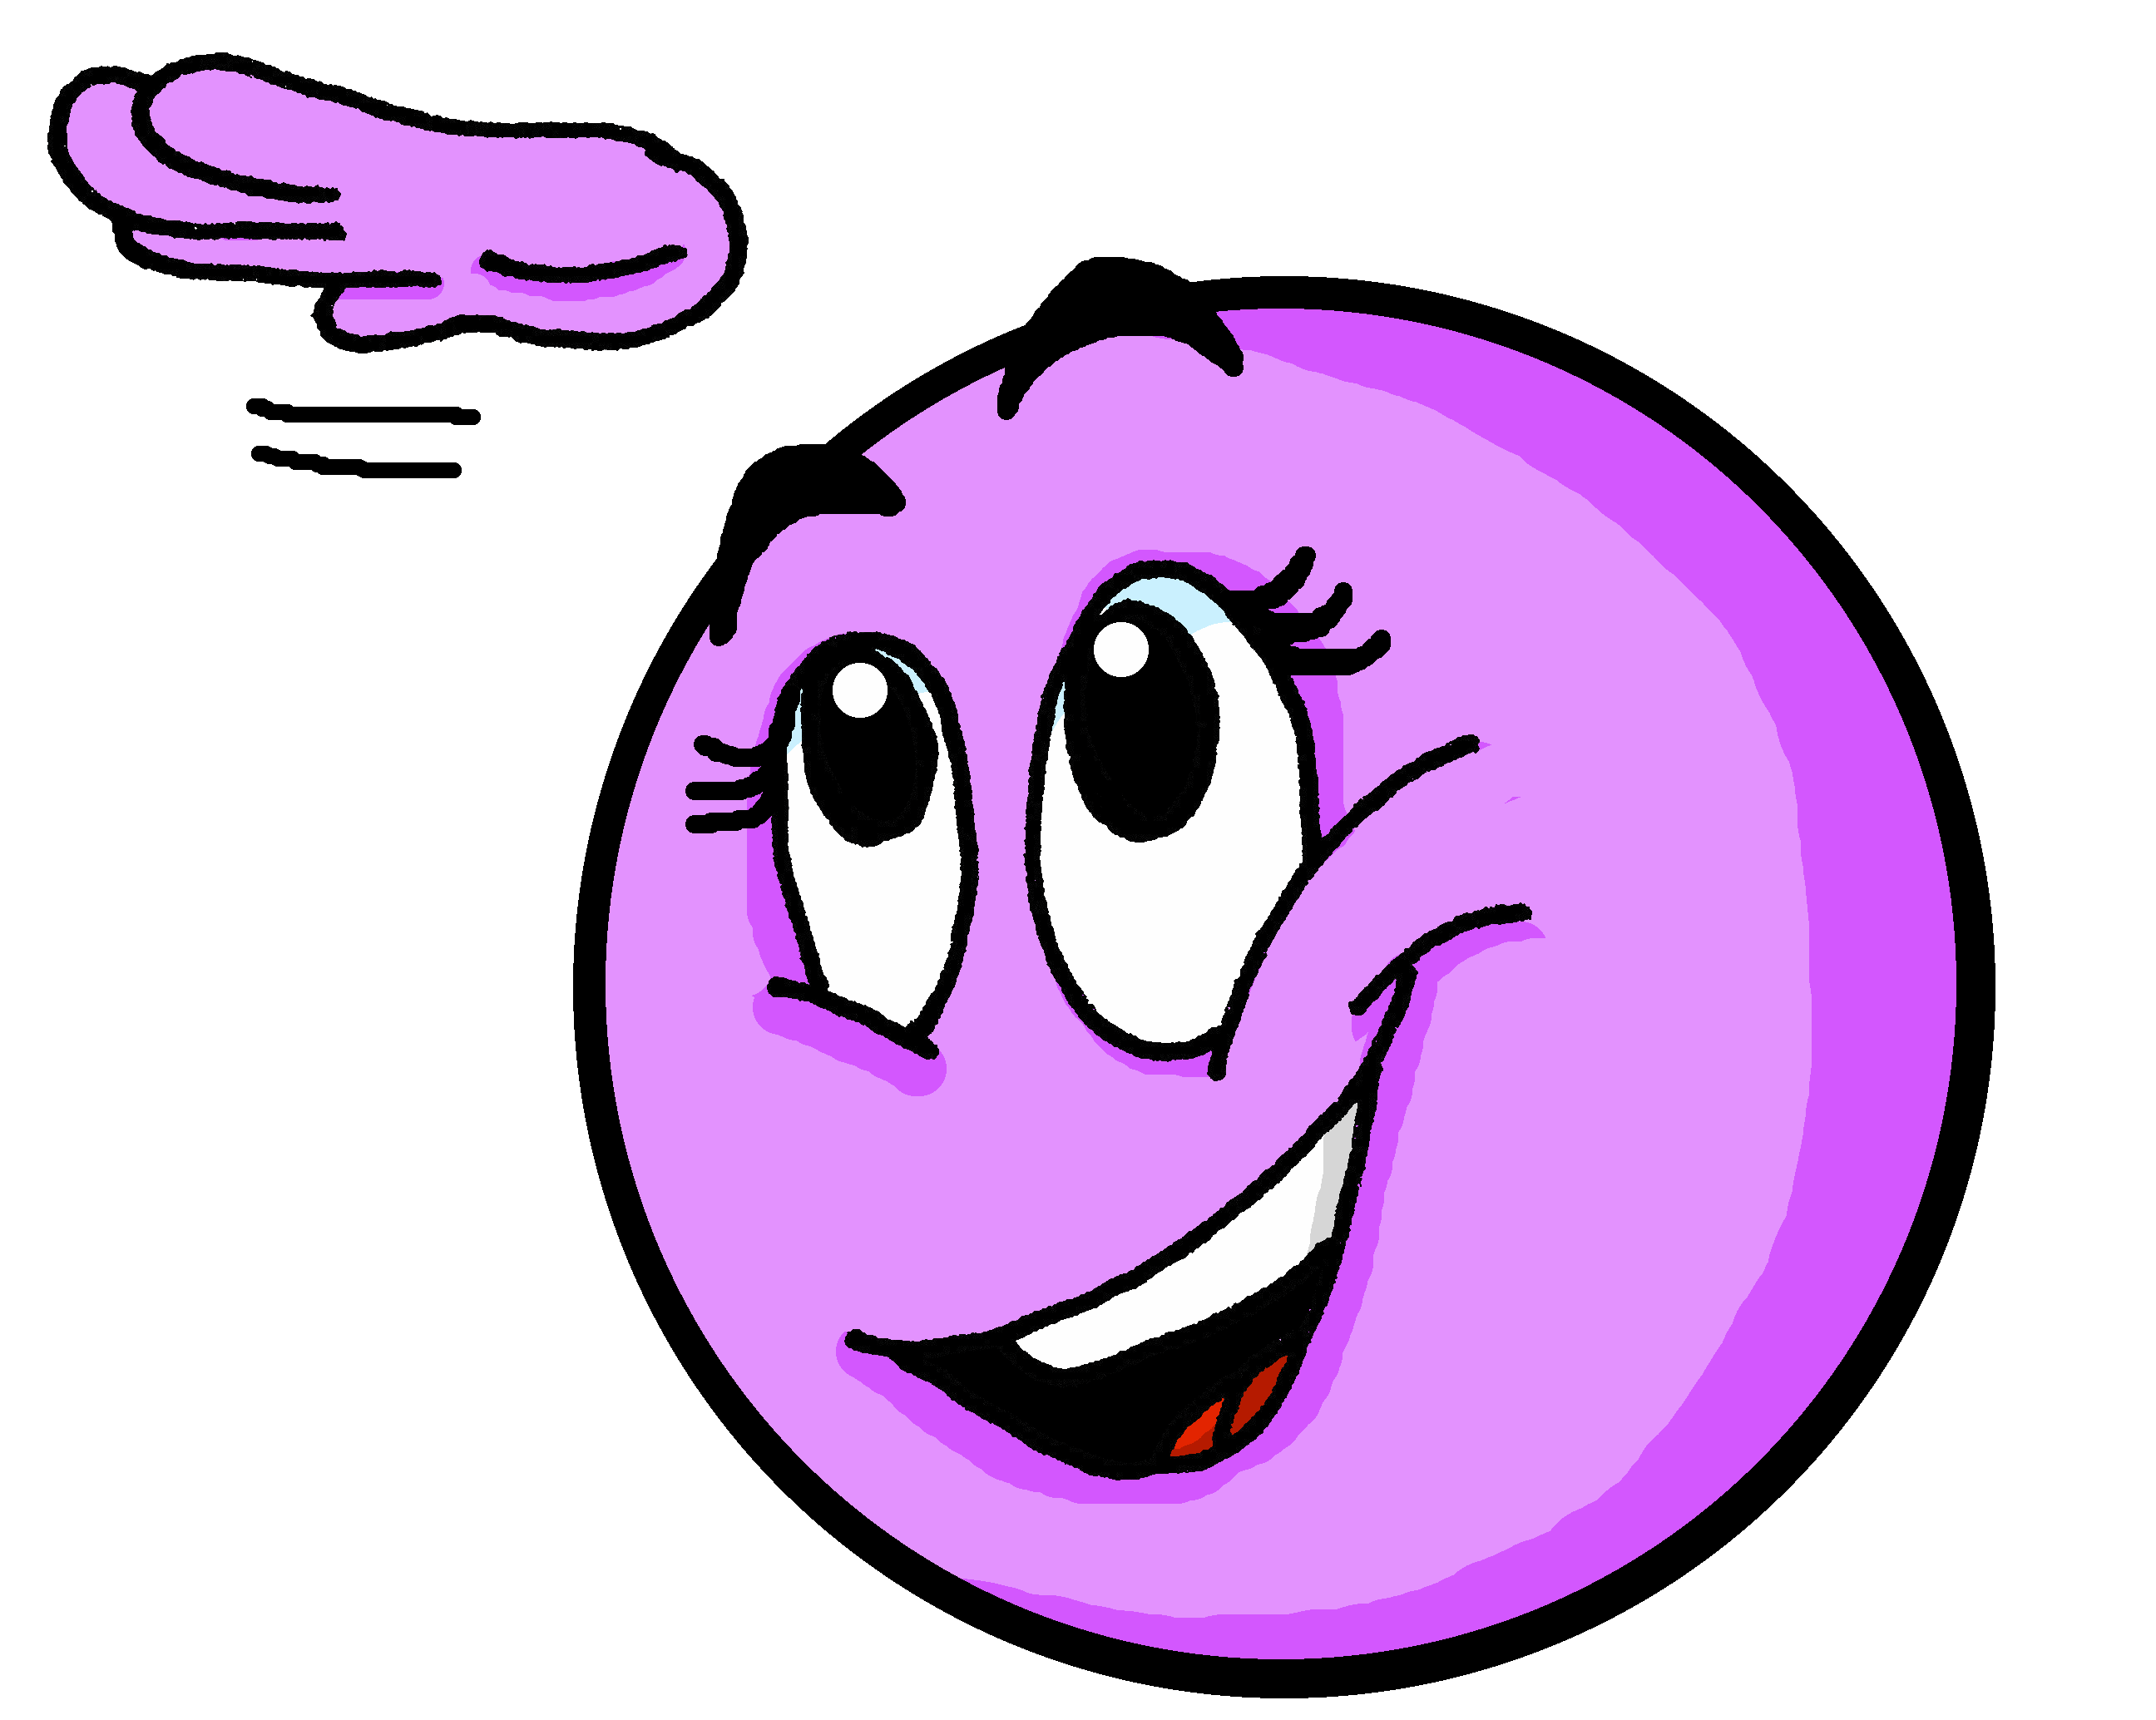
Follow up 2:
Le Carnaval de Menton [1/10]
Décris l’image.
parler
La banane est grande.
________
Notes:
Timing: 5 minutes
Aim: To practise spoken production of correct adjective forms; to practise fluent reading aloud of familiar language.
Procedure:
Click to bring up the French sentence with the English prompt for the adjective.
Elicit the full sentences from pupils, including the adjective.
Click to reveal the written adjective.
Click on the person to hear the full audio version of each sentence.
Word frequency of unknown words: dragon [>5000] girafe [>5000] huit [877] numéro [766]
Source: Londsale, D., & Le Bras, Y. (2009). A Frequency Dictionary of French: Core vocabulary for learners London: Routledge.
Picture attribution:
Asdrubale, CC BY 2.0 https://www.flickr.com/photos/neogluk/395427413/

Slide 6
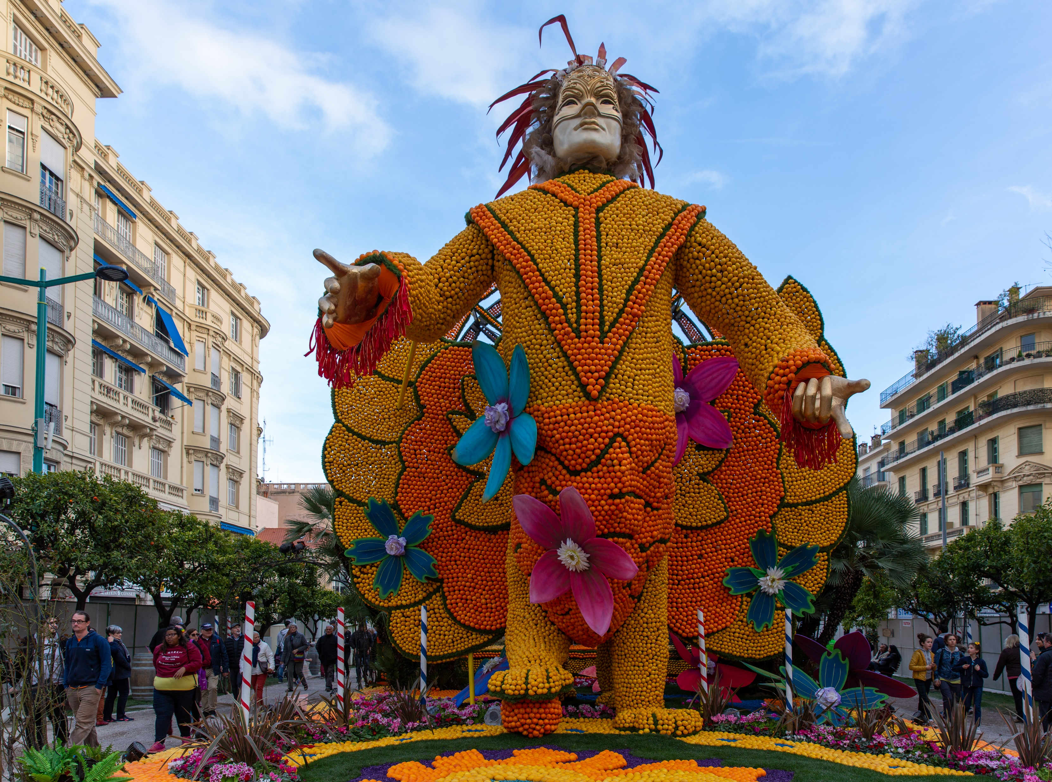
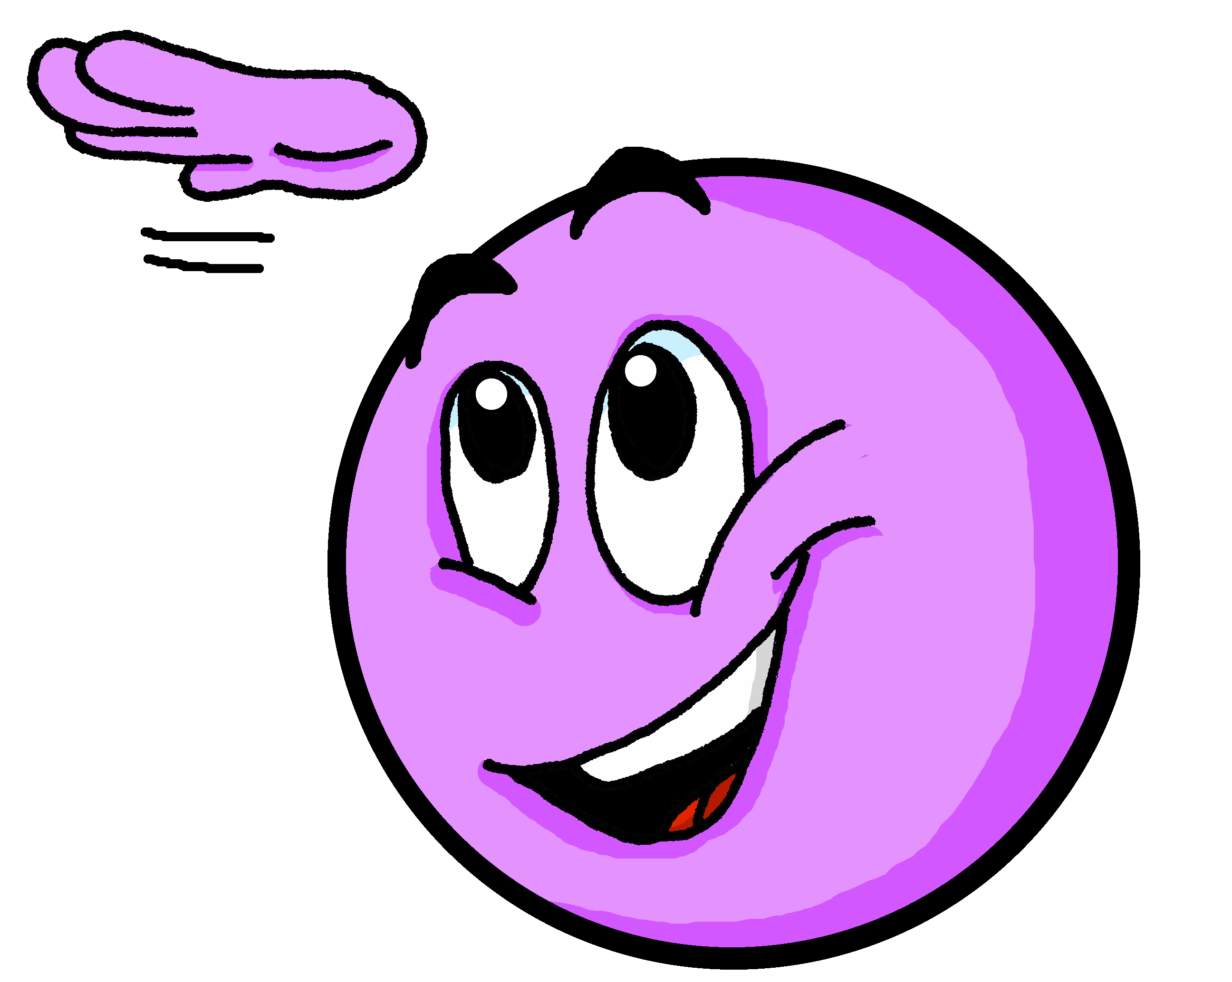
Follow up 2:
Le Carnaval de Menton [2/10]
Décris l’image.
parler
Le garçon est grand.
________.
Notes:
[2/10]
Word frequency of unknown words: dragon [>5000] girafe [>5000] huit [877] numéro [766]
Source: Londsale, D., & Le Bras, Y. (2009). A Frequency Dictionary of French: Core vocabulary for learners London: Routledge.
Picture attribution:
Shesmax, CC BY-SA 4.0 via Wikimedia Commons

Slide 7
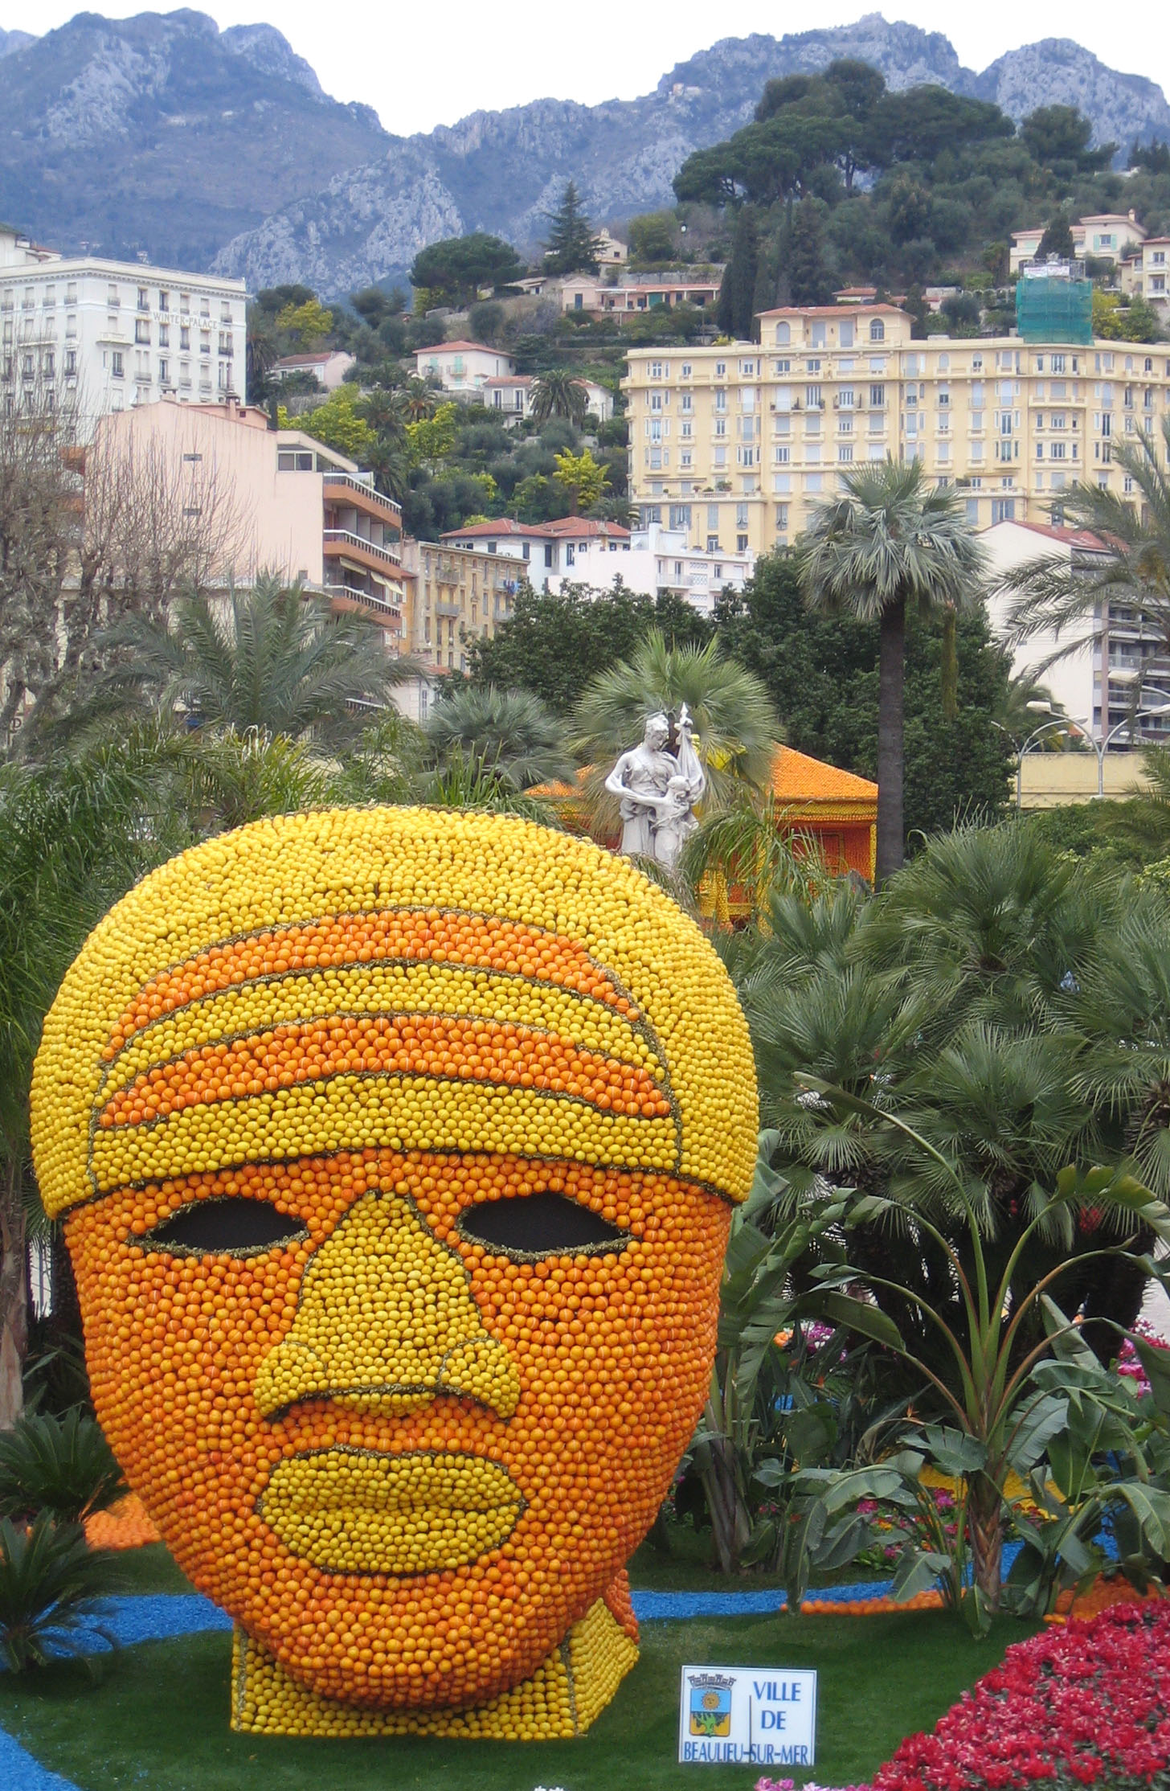
Follow up 2:
Le Carnaval de Menton [3/10]
Décris l’image.
parler
La tête est amusante.
__________
Notes:
[3/10]
Word frequency of unknown words: dragon [>5000] girafe [>5000] huit [877] numéro [766]
Source: Londsale, D., & Le Bras, Y. (2009). A Frequency Dictionary of French: Core vocabulary for learners London: Routledge.
Picture attribution:
Paul Downey, CC BY 2.0 https://www.flickr.com/photos/psd/105332685

Slide 8
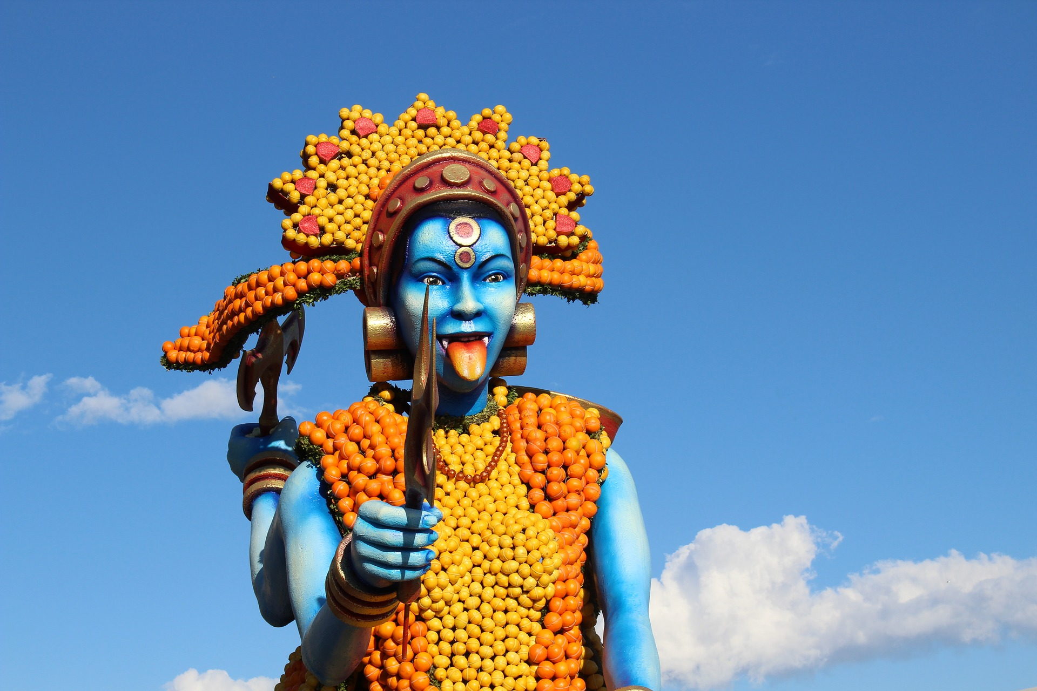
Follow up 2:
Le Carnaval de Menton [4/10]
Décris l’image.
parler
La fille est grande.
________.
Notes:
[4/10]
Word frequency of unknown words: dragon [>5000] girafe [>5000] huit [877] numéro [766]
Source: Londsale, D., & Le Bras, Y. (2009). A Frequency Dictionary of French: Core vocabulary for learners London: Routledge.
.
Picture attribution:
© Ivan Blanco Vilar, CC BY-NC-NC 3.0

Slide 9
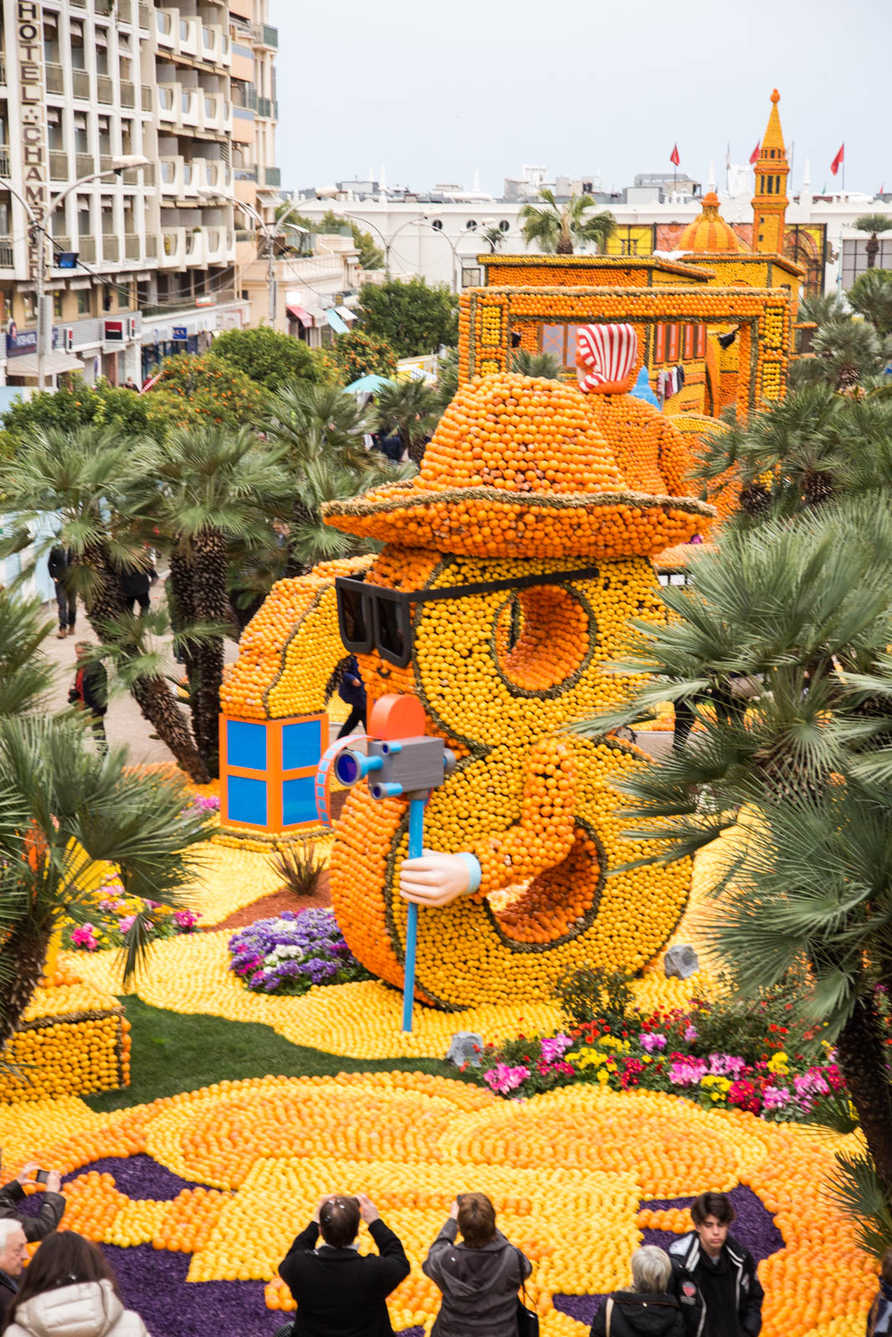
Follow up 2:
Le Carnaval de Menton [5/10]
Décris l’image.
parler
Le numéro huit est grand et il porte un chapeau.
________.
________
© Ivan Blanco Vilar
Notes:
[5/10]
Word frequency of unknown words: dragon [>5000] girafe [>5000] huit [877] numéro [766]
Source: Londsale, D., & Le Bras, Y. (2009). A Frequency Dictionary of French: Core vocabulary for learners London: Routledge.
Picture attribution:
© Ivan Blanco Vilar, CC BY-NC-NC 3.0

Slide 10
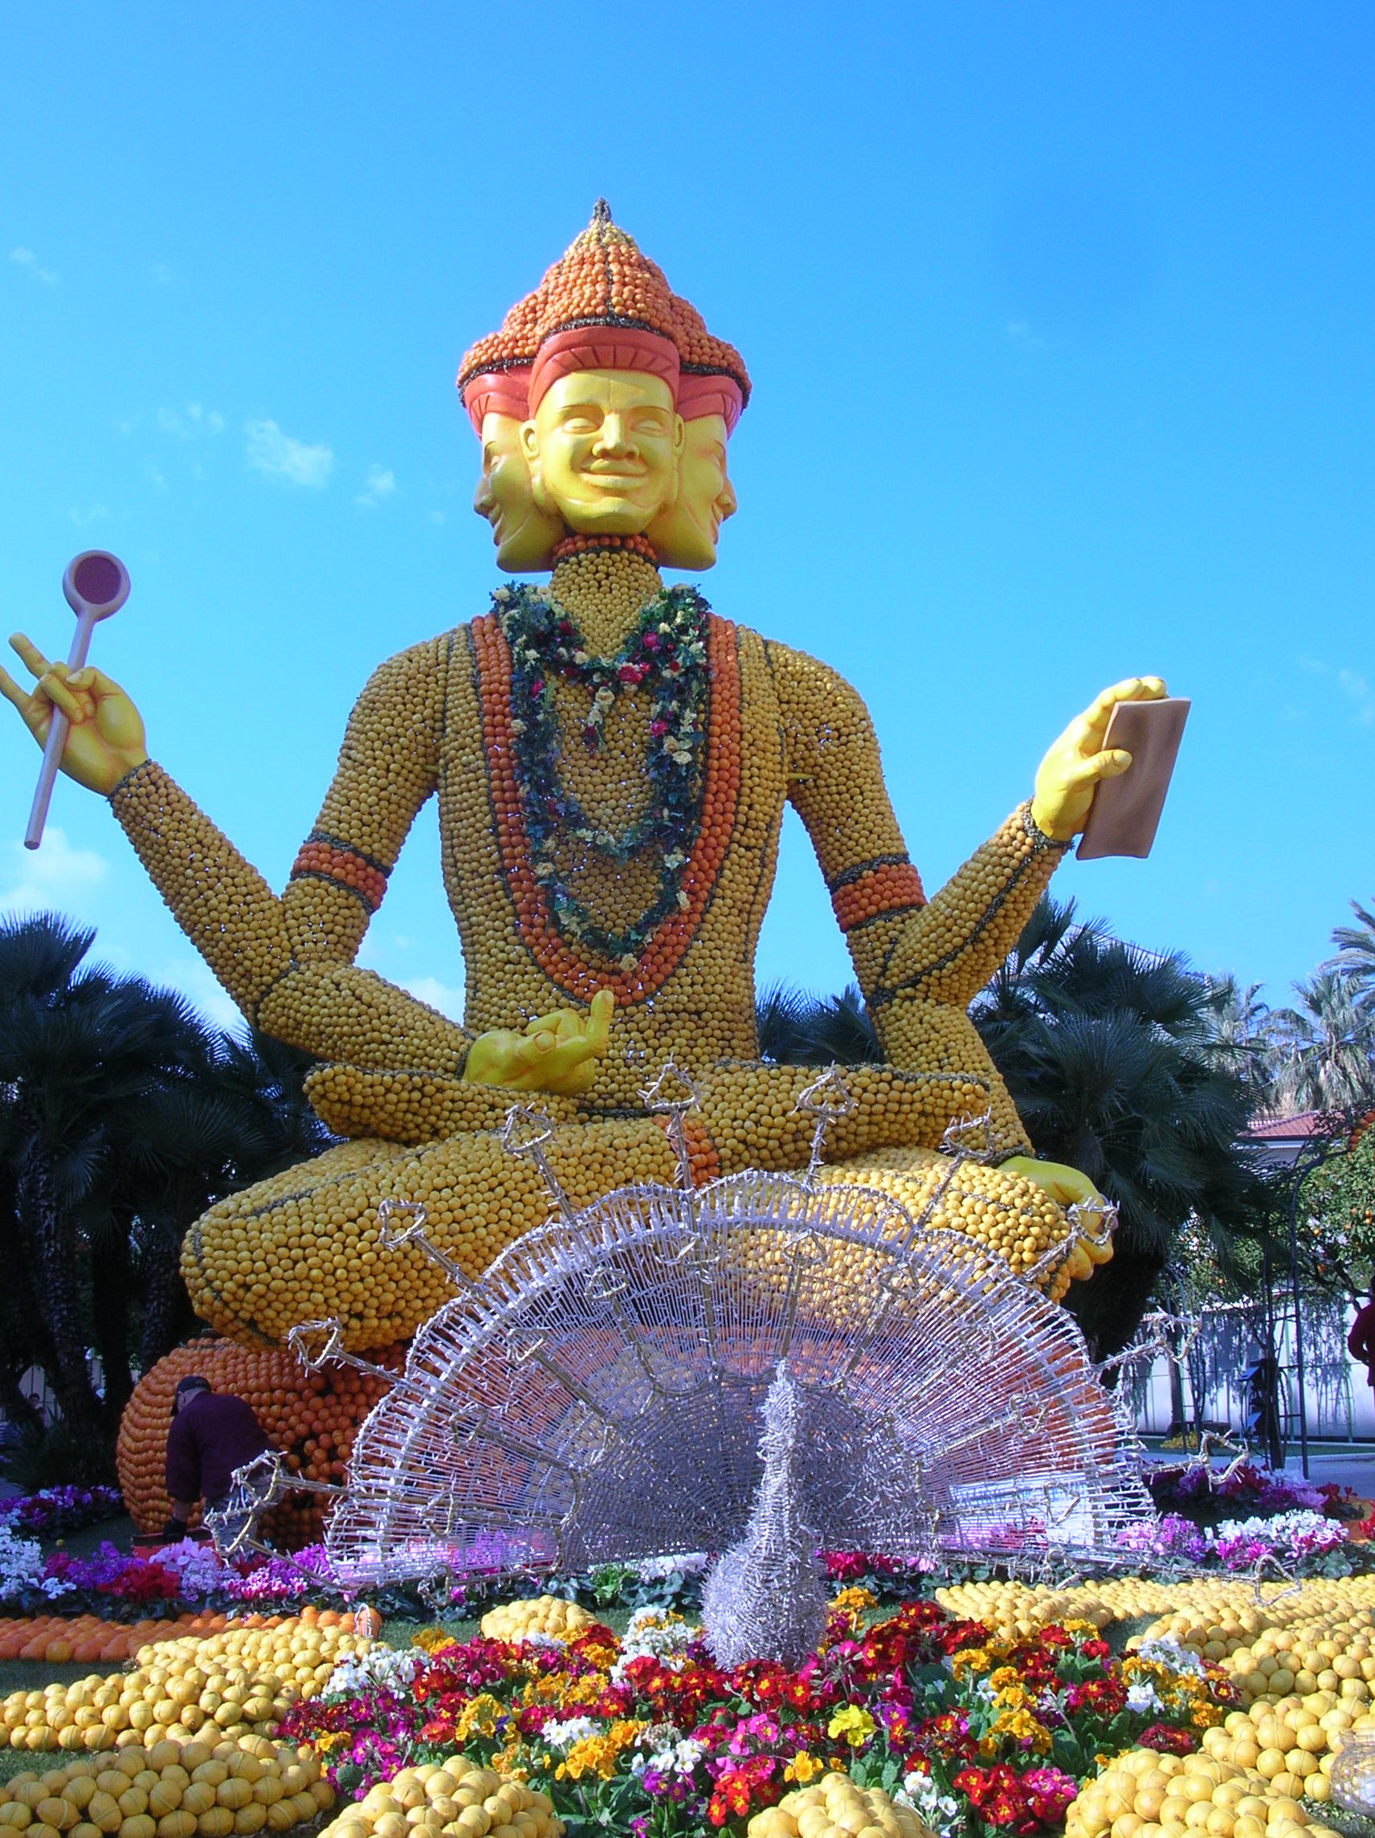
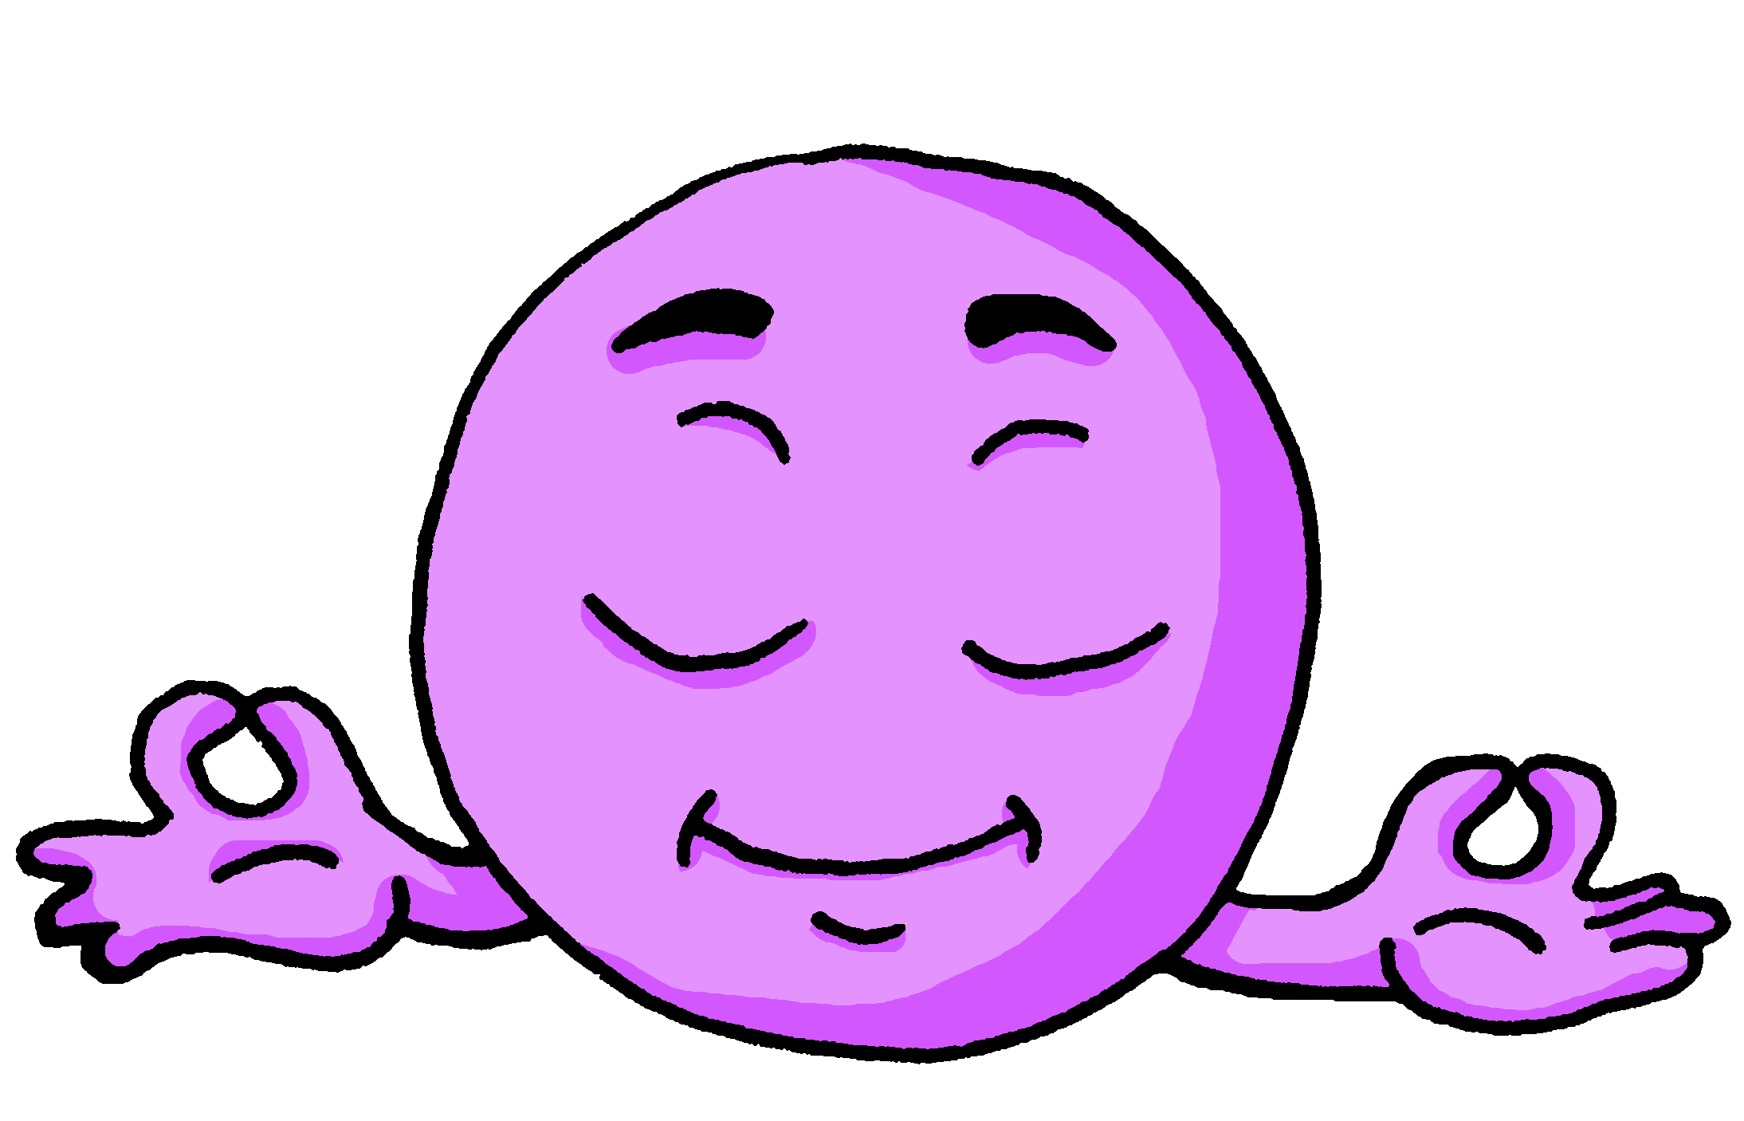
Follow up 2:
Le Carnaval de Menton [6/10]
Décris l’image.
parler
Le Datta est calme.
________.
Notes:
[6/10]
Word frequency of unknown words: dragon [>5000] girafe [>5000] huit [877] numéro [766]
Source: Londsale, D., & Le Bras, Y. (2009). A Frequency Dictionary of French: Core vocabulary for learners London: Routledge.
Picture attribution:

Slide 11
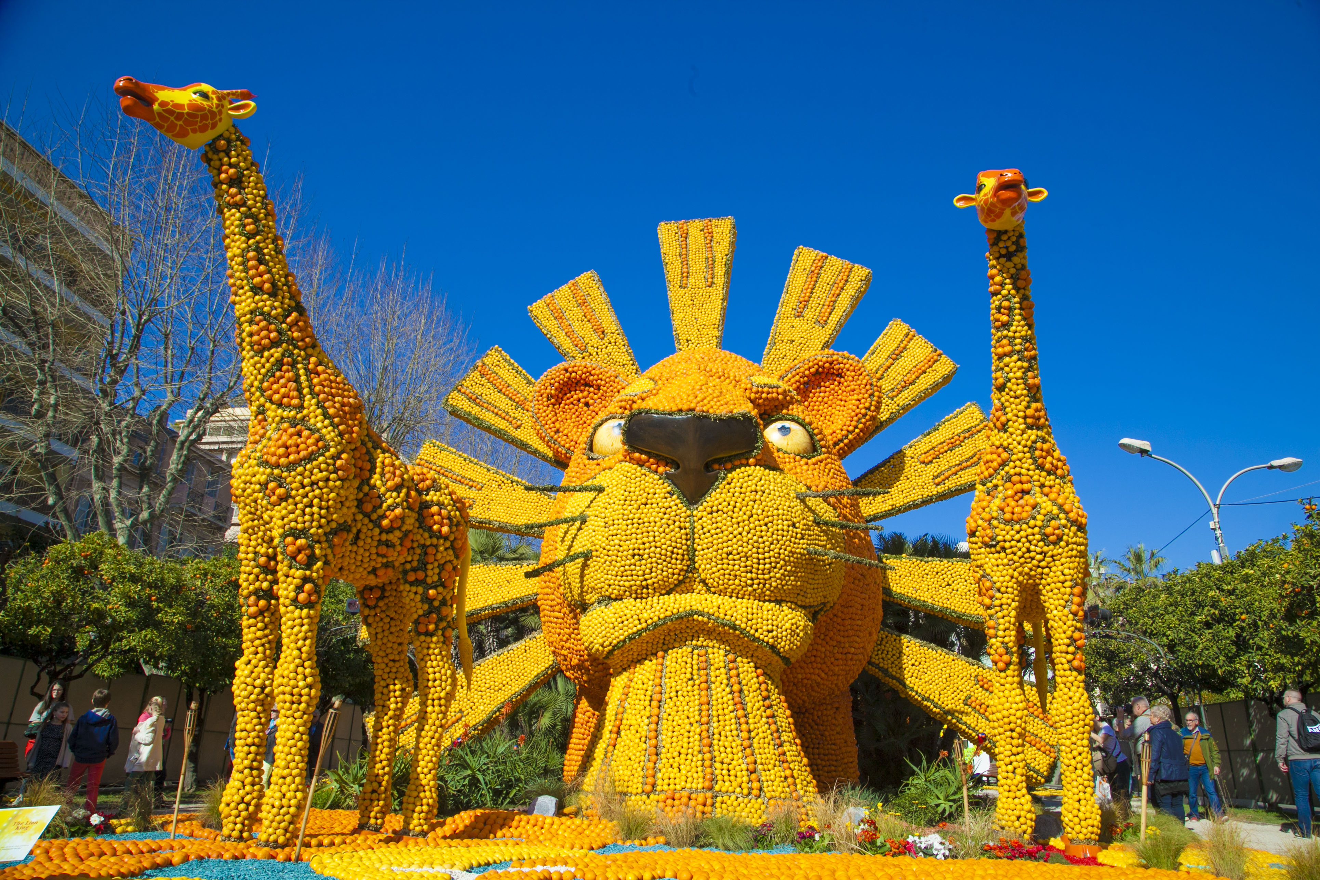
Follow up 2:
Le Carnaval de Menton [7/10]
Décris l’image.
parler
La girafe est grande.
________.
Notes:
[7/10]
Word frequency of unknown words: dragon [>5000] girafe [>5000] huit [877] numéro [766]
Source: Londsale, D., & Le Bras, Y. (2009). A Frequency Dictionary of French: Core vocabulary for learners London: Routledge.
Picture attribution:
Nicolas sartore, CC BY-SA 4.0 via Wikimedia Commons

Slide 12
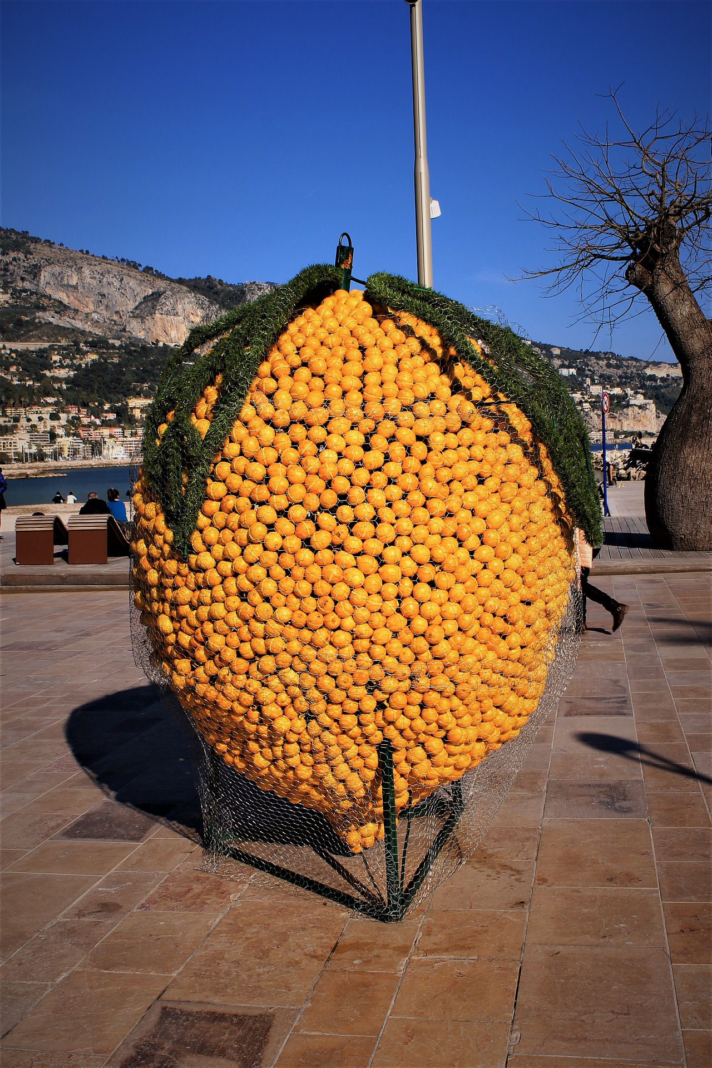
Follow up 2:
Le Carnaval de Menton [8/10]
Décris l’image.
parler
Le fruit est amusant.
________
Notes:
[8/10]
Word frequency of unknown words: dragon [>5000] girafe [>5000] huit [877] numéro [766]
Source: Londsale, D., & Le Bras, Y. (2009). A Frequency Dictionary of French: Core vocabulary for learners London: Routledge.
Picture attribution:
Nicolas sartore, CC BY-SA 4.0 via Wikimedia Commons

Slide 13
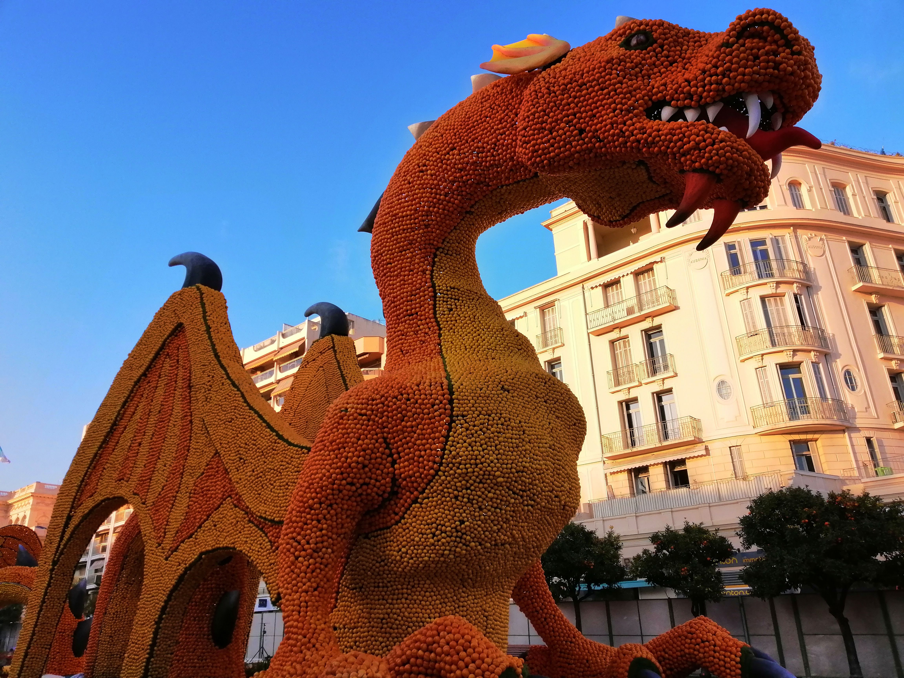
Follow up 2:
Le Carnaval de Menton [9/10]
Décris l’image.
parler
Le dragon est grand.
________.
Notes:
[9/10]
Word frequency of unknown words: dragon [>5000] girafe [>5000] huit [877] numéro [766]
Source: Londsale, D., & Le Bras, Y. (2009). A Frequency Dictionary of French: Core vocabulary for learners London: Routledge.
Picture attribution:
Luckka, CC BY-SA 4.0 via Wikimedia Commons

Slide 14
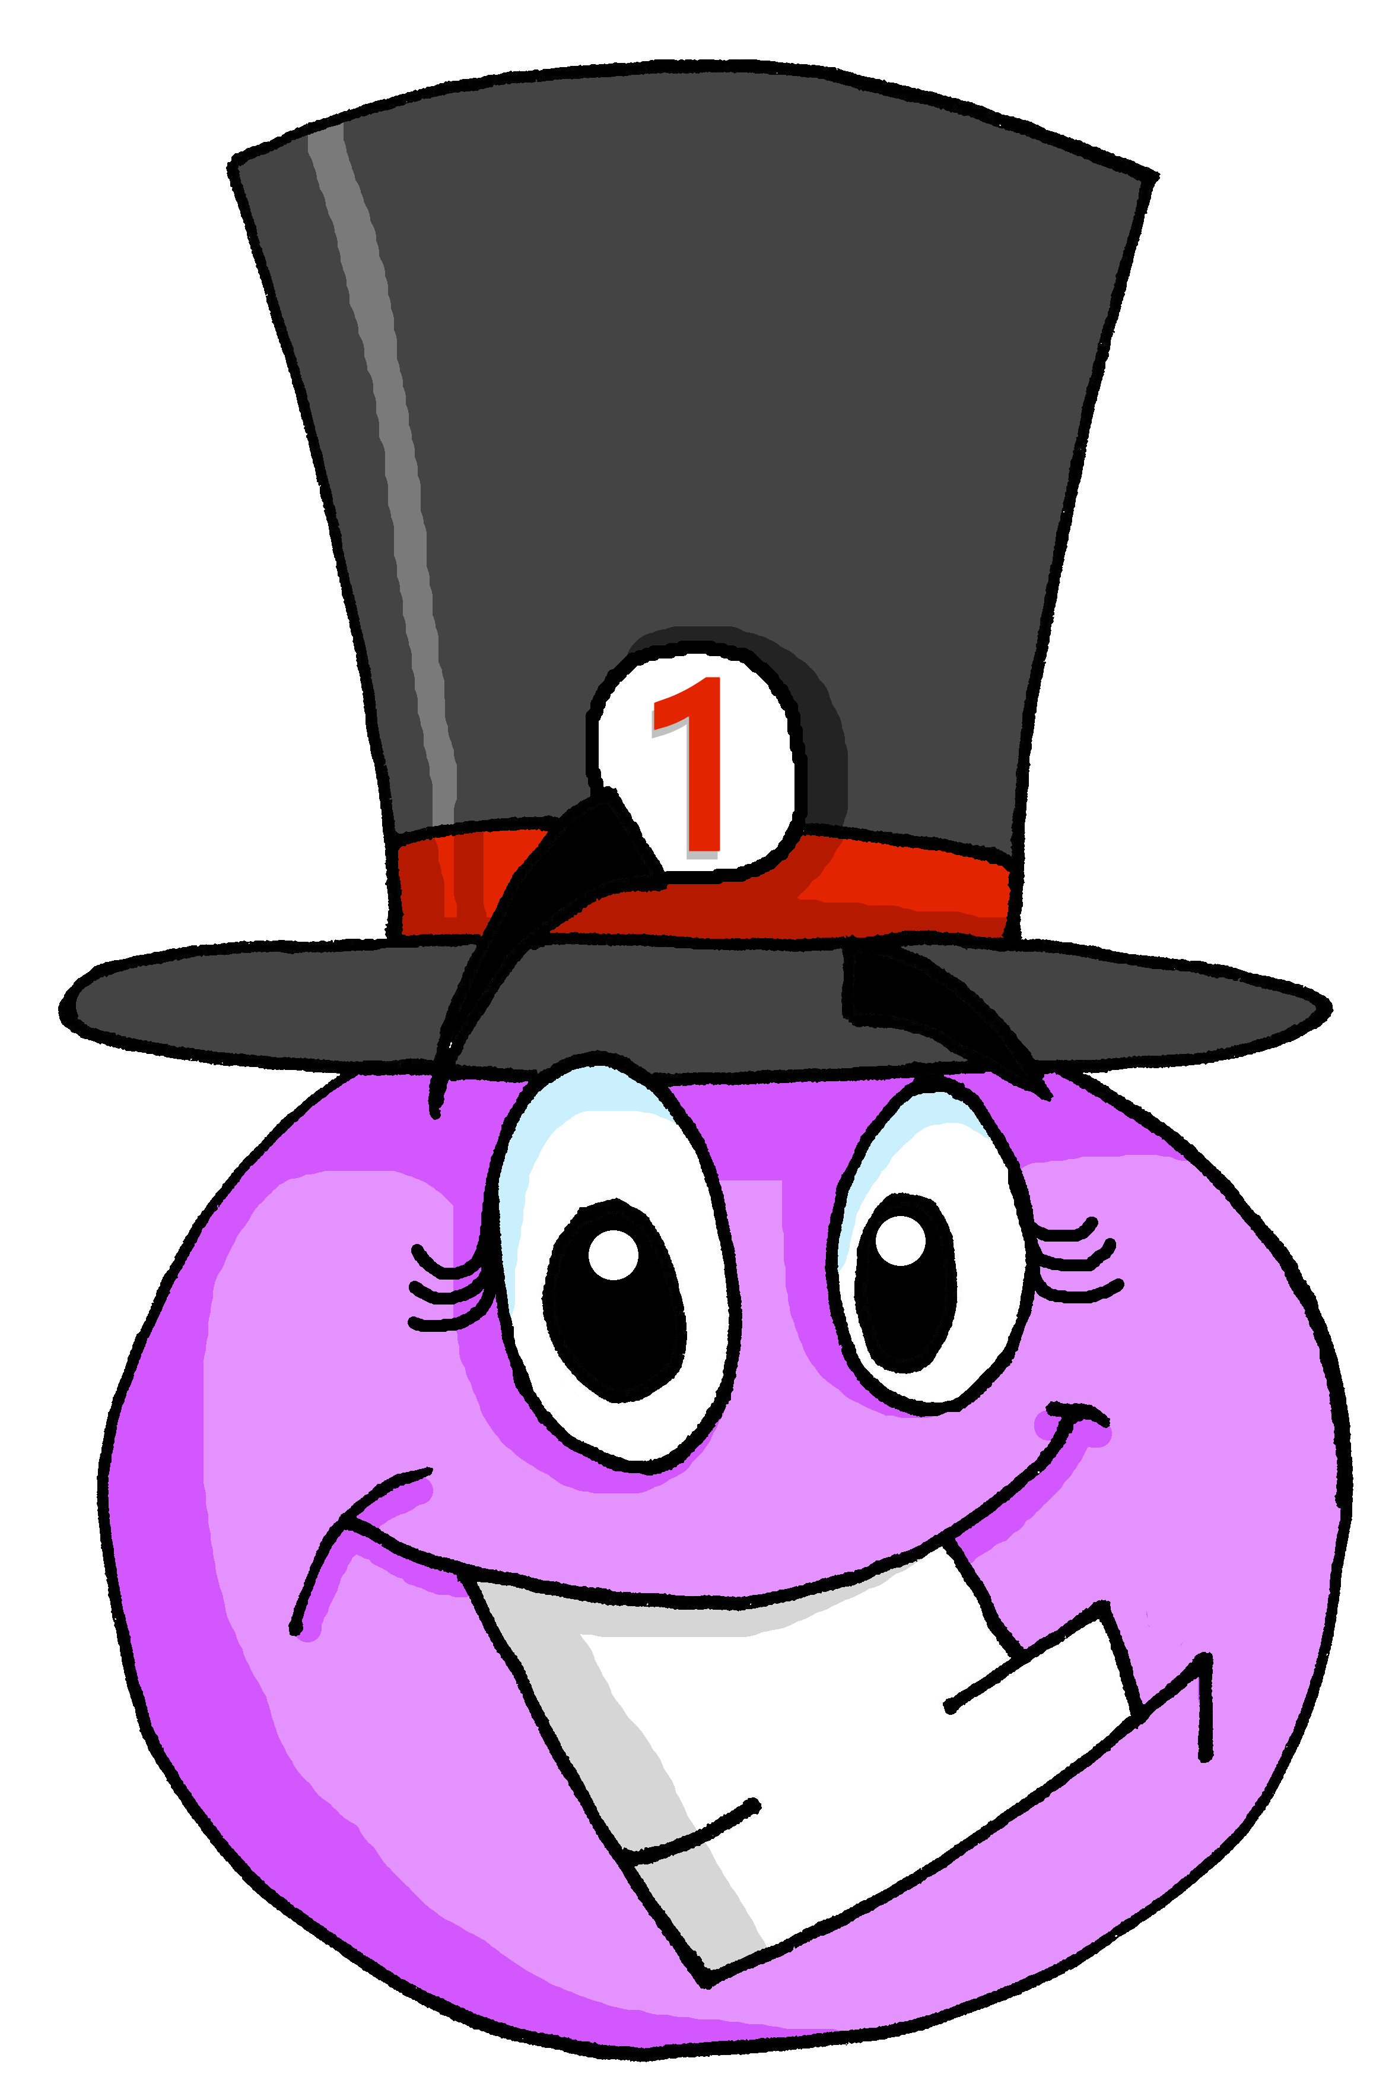
Follow up 2:
Le Carnaval de Menton [10/10]
Décris l’image.
parler
la fête est importante.
________
Notes:
[10/10]
Word frequency of unknown words: dragon [>5000] girafe [>5000] huit [877] numéro [766]
Source: Londsale, D., & Le Bras, Y. (2009). A Frequency Dictionary of French: Core vocabulary for learners London: Routledge.
Picture attribution:
Luckka, CC BY-SA 4.0 via Wikimedia Commons

Slide 15
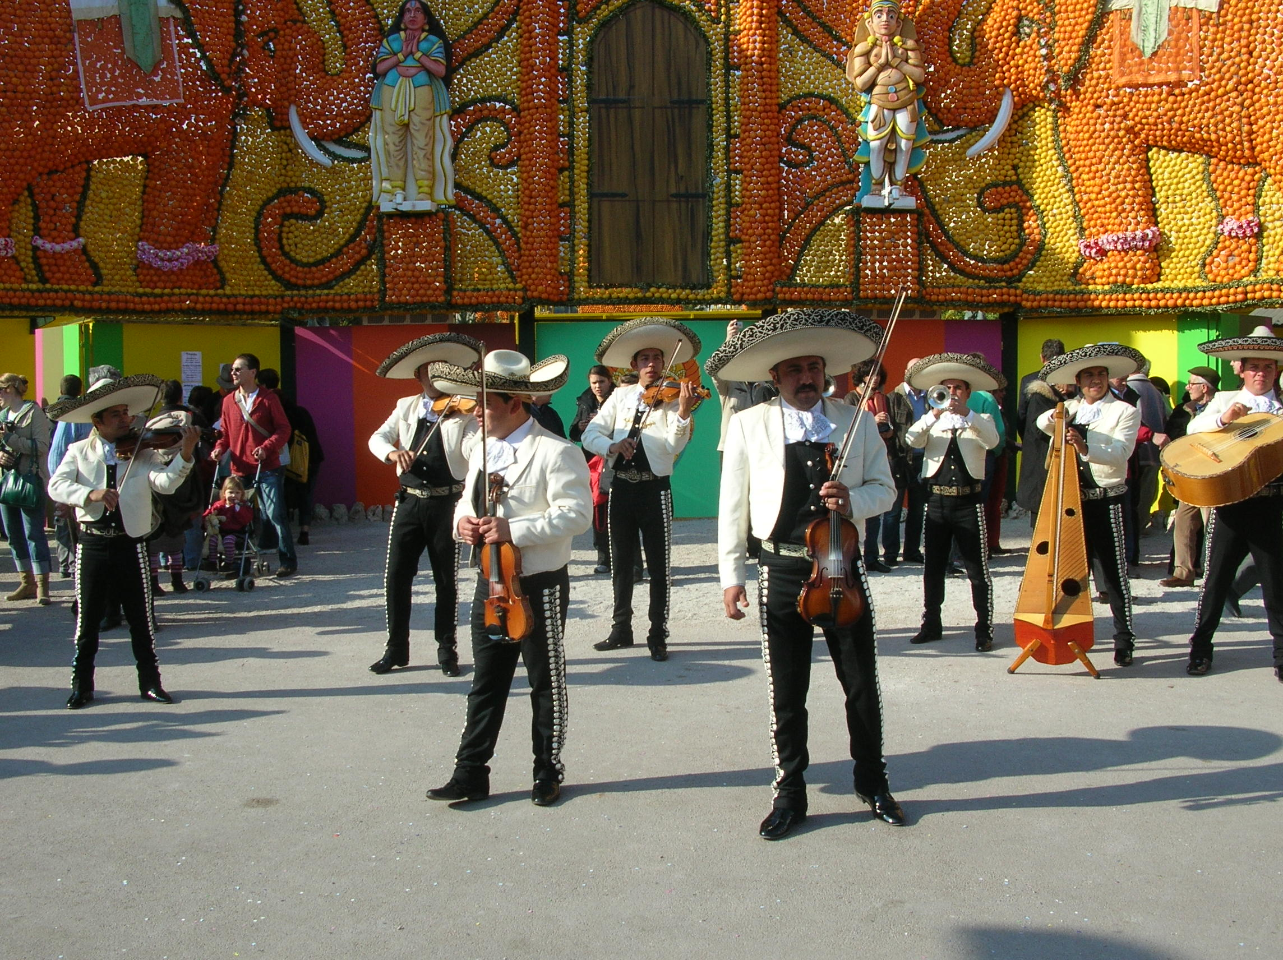
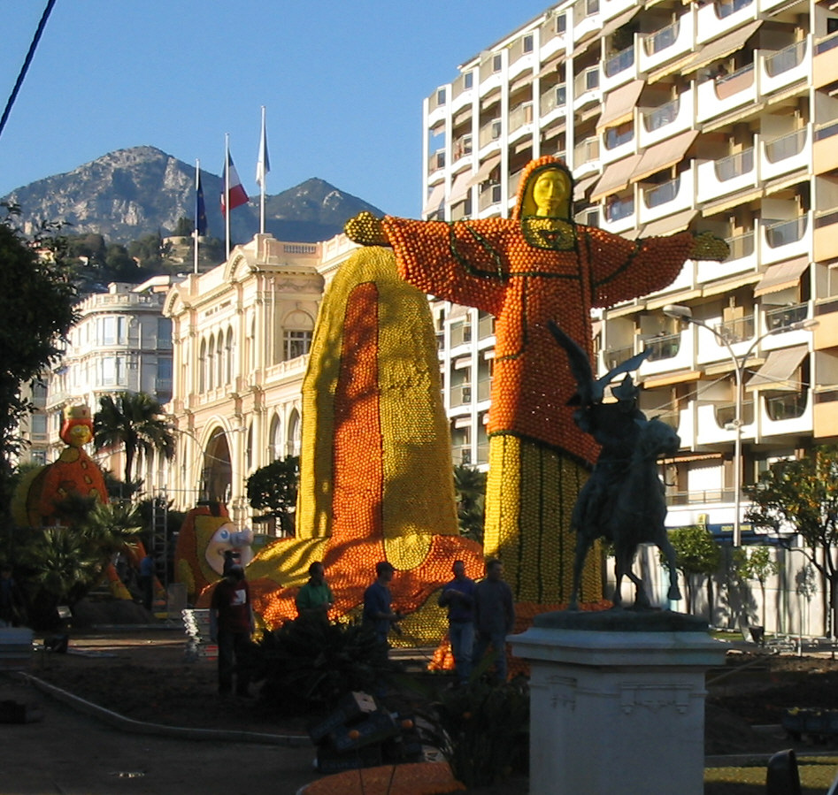
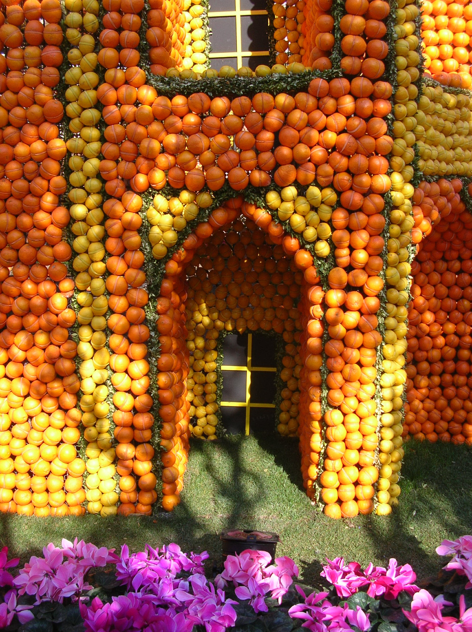
Follow up 3
Écris des phrases.
1
4
The head is big.
The boy is short.
écrire
La tête est grande.
Le garçon est petit.
2
5
The person is tall.
The fruit is small.
La personne est grande.
Le fruit est petit.
3
6
The house is small.
The celebration is big.
La maison est petite.
La fête est grande.
Notes:
Timing: 5 minutes
Aim: to practise written production of simple sentences describing pictures and using correct adjective agreement.
Procedure:
Click for each word to appear
Pupils produce the word with the correct article ‘le’, ‘la’ or ‘l’.
Click again for it to disappear into the corresponding pacperson’s mouth.
Attributions: 2] Olivier2000 at French Wikipedia., CC BY-SA 1.0 via Wikimedia Commons

Slide 16
vocabulaire
Follow up 4 - Écris en anglais : Can you get at least 15 points?
mots
 | la photo | la table | ou
 | l’animal | le chien | le chat
 | il a | elle a | quoi
 | avec | tous les jours | j’ai
 | chanter | utiliser | facile
 | le garçon | de | répéter
 | la fête | la fille | le fruit
(the) photo
(the) table
or
x3
(the) pet, animal
(the) dog
(the) cat
he has
she has
what
x2
with
every day
I have
to sing, singing
to use, using
easy
(the) boy
of
(the) father
x1
(the) party, celebration
(the) girl
(the)fruit
Notes:
Timing: 5-10 minutes
Aim: to practise written comprehension of vocabulary from this week and previous weeks.
Procedure: Give pupils a blank grid. They fill in the English meanings of any of the words they know, trying to reach 15 points in total.
Note: The most recently learnt and practised words are pink, words from the previous week are green and those from earlier are blue, thus more points are awarded for them, to recognise that memories fade and more effort (heavy lifting!) is needed to retrieve them.
16

Slide 17
vocabulaire
Follow up 5 - Écris en français : Can you get at least 15 points?
mots
 | (the) photo | (the) table | or
 | (the) pet, animal | (the) dog | (the) cat
 | he has | she has | what
 | with | every day | I have
 | to sing, singing | to use, using | easy
 | (the) boy | of | to repeat, repeating
 | (the) party, celebration | (the) girl | (the) fruit
la photo
la table
ou
x3
l’animal
le chien
le chat
il a
elle a
quoi
x2
avec
tous les jours
j’ai
chanter
utiliser
facile
le garçon
de
répéter
x1
la fête
la fille
le fruit
Notes:
Timing: 5-10 minutes
Aim: to practise written comprehension of vocabulary from this week and previous weeks.
Procedure: Give pupils a blank grid. They fill in the French meanings of any of the words they know, trying to reach 15 points in total.
Note: The most recently learnt and practised words are pink, words from the previous week are green and those from earlier are blue, thus more points are awarded for them, to recognise that memories fade and more effort (heavy lifting!) is needed to retrieve them.
17

Slide 18
vocabulaire
Écris en anglais : Can you get at least 15 points?
mots
 | la photo | la table | ou
 | l’animal | le chien | le chat
 | il a | elle a | quoi
 | avec | tous les jours | j’ai
 | chanter | utiliser | facile
 | le garçon | de | répéter
 | la fête | la fille | le fruit
x3
x2
x1
Notes:
HANDOUT Follow up 4
18

Slide 19
vocabulaire
Écris en français : Can you get at least 15 points?
mots
 | (the) photo | (the) table | or
 | (the) pet, animal | (the) dog | (the) cat
 | he has | she has | what
 | with | every day | I have
 | to sing, singing | to use, using | easy
 | (the) boy | of | to repeat, repeating
 | (the) party, celebration | (the) girl | (the) fruit
x3
x2
x1
Notes:
HANDOUT Follow up 5
19

