Slide 1
Saying what I and others do
La famille
Definite articles: le, la singular words for ‘the’
SSC open and closed [eu]
rouge
Notes:
Artwork by Steve Clarke. Pronoun pictures from NCELP (www.ncelp.org). All additional pictures selected from Pixabay and are
available under a Creative Commons license, no attribution required.
The AUDIO version of the lesson material includes additional audio for the new language presented (phonics, vocabulary) and audio for the instructions
on the slide.
In addition, it includes VIDEO clips of the phonics and the phonics’ source words. Pupils can be encouraged to look at the shape of the mouth/lips on
slides where these appear, and try to copy it/them.
Phonics: revisit closed [eu] and introduce open [eu] un peu [91] peur [755] jeune [152] neuf [787] acteur [1552] seul [102]
Vocabulary (new words in bold): donner [46] préparer [368] trouver [83] famille [172] frère [1043] mère [645] père [559] sœur [1558] le [1] la [1] à (meaning ‘to’) [4]
Revisit 1: --
Revisit 2: un [3] une [3] ballon [3692] bouteille [2979] cahier [4001] jeu [291] orange [3912] peluche [>5000] sac [2343] stylo [>5000] (revisit banane)
Londsale, D., & Le Bras, Y. (2009). A Frequency Dictionary of French: Core vocabulary for learners London: Routledge.
The frequency rankings for words that occur in this PowerPoint which have been previously introduced in these resources are given in the SOW and in the resources that first introduced and formally re-visited those words. For any other words that occur incidentally in this PowerPoint, frequency rankings will be provided in the notes field wherever possible.
1

Slide 2
closed [eu]
open [eu]
prononcer
un peu
peur
It sounds like the ‘ur’ in ‘hurt’.
[a bit]
[fear]
This is a closed vowel. When you say this sound, your tongue is near the top of your mouth.
This is an open vowel. When you say this sound, your tongue is near the bottom of your mouth.
Notes:
Timing: 2 minutes
Aim: to revisit closed [eu] and introduce open [eu].
Procedure:
Click to bring up the closed [eu]. Repeat the SSC [eu] with the class.
Click to bring up the phrase ‘un peu’ (with gesture, if using).
Click to bring up the English translation and picture.
Pupils to practise saying the phrase several times.
Click to bring up the callout about closed vowel tongue position.
Click to bring up the open [eu]. Repeat the SSC with the class.
Click to bring up the word ‘peur’ (with gesture, if using).
Click to bring up the English translation and picture, and the callout hint about ‘hurt’.
Say this SSC several times with the class.
Click to bring up the call out about open SSC [eu].
Practise alternating between ‘peu’ and ‘peur’ several times.

Slide 3
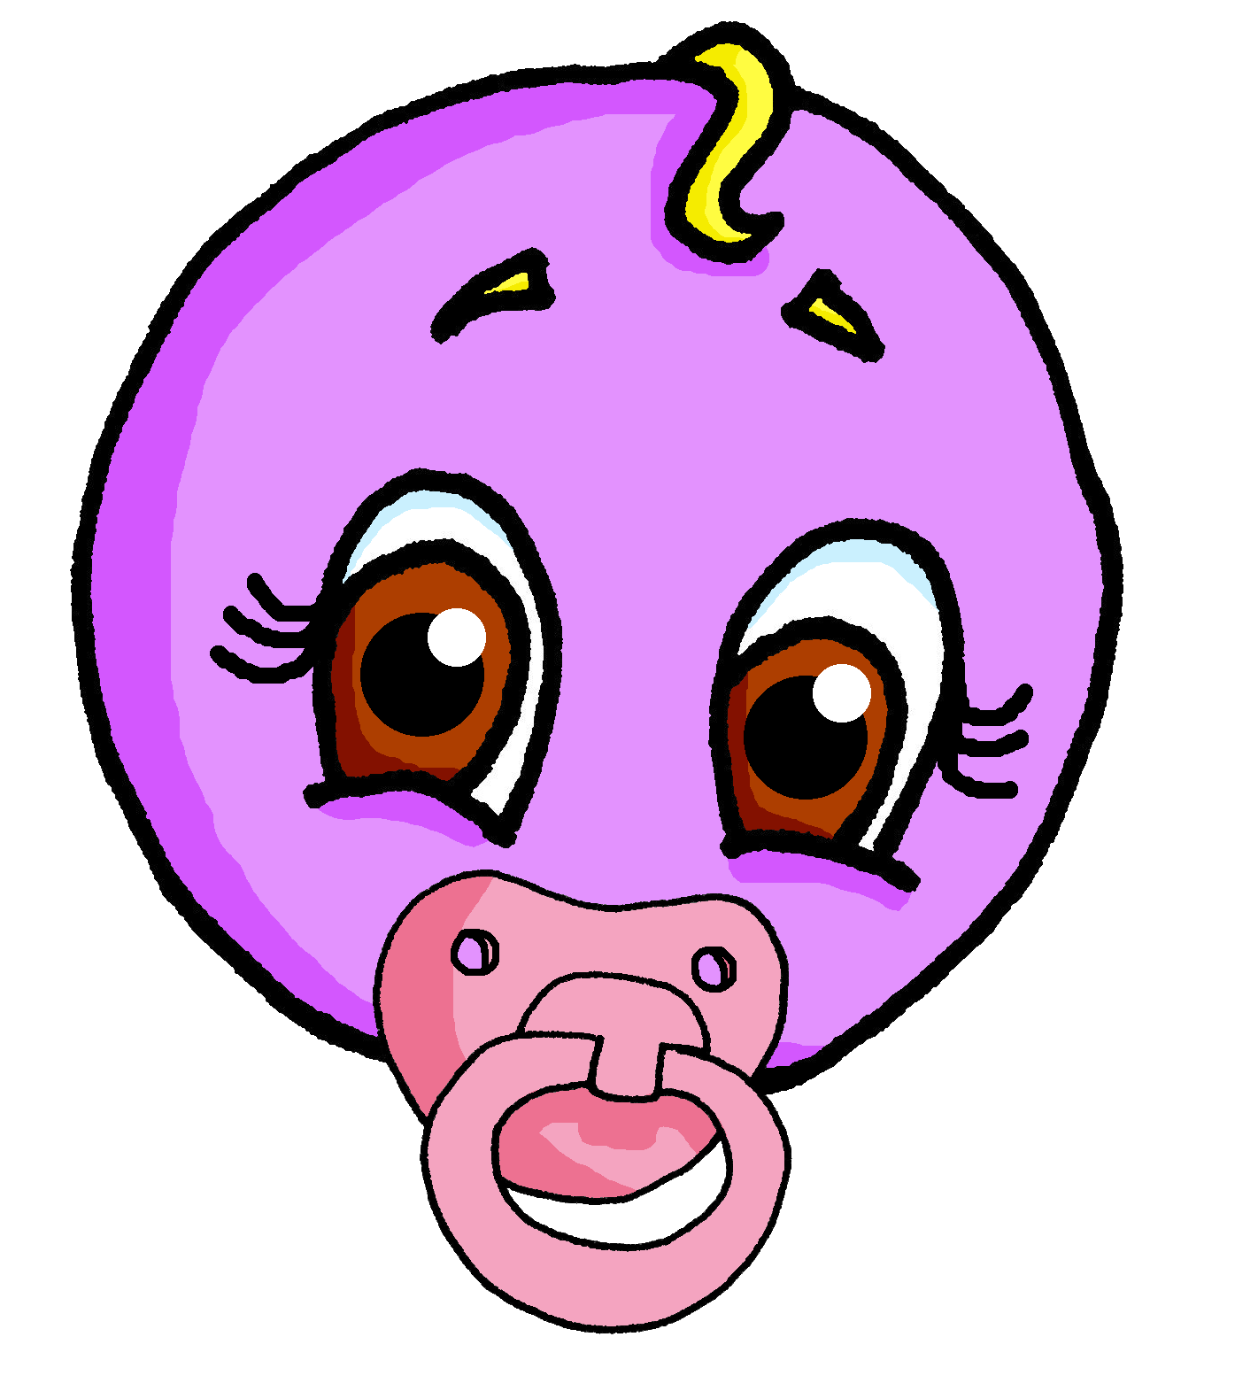
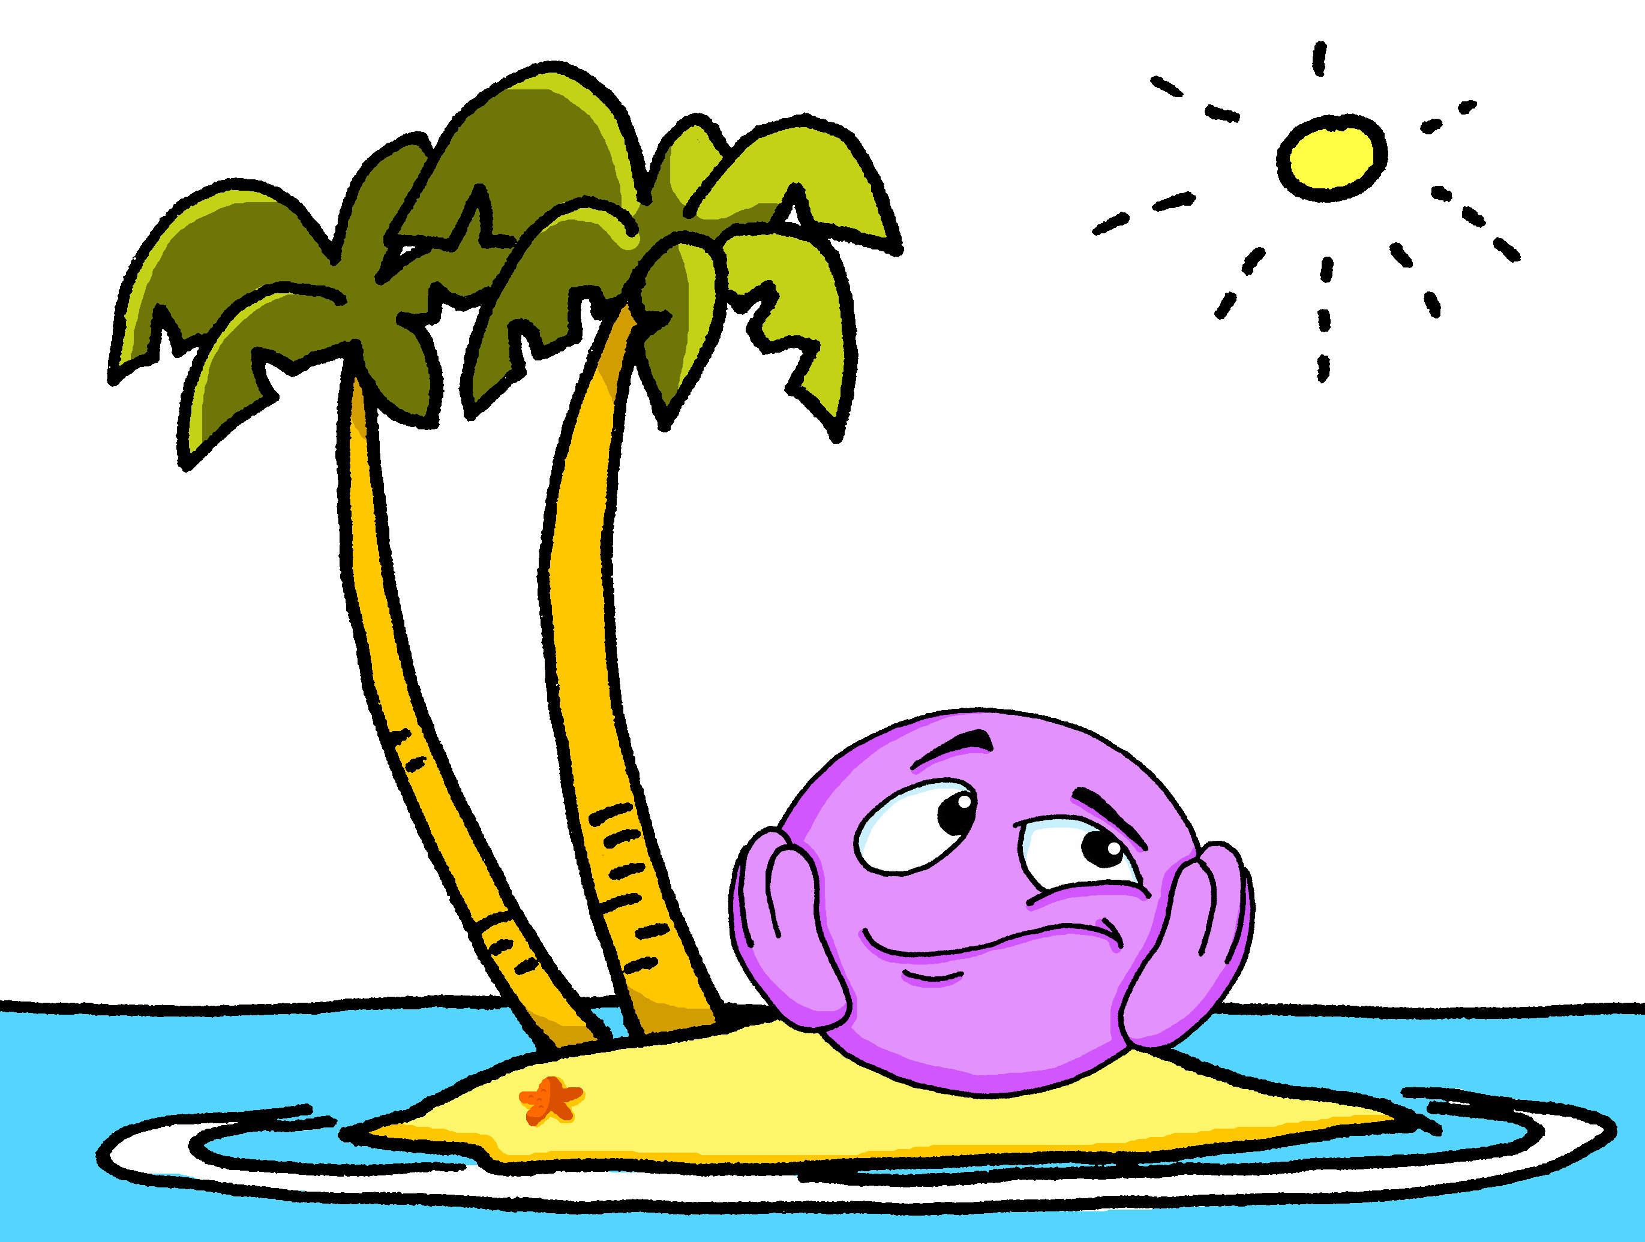
open [eu]
prononcer
jeune
seul
Notes:
Timing: 2 minutes (two slides)
Aim: to practise open SSC [eu] in words where [eu] is followed by –l, -f, -r, -n(e).
Procedure:
Elicit the pronunciation of the individual SSC [eu].
Click to bring on the first picture and word and elicit the pronunciation from pupils. Note: jeune and seul are already known.
Move to next slide.
3

Slide 4
open [eu]
prononcer
neuf
acteur
[eu] is open when followed by r, f, l, but closed before x, s.
Notes:
Timing: 2 minutes (two slides)
Aim: to practise open SSC [eu] in words where [eu] is followed by –l, -f, -r, -n(e).
Procedure:
Click to present neuf and acteur and practise these with pupils, e.g. by prompting with the English and eliciting choral responses.
Finally, click to bring up the callout. This provides a link to the vocabulary for this week, which are adjectives ending in –eux, with closed [eu].
4

Slide 5
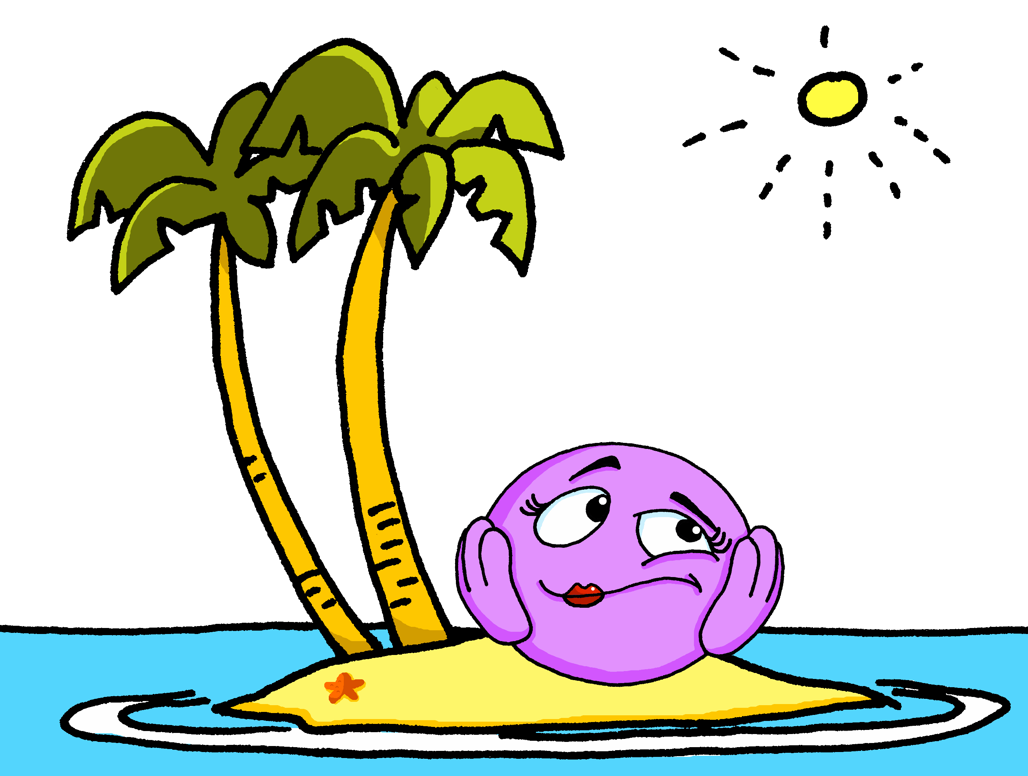
Closed or open [eu]?
Écris 1-8 et ‘open’ ou ‘closed’.
prononcer
 |  | open [eu] | closed [eu]
 | bleu
 | deux
 | ordinateur
 | seule
 |  | open [eu] | closed [eu]
 | sérieuse
 | fleur
 | bœuf
 | curieux
Remember: [eu] is open when followed by r, f, l, but closed before x, s.
Notes:
Timing: 5 minutes
Aim: to apply written recognition of the open/closed [eu] rule; to practise aural recognition of open and closed [eu/œu] when checking answers.
Procedure:
Click to bring up the reminder about the rule.
2. Pupils read the words and decide, based on spelling, if the [eu/œu] is open or closed.
3. Click to listen and check (allow pupils a moment to adjust their answers, as needed).
4. Click again to reveal ticks.
Transcript: bleu deux ordinateur seule sérieuse fleur bœuf
curieux
Word frequency (1 is the most frequent word in French): bleu [1216] bœuf [3914] curieux [2424] deux [41] fleur [2305] ordinateur [2201] sérieux [412] seul [102]
Source: Londsale, D., & Le Bras, Y. (2009). A Frequency Dictionary of French: Core vocabulary for learners London: Routledge.
Note: with the exception of bœuf all words have been or will be taught in this SOW.
5

Slide 6
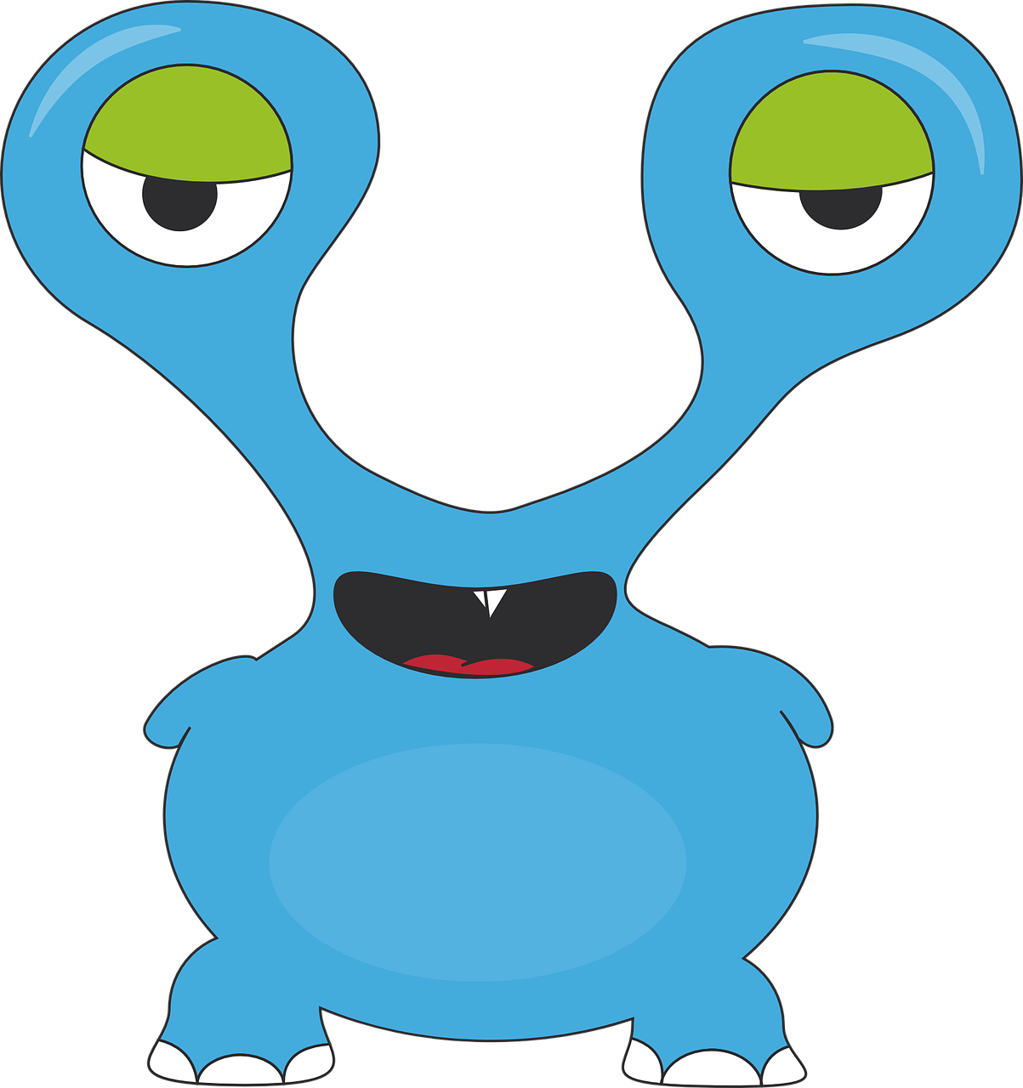
vocabulaire
Écoute et répète. [1/2]
mots
une famille
une mère
un père
une sœur
un frère
un animal
une peluche
Notes:
Timing: 4 minutes (two slides)
Aim: to introduce key vocabulary for the context of family.
Procedure: 1. Teacher clicks to present the French words one by one. Pupils can repeat.
2. Pupils either work individually or in pairs, reading the French words out loud and looking at the English meanings (1 minute). 3. Then the teacher removes the English words or pictures (one by one) and pupils try to recall the English orally (chorally), looking at the French (1 minute).
4. When teacher clicks, the French words re-appear (with audio in the audio version). 5. Then the French meanings are removed (one by one) and pupils try to recall them orally (again, chorally), looking at the English (1 minute) 6. Further rounds of learning can be facilitated by one pupil turning away from the board, and his/her partner asking him/her the meanings (‘Comment dit-on XXX en anglais/français ?’). This activity can work from L2 → L1 or L1 → L2.
6

Slide 7
vocabulaire
Écoute et répète. [2/2]
mots
donner
préparer
[to prepare, preparing]
[to give, giving]
trouver
à
[to find, finding]
[to, at]

Slide 8
The definite article
Words for ‘the’
We know that all French nouns have gender, and are masculine or feminine.
To mean a or an in French before a noun, use un (masculine) or une (feminine).
When le is followed by a vowel it becomes l’
When la is followed by a vowel it also becomes l’
a phrase
une
phrase
the phrase
un
la
le
sac
a bag
the bag
la
règle
a ruler
un
a present
une
the ruler
le
cadeau
the present
orange
an orange
un
une
the orange
l’
uniforme
the uniform
l’
a uniform
To mean the in French before a noun, use le (masculine) or la (feminine).
Notes:
Timing: 2 minutes
Aim: to recap singular indefinite articles and to introduce singular definite articles.
Procedure: 1. Click to present the new information.
2. Elicit responses from pupils, following the animated question marks.

Slide 9
vocabulaire
C’est le ou la ?
mots
ballon
uniforme
phrase
sac
orange
cahier
peluche
règle
jeu
gomme
gâteau
film
chapeau
chanson
t-shirt
cadeau
le (l’)
la (l’)
Notes:
Timing: 3 minutes
Aim: to practise gender recognition and connection to the appropriate definite article with previously taught vocabulary.
Procedure:
Pupils nominate and word, saying it with its definite article.
Click on the word to make it ‘fly’ to the ‘le’ or ‘la’.
Note: pupils can nominate the words in any order, as they are triggered.

Slide 10
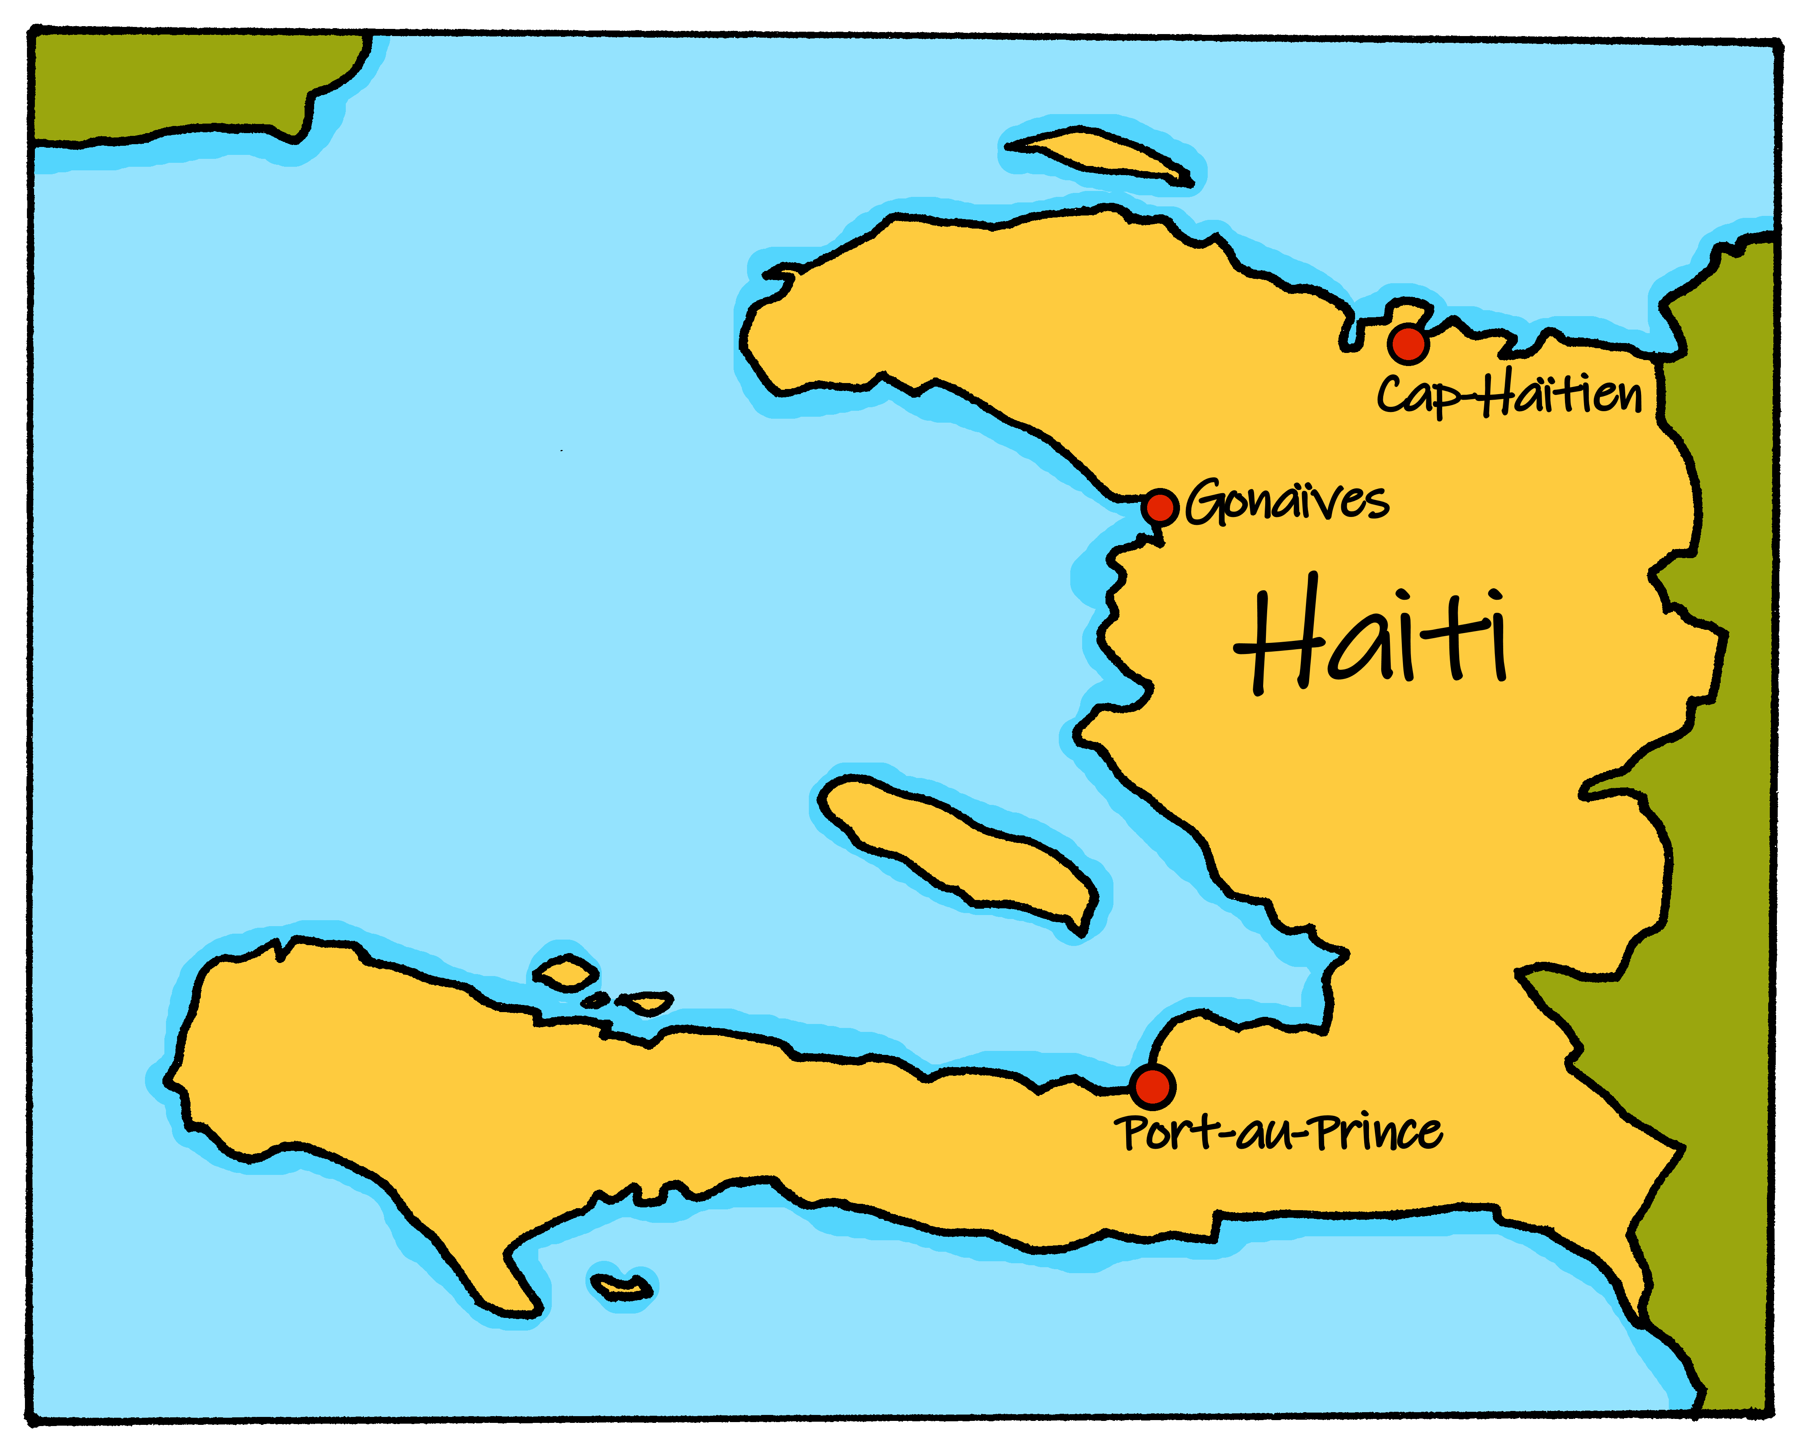
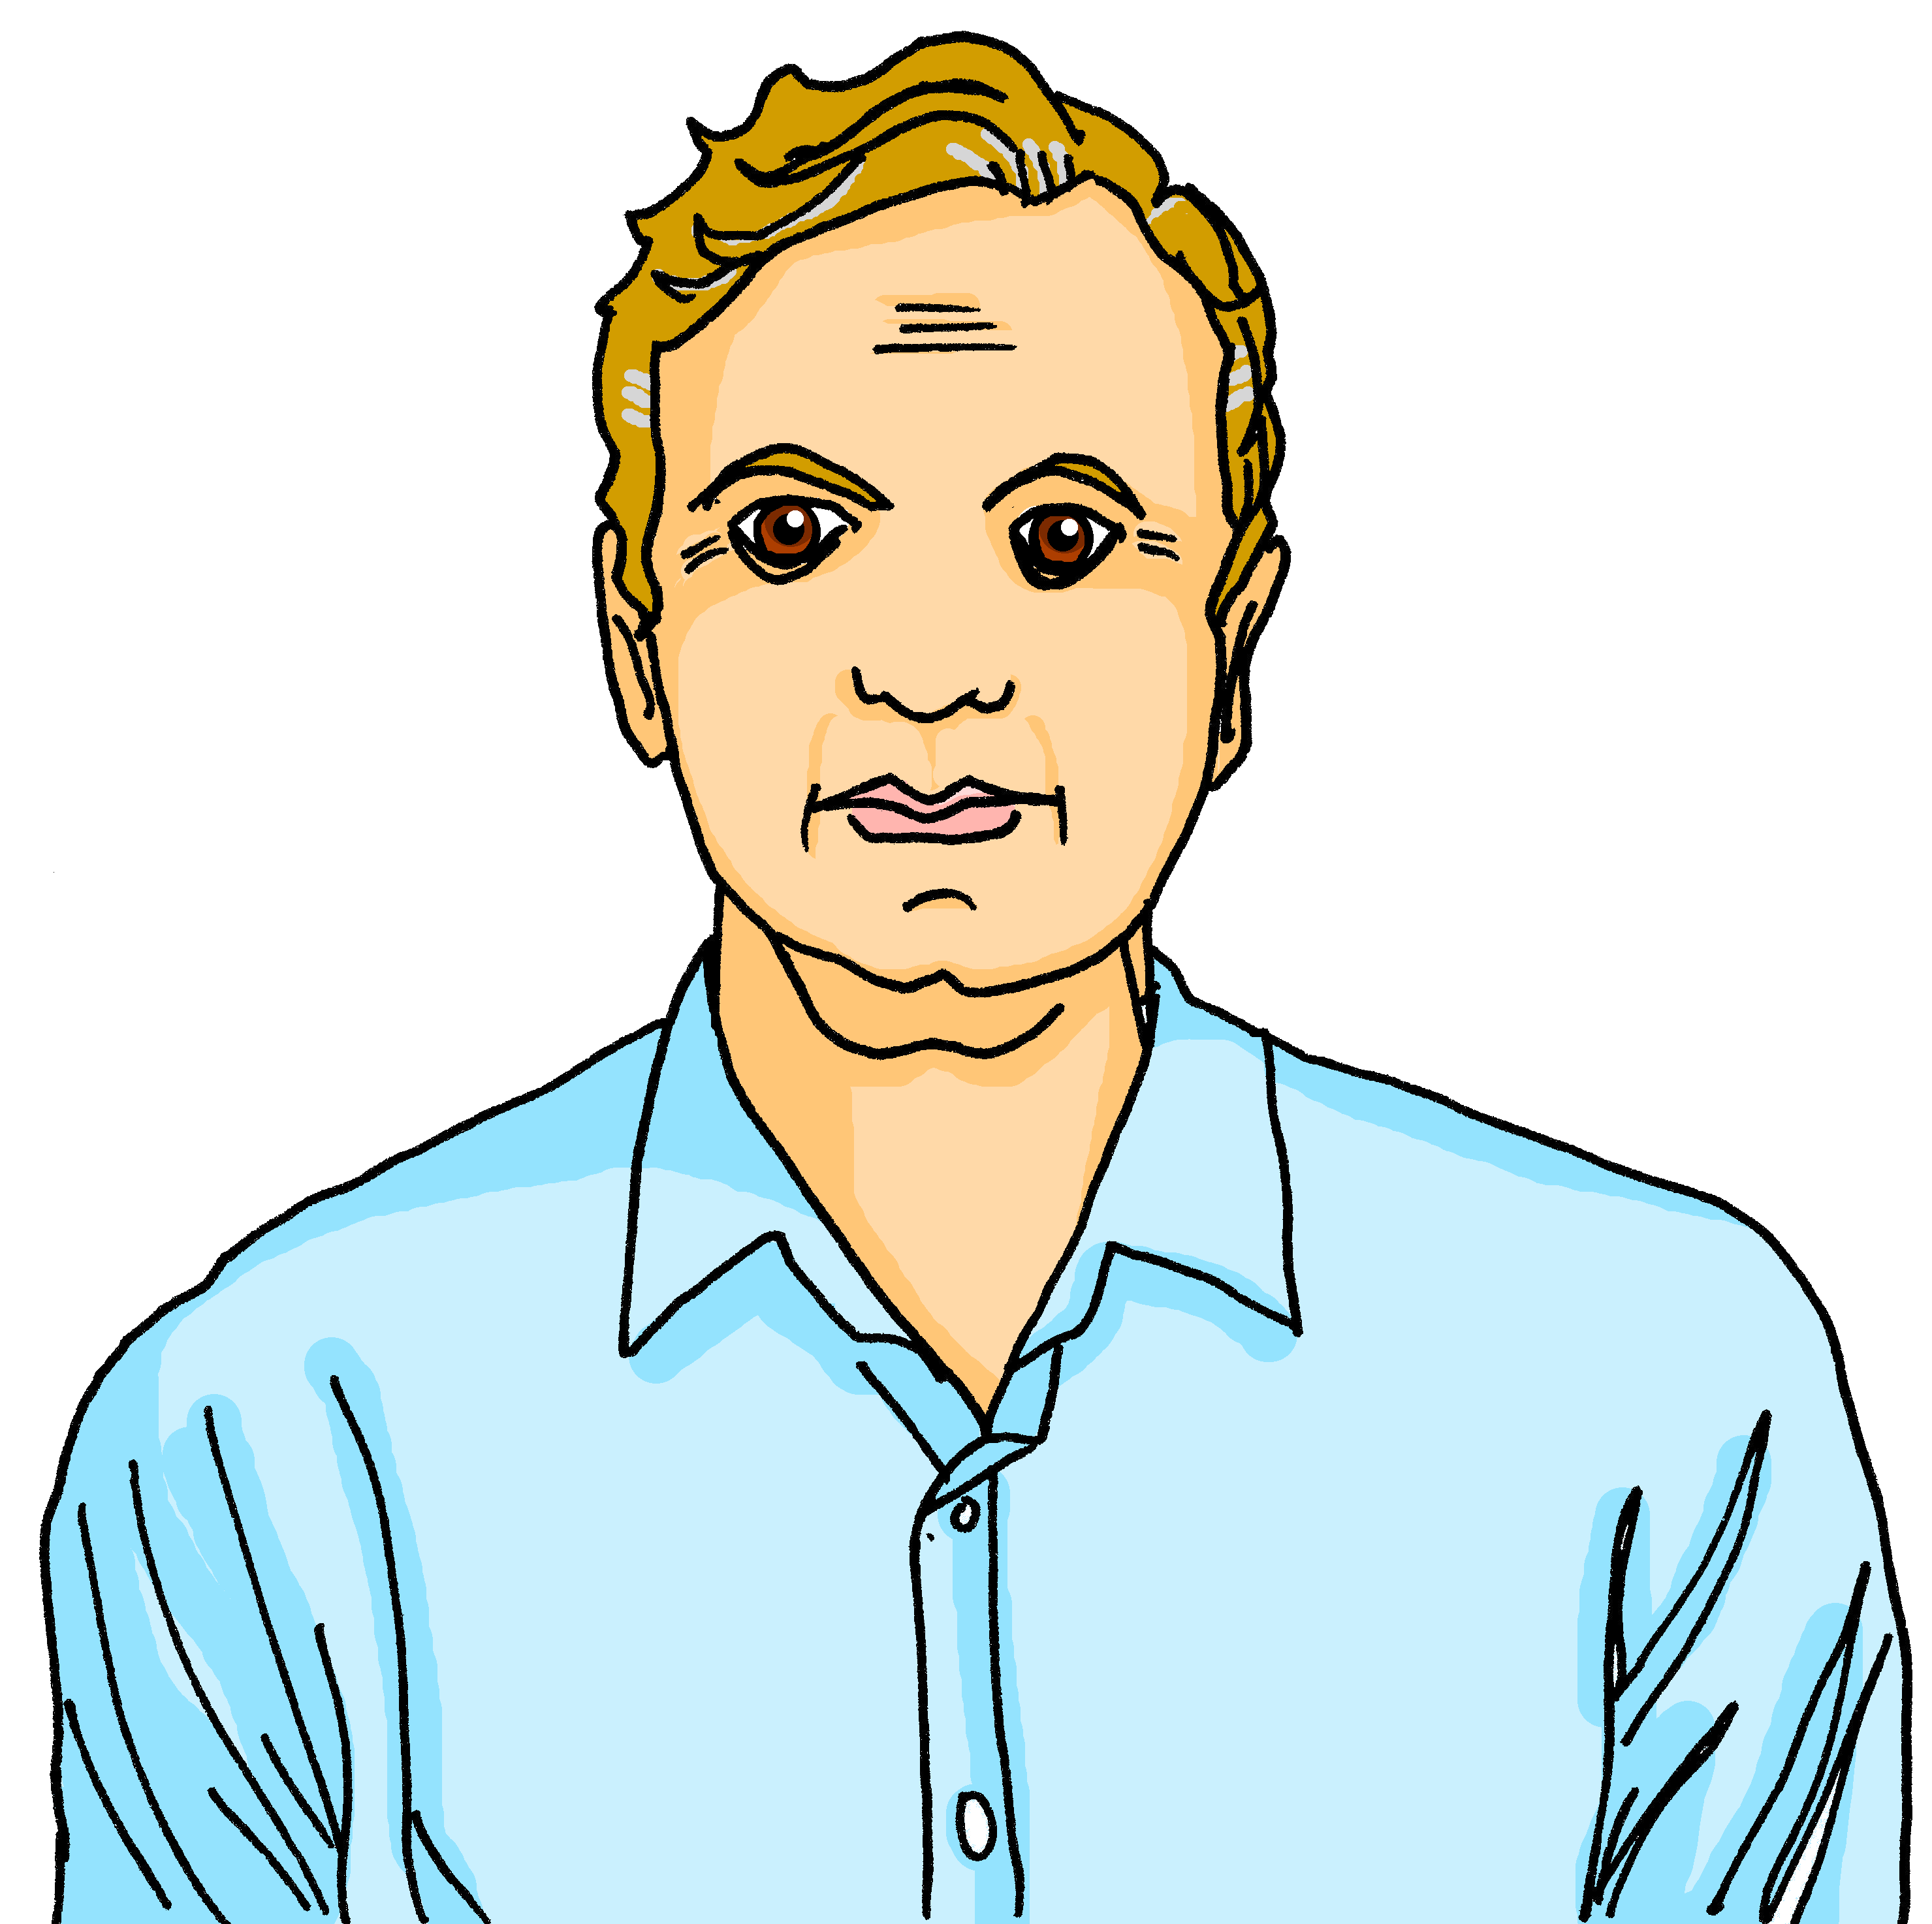
lire
La famille Kergosien
C’est qui ?
Voici Annick, la mère
Voici Jacques, le père
Voici Clémentine, la sœur
Voici Jean-Michel, le frère
voici – here is, this is
Notes:
Timing: 1 minute
Aim: to present the parents of Clémentine and Jean-Michel, and introduce the surname Kergosien.
Procedure: Click through the animations to present the family members and to re-encounter five key vocabulary items for this week.

Slide 11
lire
Activités en famille
C’est qui ? C’est quelle activité ?
1 | Le | mère | père | prépare le | chanson. | gâteau.
The father prepares the cake.
2 | La | sœur | frère | trouve le | cadeau. | gomme.
The sister finds the present.
3 | La | chien | famille | regarde l’ | chat. | animal.
The family looks at the animal.
4 | L’ | peluche| animal | est orange.
The animal is orange.
5 | La | mère | père | donne le | peluche | cadeau | à Jean-Michel.
The mother gives the present to Jean-Michel.
6 | La | sœur | frère | aime la | cadeau. | réponse.
The sister likes the response.
Notes:
Timing: 7 minutes
Aim: to practise written recognition of definite articles and their connection with corresponding nouns; to practise comprehension of new and previously taught vocabulary
Procedure:
Ensure that the context is clear. It is J-M’s birthday.
Pupils read the sentence and select the appropriate noun based on the definite article.
They then translate the sentence (this can be done orally with the whole class or written, and then checked).
Click to reveal answers.
11

Slide 12
lire
l’anniversaire* de Jean-Michel
C’est quoi le cadeau ?
Il adore le cadeau - c’est super !
Wow ! C’est un hamster !
l’anniversaire - birthday
Notes:
Timing: 1 minute
Aim: to answer the question left at the end of the previous activity: what’s in the present?
Procedure:
Click to reveal the present – a hamster.
Click for the two callouts.

Slide 13
écouter
Activités en famille
C’est qui ? C’est quelle activité ?
 | C’est qui ? |  | Extra details
 | le | la | famille | frère | sings the song.
 | le | la | chien | sœur | finds the rubber.
 | le | la | mère| frère | wears the hat.
 | le | la | sœur | père | gives the present to J-M.
 | le | la | chien | peluche | repeats the phrase.
 | le | la | chat | famille | watches the film.
1
v
1
2
v
2
3
v
3
4
v
4
5
v
5
6
v
6
Notes:
Timing: 5 minutes
Aim: to practise aural recognition of definite articles and connect written forms with meaning.
Procedure:
Click on a number to hear a sentence with the noun obscured.
Pupils write 1-6 and the word to which the article refers, along with any additional information they hear.
Click to reveal answers.
A further click brings up a set of audio buttons with full sentences for further reinforcement / practice.
Transcript
1) La [famille] chante la chanson.
2) Le [chien] trouve la gomme.
3) La [mère] porte le chapeau.
4) La [sœur] donne le cadeau à Jean-Michel
5) La [peluche] répète la phrase.
6) Le [chat] regarde le film.

Slide 14
Au revoir !
rouge
Notes:
14

