Slide 1
Saying what I and others do
rouge
-ER verbs: je, tu, il, elle
intonation questions
SSC [et] [ez]
Notes:
Artwork by Steve Clarke. Pronoun pictures from NCELP (www.ncelp.org). All additional pictures selected from Pixabay and are
available under a Creative Commons license, no attribution required.
The AUDIO version of the lesson material includes additional audio for the new language presented (phonics, vocabulary) and audio for the instructions
on the slide.
In addition, it includes VIDEO clips of the phonics and the phonics’ source words. Pupils can be encouraged to look at the shape of the mouth/lips on
slides where these appear, and try to copy it/them.
Phonics: SSC [et] [ez] - et [6] nez [2661] Vocabulary (new words in bold): porter [105] regarder [425] chanson [2142] chapeau [2908] film [848] maison [325] uniforme [1801] et [6] mais [30] à (meaning ‘at’ and ‘to’) [4] Revisit 1: --
Revisit 2: Revisit days of the week, sérieux [412] heureux [764] curieux [2424] courageux [2198 semaine [245]
Londsale, D., & Le Bras, Y. (2009). A Frequency Dictionary of French: Core vocabulary for learners London: Routledge.
The frequency rankings for words that occur in this PowerPoint which have been previously introduced in these resources are given in the SOW and in the resources that first introduced and formally re-visited those words. For any other words that occur incidentally in this PowerPoint, frequency rankings will be provided in the notes field wherever possible.
1

Slide 2
prononcer
[é]
[er]
[et]
[ez]
[et] and [ez] also sound the same as [é] and [er].
répéter
[and]
et
nez
Notes:
Timing: 2 minutes
Aim: to introduce SSC [et] and [ez], which are the same sound as [é] and [er], written differently.
Procedure:
Introduce and elicit the pronunciation of the individual SSC [et] and [ez] and remind them of the source word ‘répéter’, which has both other spellings of the same sound.
Click to bring on the picture and get students to repeat (with gesture, if using).
Present and practise the cluster words.
Gesture: gesture for répéter – hand with thumb and two fingers pointing forwards doing a three downwards motions, one for each syllable of the word.
https://www.signbsl.com/sign/repeat (the 2nd video marked again: repeat with the female signer) gesture for et – right hand with index finger extended does rapid looped pointing action from right to left. (the 1st video on the left) - https://www.signbsl.com/sign/and gesture for le nez – point to your own nose
2

Slide 3
prononcer
Bonne année et bonne santé
Janvier c’est pour souhaiter Bonne année et bonne santé Et c’est pour se régaler Février c’est pour skier Pour s’aimer pour s’amuser Et aussi se déguiser
January is for wishing a good year and good health and it’s for feasting February is for skiing for loving and for having fun
and also for dressing up
Notes:
Timing: 5 minutes
Aim: to practise the pronunciation of SSC [é, er] in a poem about the new year.
Procedure:
Pupils listen to each line of the poem and then read it aloud chorally, themselves.
They then practise once again, reading each line aloud before the teacher clicks for them to hear it.
Using the English translation provided, the teacher asks Comment dit-on ‘January’ etc.. to provide additional practice of words with the target SSC.
The teacher points out that the English version of the poem has lots of –ing forms of the verb, and asks if pupils can identify the corresponding pattern in French (i.e. –er).
Then, the teacher asks pupils to say all of the verbs aloud, and clicks to highlight each one.
Note: we recap this poem and provide some further cultural information about January in France in the follow ups for this week.
3

Slide 4
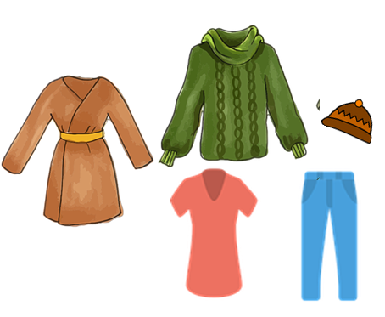
vocabulaire
Écoute et répète. [1/2]
mots
porter
regarder
[to look, watch]
[to wear, wearing]
un chapeau
un film
un uniforme
[a hat]
[a uniform]
[a film]
Notes:
Timing: 5 minutes (two slides)
Aim: to introduce key vocabulary for the context of weekend activities.
Procedure: 1. Pupils either work in pairs, reading the French words out loud and looking at the English meanings (1 minute). 2. Then the teacher removes the English words or pictures (one by one) and pupils try to recall the English orally (chorally), looking at the French (1 minute). 3. Then the French meanings are removed (one by one) and pupils try to recall them orally (again, chorally), looking at the English (1 minute) 4. Further rounds of learning can be facilitated by one pupil turning away from the board, and his/her partner asking him/her the meanings (‘Comment dit-on XXX en anglais/français ?’). This activity can work from L2 → L1 or L1 → L2.
4

Slide 5
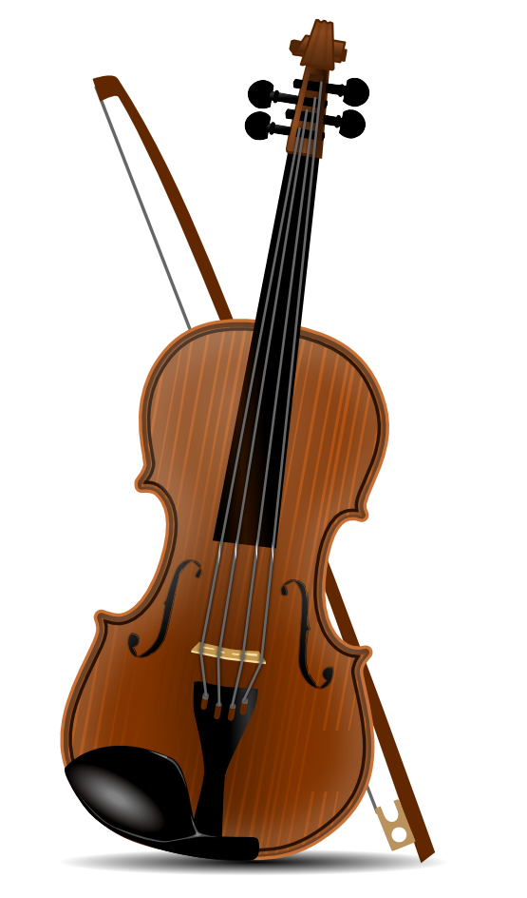
vocabulaire
Écoute et répète. [2/2]
mots
une chanson
un instrument
[a song]
[an instrument]
[and]
et
mais
[at]
à
[but]
Notes:
[2/2]
5

Slide 6
vocabulaire
00
__ semaine a week
00
00
00
00
__ t-shirt a t-shirt
__ chanson a song
__ uniforme a uniform
__ instrument an instrument
00
00
__ sac a bag
00
__ phrase a phrase
__ film a film
00
__ chapeau a hat
Vocabulaire
mots
Jean-Michel has mixed up all his flashcards. Help him to sort them out!
un
une
00
__ film a film
00
__ t-shirt a t-shirt
00
__ chanson a song
00
00
__ sac a bag
__ uniforme a uniform
00
__ semaine a week
00
00
__ instrument an instrument
__ phrase a phrase
00
__ chapeau a hat
Notes:
Timing: 3 minutes (one slide)
Aim: to introduce key vocabulary for the context of weekend and weekday activities.
Procedure: Pupils either work in pairs or chorally as a class, reading the French words out loud, including the correct article, and the English meanings.
Frequency of unknown words or cognates: t-shirt [>5000]
6

Slide 7
Knowing who does what
It is also the form of a verb you see in a dictionary.
[–er verbs: ‘I’ and ‘you’]
We know the infinitive verb tells us the general meaning.
C’est facile de parler français.
It’s easy to speak French.
In English, this is often written ‘to + verb’.
In French, most infinitives end in –er.
To mean ‘I’ with a verb, change the ending to match the pronoun:
Je parle français.
I speak French.
Note that parle and parles sound the same because of the Silent Final Consonant.
To mean ‘you’ with a verb:
Tu parles français.
You speak French.
Notes:
Timing: 3 minutes
Aim: to introduce 1st and 2nd persons singular for –er verbs.
Procedure:
Click through the animations to present the new information.
Elicit English translations for the French examples provided.

Slide 8
lire
Un accident ! 💧
Médor has spilled water on Pierre’s English homework.
Pardon !
Tu portes un uniforme chaque jour.
Médor !
1
You wear a uniform every day.
 | I | you
1
2
3
4
5
6
Verbe
Je chante une chanson en anglais.
2
I sing a song in English.
you wear
Je regarde un film à la maison.
3
I sing
I watch a film at home.
Note: The 2nd accent changes: répéter → je répète, tu répètes.
Tu utilises un stylo pour écrire.
4
I watch
You use a pen for writing.
Je porte un sac tous les jours.
you use
5
I carry a bag every day.
Tu répètes une phrase en anglais.
I carry
6
You repeat a phrase in English.
you repeat
Notes:
Timing: 7 minutes
Aim: to practise written comprehension of 1st and 2nd person singular –ER verbs.
Procedure:
Read the title and explain the context of the task.
Do [1] with them to model the task and draw their attention to the verb (portes). Is it ‘I’ or ‘you’? Does it mean ‘wear’ or ‘carry’?
Pupils complete 2-6.
Click through the animations to bring up answers.
If desired, click on the numbered buttons to hear audio for each sentence.
8

Slide 9
Knowing who does what
[–er verbs: ‘he’ and ‘she’]
To mean ‘he’ and ‘she’ with a verb, use ‘il’ and ‘elle’ and the ending –e:
Il porte un chapeau à la maison.
Note that porter means ‘wear’ and ‘carry’.
He wears a hat at home/at the house.
Elle porte un sac à l’école.
She carries a bag at school.
Notes:
Timing: 3 minutes
Aim: to introduce 3rd person singular for –er verbs.
Procedure:
Click through the animations to present the new information.
Elicit English translations for the French examples provided.

Slide 10
lire
Adèle parle à Pierre.
Is she asking about Pierre (tu) or Max (il)?
Pierre, tu… ?
Et Max ? Il… ?
en ligne = online une école = a school
 |  | (tu) | (il) |  |  | (tu) | (il)
1 | … porte un sac à l’école tous les jours ? |  |  | 5 | … portes un uniforme chaque jour ?
2 | … parles en ligne* avec Yves, aujourd’hui ? |  |  | 6 | … utilises un cahier pour le vocabulaire français à l’école* ?
3 | … regardes un film avec Maman le samedi ? |  |  | 7 | … regarde un match de football le weekend ?
4 | Le weekend, … porte un chapeau à la maison ? |  |  | 8 | … utilise un instrument à l’école ? Un saxophone ?
1
5
2
6
3
7
4
8
Notes:
Timing: 7 minutes
Aim: to practise written comprehension of 2nd and 3rd person singular –ER verbs.
Procedure:
Read the title and explain the context of the task.
Do [1] with them to model the task and draw their attention to the verb (porte). Is it ‘you’ or ‘he’? Does it mean ‘wear’ or ‘carry’?
Pupils complete 2-8.
Click through the animations to bring up answers.
If desired, click on the numbered buttons to hear audio for each sentence.
Elicit English meanings of each question, orally. Pay particular attention to the meanings of ‘porte(s)’ in each case.
Frequencies of unknown words and cognates: école [477] (en) ligne [342] football [2602] match [1906] saxophone [>5000] vocabulaire [4159] weekend [2475]
10

Slide 11
Au revoir !
rouge
Notes:
11

