Slide 1
Saying what I and others do
rouge
Follow ups 1-5
Notes:
Artwork by Steve Clarke. Pronoun pictures from NCELP (www.ncelp.org). All additional pictures selected from Pixabay and are available under a Creative Commons license, no attribution required.
Phonics: SSC [et] [ez] - et [6] nez [2661] Vocabulary (new words in bold): porter [105] regarder [425] chanson [2142] chapeau [2908] film [848] maison [325] uniforme [1801] et [6] mais [30] à (meaning ‘at’ and ‘to’) [4] Revisit 1: --
Revisit 2: Revisit days of the week, sérieux [412] heureux [764] curieux [2424] courageux [2198 semaine [245]
Londsale, D., & Le Bras, Y. (2009). A Frequency Dictionary of French: Core vocabulary for learners London: Routledge.
The frequency rankings for words that occur in this PowerPoint which have been previously introduced in these resources are given in the SOW and in the resources that first introduced and formally re-visited those words.
For any other words that occur incidentally in this PowerPoint, frequency rankings will be provided in the notes field wherever possible.

Slide 2
Follow up 1a:
Lis le poème avec un/une partenaire.
[é][er]
Janvier c’est pour souhaiter Bonne année et bonne santé Et c’est pour se régaler Février c’est pour skier Pour s’aimer pour s’amuser Et aussi se déguiser
January is for wishing a good year and good health and it’s for feasting February is for skiing for loving and for having fun
and also for dressing up
Notes:
Timing: 3 minutes
Aim: to practise the pronunciation of SSC [é, er] in a poem about the new year.
Procedure:
This time pupils read the poem aloud in pairs, line by line.
Then click to listen to the full poem.
Move on to the next slide with some cultural information about January in France.

Slide 3
Follow up 1b:
Bonne Année ! Literally ‘Good year!’ it means ‘Happy New Year!’. It is the first thing you have to say to everyone you talk to for the first time in January. In France, you have the whole month of January to souhaiter la bonne année.
You can say Bonne année ! or Bonne année et bonne santé ! (Happy New Year and good health!)
Janvier c’est pour souhaiter Bonne année et bonne santé
January is for wishing a good year and good health
Wish five people in your class a Happy New Year in French.
Notes:
Timing: 2 minutes
Aim: to present some cultural information about January in France.
Procedure:
Click to present the information.
Pupils practise saying one of the two New Year’s greetings to five others in their class.
Source information:
https://www.commeunefrancaise.com/blog/happy-new-year-france

Slide 4
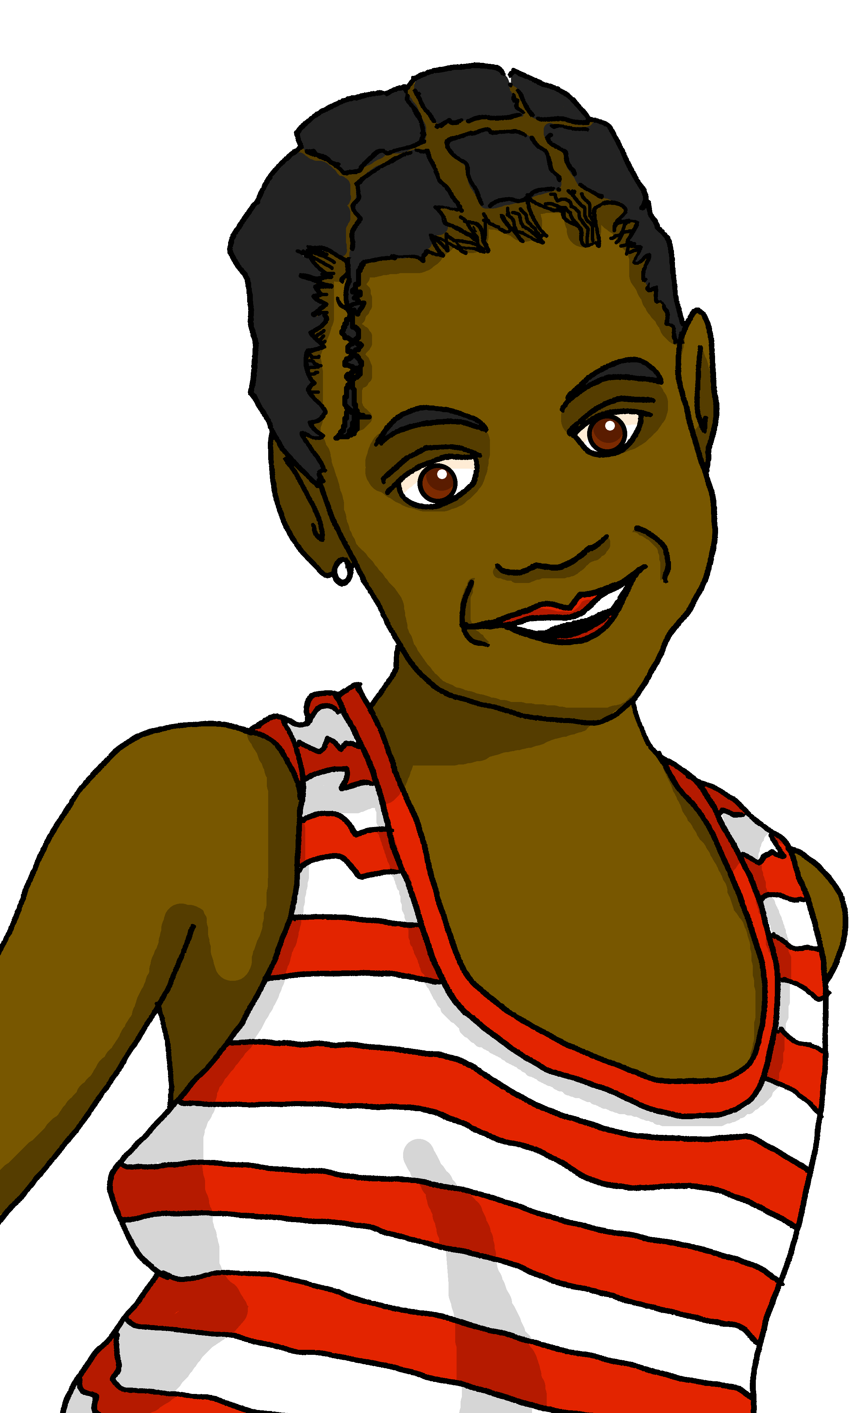
Follow up 2:
Lis les messages.
un jean = jeans en ligne = online une école = a school
Clémentine décrit les activités d’Adèle et de Pierre.
Écris en anglais.
lire
Le samedi, elle porte un t-shirt à la maison.
Who? | What? | extra details
Aujourd’hui elle parle en ligne* avec Léa.
wears a t-shirt
at home
Normalement, il porte un jean* à la maison.
is talking online
with Léa
Chaque jour il porte un uniforme.
wears jeans
at home normally
Elle porte un sac à l’école*.
wears a uniform
each day
carries a bag
at school
Il utilise un cahier pour le vocabulaire français.
uses an exercise book
for French vocabulary
Il regarde un film avec Maman.
is watching a film
with mum
Notes:
Timing: 5 minutes
Aim: to practise written comprehension of present tense sentences a range of revisited vocabulary, with a particular focus on ‘il’ and ‘elle’.
Procedure: 1. Read the task and instructions and clarify meanings.
2. Do number [1] with pupils to model the task.
3. Pupils complete 2-7.
4. Elicit answers and click to confirm.
5. Ask if there are any sentences that seem wrong or strange (i.e., Pierre wearing a uniform every day as this is uncommon in France – we will assume that Clémentine has made a mistake, here).
Note: if desired, click on the speech bubbles to hear the messages.

Slide 5
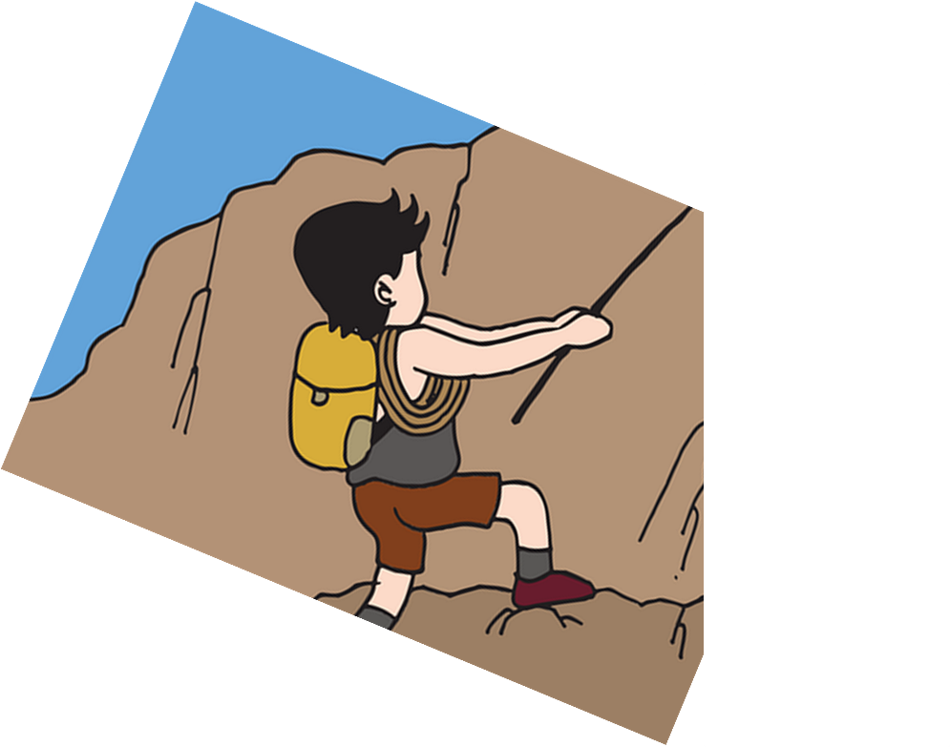
Follow up 3:
Parle en français. [1/6]
You are watching a film in French.
parler
5
en français
tous les jours
4
un match
un chapeau
un instrument
un film
3
regarde
porte
regardes
portes
2
tu
il
je
elle
1
Notes:
Timing: 5 minutes (6 items, 12 slides)
Aim: to practise read aloud and written recognition of vocabulary and structures. Note: this activity could also be a writing task on mini whiteboards.
Procedure:
Tell pupils they need to use the words, starting from the bottom, to climb up the mountain (And translate the sentence!).
Ask pupils to work in pairs to practise first.
Click to trigger the timer (5 seconds per sentence).
Ask a volunteer from a pair to say the French sentence out loud – next slide reveals the answer.
Repeat with the next 5 sentences (there are 6 in total, including this one).

Slide 6
Follow up 3:
Parle en français.
You are watching a film in French.
parler
en français
tous les jours
un match
un chapeau
un instrument
un film
regarde
porte
regardes
portes
tu
il
je
elle
Notes:
[2/12] Answer 1

Slide 7
Follow up 3:
Parle en français. [2/6]
She usesan instrument at school.
parler
5
à l’école
à la maison
4
un instrument
un sac
un uniforme
un jean
3
portes
porte
utilise
utilises
2
il
je
tu
elle
1
Notes:
[3/12] Item 2

Slide 8
Follow up 3:
Parle en français. [2/6]
She uses an instrument at school.
parler
à l’école
à la maison
un instrument
un sac
un uniforme
un jean
portes
porte
utilise
utilises
il
je
tu
elle
Notes:
[4/12] Answer 2

Slide 9
Follow up 3:
Parle en français. [3/6]
He sings a Christmas song.
parler
5
en français
à l’école
en anglais
de Noёl
4
un film
une chanson
une phrase
un match
3
chantes
regarde
chante
regardes
2
je
tu
elle
il
1
Notes:
[5/12] Item 3

Slide 10
Follow up 3:
Parle en français. [3/6]
He sings a Christmas song.
parler
en français
à l’école
en anglais
de Noёl
un film
une chanson
une phrase
un match
chantes
regarde
chante
regardes
je
tu
elle
il
Notes:
[6/12] Answer 3

Slide 11
Follow up 3:
Parle en français. [4/6]
You wear a t-shirt at home.
parler
5
le weekend
à l’école
à la maison
tous les jours
4
un match
un film
un t-shirt
un chapeau
3
portes
porte
regarde
regardes
2
tu
elle
il
je
1
Notes:
[7/12] Item 4

Slide 12
Follow up 3:
Parle en français. [4/6]
You wear a t-shirt at home.
parler
le weekend
à l’école
à la maison
tous les jours
un match
un film
un t-shirt
un chapeau
portes
porte
regarde
regardes
tu
elle
il
je
Notes:
[8/12] Answer 4

Slide 13
Follow up 3:
Parle en français. [5/6]
He wears a uniform every day.
parler
5
le weekend
à l’école
à la maison
tous les jours
4
un uniforme
un crayon
un cahier
un chapeau
3
portes
porte
utilise
utilises
2
tu
elle
il
je
1
Notes:
[9/12] Item 5

Slide 14
Follow up 3:
Parle en français. [5/6]
He wears a uniform every day.
parler
le weekend
à l’école
à la maison
tous les jours
un uniforme
un crayon
un cahier
un chapeau
portes
porte
utilise
utilises
tu
elle
il
je
Notes:
[10/12] Answer 5

Slide 15
Follow up 3:
Parle en français. [6/6]
You repeat a phrase in English.
parler
5
en français
à l’école
en anglais
tous les jours
4
une phrase
à Léa
une chanson
à Mme Dior
3
parles
répète
parles
répètes
2
je
tu
il
elle
1
Notes:
[11/12] Item 6

Slide 16
Follow up 3:
Parle en français. [6/6]
You repeat a phrase in English.
parler
en français
à l’école
en anglais
tous les jours
une phrase
à Léa
une chanson
à Mme Dior
parles
répète
parles
répètes
je
tu
il
elle
Notes:
[12/12] Answer 6

Slide 17
Follow up 4:
Écris 5 phrases en français.
[I sing] [You sing] [I listen to] [S/he listens to] [I use] [You use] [I speak] S/he speaks]
[I watch] [You watch] [I wear, carry] [S/he wears, carries]
un chapeau
un uniforme
un instrument
un t-shirt
une règle un sac un cahier
une phrase un film
une chanson
en anglais
en français à la maison à l’école
écrire
If you like, make your sentences longer using mais.
Je chante en anglais mais tu chantes en français.
une école = a school
Notes:
Timing: 5 minutes
Aim: to practise written production of verb forms from this week and last week and written recognition of other revisited vocabulary.
Procedure: 1. Pupils write five sentences using five different verb forms, translating from English into French, and then selecting appropriate sentence endings from the French items in the blue box on the right. 2. Pupils read each other their sentences and the listening partners interprets into English.
Note: there is an option to extend sentences using ‘mais’. We will practise creating more compound sentences during the next few weeks.

Slide 18
vocabulaire
Follow up 5 - Écris en français : Can you get at least 15 points?
mots
 | brave (m) | curious (f) | serious (m)
 | Sunday | a week | happy (f)
 | Thursday | Friday | Saturday
 | Monday | Tuesday | Wednesday
 | a uniform | but | at
 | a hat | a film | a house
 | to wear, carry | to look, watch | a song
courageux
curieuse
sérieux
x3
dimanche
une semaine
heureuse
jeudi
vendredi
samedi
x2
lundi
mardi
mercredi
un uniforme
mais
à
un chapeau
un film
une maison
x1
porter
regarder
une chanson
Notes:
Timing: 5-10 minutes
Aim: to practise written comprehension of vocabulary from this week and previous weeks.
Procedure: Give pupils a blank grid. They fill in the French meanings of any of the words they know, trying to reach 15 points in total.
Note: The most recently learnt and practised words are pink, words from the previous week are green and those from week 1 are blue, thus more points are awarded for them, to recognise that memories fade and more effort (heavy lifting!) is needed to retrieve them.
18

Slide 19
vocabulaire
Écris en français : Can you get at least 15 points?
mots
 | brave (m) | curious (f) | serious (m)
 | Sunday | a week | happy (f)
 | Thursday | Friday | Saturday
 | Monday | Tuesday | Wednesday
 | a uniform | but | at
 | a hat | a film | a house
 | to wear, carry | to look, watch | a song
x3
x2
x1
Notes:
HANDOUT
19

