Slide 1
Saying what I and others do
Activités en classe
rouge
-ER verbs: infinitives
SSC [é] [er]
Notes:
Artwork by Steve Clarke. Pronoun pictures from NCELP (www.ncelp.org). All additional pictures selected from Pixabay and are
available under a Creative Commons license, no attribution required.
The AUDIO version of the lesson material includes additional audio for the new language presented (phonics, vocabulary) and audio for the instructions
on the slide.
In addition, it includes VIDEO clips of the phonics and the phonics’ source words. Pupils can be encouraged to look at the shape of the mouth/lips on
slides where these appear, and try to copy it/them.
Phonics: [é] [er] répéter [630] écrire [382] bébé [2271] donner [46] parler [106]
Vocabulary (new words in bold): répéter [630] chanter [1820] utiliser [345] phrase [2074] facile [822] important [215] normal [833] avec [23] tous les jours [n/a] Revisit 1: jour [78] chaque [151] revisit days of the week
Revisit 2: lundi [1091] mardi [1044] mercredi [1168] jeudi [1112] vendredi [1086] samedi [1356] dimanche [1235] aujourd’hui [233] ce (c') [12]
Londsale, D., & Le Bras, Y. (2009). A Frequency Dictionary of French: Core vocabulary for learners London: Routledge.
The frequency rankings for words that occur in this PowerPoint which have been previously introduced in these resources are given in the SOW and in the resources that first introduced and formally re-visited those words. For any other words that occur incidentally in this PowerPoint, frequency rankings will be provided in the notes field wherever possible.
1

Slide 2
prononcer
[é]
[er]
répéter
[é] and [er] sound the same. They are two ways to write exactly the same sound.
Notes:
Timing: 2 minutes
Aim: to introduce SSC [é] and [er], which are the same sound written differently.
Note: there are two further letter combinations that are also pronounced the same. We will introduce those next week.
Procedure:
Introduce and elicit the pronunciation of the individual SSC [é] and [er] then the source word ‘répéter’, which has both spellings of the sound.
Click to bring on the picture and get students to repeat (with gesture, if using).
Gesture: gesture for répéter – hand with thumb and two fingers pointing forwards doing a three downwards motions, one for each syllable of the word.
https://www.signbsl.com/sign/repeat (the 2nd video marked again: repeat with the female signer)
2

Slide 3
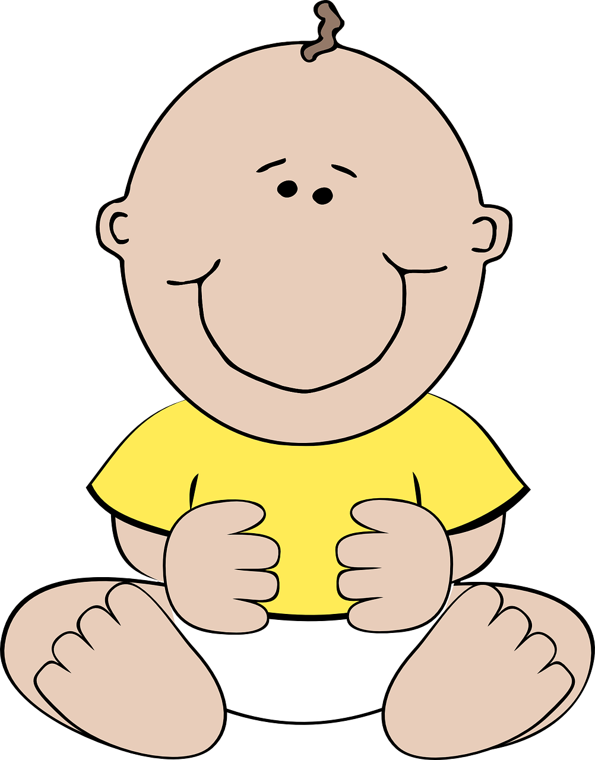
prononcer
[é]
[er]
répéter
écrire
parler
bébé
donner
[to give]
Notes:
Timing: 2 minutes
Aim: to introduce SSC [é] and [er], which are the same sound written differently.
Procedure:
Introduce and elicit the pronunciation of the individual SSC [é] and [er] then the source word ‘répéter’, which has both spellings of the sound.
Click to bring on the picture and get students to repeat (with gesture, if using).
Present and practise the cluster words. Note that pupils already know écrire and parler from term 1.
Gesture: gesture for répéter – hand with thumb and two fingers pointing forwards doing a three downwards motions, one for each syllable of the word.
https:/./www.signbsl.com/sign/repeat (the 2nd video marked again: repeat with the female signer).
Note that the cluster words are also suggestive of simple gestures that teachers may want to use to elicit the words from pupils in the practice phase.
3

Slide 4
vocabulaire
Écoute et répète.
mots
chanter
écouter
[to listen, listening]
[to sing, singing]
répéter
utiliser
[to repeat, repeating]
[to use, using]
Notes:
Timing: 3 minutes (one slide)
Aim: to introduce key vocabulary for the context of classroom activities (a range of infinitive verbs).
Procedure: 1. Pupils either work in pairs, reading the French words out loud and looking at the English meanings (1 minute). 2. Then the teacher removes the English words or pictures (one by one) and pupils try to recall the English orally (chorally), looking at the French (1 minute). 3. Then the French meanings are removed (one by one) and pupils try to recall them orally (again, chorally), looking at the English (1 minute) 4. Further rounds of learning can be facilitated by one pupil turning away from the board, and his/her partner asking him/her the meanings (‘Comment dit-on XXX en anglais/français ?’). This activity can work from L2 → L1 or L1 → L2.
4

Slide 5
vocabulaire
mots
important
facile
avec
une phrase
normal
utiliser
tous les jours
répéter
chanter
to sing, singing
to use, using
to repeat, repeating
normal
important
easy
every day
a phrase
with
Notes:
Timing: 3 minutes
Aim: to practise the 3 new infinitive verbs, introduce 3 new adjectives, 1 new noun, 1 multi-word time phrase and 1 preposition.
Procedure: 1. Elicit pronunciation from pupils for the French words.
2. Click for an English prompt.
3. Elicit the French word from pupils. 4. Continue until all 9 items have been seen and heard.
5

Slide 6
Infinitives: -er verbs
The infinitive form of a verb is the form you see in a dictionary.
[to ______]
The infinitive often describes the general meaning of the verb.
In English, this is often written ‘to + verb’:
It’s fun to sing in French.
You add ‘de’ to link adjective and verb.
In French, many infinitives end in –er:
C’est amusant de chanter en français.
You can also begin a French sentence with the infinitive:
Chanter en français, c’est amusant !
In this case, we translate the French infinitive with the –ing form of the verb in English.
Singing in French is fun!
Notes:
Timing: 3 minutes
Aim: to introduce the notion of infinitive –ER verbs and their two positions and two English translations.
Procedure:
Click through the animations to present the new information.
Elicit English translations for the French examples provided.
6

Slide 7
lire
Adèle écrit.
After a term Adèle writes what she’s learned.
1
C’est important de parler avec Madame Dior.
Complète les phrases ✍.
2
Lire un texte avec Léa, c’est amusant !
to
[1] It is important ____ _______ to Mrs Dior.
[2] _____________ a text with Léa is fun.
[3] It is important ____ __________ a ruler in class.
[4] _____________ an animal in class is difficult!
[5] It is _________ ___ ___________ a phrase.
[6] It’s important ____ ________ with Léa in class.
[7] _____________ in French is good!
talk
Reading
3
C’est important d’utiliser une règle en classe.
to
use
4
Avoir un animal en classe, c’est difficile !
Having
5
C’est facile de répéter une phrase.
easy
to
repeat
to
speak
6
C’est important de parler avec Léa en classe.
Singing
7
Chanter en français, c’est bien ça !
Notes:
Timing: 7 minutes
Aim: to practise written comprehension of –er verbs, including both possible translations into English (to __ / ing) and previously taught vocabulary.
Procedure:
Read the title and click to explain the context of the task (Adèle reflects on what she’s learned in lessons).
Click to bring up a further instruction in French (complète les phrases).
Do [1] with them to model the task. Remind students about the English translation of the infinitive form of the verb in French.
Students complete 2-7.
Click through the animations to bring up answers.
Frequency of unknown words and cognates: completer [2034] difficile [296] texte [631]
7

Slide 8
écouter
Activités en classe
Madame Dior parle.
L’infinitif, c’est où ?
Écoute et écris.
 | beginning | in the middle
l’infinitif | en anglais
1
écouter
to listen
It’s easy __ _______ to Madame Dior.
Having
avoir
_________ an exercise book in class is normal!
2
chanter
to sing
3
It’s fun ___ _________ in class.
écrire
Writing
4
_________ a paragraph is easy!
to repeat
5
répéter
It’s important ___ _________ a phrase in French.
6
lire
Reading
_________ in French is fun!
Note: Most infinitives end in –er, but you know a few verbs already that end in –ir and –re.
Notes:
Timing: 7 minutes
Aim: to practise aural recognition of infinitive verbs, their position and corresponding meaning in English.
Procedure:
Read the title and click to bring up the instructions.
Clarify the task. Pupils listen out first for the infinitive and note its position in the sentence.
Click to bring up the answers.
Click to bring up the 2nd table and instruction.
Pupils listen again and write the infinitive.
They also write the English meaning, using the gapped English sentence for support.
Note: for additional challenge pupils could turn away and try to complete the task without the English sentence support.
7. Click to elicit and confirm the answers.
Transcript:
1. C’est facile d’écouter Madame Dior. 2. Avoir un cahier en classe, c’est normal !
3. C’est amusant de chanter en classe ! 4. Écrire un paragraphe, c’est facile ! 5. C’est important de répéter une phrase en français. 6. Lire en français, c’est amusant!
8

Slide 9
lire
Une porte est ouverte : Chouchou est en danger !
parler
Read the sentence aloud with your partner before Chouchou gets to the door.
C’est normal d’utiliser un stylo.
C’est normal d’[to use] un stylo.
avoir
écouter
utiliser
une porte = a door en danger = in danger
Notes:
Timing: 5 mins [5 slides in total] [1/5]
Aim: to practise read aloud of this week’s language and spoken production of infinitive verbs.
Procedure:
Teacher reads the title and elicits English translation from students.
Click to bring up the English instruction.
Pupils work in pairs to say the sentence aloud in French. Encourage most able to translate it too.
Once Chou chou disappears, the infinitive is removed from the board and three options are provided.
Elicit the full sentence again from students, with the correct infinitive.
Frequency of unknown words and cognates: danger [932]
9

Slide 10
lire
Une porte est ouverte : Chouchou est en danger !
parler
Read the sentence aloud with your partner before Chouchou gets to the door.
Avoir une bouteille en classe, c’est parfait !
[Having] une bouteille en classe, c’est parfait !
avoir
répéter
utiliser
une porte = a door en danger = in danger
Notes:
[2/5]
Frequency of unknown words and cognates: danger [932]
10

Slide 11
lire
Une porte est ouverte : Chouchou est en danger !
parler
Read the sentence aloud with your partner before Chouchou gets to the door.
C’est important d’écouter tous les jours.
C’est important d’[to listen] tous les jours.
avoir
utiliser
écouter
une porte = a door en danger = in danger
Notes:
[3/5]
Frequency of unknown words and cognates: danger [932]
11

Slide 12
lire
Une porte est ouverte : Chouchou est en danger !
parler
Read the sentence aloud with your partner before Chouchou gets to the door.
C’est facile de [to speak] avec un partenaire.
C’est facile de parler avec un partenaire.
lire
parler
répéter
une porte = a door en danger = in danger
Notes:
[4/5]
Frequency of unknown words and cognates: danger [932]
12

Slide 13
lire
Une porte est ouverte : Chouchou est en danger !
parler
Read the sentence aloud with your partner before Chouchou gets to the door.
Répéter une phrase en français, c’est facile !
[Repeating] a phase in French is easy!
répéter
parler
écrire
une porte = a door en danger = in danger
Notes:
[5/5]
Frequency of unknown words and cognates: danger [932]
13

Slide 14
Au revoir !
rouge
Notes:
14

