Slide 1
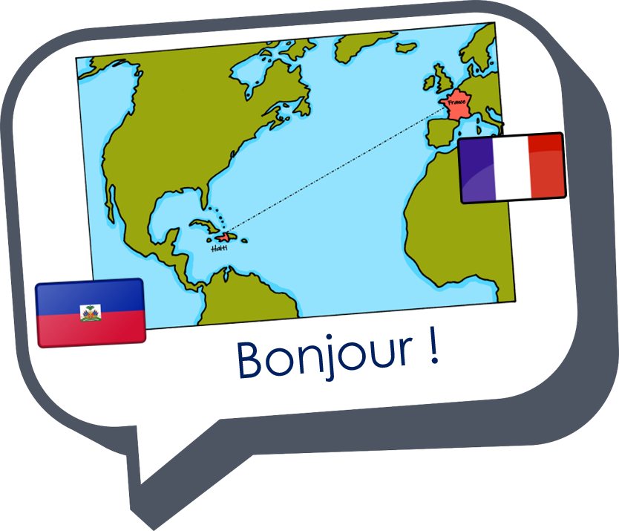
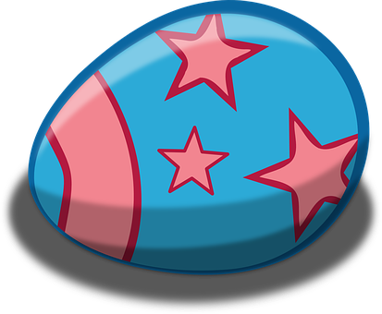
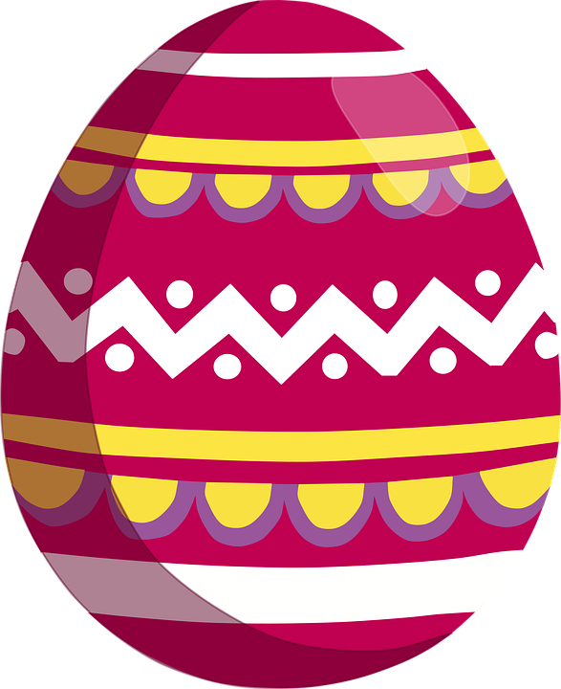
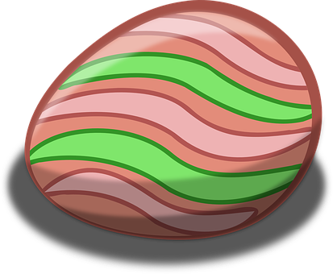
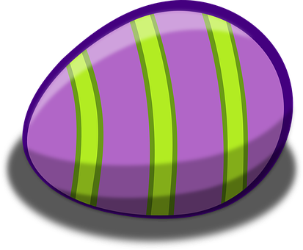
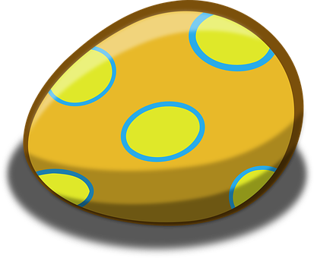
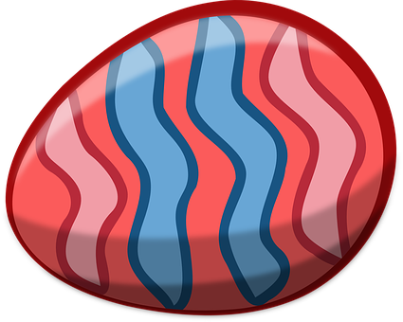
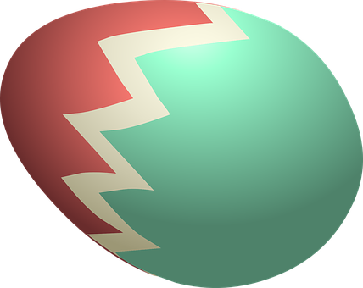
Saying how many and describing things
rouge
Phonics quiz
Easter activities
Notes:
Artwork by Steve Clarke. Pronoun pictures from NCELP (www.ncelp.org). All additional pictures selected from Pixabay and are
available under a Creative Commons license, no attribution required.
The AUDIO version of the lesson material includes additional audio for the new language presented (phonics, vocabulary) and audio for the instructions
on the slide.
In addition, it includes VIDEO clips of the phonics and the phonics’ source words. Pupils can be encouraged to look at the shape of the mouth/lips on
slides where these appear, and try to copy it/them.
Phonics: revisit [u] introduce [ou] tu [112] salut! [2205] amusant [4695] utiliser [345] nous [31] bonjour! [1972] douze [1664] jouer [219] jour [78]
Vocabulary (new words in bold): jour [78] chaque [151] revisit days of the week Revisit 1: avoir [8] j’ai, il a, elle a, quoi [297] animal [1002] chien [1744] chat [3138] photo [1412] ou [33]
Revisit 2: Ça va ? [54/53] bien [47] mal [277] Oui [284] Non [75] Au revoir [4/1274]
Londsale, D., & Le Bras, Y. (2009). A Frequency Dictionary of French: Core vocabulary for learners London: Routledge.
The frequency rankings for words that occur in this PowerPoint which have been previously introduced in these resources are given in the SOW and in the resources that first introduced and formally re-visited those words. For any other words that occur incidentally in this PowerPoint, frequency rankings will be provided in the notes field wherever possible.
1

Slide 2
prononcer
[er]
[ez]
prononcer
aller
assez
Notes:
Timing: 3 minutes (two slides)
Aim: to present [ai]
Procedure:
Present the letter(s) and say the [ai] sound first, on its own. Students repeat it with you.
2. Bring up the word ”vrai” on its own, say it, students repeat it, so that they have the opportunity to focus all of their attention on the connection between the written word and its sound.
3. Repeat again, along with the picture, and with gesture, if using.
4. Roll back the animations and work through 1-3 again, but this time, dropping your voice completely to listen carefully to the students saying the [ai] sound, pronouncing ”vrai” and, if using, doing the gesture.
Suggested gesture: gesture for vrai – either mime a tick Or use the BSL (4th video is the best one): https://www.signbsl.com/sign/true
Word frequency (1 is the most frequent word in French):
vrai [292]
Source: Londsale, D., & Le Bras, Y. (2009). A Frequency Dictionary of French: Core vocabulary for learners London: Routledge.
2

Slide 3
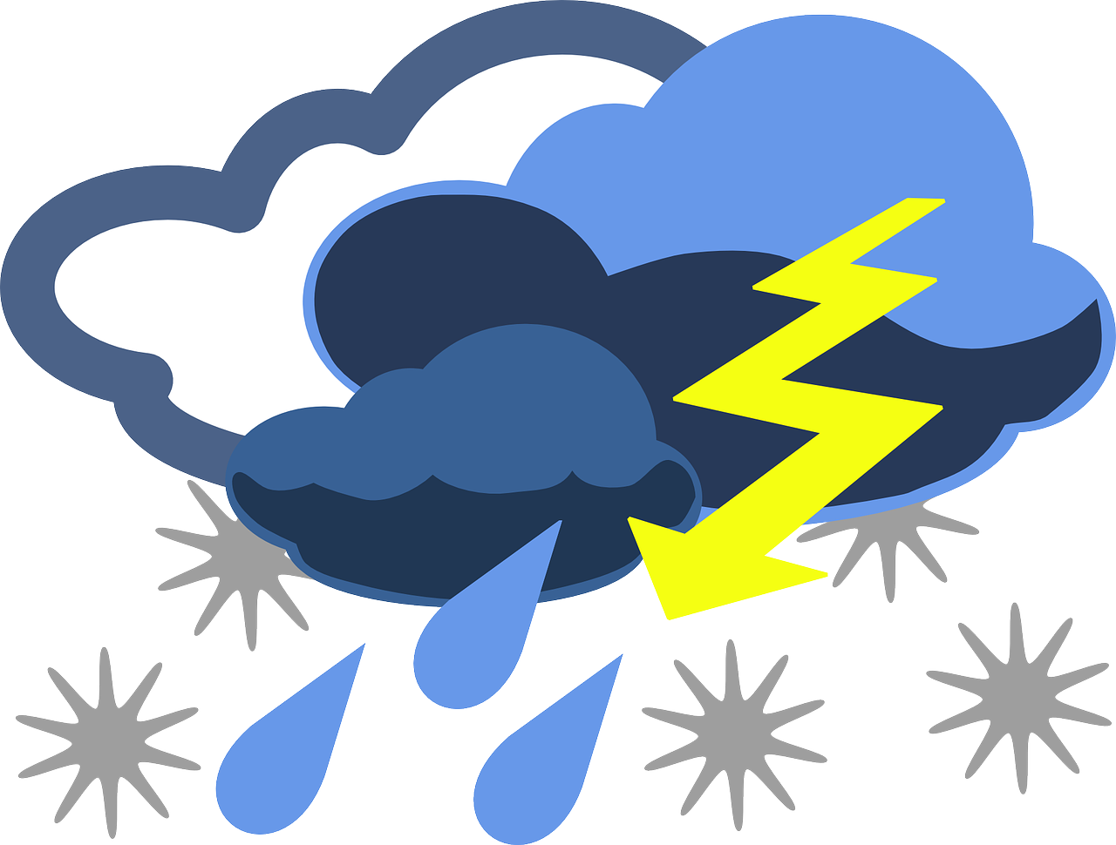
prononcer
[eu]
[ê]
open
prononcer
[storm]
couleur
tempête
Notes:
Timing: 3 minutes (two slides)
Aim: to present [ai]
Procedure:
Present the letter(s) and say the [ai] sound first, on its own. Students repeat it with you.
2. Bring up the word ”vrai” on its own, say it, students repeat it, so that they have the opportunity to focus all of their attention on the connection between the written word and its sound.
3. Repeat again, along with the picture, and with gesture, if using.
4. Roll back the animations and work through 1-3 again, but this time, dropping your voice completely to listen carefully to the students saying the [ai] sound, pronouncing ”vrai” and, if using, doing the gesture.
Suggested gesture: gesture for vrai – either mime a tick Or use the BSL (4th video is the best one): https://www.signbsl.com/sign/true
Word frequency (1 is the most frequent word in French):
vrai [292]
Source: Londsale, D., & Le Bras, Y. (2009). A Frequency Dictionary of French: Core vocabulary for learners London: Routledge.
3

Slide 4
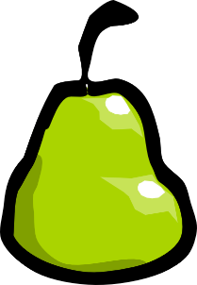
prononcer
[ai]
[oi]
prononcer
[try]
essai
poire
Notes:
Timing: 3 minutes (two slides)
Aim: to present [ai]
Procedure:
Present the letter(s) and say the [ai] sound first, on its own. Students repeat it with you.
2. Bring up the word ”vrai” on its own, say it, students repeat it, so that they have the opportunity to focus all of their attention on the connection between the written word and its sound.
3. Repeat again, along with the picture, and with gesture, if using.
4. Roll back the animations and work through 1-3 again, but this time, dropping your voice completely to listen carefully to the students saying the [ai] sound, pronouncing ”vrai” and, if using, doing the gesture.
Suggested gesture: gesture for vrai – either mime a tick Or use the BSL (4th video is the best one): https://www.signbsl.com/sign/true
Word frequency (1 is the most frequent word in French):
vrai [292]
Source: Londsale, D., & Le Bras, Y. (2009). A Frequency Dictionary of French: Core vocabulary for learners London: Routledge.
4

Slide 5
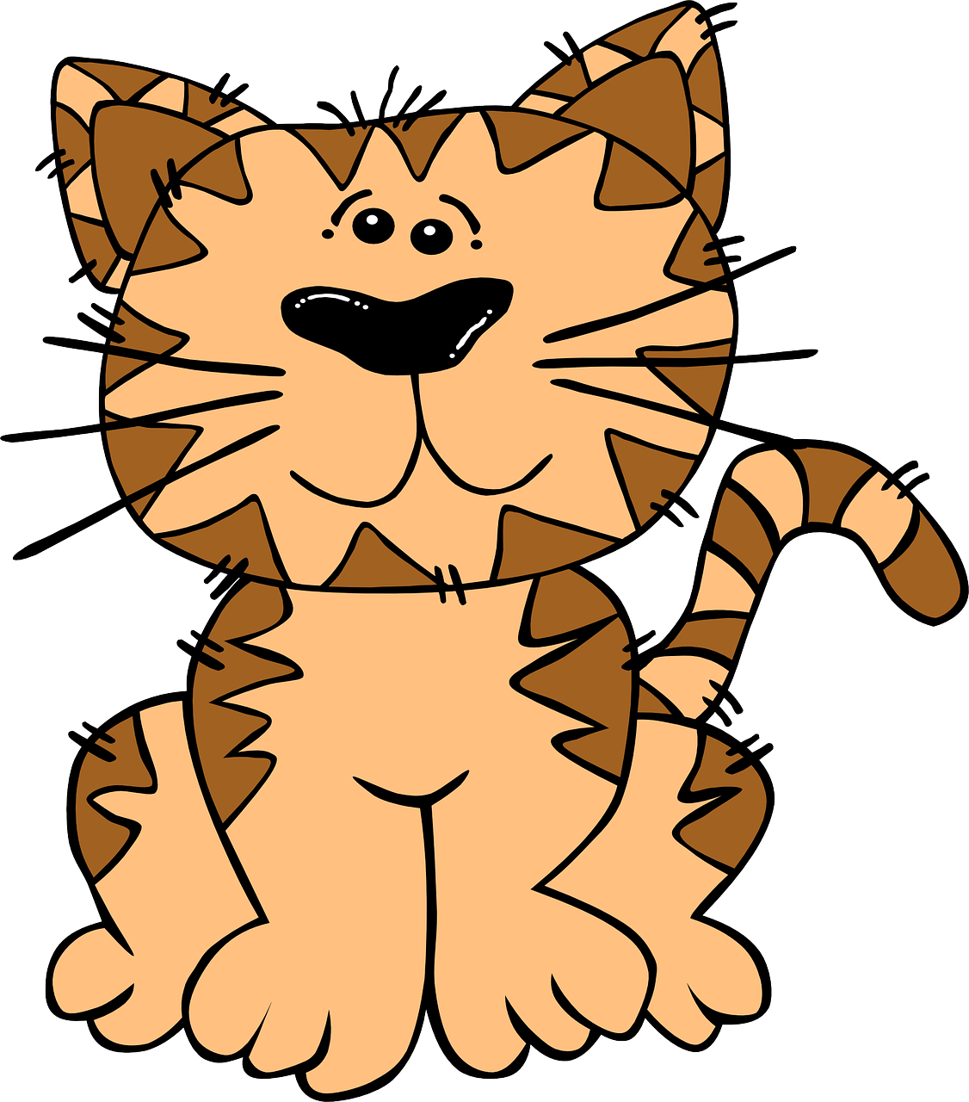
prononcer
[u]
prononcer
C’est un chat.
lune
Notes:
Timing: 3 minutes (two slides)
Aim: to present [ai]
Procedure:
Present the letter(s) and say the [ai] sound first, on its own. Students repeat it with you.
2. Bring up the word ”vrai” on its own, say it, students repeat it, so that they have the opportunity to focus all of their attention on the connection between the written word and its sound.
3. Repeat again, along with the picture, and with gesture, if using.
4. Roll back the animations and work through 1-3 again, but this time, dropping your voice completely to listen carefully to the students saying the [ai] sound, pronouncing ”vrai” and, if using, doing the gesture.
Suggested gesture: gesture for vrai – either mime a tick Or use the BSL (4th video is the best one): https://www.signbsl.com/sign/true
Word frequency (1 is the most frequent word in French):
vrai [292]
Source: Londsale, D., & Le Bras, Y. (2009). A Frequency Dictionary of French: Core vocabulary for learners London: Routledge.
5

Slide 6
prononcer
[SFC]
[eu]
closed
prononcer
always
toujours
yeux
Notes:
Timing: 3 minutes (two slides)
Aim: to present [ai]
Procedure:
Present the letter(s) and say the [ai] sound first, on its own. Students repeat it with you.
2. Bring up the word ”vrai” on its own, say it, students repeat it, so that they have the opportunity to focus all of their attention on the connection between the written word and its sound.
3. Repeat again, along with the picture, and with gesture, if using.
4. Roll back the animations and work through 1-3 again, but this time, dropping your voice completely to listen carefully to the students saying the [ai] sound, pronouncing ”vrai” and, if using, doing the gesture.
Suggested gesture: gesture for vrai – either mime a tick Or use the BSL (4th video is the best one): https://www.signbsl.com/sign/true
Word frequency (1 is the most frequent word in French):
vrai [292]
Source: Londsale, D., & Le Bras, Y. (2009). A Frequency Dictionary of French: Core vocabulary for learners London: Routledge.
6

Slide 7
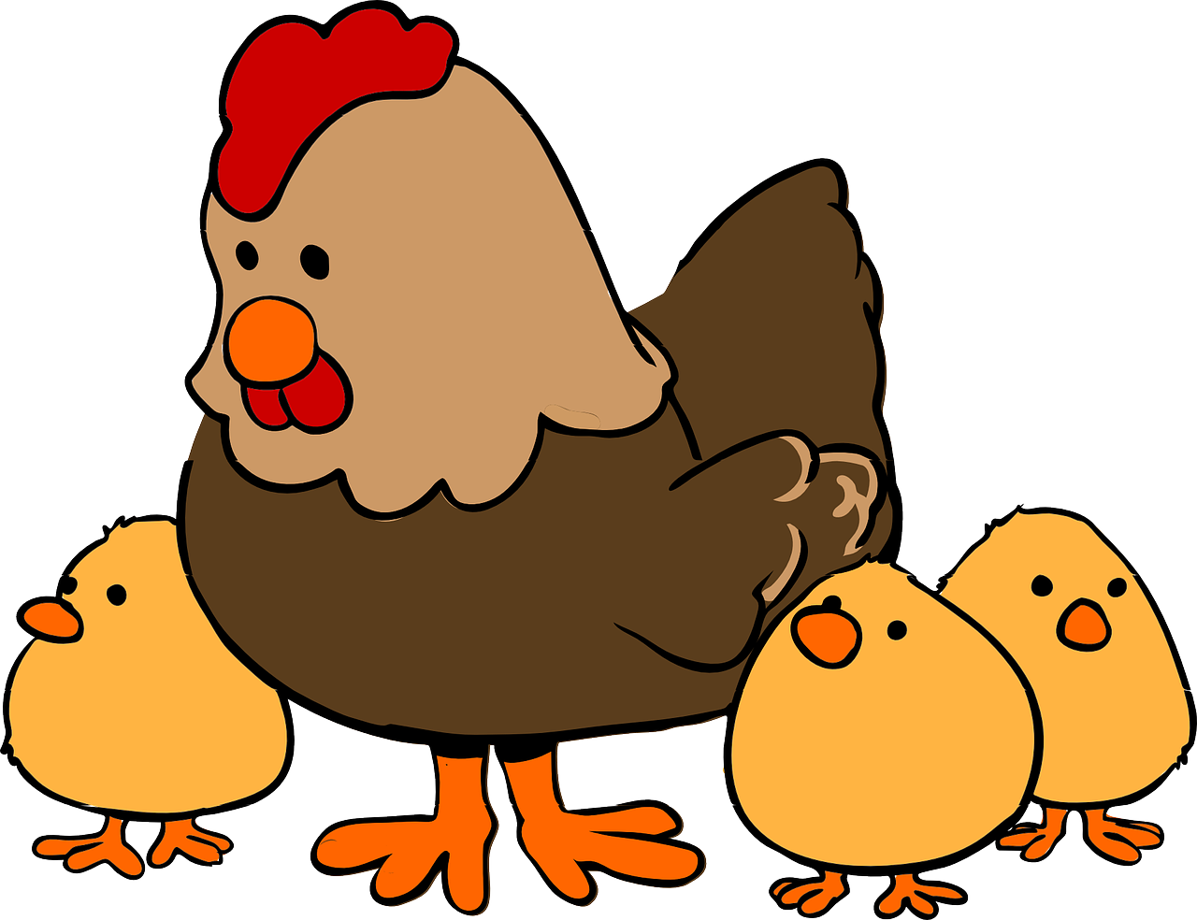
prononcer
[(e)au]
[ou]
prononcer
bateau
poule
Notes:
Timing: 3 minutes (two slides)
Aim: to present [ai]
Procedure:
Present the letter(s) and say the [ai] sound first, on its own. Students repeat it with you.
2. Bring up the word ”vrai” on its own, say it, students repeat it, so that they have the opportunity to focus all of their attention on the connection between the written word and its sound.
3. Repeat again, along with the picture, and with gesture, if using.
4. Roll back the animations and work through 1-3 again, but this time, dropping your voice completely to listen carefully to the students saying the [ai] sound, pronouncing ”vrai” and, if using, doing the gesture.
Suggested gesture: gesture for vrai – either mime a tick Or use the BSL (4th video is the best one): https://www.signbsl.com/sign/true
Word frequency (1 is the most frequent word in French):
vrai [292]
Source: Londsale, D., & Le Bras, Y. (2009). A Frequency Dictionary of French: Core vocabulary for learners London: Routledge.
7

Slide 8
pronunciar
Pupil name:
Pupil name:
SSC and word | px
aller
assez
couleur
tempête
essai
poire
C’est un chat.
lune
toujours
yeux
bateau
poule
SSC and word | px
aller
assez
couleur
tempête
essai
poire
C’est un chat.
lune
toujours
yeux
bateau
poule
Notes:
Pupil feedback and assessment sheet
8

Slide 9
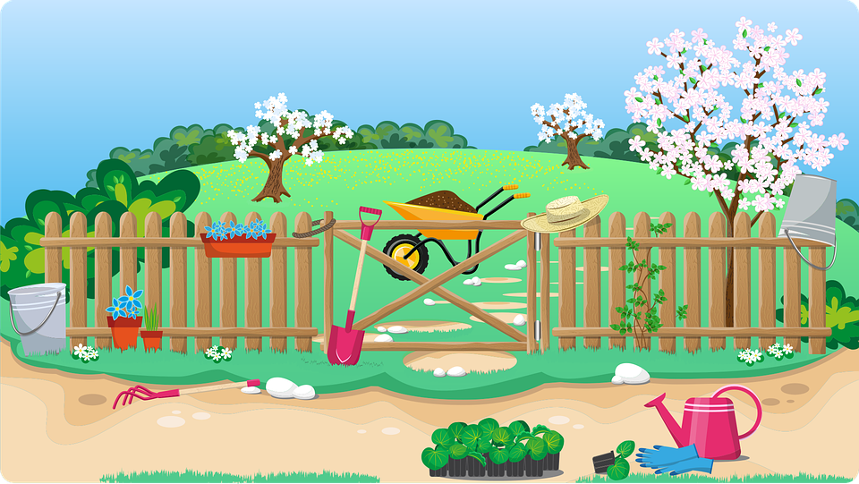
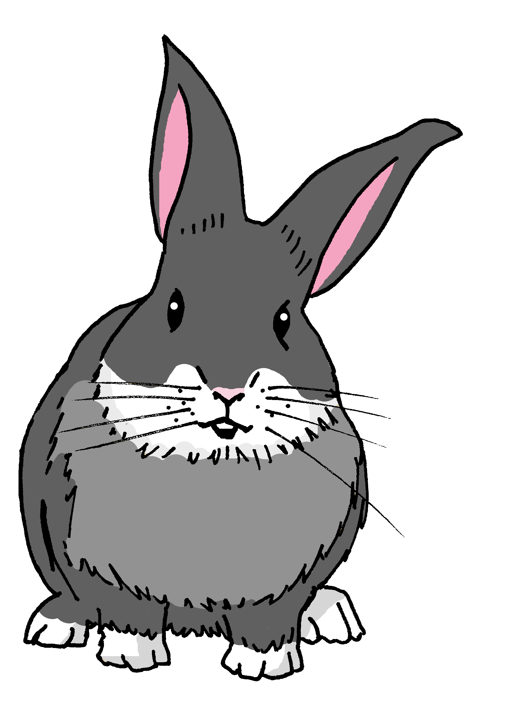
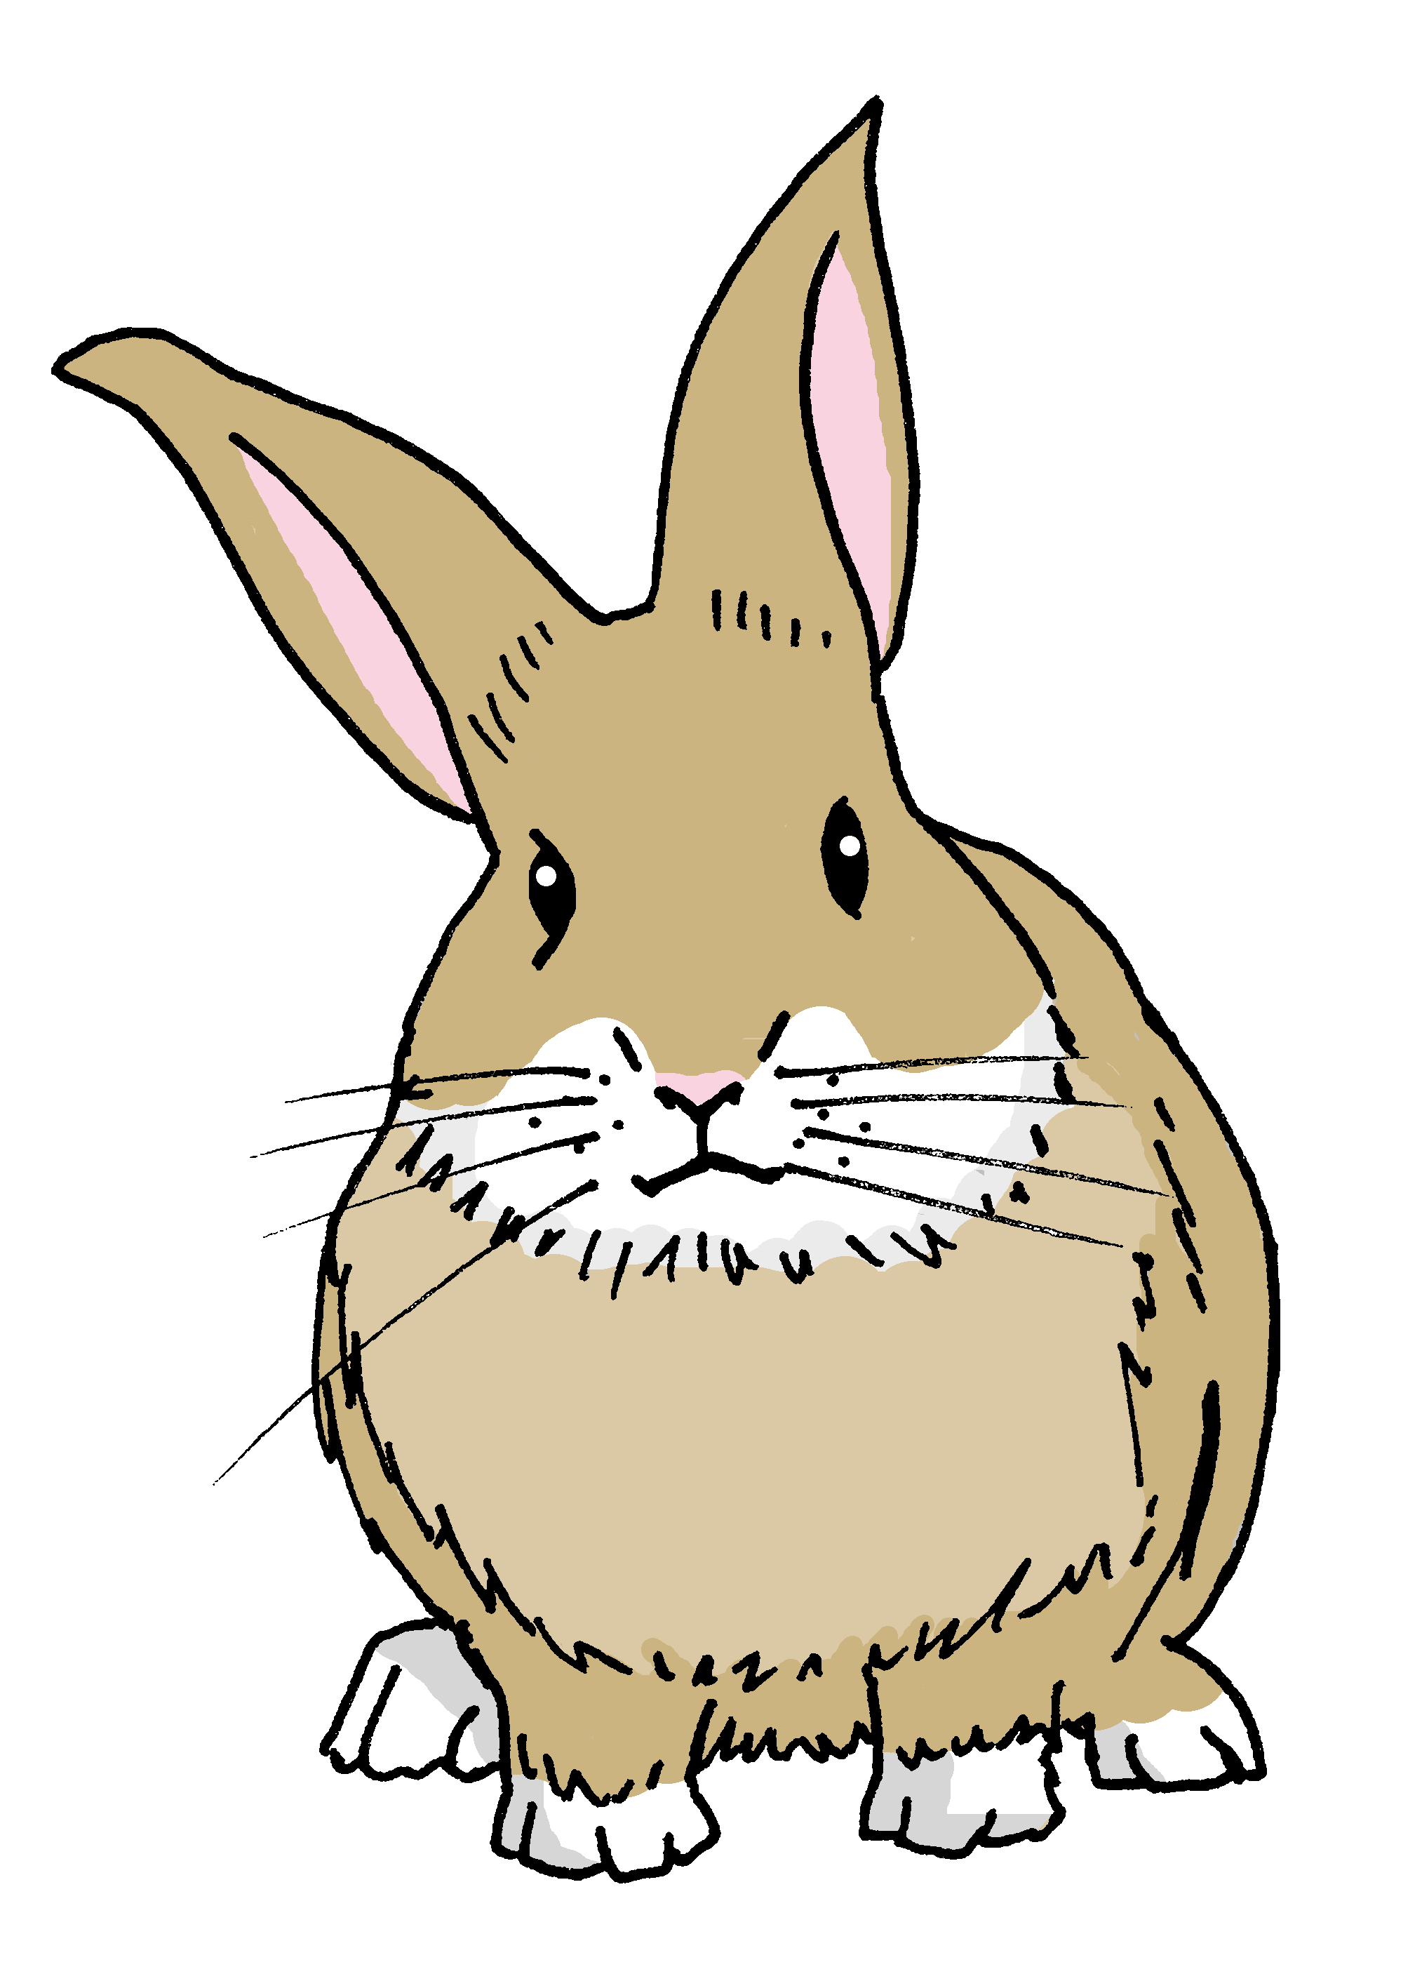
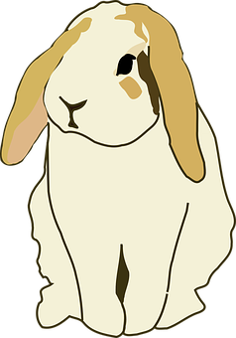
les œufs 🥚
Cherche 🔎.
les lapins 🐰
les fleurs 🌷
1 Écris. ✍
Il y a combien d’œufs?
Il y a _____ ___________.
Il y a combien de lapins?
Il y a _____ ___________.
Il y a combine de fleurs ?
Il y a _____ ___________.

Slide 10
Un message
y
q
u
e
â
o
s
p
j
2 Use the eggs to decipher the message:
J
o
y
e
u
s
e
s
P
â
q
u
e
s
3 Unscramble the letters to translate the message into English.
Happy
Easter
pahpy sEtare ➡ _ _ _ _ _ _ _ _ _ _ _

Slide 11
pronunciar
Teacher audio version
SSC and word | px
aller
assez
couleur
tempête
essai
poire
C’est un chat.
lune
toujours
yeux
bateau
poule
Notes:
Pupil feedback and assessment sheet
11

