Slide 1
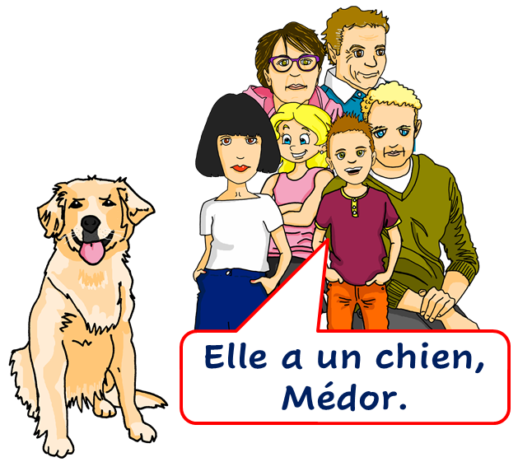
Saying what I and others have
rouge
« Avoir » : j’ai, il/elle a
C’est quoi ? intonation + wh-word questions
SSC [ch]
Term 1 Week 9
Notes:
Artwork by Steve Clarke. Pronoun pictures from NCELP (www.ncelp.org). All additional pictures selected from Pixabay and are
available under a Creative Commons license, no attribution required.
The AUDIO version of the lesson material includes additional audio for the new language presented (phonics, vocabulary) and audio for the instructions
on the slide. In addition, it includes VIDEO clips of the phonics and the phonics’ source words. Pupils can be encouraged to look at the shape of the mouth/lips on
slides where these appear, and try to copy it/them.
Phonics: [ch] chercher [336] chat [3135] bouche [1838] marché [280] dimanche [1235]
Frequency of new words:
Vocabulary: avoir [8] j’ai, il a, elle a, quoi [297] animal [1002] chien [1744] chat [3138] photo [1412] ou [33]
Revisit 1: lundi [1091] mardi [1044] mercredi [1168] jeudi [1112] vendredi [1086] samedi [1356] dimanche [1235] aujourd’hui [233] ce (c') [12]
Londsale, D., & Le Bras, Y. (2009). A Frequency Dictionary of French: Core vocabulary for learners London: Routledge.
The frequency rankings for words that occur in this PowerPoint which have been previously introduced in these resources are given
in the SOW and in the resources that first introduced and formally re-visited those words.
For any other words that occur incidentally in this PowerPoint, frequency rankings will be provided in the notes field wherever
possible.
1

Slide 2
[ch]
prononcer
chercher
[un] is nasal before a consonant and at the end of words.
[to look for]
Notes:
Timing: 2 minutes
Aim: to present SSC [ch].
Procedure:
Click to bring up the SSC [ch]. Repeat the SSC [ch] and the source word chercher with the class.
Click to bring up the English translation and picture.
Pupils to practise saying the SSC and source word several times.

Slide 3
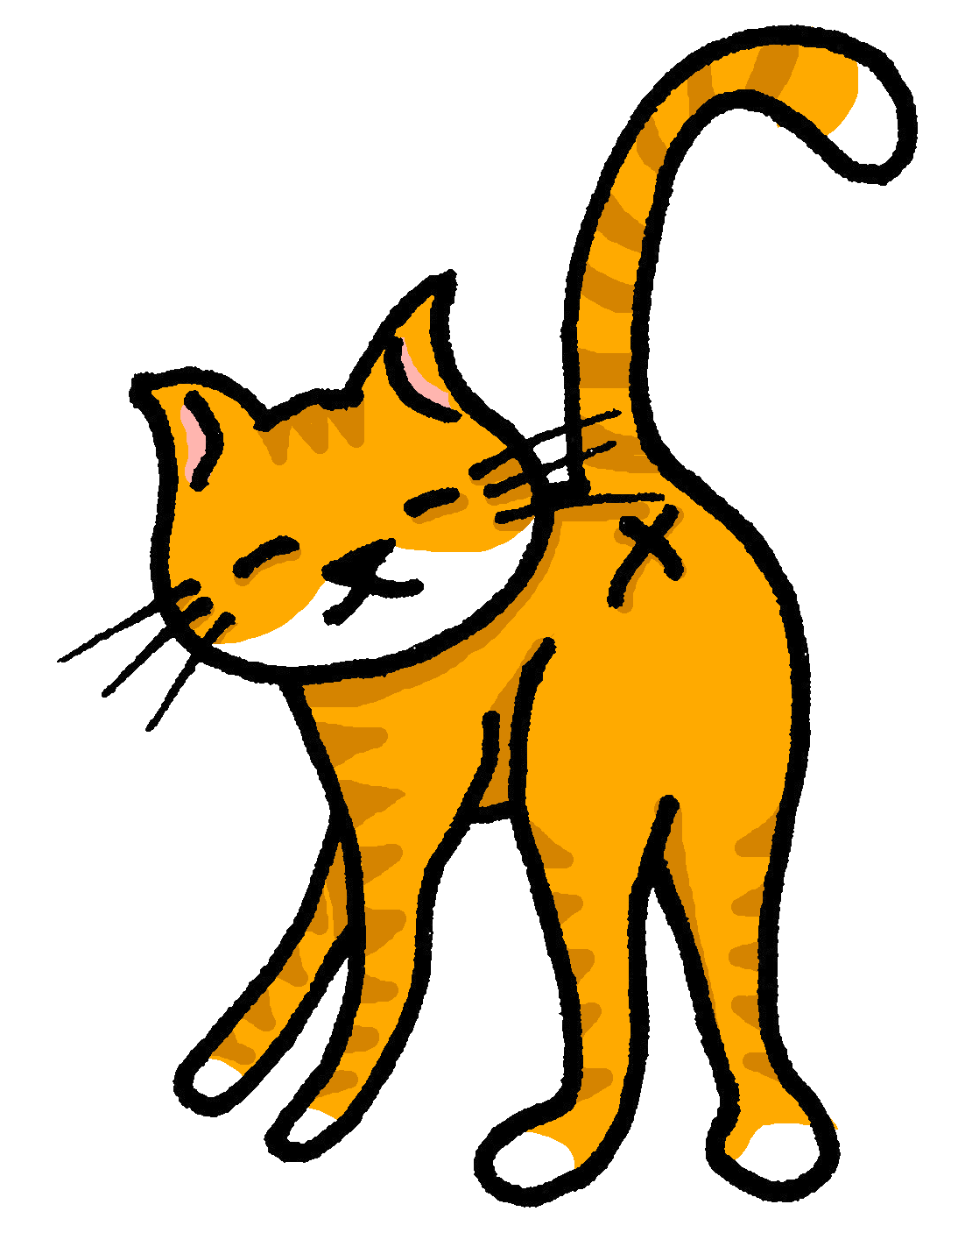
[ch]
chercher
prononcer
bouche
chat
marché
dimanche
[to look for]
Sun
Notes:
Timing: 2 minutes
Aim: to practise the pronunciation of SSC [ch] in four cluster words.
Procedure:
Click to bring up the SSC [ch]. Repeat the SSC [ch] with the class and the source word chercher.
Click to bring up the English translation and picture. Do the gesture, if using.
Click to bring up each cluster word in turn: bouche, chat, marché, dimanche. The pictures appear after the words to give a further opportunity for word repetition.
Suggested gesture: The 3rd video (the woman)’s version is the one I like the best for search, look for: https://www.signbsl.com/sign/search

Slide 4
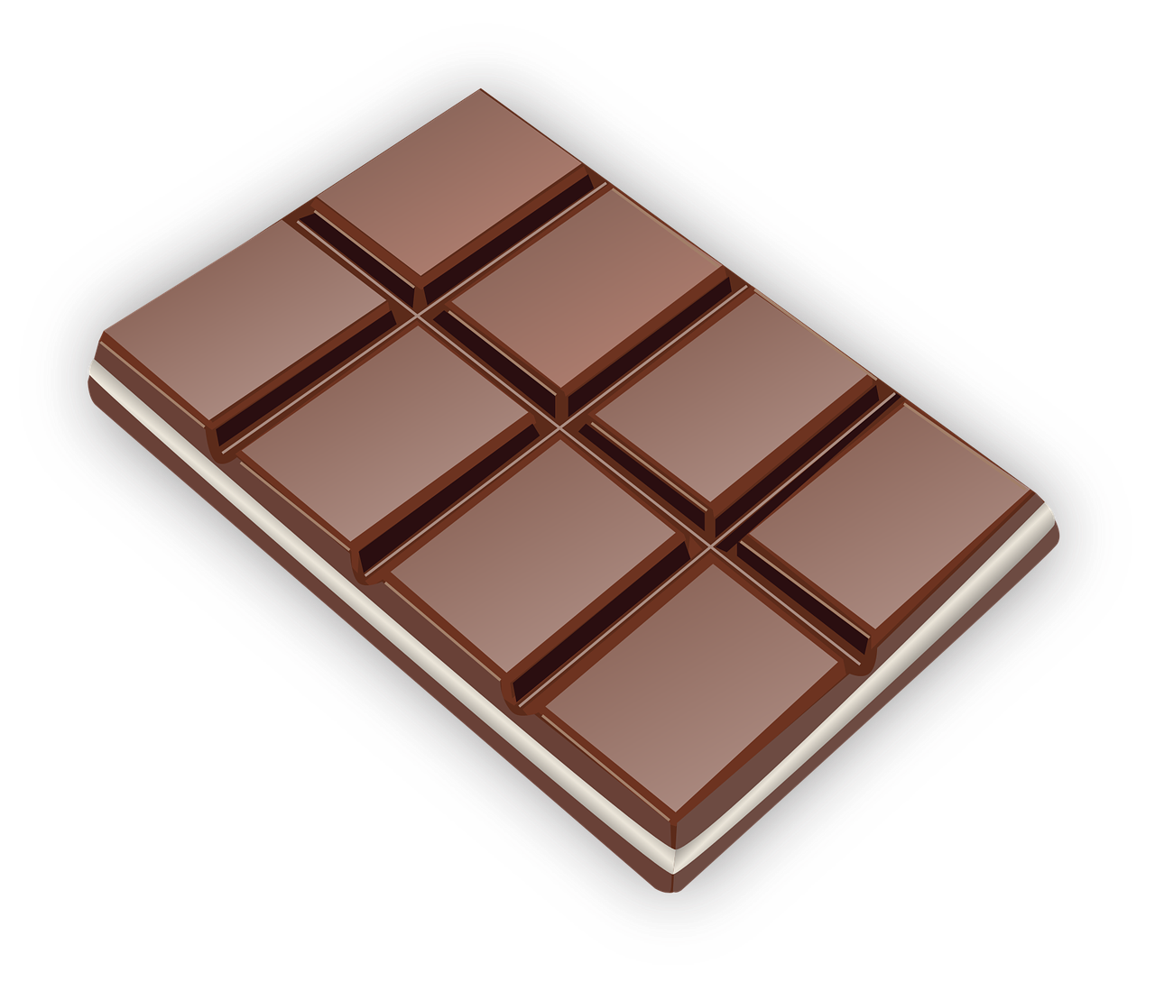
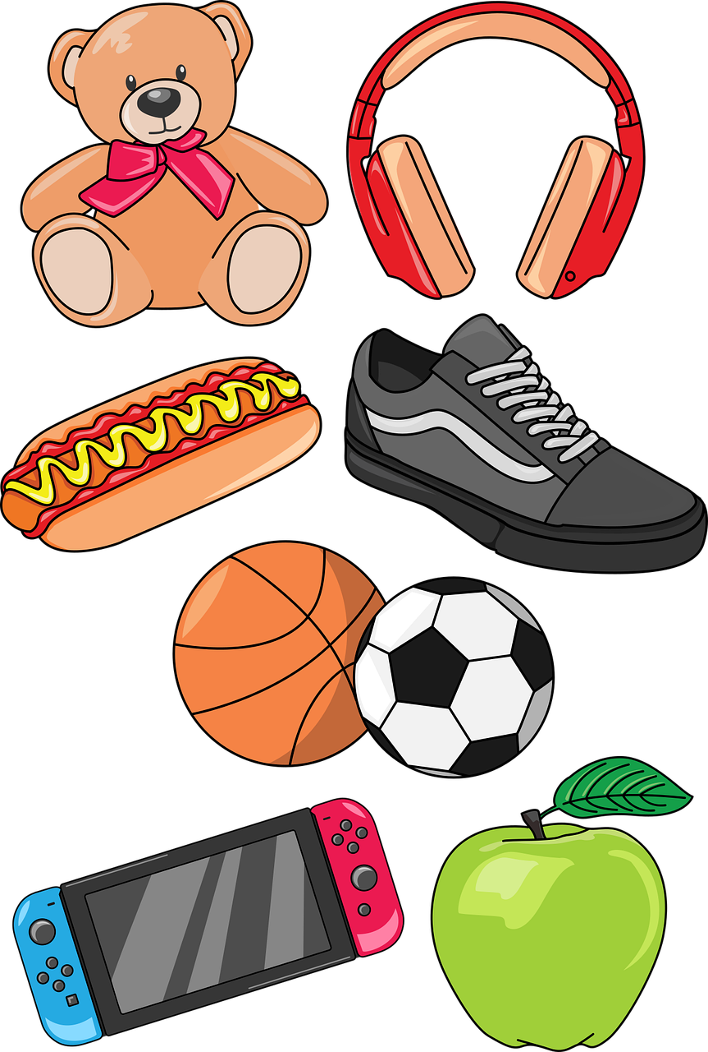
[ch]
prononcer
chocolat
chanter
vache
45
peluche
toucher
chambre
choses
Chouchou
cheval
0
DÉBUT
Notes:
Timing: 2 minutes
Aim: to practise the pronunciation of SSC [ch] in familiar and a few unfamiliar words.
Procedure: 1. Start the timer. Pupil A tries to read aloud all of the words within the 60 seconds allowed.
2. Pupil B listens. If Pupil A pronounces [ch] in an English way by mistake, Pupil B can direct him/her to start again from the beginning. 3. They swap roles and repeat the task.
Note: ensure pupils know they don’t need to rush too much. They have 5 seconds per word. If preferred, remove the timer altogether.
Frequency of unknown words and cognates (1 is the most frequent word in French): chocolat [4556] chanter [1820] vache [2768] toucher [231]
Source: Londsale, D., & Le Bras, Y. (2009). A Frequency Dictionary of French: Core vocabulary for learners London: Routledge.

Slide 5
Asking questions
Remember! To change a statement into a yes/no question, raise your voice at the end:
C’est un chat.
C’est un chat ?
Non, c’est un chien.
It’s a cat.
Is it a cat?
No, it’s a dog.
To ask an information question (e.g. what?) raise your voice and put a question word at the end:
C’est quoi ?
In English, we usually put question words at the start:
C’est un chat.
What is it?
It’s a cat.
Notes:
Timing: 3 minutes
Aim: to revisit how to form intonation questions and intonation questions + wh-words.
Procedure:
Click to present the information.
Elicit the English at each stage from pupils after presenting the French examples.

Slide 6
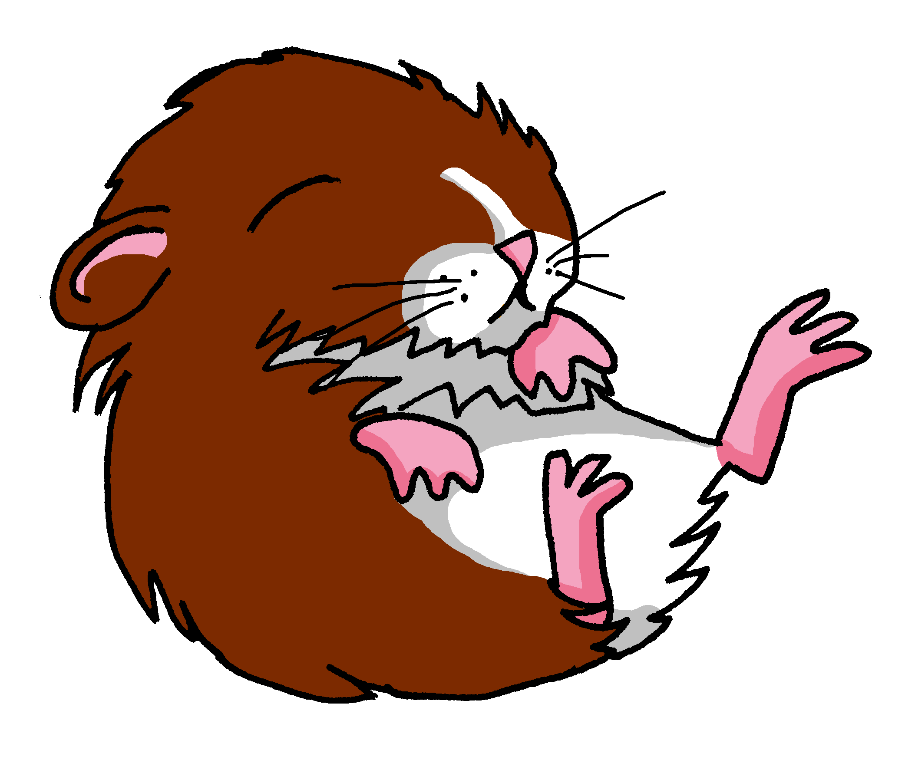
vocabulaire
Écoute et répète.
mots
un cheval
un animal
[a pet]
un chat
une orange
une moto
un stylo
Notes:
Timing: 6 minutes (two slides)
Aim: to present and practise written comprehension and oral recall of the new and revisited vocabulary for this week.
Procedure: 1. Click and one of the pictures disappears. Pupils say the English. Repeat for the other 5 pictures.
2. Click for one of the French words to disappear. Pupils say the French. Repeat for the remaining 5 pictures.
6

Slide 7
vocabulaire
Écoute et répète.
mots
une banane
un cahier
une photo
une peluche
une bouteille
un chien
Notes:
[2/2]
7

Slide 8
vocabulaire
C’est… ou*… ?
.
ou - or
mots
C’est un animal.
Notes:
Timing: 3 minutes (six slides)
Aim: to practise oral recognition and pronunciation of vocabulary.
Procedure: 1. Click to listen to the audio.
2. Pupils respond orally, i.e., c’est un animal.
3. Click to bring up the written answer. 4. Repeat for the following 5 slides.
Transcript: C’est une peluche ou c’est un animal ?
8

Slide 9
vocabulaire
C’est… ou*… ?
.
ou - or
mots
C’est un chat.
Notes:
[2/6]
Transcript:
C’est un cheval ou c’est un chat ?
9

Slide 10
vocabulaire
C’est… ou*… ?
.
ou - or
mots
C’est un ballon.
Notes:
[3/6]
Transcript:
C’est une orange ou c’est un ballon ?
10

Slide 11
vocabulaire
C’est… ou*… ?
.
ou - or
mots
C’est une photo.
Notes:
[4/6]
Transcript:
C’est une photo ou c’est un cahier ?
11

Slide 12
vocabulaire
C’est… ou*… ?
.
ou - or
mots
C’est un stylo.
Notes:
[5/6]
Transcript:
C’est un stylo ou c’est une bouteille ?
12

Slide 13
vocabulaire
C’est… ou*… ?
.
ou - or
mots
C’est un chien.
Notes:
[6/6]
Transcript:
C’est un chien ou c’est une peluche ?
13

Slide 14
vocabulaire
C’est ‘un’ ou ‘une’ ?
.
animal
mots
peluche
cheval
ballon
cahier
photo
bouteille
banane
chien
orange
chat
un
une
Notes:
Timing: 4 minutes
Aim: to practise connecting taught nouns with their gender / indefinite article.
Procedure:
Each item is triggered, allowing the teacher to elicit answers in any order from pupils.
When pupils say a noun with its correct article, e.g. une peluche, the teacher clicks on the word and the animation sees it slot into the correctly gendered box.
3. Repeat for all 11 nouns.
14

Slide 15
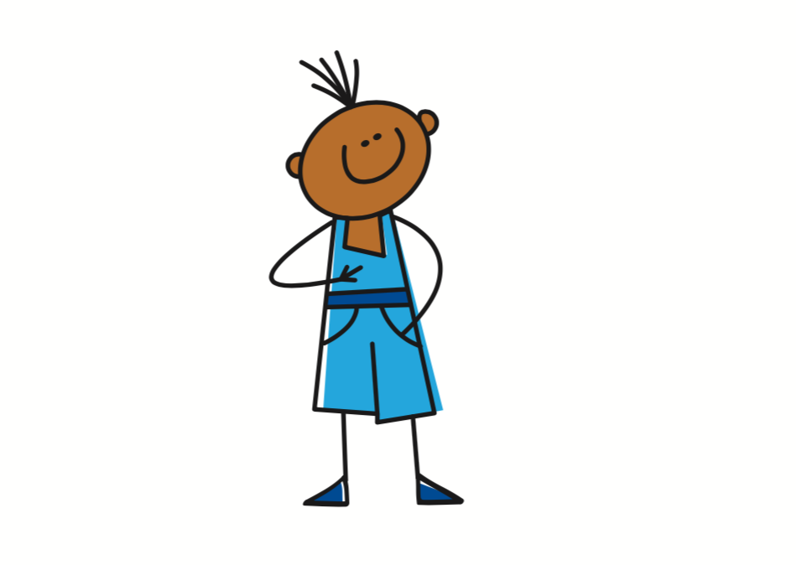
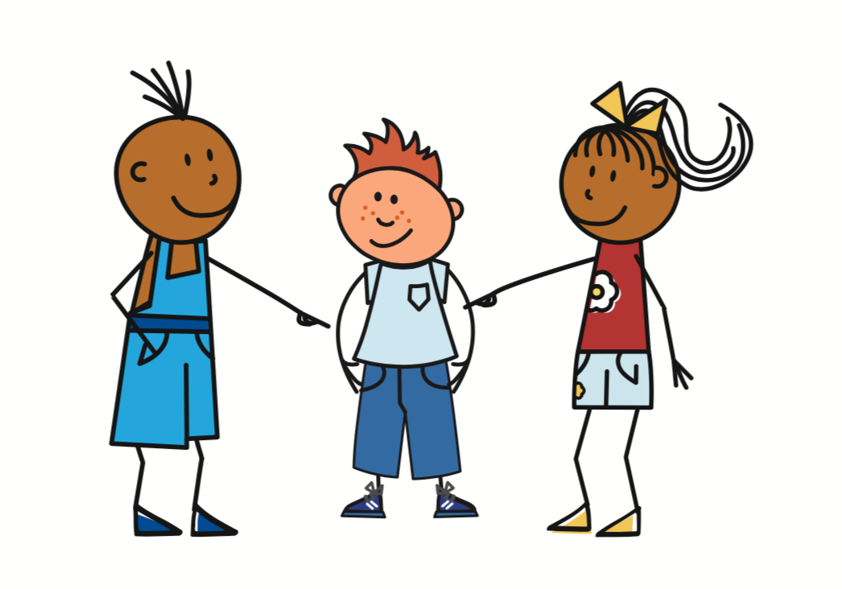
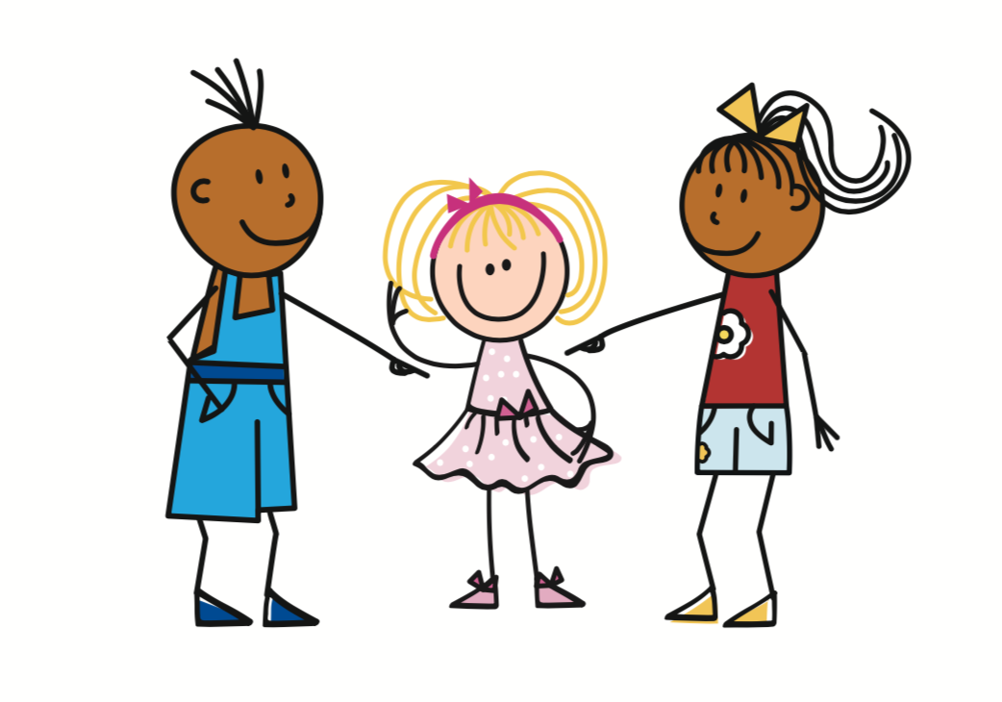
Avoir [to have, having]
The verb avoir means ‘to have’ or ‘having’:
I
je becomes j’ before a vowel.
j’ai
To say I have, use ______.
J’ai un chat.
I have a cat.
he
il a
Il a un chien.
To say he has, use _____.
He has a dog.
she
elle a
Elle a une peluche.
To say she has, use _______.
She has a cuddly toy.
Notes:
Timing: 3 minutes
Aim: to introduce the verb avoir (to have), I have, he has and she has.
Procedure:
Click to present the information.
Elicit the English at each stage from pupils after presenting the French examples.

Slide 16
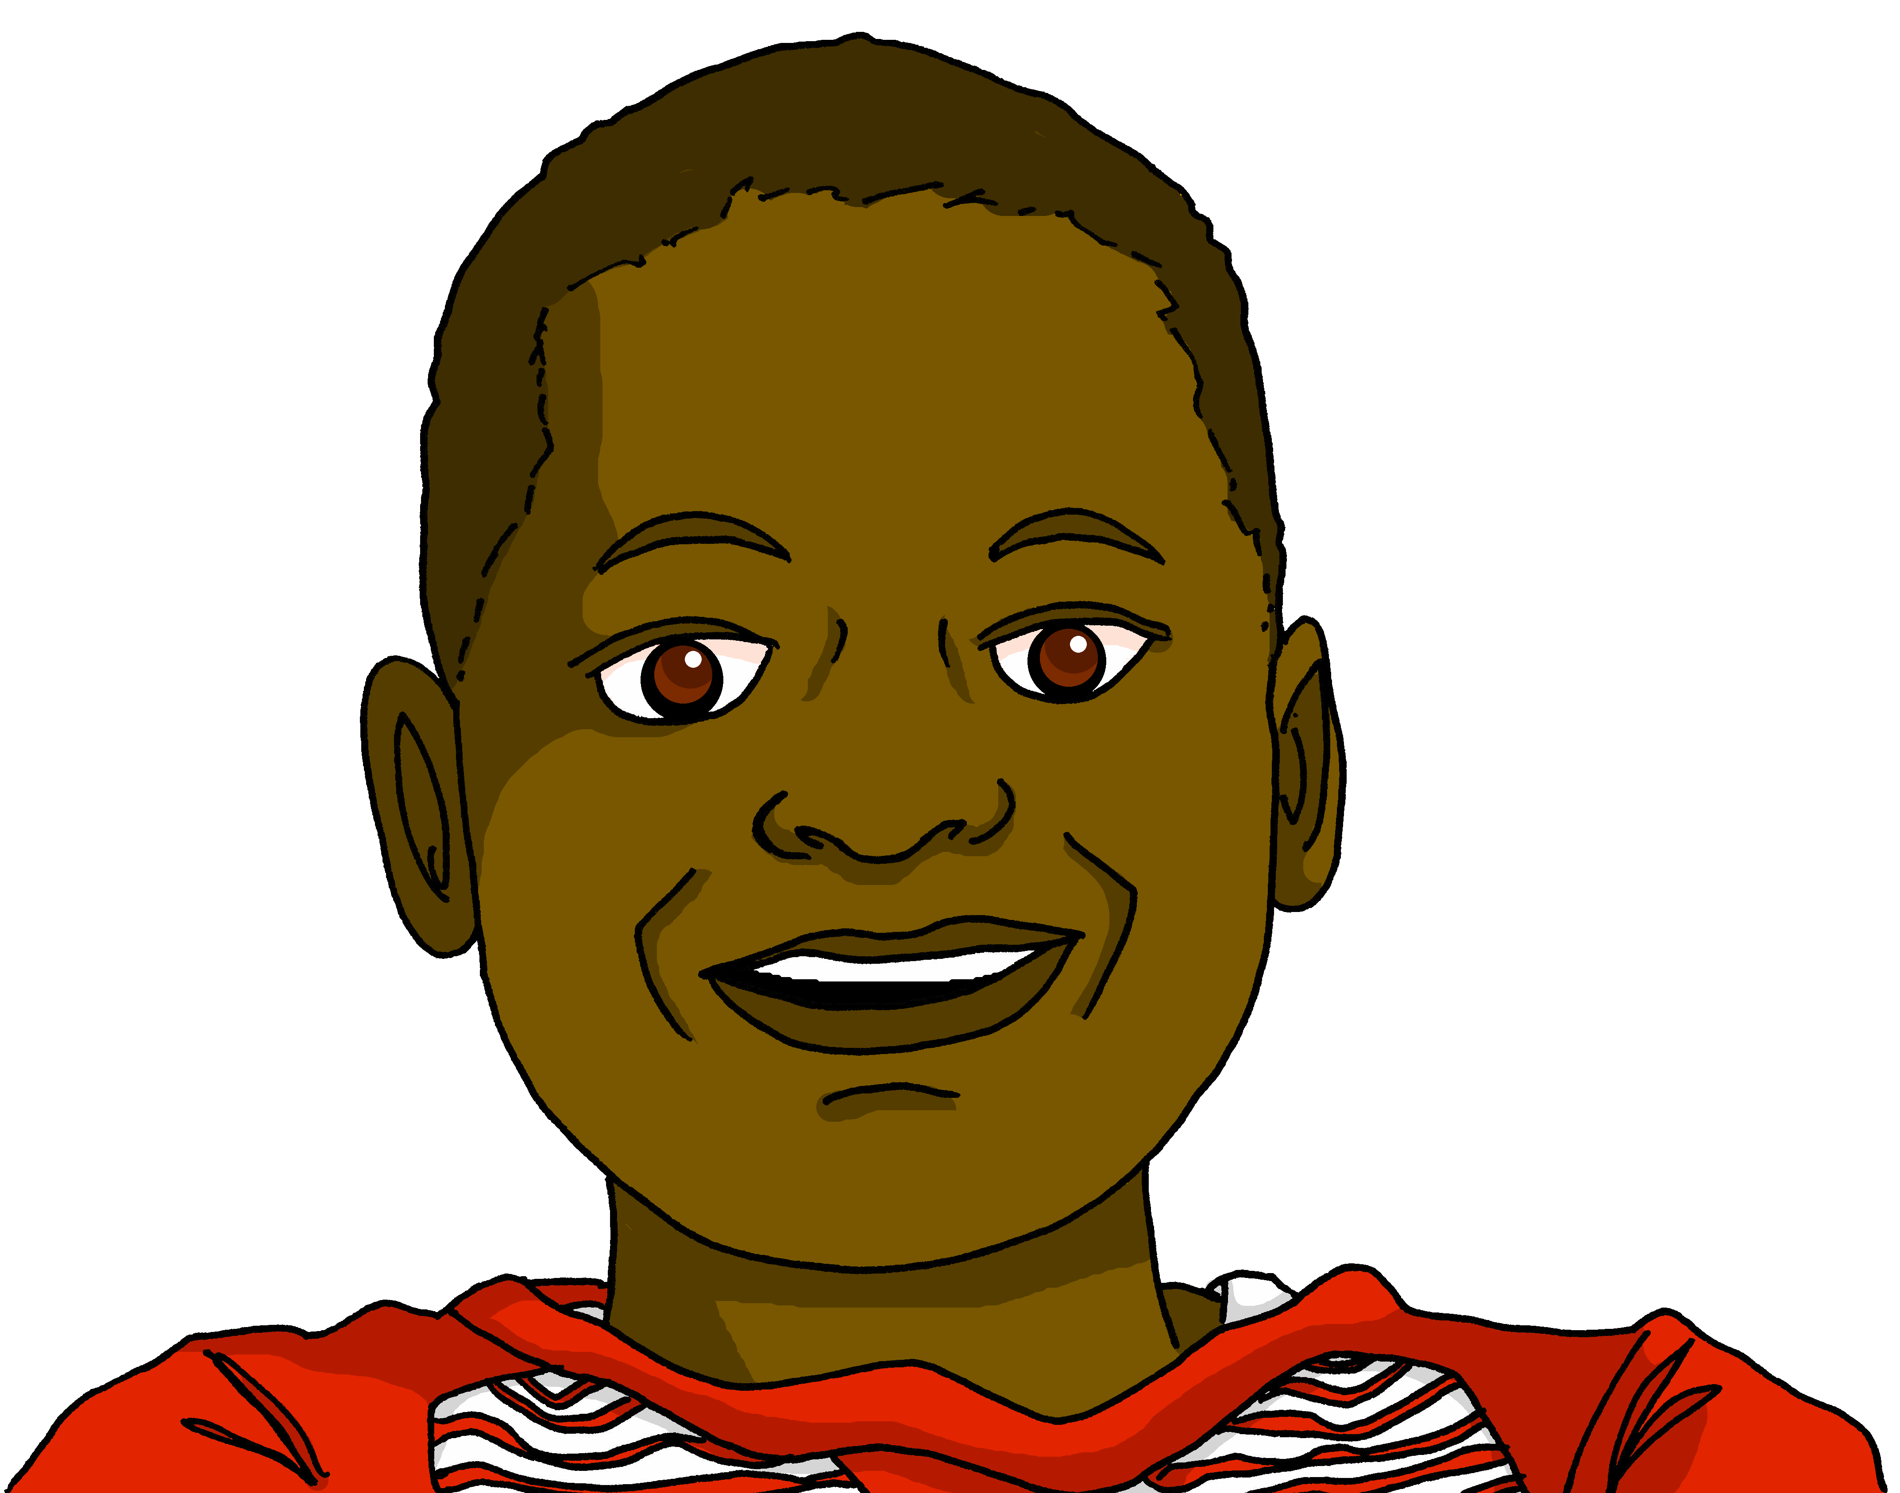
lire
Pierre écrit des messages à Jean-Michel.
C’est ‘I have’ ou ‘she has’ ?
Complète les deux listes.
1
4
J’ ai une photo.
Elle a un chien.
◆
◆
2
5
Elle a une mini moto.
Elle a un sac.
◆
Pierre (I have)
 | ______
 | ______
 | ______
Adèle (she has)
 | ______
 | ______
 | ______
◆
cuddly toy
dog
photo
bag
mini motorbike
3
6
ball
J’ ai une peluche.
◆
J’ ai un ballon.
◆
Notes:
Timing: 5 minutes
Aim: to practise written comprehension of j’ai (I have) and elle a (she has).
Procedure:
Pupils write two headings Pierre (I have) and Adèle (she has) and the three items that each has.
Click to reveal answers.
16

Slide 17
Au revoir !
rouge
Notes:
17

