Slide 1
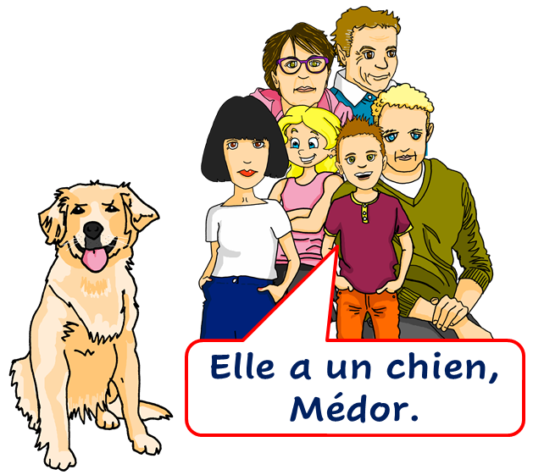
Saying what I and others have
rouge
Follow ups 1-5
Term 1 Week 9
Notes:
Artwork by Steve Clarke. Pronoun pictures from NCELP (www.ncelp.org). All additional pictures selected from Pixabay and are available under a Creative Commons license, no attribution required.
Phonics: [ch] chercher [336] chat [3135] bouche [1838] marché [280] dimanche [1235]
Frequency of new words:
Vocabulary: avoir [8] j’ai, il a, elle a, quoi [297] animal [1002] chien [1744] chat [3138] photo [1412] ou [33]
Revisit 1: lundi [1091] mardi [1044] mercredi [1168] jeudi [1112] vendredi [1086] samedi [1356] dimanche [1235] aujourd’hui [233] ce (c') [12]
Londsale, D., & Le Bras, Y. (2009). A Frequency Dictionary of French: Core vocabulary for learners London: Routledge.
The frequency rankings for words that occur in this PowerPoint which have been previously introduced in these resources are given in the SOW and in the resources that first introduced and formally re-visited those words.
For any other words that occur incidentally in this PowerPoint, frequency rankings will be provided in the notes field wherever possible.

Slide 2
Follow up 1
.
Écoute.
Tally the number of times you hear [ch] in each sentence.
////
écouter
1
C’est lundi ? Non, c’est dimanche.
/
Is it Monday? No, it’s Sunday.
2
Une machine prépare un chocolat chaud.
///
A machine prepares a hot chocolate.
3
Un chat et un chien cherchent le marché.
////
A cat and a dog look for the market.
4
Un champion chante une chanson.
///
A champion sings a song.
5
C’est une bouche avec une moustache au-dessus.
//
It’s a mouth with a moustache on top.
Notes:
Timing: 5 minutes
Aim: to practise aural recognition of SSC [ch].
Procedure: 1. Click to listen to each sentence. 2. Pupils note each instance of [ch] 3. Click to reveal the written sentence and the answer. 4. Allow pupils to tell you the meanings of the words they know. Click again to reveal the English meaning.
Transcript:
C’est lundi ? Non, c’est dimanche.
Une machine prépare un chocolat chaud.
Un chat et un chien cherchent le marché. Un champion chante une chanson. C’est une bouche avec une moustache au-dessus.

Slide 3
Follow up 2
.
Écoute et lis les phrases. C’est quoi ?
1
[un cheval | un chat]
écouter
C’est un animal. C’est petit.
2
[un cahier | une moto]
C’est dans un sac.
[une photo | un stylo]
3
C’est pour écrire.
[une banane | une orange]
4
C’est un fruit. C’est comme un ballon.
5
C’est pour le football.
[une bouteille| un ballon]
C’est un animal. C’est Médor.
6
[un chien | Chouchou]
Notes:
Timing: 5 minutes
Aim: to practise aural/written comprehension of a range of family vocabulary.
Procedure: 1. Click to listen and read each clue. 2. Pupils select the noun that is described.
3. Elicit the answers orally and click to reveal the answers.
Transcript:
1. C’est un animal. C’est petit.
2. C’est dans un sac. 3. C’est pour écrire. 4. C’est un fruit. C’est comme un ballon.
5. C’est pour le football. 6. C’est un animal. C’est Médor.

Slide 4
Follow up 3
.
Écoute. Adèle parle. Qui a quoi ?
1
[ballon| peluche]
1
écouter
2
2
[stylo | photo]
Adèle (I have)
 | ______
 | ______
 | ______
 | ______
3
3
[bouteille| chien]
ball
4
4
[banane | jeu]
photo
game
Pierre (he has)
 | ______
 | ______
 | ______
 | ______
5
[sac| orange]
5
banana
6
[chat | peluche]
bottle
6
bag
7
[sac| banane]
7
cuddly toy
dog
8
8
[chien | photo]
Notes:
Timing: 5 minutes
Aim: to practise aural comprehension of j’ai and il a and correctly connect indefinite articles with nouns of the correct gender.
Procedure: 1. Click to listen. 2. Pupils decide if Adèle says ‘I have’ or ‘he has’ and select the noun that is described.
3. They write the noun in English under the correct name heading.
4. Elicit the answers orally and click to bring up full sentence audio and to reveal the answers.
Transcript:
1. J’ai un [ballon].
2. J’ai une [photo]. 3. Il a une [bouteille]. 4. J’ai un [jeu]. 5. Il a un [sac]. 6. Il a une [peluche]. 7. J’ai une [banane]. 8. Il a un [chien].

Slide 5
Follow up 4:
Parle avec un/une partenaire.
Exemple :
J’ai …
parler
…un chien.
a dog
 | Adèle (J’ai…) | Pierre (Il a…)
1 | un chien | un stylo
2
1 | I have …………………
2
Notes:
Timing: 5 minutes
Aim: to practise oral production of j’ai and il a, and oral comprehension of known vocabulary.
Procedure: 1. Model the task using the example. Click to demonstrate each stage.
2. Give out the handouts (they are found at the end of this PPT). 2. Pupil As start by saying either j’ai or il a.
3. Pupil Bs listen and finish their partner’s sentence correctly.
4. Pupil As complete the English sentence meanings appropriately.
5. Pupils swap roles.

Slide 6
Follow up 5: Les réponses pour A
Les réponses pour la personne A.
parler
1 | I have…………………..
2 | He has………………….
3 | He has………………….
4 | I have…………………..
5 | I have………………….
6 | He has………………….
 | Adèle (J’ai…) | Pierre (Il a…)
1 | …un chien. | …un stylo.
2 | …un animal. | …une photo.
3 | …un cheval. | …un jeu.
4 | …un chat. | …un sac.
5 | …une orange. | …une banane.
6 | …un ballon. | …une peluche.
a dog
a photo
a game
a cat
an orange
a cuddly toy
Notes:
ANSWERS A

Slide 7
Follow up 5: Les réponses pour B
Les réponses pour la personne B.
parler
 | Adèle (J’ai…) | Pierre (Il a…)
1 | …une bouteille. | …un sac.
2 | …un cahier. | …une cheval.
3 | …un jeu. | …un chien.
4 | …un ballon. | …un animal.
5 | …une banane. | …une photo.
6 | …un animal. | …un stylo.
1 | I have…………………..
2 | I have………………….
3 | He has………………….
4 | He has…………………..
5 | He has………………….
6 | I have………………….
a bottle
an exercise book
a dog
a pet
a photo
a pet
Notes:
ANSWERS B

Slide 8
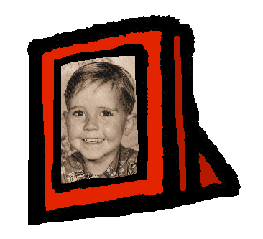
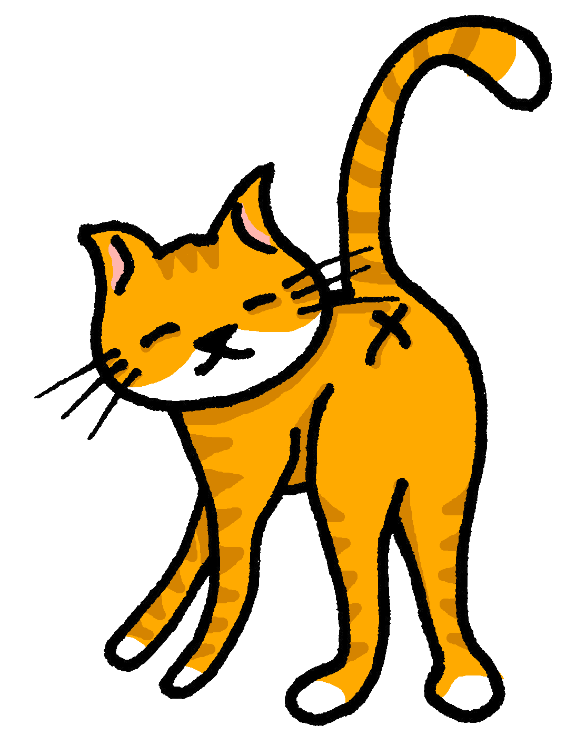
Follow up 4:

Écris des phrases.
Tu es Pierre. Écris six phrases.
écrire
 | I have | she has
1
2
3
4
5
6
1. J’ai une photo.
2. Elle a un cahier.
3. Elle a un chat.
4. J’ai un chien.
5. J’ai un sac.
6. Elle a une bouteille.
Notes:
Timing: 10 minutes (or 5 minutes for 3 sentences)
Aim: to practise written production of this week’s new language.
Procedure:
Tell pupils they need to write as if they are Pierre.
Click for written versions of the sentences.

Slide 9
Follow up 5: Handout A
Now your turn to listen to your partner. Do you hear j’ai or il a ? Say the correct noun.
Start each sentence in French. Write the English meaning of what your partner says.
parler
1 | I have…………………..
2 | He has………………….
3 | He has………………….
4 | I have…………………..
5 | I have………………….
6 | He has………………….
 | Adèle (J’ai…) | Pierre (Il a…)
1 | …une bouteille. | …un sac.
2 | …un cahier. | …une cheval.
3 | …un jeu. | …un chien.
4 | …un ballon. | …un animal.
5 | …une banane. | …une photo.
6 | …un animal. | …un stylo.

Slide 10
Follow up 5: Handout B
Listen to your partner. Do you hear j’ai or il a ? Say the correct noun.
parler
 | Adèle (J’ai…) | Pierre (Il a…)
1 | …un chien. | …un stylo.
2 | …un animal. | …une photo.
3 | …un cheval. | …un jeu.
4 | …un chat. | …un sac.
5 | …une orange. | …une banane.
6 | …un ballon. | …une peluche.
Start each sentence in French. Write the English meaning of what your partner says.
1 | I have…………………..
2 | I have………………….
3 | He has………………….
4 | He has…………………..
5 | He has………………….
6 | I have………………….

