Slide 1
Saying what I and others have
C’est un éléphant !
rouge
Gender & indefinite articles un / une
Liaison : c’est un / une
Term 1 Week 8
Notes:
Artwork by Steve Clarke. Pronoun pictures from NCELP (www.ncelp.org). All additional pictures selected from Pixabay and are
available under a Creative Commons license, no attribution required.
The AUDIO version of the lesson material includes additional audio for the new language presented (phonics, vocabulary) and audio for the instructions
on the slide.
In addition, it includes VIDEO clips of the phonics and the phonics’ source words. Pupils can be encouraged to look at the shape of the mouth/lips on
slides where these appear, and try to copy it/them.
Phonics: [un] un [3] lundi [1091] jungle [4891] brun [>5000] commun [780]
[un] vs. [une]
liaison - c'est un/une
Frequency of new words:
Vocabulary: un [3] une [3] ballon [3692] bouteille [2979] cahier [4001] jeu [291] orange [3912] peluche [>5000] sac [2343] stylo [>5000] (revisit banane)
Revisit 1: malade [1066] calme [1731] intelligent [2509] amusant [4695] méchant [3184]
Londsale, D., & Le Bras, Y. (2009). A Frequency Dictionary of French: Core vocabulary for learners London: Routledge.
The frequency rankings for words that occur in this PowerPoint which have been previously introduced in these resources are given
in the SOW and in the resources that first introduced and formally re-visited those words.
For any other words that occur incidentally in this PowerPoint, frequency rankings will be provided in the notes field wherever
possible.
1

Slide 2
[un]
un
prononcer
[un] is nasal before a consonant and at the end of words.
[a/an, one]
Notes:
Timing: 2 minutes
Aim: to present SSC [un].
Procedure:
Click to bring up the SSC [un]. Repeat the SSC [un] with the class.
Click to bring up the English translation and picture.
Pupils to practise saying the SSC several times.
Click to bring up the callout about nasal vowels.

Slide 3
[un]
un
prononcer
lundi
jungle
Mon
brun
commun
[common]
[a/an, one]
Notes:
Timing: 2 minutes
Aim: to practise the pronunciation of nasal [un] in four cluster words.
Procedure:
Click to bring up the SSC [un]. Repeat the SSC [un] with the class.
Click to bring up the English translation and picture.
Click to bring up each cluster word in turn: lundi, jungle, brun, commun.
The pictures appear after the words to give a further opportunity for word repetition.

Slide 4
Gender in French
This is grammatical, not biological gender! A table (une table) is not female, it is a feminine noun.
Indefinite articles: a/an
In French, things, as well as people and animals, are either masculine or feminine. We say that they have gender.
[un] is oral before a vowel. Practise the different sounds: un – une – un - une
To say a (or an) in French use un before a masculine noun and une before a feminine noun.
Many feminine nouns end in –e but you have to learn the gender of each noun when you learn the word.
Masculine
Feminine
un
__ univers
une
a universe
___ banane
a banane
un
__ cheval
a table
a horse
une
___ table
un
a game
une
an idea
__ jeu
___ idée
Notes:
Timing: 3 minutes
Aim: to introduce grammatical gender and singular indefinite articles (un/une).
Procedure:
Click to present the new information about gender and indefinite articles in French.
Click to bring up three examples of masculine nouns with their indefinite article ‘un’.
Click to bring up three examples of feminine nouns with their indefinite article ‘une’.
Click to provide one pattern (feminine nouns often end in –e) but reinforce the fact that there are exceptions and in French you need to learn the gender of each noun when you learn the word.
These example nouns are all taken from the SSC source/cluster words from weeks 1-8 except table [866] and idée [239]. Students should already familiar with these from their phonics learning.
Vocabulary: table [1019] idée [239]
Londsale, D., & Le Bras, Y. (2009). A Frequency Dictionary of French: Core vocabulary for learners London: Routledge.

Slide 5
écouter
.
Écoute. C’est un ou une ?
animaux. C’est [ien] ou [(a)in]?
Écris de 1à 8 ‘un’ ou ‘une’. Puis, complète le mot.
 | un / une | français | anglais
 | un | s a c | bag
 | un | b a l l o n | ball
 | une | o r a n g e | orange
 | un | j e u | game
 | une | p e l u c h e | cuddly toy
 | une | b o u t e i l l e | bottle
 | un | s t y l o | pen
 | un | c a h i e r | exercise book
1
___
_
2
___
_
_
3
___
_
_
4
___
_
_
5
___
_
6
___
_
_
7
___
_
8
___
_
Notes:
Timing: 6 minutes
Aim: to practise aural recognition of singular indefinite articles un and une, and several familiar SSC (a, u, o, i, eu, on, an); to introduce the new vocabulary for this week.
Procedure:
Click to play audio.
Pupils write the article un or une.
Repeat for items 2-8.
Click to check answers.
Click to listen again.
This time pupils write the words (or just the missing letters).
Click to check answers.
Transcript:
un sac
un ballon
une orange
un jeu
une peluche
une bouteille
un stylo
un cahier
5

Slide 6
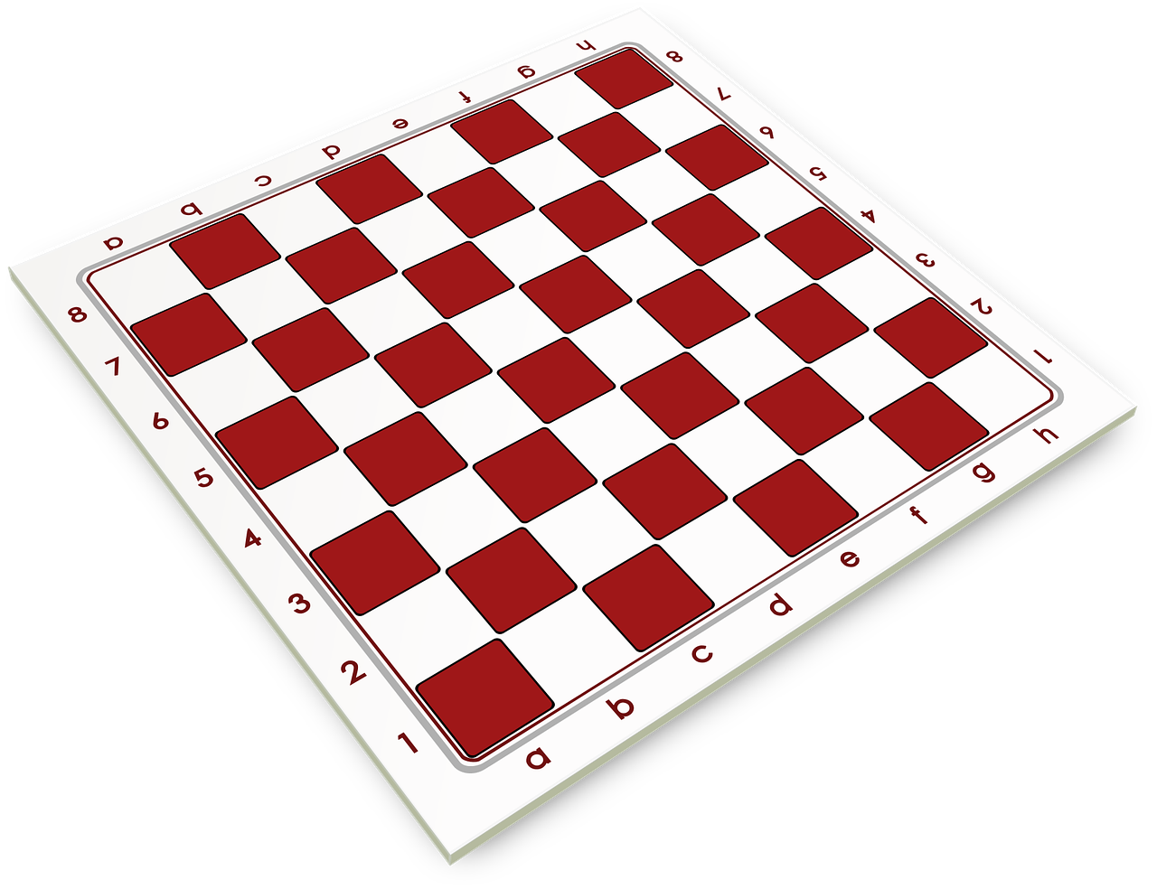
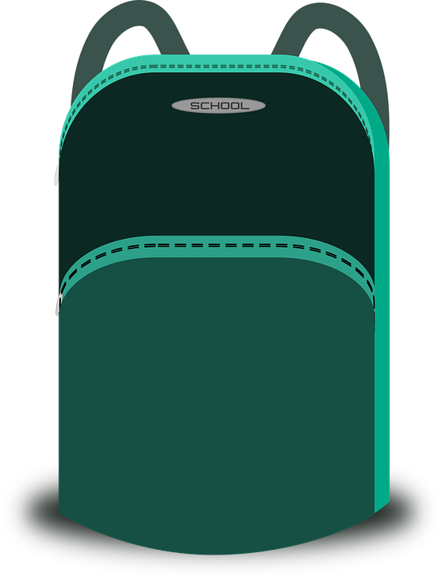
vocabulaire
.
Écoute et répète.
mots
une bouteille
une orange
un jeu
un stylo
un ballon
un sac
une peluche
un cahier
an exercise book
a ball
a bottle
a pen
a cuddly toy
a bag
a game
an orange
Notes:
Timing: 4 minutes
Aim: to present and practise written comprehension and read aloud of the new vocabulary for this week.
Procedure: 1. Click for an English prompt.
2. Elicit the French article from pupils (un or une) and say the French word for pupils to repeat. In some cases, pupils will be able to read the new word aloud themselves. Note that they haven’t yet learnt enough SSC to be able to be confident about pronouncing all of these words from the written form. However, they should be able to do ballon, orange and jeu. They may need some support with the other words, even though they have just heard them in the previous activity. 3. Continue until all 8 items have been seen and heard.
6

Slide 7
Liaison
As you know c’est means it is or it’s.
C’est drôle !
It’s funny!
The ‘t’ is a Silent Final Consonant.
But…
C’est un ballon.
It’s a ball.
Because the ‘t’ is followed by a vowel you pronounce it.
This is called liaison.
Notes:
Timing: 2 minutes
Aim: to introduce t-liaison with c’est before a vowel.
Procedure:
Click to present the new information about liaison.
2. Elicit the English for the French examples.

Slide 8
vocabulaire
.
Écoute et répète.
mots
C’est calme.
It’s calm.
Notes:
Timing: 6 minutes (nine slides)
Aim: to practise SFC ‘t’ before a consonant and t-liaison before a vowel (the indefinite article un/une).
Procedure:
Click to bring up the sentence.
Click the audio button to hear the sentence.
Pupils repeat.
Elicit English meaning and click to reveal English and picture.
Continue with the next seven slides.
Transcript: C’est calme.
8

Slide 9
vocabulaire
.
Écoute et répète.
mots
C’est un stylo.
It’s a pen.
Notes:
[2/9]
Transcript:
C’est un stylo.
9

Slide 10
vocabulaire
.
Écoute et répète.
mots
C’est une peluche.
It’s a cuddly toy.
Notes:
[3/9]
Transcript:
C’est une peluche.
10

Slide 11
vocabulaire
.
Écoute et répète.
mots
C’est lundi.
It’s Monday.
Mon
Notes:
[4/9]
Transcript: C’est lundi.
11

Slide 12
vocabulaire
.
Écoute et répète.
mots
C’est une bouteille.
It’s a bottle.
Notes:
[5/9]
Transcript:
C’est une bouteille.
12

Slide 13
vocabulaire
.
Écoute et répète.
mots
C’est un sac.
It’s a bag.
Notes:
[6/9]
Transcript:
C’est un sac.
13

Slide 14
vocabulaire
.
Écoute et répète.
mots
C’est petit.
It’s small.
Notes:
[7/9]
Transcript: C’est petit.
14

Slide 15
vocabulaire
.
Écoute et répète.
mots
C’est une orange.
It’s an orange.
Notes:
[8/9]
Transcript:
C’est une orange.
15

Slide 16
vocabulaire
.
Écoute et répète.
mots
C’est un cahier.
It’s an exercise book.
Notes:
[9/9]
Transcript:
C’est un cahier.
16

Slide 17
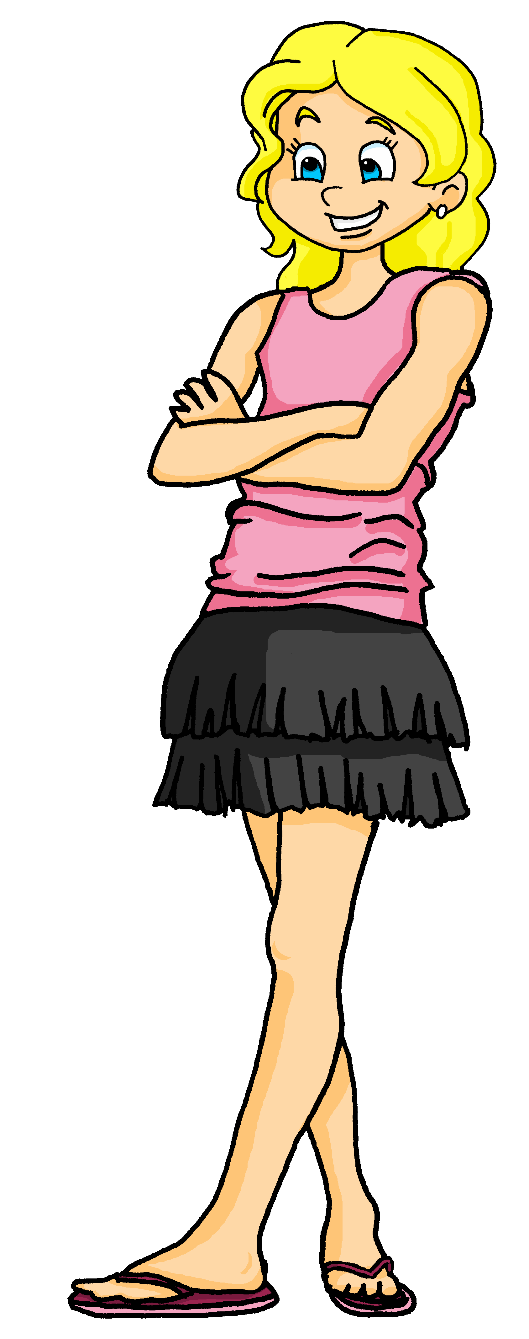
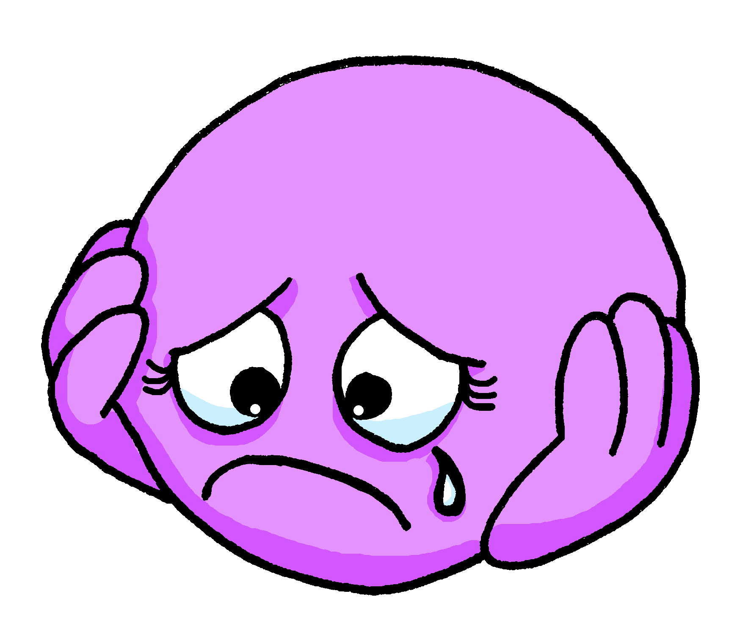
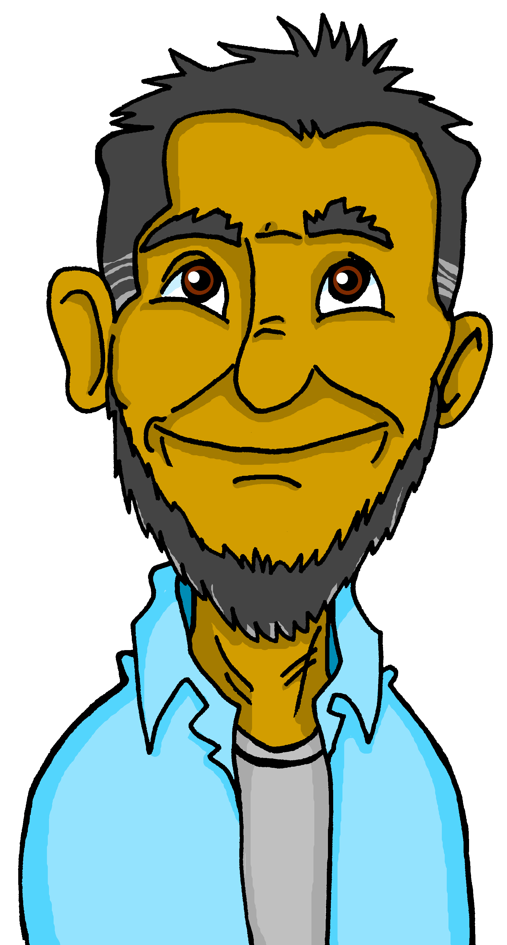
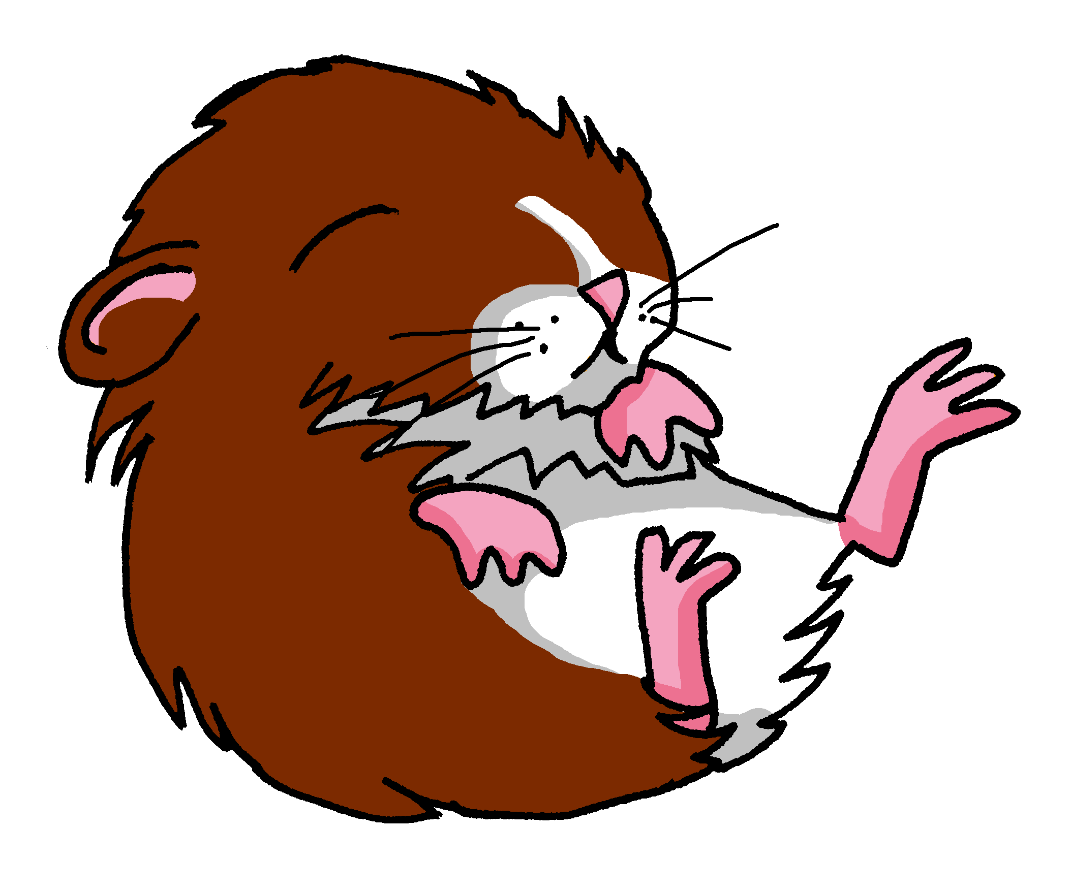
écouter
.
Écoute.
What is Adèle saying about these things?
Write 1 – 8 and the correct end of the sentence.
1
C’est…
[sad]
[person]
1
[funny]
2
C’est…
2
C’est…
3
[curious]
3
[teacher]
C’est…
4
[small]
4
5
C’est…
5
[tall]
[animal]
6
C’est…
6
[bluel]
Notes:
Timing: 5 minutes
Aim: to detect the presence or absence of a t-liaison with c’est, and connect this with meaning.
Procedure:
Students write 1-6.
Click on a button to hear a form of ‘c’est’, followed by a beep.
Based on the presence or absence of a liaison, students decide what comes next. Remind them it is the presence or absence of a -t- sound that will give them this information – they won’t be able to tell the answer from the picture!
Click to bring up a 2nd set of audio buttons to check answers.
Click to reveal answers.
Transcript:
C’est [triste].
C’est [un jeu].
C’est [curieux].
C’est [un cahier].
C’est [grand].
C’est [un sac].
17

Slide 18
Au revoir !
rouge
Notes:
18

