Slide 1
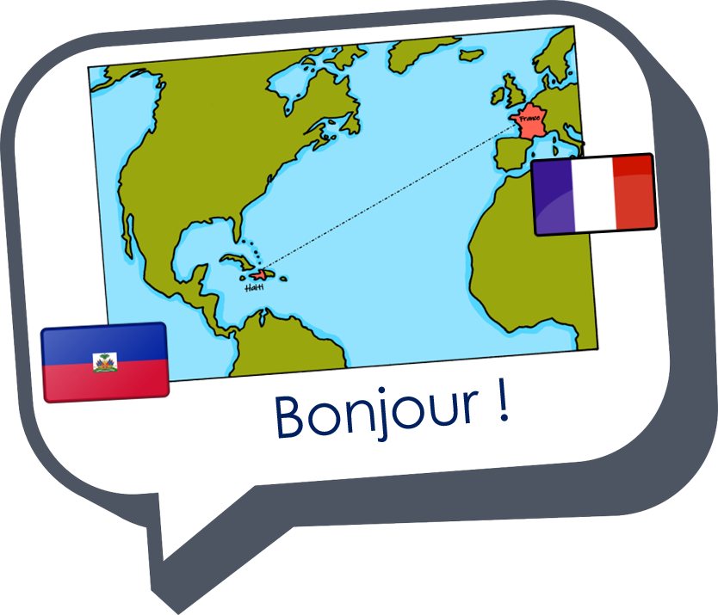
Saying what I and others have
C’est un éléphant !
rouge
Follow ups 1-5
Notes:
Artwork by Steve Clarke. Pronoun pictures from NCELP (www.ncelp.org). All additional pictures selected from Pixabay and are available under a Creative Commons license, no attribution required.
Phonics: [un] un [3] lundi [1091] jungle [4891] brun [>5000] commun [780]
[un] vs. [une]
liaison - c'est un/une
Frequency of new words:
Vocabulary: un [3] une [3] ballon [3692] bouteille [2979] cahier [4001] jeu [291] orange [3912] peluche [>5000] sac [2343] stylo [>5000] (revisit banane)
Revisit 1: malade [1066] calme [1731] intelligent [2509] amusant [4695] méchant [3184]
Londsale, D., & Le Bras, Y. (2009). A Frequency Dictionary of French: Core vocabulary for learners London: Routledge.
The frequency rankings for words that occur in this PowerPoint which have been previously introduced in these resources are given in the SOW and in the resources that first introduced and formally re-visited those words.
For any other words that occur incidentally in this PowerPoint, frequency rankings will be provided in the notes field wherever possible.

Slide 2
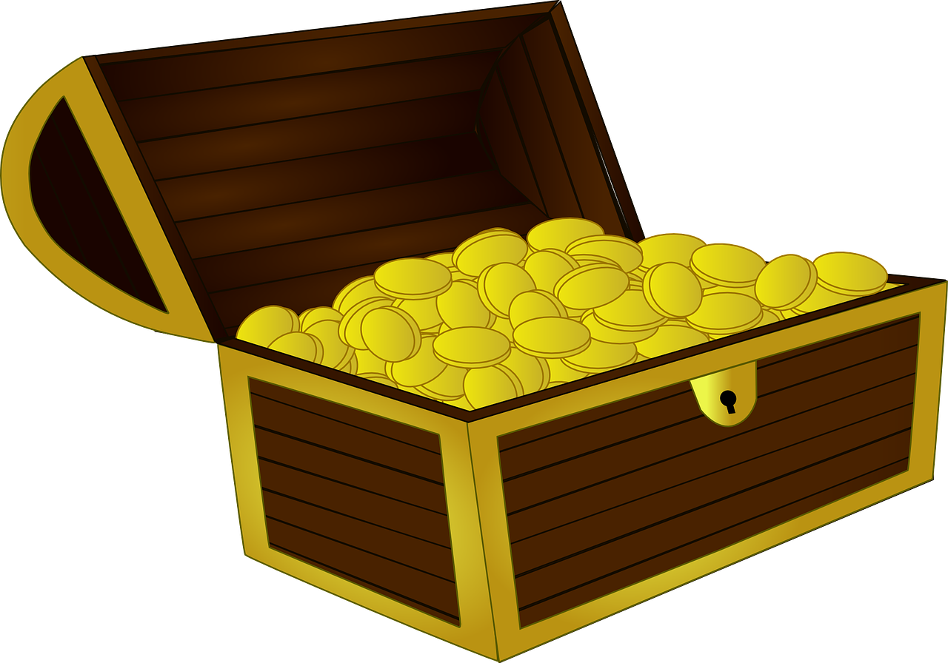
Follow up 1: Prononce les mots.
[un]
[une]
prononcer
60
lune
fortune
brun
unique
S
chacun
quelqu’un
lunette
parfum
0
Note: [um] sounds the same as [un]
DÉBUT
Notes:
Timing: 5 minutes
Aim: to practise applying knowledge of SSC [un] and [une] to unknown words.
Procedure: 1. Start the timer. Pupil A tries to read aloud all of the words differentiating between [un] and [une], within the 60 seconds allowed.
2. Pupil B listens. If Pupil A [un] instead of [une] or vice versa by mistake, Pupil B can direct him/her to start again from the beginning. 3. They swap roles and repeat the task.
Note: ensure pupils know they don’t need to rush. They have 10 seconds per word. If preferred, remove the timer altogether.

Slide 3
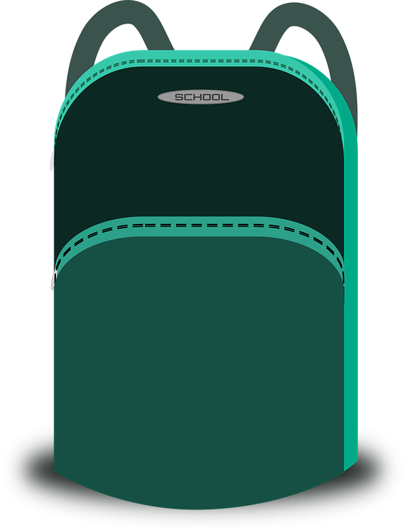
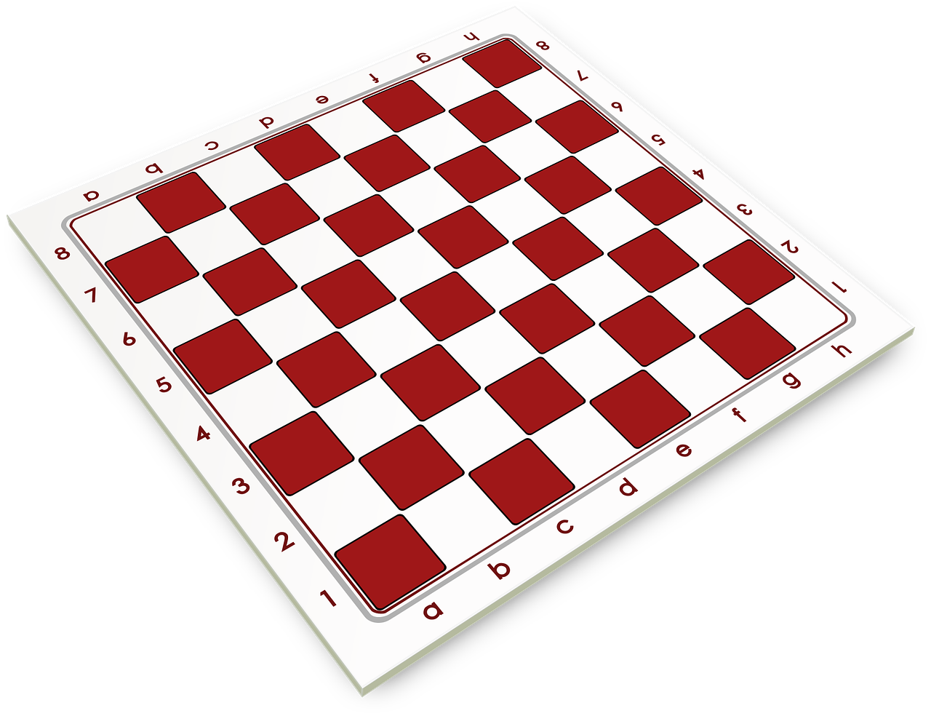
Follow up 2:
C’est un ou une ?
mots
vocabulaire
[un]
[une]
___ bouteille [a bottle]
___ cahier [an exercise book]
___ peluche [a cuddly toy]
___ orange [an orange]
___ ballon [a ball]
___ jeu [a game]
___ stylo [a pen]
___ sac [a bag]
Notes:
Timing: 5 minutes
Aim: to practise aural production of and distinction between un and une; to have a further opportunity to encounter the new vocabulary for this week in sound and writing, and with English meanings.
Procedure:
Click for each word to appear with audio (without article).
Pupils say ‘un’ or ‘une’, depending on the noun ending.
Click again for it to disappear into the corresponding pacperson’s mouth.

Slide 4
Follow up 3:
Parle avec un/une partenaire.
If you don’t hear –t say the option that starts with a consonant.
If you hear –t say the option that starts with a vowel.
Exemple :
Don’t pronounce the –t!
Pronounce the –t when it’s in bold!
parler
un stylo.
grand.
C’est…
C’est…
Complete the sentence in English.
1 | C’est… (It is …………………).
2 | C’est… (It is …………………).
1 | un stylo | mardi
2 | grand | amusant
a pen
tall
Complete the sentence in English.
Notes:
Timing: 5 minutes
Aim: to practise oral production of t-liaison (or silent final consonant –t) with c’est before vowels and consonants.
Procedure: 1. Model the task using the example. Click to demonstrate each state.
2. Give out the handouts (at the end of this PPT). 2. Pupil As start by saying either C’est with SFC or C’est + t-liaison.
3. Pupil Bs listen and finish their partner’s sentence correctly.
4. Pupil As complete the English sentence meanings appropriately.
5. Pupils swap roles.

Slide 5
Follow up 4:

Écris des réponses.
C’est une banane ?
C’est une orange ?
écrire
1 _____________________________
4 _____________________________
Non, c’est une orange.
Non, c’est un ballon.
C’est un jeu ?
C’est mardi ?
2 _____________________________
5 _____________________________
Non, c’est un stylo.
Non, c’est vendredi.
FRI
C’est une peluche ?
C’est un cahier ?
3 _____________________________
6 _____________________________
Non, c’est un sac.
Oui, c’est un cahier.
Notes:
Timing: 10 minutes (or 5 minutes for 3 sentences)
Aim: to practise written production of this week’s new language.
Procedure:
1. Tell pupils they need to answer the yes/no questions in full sentences in French, and according to the pictures. 2. Elicit the meaning of the first question: Is it a banana? 3. Ensure pupils are clear how to answer: No, it’s an orange. 4. Elicit the French for ‘no’, ‘it is’, ‘an orange’. 5. Given pupils a minute to write their sentence. 6. Reveal the answer. 7. Continue for items 2 – 6.

Slide 6
vocabulaire
Follow up 5 - Écris en anglais : Can you get at least 15 points?
mots
 | malade | calme | intelligente
 | méchant | amusante | méchante
 | oui | une banane | intelligent
 | non | amusant | un ballon
 | une bouteille | une orange | un jeu
 | un sac | un | une
 | un stylo | une peluche | un cahier
ill, sick
calm
intelligent (f)
x3
naughty (m)
amusing (f)
naughty (f)
yes
a banana (f)
intelligent (m)
x2
no
amusing
a ball (m)
a bottle (f)
an orange (f)
a game (m)
a bag (m)
a/an (m)
a/an (f)
x1
a pen (m)
a cuddly toy (f)
an exercise book (m)
Notes:
Timing: 5 minutes
Aim: to practise written comprehension of vocabulary from this week and previous weeks.
Procedure: 1. Give pupils a blank grid. They fill in the English meanings of any of the words they know, trying to reach 15 points in total. 2. Remind pupils that adjectives can refer to male or female persons and they should note this in their translations. E.g. pleased (f), short (m).
Note: The most recently learnt and practised words are pink, words from the previous week are green and those from week 1 are blue, thus more points are awarded for them, to recognise that memories fade and more effort (heavy lifting!) is needed to retrieve them.
6

Slide 7
Follow up 3: Handout A
Now your turn to listen to your partner. Do you hear –t? If so, choose and say the sentence ending which starts with a vowel.
Start each sentence. Pronounce the –t when it’s bold, otherwise for a Silent Final Consonant.
parler
1 | C’est… (It is …………………).
2 | C’est… (It is …………………).
3 | C’est… (It is …………………).
4 | C’est… (It is …………………).
5 | C’est… (It is …………………).
6 | C’est… (It is …………………).
1 | …lundi. | …une peluche.
2 | …un ballon. | curieux.
3 | …une orange. | …triste.
4 | …mercredi. | …un jeu.
5 | …vendredi. | …un stylo.
6 | …grand. | …une bouteille.
Notes:
HANDOUT

Slide 8
Follow up 3: Handout B
Now you start each sentence. Pronounce the –t when it’s bold, otherwise for a Silent Final Consonant.
Listen to your partner. Do you hear –t? If so, choose and say the sentence ending which starts with a vowel.
parler
1 | …un sac. | …dimanche.
2 | …sérieux. | aujourd’hui.
3 | …calme. | …un cahier.
4 | …une peluche. | …samedi.
5 | …une semaine. | …dangereux.
6 | …amusant. | …petit.
1 | C’est… (It is …………………).
2 | C’est… (It is …………………).
3 | C’est… (It is …………………).
4 | C’est… (It is …………………).
5 | C’est… (It is …………………).
6 | C’est… (It is …………………).
Notes:
HANDOUT

Slide 9
vocabulaire
Écris en anglais : Can you get at least 15 points?
mots
 | malade | calme | intelligente
 | méchant | amusante | méchante
 | oui | une banane | intelligent
 | non | amusant | un ballon
 | une bouteille | une orange | un jeu
 | un sac | un | une
 | un stylo | une peluche | un cahier
x3
x2
x1
Notes:
FOLLOW UP 5 HANDOUT
9

