Slide 1
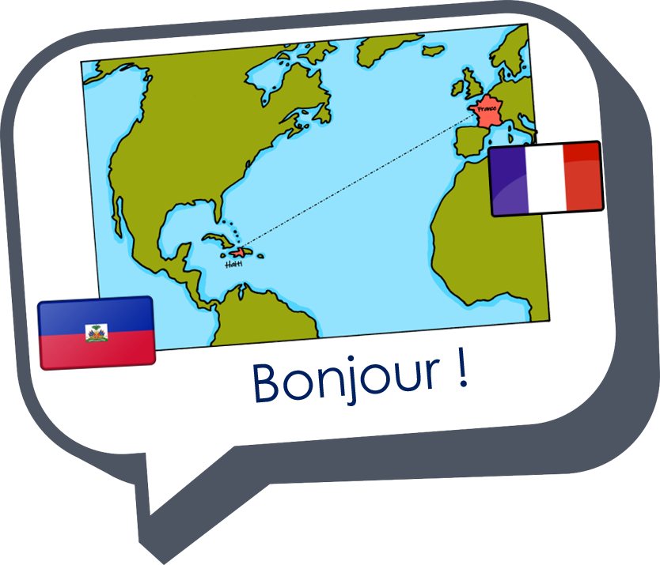
Describing me and others
rouge
SSC [eu]
C’est (it is, it’s)
Days of the week
Notes:
Artwork by Steve Clarke. Pronoun pictures from NCELP (www.ncelp.org). All additional pictures selected from Pixabay and are available under a Creative Commons license, no
attribution required.
The AUDIO version of the lesson material includes additional audio for the new language presented (phonics, vocabulary) and audio for the instructions
on the slide.
In addition, it includes VIDEO clips of the phonics and the phonics’ source words. Pupils can be encouraged to look at the shape of the mouth/lips on
slides where these appear, and try to copy it/them.
Phonics: [eu] and [SFC] with words ending in -x
Frequency of new words:
Phonics: deux [41] un (petit) peu [91] un jeu [291]
Vocabulary: ce (c') [12] lundi [1091] mardi [1044] mercredi [1168] jeudi [1112] vendredi [1086] samedi [1356] dimanche [1235] aujourd’hui [233]
Londsale, D., & Le Bras, Y. (2009). A Frequency Dictionary of French: Core vocabulary for learners London: Routledge.
The frequency rankings for words that occur in this PowerPoint which have been previously introduced in these resources are given in the SOW and in the resources that first
introduced and formally re-visited those words.
For any other words that occur incidentally in this PowerPoint, frequency rankings will be provided in the notes field wherever possible.
1

Slide 2
[eu]
deux
prononcer
Notes:
Timing: 1 minute
Aim: To introduce SSC [eu]
Procedure:
Introduce and elicit the pronunciation of the individual SSC [eu].
Click to bring up the source word ‘deux’ (with gesture, if using).
Say the word and bring up the reminder that the final –t is silent.
Pupils to practise saying the word several times.
Note:
a gesture for ‘deux’ might be to do the British Sign Language gesture for two: https://www.signbsl.com/sign/two Note: if teachers want to avoid a backwards ‘v’ they could instead use the front-facing peace ‘v’ symbol.

Slide 3
[SFC]
prononcer
Silent final consonant
deux
Notes:
Timing: 1 minute
Aim: to revisit [SFC], this time with a new consonant ‘x’. Pupils have now encountered SFC with –t, -s, -d and now –x.
Procedure:
Repeat the source word ‘deux’ with gesture, if using.
Bring your fingers to your lips to signal [SFC].
Elicit from students the other SFCs they remember, with examples of words. E.g. petit, mais, grand.
3

Slide 4
[eu]
prononcer
un (petit) peu
[a little bit]
Notes:
Timing: 2 minutes (three slides)
Aim: to introduce two cluster words with the SSC [eu] for further practice.
Procedure:
Repeat the SSC [eu].
Click to bring up the cluster word/phrase ‘un petit peu’ (with gesture, if using).
Click to bring up the English translation.
Pupils to practise saying the phrase several times.
Note:
a gesture for ‘un petit peu’ might be to mimic the gesture from the picture.
pupils have already learnt ‘petit’ and in week 8 they will learn ‘un/une’ meaning ‘a’.

Slide 5
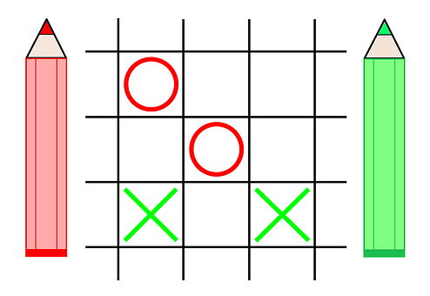
[eu]
prononcer
un jeu
[a game]
Notes:
Procedure:
Repeat the SSC [eu].
Click to bring up the cluster word ‘un jeu’ (with gesture, if using).
Click to bring up the English translation.
Pupils to practise saying the phrase several times.
Note:
a gesture for ‘un jeu’ might be to use the BSL for ‘game’, as shown here: https://www.youtube.com/watch?v=5Hg3s6pxusM
alternatively, agree a suitable gesture with the class.

Slide 6
vocabulaire
Écoute et répète.
mots
Ce means it. Ce est (it is) becomes c’est to make it easier to say.
aujourd’hui
ce
today
it
Notes:
Timing: 4 minutes (four slides)
Aim: to present and practise new vocabulary for this week.
Procedure:
Click to bring up the word. Say the word.
Click for the English meaning. Say the French word again. Pupils repeat.
Repeat steps 1 and 2 for the 2nd word.
Click to bring up the callout.
6

Slide 7
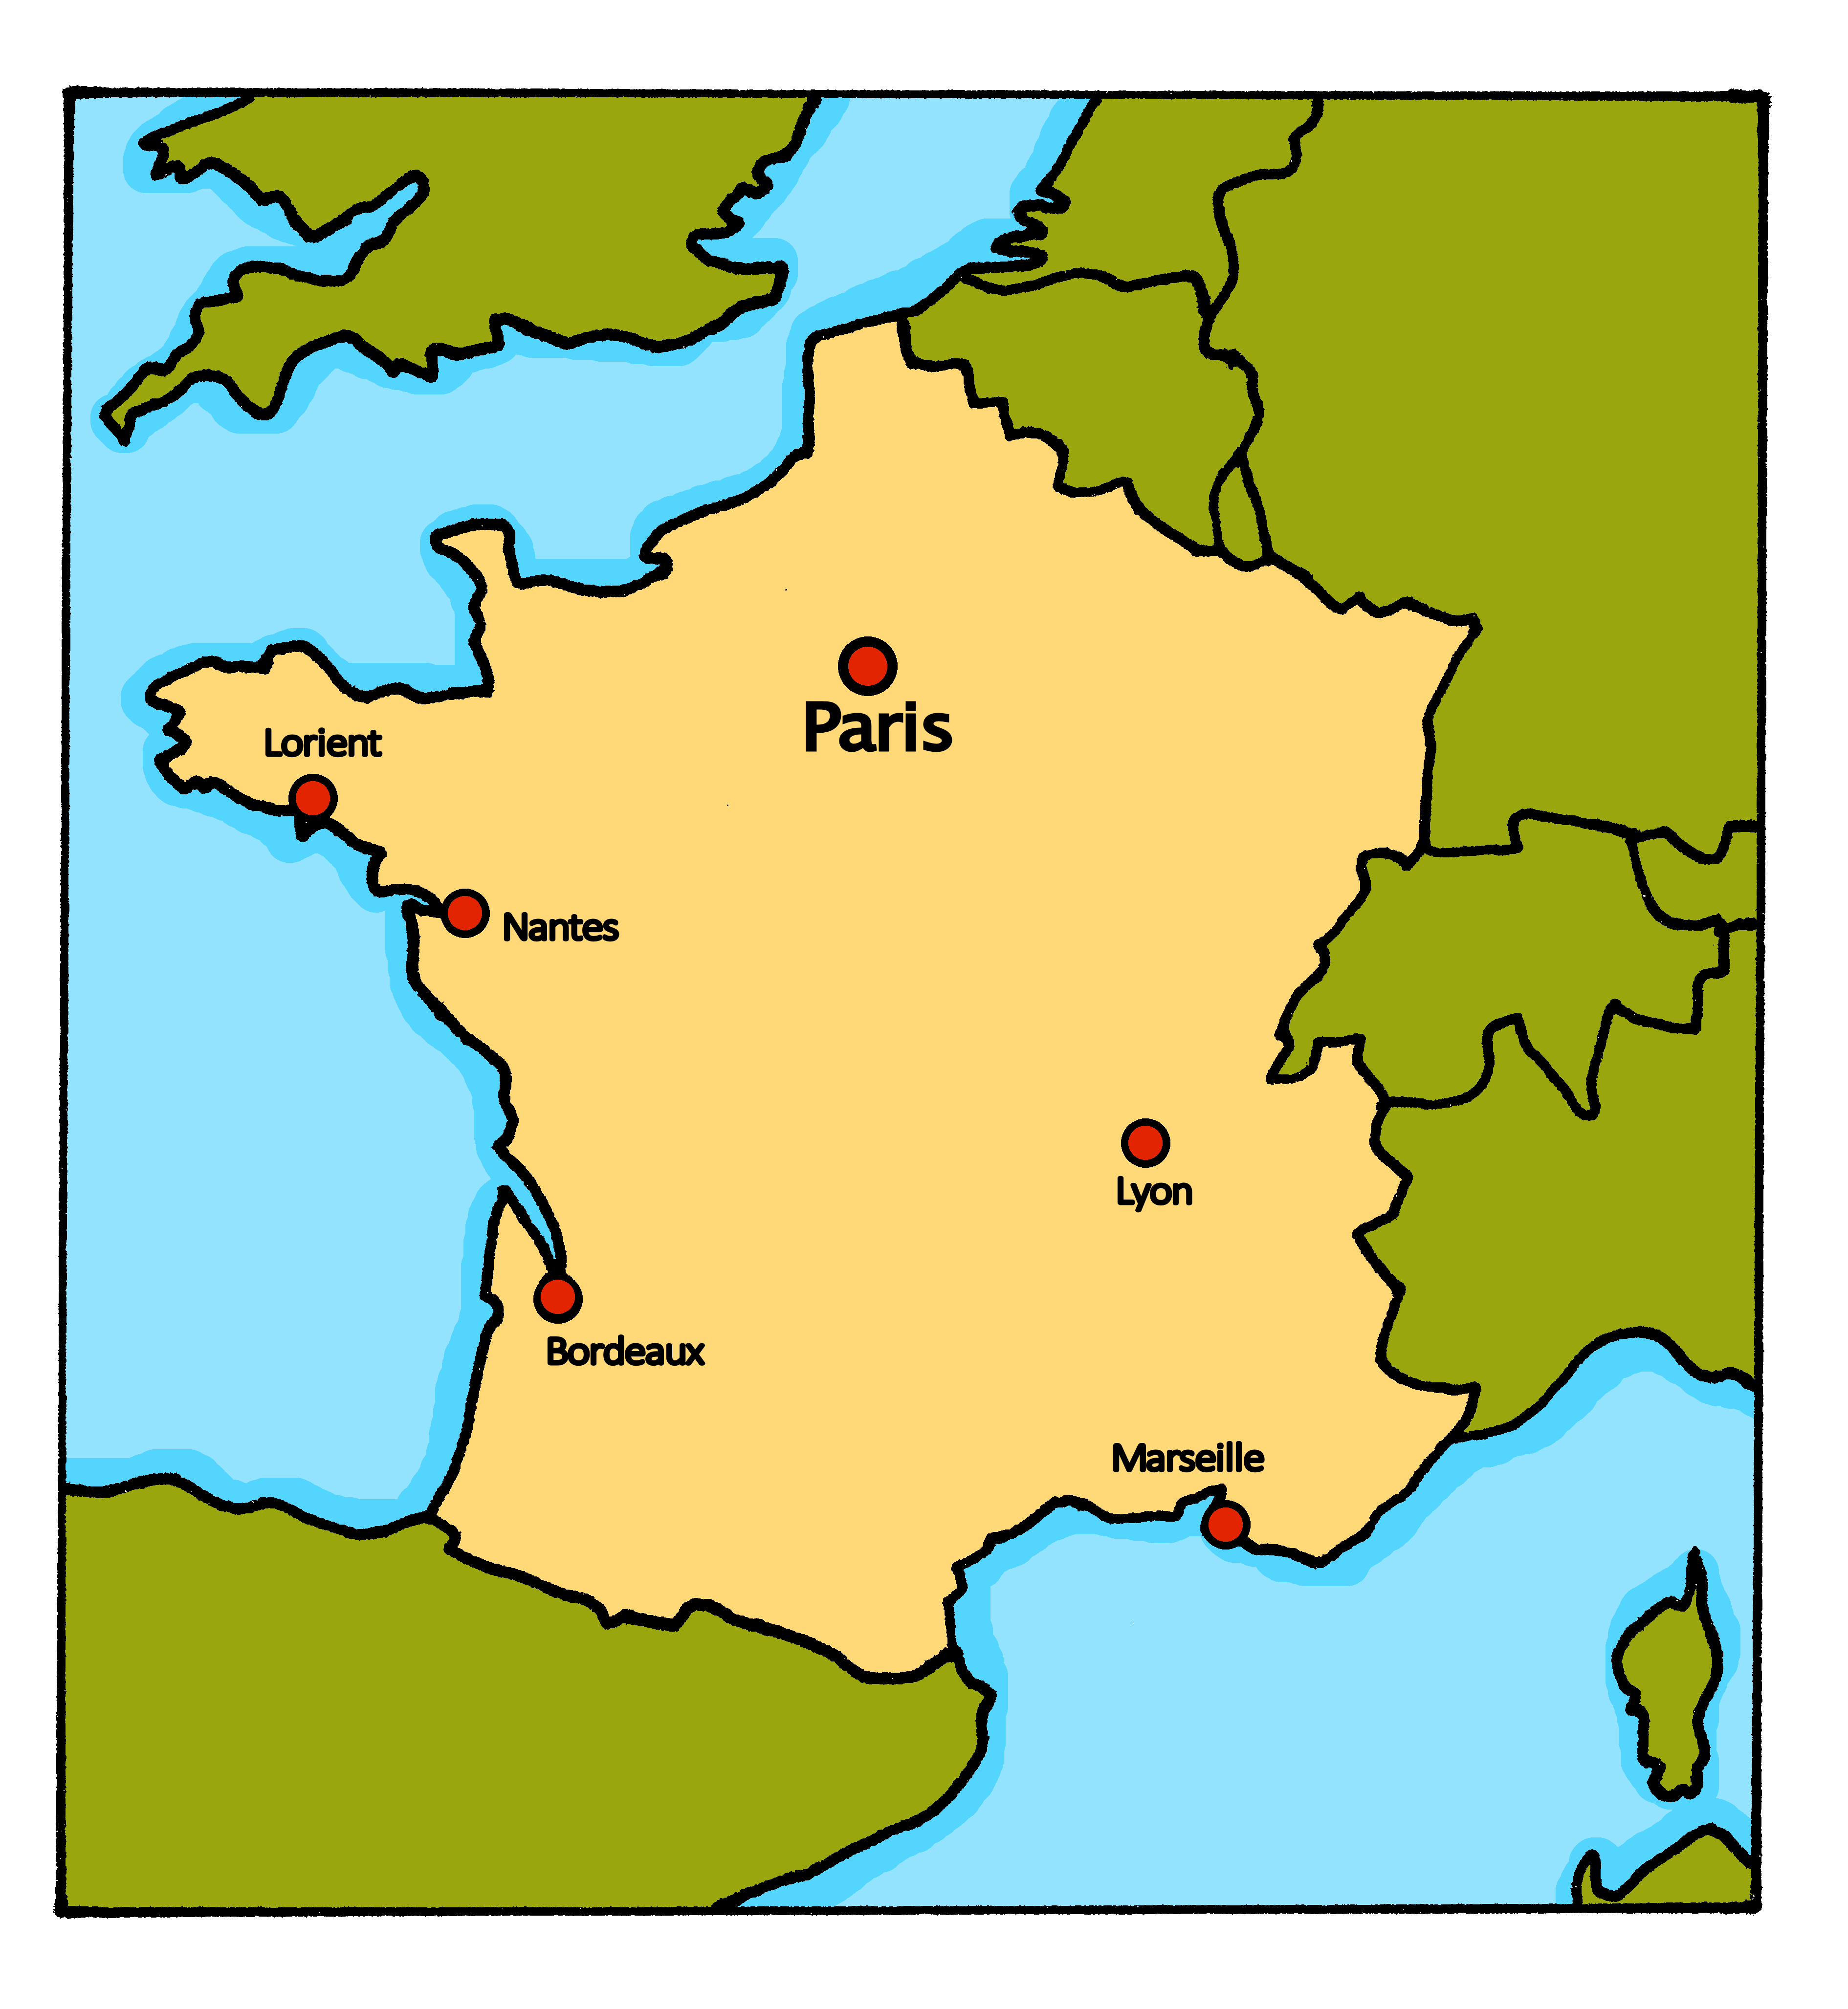
vocabulaire
Écoute et répète.
mots
Aujourd’hui, c’est lundi.
In France, the first day of the week is Monday (lundi) and the last day of the week is Sunday (dimanche).
lundi
Monday
Notes:
Procedure:
Click to bring up the word. Say the word.
Click for the English meaning. Say the French word again. Pupils repeat.
Click to bring up the callout.
Click to bring up the map of France, Adèle and the phrase ‘Aujourdhui, c’est lundi’.
Elicit the English meaning of the French phrase.
7

Slide 8
vocabulaire
Écoute et répète.
mots
Aujourd’hui, c’est mardi.
mardi
Tuesday
Notes:
Procedure:
Click to bring up the word. Say the word.
Click for the English meaning. Say the French word again. Pupils repeat.
3. Click to bring up the map of France, Adèle and the phrase ‘Aujourdhui, c’est mardi’.
4. Elicit the English meaning of the French phrase.
5. Continue with the next slide.
8

Slide 9
vocabulaire
Écoute et répète.
mots
Aujourd’hui, c’est mercredi.
Careful with spelling mercredi! The ‘c’ is in an ‘r’ sandwich. m – e – r – c – r – e – d - i
mercredi
Wednesday
Notes:
Procedure:
Click to bring up the word. Say the word.
Click for the English meaning. Say the French word again. Pupils repeat.
Click to bring up the callout.
4. Click to bring up the map of France, Adèle and the phrase ‘Aujourdhui, c’est mercredi’.
5. Elicit the English meaning of the French phrase.
6. Continue with the next slide.
9

Slide 10
lire
Complète la phrase.
C’est…
lundi.
lundi
mardi.
mercredi.
Notes:
Timing: 2 minutes (four slides)
Aim: to practise written comprehension and read aloud of the new vocabulary so far.
Procedure:
Teacher initiates the phrase C’est…
Pupils respond orally with the correct word, using the partially obscured day as their clue.
Teacher clicks to confirm the answer, and elicits English meaning.
Repeat for the next slides.
10

Slide 11
lire
Complète la phrase.
C’est…
mercredi.
aujourd’hui
mardi.
aujourd’hui.
Notes:
[2/4]
11

Slide 12
lire
Complète la phrase.
C’est…
aujourd’hui.
mercredi
mercredi.
mardi.
Notes:
[3/4]
12

Slide 13
lire
Complète la phrase.
C’est…
lundi.
mardi
mardi.
mercredi.
Notes:
[4/4]
13

Slide 14
vocabulaire
Complète la phrase.
mots
The [eu] in jeudi is the same sound as in deux, un petit peu, un jeu.
jeudi
Thursday
Notes:
Timing: 4 minutes (three slides)
Aim: to present and practise the remaining new vocabulary for this week.
Procedure:
Click to bring up the word. Say the word.
Click for the English meaning. Say the French word again. Pupils repeat.
3. Click to bring up the callout.
4. Continue with the next slide.
14

Slide 15
vocabulaire
Complète la phrase.
mots
In French the days of the week are only capitalised at the start of a sentence.
vendredi
samedi
Friday
Saturday
Notes:
Aim: to present and practise the remaining new vocabulary for this week.
Procedure:
Click to bring up the word. Say the word.
Click for the English meaning. Say the French word again. Pupils repeat.
3. Repeat steps 1 and 2 with the 2nd word.
4. Continue with the next slide.
15

Slide 16
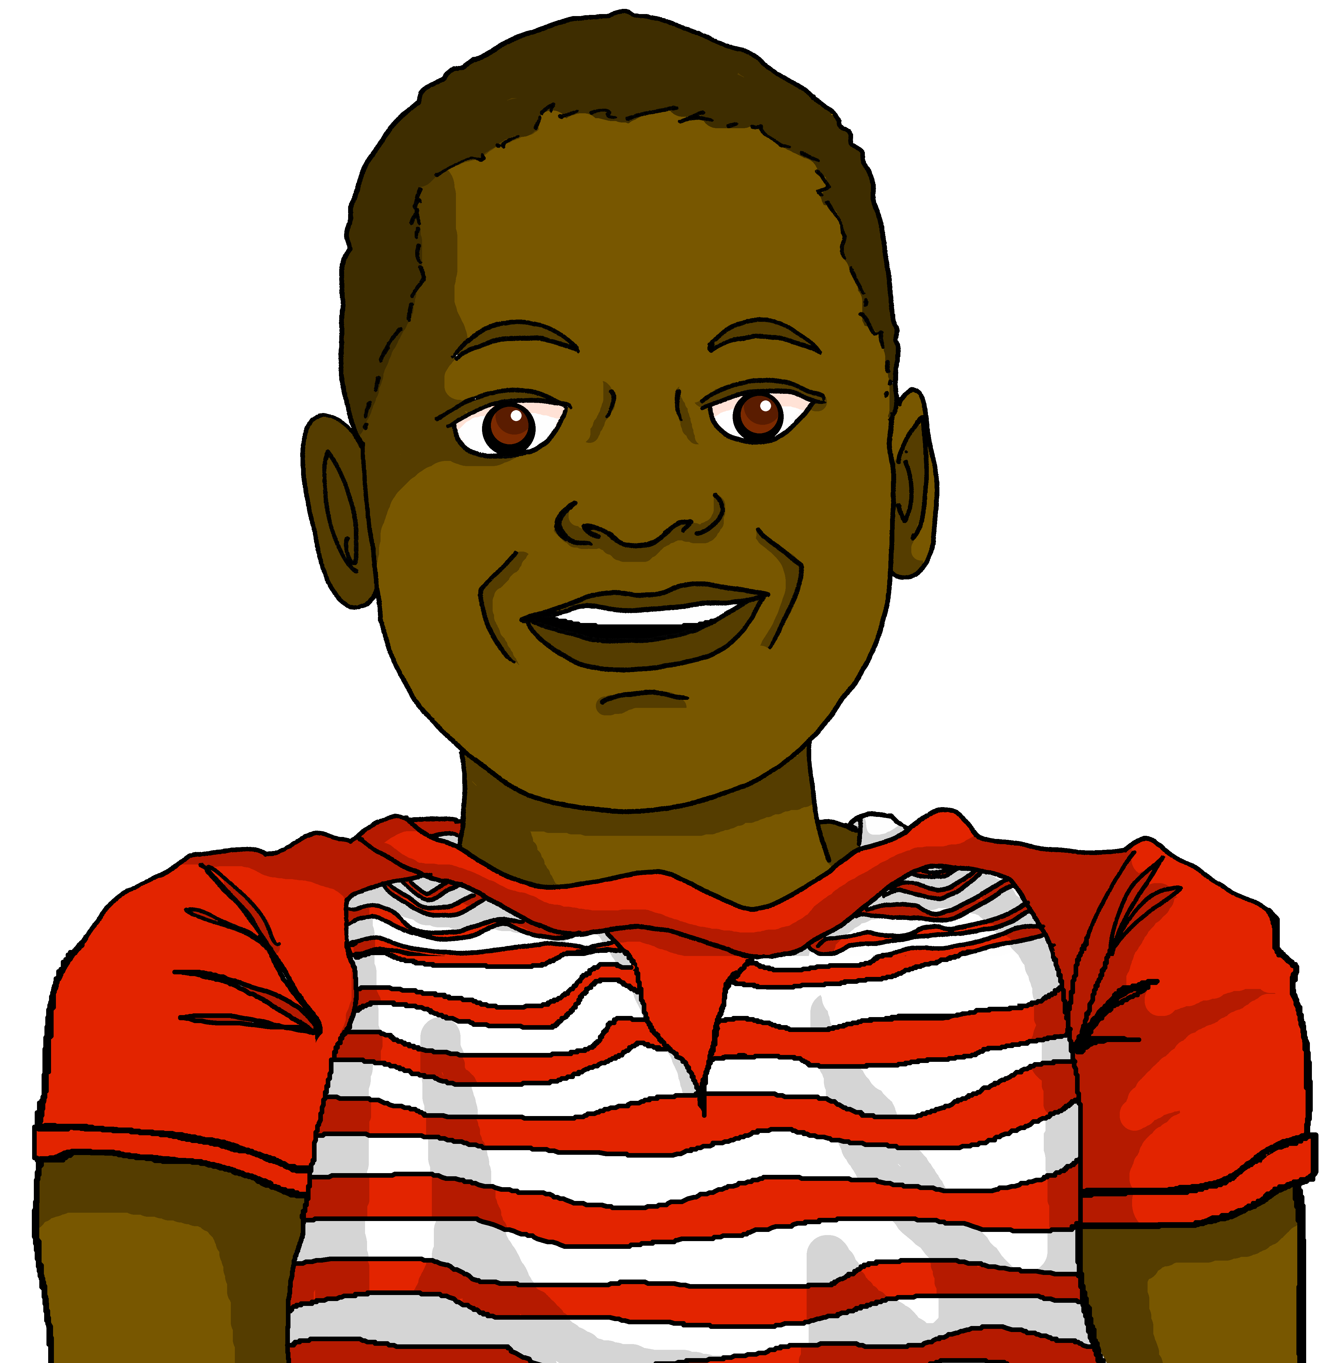
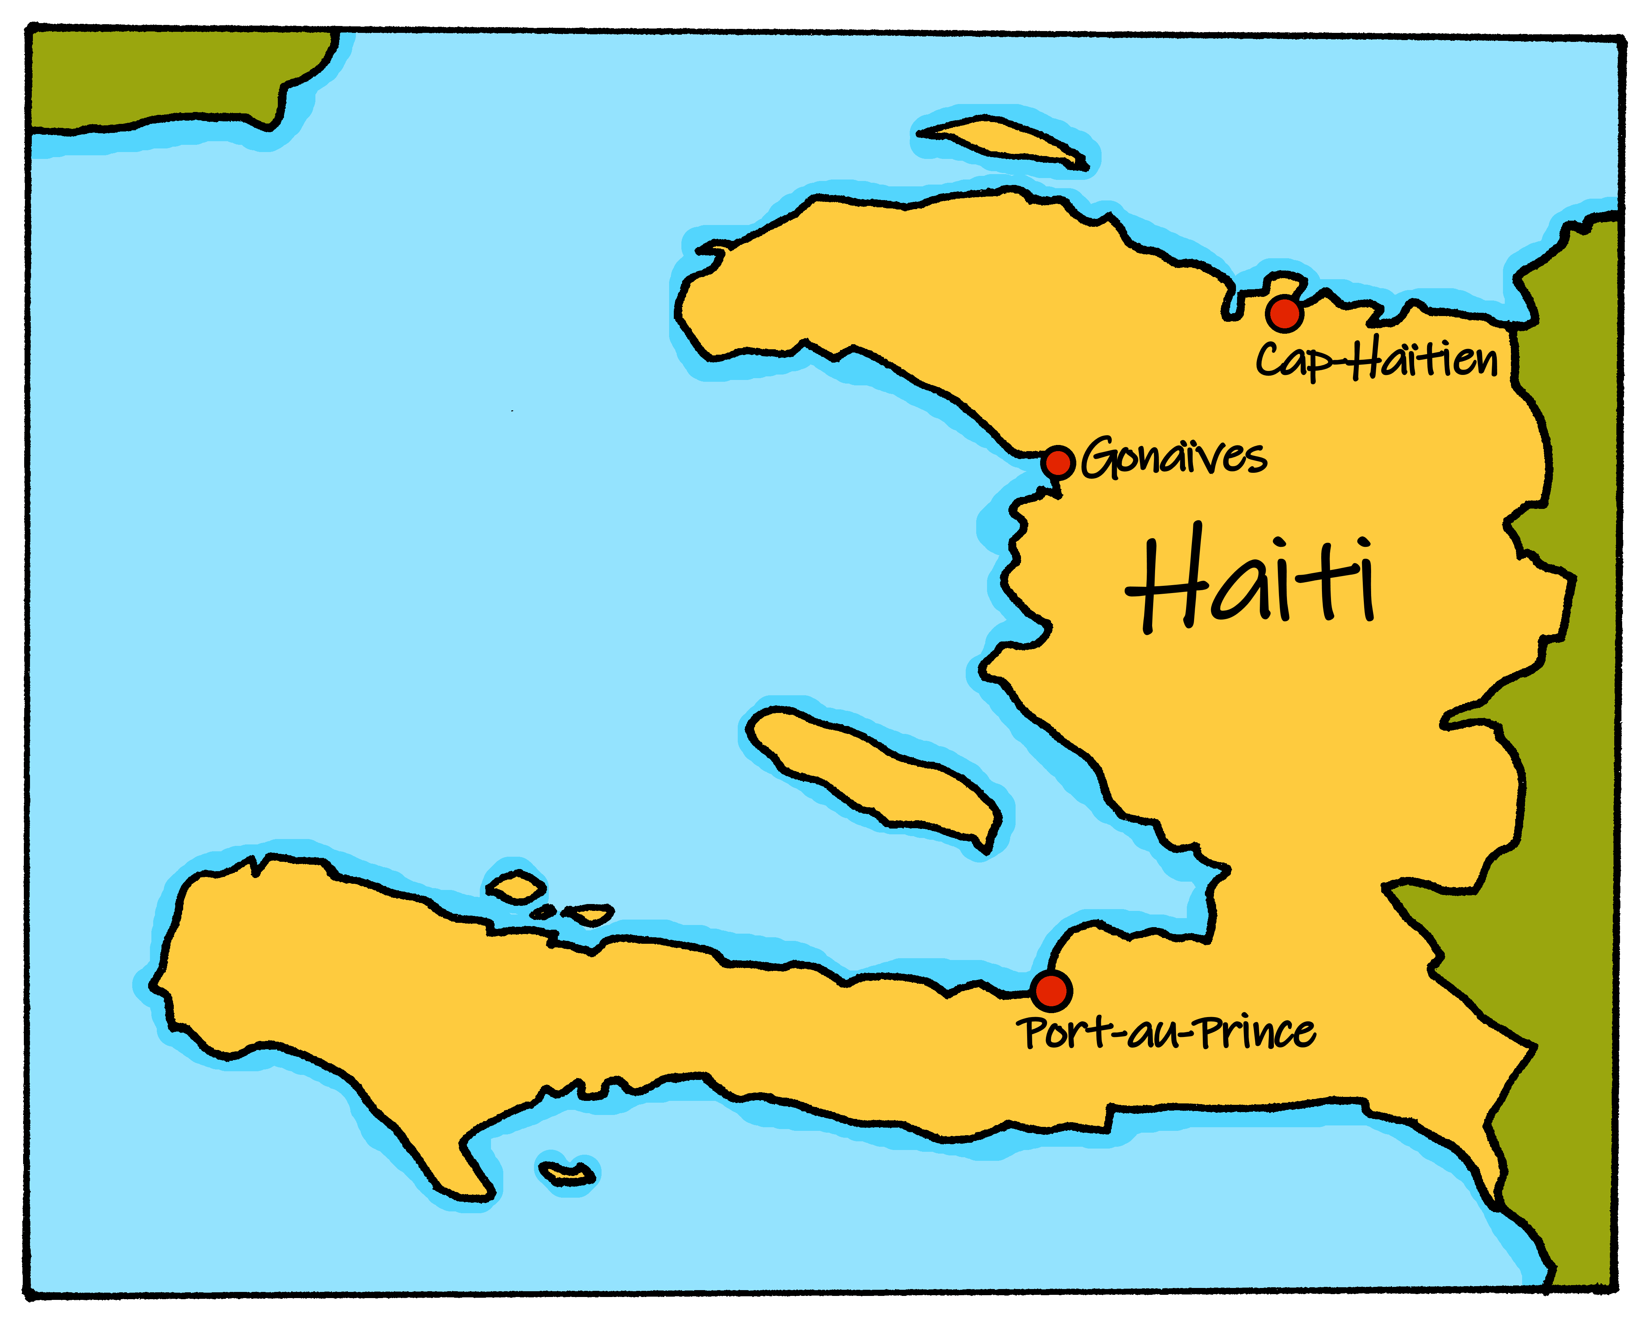
vocabulaire
Écoute et répète.
mots
Aujourd’hui c’est dimanche.
In Haϊti, the first day of the week is Sunday (dimanche) and the last day of the week is Saturday (samedi).
dimanche
Sunday
Notes:
Procedure:
Click to bring up the word. Say the word.
Click for the English meaning. Say the French word again. Pupils repeat.
Click to bring up the callout.
4. Click to bring up the map of Haϊti, Jean-Michel and the phrase ‘Aujourdhui, c’est dimanche’.
5. Elicit the English meaning of the French phrase.
16

Slide 17
lire
Complète la phrase.
C’est…
mardi.
lundi.
vendredi.
Friday
mercredi.
Notes:
Timing: 2 minutes (four slides)
Aim: to practise written comprehension and read aloud of this week’s new vocabulary.
Procedure:
Teacher initiates the phrase C’est…
Pupils respond orally with the correct word, using the English word as their prompt.
Teacher clicks to confirm the answer..
Repeat for the next slides.
17

Slide 18
lire
Complète la phrase.
C’est…
samedi.
dimanche.
vendredi.
Sunday
jeudi.
Notes:
[2/4]
18

Slide 19
lire
Complète la phrase.
C’est…
jeudi.
vendredi.
dimanche.
Thursday
lundi.
Notes:
[3/4]
19

Slide 20
lire
Complète la phrase.
C’est…
dimanche.
jeudi.
vendredi.
Saturday
samedi.
Notes:
[4/4]
20

Slide 21
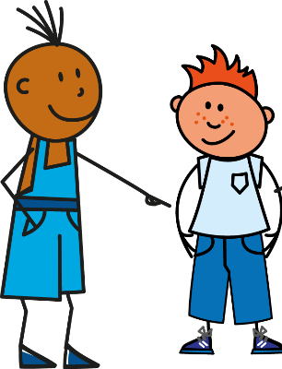
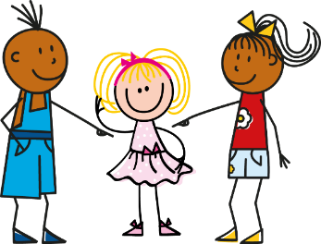
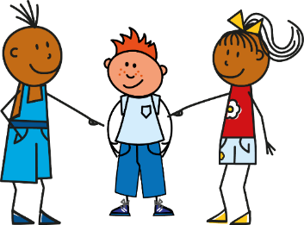
être
[to be | being]
Remember, the verb être means ‘to be’.
You already know the parts I am, you are and he/she is:
Je suis
Tu es
Il est
Elle est
I am
You are
He is
She is
It is is also part of the verb ‘to be’:
Remember: in French, use an extra space in front of any two-part punctuation marks!
Ce means it. Ce est becomes c’est to make it easier to say.
Remember: change a statement into a question by raising your voice at the end.
C’est
It is
C’est ici ?
Oui, c’est ici !
Non, c’est là !
Is it here?
Yes, it is here!
No, it is there!
Notes:
Timing: 2 minutes
Aim: to revisit parts of être and introduce ce|c’est.
Procedure:
Click to animate the explanation.
Elicit English translations for the French examples provided.

Slide 22
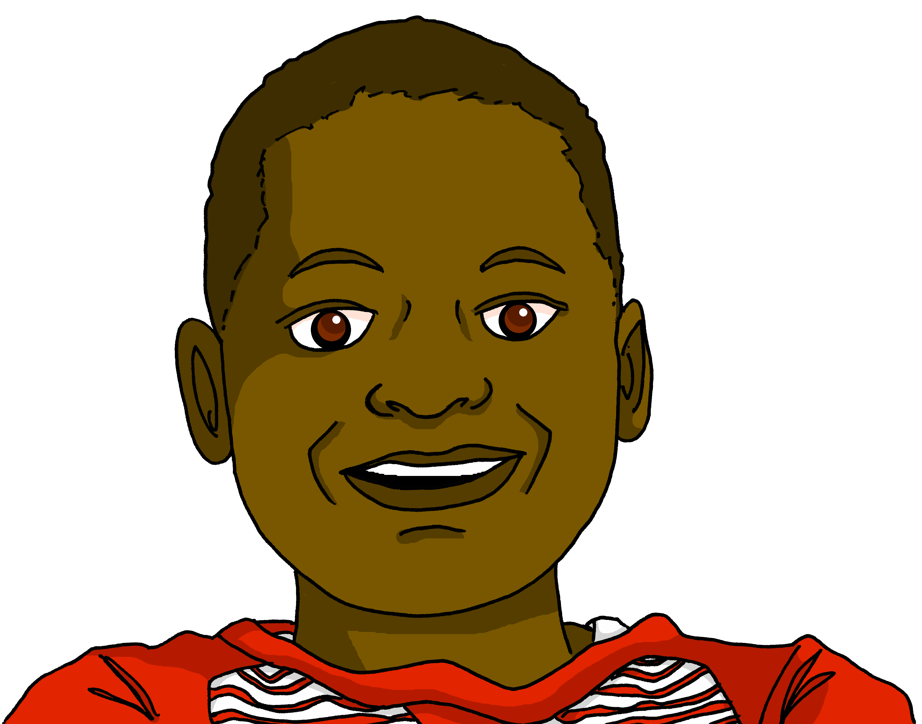
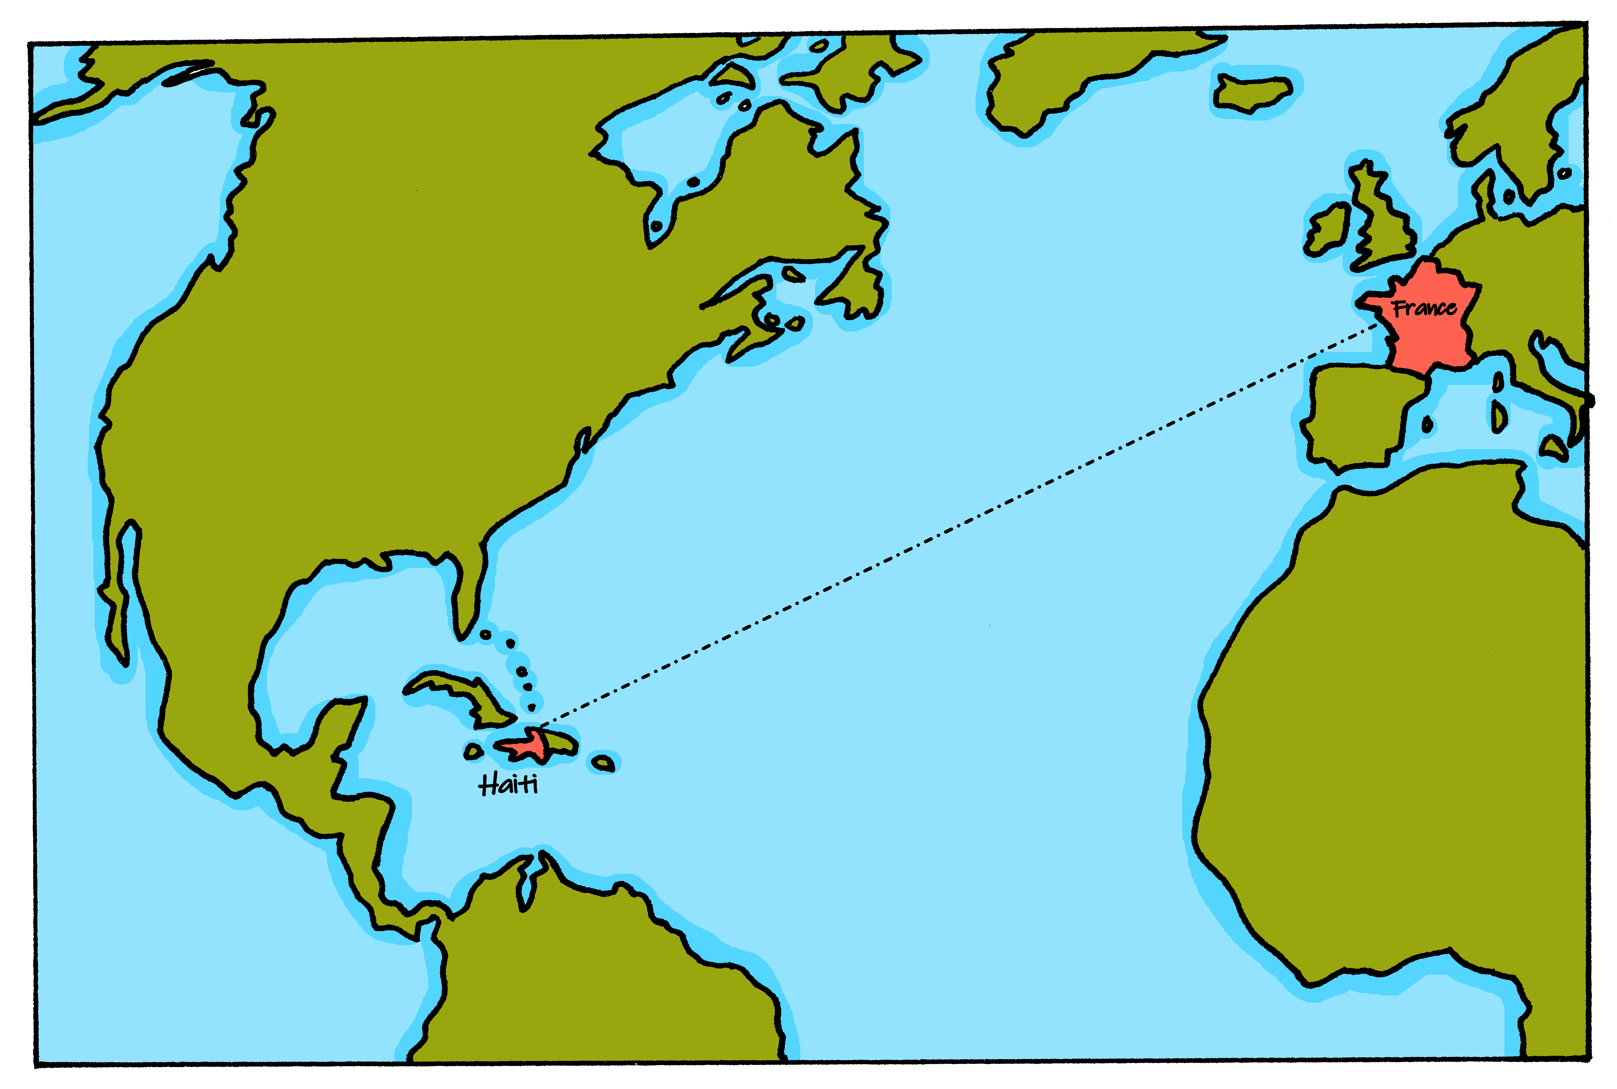
lire
Lis les messages de Pierre et Jean-Michel.
Complète en anglais.
Jean-Michel, ________ Monday?
Jean-Michel, c’est lundi ?
is it
No
_____, it’s _____________!
Non, c’est dimanche !
Sunday
There is a time difference between France and Haϊti! Pierre is confused, and Jean-Michel gets cross.
Wednesday
Jean-Michel, ____ ___________?
Jean-Michel, c’est mercredi ?
is it
Today
No! __________ _______ Tuesday!
Non ! Aujourd’hui, c’est mardi !
it’s
is it
Friday
Jean-Michel, c’est vendredi ?
Jean-Michel, ________ __________?
Thursday
No! _______ it’s _____________!
Non ! Ici, c’est jeudi !
Here
Jean-Michel, c’est samedi ?
is it
Saturday
Jean-Michel, ________ ________?
Yes
it’s
Oui ! C’est samedi, à midi ! C’est le weekend. Hourra !
_____! ____ Saturday, at midday! _______ the weekend. Hurrah!
It’s
Notes:
Timing: 6 minutes
Aim: to practise written understanding of questions and statements with c’est, and days of the week.
Procedure:
Read the task context with pupils.
Click the action button to listen to and read the full dialogue in French. Alternatively, teachers can click each speech bubble to hear each line separately.
Pupils read the conversation again. They can do this in pairs, aloud.
Click to bring up the gapped English dialogue.
Pupils complete the gapped translation in English.
Click for answers.
22

Slide 23
lire
Culture : France et Haϊti
Pierre messages Jean-Michel at 5:30 Monday morning. For Jean-Michel it is Sunday night because Haϊti is six hours behind France. What time exactly is it for Jean-Michel?
Notes:
Timing: 2 minutes
Aim: to learn about the time difference between France and Haϊti.
Procedure:
Read the information with pupils.
Allow them time to work out the exact time in Haϊti when it is 5:30am in France.
Click for answer.
23

Slide 24
prononciation
lundi
Notes:
Timing: 4 minutes (seven slides)
Aim: to practise reading aloud the days of the week once again, cuing pupils with hand gestures to represent the number of each day.
Procedure:
Use hand gesture and (1-7 for days of the week) in combination with oral production of day of the week & get pupils to repeat.

Slide 25
prononciation
Did you know…? French people always show the number 2 like this.
mardi
Notes:
[2/7]

Slide 26
prononciation
And the number 3 like this, with the thumb and two fingers, not with three fingers.
mercredi
Notes:
[3/7]

Slide 27
prononciation
jeudi
Notes:
[4/7]

Slide 28
prononciation
vendredi
Notes:
[5/7]

Slide 29
prononciation
samedi
Notes:
[6/7]

Slide 30
prononciation
dimanche
Notes:
[7/7]

Slide 31
parler
Au revoir.
Notes:
Timing: 30 seconds
Aim: to recap a further item of vocabulary from week 3, this week’s revisited week.
Procedure:
Click to bring up words and images.
Ensure pupils are clear about the meaning.
Repeat with the class to bring the lesson to an end.
31

Slide 32
Au revoir !
rouge
Notes:
32

