Slide 1
Describing me and others
rouge
Follow ups 1-5
Notes:
Artwork by Steve Clarke. Pronoun pictures from NCELP (www.ncelp.org). All additional pictures selected from Pixabay and are available under a Creative Commons license, no attribution required.
Phonics: [eu] and [SFC] with words ending in -x
Frequency of new words:
Phonics: deux [41] un (petit) peu [91] un jeu [291]
Vocabulary: ce (c') [12] lundi [1091] mardi [1044] mercredi [1168] jeudi [1112] vendredi [1086] samedi [1356] dimanche [1235] aujourd’hui [233]
Londsale, D., & Le Bras, Y. (2009). A Frequency Dictionary of French: Core vocabulary for learners London: Routledge.
The frequency rankings for words that occur in this PowerPoint which have been previously introduced in these resources are given in the SOW and in the resources that first introduced and formally re-visited those words.
For any other words that occur incidentally in this PowerPoint, frequency rankings will be provided in the notes field wherever possible.

Slide 2
Follow up 1A :
[an|en]
enfant
Écoute.
[eu]
deux
écouter
Does the word have [eu] or [an/en] or both?
 | [eu] | [an|en] | en anglais
content |  |  | pleased
sérieux |  |  | serious
dangereux |  |  | dangerous
français |  |  | French
furieux |  |  | furious
mystérieux |  |  | mysterious
anxieux |  |  | anxious
Ex
1
2
3
4
5
6
Notes:
Timing: 5 minutes (two slides)
Aim: to practise aural recognition of this week’s SSC [an/en] and [eu] in a set of mostly unfamiliar words.
Procedure:
Click on each audio symbol to listen to the word.
Pupils tick if they hear [eu] [an|en]
Click for the answer ticks, the French word and then the English word (which pupils may offer suggestions for, as we include some written cognates here).
Transcript Ex. content [1] sérieux [2] dangereux [3] français [4] furieux [5] mystérieux
[6] anxieux

Slide 3
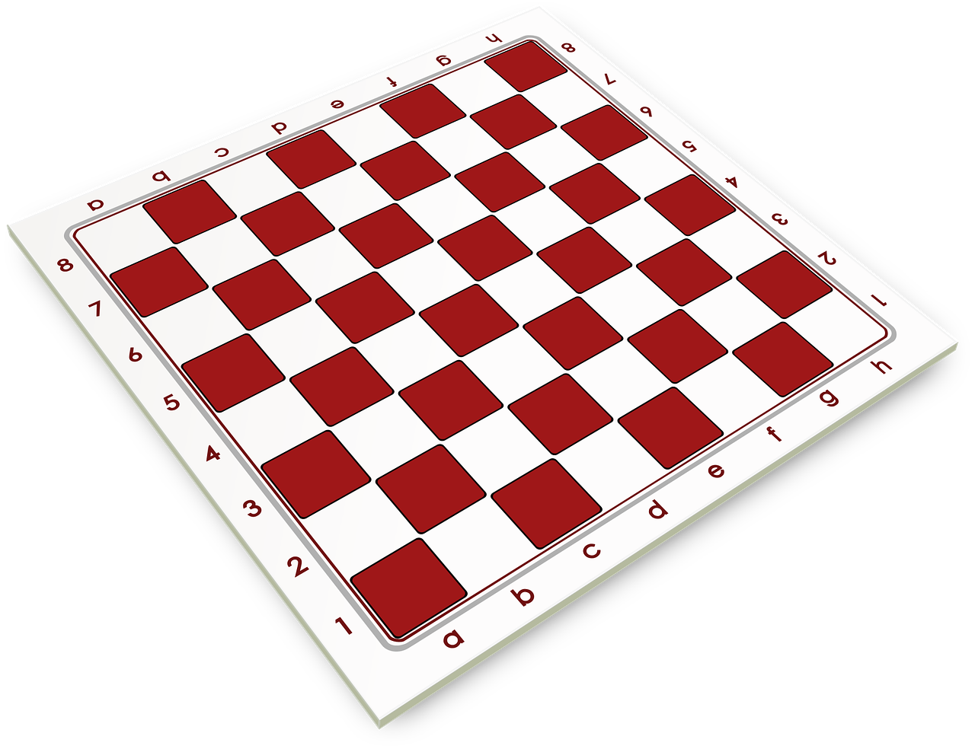
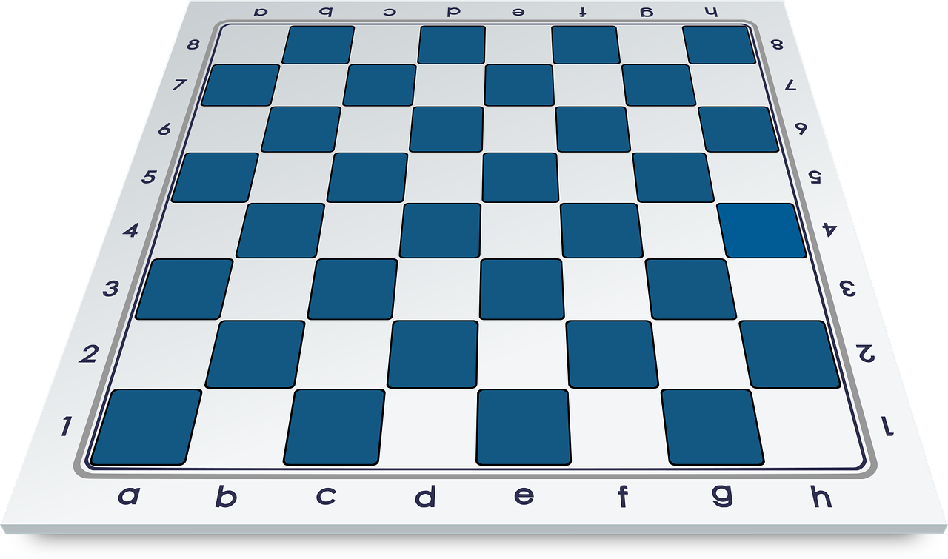
Follow up 1B :
[eu]
deux
Pratique avec ton/ta partenaire.
prononcer
Mathieu veut deux jeux bleus ; Eugénie veut un jeu rouge.
Matthieu wants two blue games; Eugénie wants a red game.
Notes:
Timing: 5 minutes
Aim: to practise oral production of SSC [eu] and [SFC].
Procedure:
Elicit pronunciation from pupils.
Click to listen and check.
Practise in pairs 2-3 more times.
Transcript Mathieu veut deux jeux bleus ; Eugénie veut un jeu rouge.

Slide 4
Follow up 2 :
B Écoute.
Use the correct words to
rewrite the sentences.
There are some extra ones!
A Écoute. C’est quel* mot ?
écouter
E
I am | he is | you are
c’
samedi
es
aujourd’hui
est
1
Monday | Tuesday | Thursday
Ex
Aujourd’hui, c’est samedi.
2
today | Friday | Thursday
c’
mardi
est
mercredi
ici
1
C’est mercredi.
3
you are | she is | it is
c’
lundi
es
aujourd’hui
est
4
Friday | Saturday | Sunday
2
Aujourd’hui, c’est lundi?
5
day | today | there
suis
contente
je
aujourd’hui
3
6
I am | you are | she is
Aujourd’hui je suis contente.
est
vendredi
c’
aujourd’hui
4
quel – which
Aujourd’hui, c’est vendredi.
Notes:
Timing: 5 minutes
Aim: to practise aural comprehension of this week’s new vocabulary and revisit adjectives from week 2-6.
Procedure:
(Part A) Click to listen. Pupils circle the correct word (if they have the sheet printed). If not, they can use numbers 1,2,3. Click for answers.
(Part B) Pupils listen to 1-5 and write the sentences, selecting from the options given (there are a few additional words that are not needed).
Click to reveal answers.
Note: alternatively, for greater challenge, in Part B pupils could write the sentences first (reading) and then listen and check their answers.
Transcript (Part A):
Exemple: Je suis
1. Aujourd’hui, c’est mardi.
2. vendredi
3. c’est
4. samedi
5. aujourd’hui
6. tu es
Transcript (Part B):
Exemple Aujourd’hui, c’est samedi. 1. C’est mercredi 2. Aujourd’hui, c’est lundi ? 3. Aujourd’hui je suis contente. 4. Aujourd’hui, c’est vendredi.

Slide 5
Follow up 3 :
Écoute. Madame Vidal parle.
Bonjour, tout le monde ! Aujourd’hui, c’est…?
C’est lundi ? Écris en anglais.
écouter
 | Tuesday | Wednesday | Monday | Thursday
 | Wednesday | Friday | Sunday | Saturday
 | Tuesday | Sunday | Wednesday | Thursday
 | Wednesday | Saturday | Monday | Friday
 | Thursday | Monday | Sunday | Tuesday
 | Sunday | Monday | Tuesday | Saturday
Ex
1
2
3
4
5
Notes:
Timing: 7 minutes
Aim: to practise aural identification of the days of the week in French.
Procedure:
1. Ensure pupils are clear about the task.
2. Click to play the example. Ask pupil to write the day of the week in English.
3. Click to reveal the answer.
4. Repeat with items 1-5.
Transcript:
Ex. Aujourd’hui, c’est mardi. 1. Aujourd’hui, c’est dimanche.
2. Aujourd’hui, c’est mercredi.
3. Aujourd’hui, c’est vendredi.
4. Aujourd’hui, c’est lundi.
5. Aujourd’hui, c’est samedi.

Slide 6
Follow up 4 : Read in the correct order.
parler
30
mardi
mercredi
samedi
S
vendredi
lundi
0
dimanche
jeudi
DÉBUT
Notes:
Timing: 2 minutes
Aim: to consolidate days of the week (in combination with hand gestures to embed meaning).
Procedure:
Read the instruction.
In pairs, ask pupils to read the days of the week in the correct order.
Click “début” to trigger 30-second timer.
Go to next slide for answers.

Slide 7
Follow up 4 : Read in the correct order.
mardi
vendredi
parler
samedi
jeudi
30
lundi
mercredi
dimanche
S
lundi
mardi
mercredi
jeudi
0
vendredi
samedi
dimanche
DÉBUT
Notes:
ANSWERS Procedure:
Click to make the days disappear in the correct order and click again to bring up the correct answer with image.
Click again to make all of the answers disappear and bring back the jumbled days.
Click “début” to trigger 30-second timer. Pupils practise one more time saying all of the days in the correct order.

Slide 8
Follow up 5:

Écris : Lotto
Write one different French word from this week into each square.
yes | Thursday
no | Friday
it | Saturday
today | Sunday
is | How’s it going?
Monday | well/good
Tuesday | badly
Wednesday | Goodbye
écrire
Notes:
Timing: 10 minutes
Aim: to practise written production of this week’s new language.
Procedure: 1. Pupils choose any 9 of the words from the English table and write them into their grid in French.
2. Teacher then calls out the French for any of the 16 words in the table in whichever order.
3. Pupils call Lotto when they have any three in a row (vertical, horizontal, or diagonal) and then again for the first full house.

Slide 9
chanter
Les jours de la semaine (The days of the week)
Notes:
OPTIONAL
Timing: 5 minutes
Aim: to practise oral production of the days of the week (in a song that constrains the time and helps to speed up production).
Procedure:
Click to play the song.
Encourage pupils to join in when they can.
Link to song: https://www.youtube.com/watch?v=x-G1kkJR65Q
Notes: i) the song is just the days (repeated over and over) but the tune is catchy after a while and the harmonies make it not unpleasant to listen to, despite the minion-type voices!
ii) we recommend opening the link in a separate window just prior to the start of the lesson and playing through the adverts, leaving the song paused at the start ready to go, when needed.

