Slide 1
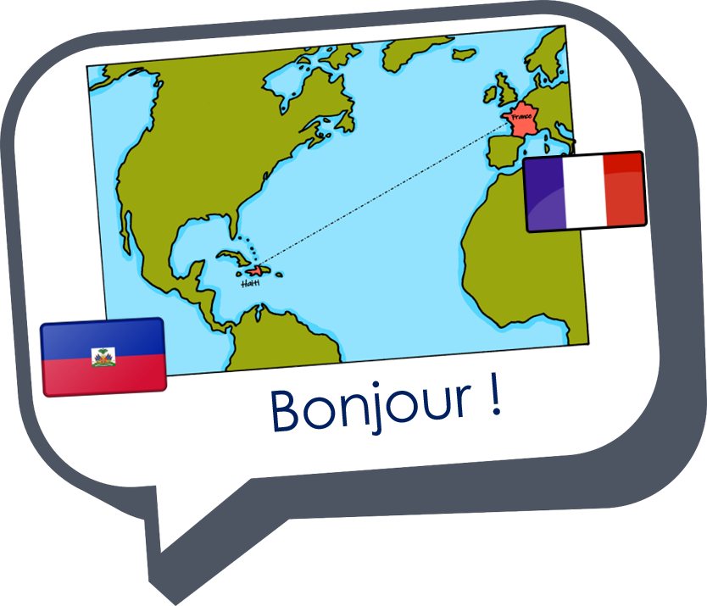
Describing me and others
amusant
amusante
Review of « Être » : je suis, tu es, il/elle est
Adjectival agreement
Intonation questions
[an/en] (nasal sound)
SFC
rouge
Notes:
Artwork by Steve Clarke. Pronoun pictures from NCELP (www.ncelp.org). All additional pictures selected from Pixabay and are
available under a Creative Commons license, no attribution required.
The AUDIO version of the lesson material includes additional audio for the new language presented (phonics, vocabulary) and audio for the instructions
on the slide.
In addition, it includes VIDEO clips of the phonics and the phonics’ source words. Pupils can be encouraged to look at the shape of the mouth/lips on
slides where these appear, and try to copy it/them.
Phonics: [an/en] and [a], also [SFC] with final -t
Frequency of new words:
Phonics: enfant [126] maman [2168]
Vocabulary: amusant [4695] calme [1731] intelligent [2509] malade [1066] méchant [3184]
Londsale, D., & Le Bras, Y. (2009). A Frequency Dictionary of French: Core vocabulary for learners London: Routledge.
The frequency rankings for words that occur in this PowerPoint which have been previously introduced in these resources are given
in the SOW and in the resources that first introduced and formally re-visited those words.
For any other words that occur incidentally in this PowerPoint, frequency rankings will be provided in the notes field wherever
possible.
Note that the first three lessons of the year teach language that can be continuously recycled as lesson routine every lesson in Y3/4.
The idea would be that the class teacher (whether or not s/he teaches the class French can re-use the language as part of the daily
routine with the class.
1

Slide 2
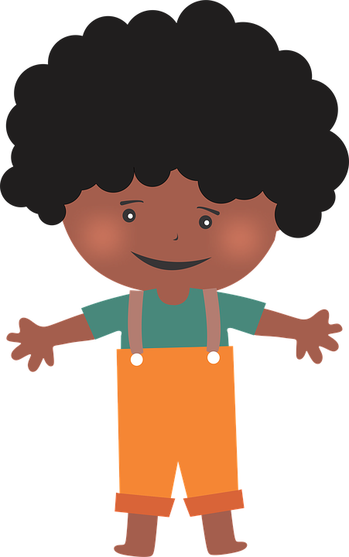
[an|en]
prononcer
enfant
French vowels are either nasal like [an|en] or
non-nasal (oral) like [e] and [a].
When you say a nasal vowel, air passes through your nose as well as your mouth.
Notes:
Timing: 1 minute
Aim: to re-introduce SSC [an|en], which pupils met last week.
Procedure:
Introduce and elicit the pronunciation of the individual SSC [an|en]. Practise saying it several times.
Click to bring up the information about nasal and oral vowel sounds. Practise saying [a] then [an|en] several times.
Click to bring up the source word ‘enfant’ (with gesture, if using). Say the word several times.
Click to bring up the picture and get pupils to repeat the words (with gesture, if using).
Pupils can also practise in pairs.

Slide 3
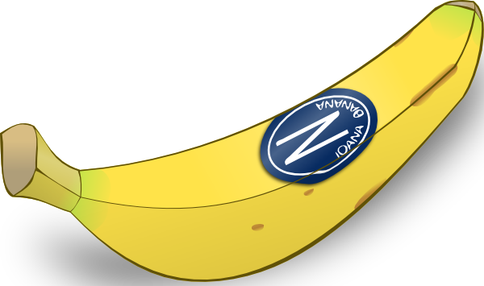
[a]
banane
prononcer
[a] is an oral vowel.
Notes:
Timing: 1 minute
Aim: to remind pupils of SSC [a]
Procedure:
Elicit the pronunciation of the individual SSC [a] and then the source word ‘banane’ (with gesture, if using).
Click to bring on the picture and get students to repeat (with gesture, if using).
Note: a gesture for ‘banana’ – we suggest making the shape of a banana with both hands – start with finger tips together in the middle, pull them apart and upwards to trace the shape of a banana (like the shape of a smile).
3

Slide 4
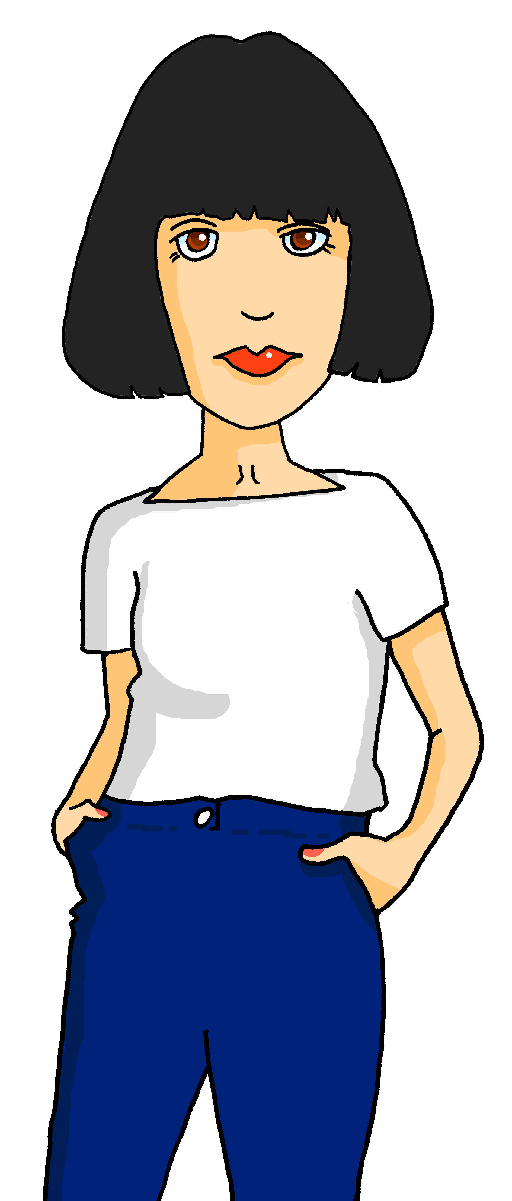
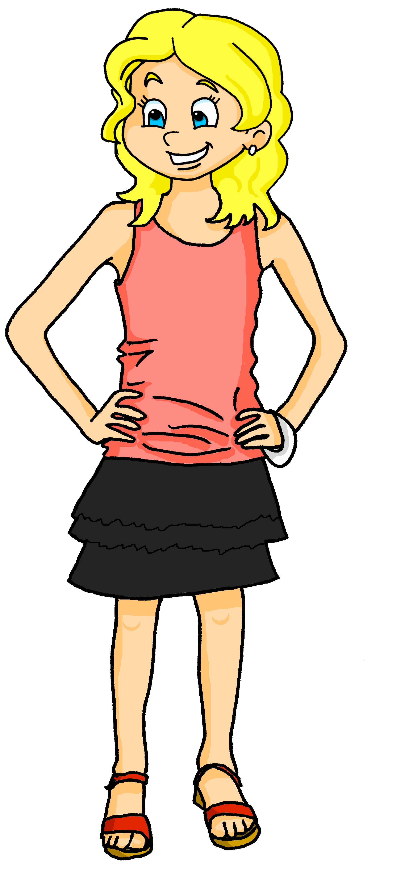
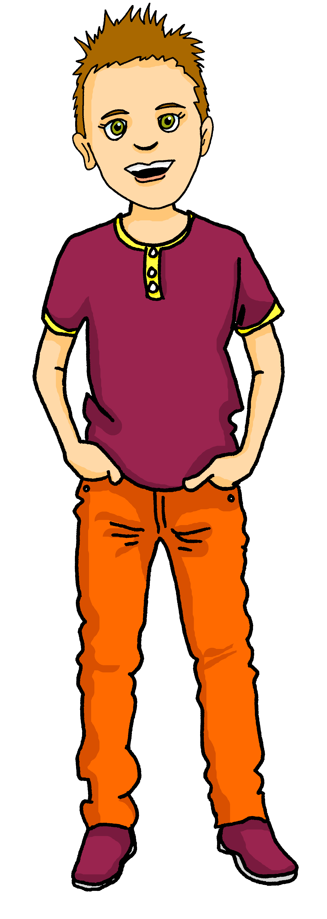
[a]
[an]
prononcer
This common French word has both an oral vowel and a nasal vowel.
Maman
oral vowel
nasal vowel
Voici Claudine, la maman de Pierre et Adèle.
Notes:
Timing: 1 minute
Aim: to focus further on the difference in sound between [a] and [an|en].
Procedure:
Click to bring up the two SSC [a] and [an|en].
Click to bring up the cluster word ‘maman’. Say the word several times.
Click to bring up the call out and labels for [a] and [an|en].
Click to introduce Claudine, Pierre and Adèle’s mum.
4

Slide 5
vocabulaire
Écoute et répète.
mots
The ‘e’ at the end means you do pronounce the ‘t’. This ‘e’ is called Silent Final ‘e’ [Sfe].
amusant
amusante
amusing (m)
amusing (f)
Notes:
Timing: 4 minutes (five slides)
Aim: to present and practise new vocabulary for this week.
Procedure:
Click to bring up the word. Say the word.
Click for the English meaning. Say the French word again. Pupils repeat.
Click to bring up the picture. Say the word again, together with pupils this time. Do the accompanying gesture.
Teacher uses the gesture again to elicit the word again from pupils.
Click for the reminder of the silent final –t for the masculine, and the pronounced –t for the feminine form.
Continue with the next four slides.
5

Slide 6
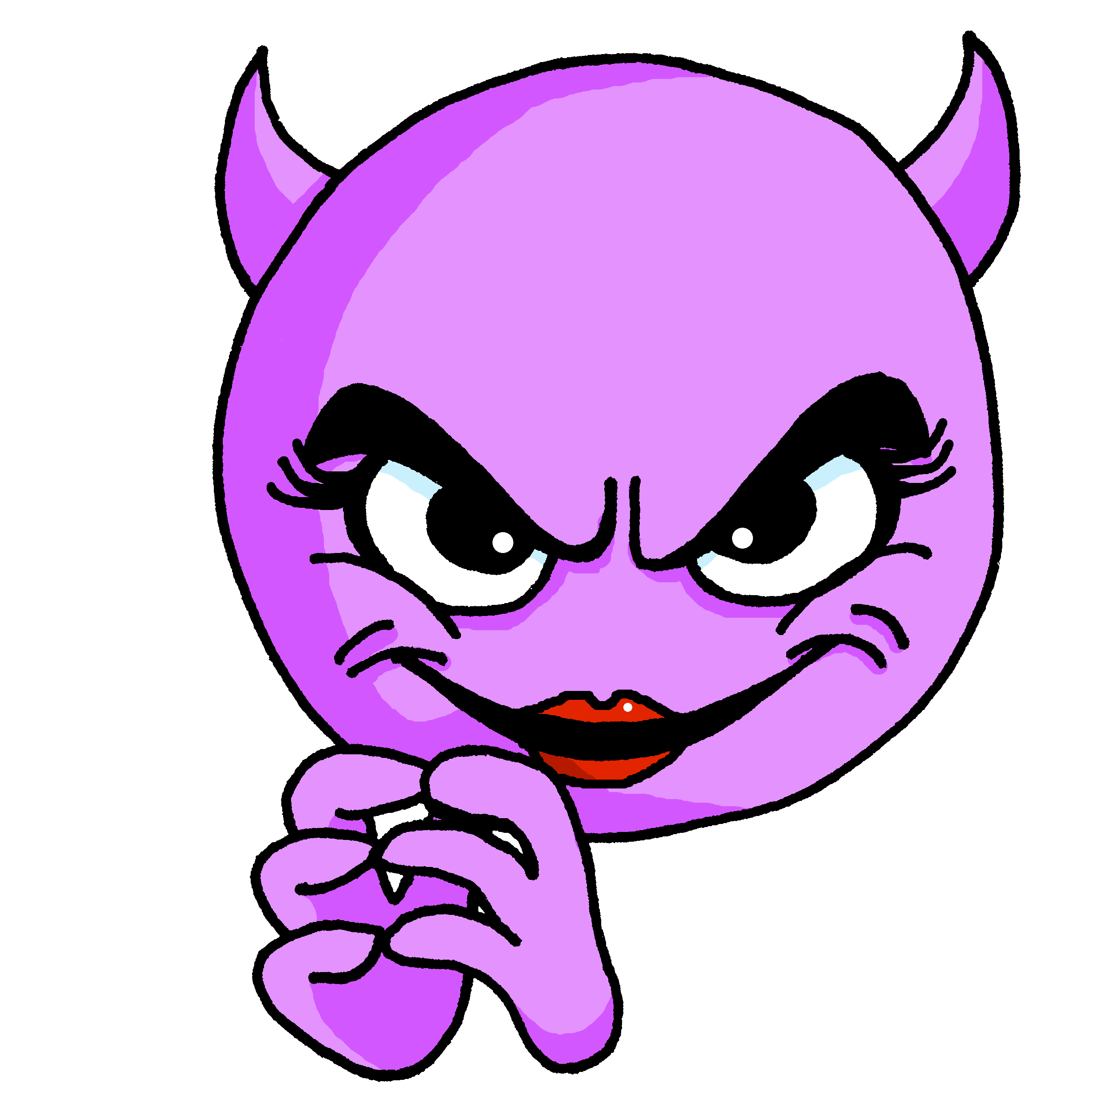
vocabulaire
Écoute et répète.
mots
méchant
méchante
naughty (m)
naughty (f)
Notes:
[2/5]
6

Slide 7
vocabulaire
Écoute et répète.
mots
intelligent
intelligente
intelligent (m)
intelligent (f)
Notes:
[3/5]
7

Slide 8
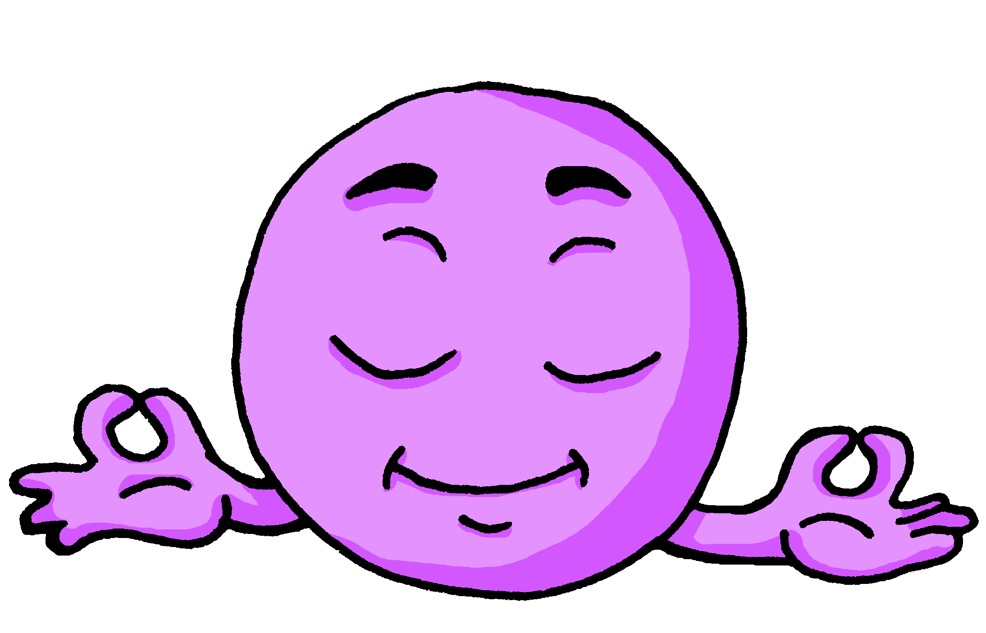
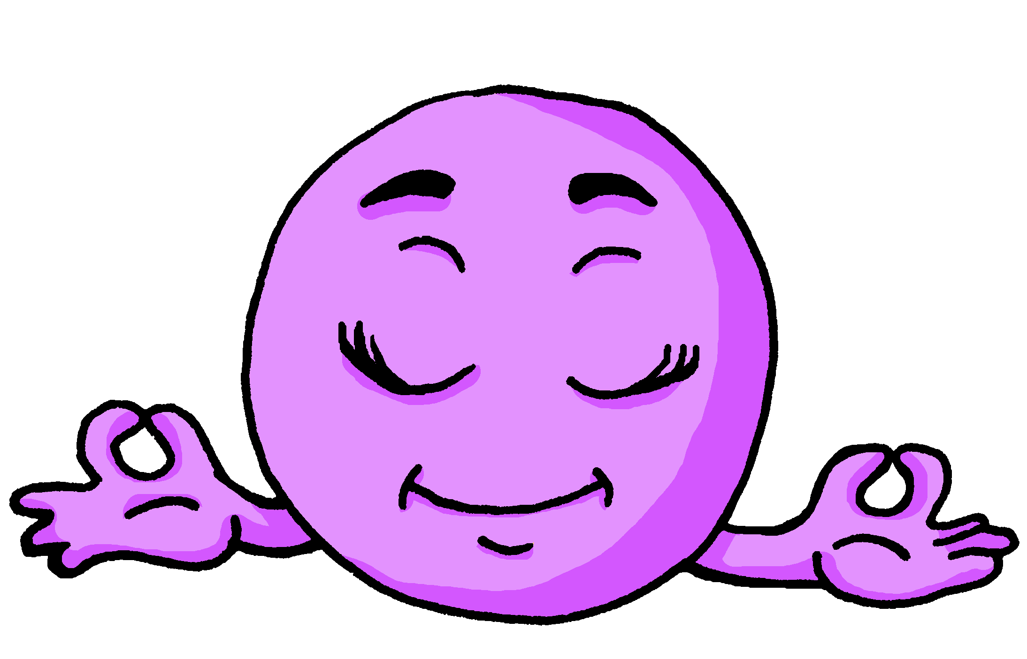
vocabulaire
Écoute et répète.
mots
When the word ends in ‘e’, masculine and feminine forms are the same.
calme
calme
calm (m)
calm (f)
Notes:
[4/5]
8

Slide 9
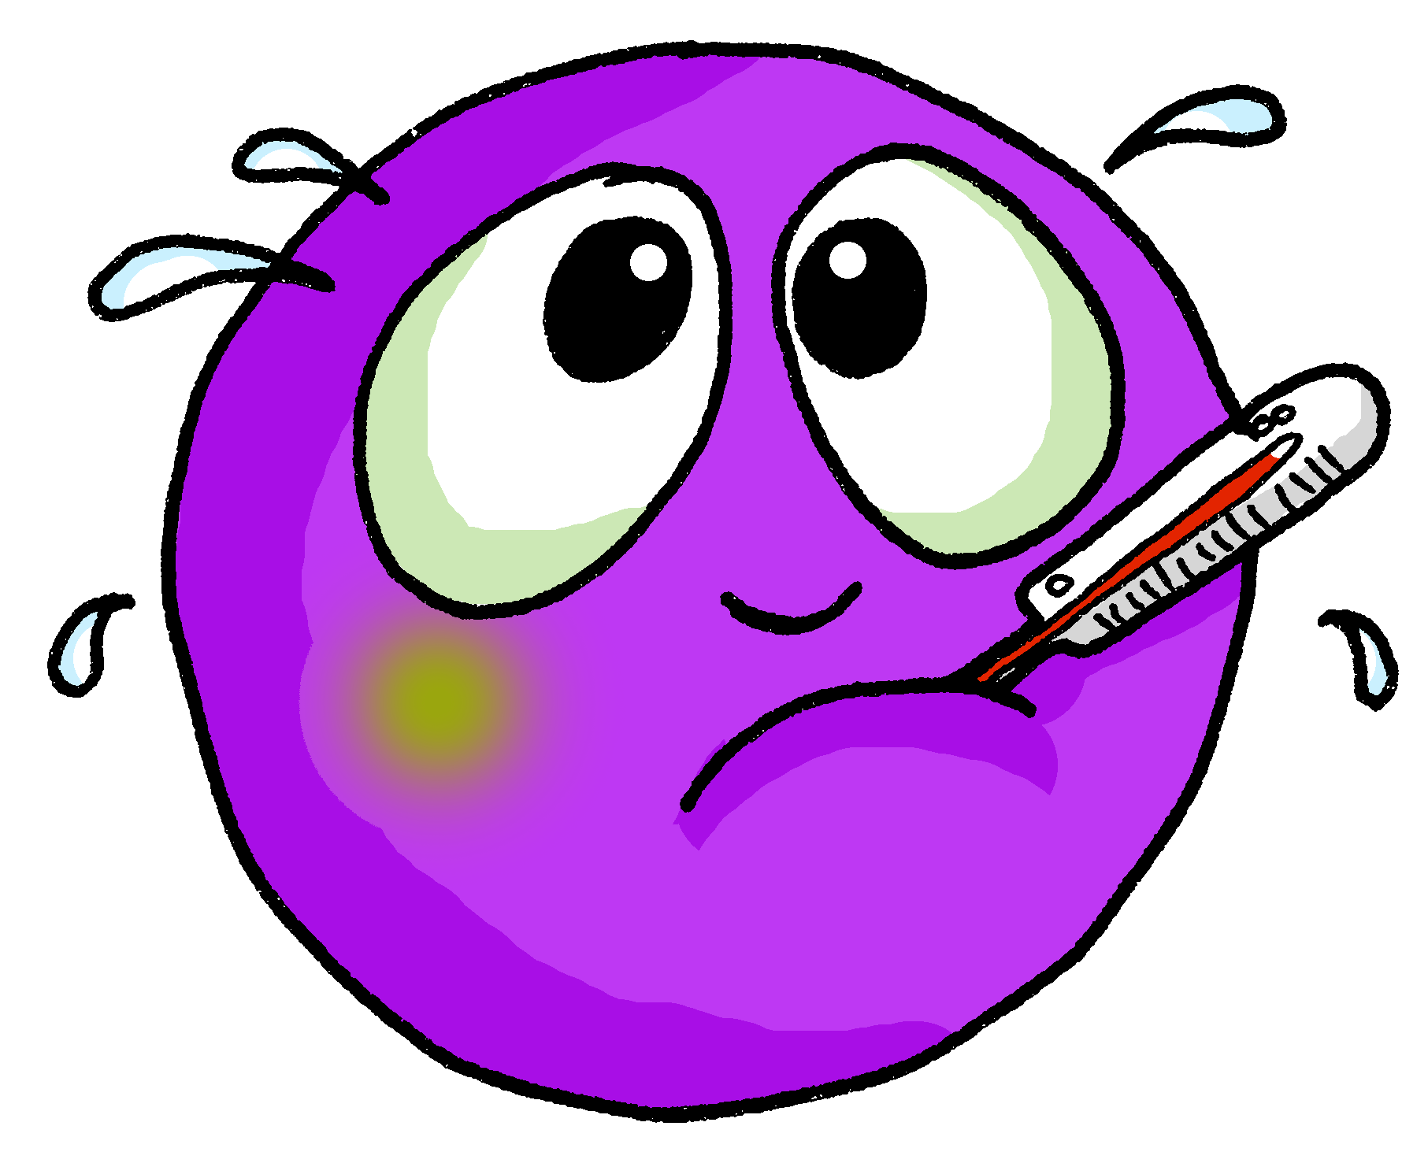
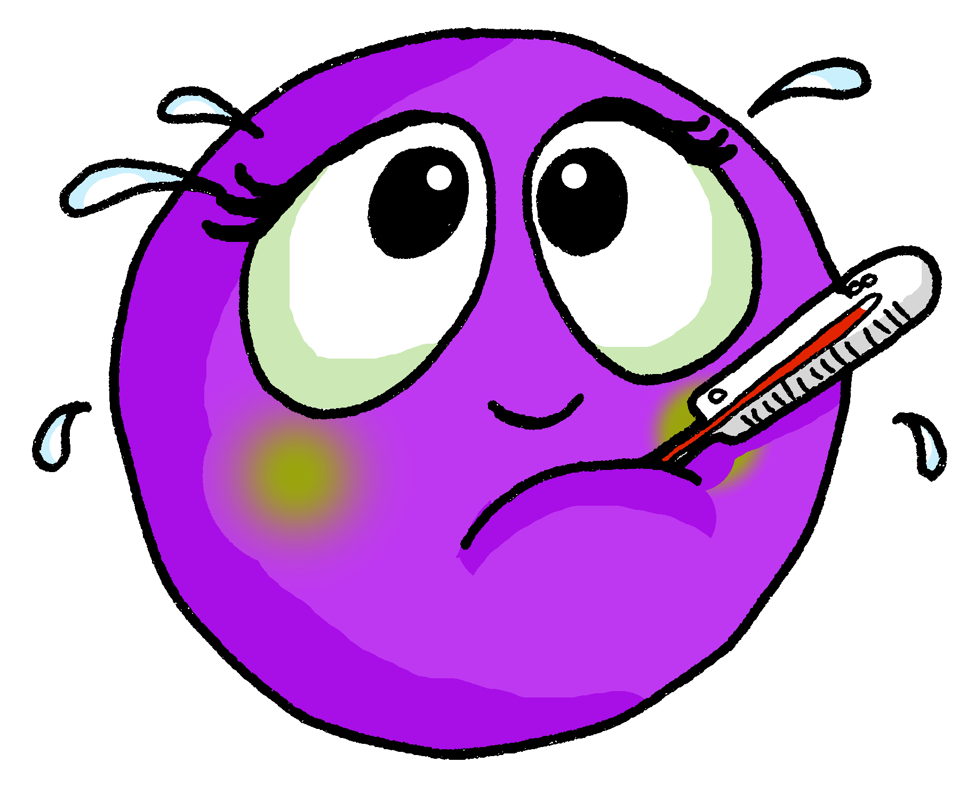
vocabulaire
Écoute et répète.
mots
malade
malade
ill, sick (m)
ill, sick (f)
Notes:
[5/5]
9

Slide 10
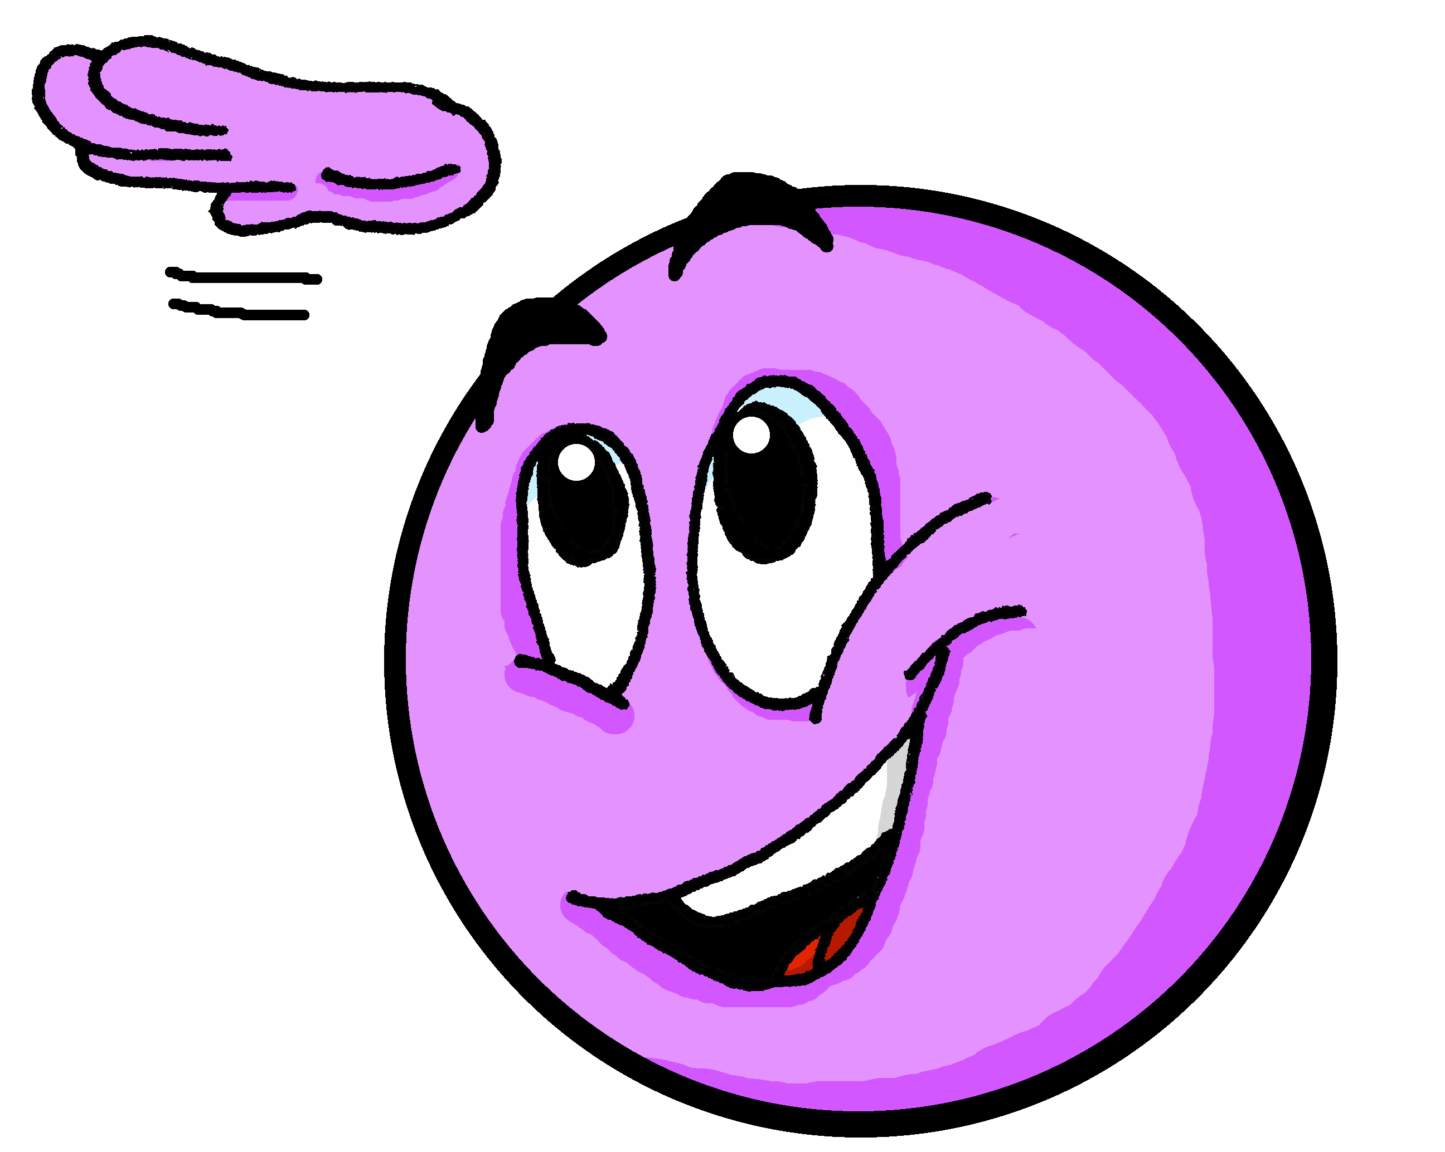
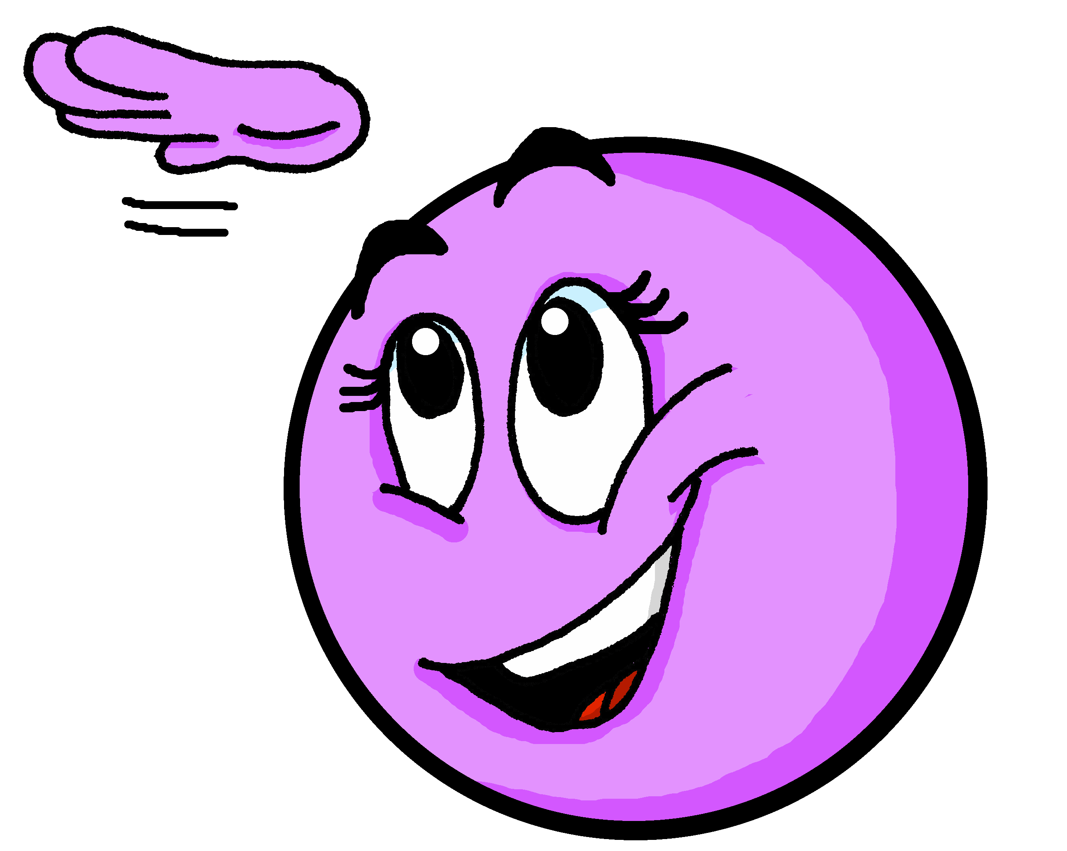
Using adjectives [1/2]
The spelling and sound of adjectives sometimes change.
The most common change is to add ‘e’ to the end of the word in the feminine form.
Je suis grand.
I (a boy) am tall.
Masculine
Tu es grand.
You (a boy) are tall.
An ‘e’ at the end means you do pronounce the ‘d’.
Il est grand.
He is tall.
Je suis grande.
I (a girl) am tall.
Feminine
Tu es grande.
You (a girl) are tall.
Elle est grande.
She is tall.
Notes:
Timing: 3 minutes
Aim: to revisit the pattern for regular adjective agreement (add-e to form the feminine adjective)
Procedure:
Read the grammar explanation about adjective agreement.
Elicit English translations for the French examples provided.
Draw pupils’ attention to the SFC ‘t’ and to the change you hear when an ‘e’ is added.

Slide 11
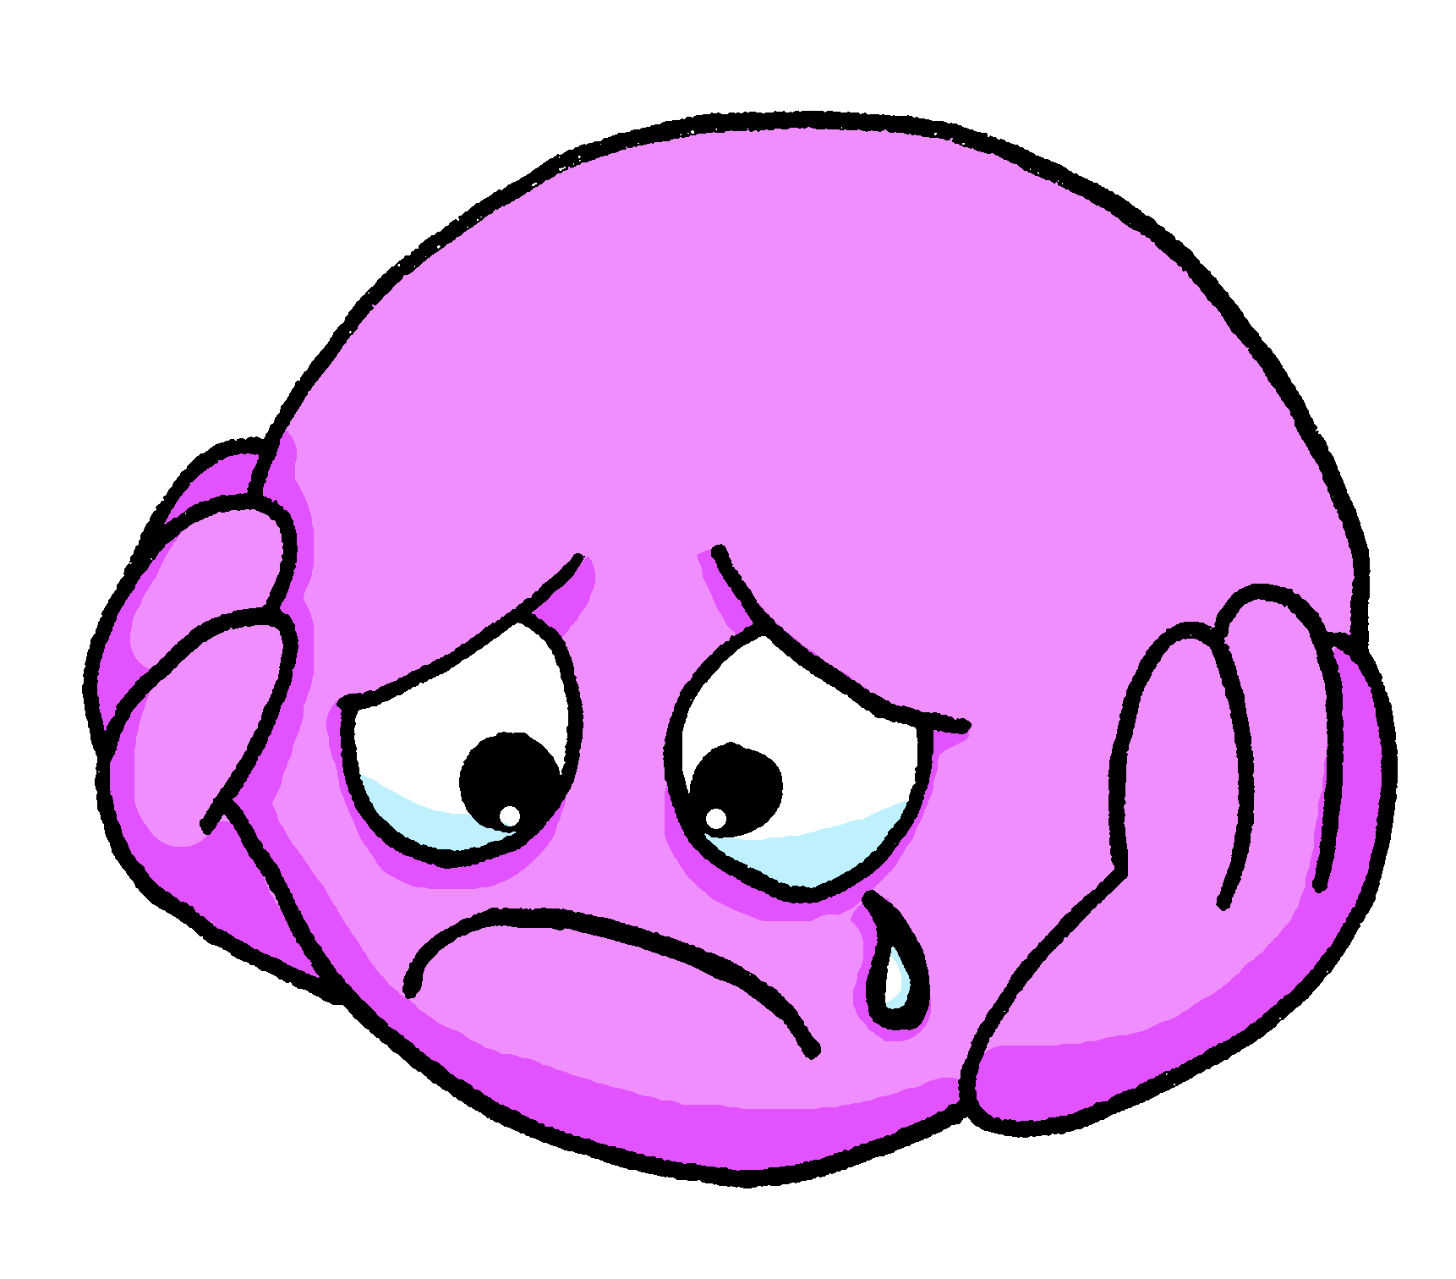
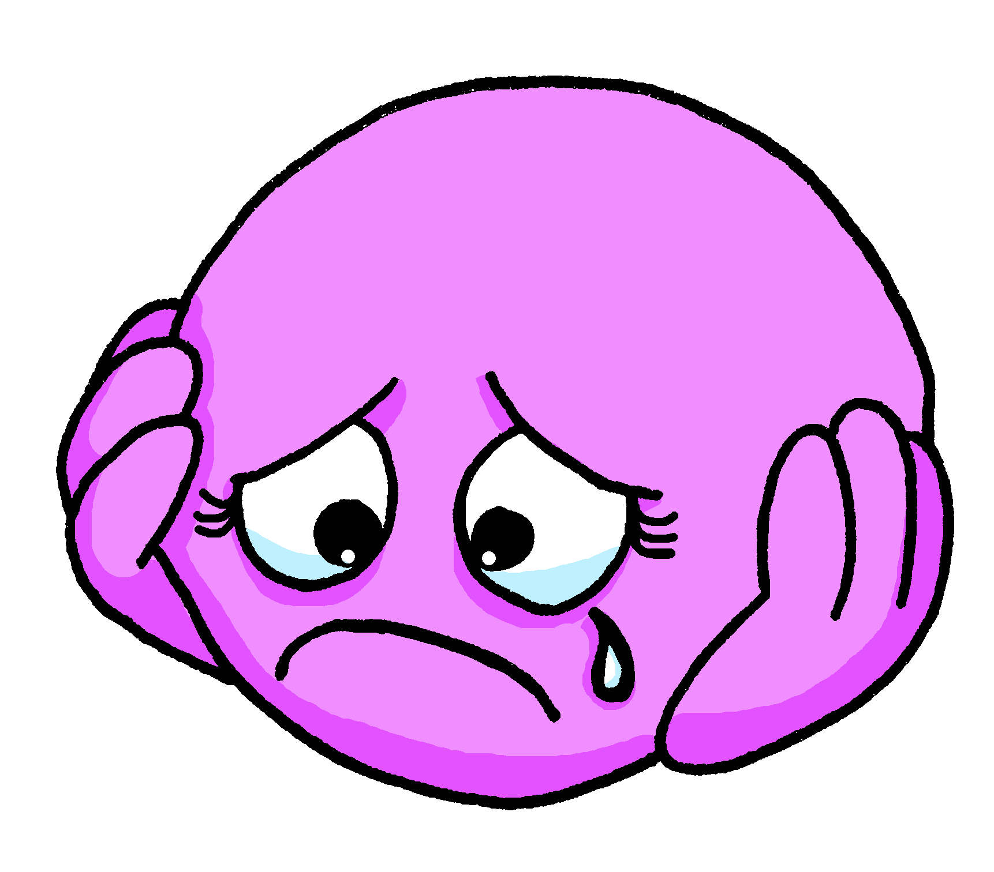
Using adjectives [2/2]
The spelling and sound of adjectives ending in e do not change.
An ‘e’ at the end means you do pronounce the ‘t’.
They are the same when describing feminine and masculine nouns.
Je suis triste.
I (a boy) am sad.
Masculine
Tu es triste.
You (a boy) are sad.
Il est triste.
He is sad.
Je suis triste.
I (a girl) am sad.
Feminine
Tu es triste.
You (a girl) are sad.
Elle est triste.
She is sad.
Notes:
Timing: 3 minutes
Procedure:
Read the grammar explanation about adjective agreement.
Elicit English translation for the French examples provided.
Draw pupils’ attention to the SFC ‘t’ and to the change you hear when an ‘e’ is added.

Slide 12
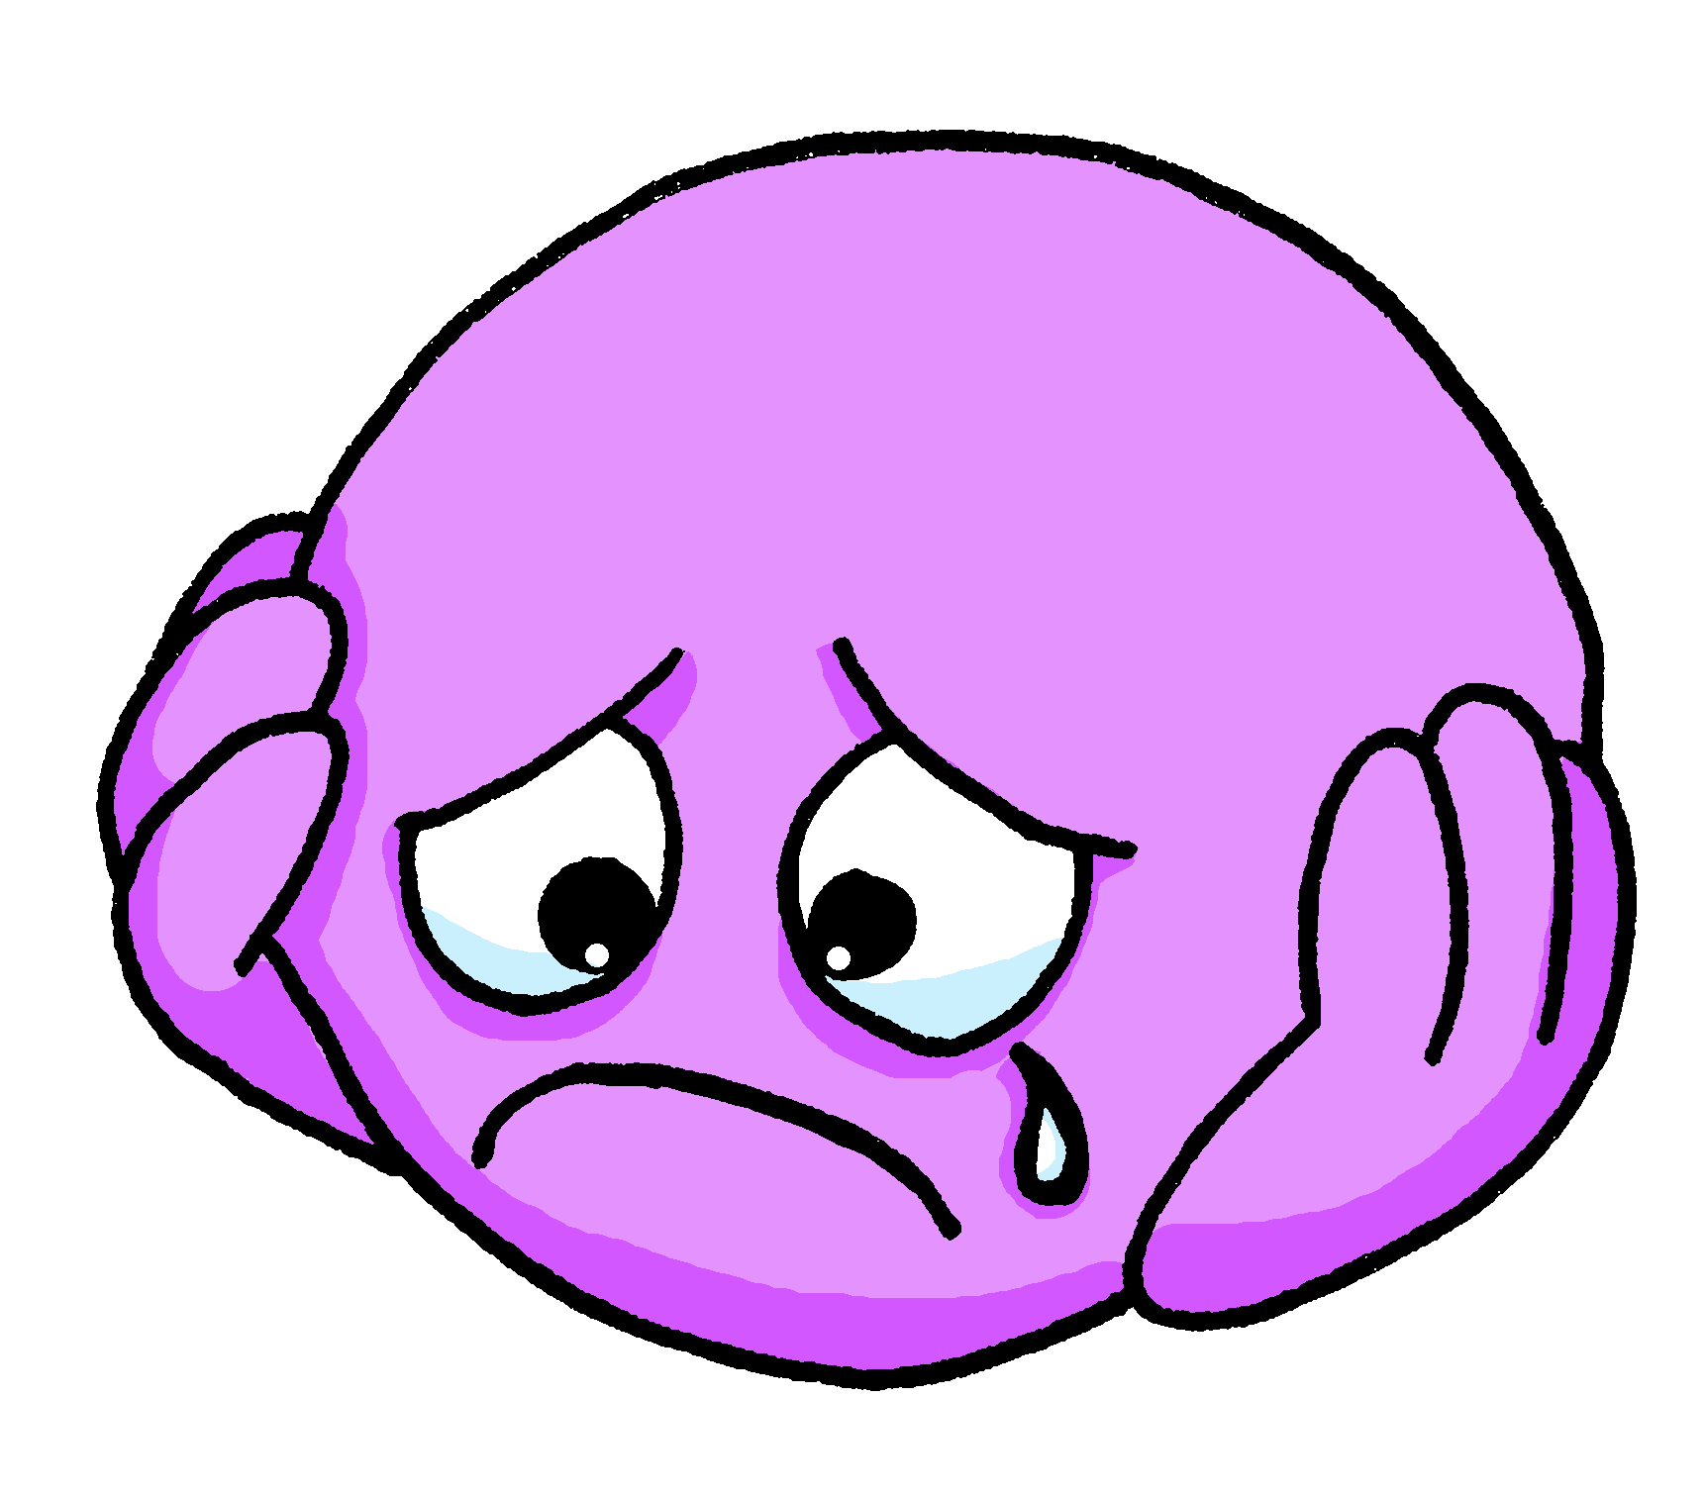
écouter
Écoute.
Is the person being described male or female?
Écris de 1à 8 ‘A’ ou ‘B’ ou ‘A + B’.
Then write the adjective in English.
 | A (male) | B (female) | ?
1
amusing
1
2
sad
2
3
intelligent
3
4
naughty
4
5
calm
5
6
amusing
6
7
ill, sick
7
8
naughty
8
Notes:
Timing: 7 minutes
Aim: to practise aural recognition of feminine and masculine adjectives and their meaning; to practise aural comprehension of this
week’s vocabulary.
Procedure:
Explain to pupils that they will not here the pronoun ‘elle’ or ‘il’ so they will need to listen for the adjective form to know if the sentence refers to a male or female person.
2. Click to hear audio.
3. Pupils write 1-8 and A or B.
4. Click to listen again. Pupils write the adjective meaning they hear in English.
5. Click for answers to provide feedback.
6. If time allows, click to bring up a 2nd set of audio buttons, which have the full sentences. Click to play and students repeat.
7. Final set of clicks brings up the emojis one by one. These could be use to elicit further repetitions of the sentences.
Note that once students hear the full sentences with pronouns, it is clear whether the person described is male or female. To highlight this, the additional emoji is removed.
Transcript:
1. [Elle] est amusante.
2. [Elle] est triste. 3. [Il] est intelligent. 4. [Elle] est méchante. 5. [Il] est calme. 6. [Il] est amusant. 7. [Elle] est malade. 8. [Il] est méchant. Transcript 2: 1. Elle est amusante.
2. Elle est triste. 3. Il es intelligent. 4. Elle est méchante. 5. Il est calme. 6. Il est amusant. 7. Elle est malade. 8. Il est méchant.
12

Slide 13
lire
In his diary, Pierre has described how his friends are feeling.
Aïe, aïe, aïe ! He’s spilled hot chocolate on it so we can’t see who he’s describing. Léa or Yves ? or could it be either?
aujourd’hui – today maintenant – now
Lis les phrases.
Léa est petite.
Écris :
Léa, Yves ou les deux ?
Yves est français.
adjectif | Léa | Yves | either | anglais
petite
Léa est triste.
short
Yves est malade aujourd’hui.
français
French
triste
sad
Léa est intelligente.
malade
ill/sick
Yves est calme maintenant.
intelligente
intelligent
calme
calm
Notes:
Timing: 8 minutes
Aim: to practise written understanding of adjective agreement and vocabulary from this and previous weeks.
Procedure:
Explain the task to pupils.
Ask students to write down the adjective & the person it refers to (Léa, Yves or either). Encourage them to write down the English meaning too.
The answers are animated – click to bring up the adjective, again for the tick, again to reveal the name in the diary, and again to reveal the English meaning. For those statements that could be both, you can ask students to suggest who they think it is briefly before revealing the name (Léa ou Yves?).

Slide 14
Lis : quel est l’intru ?
.
lire
grande
Ex
amusant |  | méchant
amusant
1
 | méchante | intelligente
intelligent
2
calme |  | malade
triste
3
amusant
calme
intelligente
4
malade | calme
grand
amusante
5
triste
l’intrus = intruder → odd one out
Notes:
Timing: 5 minutes
Aim: to revisit vocabulary and encourage students to notice patterns.
Procedure:
Ask students to work in pairs to spot the odd-one-out in each series of words. They need to be ready to give a reason.
Do the example with them (exemple). Read the words out loud and ask for a volunteer. The odd one out is “amusante” because “amusant” and “méchant” are both masculine only adjectives and “amusante” is a feminine form.
Elicit students’ reponses. Answers are animated – click to bring the answer (the font of the odd-one-out changes to pink on click).
Suggested OOO and reasons: 1. amusant (only masculine form) 2. intelligent (only masculine only form – other two adjectives could be either, end in -e) 3. amusant (only masculine only form – other two adjectives could be either, end in -e)
4. intelligente (feminine only – other two adjectives could be either) 5. grand (only one that can only be masculine – triste could be feminine and amusante is feminine)

Slide 15
Au revoir !
rouge
Notes:
15

