Slide 1
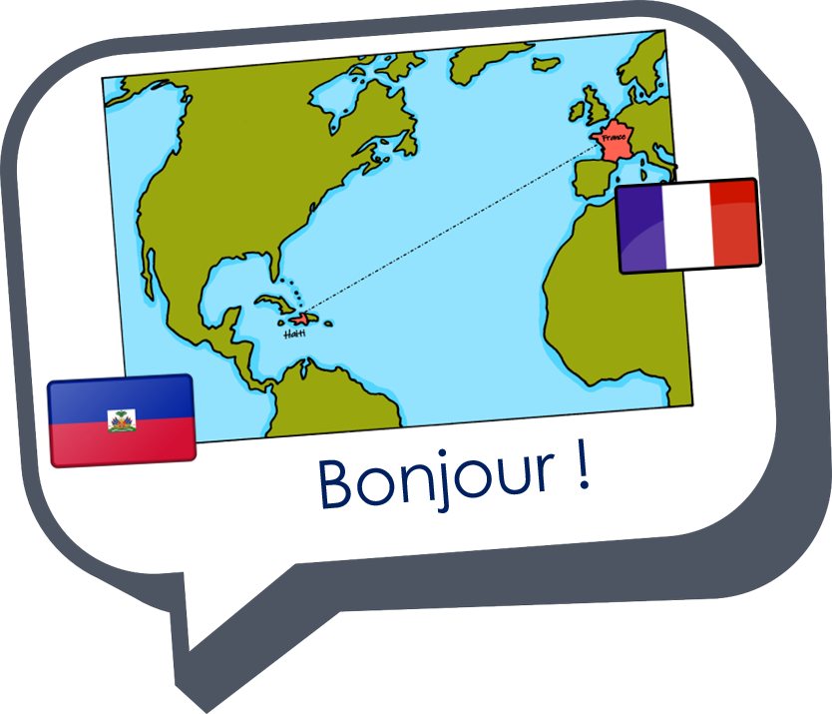
Describing me and others
amusant
amusante
rouge
Follow ups 1-5
Notes:
Artwork by Steve Clarke. Pronoun pictures from NCELP (www.ncelp.org). All additional pictures selected from Pixabay and are available under a Creative Commons license, no attribution required.
Phonics: [an/en] and [a], also [SFC] with final -t
Frequency of new words:
Phonics: enfant [126] maman [2168]
Vocabulary: malade [1066] calme [1731] intelligent [2509] amusant [4695] méchant [3184]
Londsale, D., & Le Bras, Y. (2009). A Frequency Dictionary of French: Core vocabulary for learners London: Routledge.
The frequency rankings for words that occur in this PowerPoint which have been previously introduced in these resources are given in the SOW and in the resources that first introduced and formally re-visited those words.
For any other words that occur incidentally in this PowerPoint, frequency rankings will be provided in the notes field wherever possible.

Slide 2
Follow up 1:
[an/en]
enfant
Écoute.
Does the word have [an/en]?
 |  |  | en anglais
restaurant |  |  | restaurant
bruyant |  |  | noisy
traditionnel |  |  | traditional
tranquille |  |  | quiet
semaine |  |  | week
orange |  |  | orange
pomme |  |  | apple
international |  |  | international
1
2
3
4
5
6
7
8
Notes:
Timing: 5 minutes
Aim: to practise aural recognition of this week’s SSC [an/en] and differentiate from other similar sounds, in a set of unfamiliar words.
Procedure:
Click on each audio symbol to listen to the word.
Pupils tick if they hear [an|en] and cross if not.
Click for the answer ticks, the French word and then the English word (which pupils may offer suggestions for, as we include some written cognates here).
Transcript [1] restaurant [2] bruyant [3] traditionnel [4] tranquille [5] semaine [6] orange
[7] pomme [8] international

Slide 3
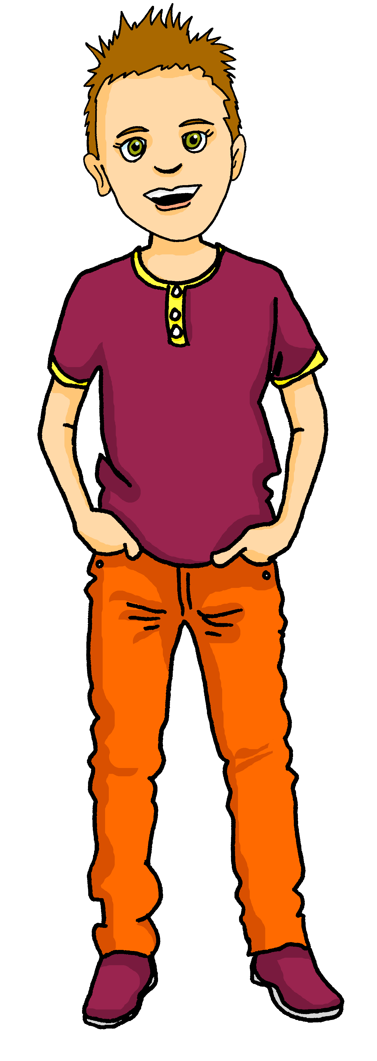
écouter
Follow up 2 :
Écoute. C’est qui ?
A) Tick ‘I’, ‘you’, ‘he’ or ‘she’.
Write . or ?
Écris le numéro.
B)
Listen again. Which question has the following adjectives?
 | I | You | She | He
Ex
sad
short
amusing
tall
English
5
1
4
2
3
Ex.
4
1
3
5
6
2
6
Notes:
Timing: 5 minutes
Aim: to practise aural understanding of pronouns je, tu, il, elle, question and statement intonation and a range of adjectives.
Procedure:
1. Pupils either draw a table (Ex., 1-6 vertically, I, you, she, he and ./? horizontally) or are given a handout.
2. Click to listen to the example, then bring up the answer (he, full stop).
3. Click to listen to items 1-6.
4. Pupils record the person and the type of utterance.
5. Click to provide answers.
6. Click to bring up Part B. Listen and identify when the adjectives are mentioned.
7. Click to correct.
Transcript:
Ex. Il est amusant.
Tu es grand?
Je suis anglaise.
Elle est grande.
Tu es petite.
Je suis triste?
Il est anglais.
3

Slide 4
Follow up 3
Pupil A reads six sentences. Pupil B listens and writes M (male), F (female) or M/F (male/female) if it could be either.
parler
Don’t read the word that’s crossed out.
Pupil A
1 | [Elle] est intelligente.
2 | [Il] est triste.
3 | [Il] est grand.
4 | [Elle] est calme.
5 | [Elle] est amusante.
6 | [Il] est méchant.
Pupil B
1 | [Il] est amusant.
2 | [Elle] est malade.
3 | [Elle] est méchante.
4 | [Il] est calme.
5 | [Elle] est intelligente.
6 | [Il] est grand.
F
M
M/F
M/F
M
F
M/F
M/F
F
F
M
M
Notes:
Time: 5 minutes
Aim: to practise aural comprehension of masculine and feminine adjectives.
Pupil B turns away from the board. S/he needs something to write on.
Click for Pupil A’s six sentences to appear. Pupil A reads each sentence to his/her partner.
3.Pupil B listens and writes M (male), F (female), M/F (male/female) if it could be either. 4. Pupils swap roles and repeat the task with the 2nd set of prompts.

Slide 5
Creating questions
To turn a statement into a question, just raise your voice at the end.
Je suis ici.
Je suis ici ?
I am here.
Am I here?
Il est là.
Il est là ?
He is there.
Is he there?
Notice that there is a space before a ? in French and also before a ! e.g. Salut !
Elle est là.
Elle est là ?
She is there.
Is she there?
Notes:
Use this recap ahead of FOLLOW UP 4.
Timing: 1 minute
Aim: to recap how to form intonation questions from statements.
Procedure:
Click to present information.
2. Elicit English translations for the French examples provided.

Slide 6
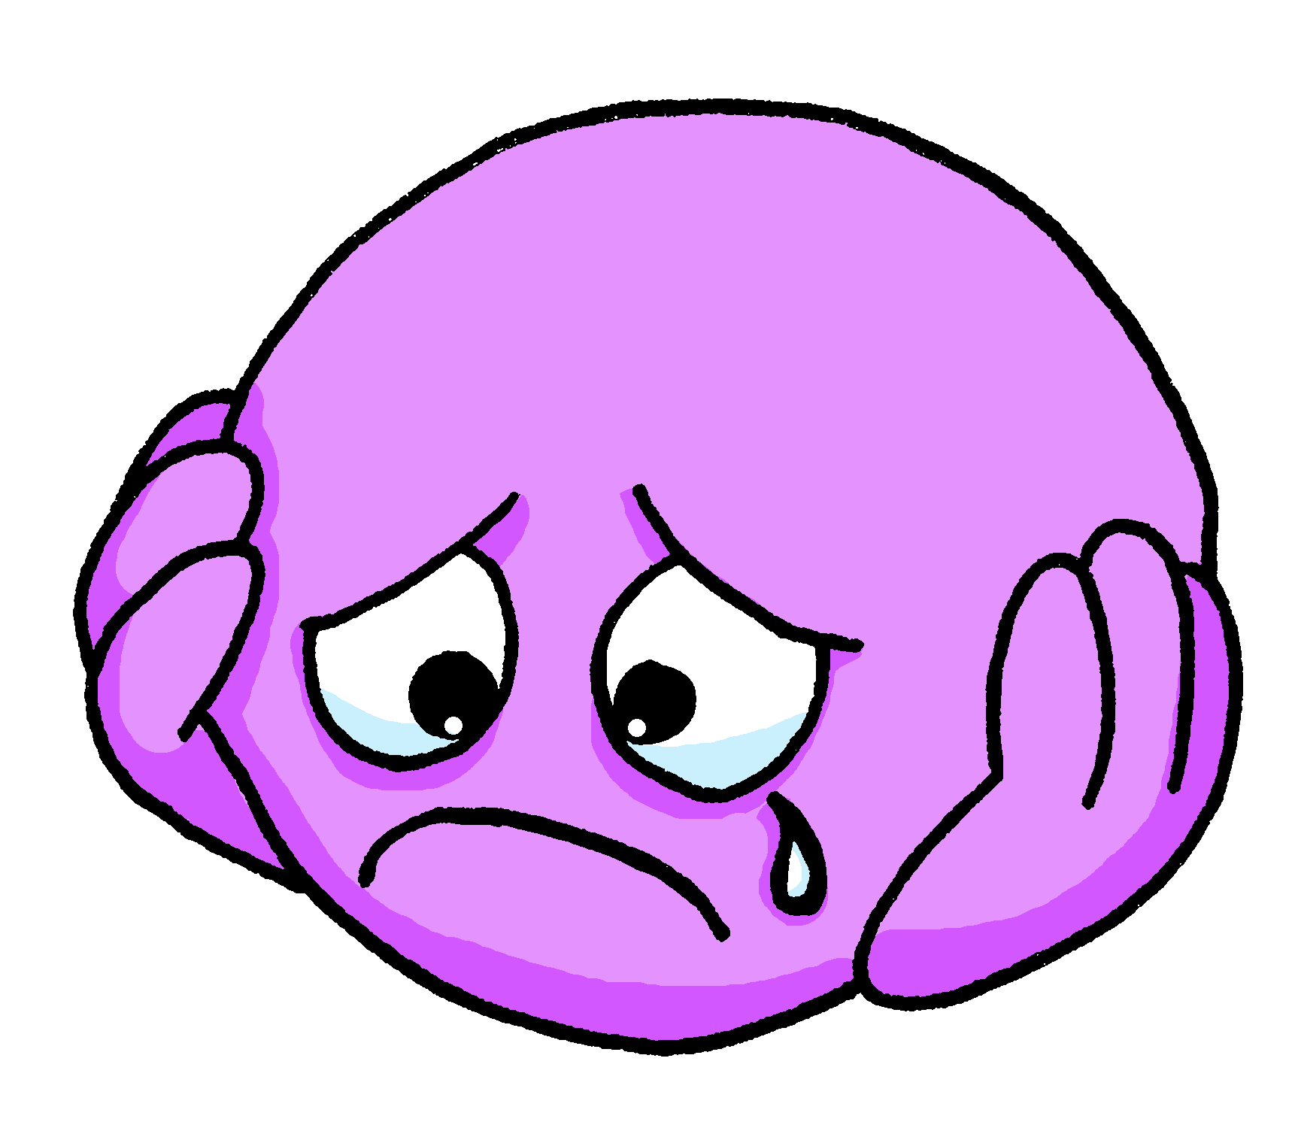
Follow up 4 :
C’est une question ou une phrase ?
parler
1
Elle est calme
5
Elle est méchante
3
2
Il est intelligent
6
Il est triste
S
3
Il est malade
7
Elle est amusante
4
Elle est grande
8
Elle est petite
0
DÉBUT
Notes:
Timing: 5 minutes
Aim: to practise oral production of statements and intonation questions (and again with a time limit).
Procedure:
Explain to the class that half will speak and half will listen, then they will swap.
Half of the class turns away from the board.
Click to bring up the punctuation for number 1. Pupils say the question.
The listening half responds, saying ‘question’. Alternatively, they could put up the right hand for questions, left hand for statements.
Continue with items 2-4.
Swap roles and complete items 5-8.
With the whole class facing the board, complete all items again, this time clicking Début to start a 3-second timer each time, to speed up production.

Slide 7
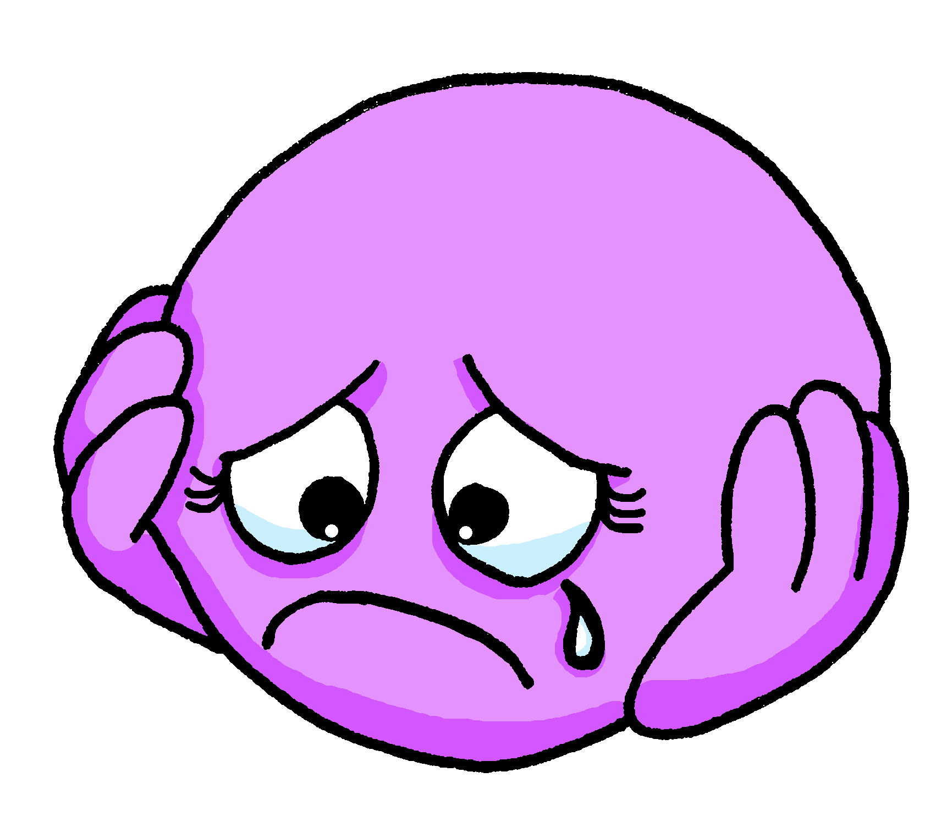
Follow up 5:

Écris.
Complete each English sentence with an adjective.

Write your sentence in French.
écrire
1 _____________________________
Il est malade.

ill, sick
(He is ____________).
4 _____________________________
Il est méchant.

naughty
(He is ____________).
Elle est amusante.
2 _____________________________
funny

(She is____________).
5 _____________________________

Elle est calme.
calm
(She is ____________).
3 _____________________________
Elle est triste.
sad.
(She is ____________).
Notes:
Timing: 10 minutes
Aim: to practise written production of this week’s new language.
Procedure: 1. Pupils first select an adjective (from this week) to complete the English version of the sentence, based on the picture prompts. 2. Then they write the sentence translation in French. 3. The animations are set up to do each sentence and then check, give feedback.

