Slide 1
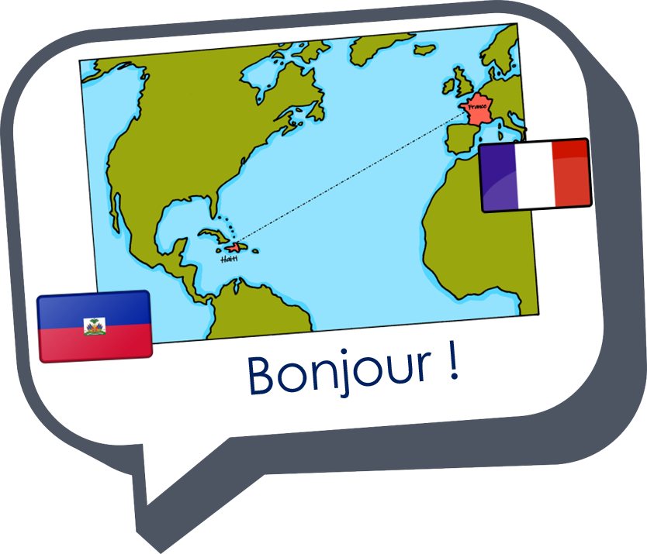
Describing me and others
rouge
Être : tu es, (je suis)
[an/en]
[SFC] with final -d
Notes:
Artwork by Steve Clarke. Pronoun pictures from NCELP (www.ncelp.org). All additional pictures selected from Pixabay and are available under a Creative Commons
license, no attribution required.
The AUDIO version of the lesson material includes additional audio for the new language presented (phonics, vocabulary) and audio for the instructions
on the slide.
In addition, it includes VIDEO clips of the phonics and the phonics’ source words. Pupils can be encouraged to look at the shape of the mouth/lips on
slides where these appear, and try to copy it/them.
Frequency of new words:
Phonics: enfant [126] grand [59]
Vocabulary: petit [138] grand [59] anglais [784] français [251] content [1841] triste [1843] tu [112] es [5]
Londsale, D., & Le Bras, Y. (2009). A Frequency Dictionary of French: Core vocabulary for learners London: Routledge.
The frequency rankings for words that occur in this PowerPoint which have been previously introduced in these resources are given in the SOW and in the
resources that first introduced and formally re-visited those words.
For any other words that occur incidentally in this PowerPoint, frequency rankings will be provided in the notes field wherever possible.
Note that the first three lessons of the year teach language that can be continuously recycled as lesson routine every lesson in Y3/4.
The idea would be that the class teacher (whether or not s/he teaches the class French can re-use the language as part of the daily routine with the class.
1

Slide 2
[an/en]
prononcer
enfant
Notes:
Timing: 1 minute
Aim: To introduce SSC [an/en]
Procedure:
Introduce and elicit the pronunciation of the individual SSC [an/en]. Tell pupils that the letter combination [an] and [en] sound the same.
Click to bring up the source word ‘enfant’ (with gesture, if using).
Say the word and bring up the reminder that the final –t is silent.
Pupils to practise saying the word several times.
Note:
a gesture for ‘enfant’ might be to copy the picture and open your arms like small children often do.

Slide 3
[SFC]
prononcer
Silent final consonant
grand
Notes:
Timing: 1 minute
Aim: to introduce the SSC [SFC] with words ending in ‘d’. Pupils have practised [SFC] with final –t and final –s in the previous two weeks.
Note: this word also contains this week’s new SSC [an/en].
Procedure:
Introduce the SSC and present the source word ‘grand’ (with gesture, if using).
Click to bring on the picture and get students to repeat the word ‘grand’ (with gesture, if using).
Ensure that pupils are clear about the meaning, i.e., tall.
Note:
a gesture for ‘grand’ might be to copy the emoji and raise your hand above your head as if measuring a tall person’s height.
3

Slide 4
vocabulaire
Écoute et répète.
mots
grand
petit
tall
short
Notes:
Timing: 4 minutes (three slides)
Aim: to present and practise new vocabulary for this week.
Procedure:
Click to bring up the word. Say the word.
Click for the English meaning. Say the French word again. Pupils repeat.
Click to bring up the picture. Say the word again, together with pupils this time. Do the accompanying gesture.
Teacher uses the gesture again to elicit the word again from pupils.
Click for the reminder of the silent final –d.
Continue with the next two slides.
4

Slide 5
vocabulaire
Écoute et répète.
mots
anglais
français
English
French
Notes:
5

Slide 6
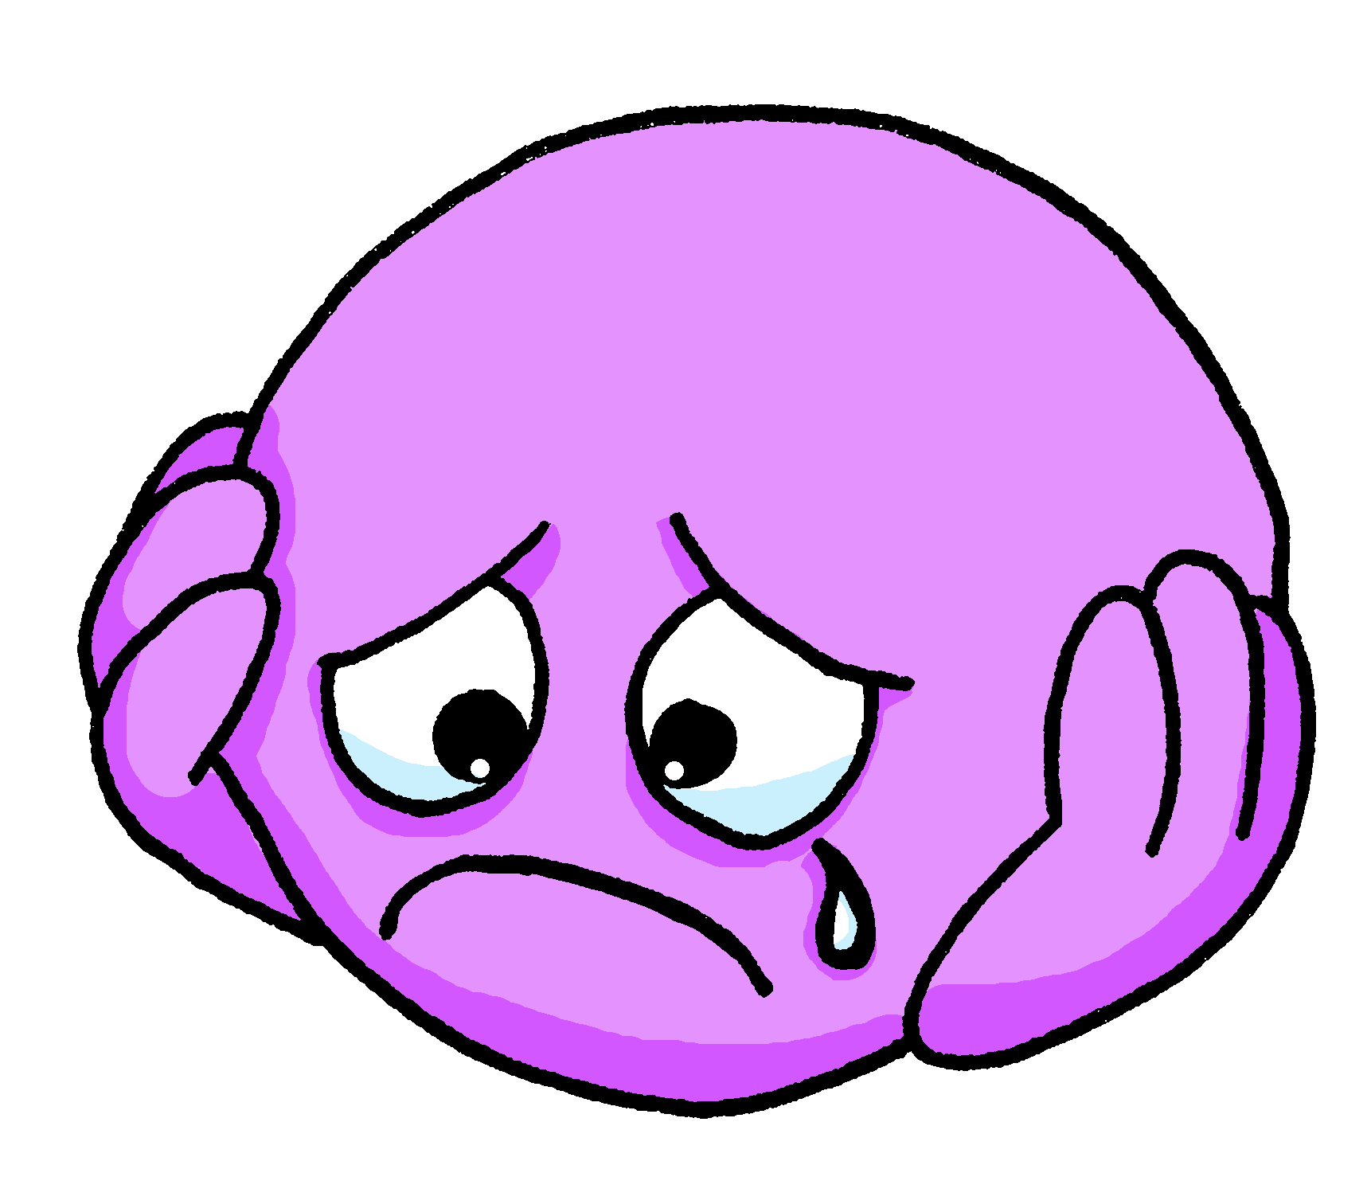
vocabulaire
Écoute et répète.
mots
content
triste
pleased
sad
Notes:
6

Slide 7
vocabulaire
Complète la phrase.
mots
Il est …
anglais.
grand.
français.
Notes:
Timing: 3 minutes (six slides)
Aim: to practise written recognition of the meaning of the new vocabulary for this week; to practise read aloud of the new vocabulary for this week, which includes many examples of [an/en] and [SFC] with –t, -s, and –d.
Procedure:
Click to bring up the emoji and three adjectives.
Prompt pupils by saying the sentence beginning ‘il est…’
Elicit the sentence ending from pupils.
Click to bring up the answer indicator.
Continue for the next five slides.
7

Slide 8
vocabulaire
Complète la phrase.
mots
Il est …
content.
triste.
petit.
Notes:
[2/6]
8

Slide 9
vocabulaire
Complète la phrase.
mots
Il est …
petit.
grand.
anglais.
Notes:
[3/6]
9

Slide 10
vocabulaire
Complète la phrase.
mots
Il est …
grand.
content.
anglais.
Notes:
[4/6]
10

Slide 11
vocabulaire
Complète la phrase.
mots
Il est …
français.
triste.
content.
Notes:
[5/6]
11

Slide 12
vocabulaire
Complète la phrase.
mots
Il est …
grand.
content.
petit.
Notes:
[6/6]
12

Slide 13
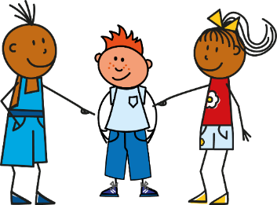
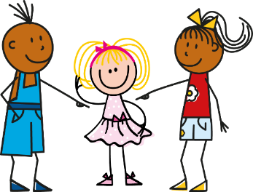
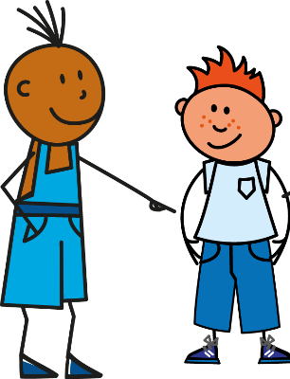
être
[to be | being]
Remember, the verb être means ‘to be’.
You already know the parts I am, he is and she is:
Je suis
Il est
Elle est
I am
He is
She is
You are is also part of the verb ‘to be’ :
Tu es
You are
Je suis ici
mais
tu es là.
I am here
[but]
you are there.
Notes:
Timing: 2 minutes
Aim: to revisit parts of être and introduce a third part, tu es.
Procedure:
Click to animate the explanation.
Elicit English translations for the French examples provided.

Slide 14
lire
Deux amis* – Pierre et* Yves.
Salut !
Pierre parle. How are they the same or different?
Écris I am 1…, 2…, 3…. You are 1…, 2…, 3…
Pierre
Yves
Tu es français. | Tu es triste.
Tu es petit. | Je suis content.
Je suis grand. | Je suis français.
I am tall, pleased, French.
You are French, short, sad.
1
____,
1
____,
2
____
3
____
2
____,
3
____.
deux – two ami – friend et – and
Pierre
Yves
Notes:
Timing: 8 minutes
Aim: to practise written comprehension of suis and es, and connect them to meaning; to practise comprehension of this week’s new vocabulary.
Procedure:
Ensure that pupils know that Pierre and Yves are friends, and that it is Pierre who is talking.
Pupils read the parts of Pierre’s statements and write I am 1,2,3 and you are 1,2,3 with the English meanings of the adjectives.
Click for answers.
14

Slide 15
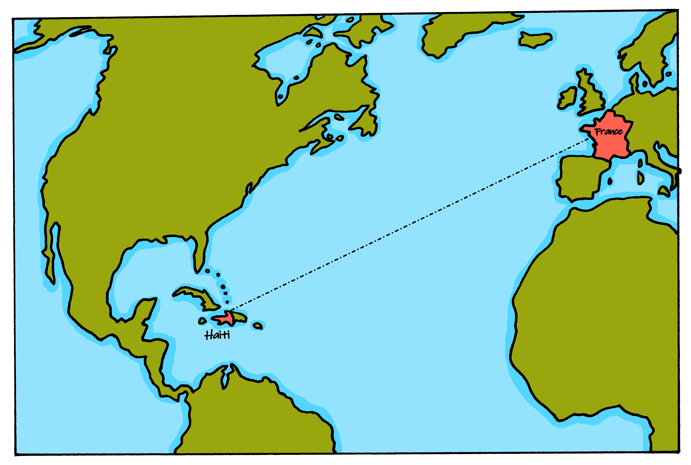
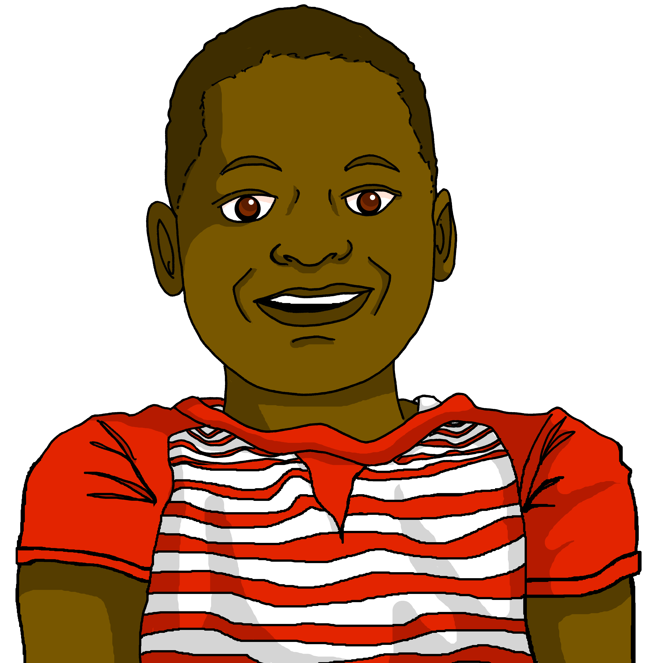
écouter
Écoute. Pierre parle à* Jean-Michel.
Jean-Michel is Pierre’s cousin and lives in Haϊti.
Salut !
Pierre
Bonjour !
Jean-Michel
Notes:
Timing: 1 minute
Aim: to introduce Pierre’s cousin Jean-Michel who is from Haϊti. He will feature in the listening activity that follows.
Procedure:
Read the information.
15

Slide 16
écouter
Écoute. Pierre parle à* Jean-Michel.
What does Pierre say to Jean-Michel about himself and Jean-Michel today?
Écris de 1-6 et ‘I’ ou ‘you’.
Then write the adjective in English.
 | You are… | I am… | ?
1
French
1
Pierre
2
short
2
3
tall
3
4
pleased
4
5
sad
5
6
cool
6
à – to
cool – cool
Notes:
Timing: 7 minutes
Aim: to practise aural recognition of ‘suis’ and ‘es’ and their connection with meaning; to practise aural comprehension of this
week’s vocabulary.
Procedure:
Explain to pupils that they will not here the pronoun ‘je’ or ‘tu’ so they will need to listen for the verb ‘suis’ or ‘es’ to know if Pierre is saying ‘you are’ to Jean-Michel or ‘I am’ about himself.
2. Click to hear audio.
3. Pupils write 1-6 and you are or I am
4. Click to listen again. Pupils write the adjective meaning they hear in English.
5. Click for answers to provide feedback.
6. If time allows, click to bring up a 2nd set of audio buttons, which have the full sentences. Click to play and students repeat.
Transcript:
1. [Je] suis français.
2. [Je] suis petit. 3. [Tu] es grand. 4. [Je] suis content. 5. [Tu] es triste. 6. [Tu] es cool. Transcript 2: 1. Je suis français.
2. Je suis petit. 3. Tu es grand. 4. Je suis content. 5. Tu es triste. 6. Tu es cool.
16

Slide 17
vocabulaire
Écris en anglais : Can you get at least 15 points?
mots
 | banane | moto | écouter
 | univers | cheval | midi
 | oui | bien | ça va ?
 | non | Au revoir ! | mal
 | petit | anglaise | content
 | tu | français | triste
 | grande | contente | es
banana
motorbike
to listen, listening
x3
universe
horse
midday
yes
good/well
is it going ok?
x2
no
Goodbye!
bad(ly)
short (m)
English (f)
pleased (m)
you
French (m)
sad (m/f)
x1
tall (f)
pleased (f)
are
Notes:
Timing: 5 minutes
Aim: to practise written comprehension of vocabulary from week 1, last week and this week.
Procedure: 1. Give pupils a blank grid. They fill in the English meanings of any of the words they know, trying to reach 15 points in total. 2. Remind pupils that adjectives can refer to male or female persons and they should note this in their translations. E.g. pleased (f), short (m).
Note: The most recently learnt and practised words are pink, words from the previous week are green and those from week 1 are blue, thus more points are awarded for them, to recognise that memories fade and more effort (heavy lifting!) is needed to retrieve them.
17

Slide 18
Au revoir !
rouge
Notes:
18

