Slide 1
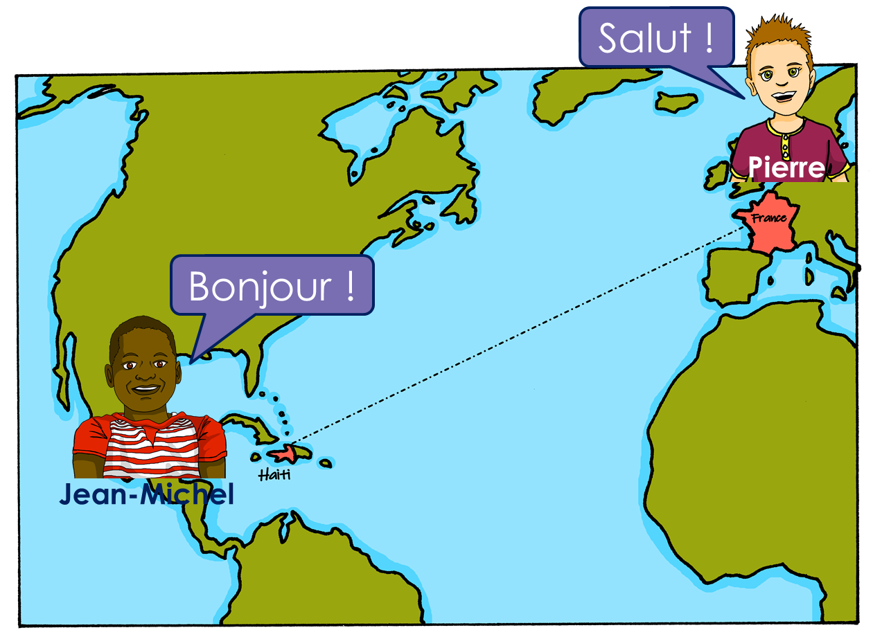
Describing me and others
rouge
Follow ups 1-5
Term 1 Week 4
Notes:
Artwork by Steve Clarke. Pronoun pictures from NCELP (www.ncelp.org). All additional pictures selected from Pixabay and are available under a Creative Commons license, no attribution required.
Phonics: [an/en] and [SFC] with final -d
Frequency of new words:
Phonics: enfant [126] grand [59]
Vocabulary: petit [138] grand [59] anglais [784] français [251] content [1841] triste [1843] tu [112] es [5]
Londsale, D., & Le Bras, Y. (2009). A Frequency Dictionary of French: Core vocabulary for learners London: Routledge.
The frequency rankings for words that occur in this PowerPoint which have been previously introduced in these resources are given in the SOW and in the resources that first introduced and formally re-visited those words.
For any other words that occur incidentally in this PowerPoint, frequency rankings will be provided in the notes field wherever possible.

Slide 2
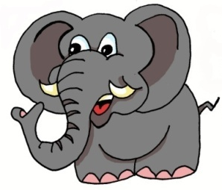
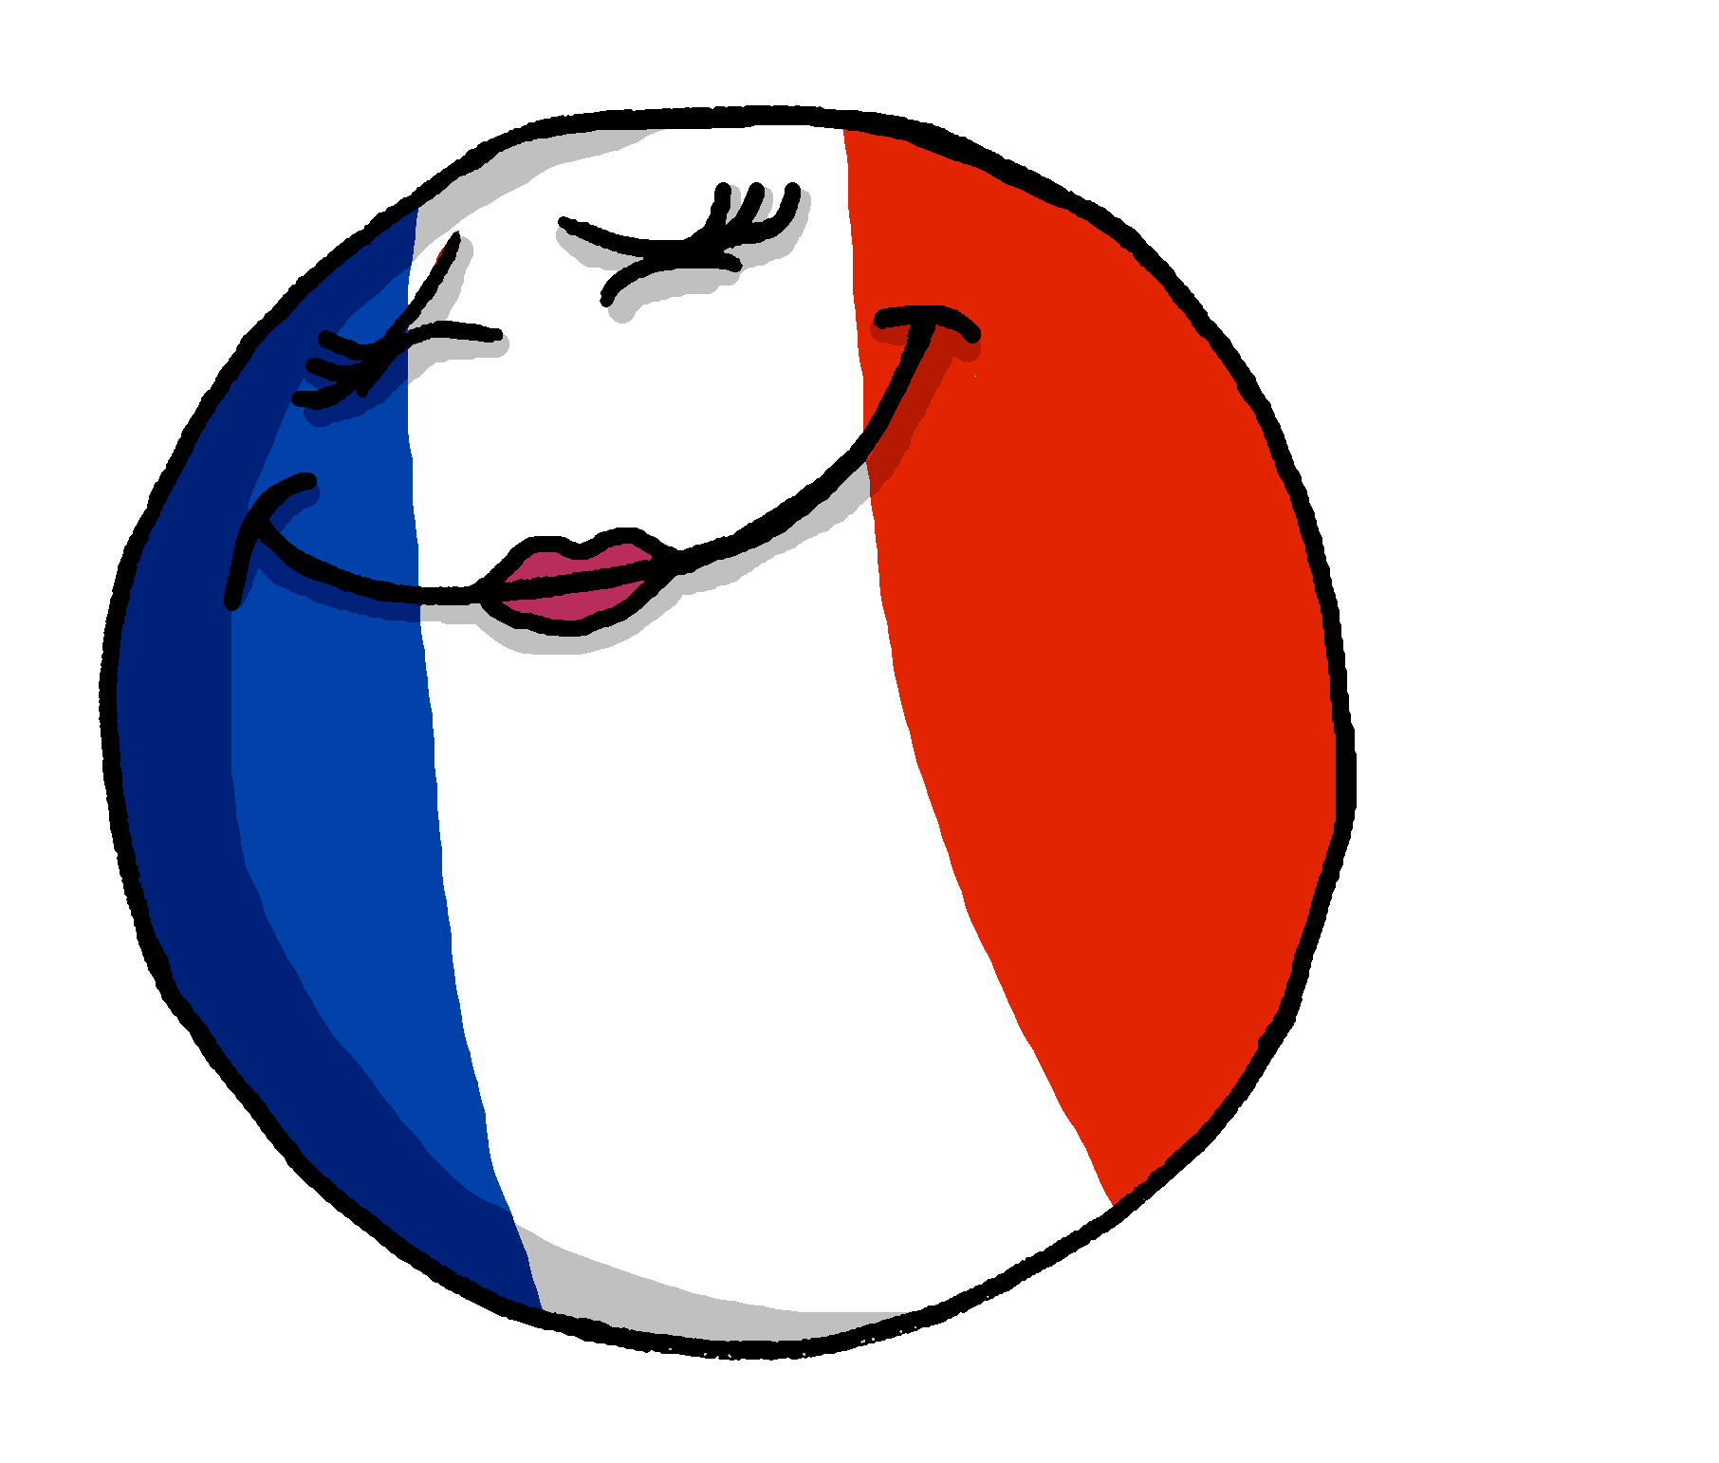
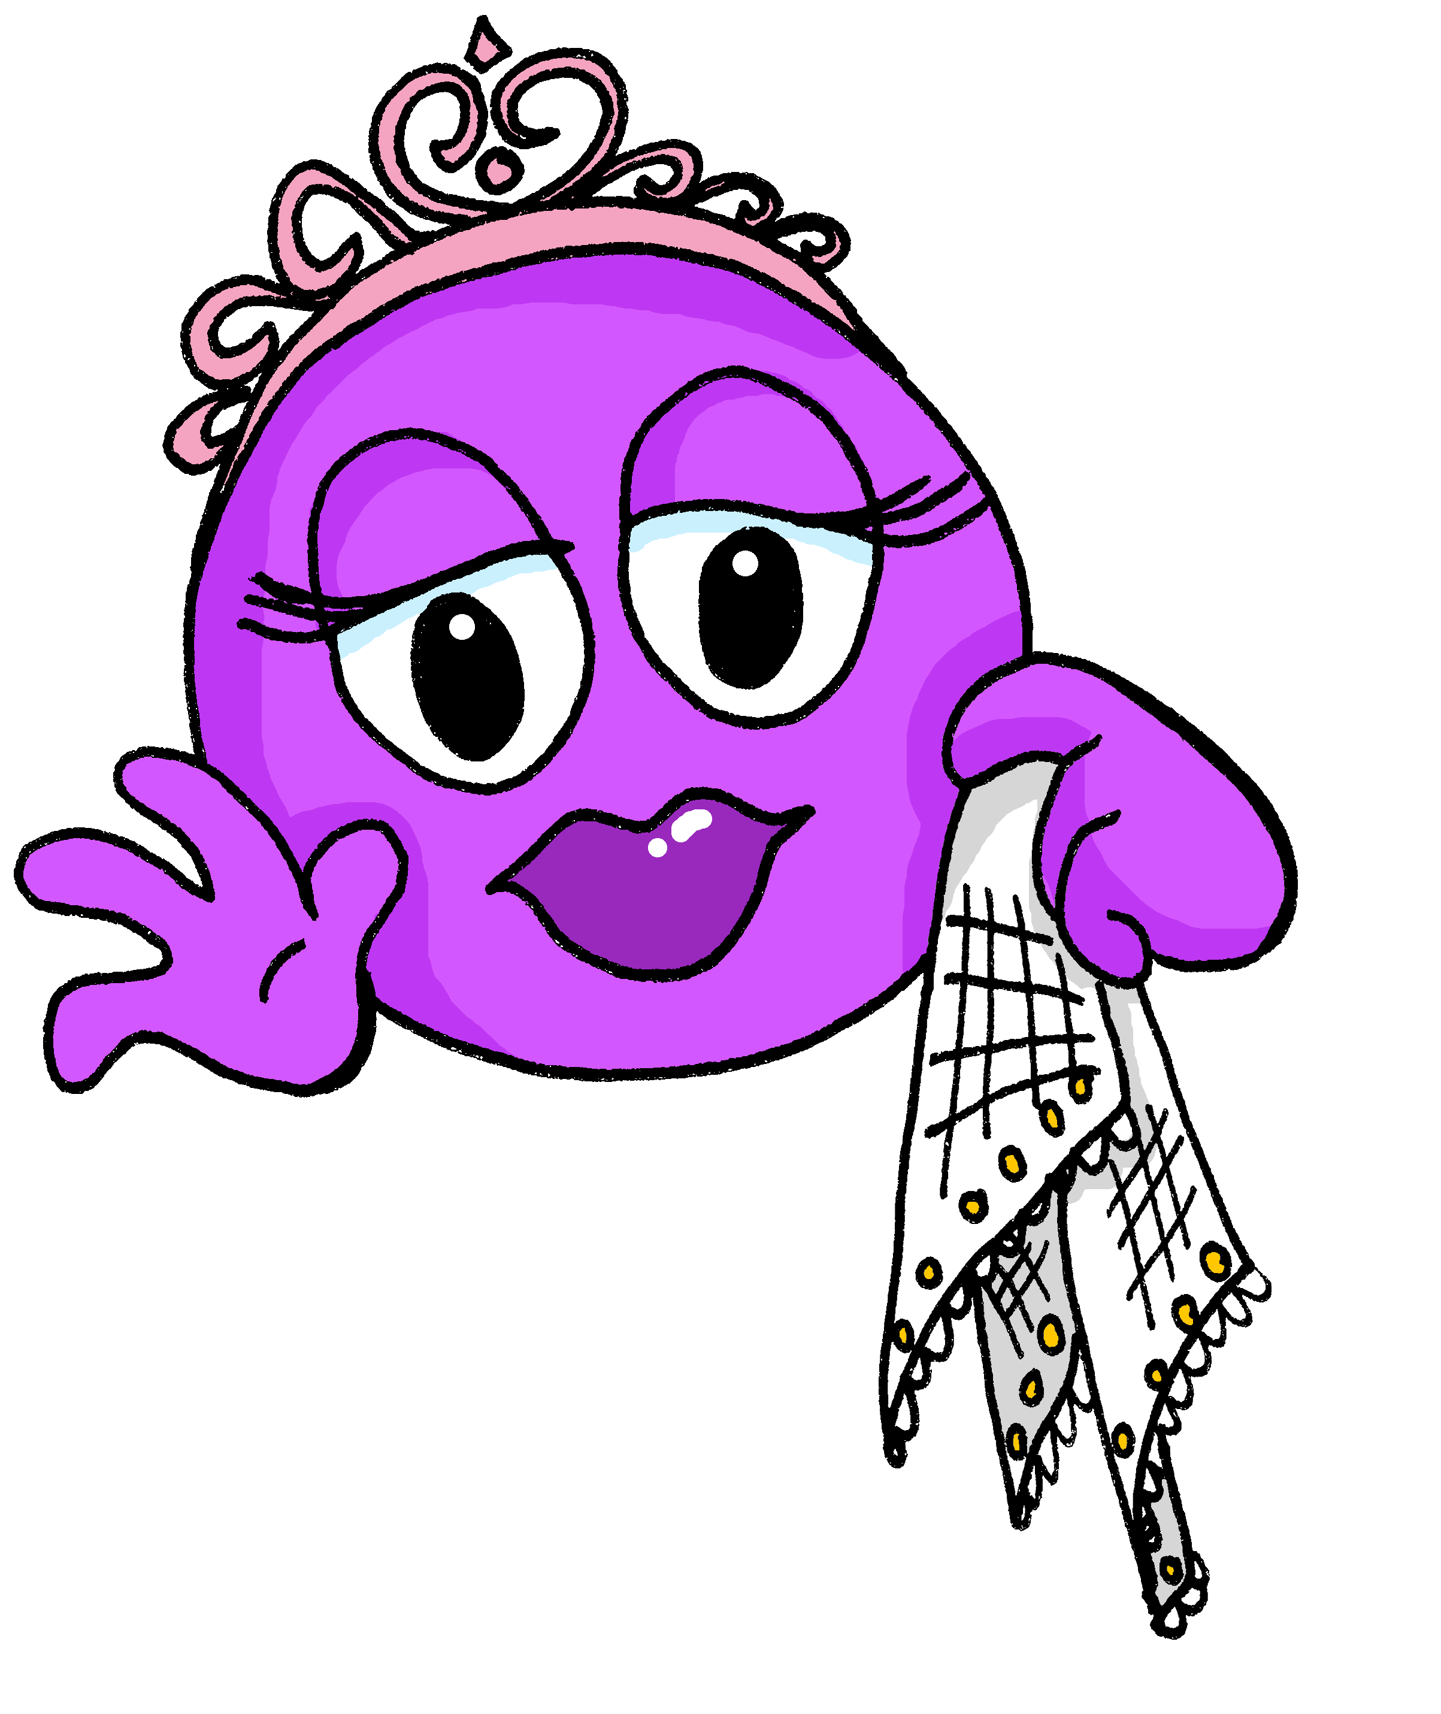
Follow up 1:
Écoute.
[an/en]
enfant
Which name has the SSC [an/en]?
A Écoute.
le Grand Prix
1
Ange | Anne
André | Denis
Jeanne | Alexandre
Marianne | Laurence
Antoine | Stéphane
Henri | Alain
Jean | Gabin
Nathan | Hannah
B Say these words one after the other as quickly as you can. Your partner will check.
2
3
éléphant
serpent
enfant
content
4
5
anglais
différent
grand
française
6
grande
élégante
français
prudent
7
8
anglaise
contente
élégant
différente
Notes:
Timing: 5 minutes
Aim: to practise aural recognition of this week’s SSC [an/en] and differentiate from other similar sounds.
Procedure:
Click to bring up the prompts.
Click on each audio symbol to listen to the two names.
Click for the answers.
Click to bring up task B.
Pupils apply their phonics knowledge to read aloud these words, a mixture of known words and unknown cognates. The listening partner can send his/her partner back to the start if s/he hears the [an/en] pronounced with English pronunciation.
Teacher circulates to listen and support, as needed.
Pupils swap roles.
Transcript Part A: [1] Ange, Anne [2] André, Denis [3] Jeanne, Alexandre [4] Marianne, Laurence [5] Antoine, Stéphane [6] Henri, Alain
[7] Jean, Gabin [8] Nathan, Hannah

Slide 3
Follow up 2:
Using adjectives
Remember to add ‘e’ to adjectives to make the feminine form:
The ‘d’ and ‘t’ are not pronounced.
Je suis grand.
I (a boy) am tall.
Masculine
An ‘e’ at the end, means you do pronounce the ‘d’ and ‘t’.
Il est petit.
He is short.
Je suis grande.
I (a girl) am tall.
Feminine
Elle est petite.
She is short.
Notes:
Timing: 5 minutes (two slides)
Aim: to revisit the previously taught pattern of adjective agreement (from Week 2).
Procedure:
Read the grammar explanation about adjective agreement.
Elicit English translation for the French examples provided.
Draw pupils’ attention to the SFC ‘t’ and to the change you hear when an ‘e’ is added.

Slide 4
Follow up 2:
Monsieur Lemaire is asking the class some questions.
Look at the adjective. Decide if the pupil is a boy or a girl.
Écris 1-8 et le nom de la personne.
lire
la liste
Ex. | Adèle | Olivier | tu es contente ?
1 | Anne | Milo | tu es français ?
2 | Lucas | Callie | tu es content ?
3 | Maxime | Hannah | tu es anglaise ?
4 | Patrice | Naomie | tu es petite ?
5 | Sophie | Oscar | tu es grand ?
6 | Pascal | Mia | tu es petit ?
7 | Odile | Ali | tu es grande ?
8 | Charlotte | Amir | tu es triste ?
Notes:
Aim: to practise written understanding of masculine and feminine adjective forms and to connect them to meaning.
Procedure:
1. Explain the task. Ensure pupils know that the only way they will know if the teacher is asking a boy or a girl each question is by look at the form of the adjective he uses. 2. Pupils write 1-8 and the name of the pupil for each. 3. Click for answers and clarify any misunderstandings. 4. If time allows, revisit the meaning of the adjectives by asking questions. E.g. Who is asked these questions: 1. who is tall? 2. who is English?

Slide 5
Follow up 3 [1/6]
Écoute.
Who is Pierre talking to? His sister Adèle or friend Yves?
écouter
Tu es française.
Adèle
Yves
Notes:
Timing: 5 minutes (six slides)
Aim: to practise aural recognition of masculine and feminine adjective forms and connect them to the correct gender.
Procedure:
Click on Pierre to hear him speak.
Pupils listen and select the correct person who is being addressed.
Click for answer and to see the written form of Pierre’s utterance.
Transcript: Tu es française.

Slide 6
Follow up 3 [2/6]
Écoute.
Who is Pierre talking to? His sister Adèle or cousin Jean-Michel?
écouter
Tu es grande.
Adèle
Jean-Michel
Notes:
[2/6]
Transcript: Tu es grande.

Slide 7
Follow up 3 [3/6]
Écoute.
Who is Pierre talking to? His sister Adèle or friend Yves?
écouter
Tu es petit.
Adèle
Yves
Notes:
[3/6]
Transcript: Tu es petit.

Slide 8
Follow up 3 [4/6]
Écoute.
Who is Pierre talking to? His sister Adèle or friend Yves?
écouter
Tu es contente.
Yves
Adèle
Notes:
[4/6]
Transcript: Tu es contente.

Slide 9
Follow up 3 [5/6]
Écoute.
Who is Pierre talking to? His sister Adèle or friend Yves?
écouter
Tu es français.
Adèle
Yves
Notes:
[5/6]
Transcript: Tu es français.

Slide 10
Follow up 3 [6/6]
Écoute.
7ho is Pierre talking to? His sister Adèle or cousin Jean-Michel?
écouter
Tu es triste.
Adjectives already ending with e do not change. They remain the same when describing a feminine or a masculine noun.
Adèle
Jean-Michel
Notes:
[6/6]
Transcript: Tu es triste. Note: next week’s lesson will focus explicitly on adjectives ending in –e.

Slide 11
Follow up 4 :
Tu es content.| Il est triste. | Elle est grande.
Say sentences to locate the hidden characters.
parler
small
tall
pleased
sad
French
English
You are
He is
She is
Notes:
Timing: 5 minutes (up to three rounds of the game)
Aim: to practise oral production of tu es, il est, elle est petit(e), grand(e), content(e), triste, français(e), anglais(e), connecting these with the English meanings.
Procedure: 1. Explain that pupils are Pierre and trying to locate Jean-Michel, Yves and Adèle.
2. Model how they create a sentence to try to locate each person.
E.g. Teacher says Tu es petit. Mouse over and click on the square to reveal what is underneath, in this case nothing. 3. Pupils volunteer sentences to locate the characters. Click on each square to make it fly out.
Note:
i) It is important to make clear that each character could be hiding behind any adjective, not just the ones that pupils think apply to him/her from the narrative so far! ii) However, each character is in the row his/her picture is in to support connection between words and meaning of the pronouns and verb forms. iii) There are two further versions of the game, with characters in different positions.
Answers: Jean-Michel is under you are English (tu es anglais). Yves is under he is tall (il est grand). Adèle is under she is pleased (elle est contente).

Slide 12
Follow up 4 :
Tu es content? Il est triste? Elle est grande?
Say sentences to locate the hidden characters.
parler
small
tall
pleased
sad
French
English
You are
He is
She is
Notes:
[2/3]
Answers: Jean-Michel is under you are sad (tu es triste). Yves is under he is French (il est français). Adèle is under she is tall (elle est grande).

Slide 13
Follow up 4 :
Tu es content? Il est triste? Elle est grande?
Say sentences to locate the hidden characters.
parler
small
tall
pleased
sad
French
English
You are
He is
She is
Notes:
[3/3]
Answers: Jean-Michel is under you are pleased (tu es content). Yves is under he is French (il est petit). Adèle is under she is English (elle est anglaise).

Slide 14
Follow up 5 :
Écris.
Complete each English sentence with an adjective.

Write your sentence in French.
1 _____________________________
écrire
Tu es français | française.
Decide if you are talking to a boy or a girl.
French
(You are ____________).

Je suis content | contente.
2 _____________________________
Here you are talking about yourself.
pleased
(I am ____________).

3 _____________________________
Elle est petite.
How do you write the adjective if you are talking about a girl?
short
(She is ____________).
Notes:
Timing: 5 minutes
Aim: to practise scaffolded written production of this week’s new language.
Procedure: 1. Pupils first select an adjective (from this week) to complete the English version of the sentence. 2. Then they write the sentence translation in French. 3. Before pupils start, click for the call out to prompt them. The animations are set up to do each sentence and then check, give feedback.
Note: There are answers given to model the process but pupils can select any of the adjectives that they know for this task.

Slide 15
vocabulaire
Écris en anglais : Can you get at least 15 points?
mots
 | banane | moto | écouter
 | univers | cheval | midi
 | oui | bien | ça va ?
 | non | Au revoir ! | mal
 | petit | anglaise | content
 | tu | français | triste
 | grande | contente | es
banana
motorbike
to listen, listening
x3
universe
horse
midday
yes
good/well
is it going ok?
x2
no
Goodbye!
bad(ly)
short (m)
English (f)
pleased (m)
you
French (m)
sad (m/f)
x1
tall (f)
pleased (f)
are
Notes:
EXTRA Note: this activity was in the 30-minute lesson for this week, but if time allows, pupils could do it again with different words this time to make their total of 15. Or they could try to do all of it. Or the teacher could use it as a quickfire meaning recall task. Timing: 5 minutes
Aim: to practise written comprehension of vocabulary from week 1, last week and this week.
Procedure: 1. Give pupils a blank grid. They fill in the English meanings of any of the words they know, trying to reach 15 points in total. 2. Remind pupils that adjectives can refer to male or female persons and they should note this in their translations. E.g. pleased (f), short (m).
Note: The most recently learnt and practised words are pink, words from the previous week are green and those from week 1 are blue, thus more points are awarded for them, to recognise that memories fade and more effort (heavy lifting!) is needed to retrieve them.
15

