Slide 1
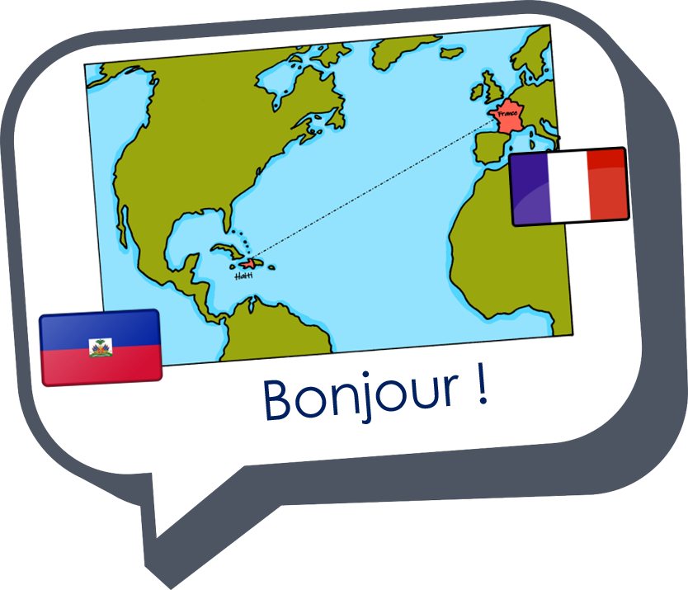
Describing me and others
rouge
Les voyelles (vowels)
SSC [a] [o] [e] [i] [u]
Term 1 Week 1
Notes:
Artwork by Steve Clarke. Pronoun pictures from NCELP (www.ncelp.org). All additional pictures selected from Pixabay and are available under a Creative Commons license, no
attribution required.
Note that this first lesson is unusual. Most lessons in this scheme of work focus on phonics, vocabulary and grammar. This first introductory lesson focuses just on five vowel sounds
and four infinitive verbs, which are learnt as individual lexical items. Later pupils will learn the pattern of –er verbs in the present tense, but they will not learn to use different persons
of –re or –ir verbs until KS3.
Frequency of new words:
Phonics: [a] [o] [e] [i] [u] source words: banane [>5000] cheval [2220] midi [2483] moto [>5000] univers [2112]
Vocabulary: écouter [429] parler [106] lire [278] écrire [382]
Londsale, D., & Le Bras, Y. (2009). A Frequency Dictionary of French: Core vocabulary for learners London: Routledge.
The frequency rankings for words that occur in this PowerPoint which have been previously introduced in these resources are given in the SOW and in the resources that first
introduced and formally re-visited those words.
For any other words that occur incidentally in this PowerPoint, frequency rankings will be provided in the notes field wherever possible.
Note that the first three lessons of the year teach language that can be continuously recycled as lesson routine every lesson in Y3/4.
The idea would be that the class teacher (whether or not s/he teaches the class French can re-use the language as part of the daily routine with the class.
1

Slide 2
Bonjour, tout le monde !
écouter
parler
lire
écrire
Notes:
Timing: 3 minutes
Aim: to introduce four infinitive verbs as part of essential classroom language.
Procedure:
Say Bonjour, tout le monde ! and explain the meaning of the words/phrase (Hello, everyone!).
Encourage pupils to respond and say ‘Bonjour!’ in response.
Introduce the French verb écouter, mime ‘to listen’ and tell pupils it means ‘to listen or listening’.
Practise the pronunciation with them.
Repeat with the other three infinitives.
Practise saying the infinitives in a jumbled order and inviting pupils to respond with the appropriate mime/gesture.

Slide 3
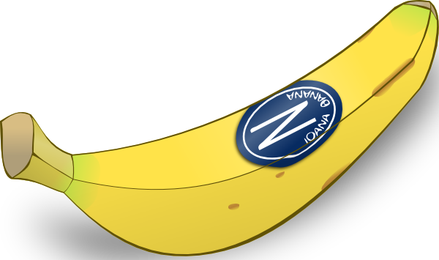
[a]
banane
prononcer
Notes:
Timing: 1 minute
Aim: To introduce SSC [a]
Procedure:
Introduce and elicit the pronunciation of the individual SSC [a] and then the source word ‘banane’ (with gesture, if using).
Click to bring on the picture and get students to repeat (with gesture, if using).
Note: a gesture for ‘banana’ – we suggest making the shape of a banana with both hands – start with finger tips together in the middle, pull them apart and upwards to trace the shape of a banana (like the shape of a smile).
3

Slide 4
[o]
moto
prononcer
Notes:
Timing: 1 minute
Aim: To introduce SSC [o]
Procedure:
Introduce and elicit the pronunciation of the individual SSC [o] and then the source word ‘moto’ (with gesture, if using).
Click to bring on the picture and get students to repeat (with gesture, if using).
Note: a gesture for moto – hands out in front as though gripping the handle bars, sway right and left as if riding quickly round corners.
4

Slide 5
prononcer
[o]
moto
[a]
banane
Notes:
Timing: 1 minute
Aim: To practise SSC [a] [o]
Procedure:
Practise pronunciation of the individual SSC [a] and [o] – invite pupils to read aloud the source words again ‘banane’ & ‘moto’ (with gestures, if using).
5

Slide 6
prononcer
banane
moto
[a]
[o]
Notes:
Timing: 1 minute
Aim: To practise key SSC [a] [o] & source words (banane – moto).
Procedure:
Elicit the SSC and the source words again ‘banane’ & ‘moto’ (with gesture, if using).
Pupils point at the right picture & work in pairs to practise action (if provided) and sound
Extra: give students 30 seconds to practise in pairs – one uses the gesture, the other says the correct source word (banane / moto) OR one says the key individual SSC [a] [o] and the other students says the source word.
6

Slide 7
prononcer
[i]
midi
Notes:
Timing: 1 minute
Aim: To introduce SSC [i]
Procedure:
Introduce and elicit the pronunciation of the individual SSC [i] and then the source word ‘midi’ (with gesture, if using).
Click to bring on the picture and get students to repeat (with gesture, if using).
Note: gesture for midday – raise both arms above your head, palms touching to mime 12 o’clock.
7

Slide 8
prononcer
[e]
cheval
Notes:
Timing: 1 minute
Aim: To introduce SSC [e]
Procedure:
Introduce and elicit the pronunciation of the individual SSC [e] and then the source word ‘cheval’ (with gesture, if using).
Click to bring on the picture and get students to repeat (with gesture, if using).
Note: a gesture for horse – mime of horse riding.
8

Slide 9
prononcer
[i]
midi
[e]
cheval
Notes:
Timing: 1 minute
Aim: To practise SSC [i] [e]
Procedure:
Practise pronunciation of the individual SSC [i] and [e] – elicit the source words again ‘midi’ & ‘cheval’ (with gestures, if using).
9

Slide 10
prononcer
[i]
midi
[e]
cheval
Notes:
Timing: 1 minute
Aim: To practise key SSC [i] [e] & source words (banane – moto).
Procedure:
Elicit the SSC and the source words again ‘midi’ & ‘cheval’ (with gesture, if using).
Pupils point at the right picture & work in pairs to practise action (if provided) and sound.
Extra: give students 30 seconds to practise in pairs – one uses the gesture, the other says the correct source word (midi / cheval) OR one says the key individual SSC [i] [e] and the other students says the source word.
10

Slide 11
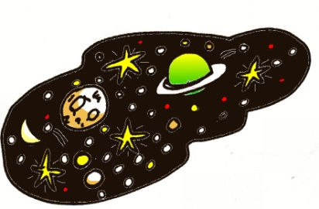
prononcer
[u]
univers
Notes:
Timing: 1 minute
Aim: To introduce SSC [u]
Procedure:
Introduce and elicit the pronunciation of the individual SSC [u] and then the source word ‘univers’ (with gesture, if using).
Click to bring on the picture and get students to repeat (with gesture, if using).
Note: gesture for universe - start with hands in front about eye level and touching. Draw them apart and around to trace the shape of the earth (we know the earth is not the universe, but it’s a helpful gesture for the sound as well). Note: the silent final consonant is greyed out in the word ‘univers’. Teachers can explain to pupils that some final letters are silent in French and that they will learn more about this next week.
11

Slide 12
prononciation
[a]
[e]
[i]
[o]
[u]
Notes:
Timing: 1 minute
Aim: to practise all of the five sound-spelling correspondences in succession, following the usual pattern of vowels (a,e,i,o,u) that pupils are used to.
Procedure:
Click to reveal [a] and elicit its pronunciation chorally from all pupils.
Repeat for the other four vowels.
12

Slide 13
les voyelles - song
Notes:
Timing: 3 minutes
Aim: to practise oral production of the five vowels sounds; saying/singing in time to music aids automatization.
Procedure:
1. Play the song and invite pupils to join in and sing along.
Video source:
https://www.youtube.com/watch?v=lXPUmC51wGc
Note: this song is good to sing along to – it includes ‘y’ as a vowel, though it is said ‘ee grec’ in the song, as the letter name. The pronunciation is the same as ‘i’ when used as a vowel.
Soon pupils will learn this, when they learn ‘stylo’ and also ‘il y a’ when it is an adverbial pronoun meaning ‘there’.
13

Slide 14
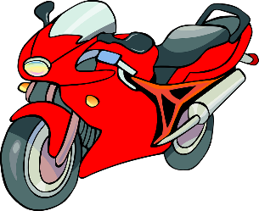
pair work
a e i o u
la le li lo lu
ma me mi mo mu
da de di do du
ta te ti to tu
Notes:
Timing: 3 minutes
Aim: to practise pronouncing the new French vowel sounds in combination with consonants that are pronounced in a similar way (at the front of words) to English (l, m, d, t).
Procedure:
1. In pairs, pupils practise saying the lines from left to right. One should speak, whilst the other listens to ensure that his/her partner is saying it correctly.
14

Slide 15
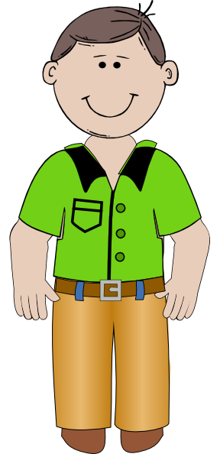
read aloud
Papa va à la cabane
Le cheval aussi, à midi
Notes:
Timing: 4 minutes (two slides)
Aim: to practise reading aloud a mixture of known and unknown words with this week’s SSC.
Procedure:
Pupils read aloud the first phrase, along with the teacher (rather than repeating after him/her).
Teachers used the animated pictures to cue the pace of read along.
Steps 1-2 can be repeated several times.
Continue with the second phrase.
Repeat all steps with the 2nd part of the ‘comptine’ on the next slide.
Note: it is not expected that pupils learn the unknown words, here. They have been selected to provide an opportunity to apply the newly learnt SSC. The pictures are provided to support understanding of the short phrases.
15

Slide 16
read aloud
La moto perdue, dans l’univers
[in]
a – e – i – o – u
Notes:
[2/2]
16

Slide 17
Au revoir, tout le monde !
écouter
parler
lire
écrire
Notes:
Timing: 3 minutes
Aim: to recap four infinitive verbs as part of essential classroom language.
Procedure:
Remind pupils of the meanings and pronunciations of these four verbs.
Repeat them with the class.
Ask them to tell you which of these activities they have done this lesson (they should say écouter, parler, lire).
Confirm this and say that next week they will do more of these three and also écrire. Ask them to tell you again what ‘écrire’ is.
Say Au revoir, tout le monde ! and explain the meaning of the words/phrase (Goodbye, everyone!).
Encourage pupils to respond and say ‘Au revoir!’ in response, perhaps with a ‘farewell wave’ gesture.
Note: usually, all lessons will be 30 minutes long, with the additional five follow up mini lessons of 5 + 5 + 5 +5 + 10. This first lesson is a few minutes shorter, to account for settling into routines at the start of the new year.

Slide 18
Au revoir !
Bonjour !
rouge
Notes:
18

