Slide 1
Describing me and others
rouge
Les voyelles (vowels)
Follow ups 1-5
Term 1 Week 1
Notes:
Artwork by Steve Clarke. Pronoun pictures from NCELP (www.ncelp.org). All additional pictures selected from Pixabay and are available under a Creative Commons license, no attribution required.
Frequency of new vocabulary and phonics:
Phonics: [a] [o] [e] [i] [u] source words: banane [>5000] cheval [2220] midi [2483] moto [>5000] univers [2112]
Vocabulary: écouter [429] parler [106] lire [278] écrire [382]
Londsale, D., & Le Bras, Y. (2009). A Frequency Dictionary of French: Core vocabulary for learners London: Routledge.
The frequency rankings for words that occur in this PowerPoint which have been previously introduced in these resources are given in the SOW and in the resources that first introduced and formally re-visited those words.
For any other words that occur incidentally in this PowerPoint, frequency rankings will be provided in the notes field wherever possible.

Slide 2
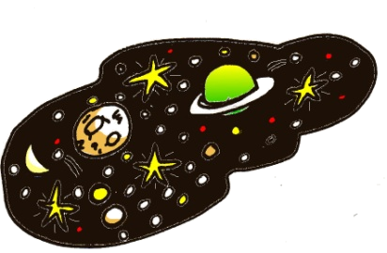
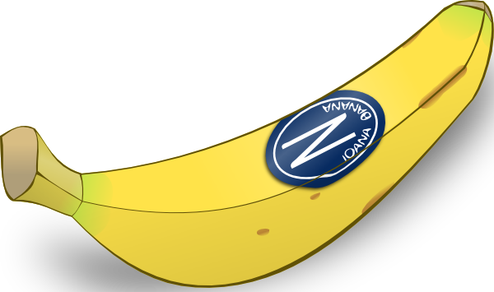
Follow up 1
A Écoute. Which number is it?
B Écoute. Draw it and write the vowel!
3
Banane is number ________.
[e]
4
[o]
Moto is number _______.
5
Cheval is number _______.
1
Midi is number _______.
2
Univers is number _______.
[u]
1
2
[i]
[a]
3
4
5
Notes:
Timing: 5 minutes
Aim: to practise aural comprehension and written production of the SSC [a] [o] [e] [i] and [u].
Procedure:
Click to bring up the prompts.
Click on each audio symbol to listen to the words.
Click for the number answers.
Click to bring up task B. Click to hear the audio.
Pupils draw the picture and write the vowel. Give a time limit for the drawing (e.g., 30 seconds for each).
Click for answers.
Transcript Part A: [1] Midi [2] Univers [3] Banane [4] Moto [5] Cheval
Part B: [1] Moto [2] Cheval [3] Univers
[4] Cheval
[5] Banane
2

Slide 3
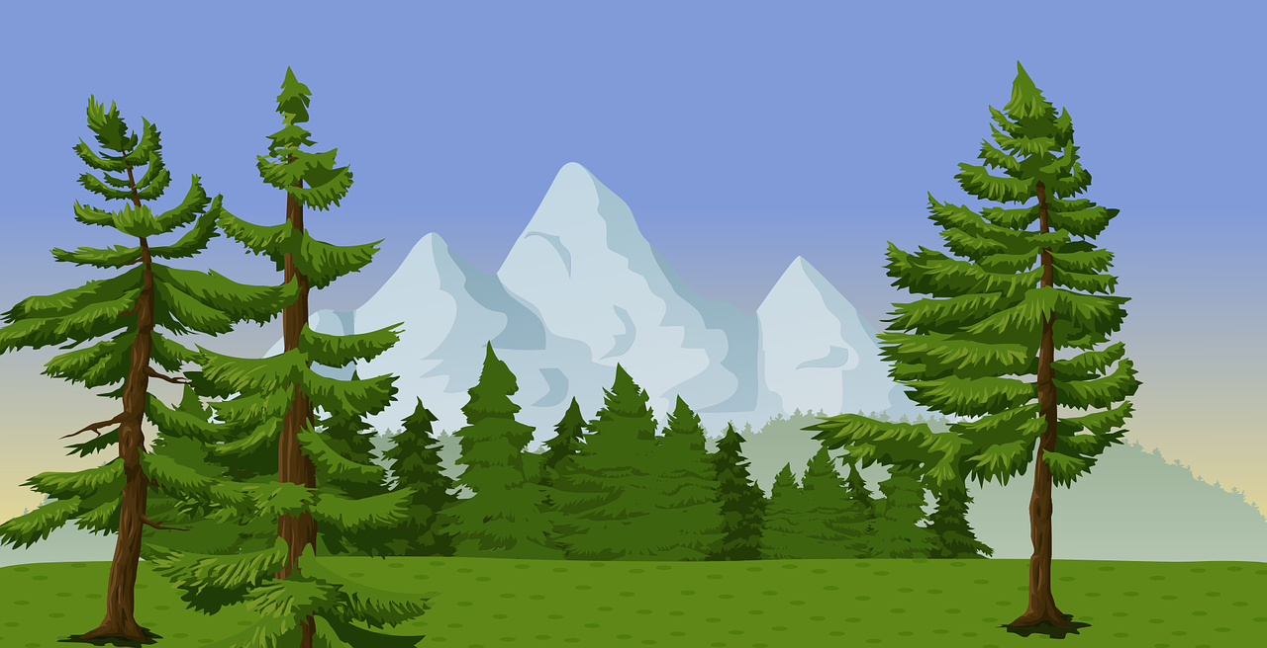
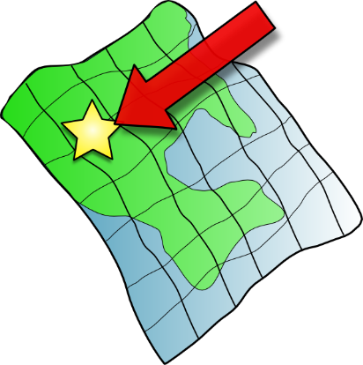
Follow up 2:
Écoute. Écris la bonne lettre.
p h o t o
2
a d u l t e
n a t u r e
1
_
_
_
_
3
_
_
écouter
4
s e c o n d
5
a n i m a l
p u b l i c
_
_
_
_
_
6
_
_
i c i
c u l t u r e
S a l u t
7
_
_
8
_
_
9
_
_
[here]
la bonne lettre – the right letter
Notes:
Timing: 5 minutes
Aim: to practise transcribing the missing vowels in unknown words.
Procedure:
Click to listen to each word.
Listen and write the missing letter(s).
Click to reveal answers.

Slide 4
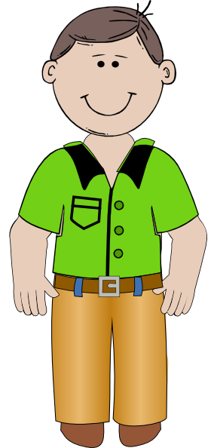
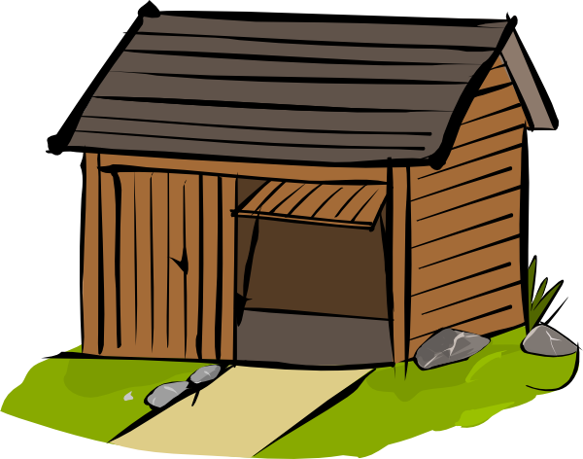
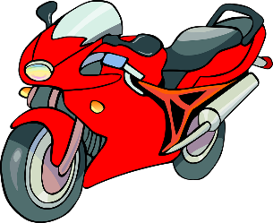
Follow up 3:
Lis les phrases.
lire
1. Papa va à la cabane.
Dad goes to the cabin.
2. Le cheval aussi, à midi .
The horse, too, at midday.
[in]
3. La moto perdue, dans l’univers.
The motorbike lost, in the universe.
4. a – e – i – o – u.
Notes:
Timing: 5 minutes
Aim: to read aloud phrases containing the key vowel sounds from this week.
Procedure: 1. Pupils read aloud each phrase.
2. Click to hear the audio. 3. Click to bring up prompt pictures one by one and elicit the words again from pupils, chorally.

Slide 5
Follow up 4:
Écoute. What is it in English?
écouter
[to listen]
[to speak]
[to read]
[to write]
écouter
parler
lire
écrire
1
2
3
4
5
6
[to read]
[to listen]
[to listen]
[to speak]
[to read]
[to write]
7
8
9
10
11
12
[to speak]
[to listen]
[to write]
[to read]
[to write]
[to speak]
Notes:
Timing: 5 minutes
Aim: to practise aural comprehension of four infinitive verbs.
Procedure:
1. Present the four verbs one by one and pupils repeat. 2. Click the audio buttons to listen 1-12. 3. Pupils respond (either with a gesture or saying the English meaning). 4. Click to reveal the answer each time.

Slide 6
Follow up 5:

Écris.

Write each word on your sleeve with your finger.
1 _______________________
écrire
Ana va
parler.
(Ana is going to speak).

p a r l e r
p a r l e r
It helps if you say the word as you write it, too.
écouter.
2 ________________________
Papa va
(Dad/Daddy is going to listen).

3 ________________________
Ali va
lire.
(Ali va to read).
Notes:
Timing: 10 minutes
Aim: to practise writing individual words from memory.
Procedure: 1. Click to model how pupils can practise writing on their sleeve first.
2. Pupils practise writing the first word (parler) on their sleeve.
2. Click to reveal parler as the answer for 1. 3. Pupils continue with words 2-3. 4. Click to remove the modelling and the answers.
5. This time, pupils write the words in pencil in their books. 6. Click to reveal the answers again.

