Slide 1
Saying what I and others have
rouge
Phonics quiz
Notes:
Artwork by Steve Clarke. Pronoun pictures from NCELP (www.ncelp.org). All additional pictures selected from Pixabay and are
available under a Creative Commons license, no attribution required.
This lesson contains a phonics assessment to check progress in SSC practised in the first 12 weeks of this year’s course.
The frequency rankings for words that occur in this PowerPoint which have been previously introduced in these resources are given in the SOW and in the resources that first introduced and formally re-visited those words. For any other words that occur incidentally in this PowerPoint, frequency rankings will be provided in the notes field wherever possible.
1

Slide 2
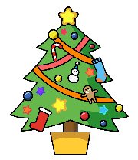
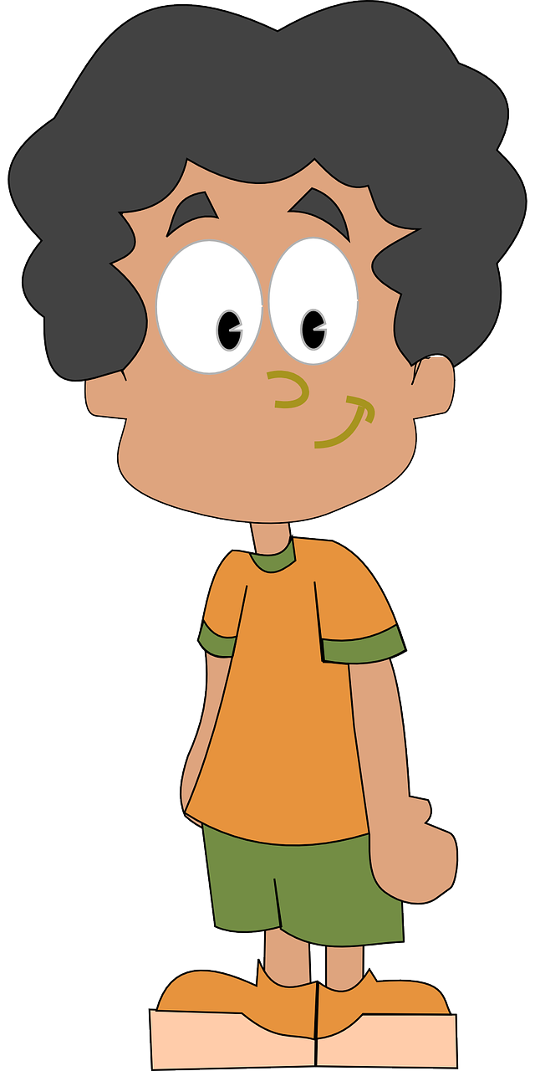
prononcer
Joyeux Noël !
Read aloud the Christmas present and the French name. They have the same final sound.
You have not learnt these words so use what you know about how to pronounce French.
statue
Remember Silent Final Consonants!
Artus
Notes:
Phonics assessment Week 14 Prior preparation: print out one set of phonics slides and cut in half; print out sufficient pupil feedback sheets to have one per pupil.
Timing: 1 minute
Aim: to introduce the phonics quiz to pupils and model an example
Procedure: 1. Click to bring up the SSC, the name and the present item.
2. Elicit the item and the name.
3. Click the words to hear them pronounced.
Note:
there are no follow up lessons this week, so it would be possible to continue the speaking assessments in the follow up time during this week, as needed.
if preferred, and the resources are available, pupils could record their answers (e.g. on computer or ipad) though this would involve the teacher listening back to assess them.
Frequency of unknown words: statue [4020]
Londsale, D., & Le Bras, Y. (2009). A Frequency Dictionary of French: Core vocabulary for learners London: Routledge.
2

Slide 3
prononcer
[SFC]
[(e)au/o]
prononcer
rat
seau
Lilas
Coco
Notes:
Timing: 1 minute per pupil
Aim: to assess pupils’ ability to read aloud the SSC taught this term. Procedure: 1. Give out the independent task that pupils will work on during the lesson. 2. Listen to individual pupils reading the words aloud. Mark in real time.
3. If desired, teachers can listen to the audio versions in preparation.
Note:
there are no follow up lessons this week, so it would be possible to continue the speaking assessments in the follow up time during this week, as needed.
if preferred, and the resources are available, pupils could record their answers (e.g. on computer or ipad) though this would involve the teacher listening back to assess them.
Frequency of unknown words: rat [4290] seau [>5000]
Londsale, D., & Le Bras, Y. (2009). A Frequency Dictionary of French: Core vocabulary for learners London: Routledge.
3

Slide 4
prononcer
[u]
[eu]
prononcer
vue
jeu
Prue
Mathieu
Notes:
Frequency of unknown words: jeu [291] vue [191]
Londsale, D., & Le Bras, Y. (2009). A Frequency Dictionary of French: Core vocabulary for learners London: Routledge.
4

Slide 5
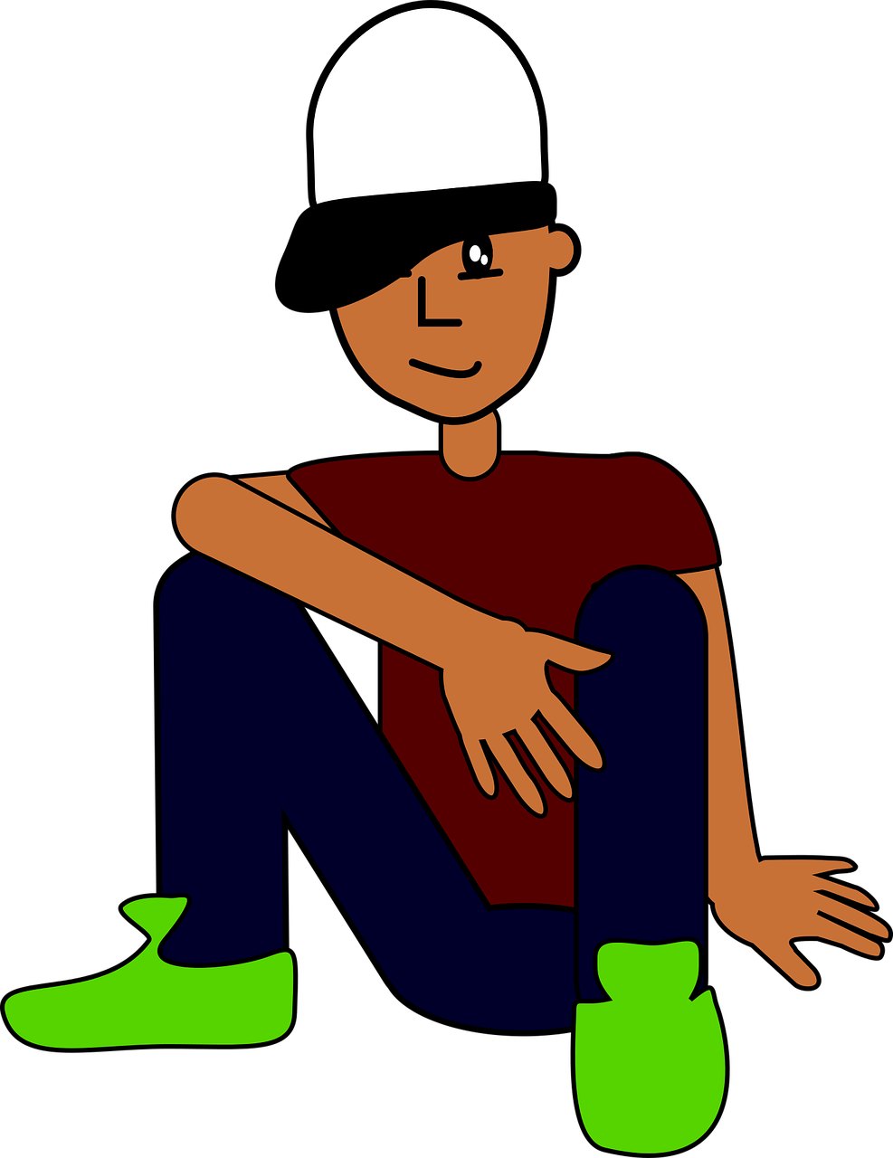
prononcer
[ou]
[on]
prononcer
iglou
chanson
Ballou
Vardon
Notes:
Frequency of unknown words: iglou [>5000] chanson [2142]
Londsale, D., & Le Bras, Y. (2009). A Frequency Dictionary of French: Core vocabulary for learners London: Routledge.
5

Slide 6
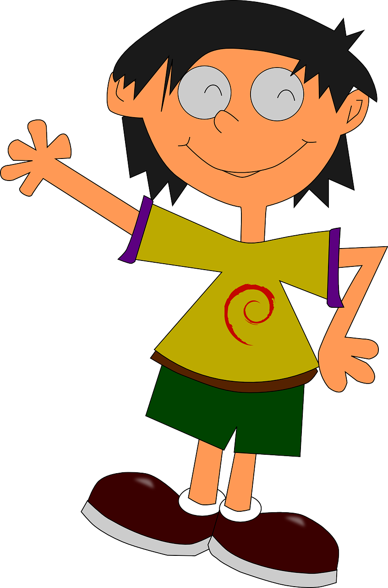
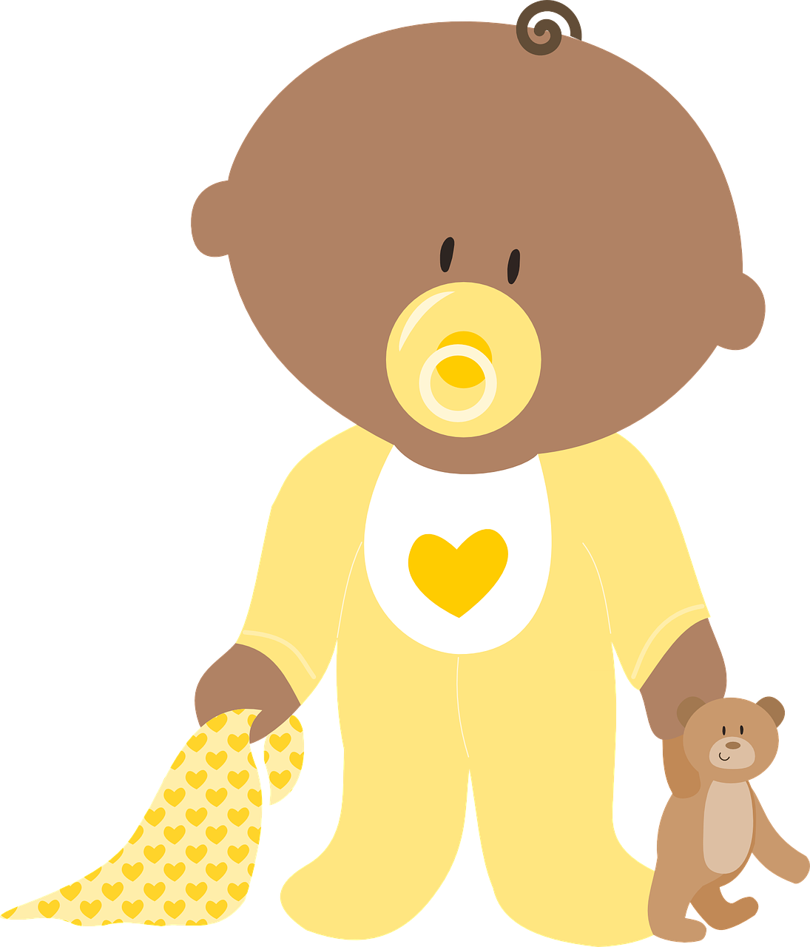
prononcer
[an/en]
[ch]
prononcer
gants
cloche
Laurent
Gavroche
Notes:
Frequency of unknown words: cloche [4273] gant [>5000]
Londsale, D., & Le Bras, Y. (2009). A Frequency Dictionary of French: Core vocabulary for learners London: Routledge.
6

Slide 7
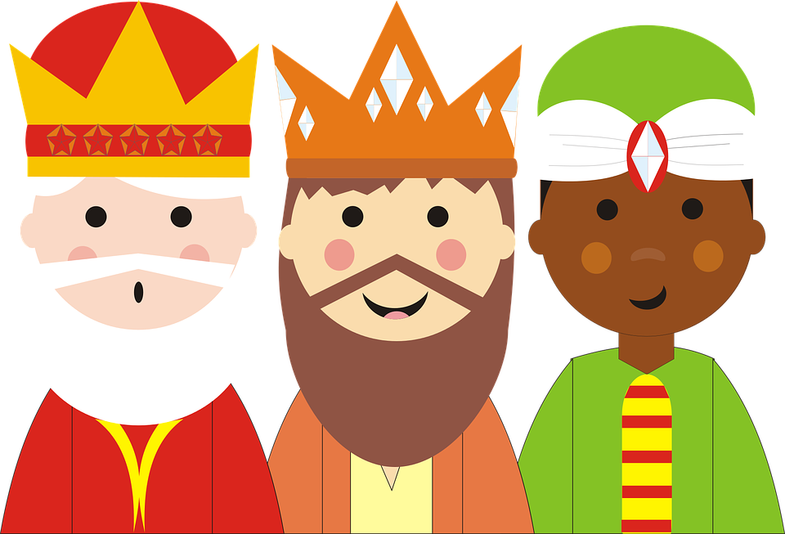
lire
In English, we often say “the three Wise Men”, whereas the French name means ‘magic kings’.
Les Rois mages
A Lis et complete le texte. ✍
Adèle eats a ‘cake of the Kings’. It is for Epiphany and the arrival of the three kings: Balthazar, Gaspard and Melchior in Bethlehem. It is a tradition.
In France, in January, there are ‘galettes’ in the north and ‘crowns’ in the south. Each cake contains a lucky charm (or figurine) and a crown!
For ‘La Fête des Rois’ a child goes under the table and decides who has their slice of galette. It is the tradition.
On the 6th January, Adèle finds the lucky charm. She wears the crown. She is very pleased. ☺
Adèle mange une galette des Rois. C’est pour l’Épiphanie et l’arrivée des trois Rois mages : Balthazar, Gaspard et Melchior à Bethléem. C’est une tradition.
En France, en janvier, il y a des galettes dans le nord et des couronnes dans le sud.
Chaque gâteau contient une fève (ou figurine)et une couronne !
Pour ‘ La Fête des Rois’, un enfant va sous la table et décide qui a sa part de galette.
C’est la tradition.
Le 6 janvier, Adèle trouve la fève. Elle porte la couronne. Elle est très contente.
__
____
__
____
______
____
__
__ _____
__ _____
_____ _
__
______
Notes:
Note: for all the activities during this lesson, pupils work independently. Teachers may want to assign activity leaders who are responsible for clicking to check the answers and to move the activity on. This frees up the teacher to listen to as many pupils doing the phonics read aloud as possible
Timing: 5 minutes
Aim: to practise written production of previously taught vocabulary.
Procedure: 1. Using the English and French versions of the text to identify the words that are missing, pupils then write in the 8 missing words in French.
2. Click to reveal the answers and pupils mark their own work.
7

Slide 8
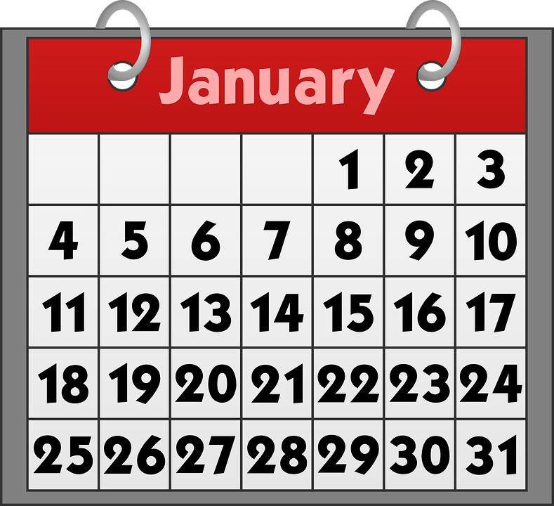
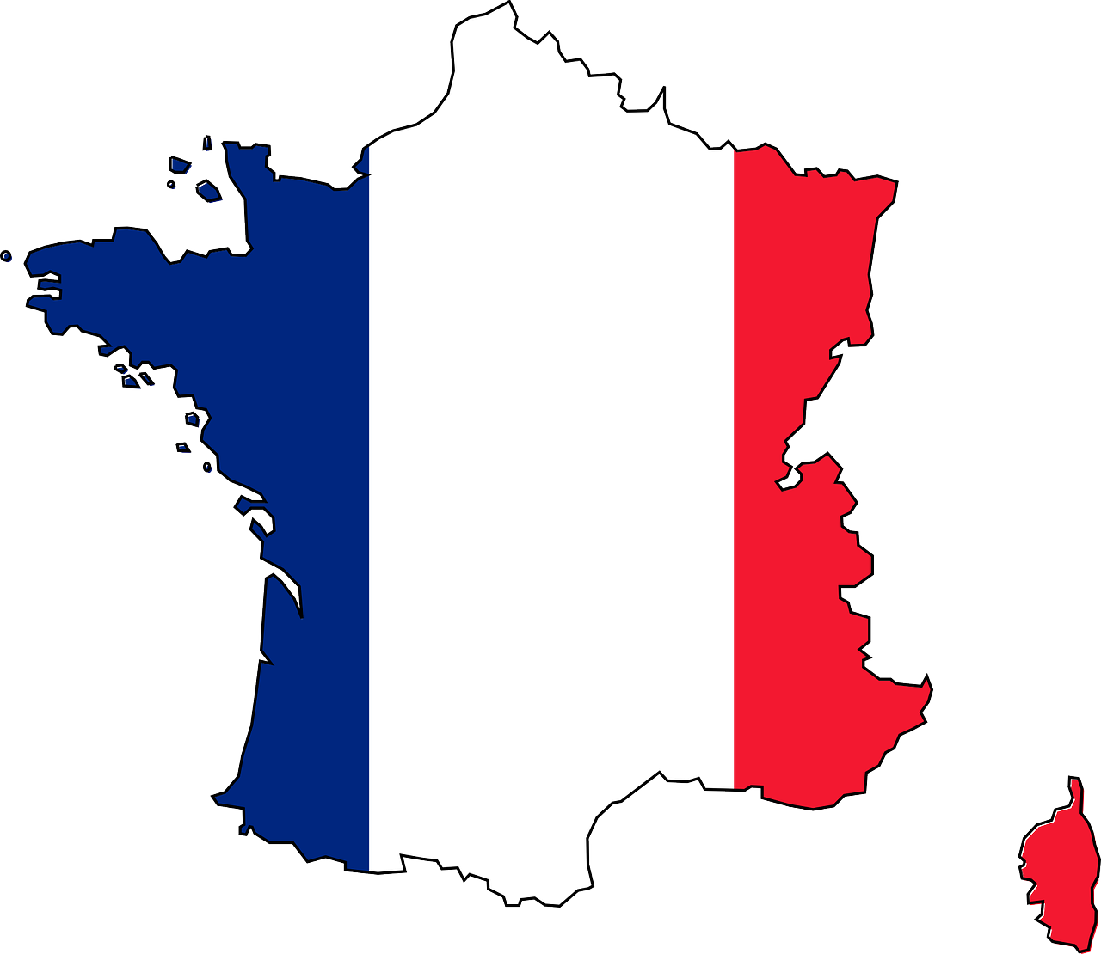
lire
maison - house
Les Rois mages
B Put the pictures in order according to the text.
Adèle mange une galette des Rois. C’est pour l’Épiphanie et l’arrivée des trois Rois mages: Balthazar, Gaspard et Melchior à Bethléem. C’est une tradition.
En France, en janvier, il y a des galettes dans le nord et des couronnes dans le sud.
Chaque gâteau contient une fève (ou figurine)et une couronne !
Pour ‘ La Fête des Rois’, un enfant va sous la table et décide qui a sa part de galette.
C’est la tradition.
Le 6 janvier, Adèle trouve la fève. Elle porte la couronne. Elle est très contente.
[A]
[5]
[B]
[4]
[E]
[7]
[C]
[1]
[6]
[F]
[G]
[2]
[3]
[D]
Notes:
Timing: 10 minutes
Aim: to practise written comprehension of the main details of the text.
Procedure:
1. Using the French and English versions of the text, as needed, pupils put the pictures in order of the text. 2. Click to reveal the correct answers.
Note: There is a full version of the audio attached to a ‘player’ top right of the slide.
8

Slide 9
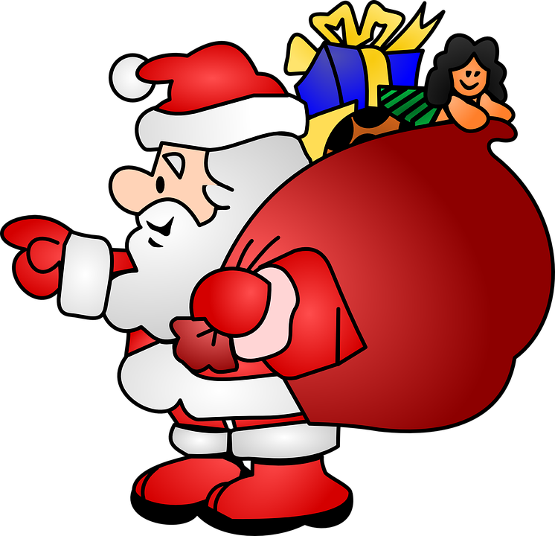
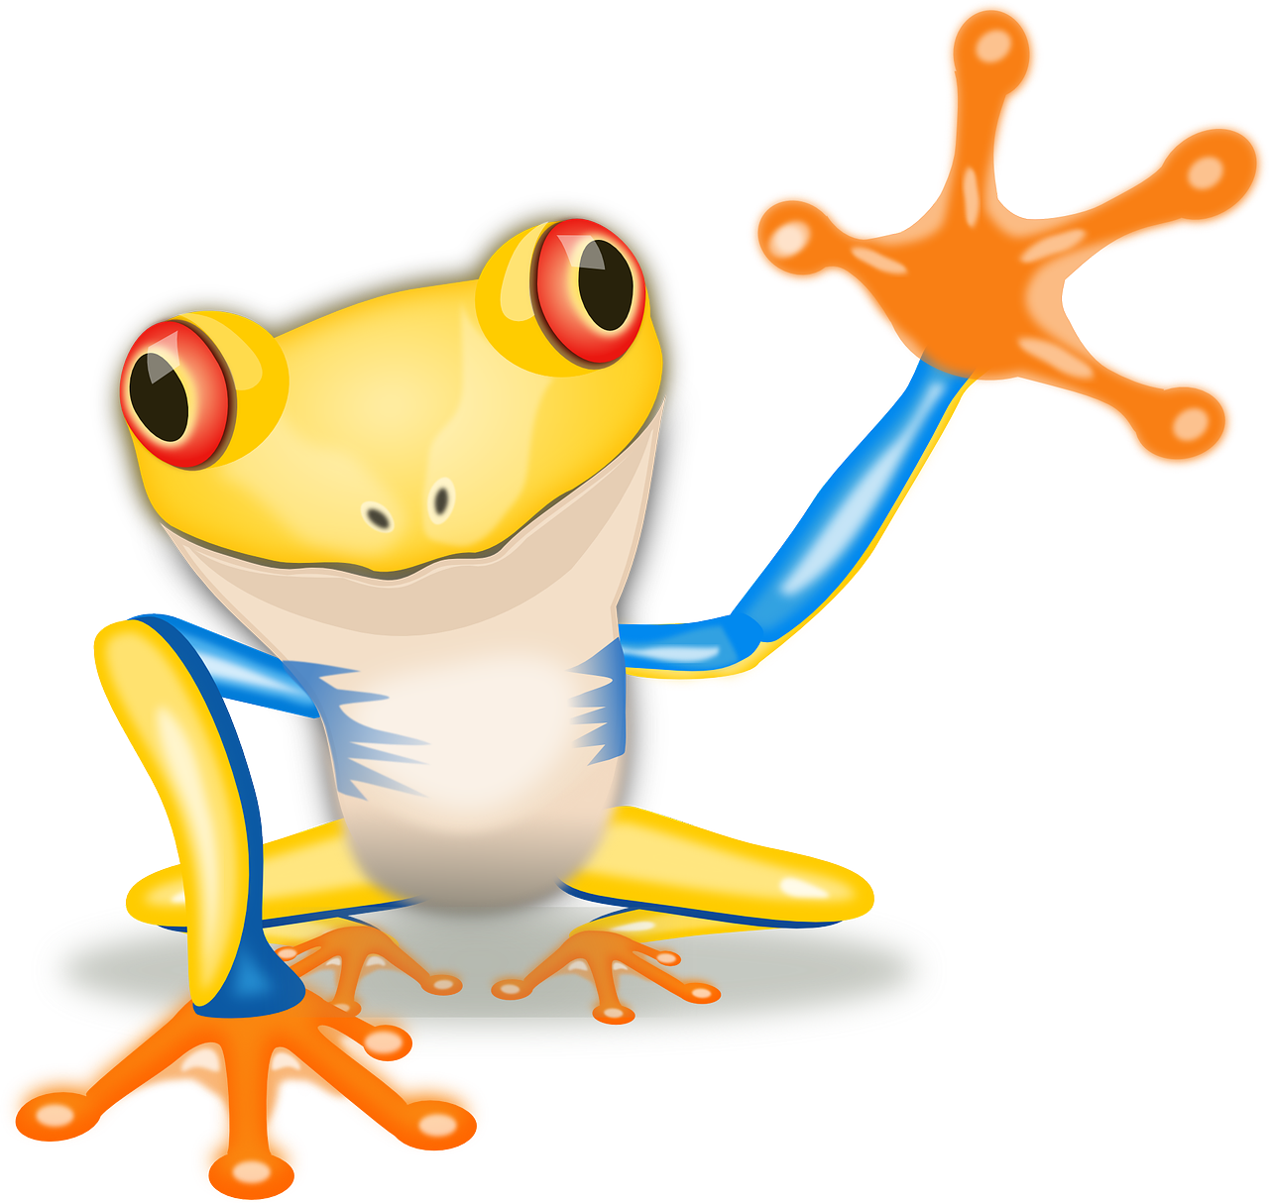
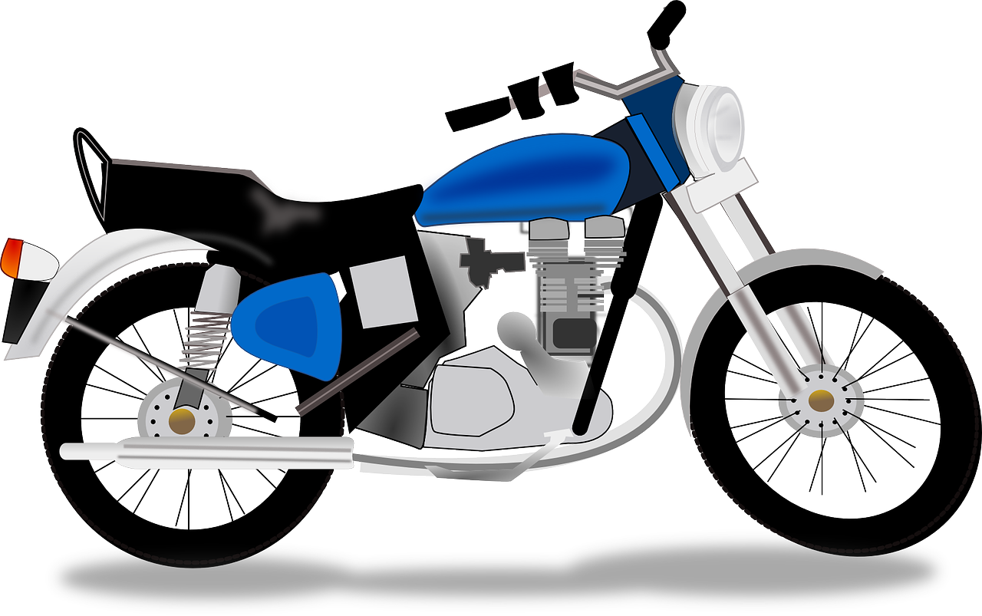
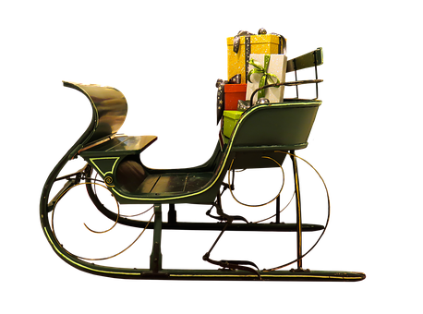
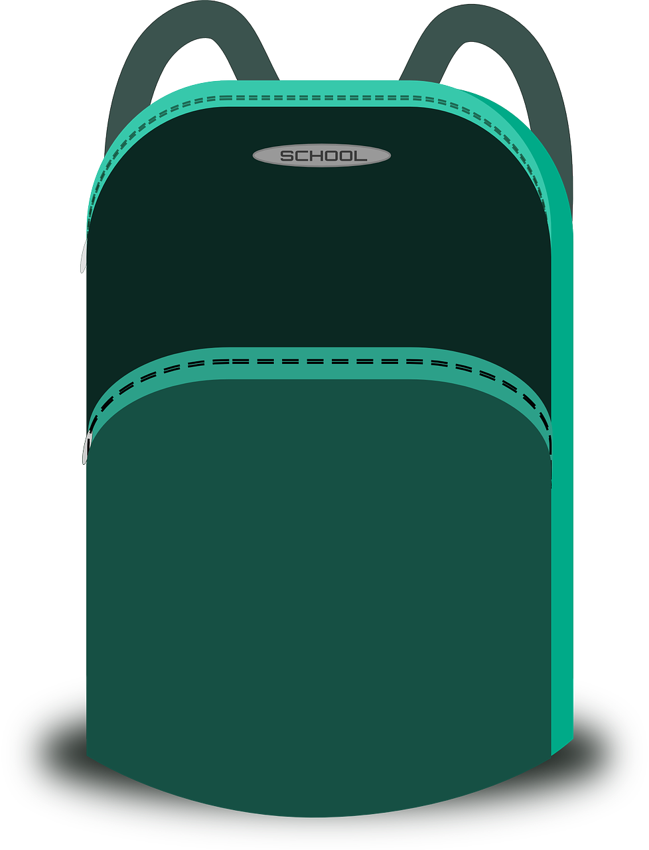
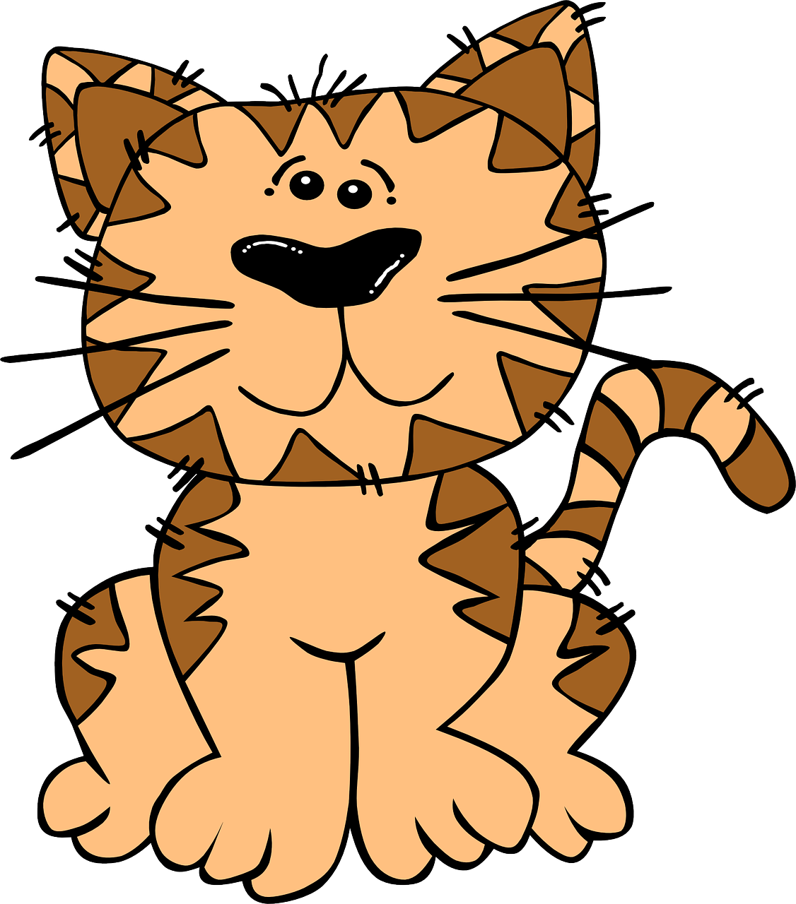
parler
Les cadeaux de Noёl
un chat | un animal | une moto
un sac | un cahier | un crayon
Father Christmas prepares to deliver presents to French children.
A Pronounce the presents. Which present is for which child?
B Regarde. C’est quel mois ?
French children normally address their letters to Father Christmas before the 25th December. Here, the Père Noël decided to match the first letter of each of the children’s names with their birthday month.
What are the
corresponding
French
months?
____ __________ pour Sacha.
____ __________ pour Fanchon.
____ __________ pour Marceau.
____ __________ pour Amal.
____ __________ pour Jacques.
____ __________ pour Didier
Un chat
septembre
Un crayon
février
Une moto
mars /mai
Un animal
avril
Un sac
juin / juillet
Un cahier
décembre
Father Christmas travels by sleigh!
Le Père Noël
un traîneau
Notes:
Timing: 5 minutes
Aim: to practise read aloud of known nouns and unfamiliar names and their SSC connection; to practise written comprehension of six previously taught nouns.
Procedure:
Pupils match the presents to each person by saying the phrase aloud.
Click to reveal the French words for the six presents.
Pupils then identify the names of the months the children have their birthdays in.
4. Click to reveal the months.

Slide 10
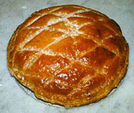
lire
La Galette des Rois
A ‘Galette des Rois’ is a traditional French flaky pastry and almond paste tart, eaten to celebrate the Epiphany on the 6th of January (12 days after Christmas day).
Hidden inside, there is a small figure. The person who finds the figure will be crowned king or queen for the day.
Originally this was a small bean (une fève) and this word is now used for the figurine.
A ‘couronne’ also accompanies the Galette, and the king or queen gets to wear it. ☺
une fève
Notes:
Timing: 10 minutes
Aim: to learn about a typical food eaten to celebrate la Fête des Rois (Epiphany) ; to practise spoken recall of singular persons of avoir and nouns from weeks 9, 10, 11 and 12.
Procedure: 1. Read the text in English explaining what the Galette des Rois is. 2. Tell pupils that they are going to have the chance to practise hiding and finding the figurine.
10

Slide 11
parler
La Galette des Rois
Where is the figurine hidden? Say French sentences to find it.
an exercise book
a female friend
a present
a question
A
B
C
D
1
Do you have…?
2
S/he has…
3
You have…
4
I have…
Notes:
Teacher-led version of the task (if needed, to model the activity) Aim: to practise spoken production of singular persons of avoir and nouns from this term. Procedure: 1. Pupils ask a question or make a statement. E.g. Tu as une amie. (You have a female friend.) 2. Teacher clicks the square to reveal what is underneath. 3. Pupils continue to ask produce utterances until the figurine has been located.
You have + a present = figurine [tu as un cadeau]
A= nouns from week 9
B = nouns from week 10
C = nouns from week 11
D = nouns from week 12

Slide 12
parler
La Galette des Rois
In secret, choose a space and draw your ‘fève’. ✍
A |  | B
English | French | English | French
a ball | un ballon | a cuddly toy | une peluche
a bottle | une bouteille | a bag | un sac
an exercise book | un cahier | a pen | un stylo
a game | un jeu | a pet | un animal
an orange | une orange | a dog | un chien
A
B
C
D
C |  | D
English | French | English | French
a cat | un chat | a ruler | une règle
a photo | une photo | a rubber | une gomme
a table | une table | a book | un livre
a pencil | un crayon | a present | un cadeau
1
Do you have…?
2
S/he has…
3
You have…
4
I have…
la fève
Notes:
Procedure: 1. Display this slide. 2. Pupils collect their handout and secretly draw their figure in their selected cell.
3. They then play in pairs, trying to be the first to find the other’s hidden figure.
4. See slides at the end of the presentation for two versions of the handout.
Picture attribution: http://www.clker.com/clipart-image-clipart-galette-des-rois.html
Note: in this version of the game, pupils can say any noun from a, b, c or d when targeting these coordinates. This gives the opportunity to practise saying/reading aloud more vocabulary.
Nouns are the 18 nouns learnt in weeks 8,9,10 and 11.

Slide 13
Au revoir !
rouge
Notes:
13

Slide 14
Teacher audio version
 | Present | Name | SSC [sound-symbol correspondence] | p/ x
1 | rat | Lilas | SFC
2 | seau | Coco | [au/eau/o]
3 | vue | Prue | [u]
4 | jeu | Mathieu | [eu]
5 | iglou | Ballou | [ou]
6 | chanson | Vardon | [on]
7 | gants | Laurent | [an/en]
8 | cloche | Gavroche | [ch]
Notes: 1] Words have been deliberately chosen to assess the same SSC spelt in different ways – as/at –o/eau – en/an This is a challenging but important aspect of French SSC knowledge. 2] Each item offers two opportunities to assess the same SSC, but only one SSC is assessed per item (e.g. Laurent only assesses [en] not [au] or SFC. 3] Teachers award one point for the SSC in each word (max. 2 points per item). 4] Teachers may want to note additional SSC that are pronounced correctly/incorrectly to inform their planning of further practice.
5] Note that we are teaching phonics to achieve clear, comprehensible speech rather than native-like pronunciation. We therefore listen out for signs that the children are applying their phonemic knowledge to these new words, knowing that the SSC are not pronounced as in English.
Notes:
Teacher audio version for preparation

Slide 15
handout
Joyeux Noël !
Read aloud the French name and the Christmas present with the same final sound. You have not learnt these words so use what you know about how to pronounce French. Remember Silent Final Consonants!
Pupil name: _____________________
Total score: _____ / 16
Joyeux Noël !
Read aloud the French name and the Christmas present with the same final sound. You have not learnt these words so use what you know about how to pronounce French. Remember Silent Final Consonants!
Pupil name: _____________________
Total score: _____ / 16
 | Present | Name | SSC [sound-symbol correspondence] | p/ x
1 | rat | Lilas | SFC
2 | seau | Coco | [au/eau/o]
3 | vue | Prue | [u]
4 | jeu | Mathieu | [eu]
5 | iglou | Ballou | [ou]
6 | chanson | Vardon | [on]
7 | gants | Laurent | [an/en]
8 | cloche | Gavroche | [ch]
 | Present | Name | SSC [sound-symbol correspondence] | p/ x
1 | rat | Lilas | SFC
2 | seau | Coco | [au/eau/o]
3 | vue | Prue | [u]
4 | jeu | Mathieu | [eu]
5 | iglou | Ballou | [ou]
6 | chanson | Vardon | [on]
7 | gants | Laurent | [an/en]
8 | cloche | Gavroche | [ch]
Notes:
pupil handout / feedback sheet
15

Slide 16
La Galette des Rois
In secret, choose a space and draw your ‘fève’. ✍
A |  | B
English | French | English | French
a ball | un ballon | a cuddly toy | une peluche
a bottle | une bouteille | a bag | un sac
an exercise book | un cahier | a pen | un stylo
a game | un jeu | a pet | un animal
an orange | une orange | a dog | un chien
parler
A
B
C
D
C |  | D
English | French | English | French
a cat | un chat | a ruler | une règle
a photo | une photo | a rubber | une gomme
a table | une table | a book | un livre
a pencil | un crayon | a present | un cadeau
1
Do you have…?
2
S/he has…
3
You have…
4
I have…
la fève
Notes:
HANDOUT A This version has the French words for all the nouns.

Slide 17
La Galette des Rois
In secret, choose a space and draw your ‘fève’. ✍
parler
A | B
English | English
a ball | a cuddly toy
a bottle | a bag
an exercise book | a pen
a game | a pet
an orange | a dog
A
B
C
D
1
Do you have…?
2
S/he has…
3
You have…
4
I have…
C | D
English | English
a cat | a ruler
a photo | a rubber
a table | a book
a pencil | a present
la fève
Notes:
HANDOUT B This version has only the English words for the nouns.

