Slide 1
Saying what I and others have
rouge
Follow ups 1-5
Term 1 Week 12
Notes:
Artwork by Steve Clarke. Pronoun pictures from NCELP (www.ncelp.org). All additional pictures selected from Pixabay and are available under a Creative Commons license, no attribution required.
Phonics: revisit [u] introduce [ou] tu [112] salut! [2205] amusant [4695] utiliser [345] nous [31] bonjour! [1972] douze [1664] jouer [219] jour [78]
Vocabulary (new words in bold): jour [78] chaque [151] revisit days of the week Revisit 1: avoir [8] j’ai, il a, elle a, quoi [297] animal [1002] chien [1744] chat [3138] photo [1412] ou [33]
Revisit 2: Ça va ? [54/53] bien [47] mal [277] Oui [284] Non [75] Au revoir [4/1274]
Londsale, D., & Le Bras, Y. (2009). A Frequency Dictionary of French: Core vocabulary for learners London: Routledge.
The frequency rankings for words that occur in this PowerPoint which have been previously introduced in these resources are given in the SOW and in the resources that first introduced and formally re-visited those words.
For any other words that occur incidentally in this PowerPoint, frequency rankings will be provided in the notes field wherever possible.

Slide 2
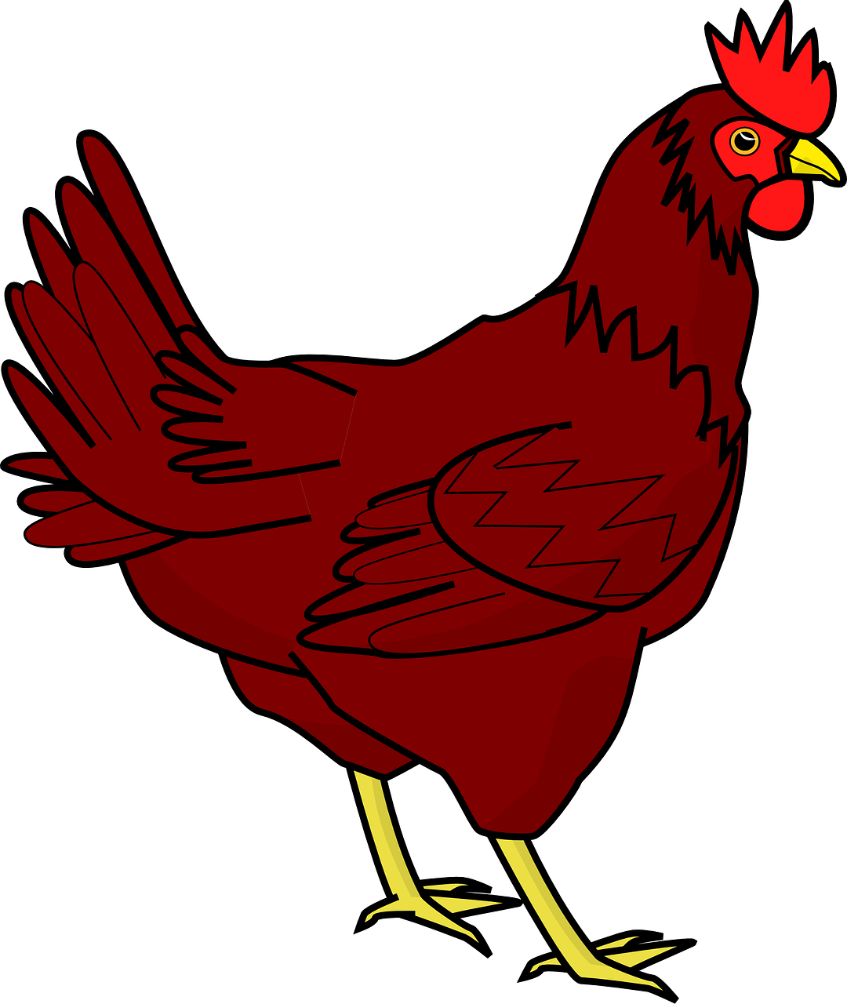
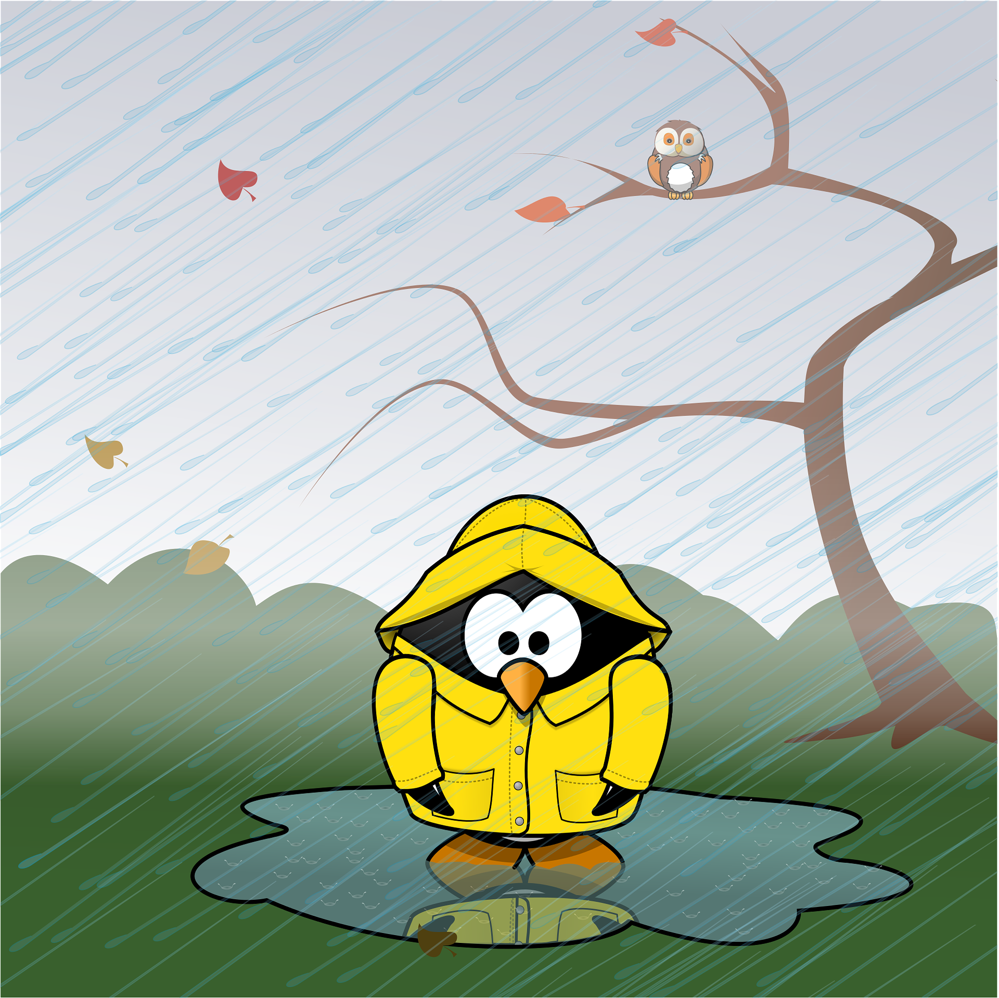
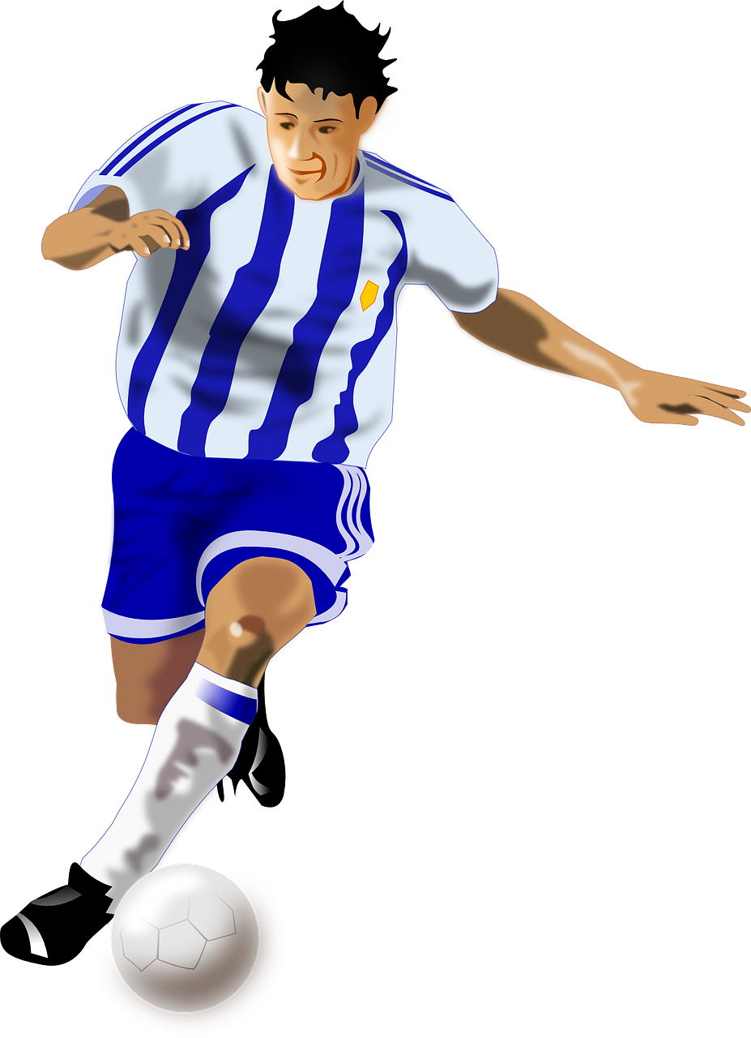
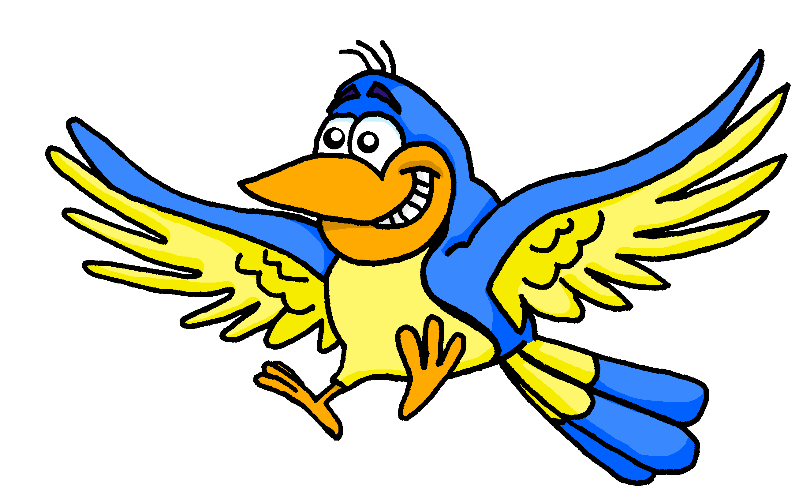
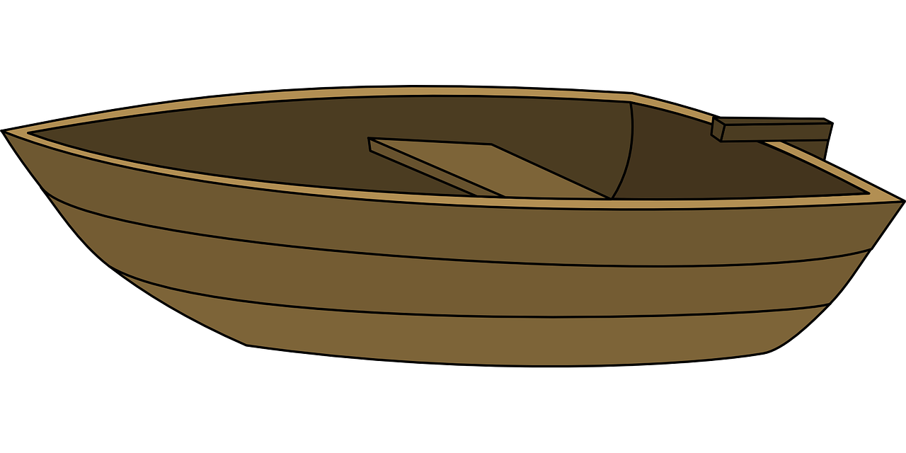
Follow up 1:
[ou] or [au]?
A Écoute et écris.
B Say these words one after the other as quickly as you can. Your partner will check.
1
2
3
4
p o u l e
b o u c h e
c h a p e a u
a u t o m n e
_ _
_ _
_ _
_ _
5
6
7
8
j o u e u r
g a u c h e
b i j o u x
o i s e a u
_ _
_ _
_ _
_ _
9
10
11
12
b a t e a u
b o u t e i l l e
b o u g i e
_ _
_ _
b u r e a u
_ _
_ _
Notes:
Timing: 5 minutes
Aim: to practise aural recognition of this week’s SSC [ou] and differentiate it from [au].
Procedure:
Click to listen. Pupils write 1-12 and [au] or [ou] for each word.
Click to reveal the missing letters.
Click to bring up the instruction for Part B.
Pupils pronounce all of the words.
Teacher circulates to listen and support, as needed.
Transcript Part A: [1] poule [2] bouche [3] chapeau [4] automne [5] joueur [6] gauche
[7] bijoux [8] oiseau
[9] bateau
[10] bouteille
[11] bougie
[12] bureau

Slide 3
Follow up 2: Adèle prépare une liste pour les vacances.
Oh là là! Un petit accident avec le chocolat chaud !
Lis la liste. C’est ‘I have’ (Adèle) ou ‘he has’ (Pierre) ?
lire
I have… | He has…
1
Il a un cahier.
J’ai une peluche.
J’ai un crayon.
Il a une orange.
J’ai une bouteille.
J’ai un cadeau.
Il a une photo.
an exercise book
2
a cuddly toy
3
a pencil
an orange
4
5
a bottle
a photo
6
a present
7
Notes:
Timing: 5 minutes
Aim: to practise written comprehension of j’ai and il a and previously taught nouns.
Procedure: 1. Explain the scenario and the task: Adèle has written a list of things she has for packing in her holiday bag, and things that Pierre has.
2. Then she spills hot chocolate on it! Can pupils still tell who has what? They write a list with ‘I have’ and ‘he has’ headings.
3. Click to remove the ‘spills’ and bring up the nouns.

Slide 4
Follow up 3
. Écoute les noms des animaux. C’est [ien] ou [(a)in]?
Écoute. Écris l’object en anglais sur la bonne liste*.
1
2
3
4
5
6
écouter
I have…
you have…
a ball
a bag
a game
a book
a present
a pen
la bonne liste – the correct list
Notes:
Timing: 5 minutes
Aim: to practise aural comprehension of the I and you forms of avoir and previously taught nouns.
Procedure: 1. Tell pupils that they need to pay attention to the forms of avoir – ai for ‘I have’ and as for ‘you have’. The pronouns will be beeped out.
2. Pupils write two headings ‘i have’ and ‘you have’ and list the three items that each person has, in English, underneath.
3. Click to reveal the six answers.
Transcript:
1. [J’] ai un sac. 2. [tu] as un ballon. 3. [tu] as un jeu. 4. [j‘] ai un livre. 5. [j‘] ai un stylo. 6. [tu] as un cadeau.

Slide 5
Follow up 4:
Adèle parle. Elle prépare une liste pour les vacances*.
. Écoute les noms des animaux. C’est [ien] ou [(a)in]?
Écoute et lis la conversation. Écris les mots en anglais.
écouter
les vacances – holidays
pas encore – not yet
Salut Pierre, ça va ?
how’s it going?
Hi Pierre, __________________?
Tu as aussi une liste pour les vacances*, oui ?
You
have
______ also ______ a list for the holidays, _____?
yes
Non !?! Oh, pas encore* !
No!?! Oh, not yet!
But
a present
_____ you have ___ __________ _______ mum? ________.
Mais tu as un cadeau pour Maman ? Bien.
for
Good
She
_____ ________ a present for _____, _________!
has
Elle a un cadeau pour toi, aussi !
you
too
Me
I have
present
_______, ___ _______ a __________ _______ _______! ☺
Moi, j’ai un cadeau pour Papa ! ☺
for
dad
Notes:
Timing: 5 minutes
Aim: to practise written comprehension of revisited vocabulary in a longer (conversation) context.
Procedure: 1. Click on each sentence to hear it.
2. Pupils can number 1-6 and just write down all the missing English meanings within each sentence.
3. Click to bring up written answers.

Slide 6
vocabulaire
Follow up 5 - Écris en français : Can you get at least 15 points?
mots
 | yes | no | Goodbye!
 | well, good | how’s it going? | bad, badly
 | she has | you have | or
 | I have | to have, having | he has
 | Friday | Saturday | Sunday
 | Tuesday | Wednesday | Thursday
 | a day | each, every | Monday
oui
non
Au revoir !
x3
bien
ça va ?
mal
elle a
tu as
ou
x2
j’ai
avoir
il a
vendredi
samedi
dimanche
mardi
mercredi
jeudi
x1
un jour
chaque
lundi
Notes:
Timing: 5-10 minutes
Aim: to practise written comprehension of vocabulary from this week and previous weeks.
Procedure: Give pupils a blank grid. They fill in the French meanings of any of the words they know, trying to reach 15 points in total.
Note: The most recently learnt and practised words are pink, words from the previous week are green and those from week 1 are blue, thus more points are awarded for them, to recognise that memories fade and more effort (heavy lifting!) is needed to retrieve them.
6

Slide 7
vocabulaire
Écris en français : Can you get at least 15 points?
mots
 | yes | no | Goodbye!
 | well, good | how’s it going? | bad, badly
 | she has | you have | or
 | I have | to have, having | he has
 | Friday | Saturday | Sunday
 | Tuesday | Wednesday | Thursday
 | a day | each, every | Monday
x3
x2
x1
Notes:
HANDOUT
7

