Slide 1
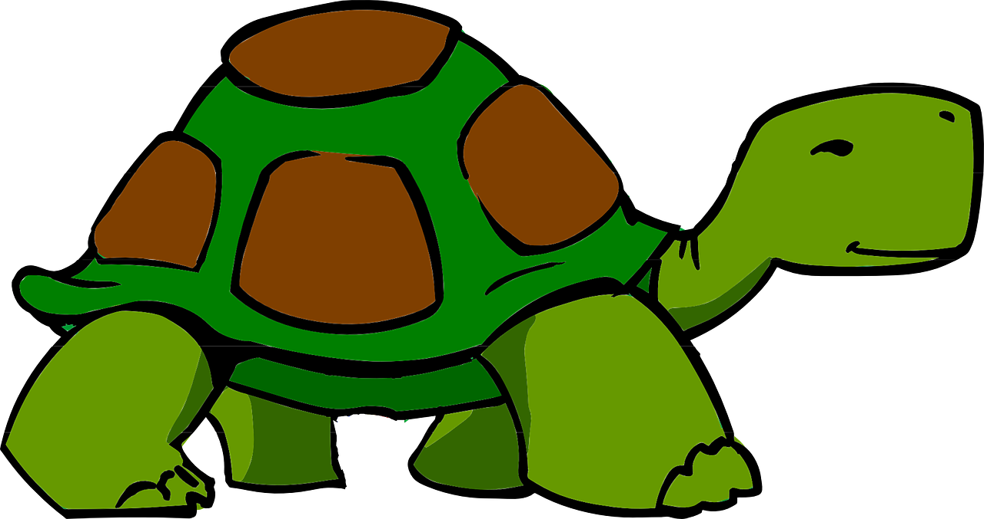
Saying what I and others have
rouge
« Avoir » : tu as, il/elle a
« Être » : tu es, il/elle est
SSC [au]
Term 1 Week 11
Notes:
Artwork by Steve Clarke. Pronoun pictures from NCELP (www.ncelp.org). All additional pictures selected from Pixabay and are
available under a Creative Commons license, no attribution required.
The AUDIO version of the lesson material includes additional audio for the new language presented (phonics, vocabulary) and audio for the instructions
on the slide.
In addition, it includes VIDEO clips of the phonics and the phonics’ source words. Pupils can be encouraged to look at the shape of the mouth/lips on
slides where these appear, and try to copy it/them.
Phonics: [au/eau/o] - gauche[607] faux [555] eau[475] photo [1412] aussi [44]
Frequency of new words:
Vocabulary: moi [132] toi [510] cadeau [2298] gâteau [4845] pour [10] de [6] parfait [1600]
Revisit 1: ballon [3692] bouteille [2979] cahier [4001] jeu [291] orange [3912] peluche [>5000] sac [2343] stylo [>5000] un [3] une [3] (revisit banane) Revisit 2: je [22] il [13] elle [38] être [5] suis, est monsieur [79] madame [294] présent [216] absent [2016] ici [167] là [109] Bonjour ! [1972] Salut ! [2205]
Londsale, D., & Le Bras, Y. (2009). A Frequency Dictionary of French: Core vocabulary for learners London: Routledge.
The frequency rankings for words that occur in this PowerPoint which have been previously introduced in these resources are given
in the SOW and in the resources that first introduced and formally re-visited those words.
For any other words that occur incidentally in this PowerPoint, frequency rankings will be provided in the notes field wherever
possible.
1

Slide 2
[au]
prononcer
[au / eau / o]
gauche
Notes:
Timing: 2 minutes
Aim: to present SSC [au].
Procedure:
Click to bring up the SSC [au]. Repeat the SSC [au] and the source word gauche with the class. Introduce the gesture, if using.
Click to bring up the picture.
Pupils to practise saying the SSC and source word several times.
Suggested gesture: https://www.signbsl.com/sign/left Tap the left forearm with the right hand.

Slide 3
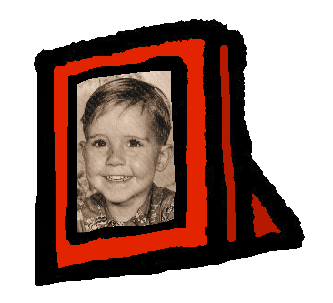
[au]
gauche
prononcer
[au / eau / o]
faux
eau
photo
aussi
[also]
Notes:
Timing: 2 minutes
Aim: To introduce SSC [au]
Procedure:
1. Introduce and elicit the pronunciation of the individual SSC [au] and then the source word again ‘gauche’ (with gesture, if using). 2. Then present and elicit the pronunciation of the five cluster words.
Frequency:
gauche [607] faux [555] eau [475] photo [1412] aussi [44]
Londsale, D., & Le Bras, Y. (2009). A Frequency Dictionary of French: Core vocabulary for learners London: Routledge.

Slide 4
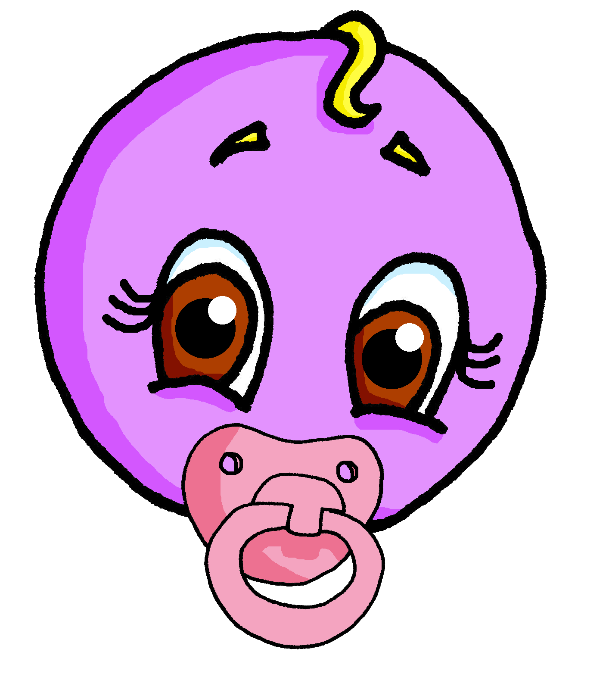
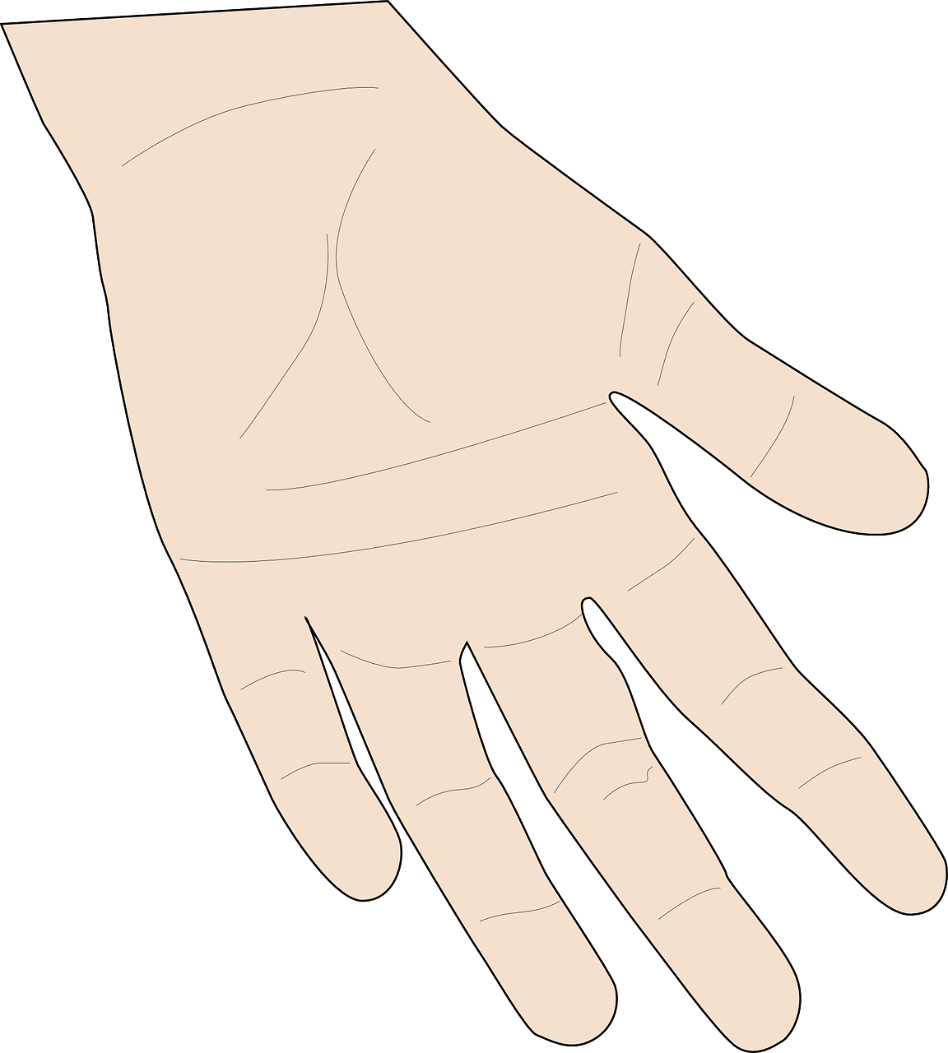
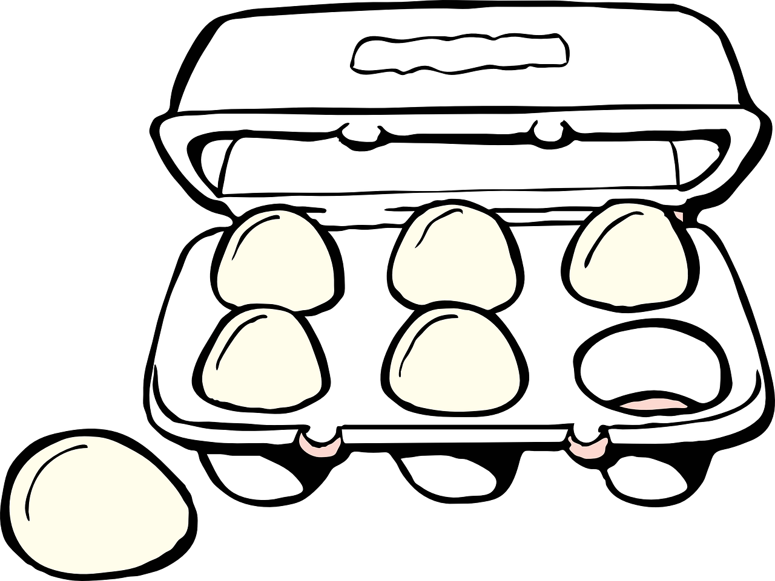
écouter
Écoute. C’est [(e)au] ou [eu] ?
Écris A ou B.
A
B
 | jeune | jaune
 | peau | peu
 | joyau | joyeux
 | deux | dos
 | feu | faux
 | eau | œufs
1
2
[skin]
3
4
5
6
Notes:
Timing: 3 minutes
Aim: to practise aural distinction between [ai] and [a] in a mixture of known and unknown words.
Procedure:
Click to play the audio.
Pupils select A or B.
Click to reveal the answer.
Transcript:
jaune peau joyeux dos feu eau
Word frequency of unknown words (1 is the most frequent word in French): deux [41] dos [1672] eau [475] faux [555] feu [786] joyau [>5000] joyeux [3987] œuf [2685] peau [2122] peu [91]
4

Slide 5
Avoir
[to have | having]
You already know some parts of avoir (to have):
You also know some parts of être (to be):
Tu as
you have
Tu es
you are
__
__
Il a
he has
Il est
he is
__
__
Elle a
she has
Elle est
she is
__
__
Tu as un chat.
Tu es ici.
You have a cat.
You are here.
Elle a un chien.
Il est là.
She has a dog.
He is there.
Notes:
Timing: 3 minutes
Aim: To recap the 2nd and 3rd persons singular of avoir and être.
Procedure:
Teacher to remind students of the meaning of the forms of avoir that they already know, eliciting the pronouns from pupils
Teacher to repeat the elicitation with the same parts of être.
Continue with the meanings of the short sentences.
5

Slide 6
écouter
. Écoute les noms des animaux. C’est [ien] ou [(a)in]?
Écoute. C’est a(s) ou es(t) ?
. Écoute les noms des animaux. C’est [ien] ou [(a)in]?
Écris de 1à 8 et le verbe. Puis écris A ou B.
 | have | are has | is | A | B
 | Tu as | Tu es | présent | un ballon
 | Tu as | Tu es | une orange | rouge
 | Il a | Il est | parfait | une peluche
 | Il a | Il est | un cadeau | là
 | elle a | elle est | un jeu | parfaite
 | elle a | elle est | un chien | ici
 | tu as | tu es | absent | une photo
 | tu as | tu es | ici | un cahier
1
1
2
2
3
3
4
4
5
5
6
6
7
7
8
8
Notes:
Timing: 8 minutes
Aim: to practise aural distinction of a(s) and es(t) and connect the verbs with meanings (have or be).
Procedure:
Click to play audio.
Pupils write the verb.
Repeat for items 2-8.
Click to check answers.
Pupils then select the correct sentence ending, based on the verb meanings. They write A or B.
Click to check answers.
Click for the 2nd set of audio buttons. Elicit the full sentences (read aloud) from pupils. After each one, click to listen and check pronunciation.
Transcript 1:
1. Tu es [présent]. 2. Tu as [une orange]. 3. Il a [une peluche].
4. Il est [là]. 5. Elle est [parfaite].
6. Elle a [un chien].
7. Tu as [une photo]. 8. Tu es [ici].
Transcript 2:
1. Tu es présent. 2. Tu as une orange. 3. Il a une peluche.
4. Il est là. 5. Elle est parfaite.
6. Elle a un chien.
7. Tu as une photo. 8. Tu es ici.
6

Slide 7
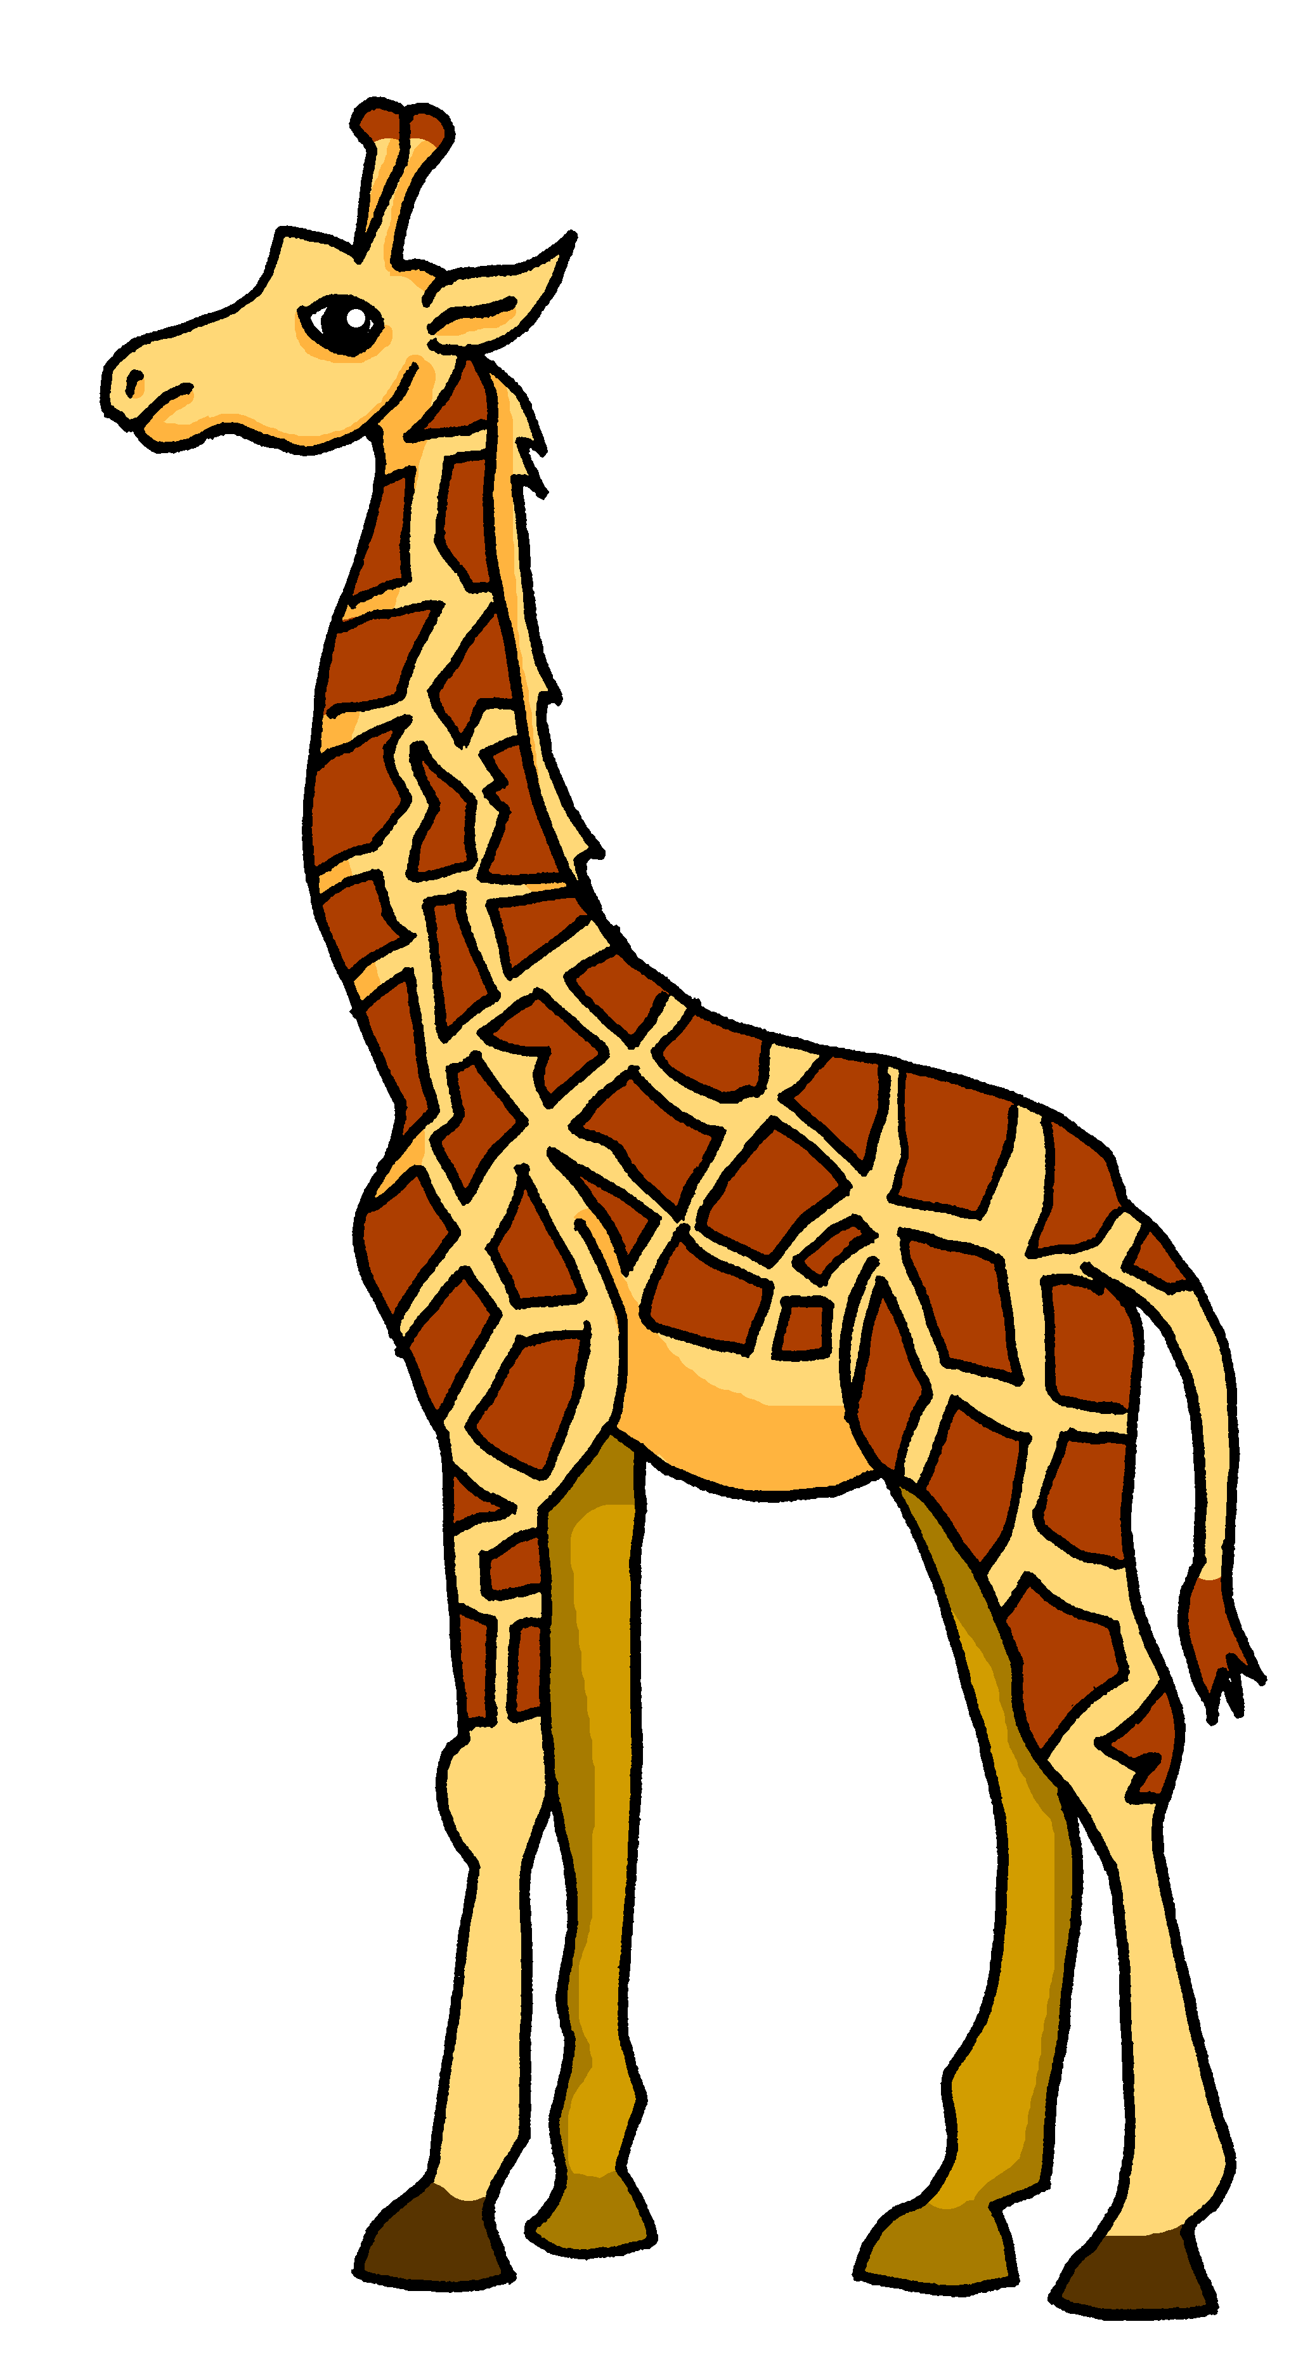
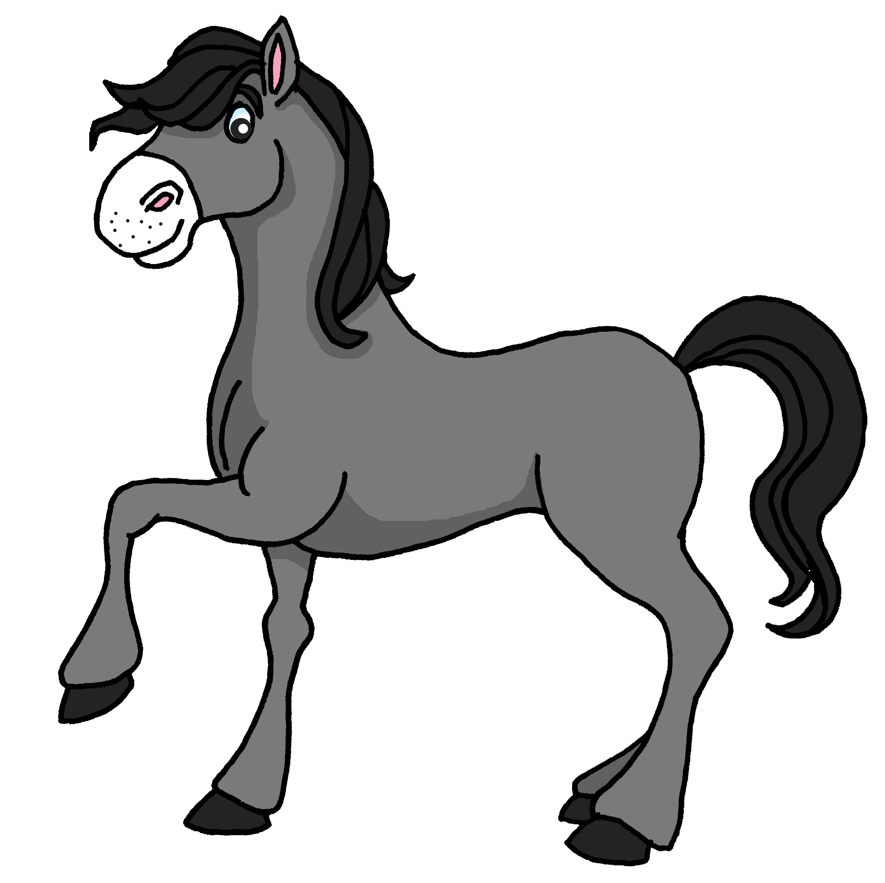
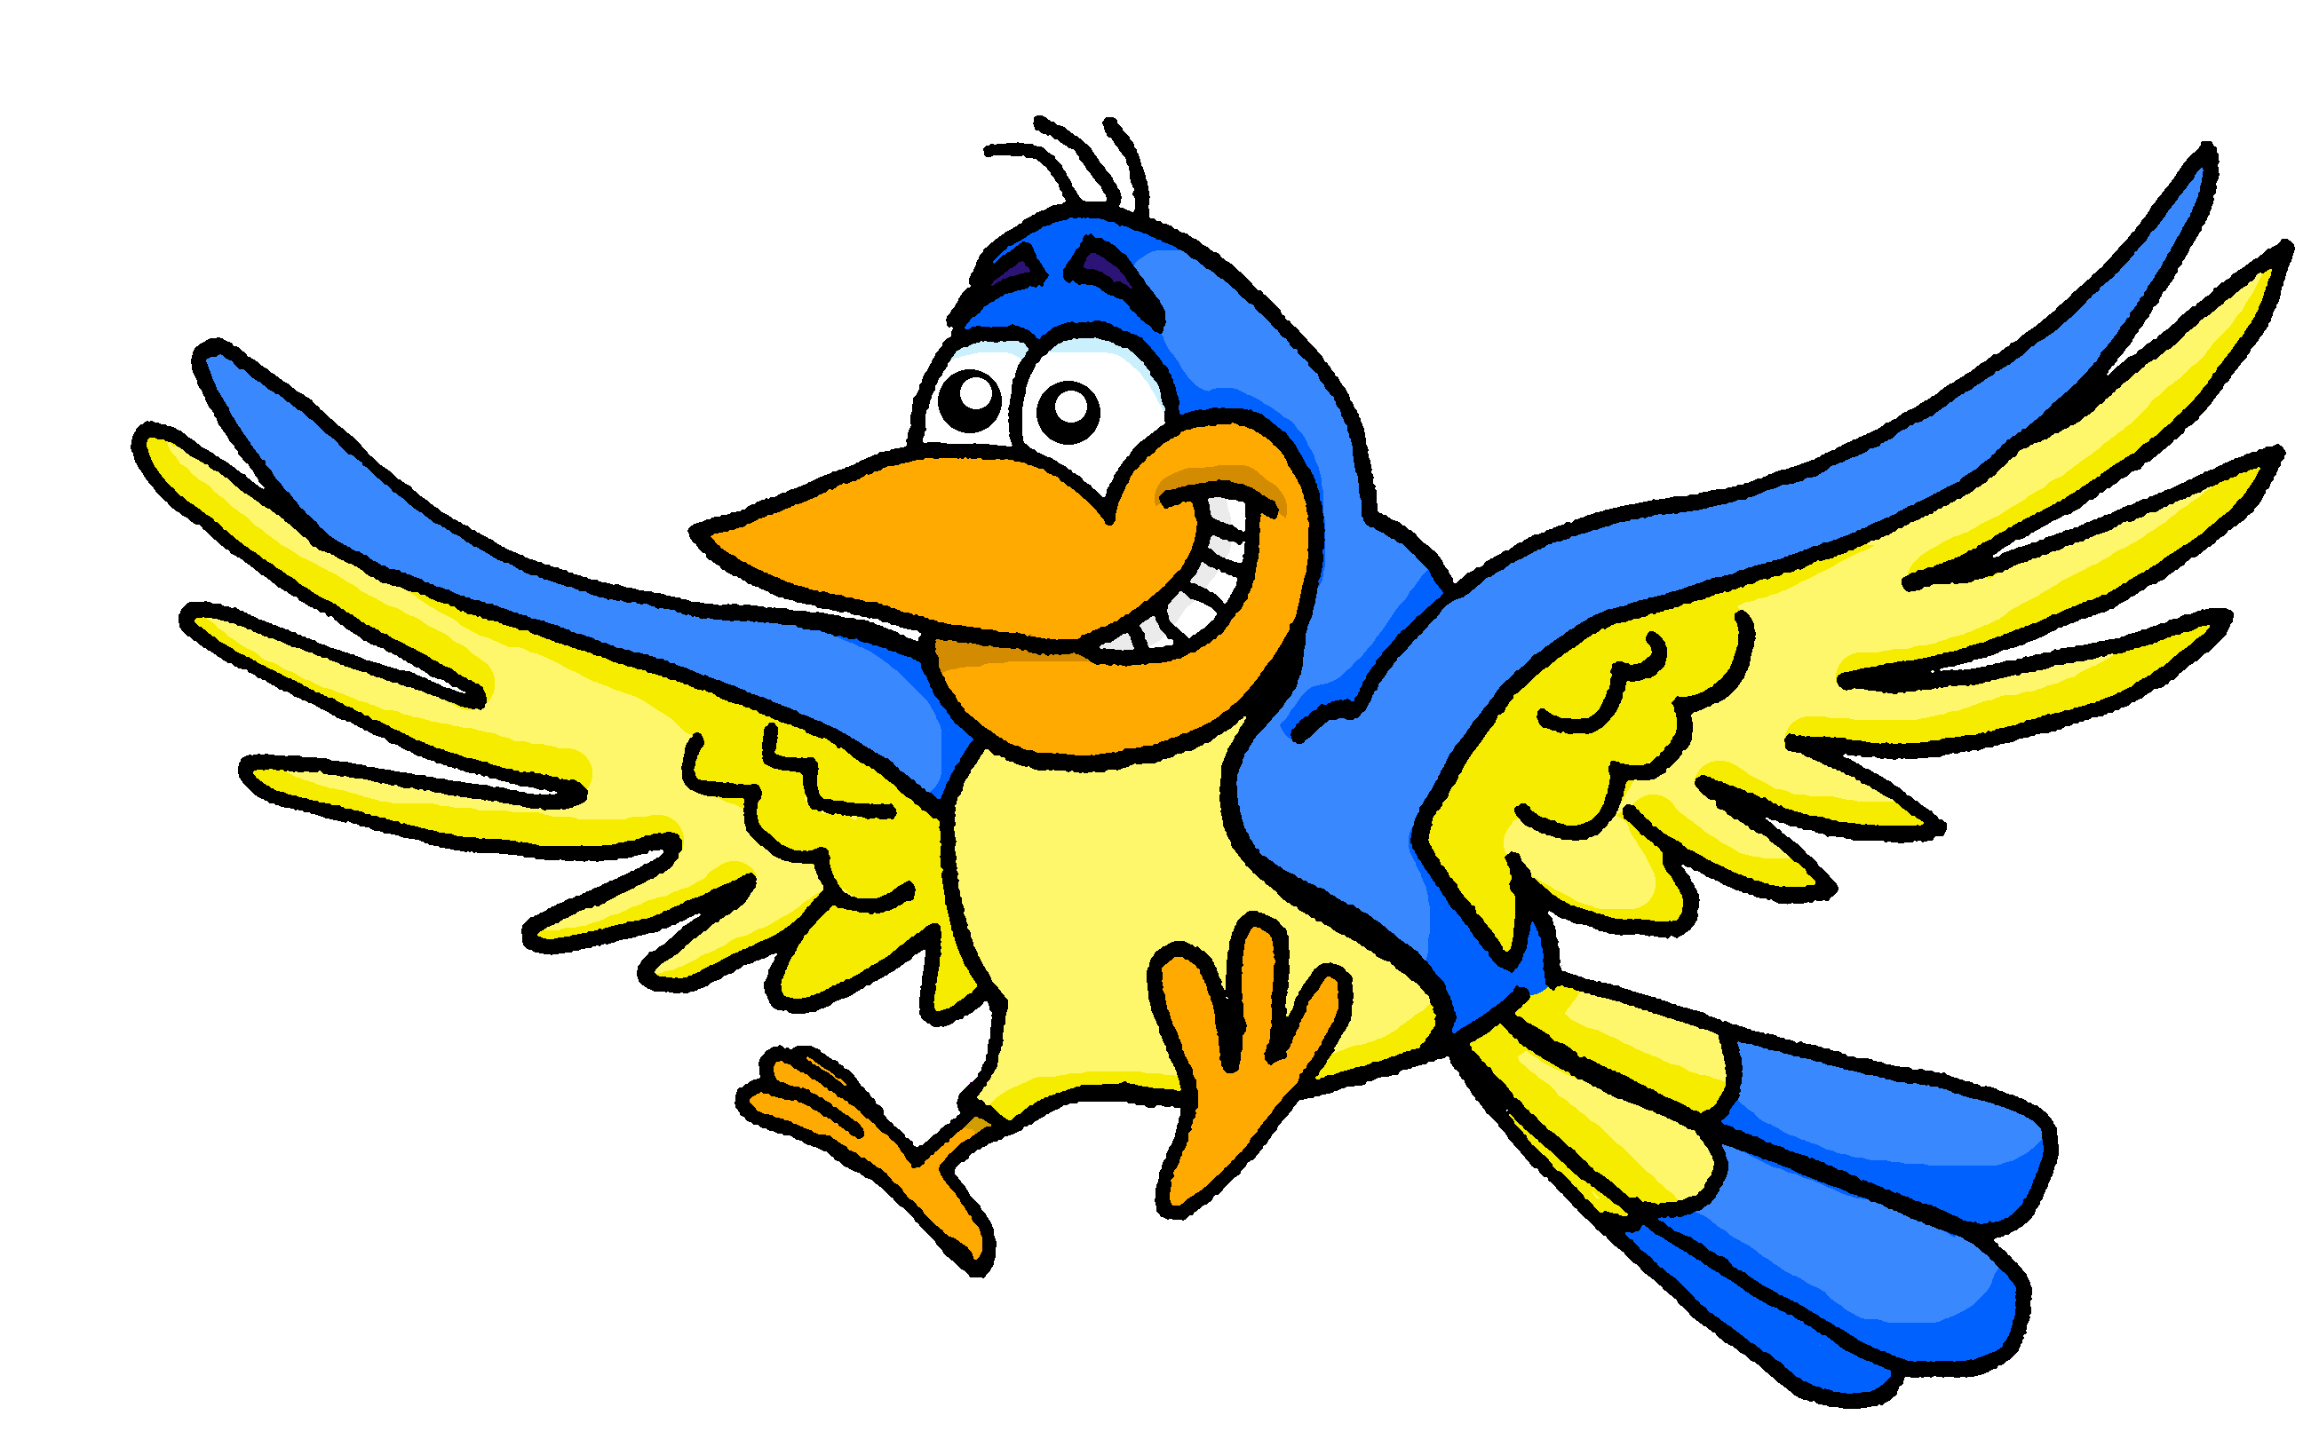
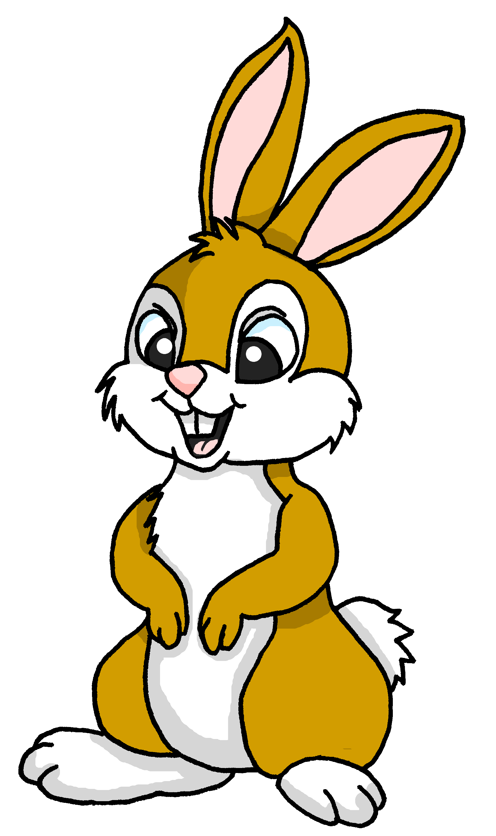
lire
Pierre rêve de Lulu la tortue.
Un ballon, c’est parfait pour Léon !
J’ai un cadeau pour toi, Léon.
Pour moi ?
Notes:
Note: For an audio version of the story, download the other version of the lesson.
Timing: 10 minutes
Aim: to practise connecting the different spellings of SSC [au] with their sound, and vocabulary from this term in a story context.
Procedure:
Ensure that the context is clear. Pierre is dreaming about Lulu, his pet tortoise.
Pupils read the story aloud, line by line, as per the animations.
Click on each speech bubble to hear each line pronounced by a native speaker.
Before the final click, elicit the present that each character has received (to practise written comprehension of previously taught nouns.
Click to bring up the picture of the present.
7

Slide 8
lire
Pierre rêve de Lulu la tortue.
Un livre, c’est parfait pour Yves !
Pour moi ?
J’ai un cadeau pour toi, Yves.
Notes:
2/8
8

Slide 9
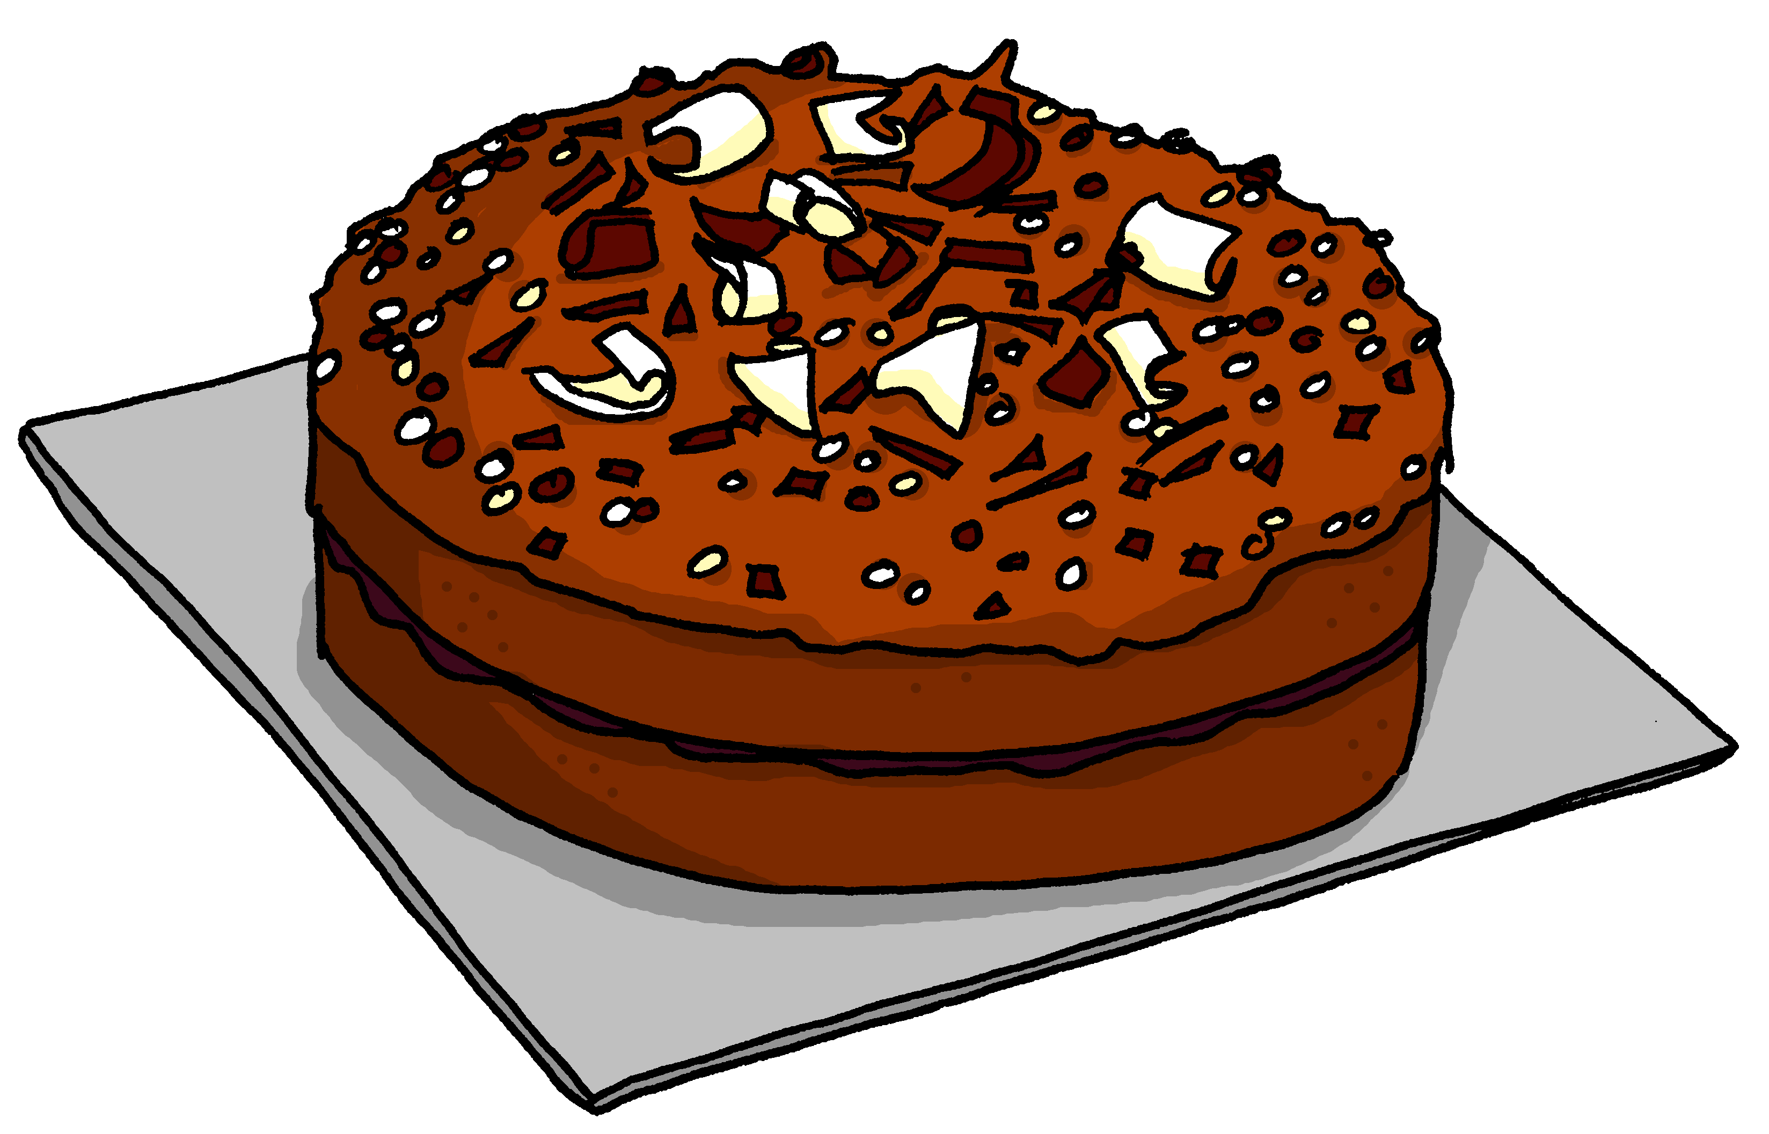
lire
Pierre rêve de Lulu la tortue.
Un gâteau, c’est parfait pour Véro !
Pour moi ?
J’ai un cadeau pour toi, Véro.
Notes:
3/8
9

Slide 10
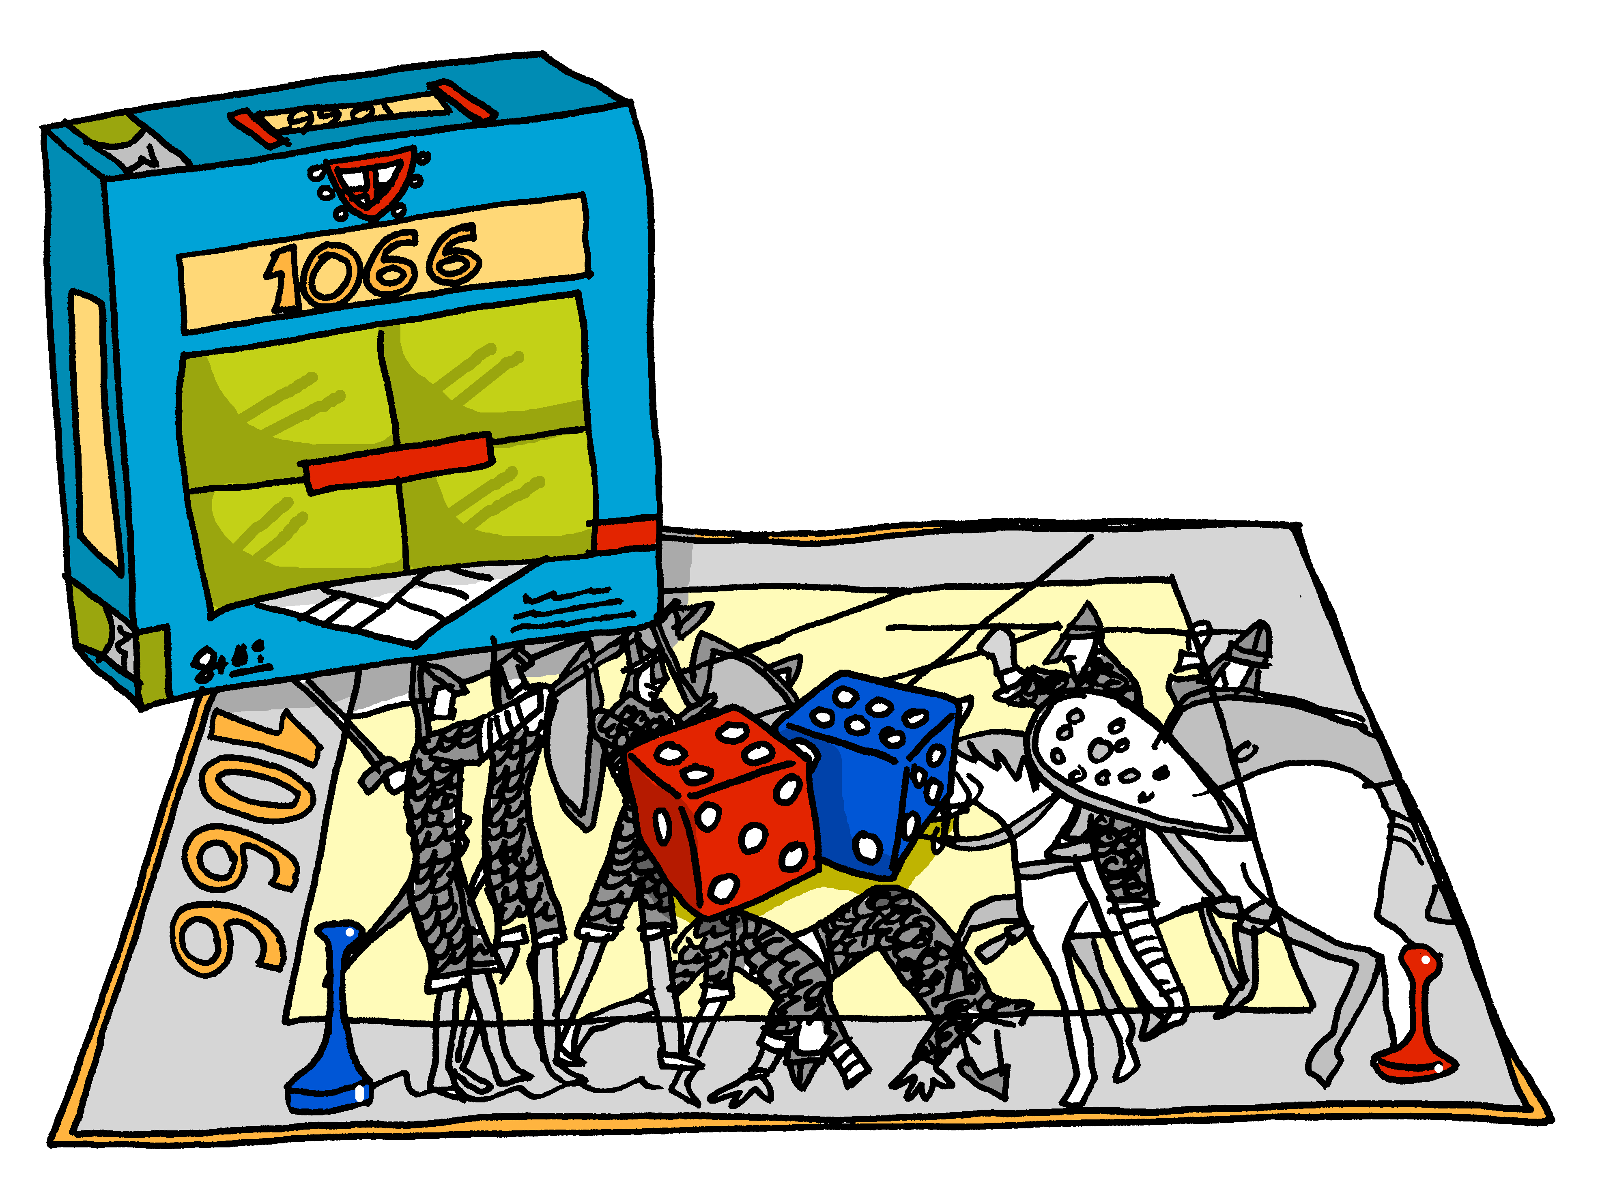
lire
Pierre rêve de Lulu la tortue.
Un jeu, c’est parfait pour Mathieu !
Pour moi ?
J’ai un cadeau pour toi, Mathieu.
Notes:
4/8
10

Slide 11
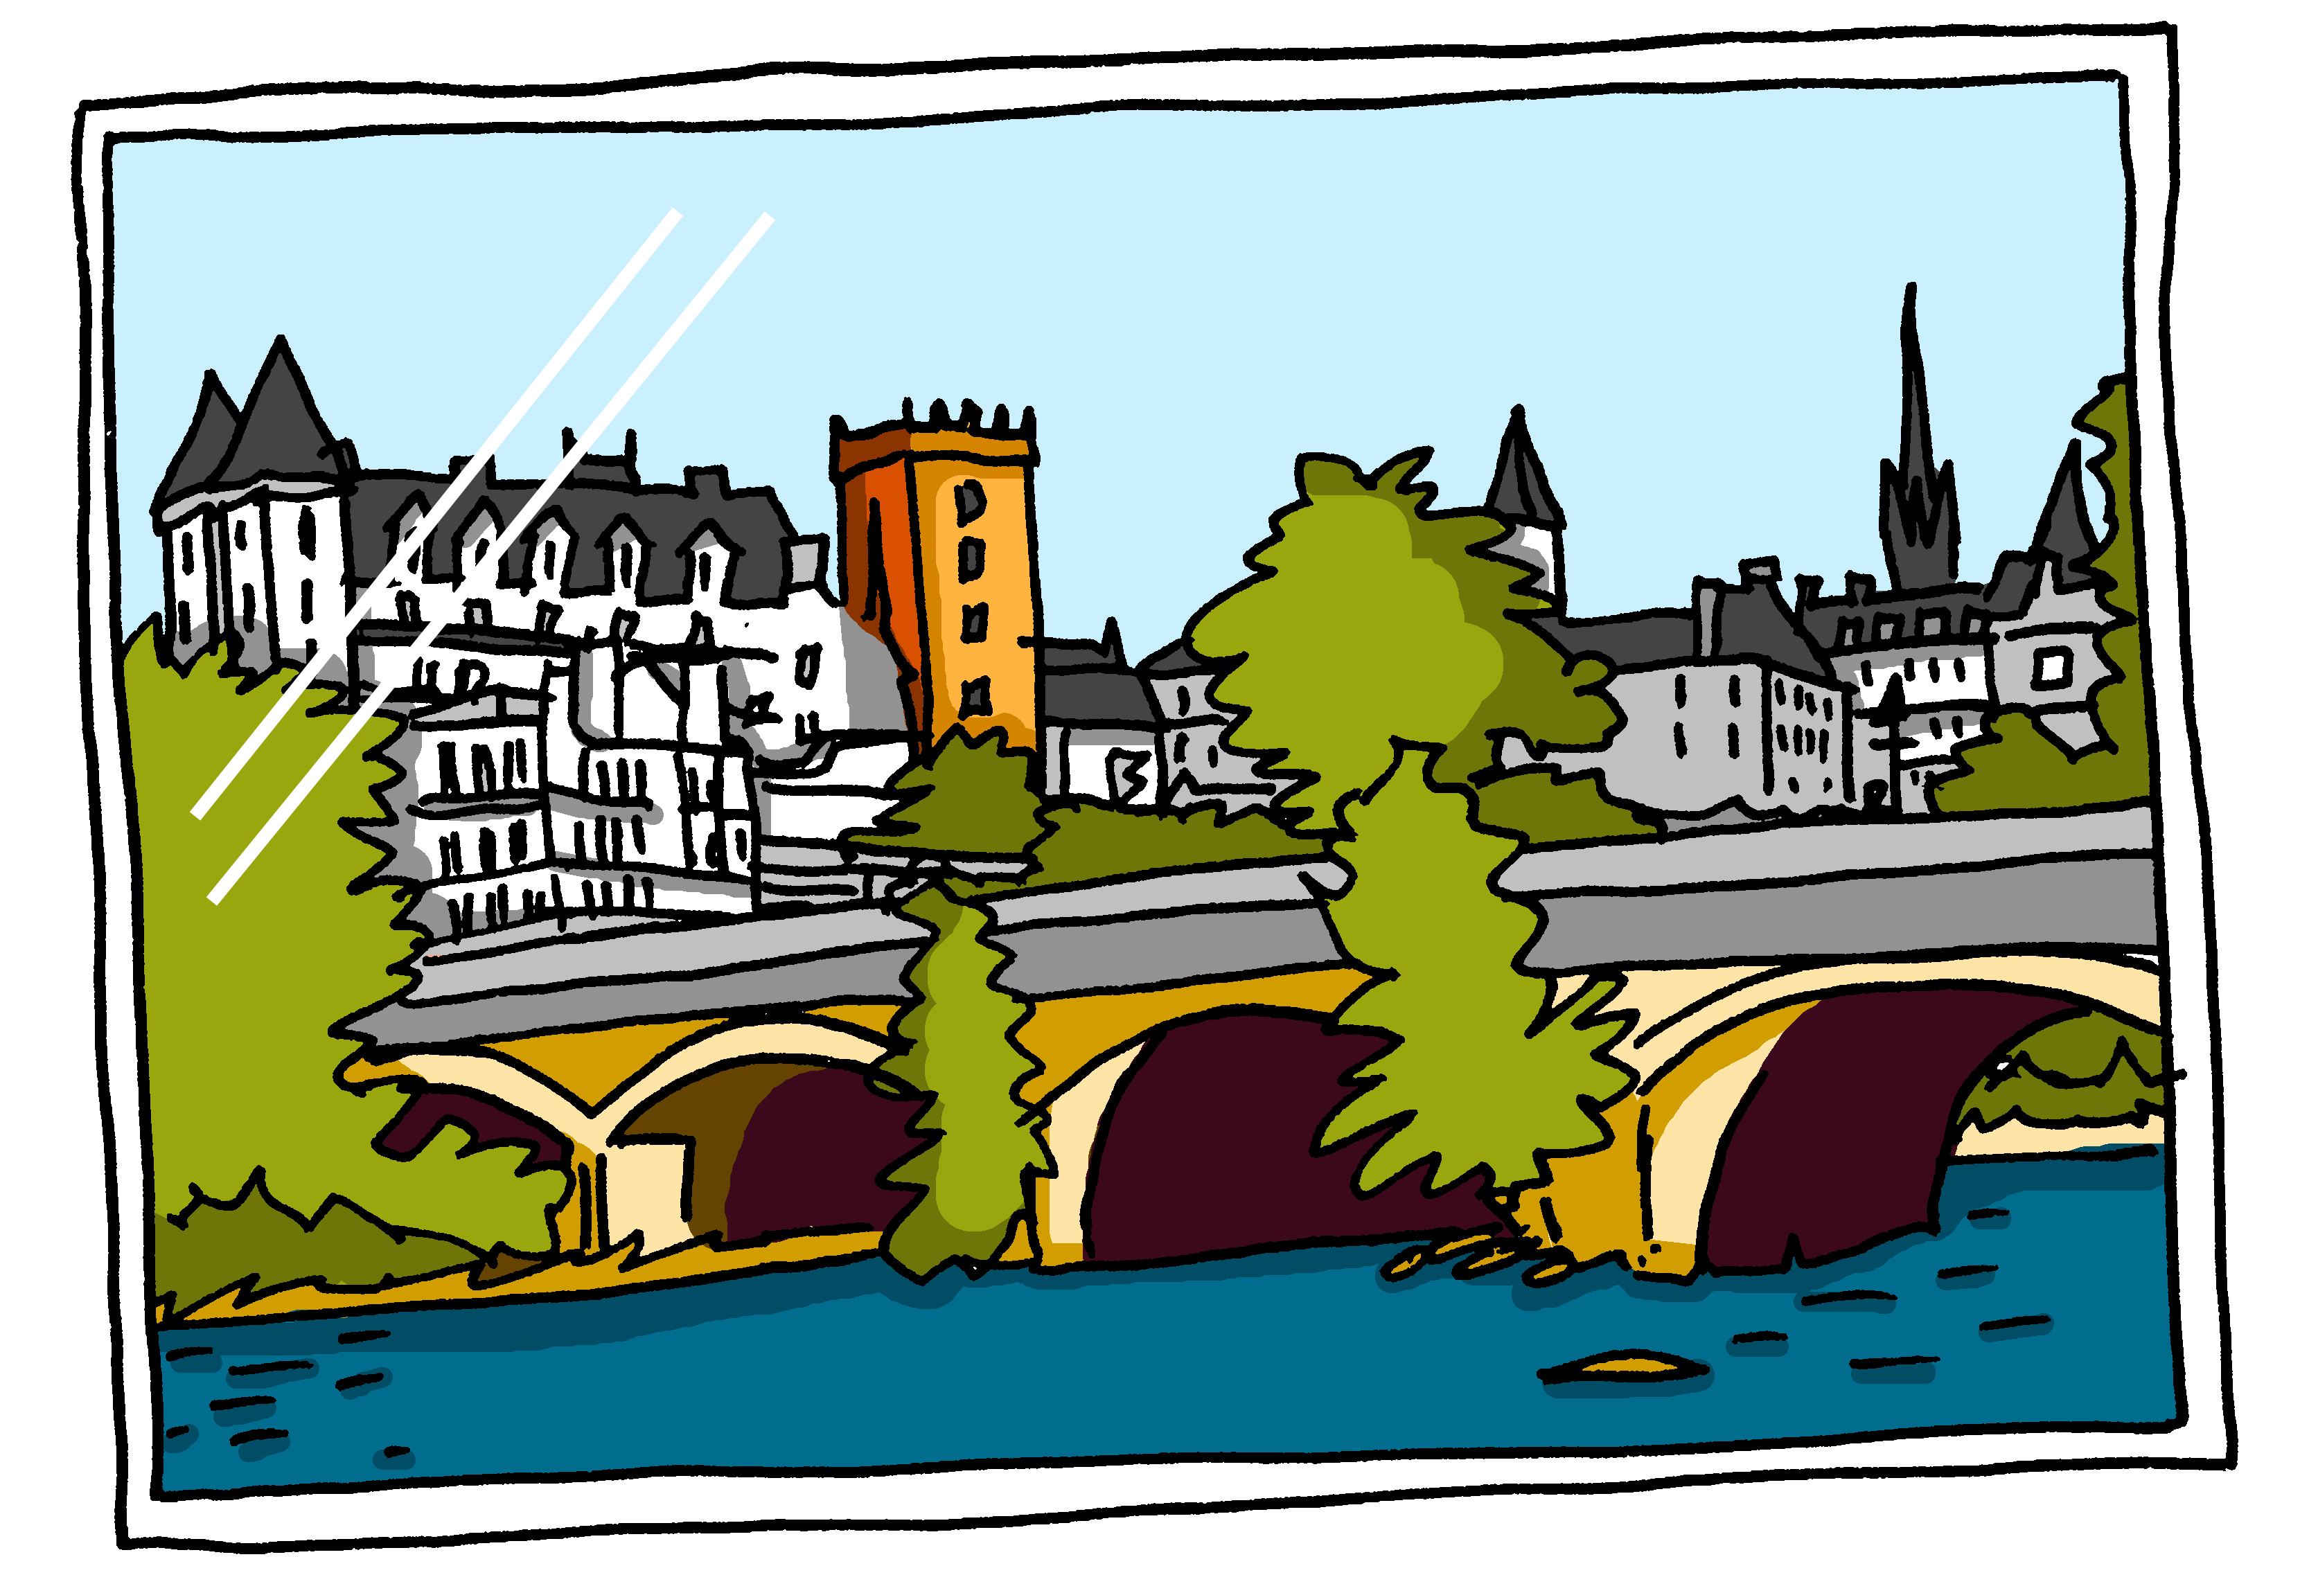
lire
Pierre rêve de Lulu la tortue.
Une photo, c’est parfait pour Margot !
Pour moi ?
J’ai un cadeau pour toi, Margot.
Notes:
5/8
11

Slide 12
lire
Pierre rêve de Lulu la tortue.
Un stylo, c’est parfait pour Milo !
Pour moi ?
J’ai un cadeau pour toi, Milo.
Notes:
6/8
12

Slide 13
lire
Pierre rêve de Lulu la tortue.
Une orange, c’est parfait pour Solange !
Pour moi ?
J’ai un cadeau pour toi, Solange.
Notes:
7/8
13

Slide 14
lire
Pierre rêve de Lulu la tortue.
Une peluche, c’est parfait pour Lulu !
J’ai un cadeau pour toi, Lulu.
Pour moi ?!
Notes:
8/8
14

Slide 15
parler
Personne A
1)
2)
Personne B
………………….an orange
………………….a dog
…………………..a ruler
………………….a game
……………….a book
Il a une règle.
He has
Notes:
Timing: 8 minutes
Aim: to practise spoken production of singular parts of avoir and previously taught nouns.
Procedure:
1. Model the task.
2. Use the handouts at the end of this presentation.
3. Personne A uses the prompt to say who has what item.
4. Personne B listens and notes down who has each item.
Note: the layout of the task as it is includes an additional level of challenge, as Partner B’s items are not on the page in numerical order. This forces Partner B to attend to the meaning of the noun and the verb form at the same time. If felt to be too challenging, the items can be edited to follow the same order as Partner A’s items 1-5. For a higher level of challenge, pupils could be expected to write both the verb, person and noun.
15

Slide 16
parler
Personne A
1)
2)
3)
4)
5)
6)
Personne B
………………….a cake.
………………….a pen.
…………………an orange.
………………….a present.
……………….a ruler.
……….........an exercise book.
Il a une orange.
I have
J’ai un cadeau.
She has
Elle a un stylo.
He has
I have
Tu as une règle.
You have
J’ai un gâteau.
Il a un cahier.
He has
Notes:
ANSWERS Round 1
16

Slide 17
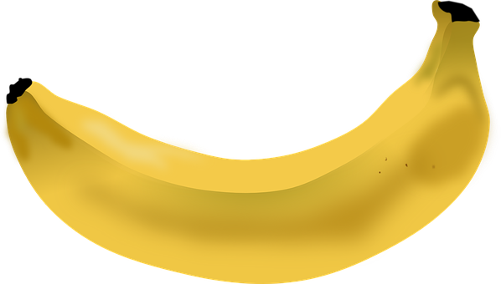
parler
Personne B
1)
2)
3)
4)
5)
6)
Personne A
………………….a game.
………………….a present.
…………………a pencil.
………………….a cake.
…………………..a book.
………...............a banana.
Tu as un livre.
She has
Elle a un jeu.
She has
J’ai un crayon.
I have
You have
Il a une banane.
You have
Tu as un gâteau.
Elle a un cadeau.
He has
Notes:
ANSWERS Round 2
17

Slide 18
Au revoir !
rouge
Notes:
18

Slide 19
parler
Handout
Personne A
1)
2)
3)
4)
5)
6)
Personne A
………………….a game.
………………….a present.
…………………a pencil.
………………….a cake.
…………………..a book.
………...............a banana.
Notes:
Handout A
19

Slide 20
parler
Handout
Personne B
………………….a cake.
………………….a pen.
…………………an orange.
………………….a present.
……………….a ruler.
……….........an exercise book.
Personne B
1)
2)
3)
4)
5)
6)
Notes:
Handout B
20

