Slide 1
Saying what I and others have
C’est bizarre !
rouge
Follow ups 1-5
Term 1 Week 11
Notes:
Artwork by Steve Clarke. Pronoun pictures from NCELP (www.ncelp.org). All additional pictures selected from Pixabay and are available under a Creative Commons license, no attribution required.
Phonics: [au/eau/o] - gauche[607] faux [555] eau[475] photo [1412] aussi [44]
Frequency of new words:
Vocabulary: cadeau [2298] gâteau [4845] pour [10] de [6] moi [132] toi [510] parfait [1600]
Revisit 1: un [3] une [3] ballon [3692] bouteille [2979] cahier [4001] jeu [291] orange [3912] peluche [>5000] sac [2343] stylo [>5000] (revisit banane)
Revisit 2: je [22] il [13] elle [38] être [5] suis, est monsieur [79] madame [294] présent [216] absent [2016] ici [167] là [109] Bonjour ! [1972] Salut ! [2205]
Londsale, D., & Le Bras, Y. (2009). A Frequency Dictionary of French: Core vocabulary for learners London: Routledge.
The frequency rankings for words that occur in this PowerPoint which have been previously introduced in these resources are given in the SOW and in the resources that first introduced and formally re-visited those words.
For any other words that occur incidentally in this PowerPoint, frequency rankings will be provided in the notes field wherever possible.

Slide 2
[au]
prononcer
[au / eau / o]
gauche
Notes:
Timing: 1 minute (two slides)
Aim: to recap SSC [au].
Procedure:
Click to bring up the SSC [au]. Repeat the SSC [au] and the source word gauche with the class. Introduce the gesture, if using.
Click to bring up the picture.
Pupils to practise saying the SSC and source word several times.
Suggested gesture: https://www.signbsl.com/sign/left Tap the left forearm with the right hand.

Slide 3
[au]
gauche
prononcer
[au / eau / o]
faux
eau
photo
aussi
[also]
Notes:
Aim: to recap SSC [au]
Procedure:
1. Introduce and elicit the pronunciation of the individual SSC [au] and then the source word again ‘gauche’ (with gesture, if using). 2. Then present and elicit the pronunciation of the five cluster words.
Frequency:
gauche [607] faux [555] eau [475] photo [1412] aussi [44]
Londsale, D., & Le Bras, Y. (2009). A Frequency Dictionary of French: Core vocabulary for learners London: Routledge.

Slide 4
Follow up 1
Écoute. C’est [au] ?
Écris de 1à 8 [au] ou ‘other’.
écouter
Mathieu
gâteau
piano
orange
stylo
bonjour
orange
docteur
jeu
piano
stylo
docteur
gâteau
Mathieu
jeu
[au]
other
bonjour
Notes:
Timing: 5 minutes
Aim: to recognise and produce SSC [au].
Procedure:
Click on a word to hear it said out loud.
Students allocate each word to either the left bucket, if they think the SCE in bold is [au] or the right bucket, if not. Tell students that even though these words look like English, English will not help them. Sometimes the SSCs sound the same as English, sometimes not.
Click to check and clarify the meaning of the words.
Once all the words have been assigned, reset the slide.
Students now try saying the words.
Click to check.
Transcript and word frequency (1 is the most frequent word in French):

Slide 5
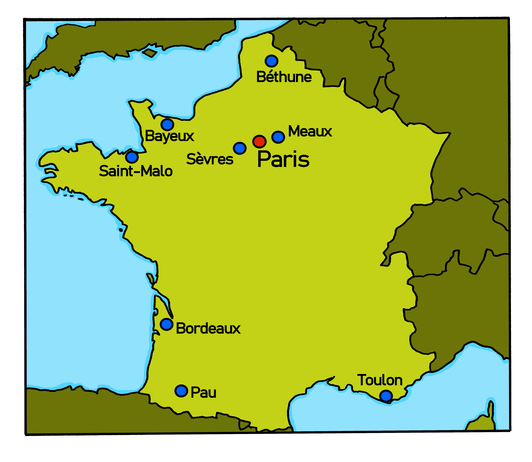
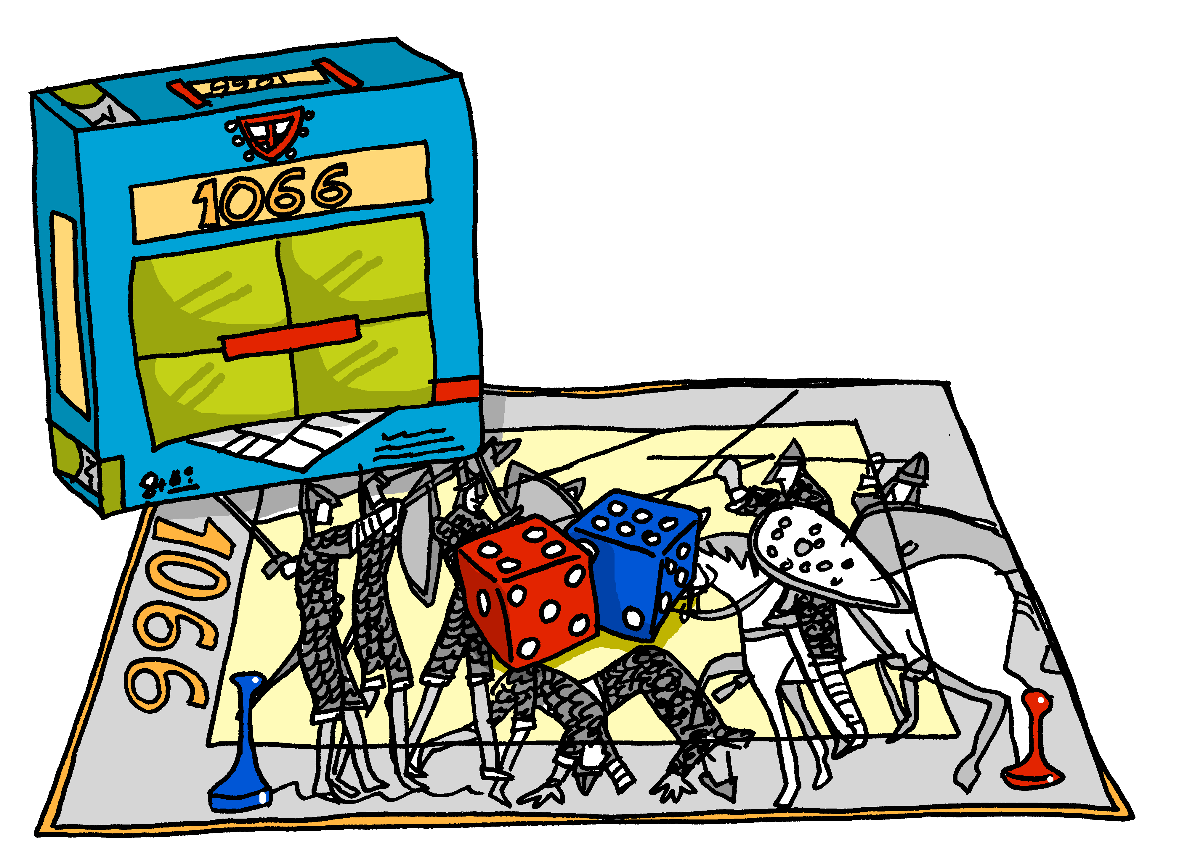
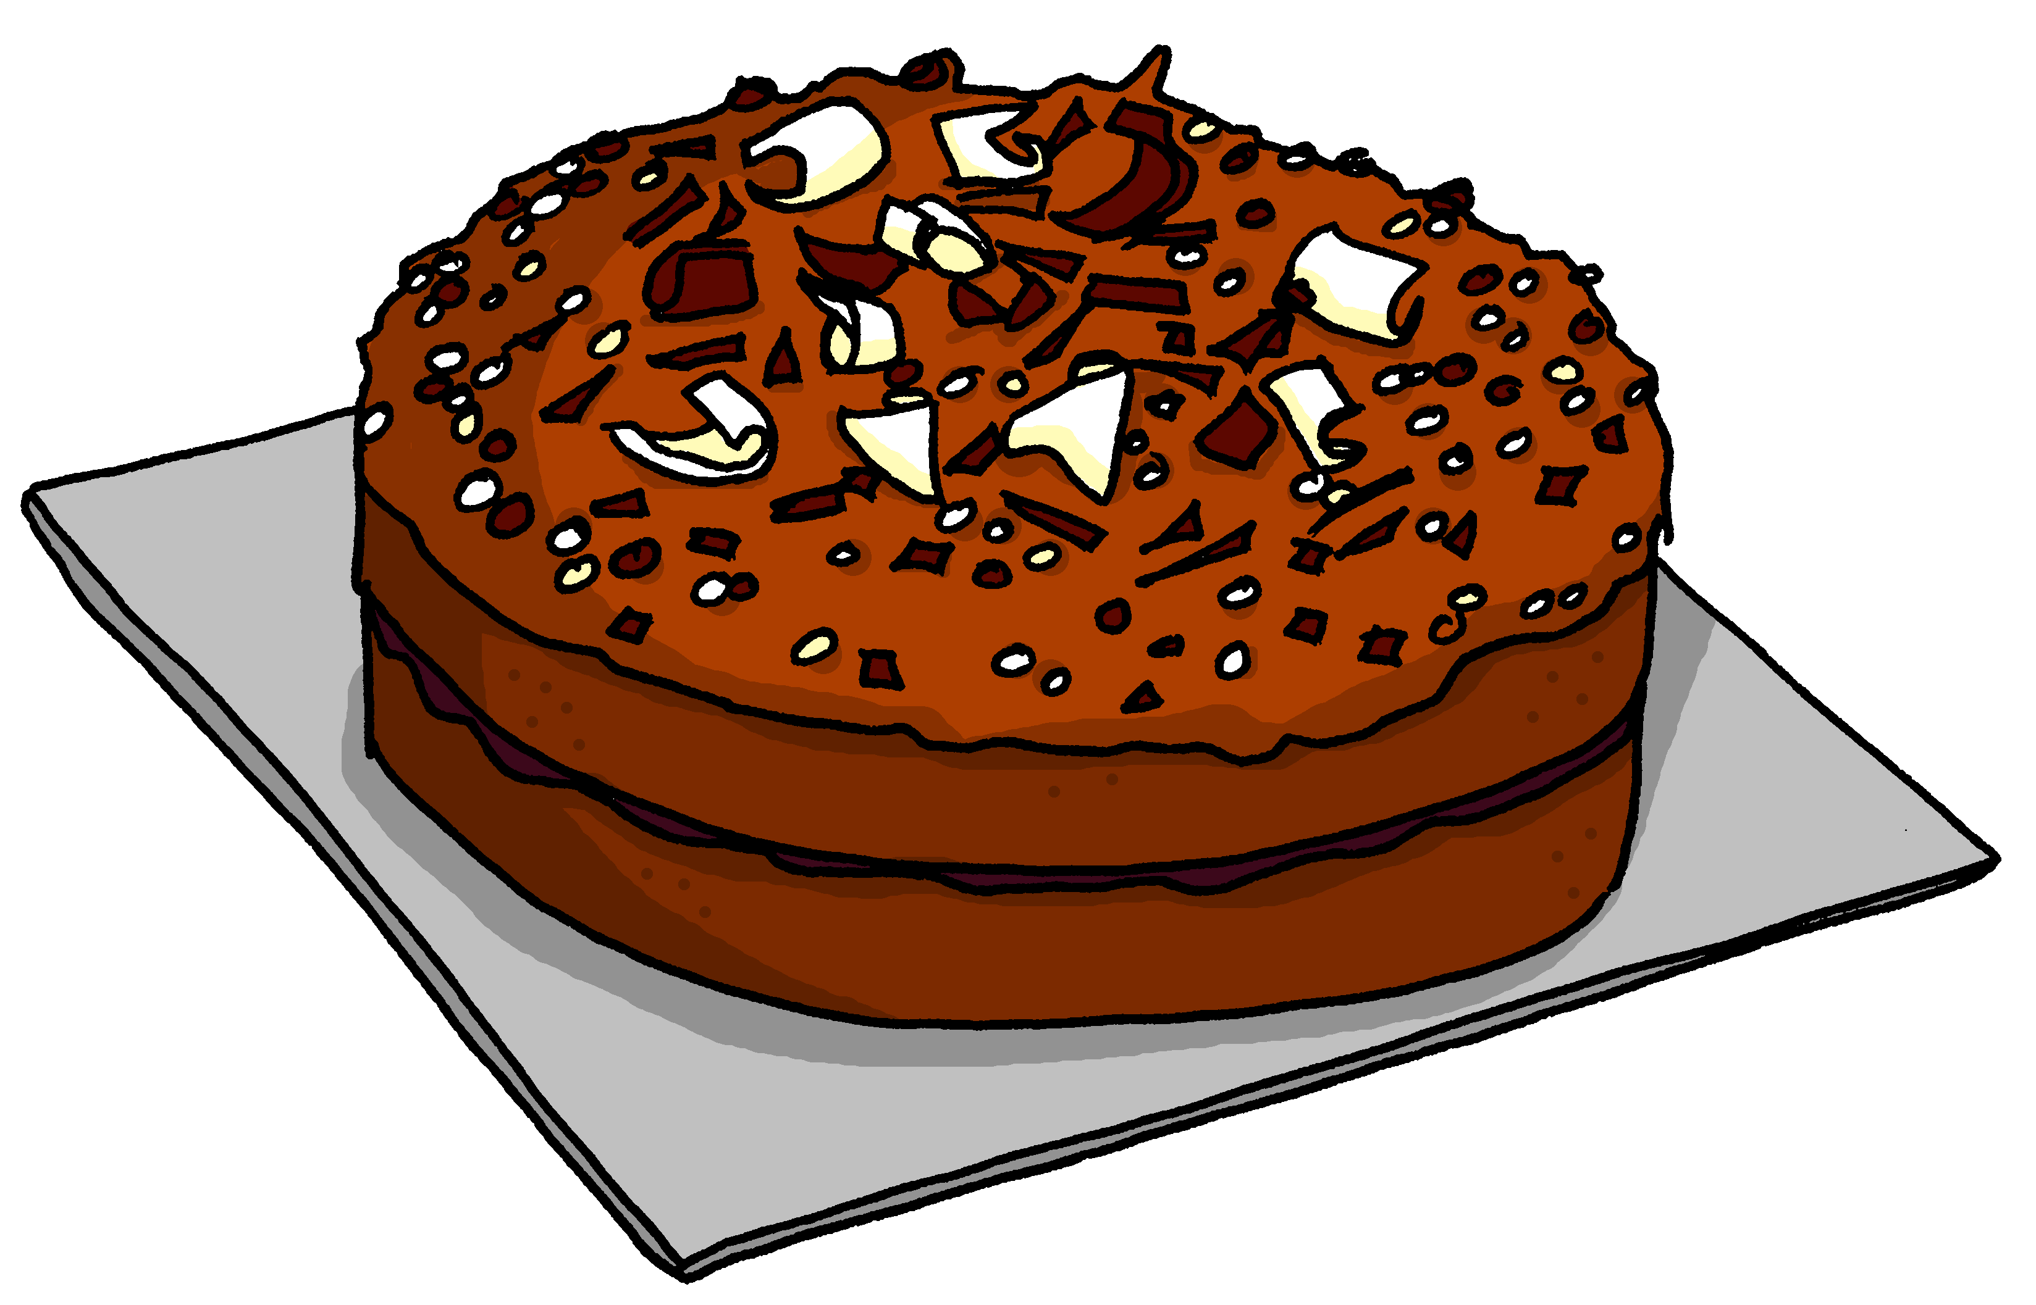
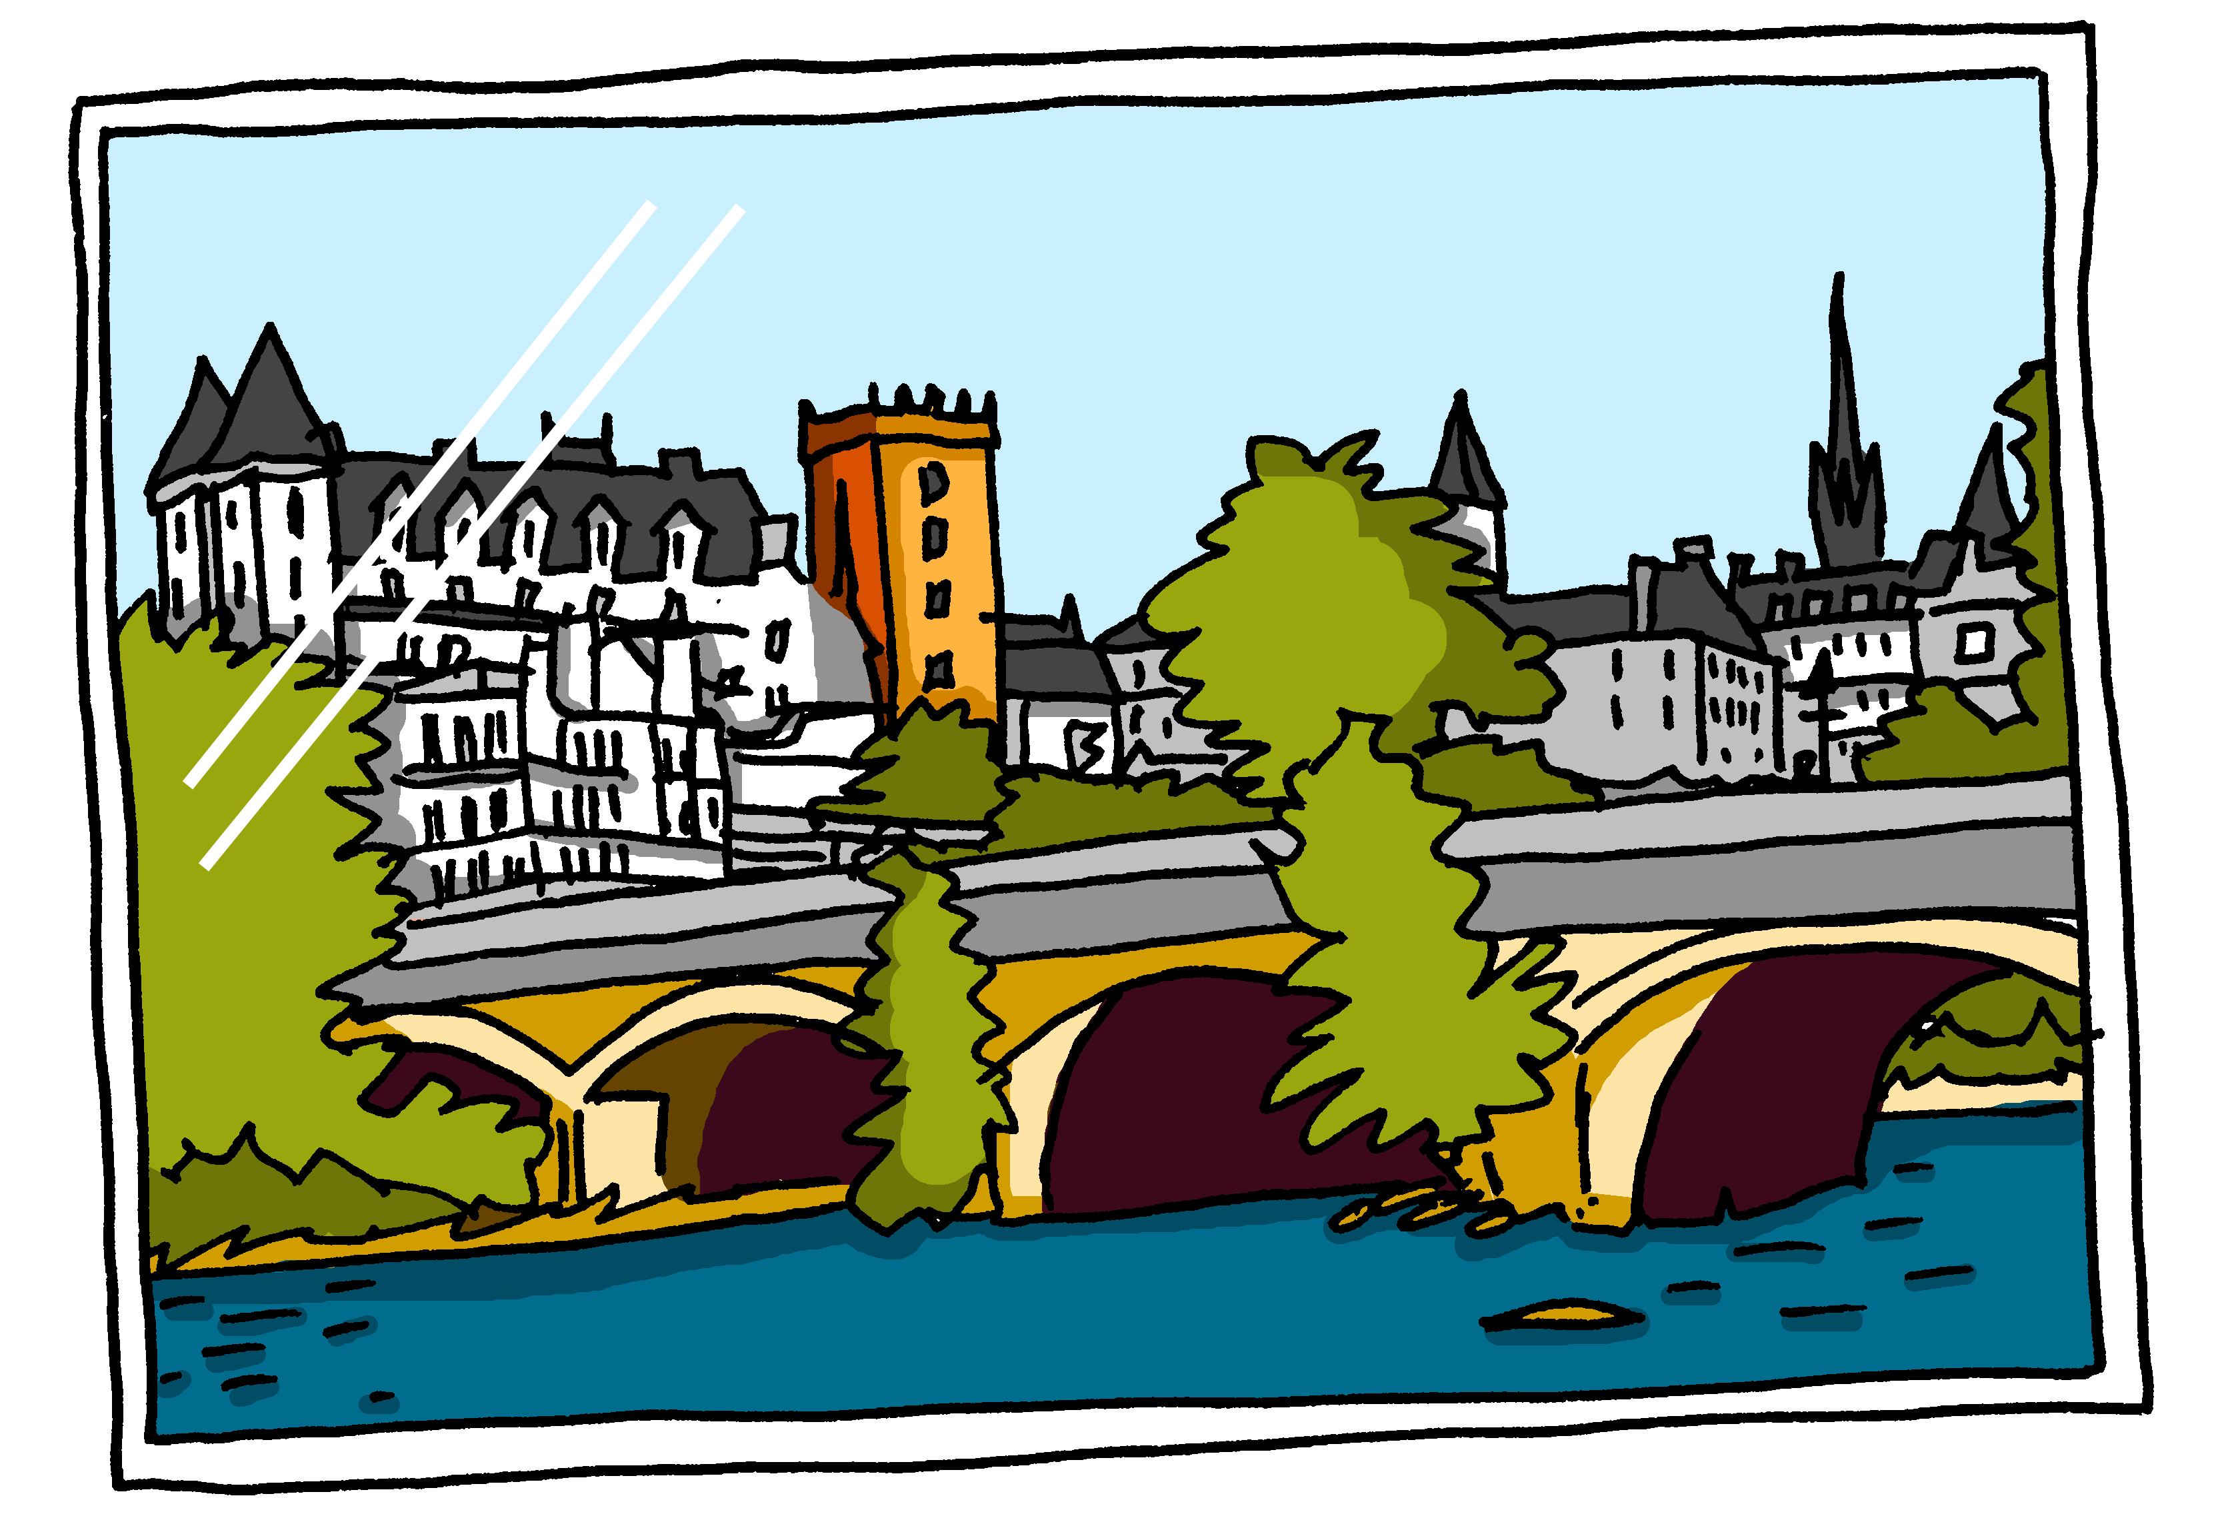
Follow up 2
. Écoute les noms des animaux. C’est [ien] ou [(a)in]?
Parle. C’est quoi ? Puis, écoute et vérifie.
1. C’est un jeu de Bayeux.
8
parler
2. C’est un livre de Sèvres.
1
3. C’est un stylo de Saint-Malo.
7
écouter
4. C’est un gâteau de Bordeaux.
2
3
5. C’est une photo de Pau.
6. C’est un ballon de Toulon.
4
7. C’est un cadeau de Meaux.
5
8. C’est une peluche de Béthune.
6
Notes:
Timing: 5 minutes
Aim: to practise spoken production of previously taught nouns and new French place names with SSC [au], [eu], [on], SFC and [u].
Procedure: 1. Explain to pupils that they are to name the item and where it is from, in French and that the item and the place share a common sound.
2. Model this with item 1. e.g., C’est un …. de… and elicit the full sentence. Click to reveal the written sentence and click on number 1 to hear the sentence said. 3. Given pupils 30 seconds to think and talk with a partner about number 2. Elicit the sentence (either chorally or from volunteers). Click for the written and audio versions. 4. Repeat with items 3 – 8.

Slide 6
Follow up 3
. Écoute les noms des animaux. C’est [ien] ou [(a)in]?
Écoute. Écris l’objet en français et en anglais.
écouter
un ballon
un livre
un gâteau
un jeu
une orange
une peluche
une photo
un stylo
Notes:
Timing: 5 minutes
Aim: to practise transcription and aural comprehension of previously taught nouns in a longer spoken context.
Procedure: 1. Click to re-listen to the story from this week’s lesson.
2. Pupils write the presents in French and English.
3. Click to reveal a picture of each object and its French word, for pupils to check their spelling and their understanding.

Slide 7
Il a quoi ? Elle a quoi ?
Remember that quoi means what.
You also know how to add quoi to make a question:
C’est quoi ?
What is it?
C’est un cadeau.
It is a present.
You can add quoi to make other questions, too:
Il a quoi ?
Elle a quoi ?
What does he have?
What does she have?
In English, we add ‘does’, in French we just make our voice go up.
Notes:
Timing: 2 minutes
Aim: to extend the use of ‘quoi’ to questions with avoir.
Procedure:
Click to present the short explanation.
Elicit English meanings for the French examples.
7

Slide 8
Follow up 4: Il a quoi ? Elle a quoi ?
Choose to ask: What does he have? OR what does she have?
Your partner will answer according to the picture.
parler
Il a quoi ?
Il a un stylo.
‘What does s/he have…..?’
Milo (m)
Solange (f)
Notes:
Timing: 5 minutes
Aim: to practise oral production of il a and elle a + quoi in raised intonation questions, and this week’s vocabulary items.
Procedure: 1. Pupil A chooses to ask ‘does she have’ or ‘does he have’ 2. Pupil B answers by selecting the correct response. There are pairs of male / female characters presented here (signified by the (m) or (f) in brackets and additionally colour-coded.
3. After slide 1 (four question and answers), move on to slide 2, swap roles and repeat the task.

Slide 9
Follow up 4A: Il a quoi ? Elle a quoi ?
1
2
Véro (f)
Yves (m)
parler
Léon (m)
Solange (f)
3
4
Milo (m)
Margot (f)
Lulu (f)
Mathieu (m)
Notes:
Partner A asks questions

Slide 10
Follow up 4B: Il a quoi ? Elle a quoi ?
1
2
Mathieu (m)
Margot (f)
Milo (m)
parler
Lulu (f)
3
4
Léon (m)
Solange (f)
Véro (f)
Yves (m)
Notes:
Partner B asks questions

Slide 11
vocabulaire
Follow up 5 - Écris en français : Can you get at least 15 points?
mots
 | Hi! | Mrs, (Miss) teacher | Hello!
 | I am | he is | Mr, Sir (teacher)
 | a bag | an exercise book | I
 | a (m) | a (f) | a bottle
 | perfect | you have (singular) | she has
 | for | for me | for you
 | a present | a cake | from
Salut !
Madame
Bonjour !
x3
je suis
il est
Monsieur
un sac
un cahier
je
x2
un
une
une bouteille
parfait
tu as
elle a
pour
pour moi
pour toi
x1
un cadeau
un gâteau
de
Notes:
Timing: 5-10 minutes
Aim: to practise written comprehension of vocabulary from this week and previous weeks.
Procedure: Give pupils a blank grid. They fill in the French meanings of any of the words they know, trying to reach 15 points in total.
Note: The most recently learnt and practised words are pink, words from the previous week are green and those from week 1 are blue, thus more points are awarded for them, to recognise that memories fade and more effort (heavy lifting!) is needed to retrieve them.
11

Slide 12
vocabulaire
Écris en français : Can you get at least 15 points?
mots
 | Hi! | Mrs, (Miss) teacher | Hello!
 | I am | he is | Mr, Sir (teacher)
 | a bag | an exercise book | I
 | a (m) | a (f) | a bottle
 | perfect | you have (singular) | she has
 | for | for me | for you
 | a present | a cake | from
x3
x2
x1
Notes:
HANDOUT
12

