Slide 1
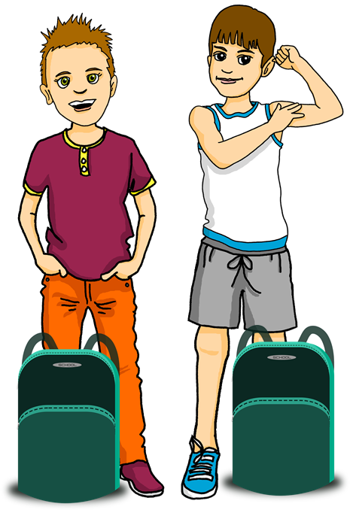
Saying what I and others have
« Avoir » : tu as
intonation questions
SSC [on]
une excursion à la montagne
rouge
Term 1 Week 10
Notes:
Artwork by Steve Clarke. Pronoun pictures from NCELP (www.ncelp.org). All additional pictures selected from Pixabay and are
available under a Creative Commons license, no attribution required.
The AUDIO version of the lesson material includes additional audio for the new language presented (phonics, vocabulary) and audio for the instructions
on the slide. In addition, it includes VIDEO clips of the phonics and the phonics’ source words. Pupils can be encouraged to look at the shape of the mouth/lips on
slides where these appear, and try to copy it/them.
Phonics: [on] non ! [72] crayon [>5000] onze [2447] monde [77] pont [1889]
Frequency of new words:
Vocabulary: tu as [8] crayon [>5000] règle [488] gomme [>5000] livre [358]
Revisit 1: Revisit days of the week sérieux [412] heureux [764] curieux [2424] courageux [2198 semaine [245]
Revisit 2: écouter [429] parler [106] lire [278] écrire [382] banane [>5000] cheval [2220] midi [2483] moto [>5000] univers [2112]
Londsale, D., & Le Bras, Y. (2009). A Frequency Dictionary of French: Core vocabulary for learners London: Routledge.
The frequency rankings for words that occur in this PowerPoint which have been previously introduced in these resources are given
in the SOW and in the resources that first introduced and formally re-visited those words.
For any other words that occur incidentally in this PowerPoint, frequency rankings will be provided in the notes field wherever
possible.
1

Slide 2
[on]
Non !
prononcer
[on] is another nasal vowel like [an|en].
[un] is nasal before a consonant and at the end of words.
When you say a nasal vowel, air passes through your nose as well as your mouth.
Notes:
Timing: 1 minute
Aim: to present and practise SSC [on].
Procedure:
Introduce and elicit the pronunciation of the individual SSC [on] the source word ‘Non !’ with gesture, if using.
Click to bring on the picture and get students to repeat (with gesture, if using).
Click to bring up the callout about nasal vowels. Ask pupils if they can remember any words, or names they know with the [an | en] sound. (e.g. orange, dimanche, vendredi, maman, grand, enfant, content, anglais etc – there are lots!)
Move onto the next slide to practise [on] in four cluster words.
Note: gesture for Non ! – moving your index finger in a ‘wagging’ motion left to right in an exaggerated way.

Slide 3
prononcer
[on]
non !
crayon
monde
pont
onze
Notes:
Timing: 2 minutes
Aim: to present and practise SSC [on]
Procedure:
Present and elicit again the pronunciation of the individual SSC [on] the source word ‘Non !’ with gesture, if using.
Click to bring on the picture and get students to repeat (with gesture, if using).
Click again to bring up four cluster words to practise the sound. Repeat the words several times.
Note: gesture for Non ! – moving your index finger in a ‘wagging’ motion left to right in an exaggerated way.
3

Slide 4
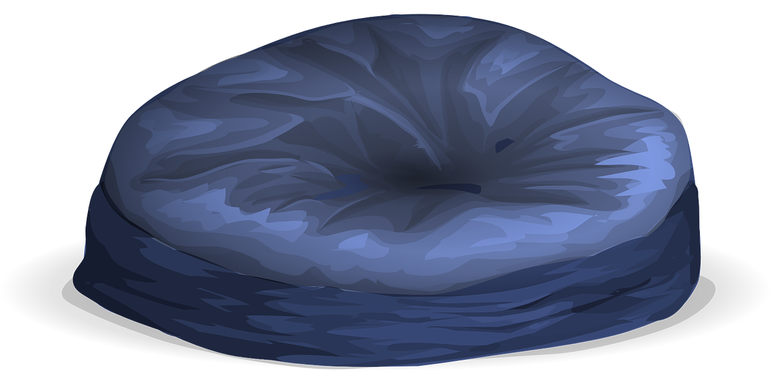
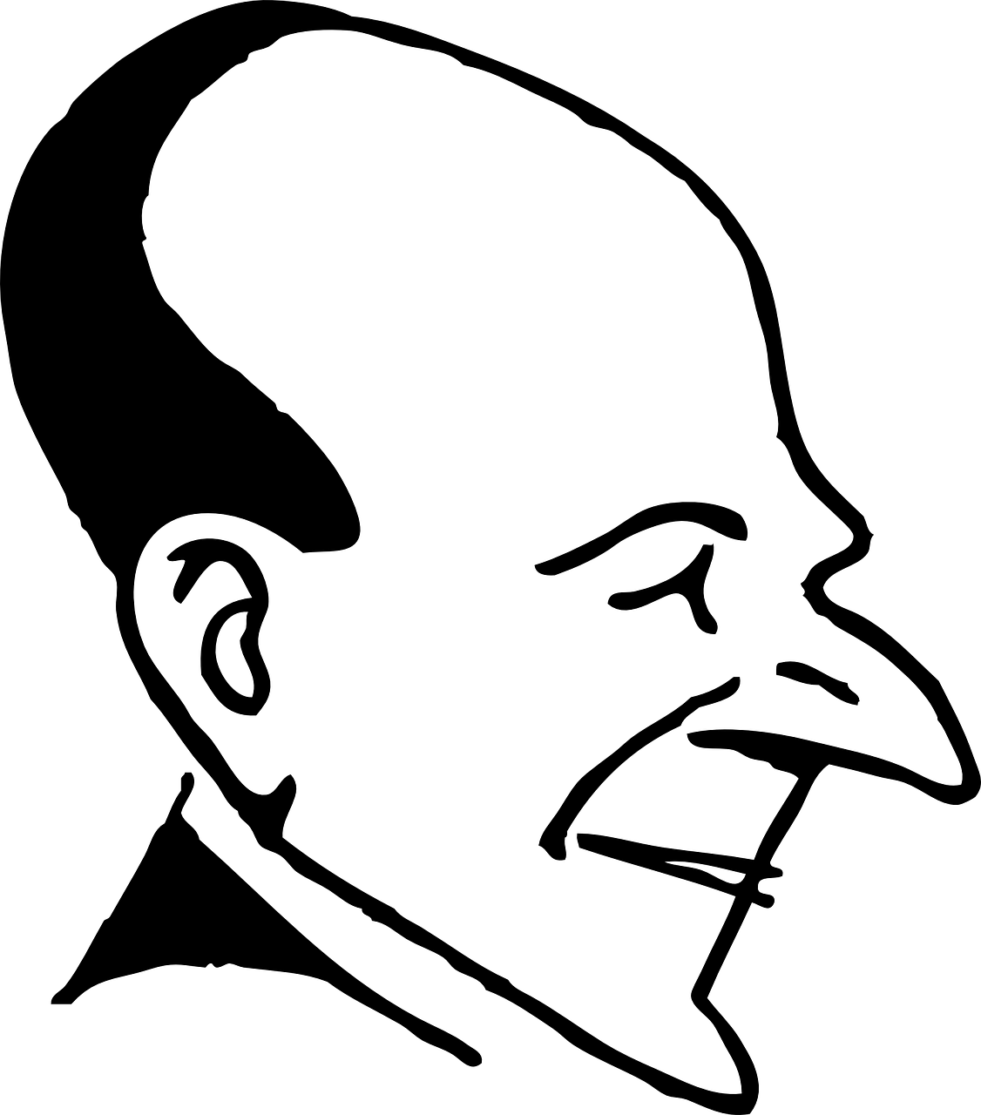
[on]
Prononce les mots.
.
seconde
consulter
confortable
religion
prononcer
25
caméléon
marron
front
passion
bonjour
Japon
0
DÉBUT
Notes:
Timing: 3 minutes
Aim: to practise the pronunciation of SSC [on] in mostly unfamiliar words.
Procedure: 1. Pupil A selects 4 of the words (making a note of them).
2. Start the timer. Pupil B tries to guess Partner A’s four words by pronouncing them within the 25 time limit.
3. Pupil B listens and ticks off Pupil A’s correct attempts.
4. They swap roles and repeat the task (taking turns until each has managed to get all four words. 5. The activity can be repeated multiple times.
Note: ensure pupils know they don’t need to rush too much. They have 2.5 seconds per word so will be able to say them all. If preferred, remove the timer altogether.
Frequency of unknown words and cognates (1 is the most frequent word in French): seconde [1542] consulter [1595] confortable [3964] religion [1699] caméléon [>5000] front [1729] marron [>5000] passion [1866] bonjour [1972] Japon [n/a]
Source: Londsale, D., & Le Bras, Y. (2009). A Frequency Dictionary of French: Core vocabulary for learners London: Routledge.
Attribution: world religions image original version Image:P religion.png - he:משתמש:נעמה מ, vector version Image:P religion world.svg - User:Booyabazooka, this version - User:Putnik, CC BY-SA 3.0, via Wikimedia Commons

Slide 5
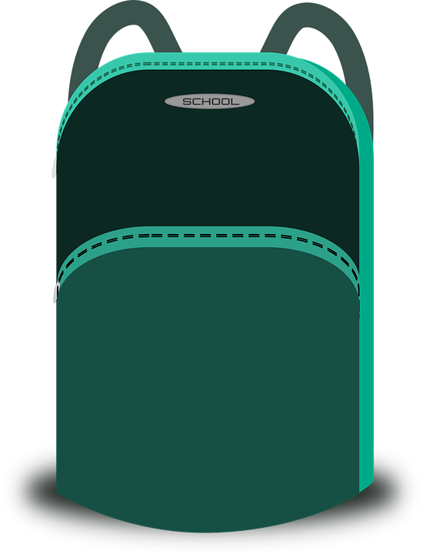
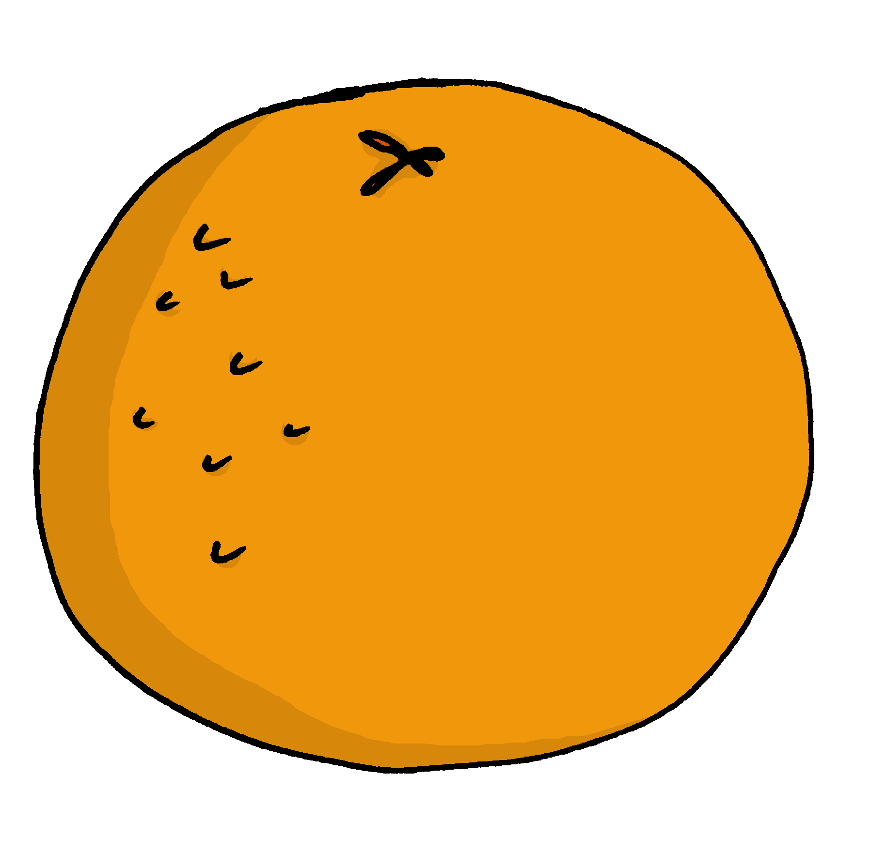
vocabulaire
Écoute et répète.
mots
[un]
[une]
__ crayon a pencil
__ gomme a rubber
__ règle a ruler
__ stylo
__ livre a book
__ orange
__ bouteille
__ sac
__ cahier
Notes:
Timing: 5 minutes
Aim: to practise distinction between un and une; to present four new vocabulary items for this week in sound and writing, and with English meanings; to practise recall of four previously taught vocabulary items.
Procedure:
Click for each word to appear with audio including the article un/une, which is not shown.
Pupils say ‘un’ or ‘une’, and in addition they might indicate with an arm pointing to show the correct gender/article.
Click again for the word to disappear into the corresponding pacperson’s mouth.
Transcript un sac une orange une bouteille un cahier un stylo une gomme un livre un crayon une règle
5

Slide 6
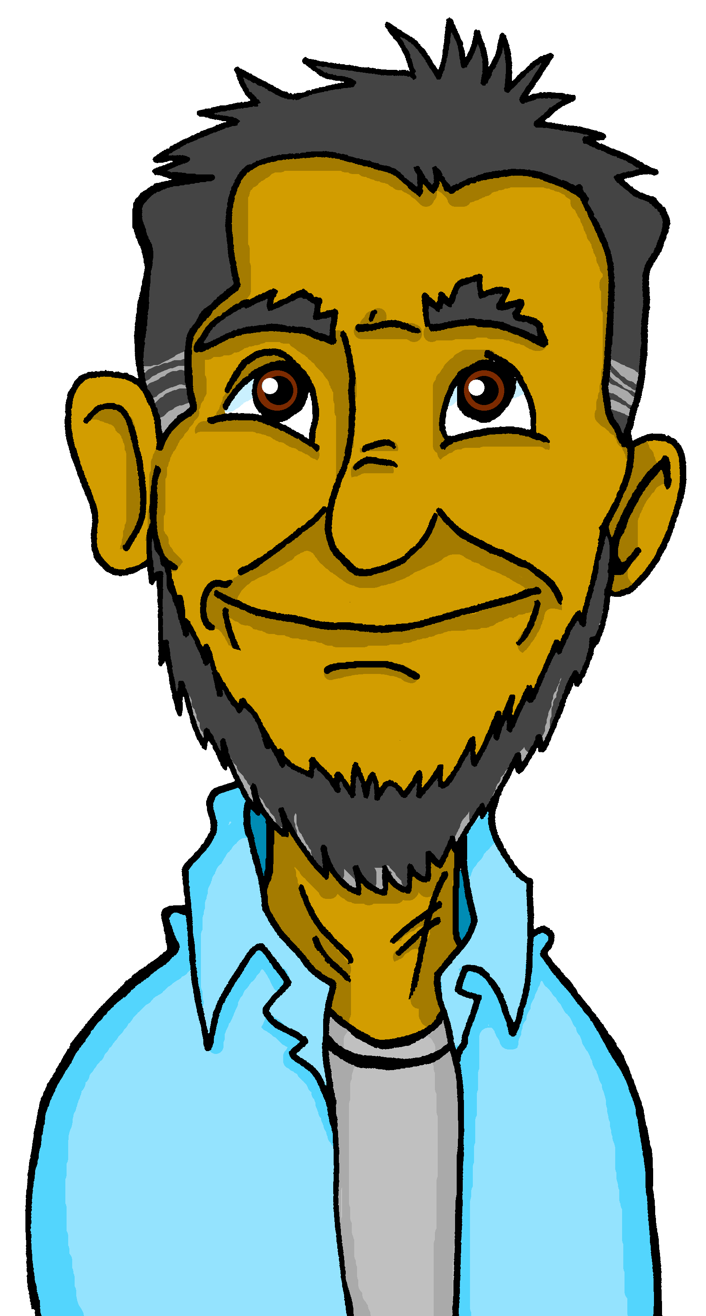
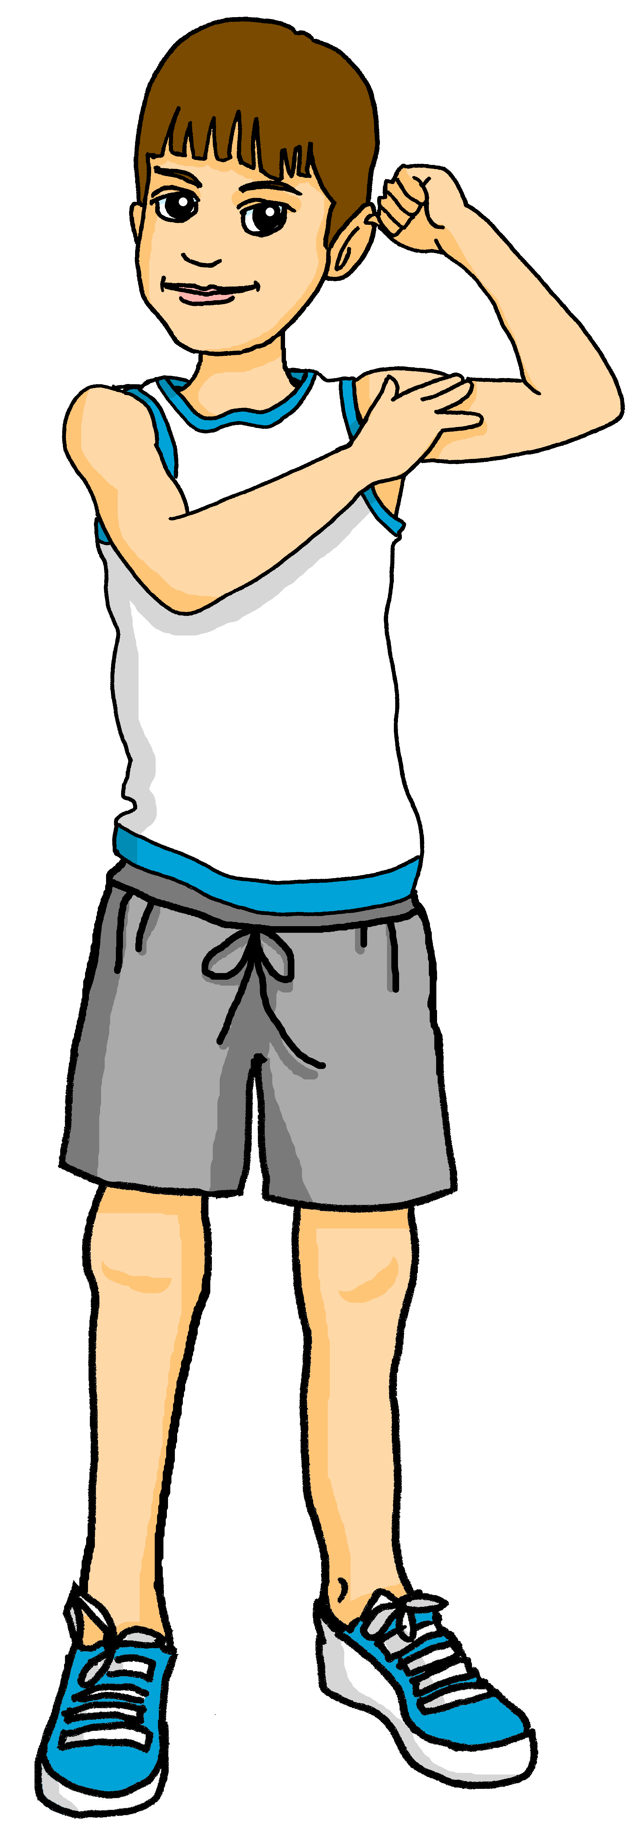
écouter
Une excursion à la montagne
Pierre and his friends are going on a school trip to the mountains.
Le professeur lit une liste.
C’est un ou une ? c’est quoi ?
 | un | une | livre | règle
 | un | une | bouteille | jeu
 | un | une | gomme | crayon
 | un | une | stylo | peluche
 | un | une | cahier | orange
1
1
2
2
3
3
4
4
5
5
Notes:
Timing: 5 minutes
Aim: to practise aural recognition of un / une and its connection with an appropriate noun.
Procedure:
Read the title and click to bring up the instructions.
Clarify the task. Pupils write the article they hear.
Click to bring up the answers.
Draw pupils’ attention to the nouns.
Pupils write (or circle) the correct noun, according to their knowledge of its gender (to match the article they heard).
Click to bring up a 2nd set of audio buttons to hear the article and noun together.
Pupils check their answers.
Click to confirm the answers.
Transcript:
un [livre]
une [bouteille]
un [crayon]
un [stylo]
une [orange]
Transcript 2:
un livre
une bouteille
un crayon
un stylo
une orange
6

Slide 7
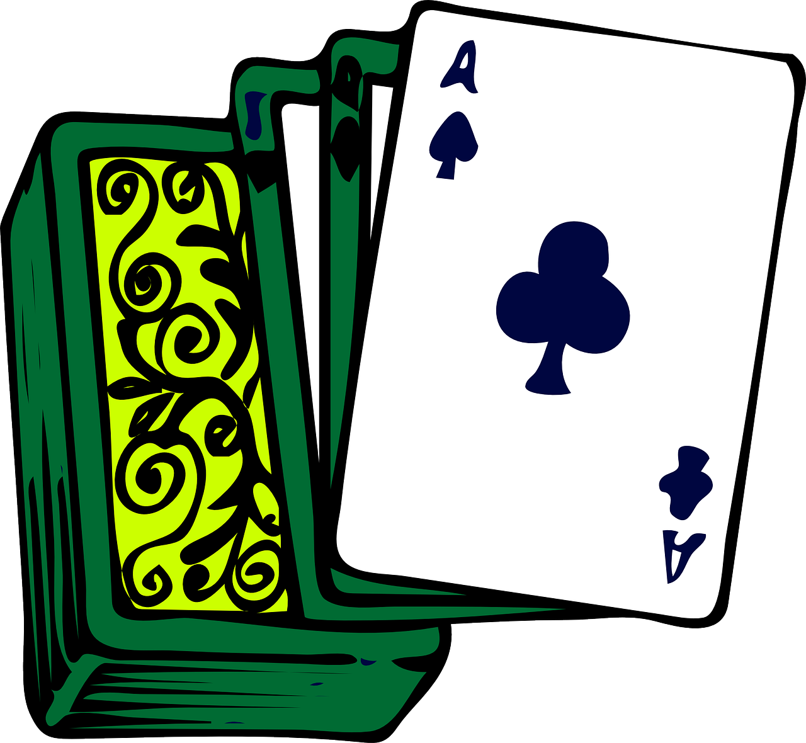
lire
C’est nécessaire ? Oui ou non ?
Complète les deux listes.
un | une | livre | règle
un | une | bouteille | jeu
un | une | gomme | crayon
un | une | stylo | peluche
un | une | cahier | orange
a book
a ruler
a bottle
a game
a pencil
a rubber
a pen
a cuddly toy
an orange
a exercise book
Notes:
Timing: 6 minutes
Aim: to practise written comprehension of the new vocabulary.
Procedure:
1. Ensure that pupils understand the task. They need to identify and list in English the 5 items that are needed for the trip, and the five items that the friends should leave at home. 2. Pupils write the words in English.
3. Click to reveal answers.
4. Note: the pictures are provided to give additional support for word comprehension as pupils have only met some of these words briefly, at the start of the lesson.
7

Slide 8
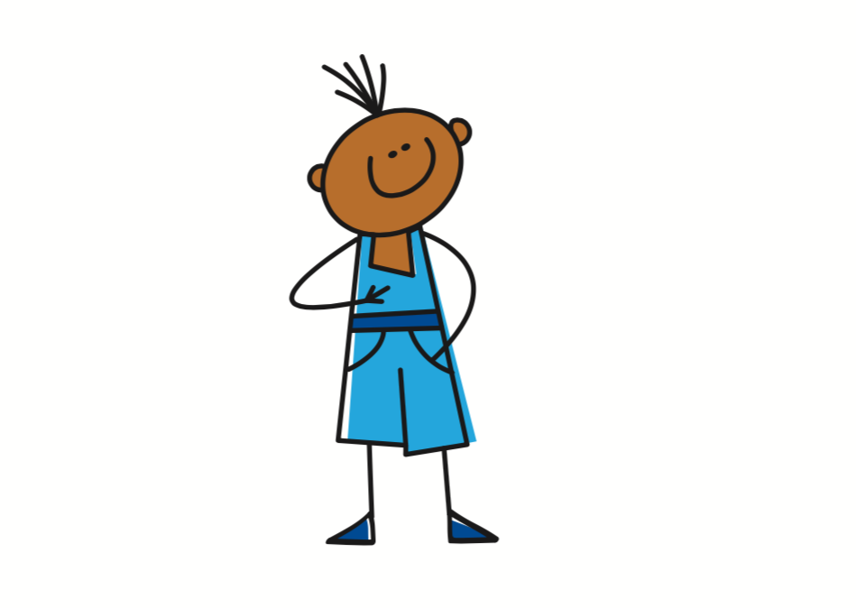
avoir
Avoir [to have, having]
The verb avoir means ‘to have’ or ‘having’:
I
je becomes j’ before a vowel.
j’ai
To say I have, use ______.
J’ai un stylo.
I have a pen.
you
tu as
Tu as un crayon.
To say you have, use _____.
You have a pencil.
Notes:
Timing: 3 minutes
Aim: to re-introduce the verb avoir (to have), I have, and introduce you have.
Procedure:
Click to present the information.
Elicit the English at each stage from pupils after presenting the French examples.

Slide 9
Asking questions
Remember! To change a statement into a yes/no question, raise your voice at the end:
J’ai un livre.
J’ai un livre ?
I have a book.
Do I have a book ?
Tu as un livre.
Tu as un livre ?
You have a book.
Do you have a book?
In English, we add ‘do’, in French we just make our voice go up.
Notes:
Timing: 2 minutes
Aim: to revisit how to form intonation questions and intonation questions.
Procedure:
Click to present the information.
Elicit the English at each stage from pupils after presenting the French examples.

Slide 10
écouter
Une excursion à la montagne
Pierre prépare le sac, mais il a des questions.
C’est qui ? Pierre (je) ou Max (tu) ?
Écris l’objet en anglais.
 | Do I have…? | Do you have…? | ???
 |  |  | an orange
 |  |  | a game
 |  |  | a pen
 |  |  | a bottle
 |  |  | a pencil
 |  |  | a rule
 |  |  | a book
 |  |  | a rubber
1
1
2
2
3
3
4
4
5
5
6
6
7
7
8
8
Notes:
Timing: 7 minutes
Aim: to practise aural recognition of ‘j’ai’ and ‘tu as’ in questions and aural comprehension of 8 previously taught nouns.
Procedure:
Read the title and click to bring up the instructions.
Clarify the task. Pupils write Do I have or Do you have and the noun in English.
Click to bring up the answers to part 1 first.
Listen again for the nouns.
Pupils write the correct noun.
Click to correct.
Transcript:
[beep] as une orange ? [beep] ai un jeu ? [beep] ai un stylo ?
[beep] as une bouteille ? [beep] as un crayon ? [beep] ai une règle ?
[beep] as un livre ? [beep] as une gomme ?
Transcript 2:
tu as une orange ? j’ai un jeu ?
j’ ai un stylo ? tu as une bouteille ?
tu as un crayon ? j’ai une règle ?
tu as un livre ? tu as une gomme ?
10

Slide 11
Au revoir !
rouge
Notes:
11

