Slide 1
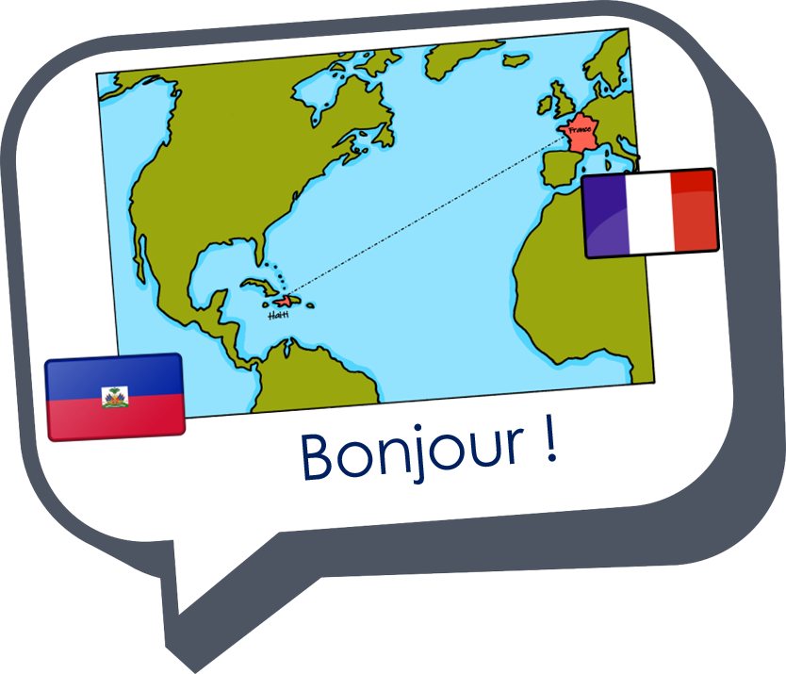
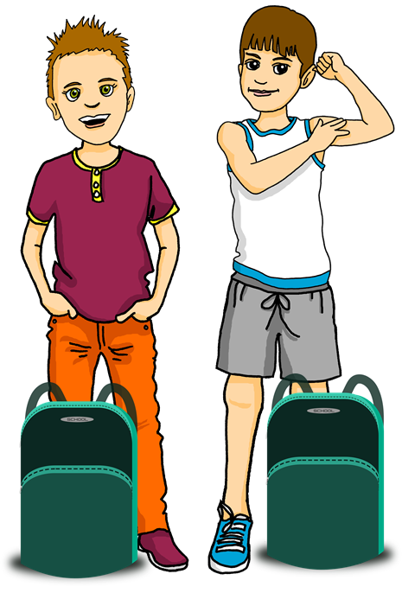
Saying what I and others have
une excursion à la montagne
rouge
Follow ups 1-5
Term 1 Week 10
Notes:
Artwork by Steve Clarke. Pronoun pictures from NCELP (www.ncelp.org). All additional pictures selected from Pixabay and are available under a Creative Commons license, no attribution required.
Phonics: [on] non ! [72] crayon [>5000] onze [2447] monde [77] pont [1889]
Frequency of new words:
Vocabulary: tu as [8] crayon [>5000] règle [488] gomme [>5000] livre [358]
Revisit 1: Revisit days of the week sérieux [412] heureux [764] curieux [2424] courageux [2198 semaine [245]
Revisit 2: écouter [429] parler [106] lire [278] écrire [382] banane [>5000] cheval [2220] midi [2483] moto [>5000] univers [2112]
Londsale, D., & Le Bras, Y. (2009). A Frequency Dictionary of French: Core vocabulary for learners London: Routledge.
The frequency rankings for words that occur in this PowerPoint which have been previously introduced in these resources are given in the SOW and in the resources that first introduced and formally re-visited those words.
For any other words that occur incidentally in this PowerPoint, frequency rankings will be provided in the notes field wherever possible.

Slide 2
Follow up 1: Écoute.
Raise your hand each time you hear [on].
Léon le caméléon
Change du couleur, quel polisson
Léon le caméléon
Où est, où est Léon? [X2]
Rose, comme un cochon
Jaune, comme un citron Blanc, comme un mouton
Où est, où est Léon?
Léon le caméléon
Change du couleur, quel polisson
Léon le caméléon
Où est, où est Léon? [X2]
Vert, comme le gazon
Rouge, comme un poisson Bleu ou bien marron
Où est, où est Léon?
écouter
Noir, comme du charbon Orange, comme du melon On a trouvé Léon Léon le polisson
Avez son frère Gaston Dans un sac de bonbons Rose, comme un cochon
Jaune, comme un citron Blanc, comme un mouton
Vert, comme le gazon
Rouge, comme un poisson
Bleu ou bien marron Noir comme du charbon Orange comme du melon Chantez la chanson La chanson de Léon
Notes:
Timing: 5 minutes
Aim: to practise aural recognition of SSC [on].
This song has a lot of the recent sounds in it and is very catchy. https://www.youtube.com/watch?v=trsEbqJ9L3E
(Note that there are several different versions available – check the link before using the lesson to make sure that this particular version is still available. If not, search up a different one).
Procedure: 1. Pre-load the youtube link so that it is paused at the start of the song.
2. Explain the task to pupils.
3. Play the song. Pupils put up a hand each time they hear [on] (it is a lot of times)
4. They will be able to join in with the repeated lines by the end of the song. 5. Read the song lyrics through with pupils again at the end.
Attribution: "Leon le caméléon" Los Amigos

Slide 3
Follow up 2:
Une excursion à la montagne.
Lis. Pierre is a bit worried. He messages Yves. Is he checking ‘you have’ with Yves or saying what Sophie (another friend) has.
lire
1
4
Elle a un livre.
Tu as un stylo.
◆
◆
Complète les deux listes.
2
5
Yves (you have)
 | ______
 | ______
 | ______
Sophie (she has)
 | ______
 | ______
 | ______
Elle a une bouteille.
◆
Tu as un crayon.
◆
a pen
a bottle
a pencil
a rubber
3
6
an ex. book
a book
Elle a une gomme.
◆
Tu as un cahier.
◆
Notes:
Timing: 5 minutes
Aim: to practise written comprehension of tu as and elle a plus 8 nouns.
Procedure:
1. Explain the scenario. 2. Pupils decide who is referred to in each message and what is talked about.
3. They write this in two lists.
4. Click to check answers.

Slide 4
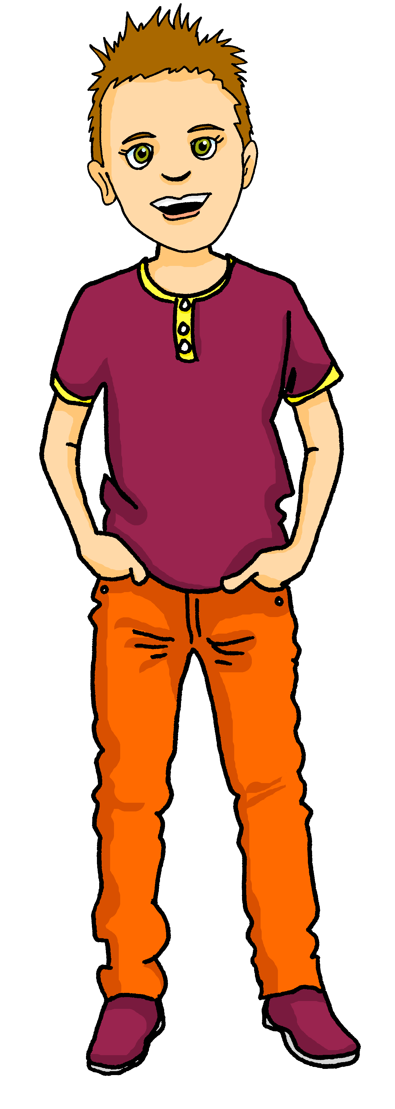
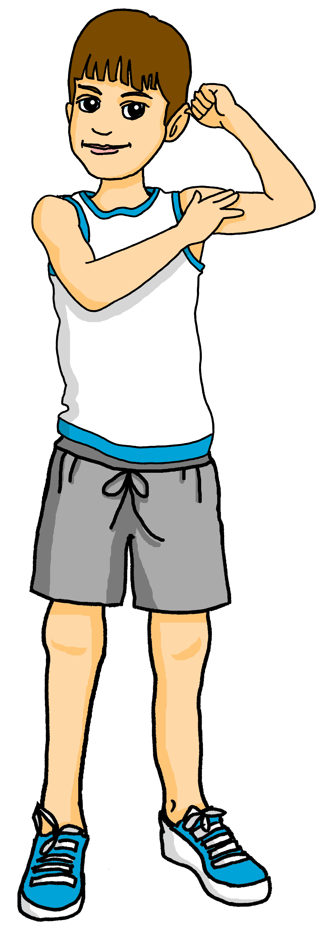
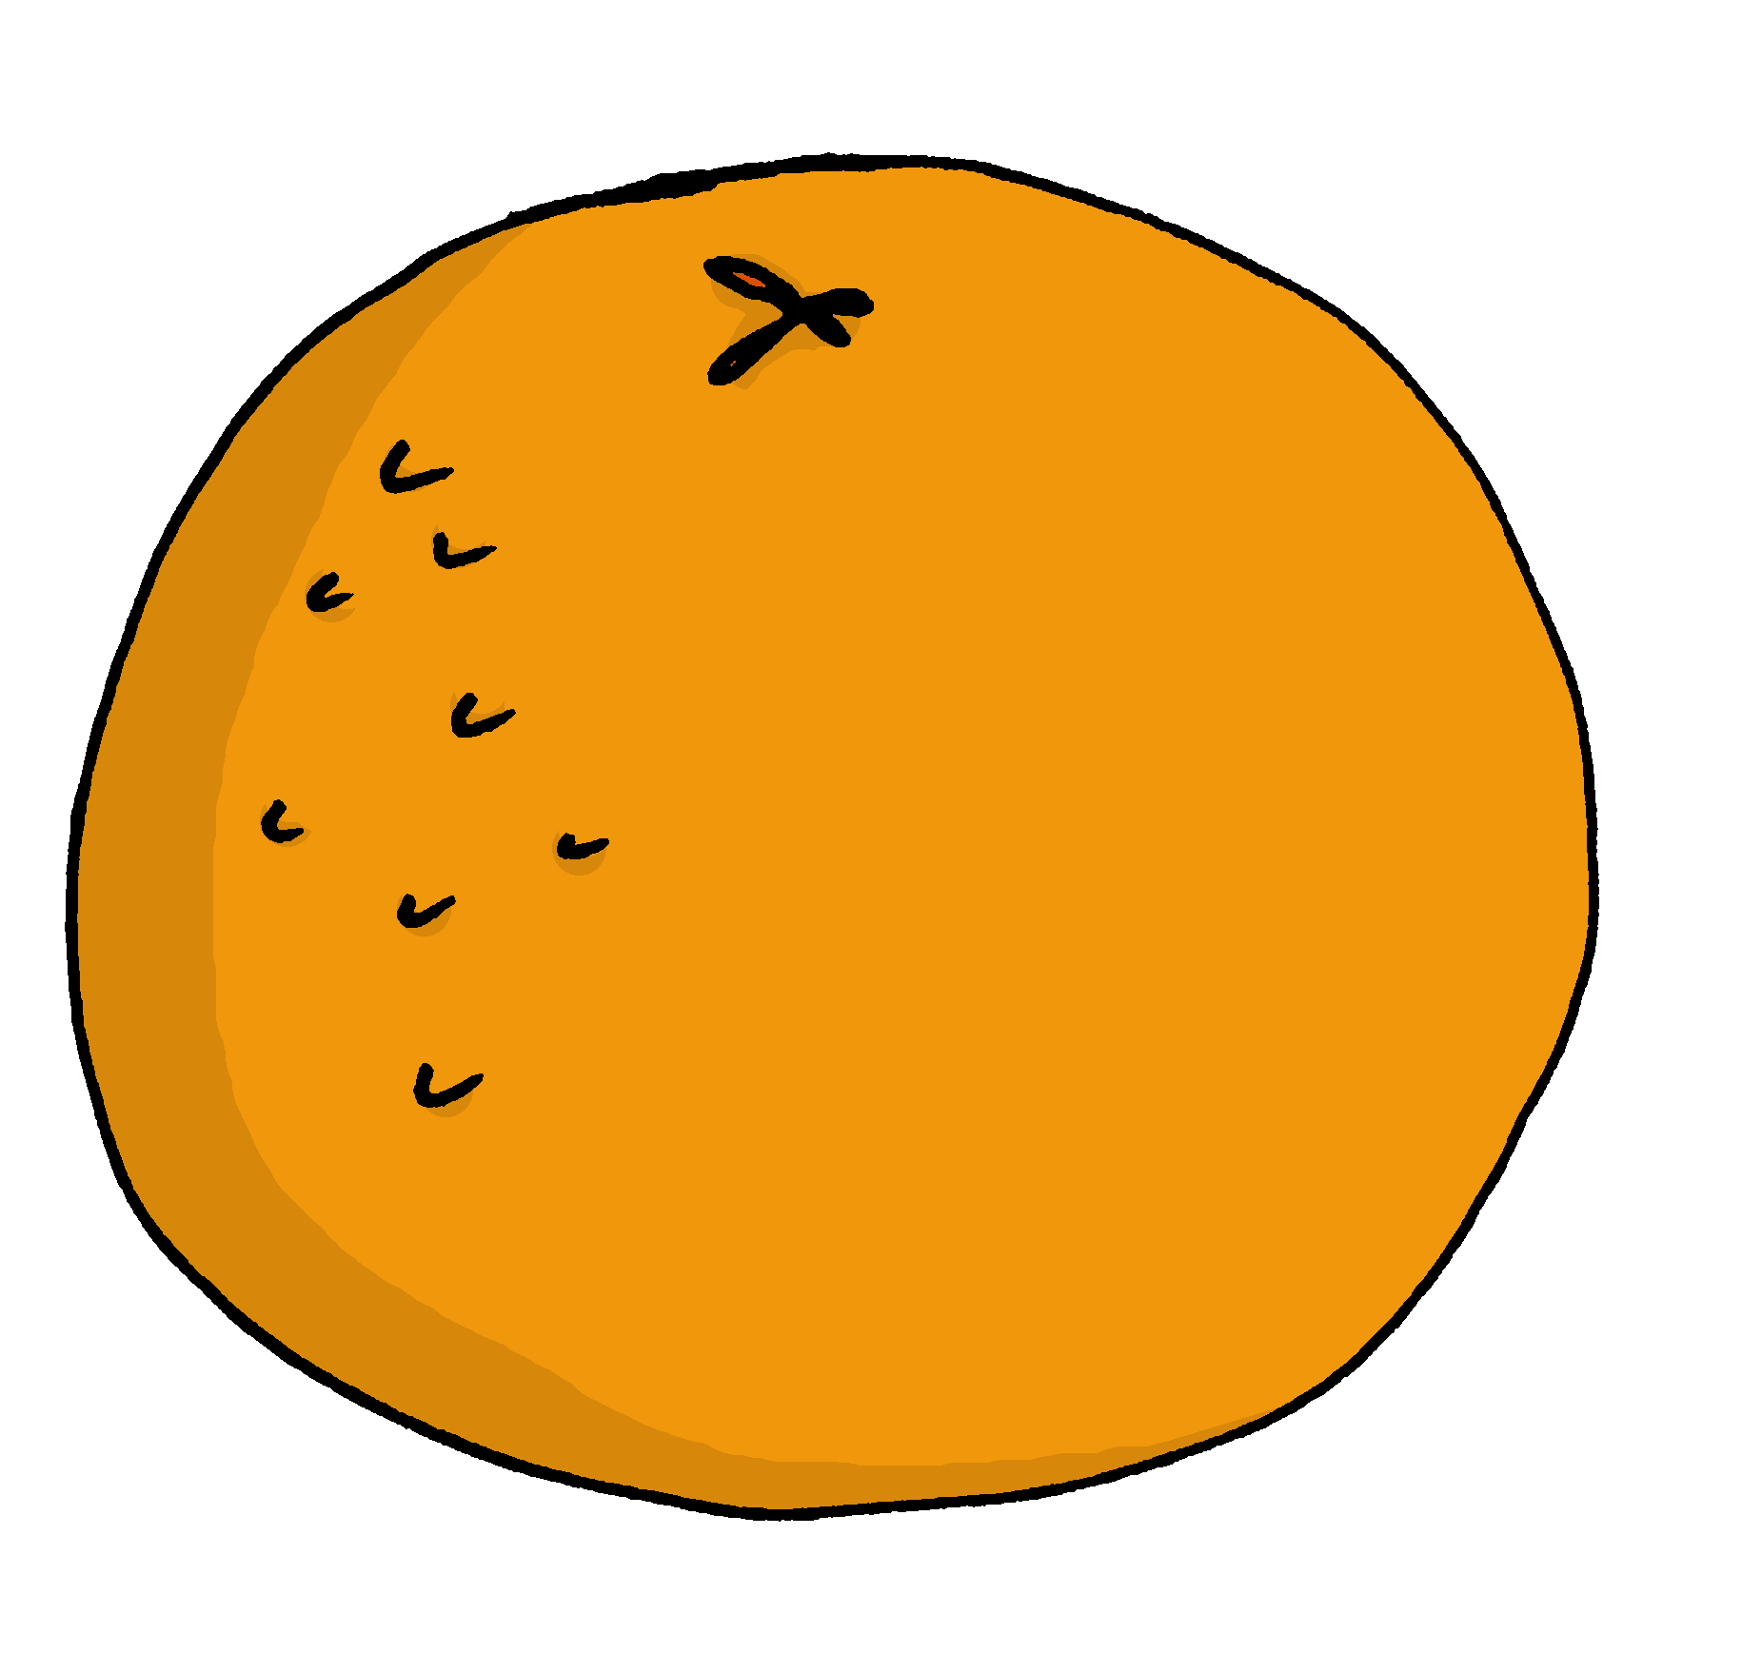
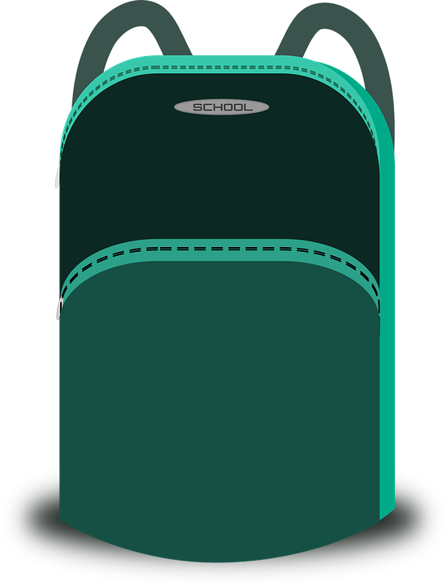
Follow up 3: Lis. Qui a quoi ?
Between the two friends, do they have everything? Write ‘I’ or ‘he’. Do they have two of anything? What don’t they need?
lire
1. J’ai un stylo.
I
2. Il a une bouteille.
3. Il a un ballon.
4. J’ai un livre.
I
5. J’ai un cahier.
I + he
6. Il a une orange.
7. J’ai une bouteille.
he
8. Il a une règle.
Notes:
Timing: 5 minutes
Aim: to practise written comprehension of a this week’s verbs and other vocabulary.
Procedure: 1. Pupils read each sentence and look at the list of five items. 2. They decide you has it (or note if no-one does).
3. Elicit the answers orally and click to reveal the answers.
4. Finally ask pupils to identify anything the boys have packed which were not on the list.
5. Elicit the English meanings of these three items, orally.

Slide 5
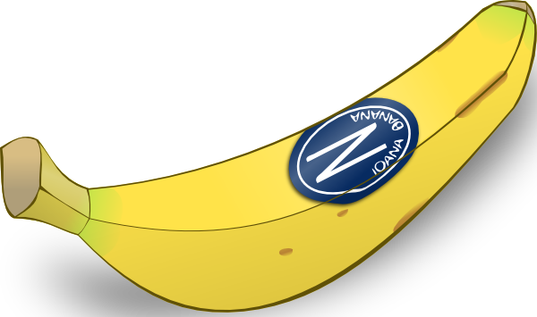
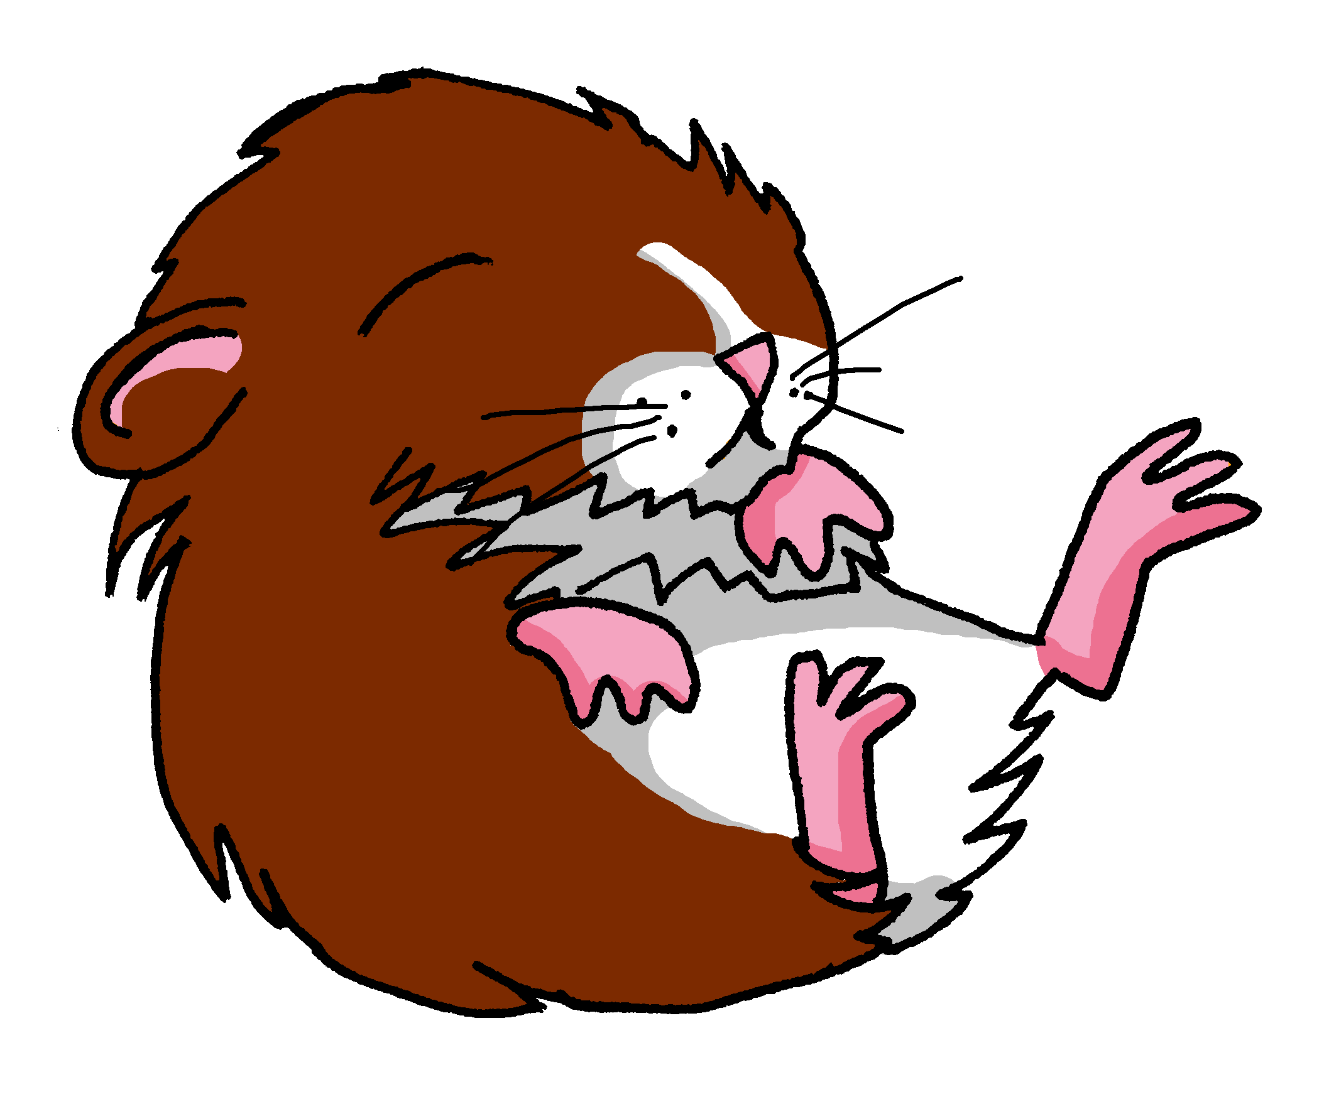
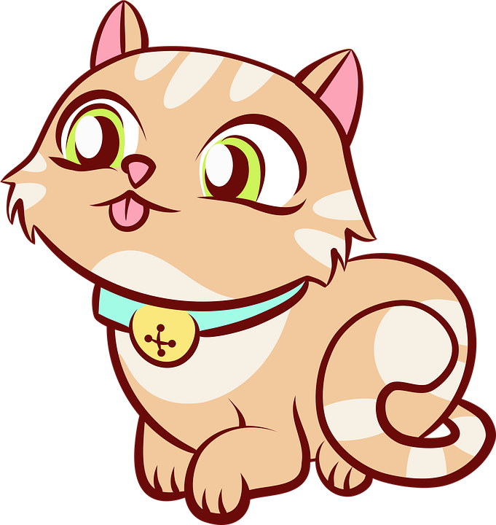
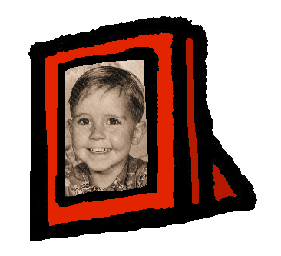
Follow up 4: Écris une lettre (A, B, C ou D).
Your partner will ask you questions to guess which bag you have chosen.
parler
Sac A
Sac B
‘Do you have…..?’
Yes. No.
Sac C
Sac D
Notes:
Timing: 5 minutes
Aim: to practise oral production of tu as in raised intonation questions, and this week’s vocabulary items.
Procedure: 1. Pupil A chooses (in secret) a bag, A, B, C or D.. 2. Pupil B asks questions to guess which bag A has chosen. 3. When B correctly guesses, pupils swap and repeat the task. Note: for lower proficiency pupils, teachers could add vocabulary support to the right hand side, though the aim should be to remove or partially obscure it on subsequent rounds of activity.

Slide 6
vocabulaire
Follow up 5 - Écris en français : Can you get at least 15 points?
mots
 | universe | to listen | to write
 | to read | to speak | midday
 | curious (m) | happy (m) | brave (f)
 | Monday | Tuesday | serious (f)
 | a book | a ruler | to have
 | she has | a pencil | a rubber
 | I have | you have | he has
univers
écouter
écrire
x3
lire
parler
midi
curieux
heureux
courageuse
x2
lundi
mardi
sérieuse
un livre
une règle
avoir
elle a
un crayon
une gomme
x1
j’ai
tu as
il a
Notes:
Timing: 5-10 minutes
Aim: to practise written comprehension of vocabulary from this week and previous weeks.
Procedure: 1. Give pupils a blank grid. They fill in the French meanings of any of the words they know, trying to reach 15 points in total. 2. Remind pupils that adjectives can refer to male or female persons and they should note this in their translations. E.g. pleased (f) → contente, short (m) → petit.
Note: The most recently learnt and practised words are pink, words from the previous week are green and those from week 1 are blue, thus more points are awarded for them, to recognise that memories fade and more effort (heavy lifting!) is needed to retrieve them.
6

Slide 7
vocabulaire
Écris en français : Can you get at least 15 points?
mots
 | universe | to listen | to write
 | to read | to speak | midday
 | curious (m) | happy (m) | brave (f)
 | Monday | Tuesday | serious (f)
 | a book | a ruler | to have
 | she has | a pencil | a rubber
 | I have | you have | he has
x3
x2
x1
Notes:
HANDOUT
7

